Slide 1

Vineyard Cultural Practices for Drought and Water Conservation
Lise Asimont, Director of Grower Relations
Francis Ford Coppola Winery

Slide 2
Notes:
Broad territory
Learned a lot about drought farming from Central Coast growers

Slide 3
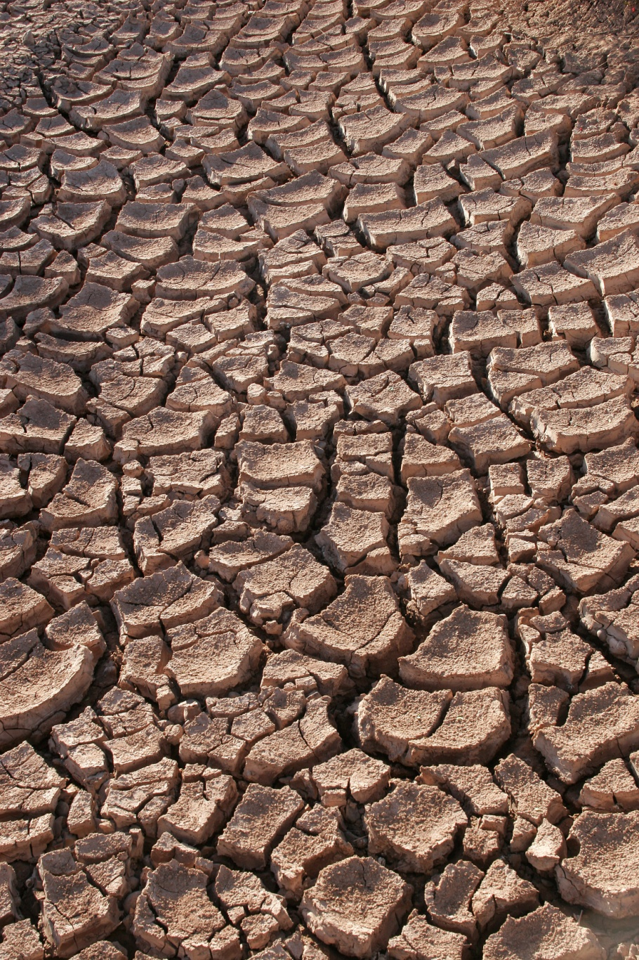
Farming for drought
10-60% of normal rainfall statewide
Viticultural Plan 2014
  Pruning to post harvest
  Back to basics
Decisions made for:
  Vine Health
  Wine Quality
  NOT VIGOR
Grow as small a vine as possible!
Notes:
Vit plan is very basic
Changes often per site

Slide 4
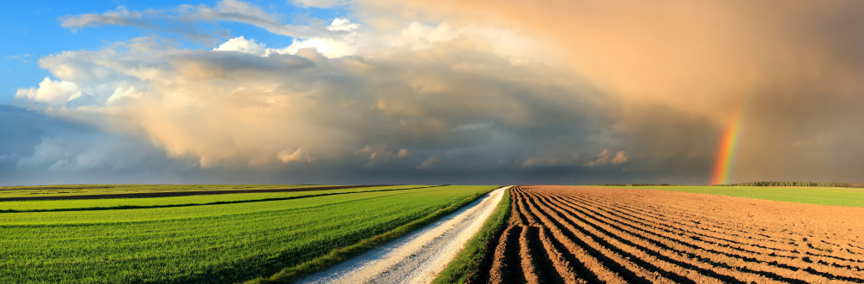
Winter
Crop insurance
  Explore +50%?
  Deadline was Jan. 31st
Estimating 10- 25% decline in crop
Notes:
FFCW and competitors preparing to be short this year

Slide 5
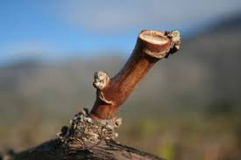
Pruning
Prune “to count”
  Vine balance
  Financial return
  No excessive growth points
  Preserve carbohydrates and nutrients
Frost insurance
  Kicker canes
  Extra buds on spurs
  REMOVE ASAP (Mid April?)
Dry wood during early pruning

Slide 6
Canopy Management
It’s about WHAT you do and WHEN you do it
Sucker “to count” by 6” of cane growth (12” at most)
  Frost insurance canes- REMOVE ASAP
  Conserve all photosynthate for count shoots
Pull leaves AT SET
  Minimal approach due to less potential vigor
  Protect the afternoon sun side
Divided or positioned canopies
  Minimize extent of tucking or dividing
  Achieve “bushier” canopy
    Maximizes efficiency of smaller canopy
    Protects fruit
Hedging = FAILURE (unless the site is ridiculously generous)
Notes:
Conserve all vine resources throughout the year

Slide 7
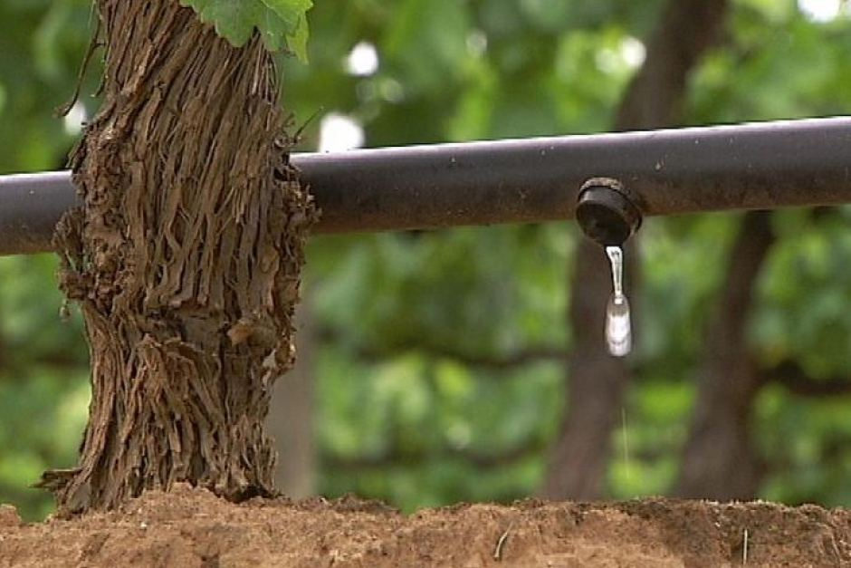
Irrigation- This Will Be CONTROVERSIAL
Irrigation at key, critical phenological events
IF you have water AND have budgeted for frost protection:
  Bud break: fill the soil profile for even break
  Prior to bloom: fill soil profile for even bloom
  Timely shots for fertigation
  “Maintenance” irrigations until harvest
    Let the vine vigor be your guide
  Post harvest irrigation:
    carbohydrate storage and fall root flush
“Whiskey’s for drinking and water’s for fighting”- Duff Bevill, experienced grower
Notes:
Up to us as growers to communicate the minimal irrigation needs of grapevines to our communities

Slide 8
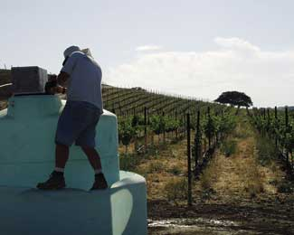
Vine Nutrition
Tissue analysis (petiole or blade) AT BLOOM
  Address nutrition immediately
  Key phenological events: set, lag phase, veraison
Application type is critical
  Dry soils = tight CEC soils
2nd analysis AT VERAISON
  Assess effectiveness of nutrition program
Post harvest adjustment
  Fertigation or broadcast (rain?)

Slide 9
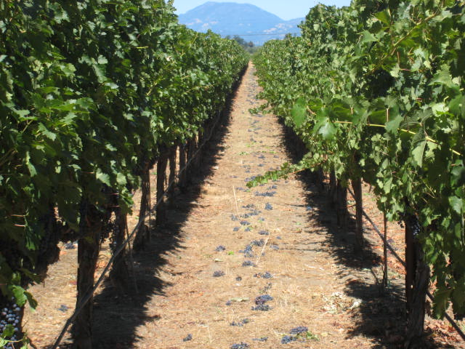
Crop Adjustment- More Controversy
As Early As Possible
  50% veraison
  2-weeks prior to veraison
No excess
  2nd crop, clumps, green clusters
  Conserve photosynthate, nutrients and irrigation
Drop sunburn late (IF excess was cut)

Slide 10
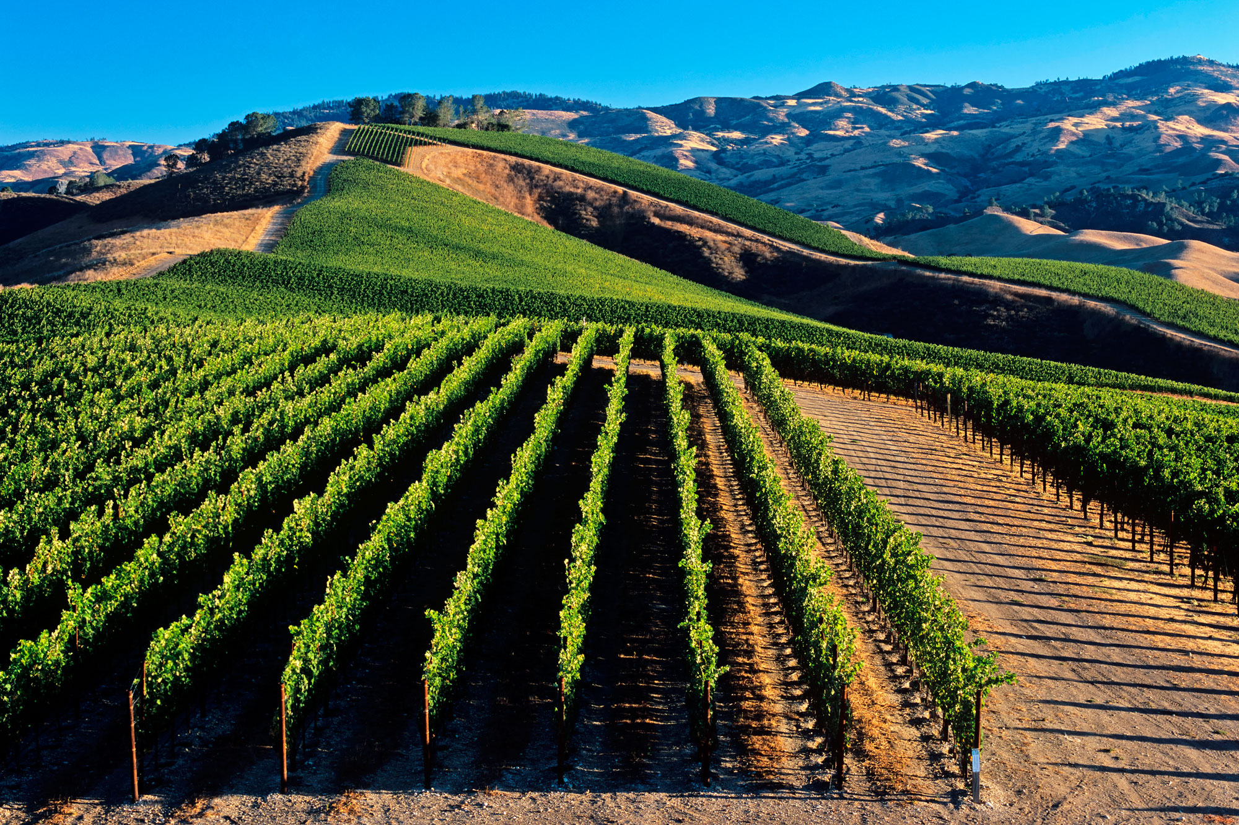
Manage Expectations
Overall vigor is less
  Less natural resistance to pests
Irrigation and fertilization timing is critical
Harvest timing will be “UNCOUPLED”
  Brix accumulation may precede phenolic development
  High °Brix vintage and lower acid profiles
WORK TOGETHER: Collaborate with neighbors and your winery

Slide 11
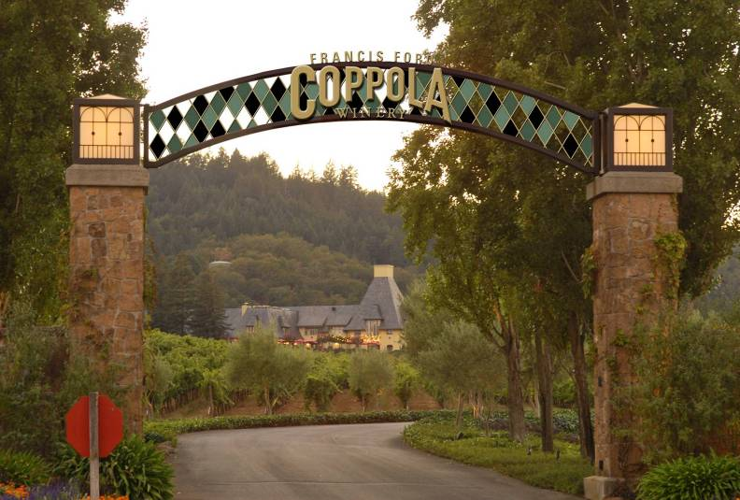
THANK YOU!
Francis Ford Coppola Winery Winegrowers and the Winemaking Team

