Slide 1
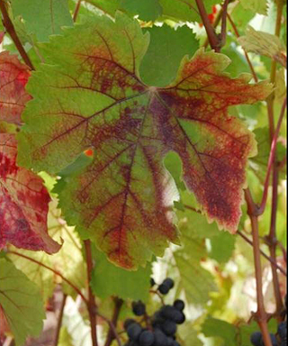
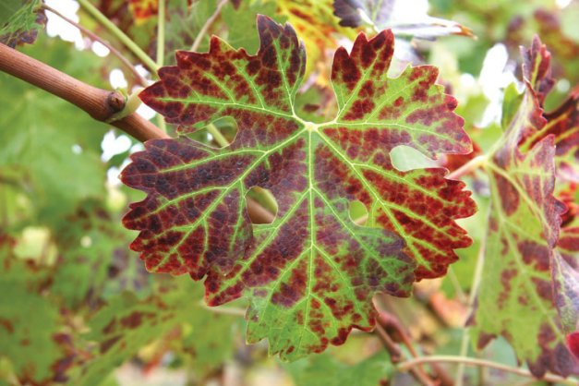
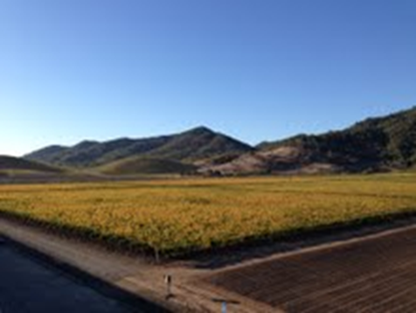
Epidemics and Management Decisions
Kari Arnold, A.J. Campbell, Neil McRoberts

Slide 2
Concerns in Leafroll Management
Is leafroll spreading in California?
  Yes, Golino et. al. 2008, Oakville study (GLRaV-3)
How is it spreading?
  Patterns, rate, epidemiology
  Mealybugs, scale insects
    Late 1980’s, initial discovery, now more real than ever
    Can we control the vector?
    Where are they coming from?
    If I remove and replace a block, how quickly will it become re-infected?
Certified stock
  Why invest in certified wood if my block will just become re-infested?
Region Based Management
  What if I decide to control leafroll, but my neighbors don’t?

Slide 3
Biology Impacts Epidemiological Characteristics of a Disease
Vectors
  Acquisition/transmission/ persistence
  Life cycles
  Mode of travel (crawling/flying/nematodes)
Spores
  Wind spread/rain splash
  Life cycles
Humans
  Machinery/clothing
  Grafting
Weather Patterns
  Wind/Rain/Drought
  Temperature
Point of entry on host
  Seed borne
  Soil borne
  Susceptible tissue
Monocyclic/Polycyclic
  Primary inoculum sources
  Secondary inoculum sources

Slide 4
The Importance of Mapping
“An epidemic is the progress of disease in TIME and SPACE”
Kranz, J. 1990. Epidemics, their mathematical analysis and modeling: An introduction. In: Epidemics of Plant Diseases: Mathematical Analysis and Modeling, 2nd Edn. Springer, Berlin.
5 years of census data*

Slide 5
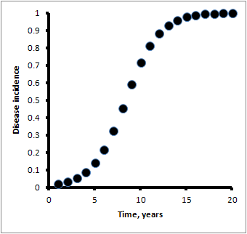
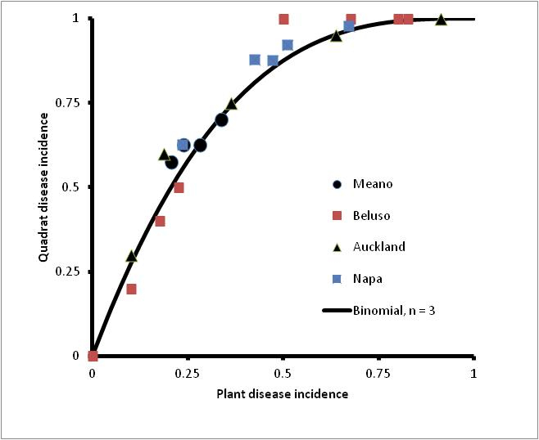
The Importance of Mapping
TIME and SPACE

Slide 6
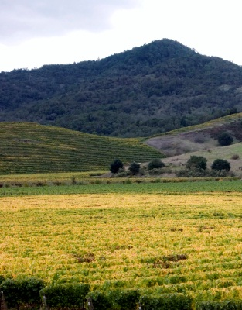

Epidemiology
70%+
% INCIDENCE →
25%-50%+
0%-5%
TIME →
Random Introduction of Infection Events (Wind, machinery etc) neighboring blocks matter*
Aggregation Stage, spread is predominantly within the block, with small levels of random infection events
Random Infections and Aggregated Infections less successful*, great source of inoculum

Slide 7
Quality and disease supply chains in the wine industry
Supply of quality
Disease
Nurseries
or other
sources
Production
Consumers
FPS
$
Disease increases production costs, reduces efficiency
of supply of quality per unit effort along the chain

Slide 8
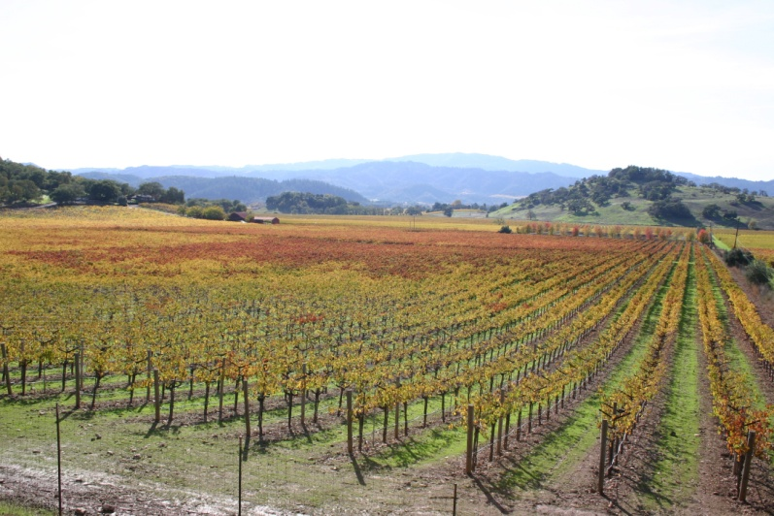
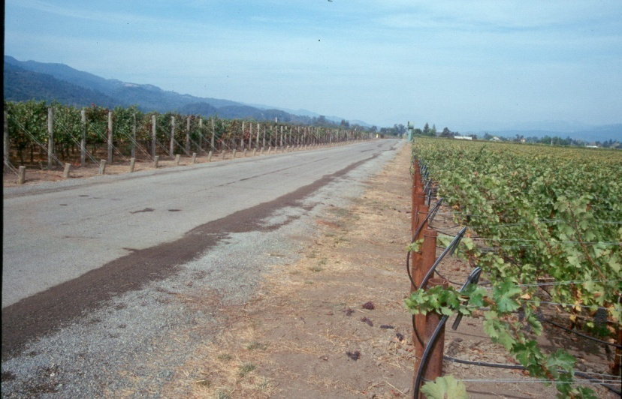
Disease supply chain interactions in maintaining vine block health
I
C
η
R
ρ
ζ
ν
r
Some things are
only controlled in
production
ρ
c
H
β
r
ν
Some things are
only controlled by
interactions
Nurseries
or other
sources
Production
Consumers
β
FPS
ζ
η

Slide 9
Interaction model of block health
I
C
η
R
ρ
ζ
ν
r
H
β
Production
Chain

Slide 10
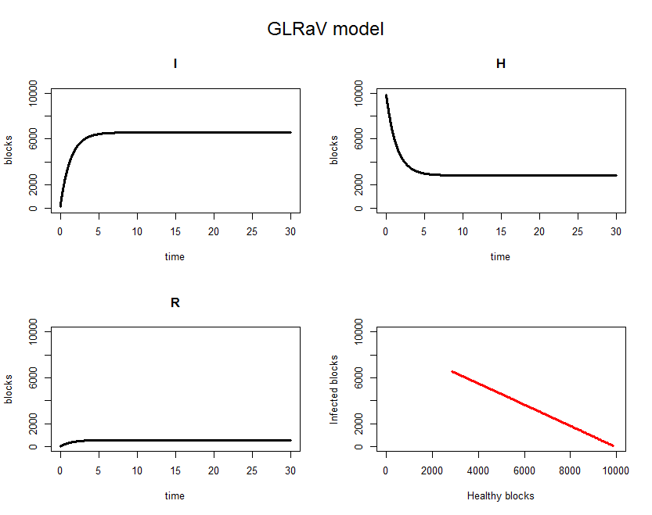
Baseline prediction using leafroll group guesstimates of parameter values
From low initial infection,
system stabilizes with:
66% Infected blocks
28% Healthy blocks (no LR)
6% blocks in rotation

Slide 11
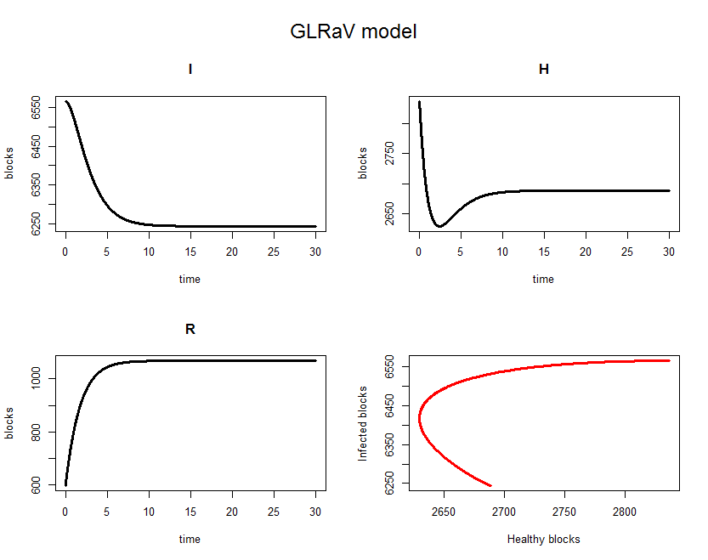
What is the effect of keeping blocks out of production for longer?
Fallow cleared blocks for one
season:
62% Infected blocks
27% Healthy blocks (no LR)
11% blocks in rotation
3-3.5% reduction in Infected blocks
1.5% reduction in Healthy blocks
5% increase in blocks in rotation
Net gain (?) because blocks coming out of rotation are more likely to be healthy

Slide 12
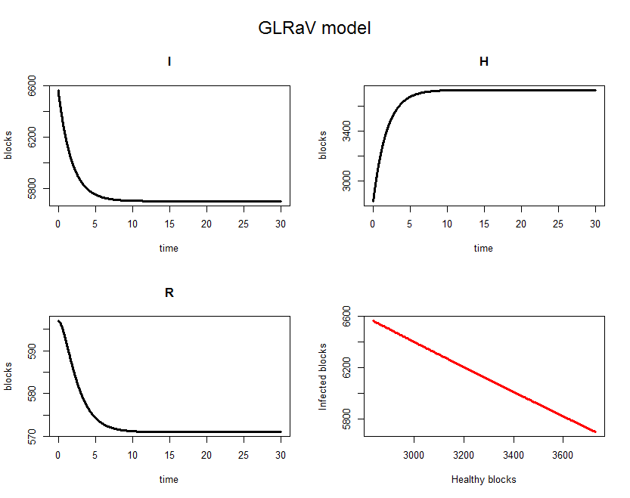
Decrease inter-block spread?
Production
57% Infected blocks
37% Healthy blocks (no LR)
6% blocks in rotation
10% reduction in Infected blocks
10% increase in Healthy blocks
<1% decrease in blocks in rotation
Big gain in healthy blocks (10% compared with baseline). Is it feasible?

Slide 13
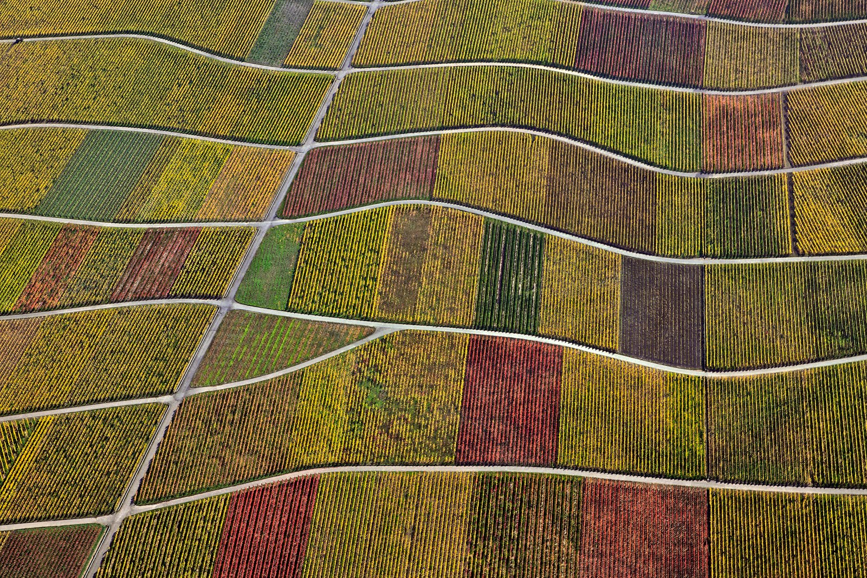
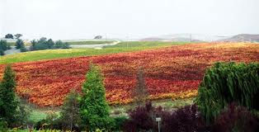
Where is it coming from?
The predominant reason for reinfection and spread is…
…NEARBY INFECTED BLOCKS.
My neighbor’s leafroll is my leafroll….
My leafroll is my leafroll….
My leafroll is my neighbor’s leafroll….

Slide 14
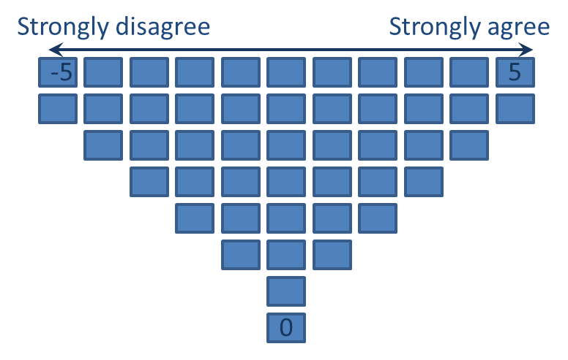
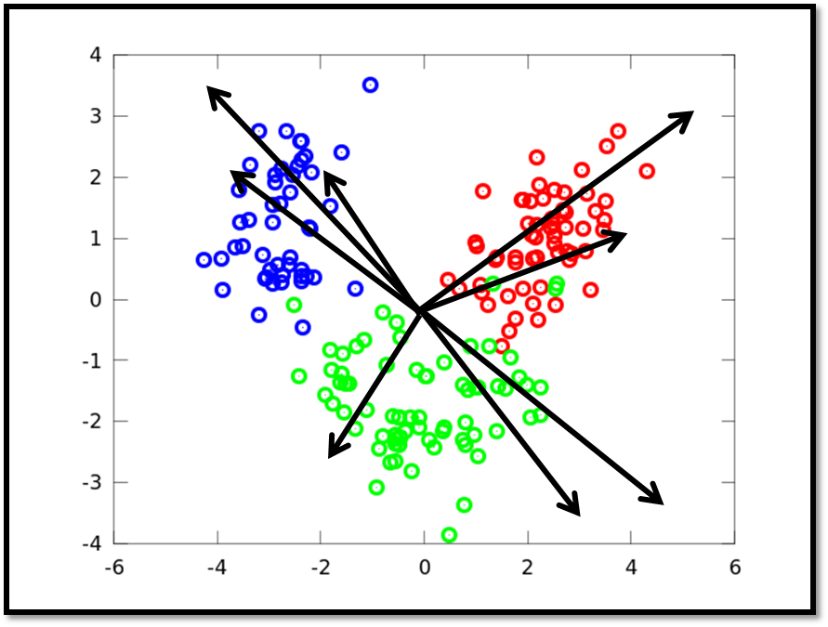
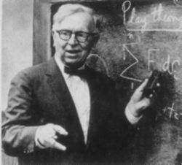
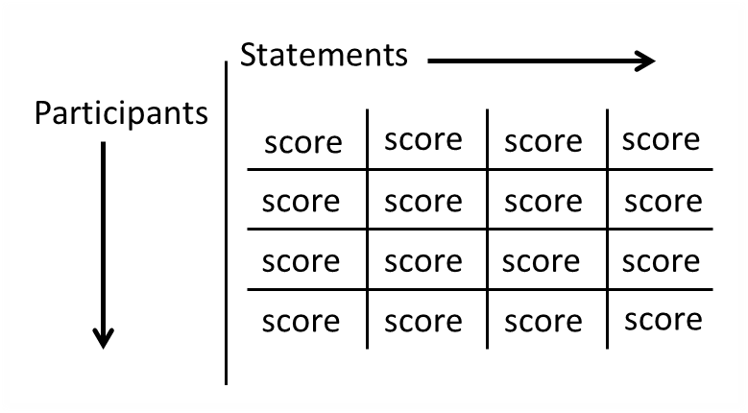
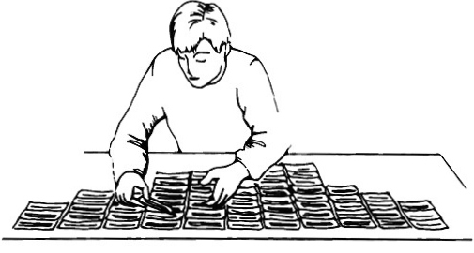
What if I do, but Others Don’t?
  Is there a tipping point for area wide disease management in terms of GLRaV-3?
Analysis of subjectivities about leafroll disease management among California grape growers and winemakers

Slide 15
Analysis/Results
Initial PCA via MVSP (37 individuals)
Approx. 16% similarity
  Approx. 84% different
  37 people, 37 distinctly different opinions (Grp.1)

Slide 16
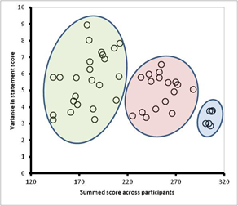
Certified Wood
EUREKA!
EVERYONE FEELS STRONGLY ABOUT THE CERTIFICATION PROCESS AND VIRUS TESTING…YEAH!

Slide 17
Bridging the Gap
Initial group, production side
Second group, predominantly nursery growers

Slide 18
Bridging the Gap
These 6 statements enforced the importance of virus testing and the certification program in terms of leafroll management
Nurseries feel strongly about these issues
AND concerns differ based on your business goals

Slide 19
Bridging the Gap
Try to see the world from the other person’s perspective.
Build good relationships within the supply chain, and nurture those relationships. Work with each other.
Honesty is a good thing.
Remember* you may not realize what you have, until it’s gone….

Slide 20
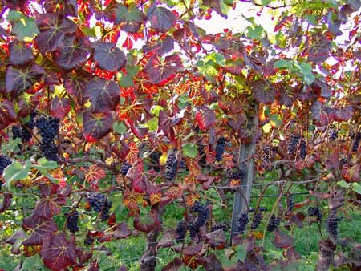
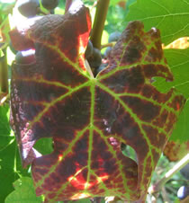
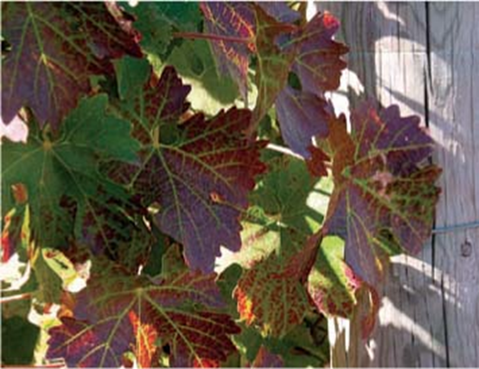
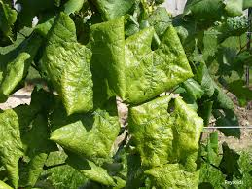
Leafroll Symptoms
(depending on grape variety and leafroll type)
Red fall color in red varieties
Green vein banding
Reduced vigor
Reduced yield
Irregular/delayed ripening of fruit
Reduced sugar content in fruit
Rolling under of leaves in some varieties

Slide 21
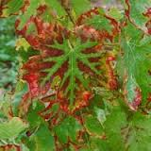
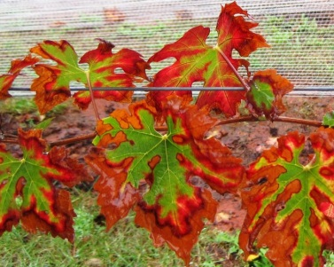
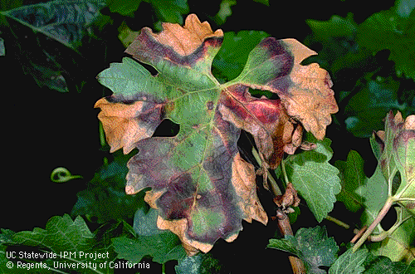
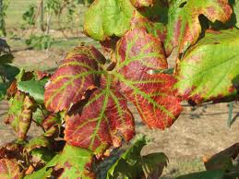
Don’t be fooled…
Potassium deficiency?
Girdling?
J rooting?
Pierce’s disease?
Other viruses?…
Leafroll…

Slide 22
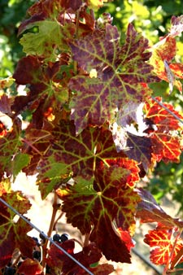

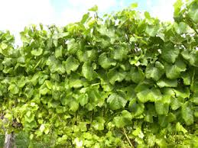
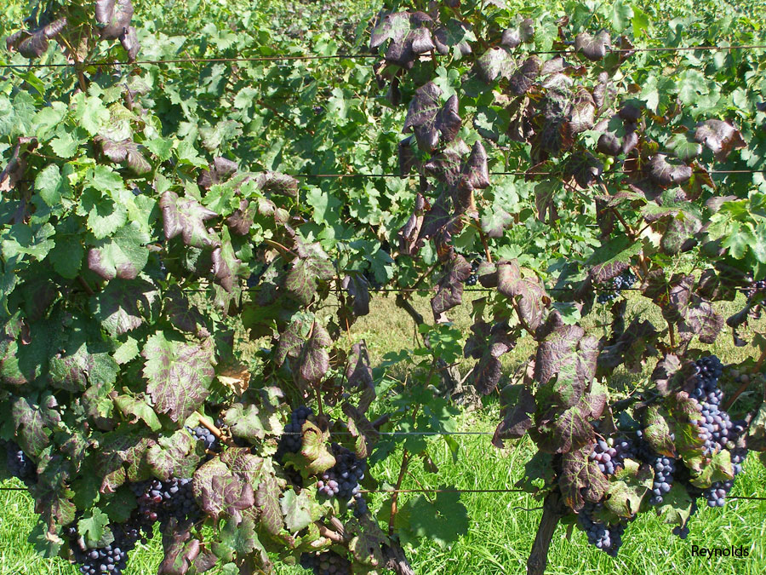
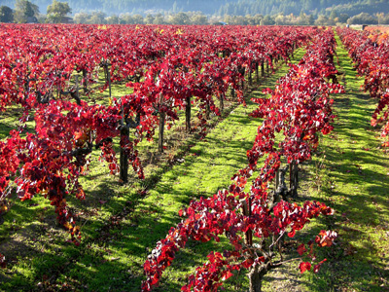
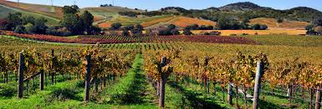
How can I be sure?

Slide 23
Diagnostic Tests
Sampling Structures
COMPOSITE SAMPLE vs. INDIVIDUAL SAMPLE
Ex. 5 vines per sample *1 vine per sample
Benefit:
More field coverage
Set back:
Not a good estimate of disease incidence in field
Benefit:
Better estimate of disease incidence in field
Set back:
Less field coverage
Ask yourself:
What do I want to know about my block?
What do I intend to sample?

Slide 24
COMPOSITE SAMPLE vs. INDIVIDUAL SAMPLE
Ex. 5 vines per sample *1 vine per sample
Benefit:
More field coverage
Set back:
Not a good estimate of disease incidence in field
Benefit:
Better estimate of disease incidence in field
Set back:
Less field coverage

Slide 25
Sampling Structures
What do I want to know about my block?
What do I intend to sample?
Symptom Based
vs.
“Blind” Sampling
Verification of visual symptoms in red varieties in the “fall”
If assessing incidence (%) without mapping entire block, make sampling plan prior to entering block to avoid positive bias*
Many white varieties
  Sauvignon blanc?
Need an estimate of incidence or knowledge of infested areas prior to symptom expression

Slide 26
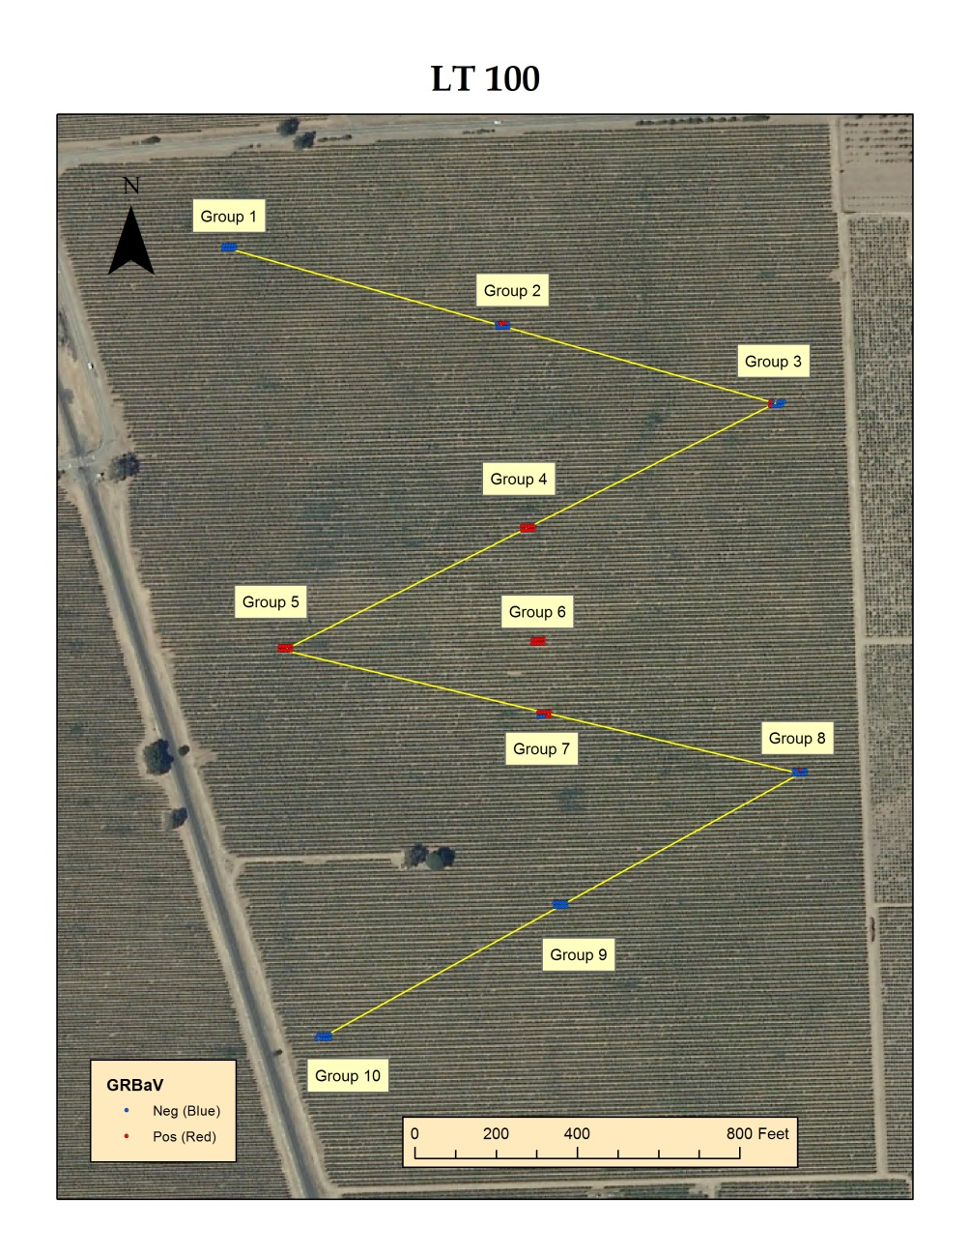
Sampling in the Real World
Large Cabernet Block
Blind Sample* needed an estimate of disease incidence in January
Wanted to know disease incidence and locations of leafroll-3 and red blotch to help in deciding on block removal

Slide 27


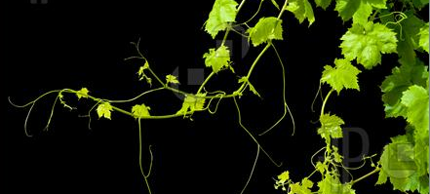
Red Blotch
How do we sample for something we know so little about?
Enter Neil and A.J. – assess what we do know
Data collection, going to the field: what are we looking for?
Vineyard maps: what is the current situation?
Epidemiological analysis: what does it all mean?
Recommendations: what can we advise based on the data?

Slide 28
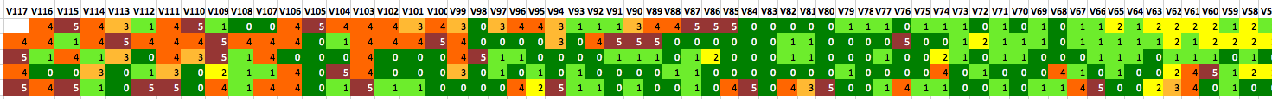
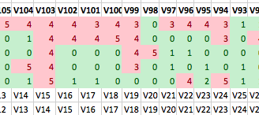
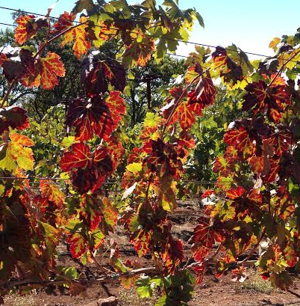
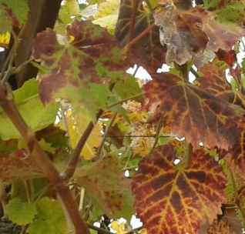
Learning symptoms and making maps

Slide 29
What do we want to know?
Analyze data covering multiple years to obtain a clearer picture of virus “spread”
Characterize Red Blotch patterns statistically to allow sample size/reliability calculations
Notes:
In other words, what do we want to get out of our epidemiological and statistical analyses of the data we collect?

Slide 30
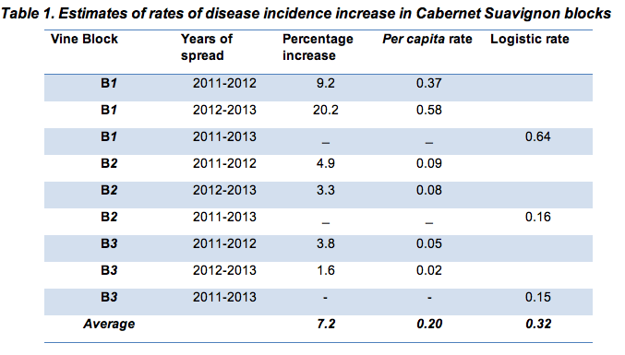
Rate of Increase
*based on initial data; a more accurate picture may emerge with more information

Slide 31
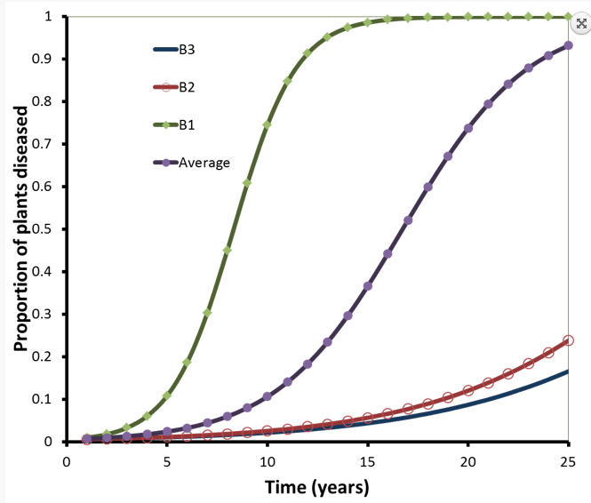
Potential Disease Progress Curves
Potential development of Red Blotch epidemics over
time based on parameters gathered from Cab. Sauv. blocks at Oakville station
Data collected in 3 blocks over 3 year period
Notes:
Talk worst case and best case scenarios

Slide 32
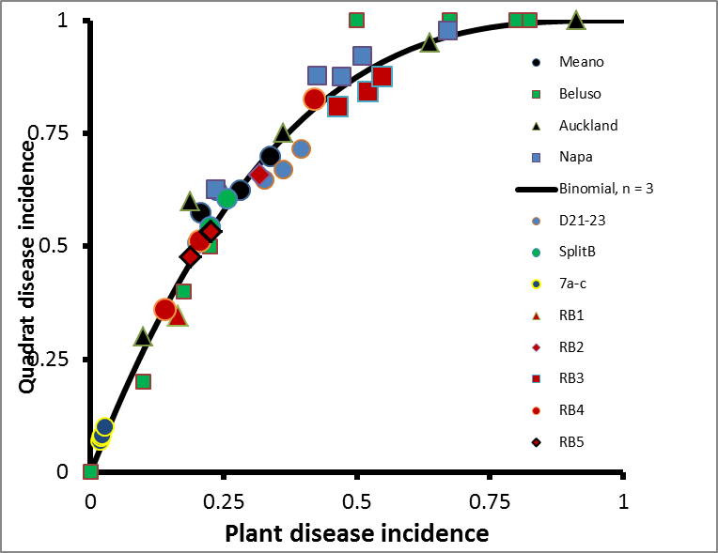
Characterizing patchiness – the key to sampling efficiency

Slide 33
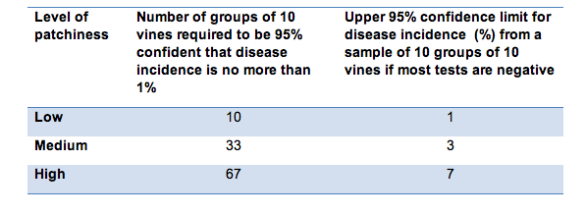
Develop best management plans for different types/sizes of vineyard operations to facilitate use of sampling
Notes:
This shows the importance of considering the patchiness factor in sampling.
For example, if there’s a high level of patchiness and you take 10 groups of 10, you could be close to 10% disease incidence and not find it.

Slide 34
How Many Samples Do I Take?
Disease patchiness index
Mean disease incidence
Z
n
Number of samples
Desired confidence
interval
Group size (composite size)

Slide 35
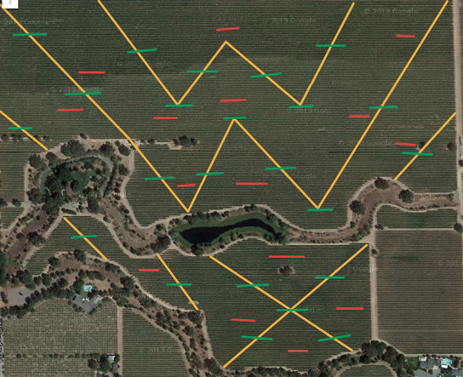
It depends on your goals
Notes:
Talk about positive bias here

Slide 36
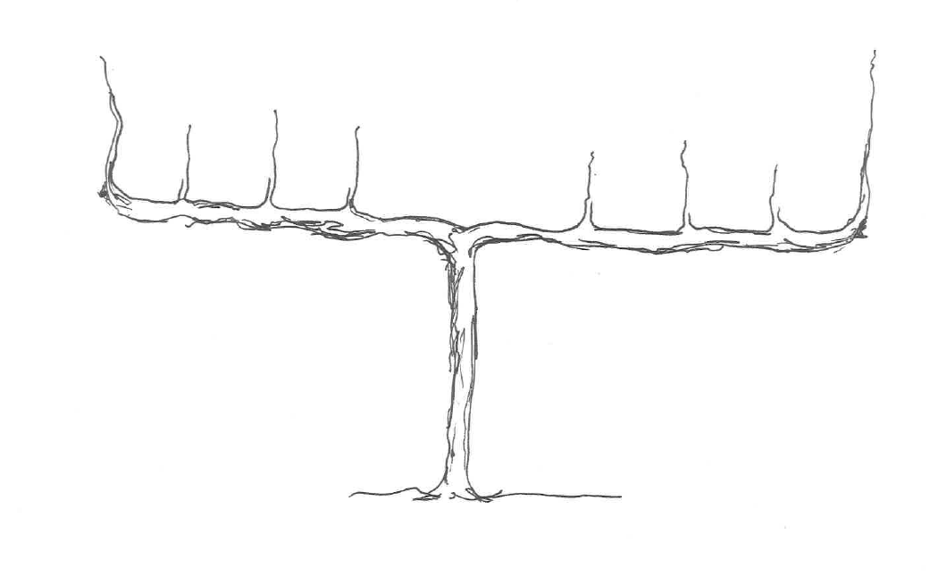
Sampling at the Vine Level
Canes
Petioles
Talk to your diagnostics lab….
*At least 2 samples, 1 from each cordon
(more is better)

Slide 37
Visual sampling can be accurate and people can quickly become proficient
Visual ratings against PCR results
in 12 Zinfandel vines
True Positive Proportion
True Negative Proportion
False Positive Proportion = 1-TNP
False Negative Proportion = 1-TPP
For decision-making under uncertainty, the likelihood
ratios are important
Notes:
In varieties where symptoms are seen, does it always pay to sample extensively? Do you have to? The power of visual assessment.
What visual assessment can do for you if you don’t need to manage the disease/vineyard.

Slide 38
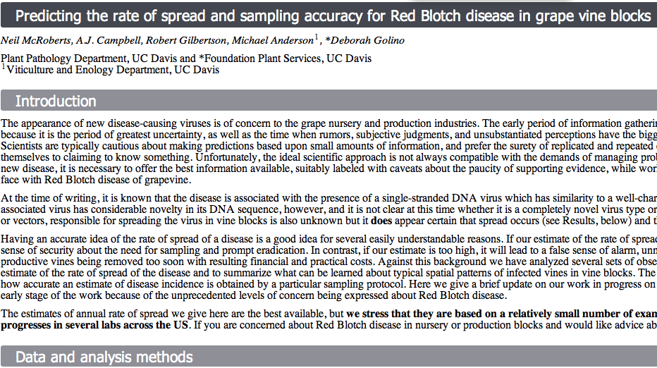

¿Want more details?
http://qbelab.plantpathology.ucdavis.edu/working-papers/
Notes:
Solicit data- give us a call or email, we can assist you in creating a sampling plan in exchange for the data it yields!!

Slide 39
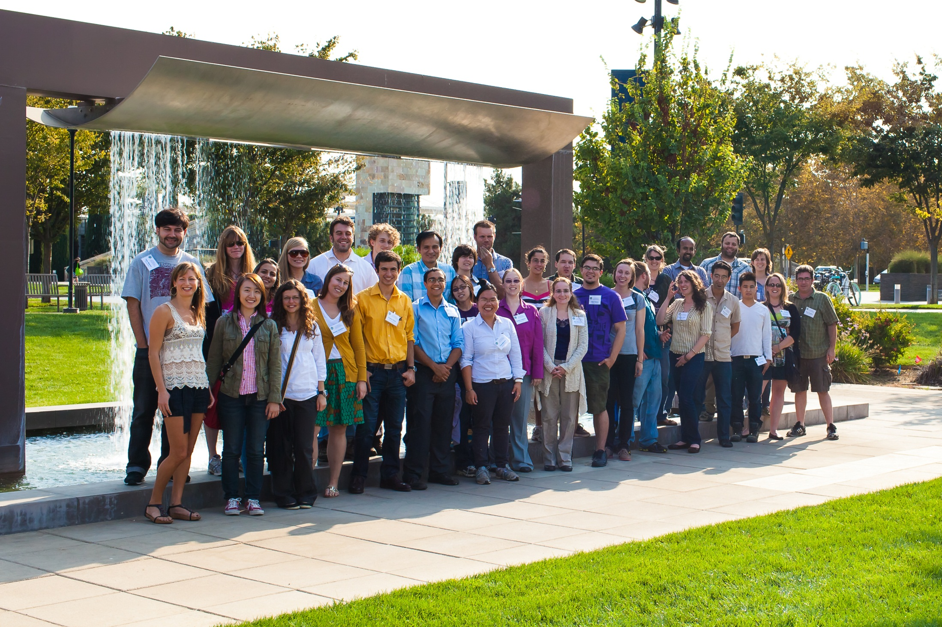
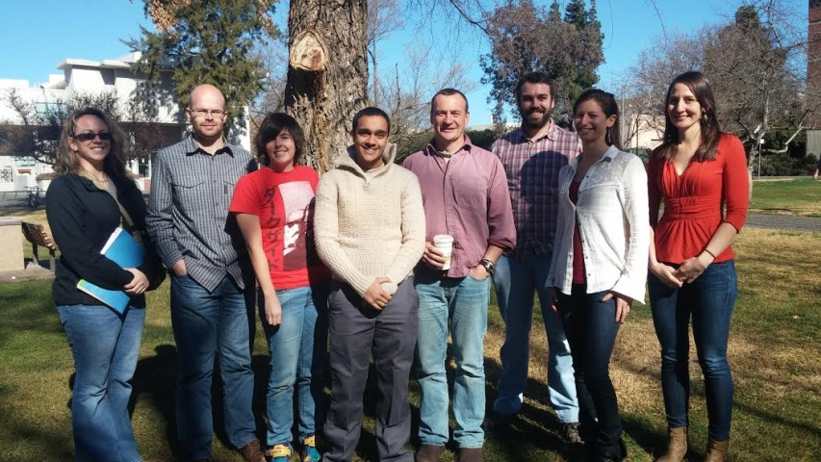
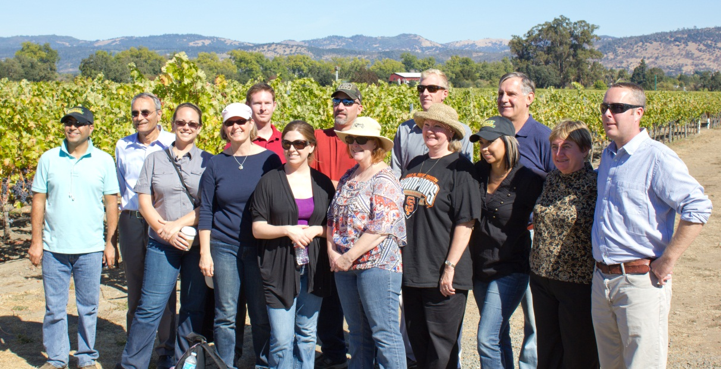

Acknowledgements
American Viticulture Foundation
Dominus Estates
Study participants and Workgroup members
FPS, Deborah Golino, Michael Anderson, Neil McRoberts, Bob Gilbertson, QBE lab colleagues
Mark Lubell and the Environmental Pol. Lab
Monica Cooper with UCCE
Current and past Plant Path grads
Grapevines, mealybugs, and leafroll ☹
VIRUSES!! ☺

Slide 40
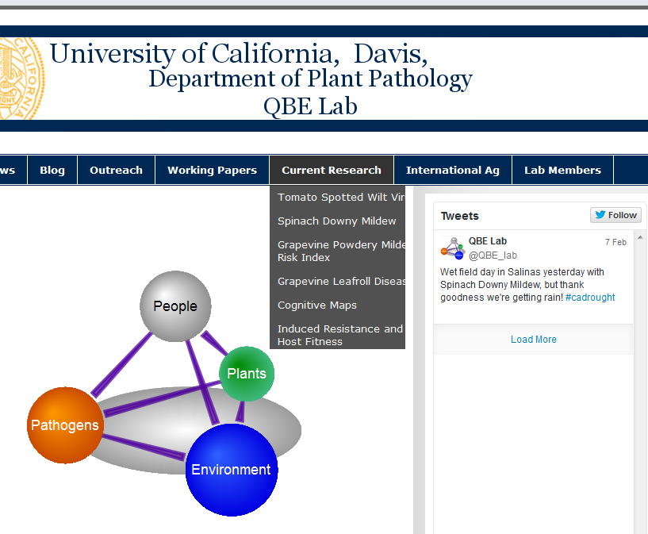
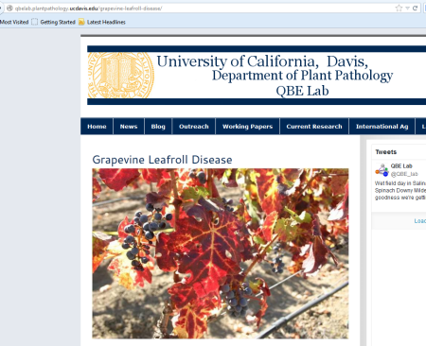
Questions/Concerns/Comments?
http://qbelab.plantpathology.ucdavis.edu

