Slide 1
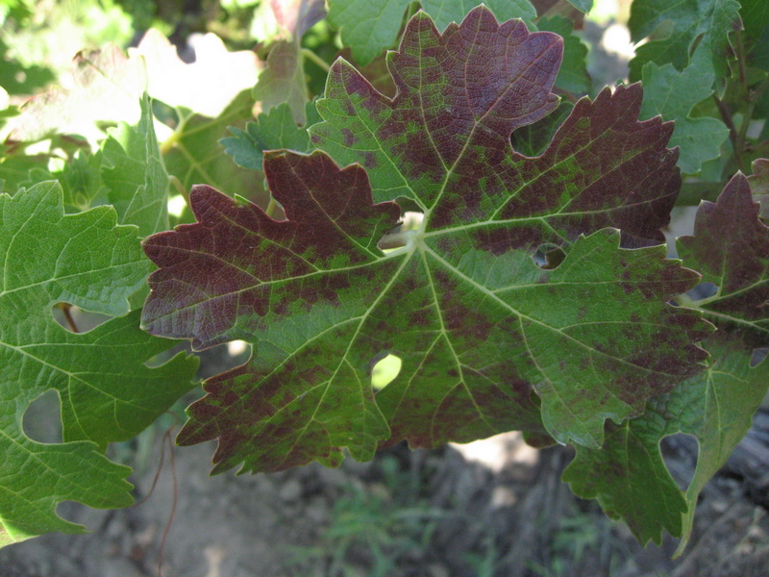
Vectors of Red Leaf Diseases
Kai Blaisdell
Dept. of Environmental Science, Policy, and Management
UC Berkeley

Slide 2
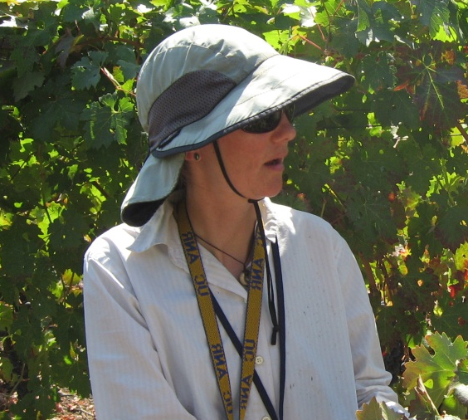
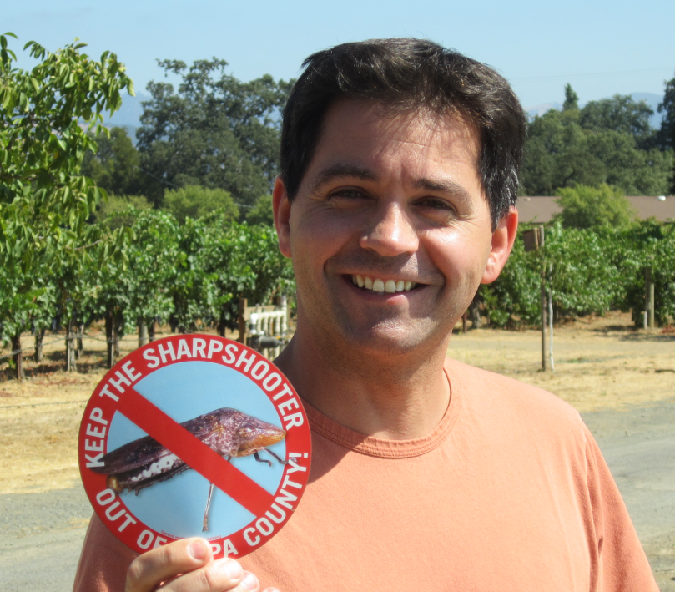
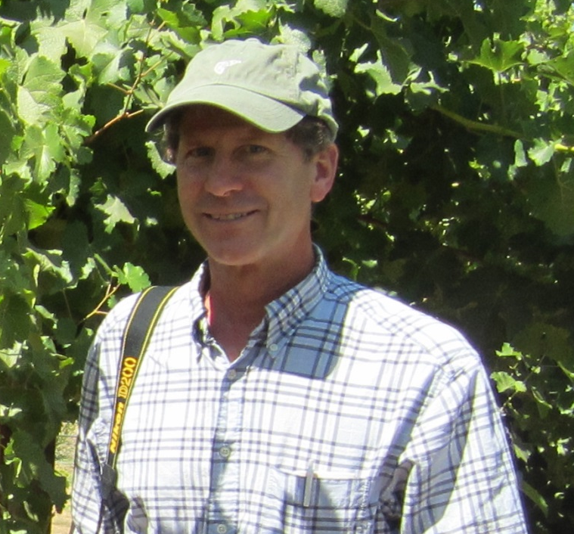
Monica Cooper, Rodrigo Almeida, Kent Daane

Slide 3
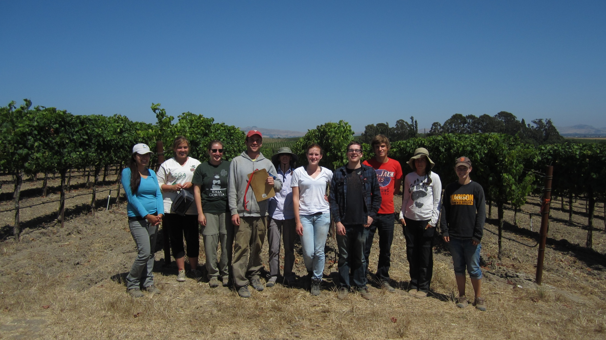






FPS: Deborah Golino, Adib Rowhani, Maher Al Rwahnih,
Vicki Klassen, Sue Sim, and others
Constellation: Katey Taylor, Jessica Fuentes, and others
Emily Kuhn
UCB : Jenny Bratburd, Brandy Chavez, Jean-Francois Darrigrand, Megan Fu, Michelle Gantos, John Hutchins, Kyle Ingraham, Ruth Lopez, Hannah Oh, Preethi Padmanaban, Barb Rotz, Cecilia Prator, Lucas Senegas, Tina Wistrom, Michelle Wong, Siming Zhang

Slide 4
Outline:
Background and history highlights: Viruses (mostly Leafroll), spread, and vector transmission studies
Recent results: Leafroll 3 and GVA, Leafroll 3 variants and mealybugs species, Leafroll 3 field inoculations
Transmission studies in progress

Slide 5
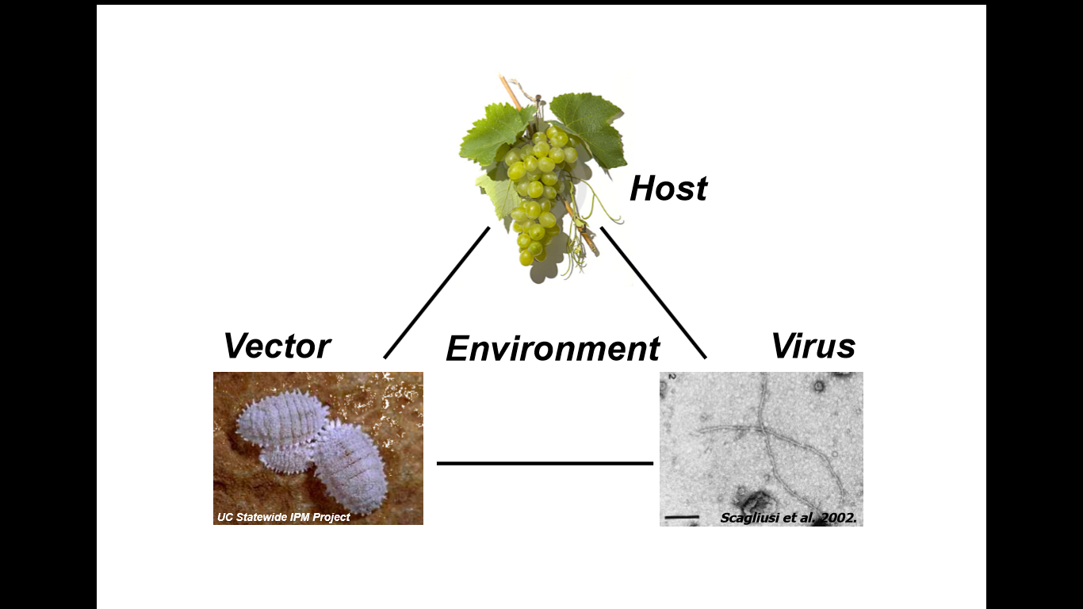

Slide 6
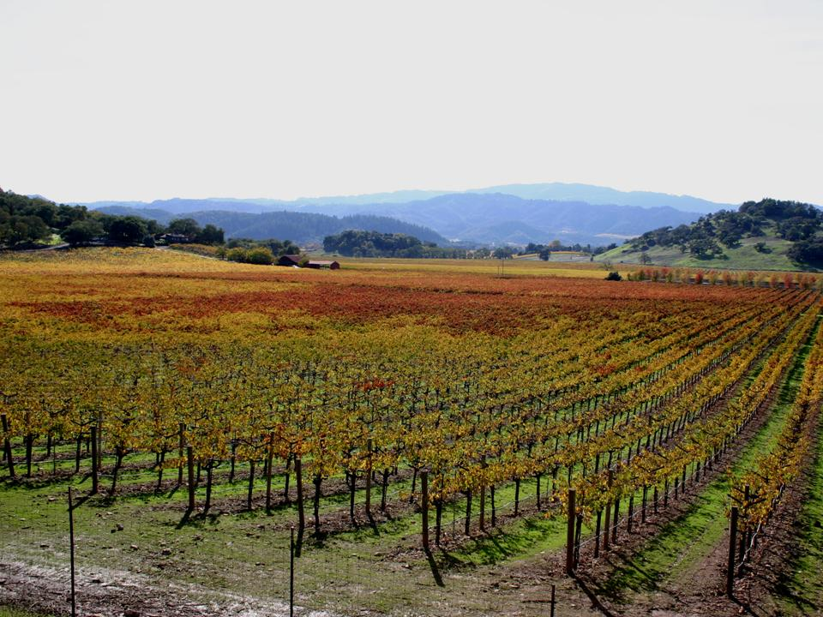
Grapevine leafroll-associated viruses
Family Closteroviridae, several species
associated with grapevine leafroll disease symptoms and spread
Photo D. Golino

Slide 7
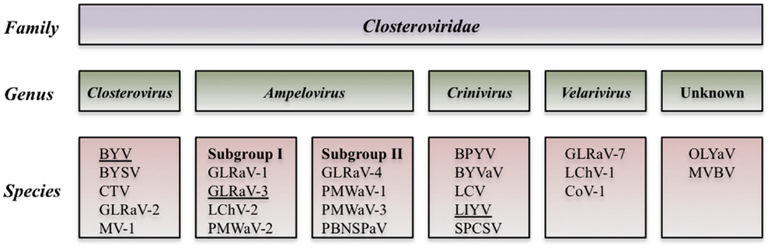
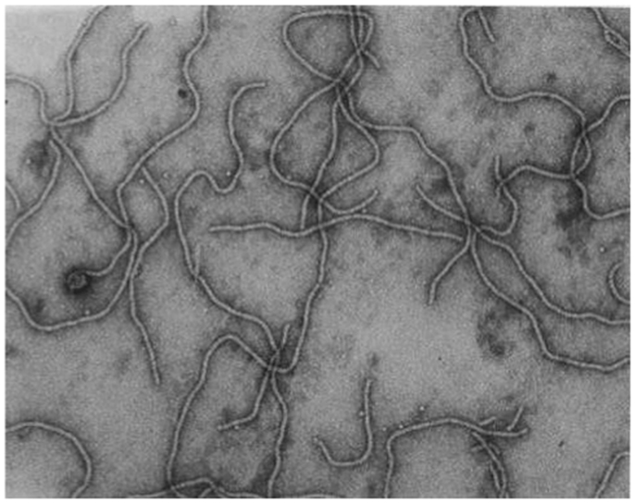

Slide 8
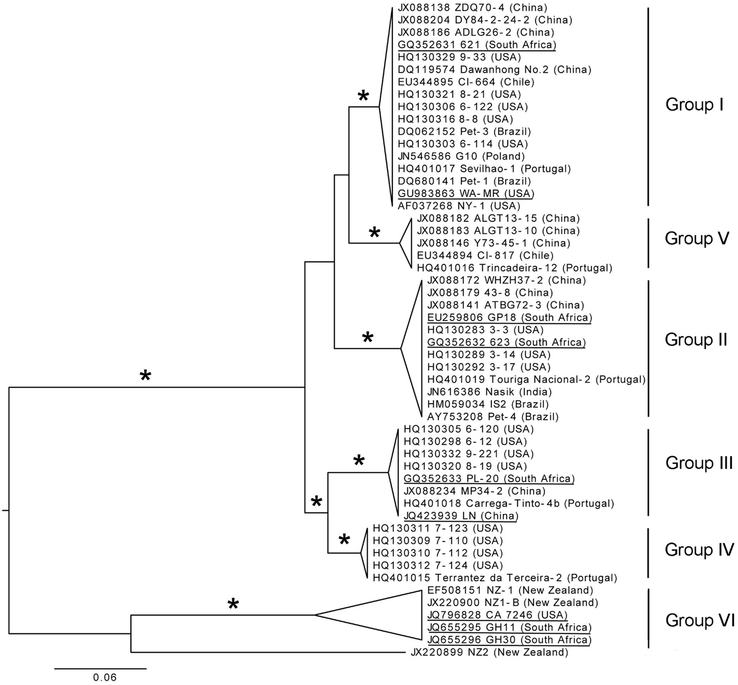
Virus:
GLRaV-3 has several genetically distinct variants
Maree et al. 2013

Slide 9
Variation in geographic distribution of GLRaV-3 variants
Sharma et al 2011

Slide 10
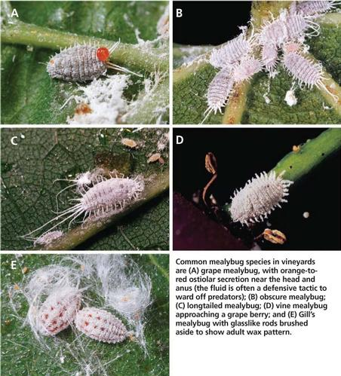
Possible mealybug vectors of Leafroll 3
Transmission by vector

Slide 11
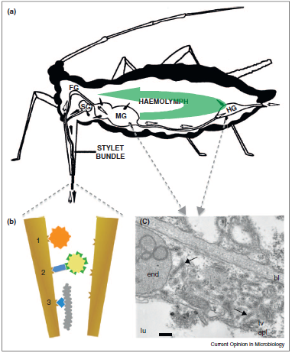

Slide 12
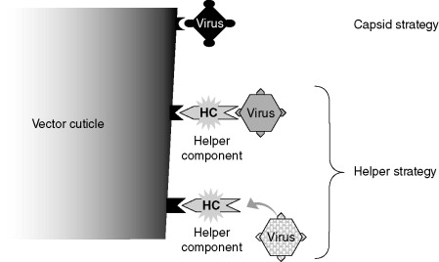
In vector
Blanc 2008

Slide 13
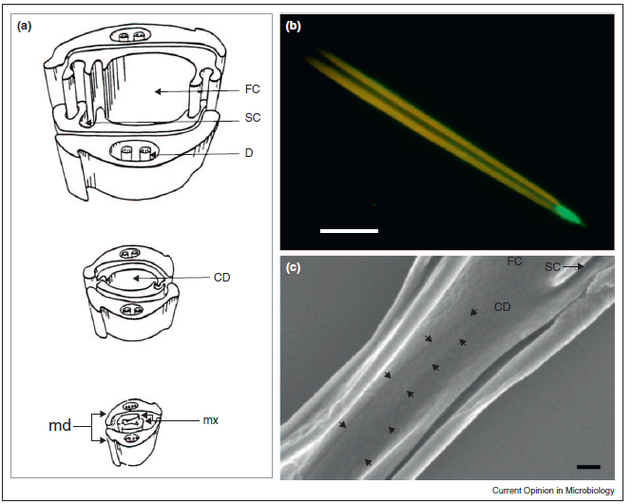
Acrostyle

Slide 14
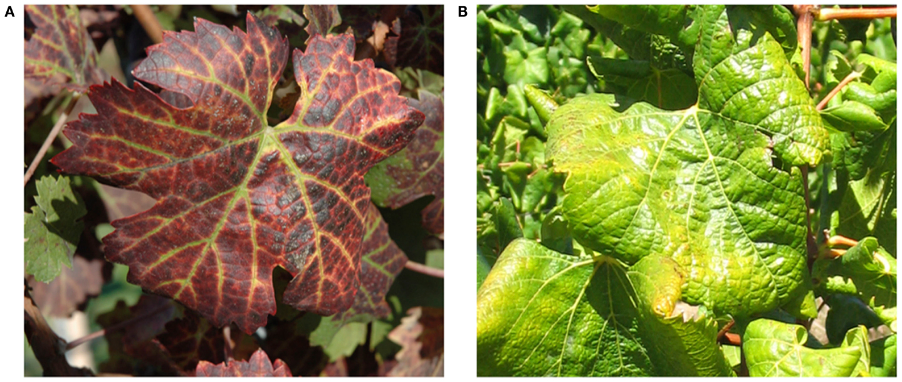
Host:
Symptoms vary among varieties
GLRaV-3, Maree et al. 2013

Slide 15
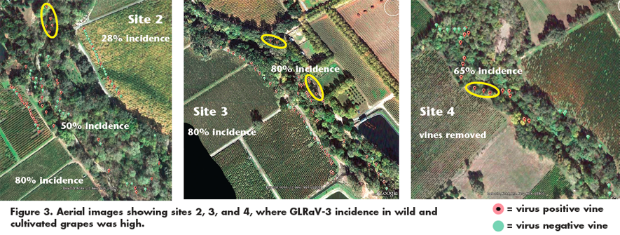
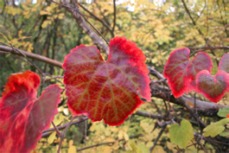
Leafroll 2, 3, GVA, and GVB found in wild grapes in Napa Valley
Klaassen et al. 2011
http://www.practicalwinery.com/winter2012

Slide 16
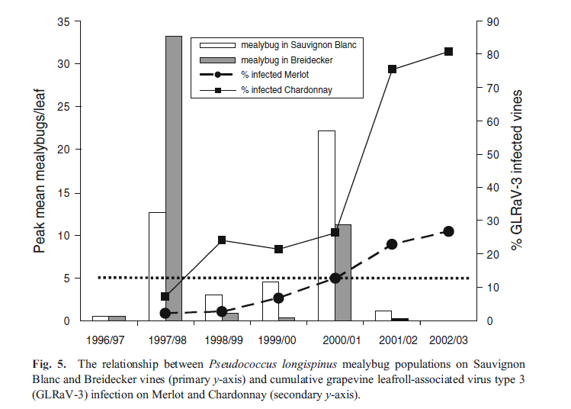
Leafroll 3 spread in New Zealand
Charles et al 2009

Slide 17
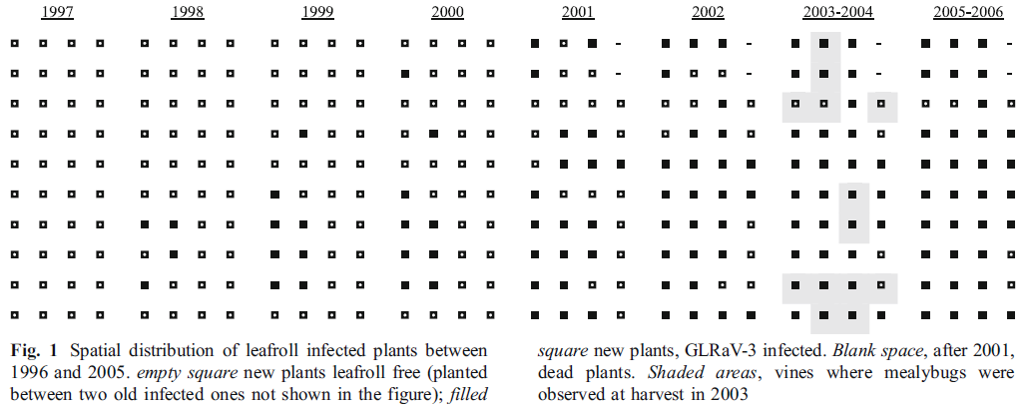
Leafroll 3 spread in Spain
Cabaleiro et al 2003

Slide 18
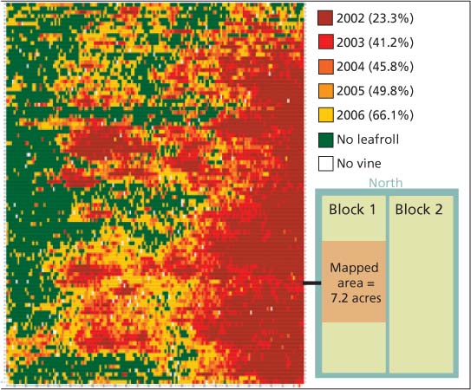
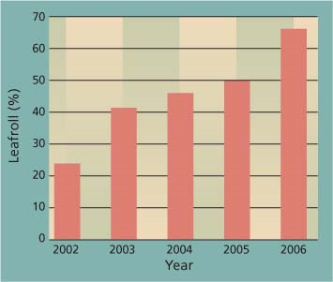
GLRaV-3 spread in Napa Valley
Golino et al 2008

Slide 19
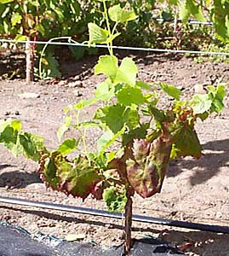
Grapevine Virus A (GVA)
Family Betaflexiviridae,
genus Vitivirus
-associated with Kober stem grooving and Shiraz disease
(Garau et al., 1994; Goszcynski and Jooste, 2003)
Image Canadian Food Inspection Agency

Slide 20
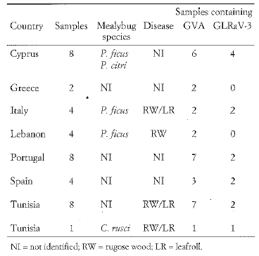
Acquisition: Mealybugs from vineyards
La Notte et al. 1997

Slide 21
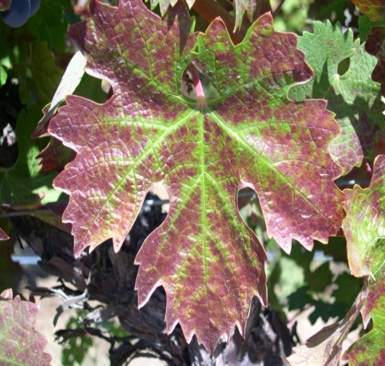
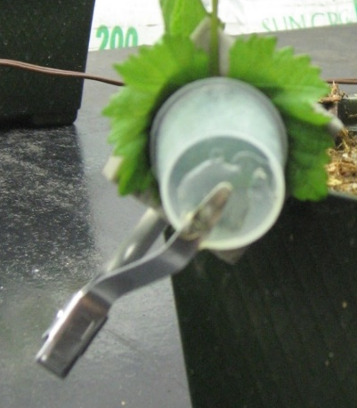
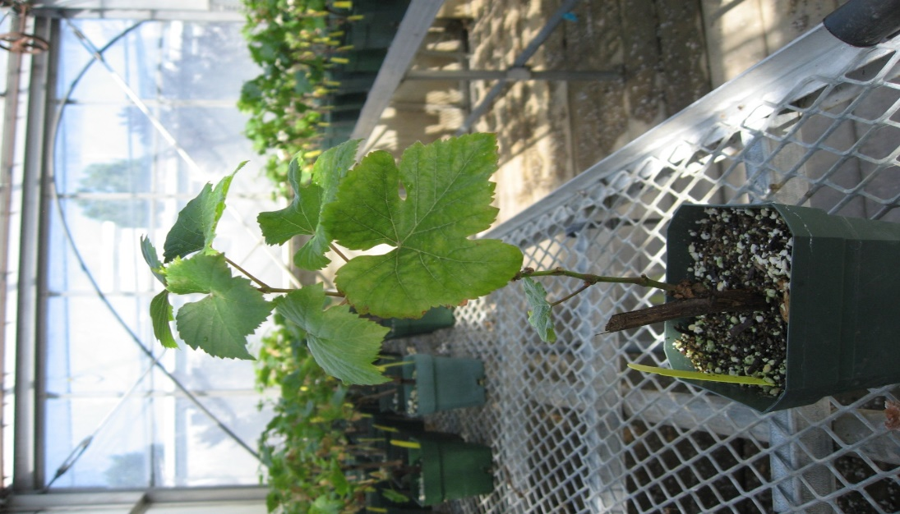
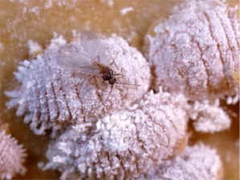
Inoculations and experimental transmission studies
Infected Source Plant
Pl. ficus
Uninfected plant

Slide 22
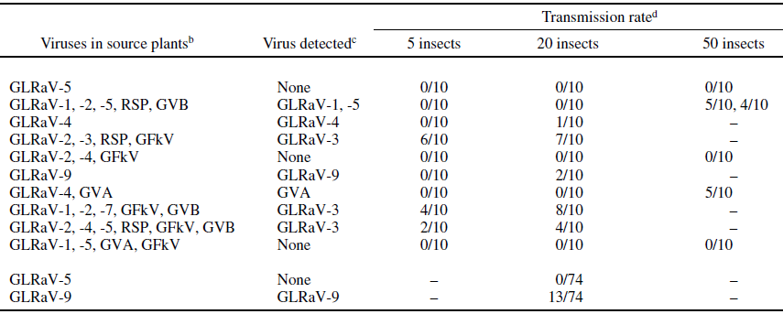
Experimental transmission studies: mealybugs
Pseudococcus longispinus
Tsai et al. 2010

Slide 23
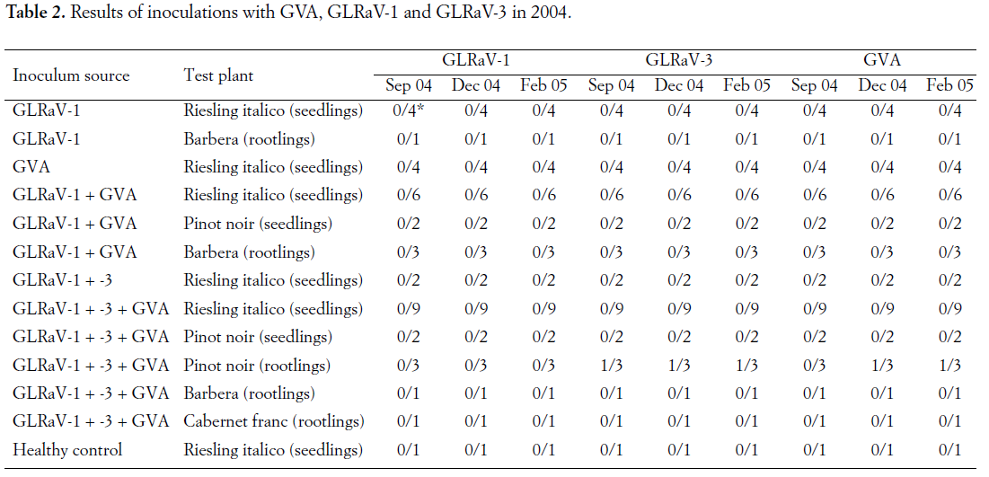
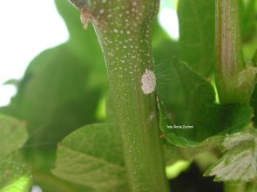
Experimental transmission studies: mealybugs
Zorloni et al 2006 Northern Italy
Heliococcus bohemicus

Slide 24
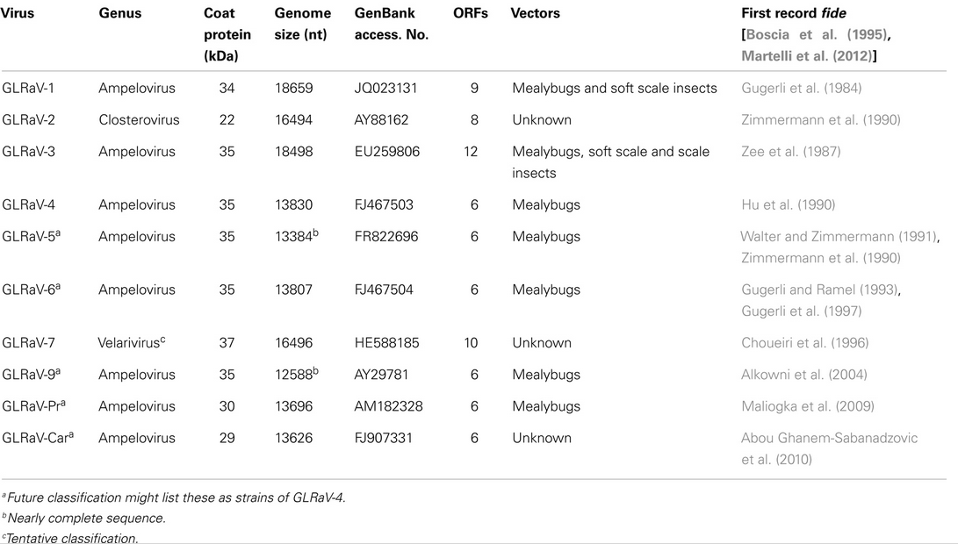
Leafroll species and known vectors

Slide 25
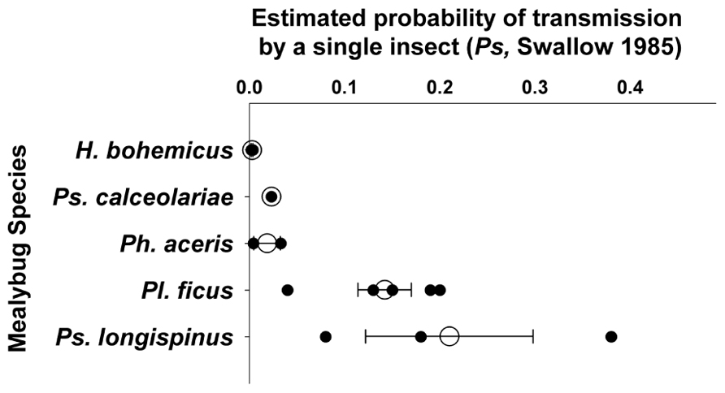
Vectors of Leafroll 3:
Several mealybug species; efficiency may vary
Almeida et al. 2013

Slide 26
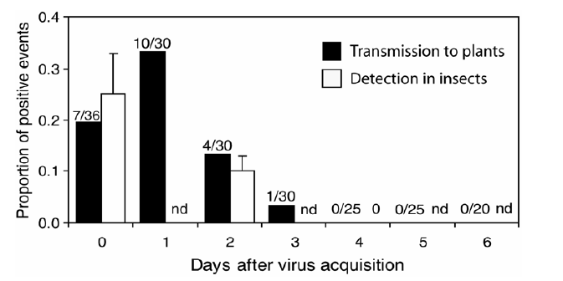
Semi-persistent transmission
Tsai et al 2008

Slide 27
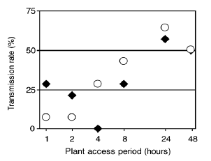
Transmission
AAP
IAP
Tsai et al 2008

Slide 28
Outline:
Background and history highlights: Viruses (mostly Leafroll), spread, and vector transmission studies
Recent results: Leafroll 3 and GVA, Leafroll 3 variants and mealybugs species, Leafroll 3 field inoculations
Transmission studies in progress

Slide 29
Inoculations and experimental transmission studies
Infected Source Plant
Pl. ficus
Uninfected plant

Slide 30
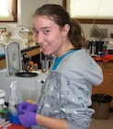
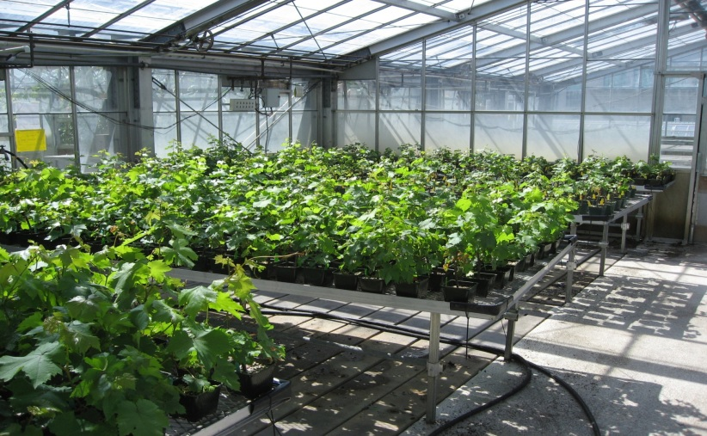
Plants in greenhouse four months
Detection using One Step RT-PCR + Fragment Analysis

Slide 31
Early Data:
Transmission of Leafroll 3 and GVA from co-infected plants
Percent plants infected
Source Plant
Comparison among source plants: X2 (24, 177) = 63.57 p < 0.0001

Slide 32
Transmission of Leafroll 3 and GVA from co-infected plants
a
a
Proportion test plants infected
b
Virus species
F (2,26) = 8.52 p = 0.0016

Slide 33
GVA can be transmitted from singly infected host plants
Proportion test plants infected
Source plant status

Slide 34
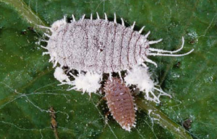
Transmisson of Leafroll 3 variants by two mealybug species
Pl. ficus
Ps. viburni

Slide 35
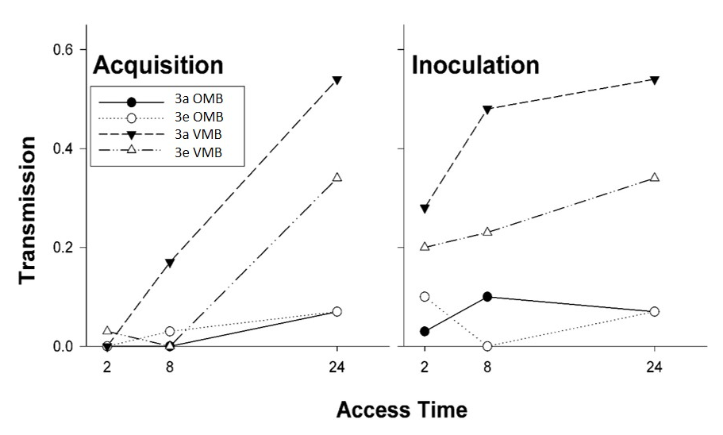
Vector species and GLRaV-3 variants:
Vine mealybugs transmit GLRaV-3 more efficiently than obscure mealybugs
There is no significant difference between GLRaV-3 variants (3a and 3e)
Pl. ficus
Ps. viburni
N = 600 test plants
3a vs 3e: X2, p = 0.12 ns
VMB vs OMB X2, p = 0.02*

Slide 36
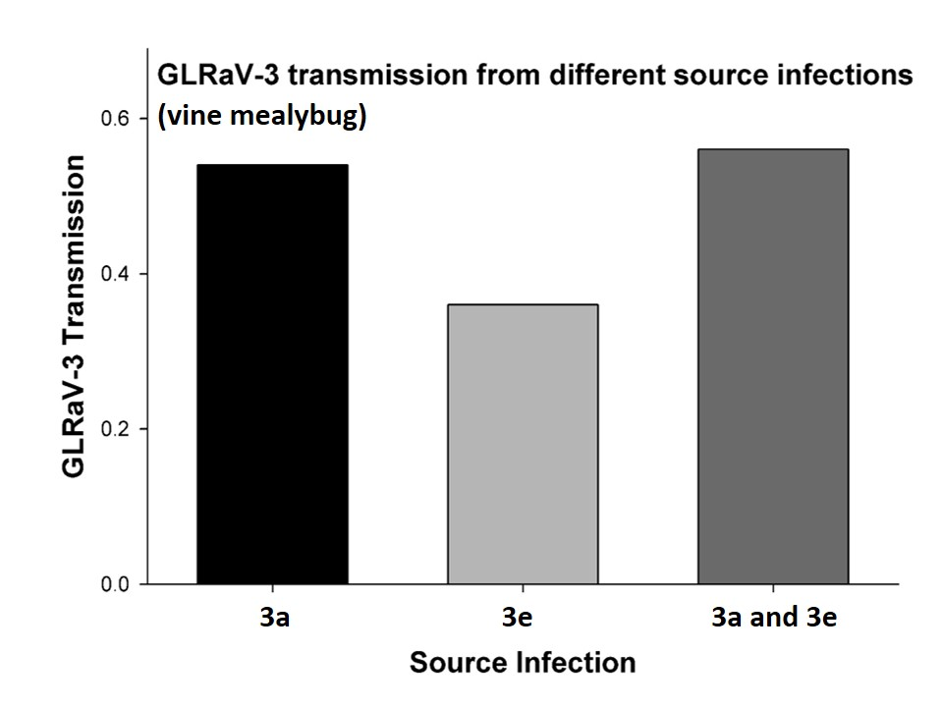
GLRaV-3 variants:
GLRaV-3 transmission is equivalent regardless of
infection status of source plant

Slide 37
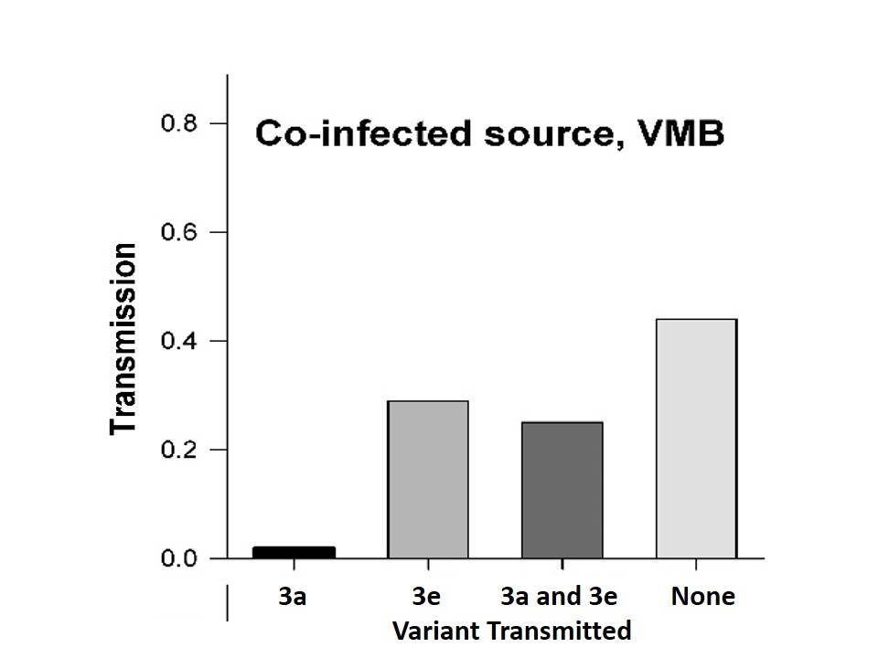
GLRaV-3 variants:
From a co-infected source (one plant with a mixed 3a-3e infection)
GLRaV-3e transmission is higher, mixed infections are common

Slide 38
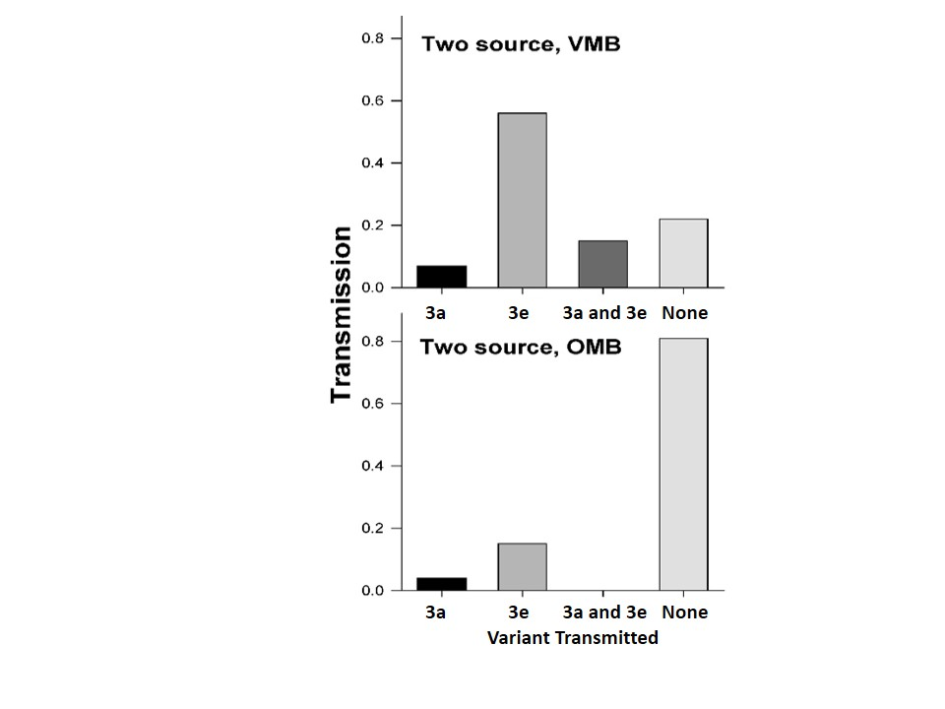
GLRaV-3 variants and vector species:
From two separate source plants
(one infected with 3a and one with 3e)
GLRaV-3e transmission is higher, and mixed infections are relatively rare
Relationship between virus variants appears similar regardless of vector species

Slide 39
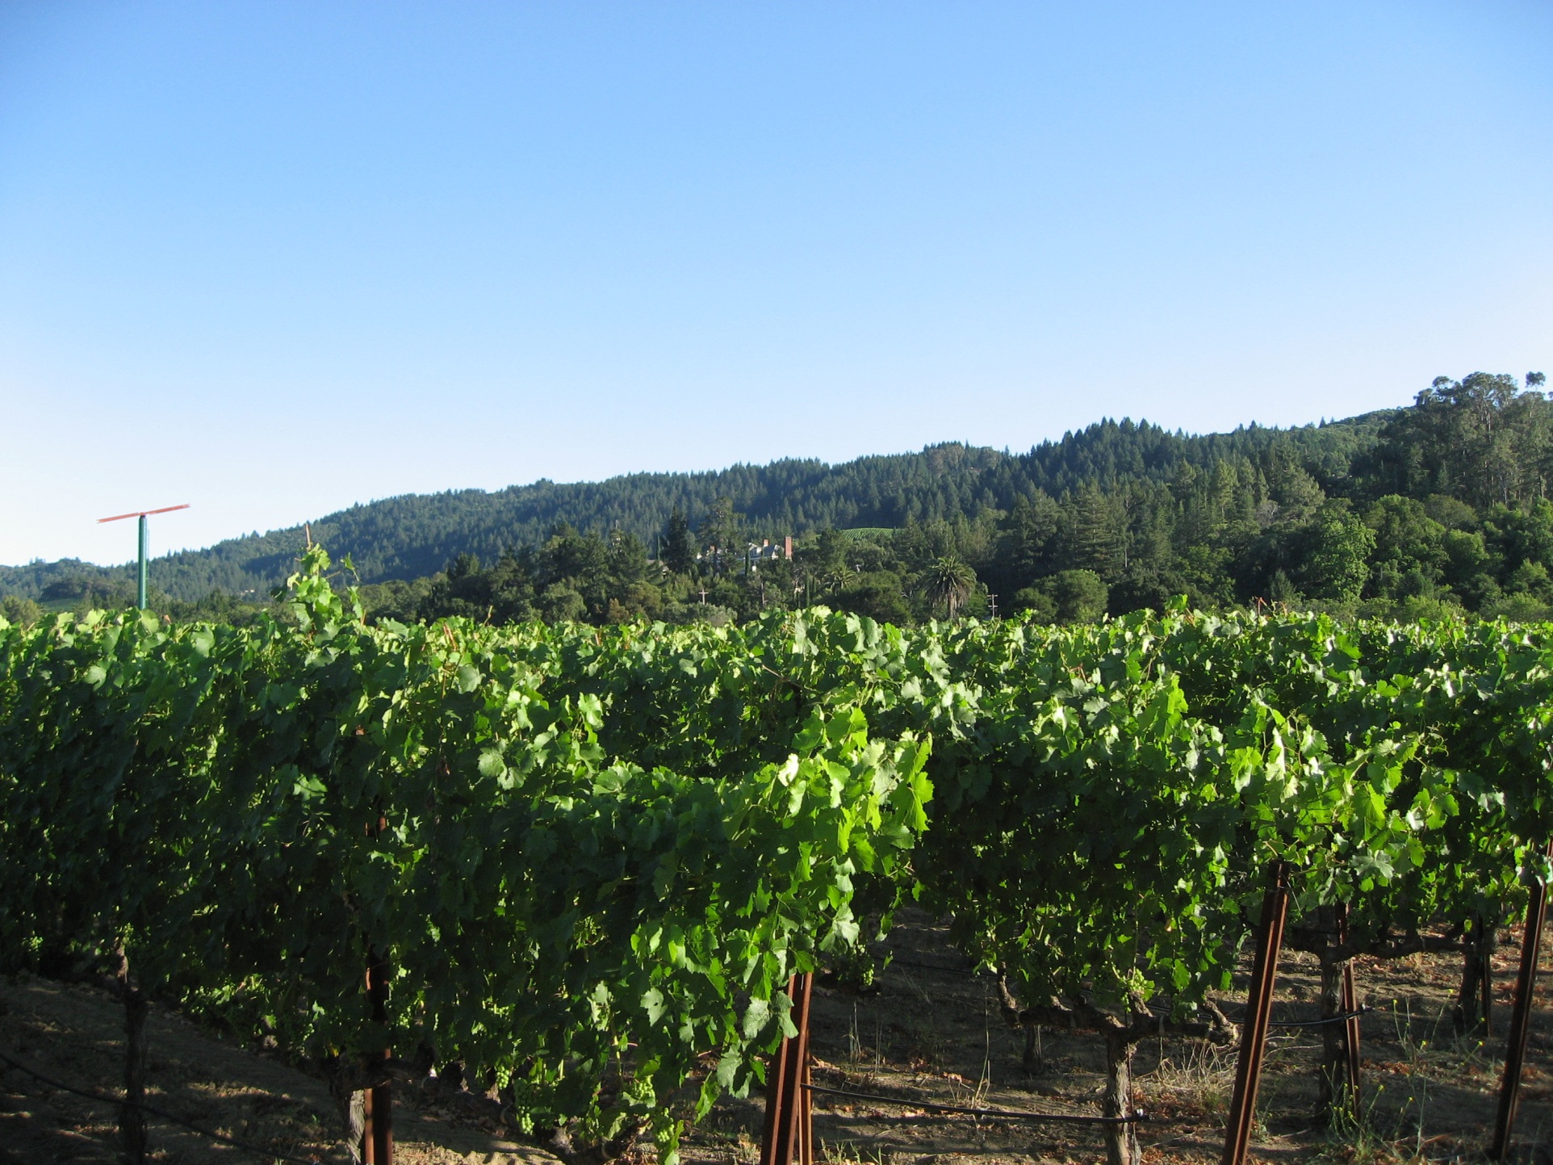
Field Inoculations

Slide 40
Unknowns
Transmission rates in vineyards vs. greenhouse experiments
Time after inoculation to:
Virus detection, lab assay
Virus symptoms
Transmission to other vines
Grape quality

Slide 41
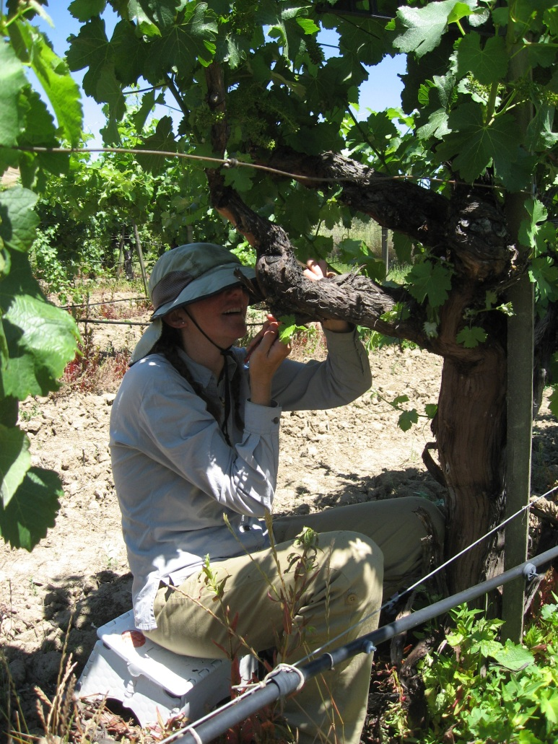
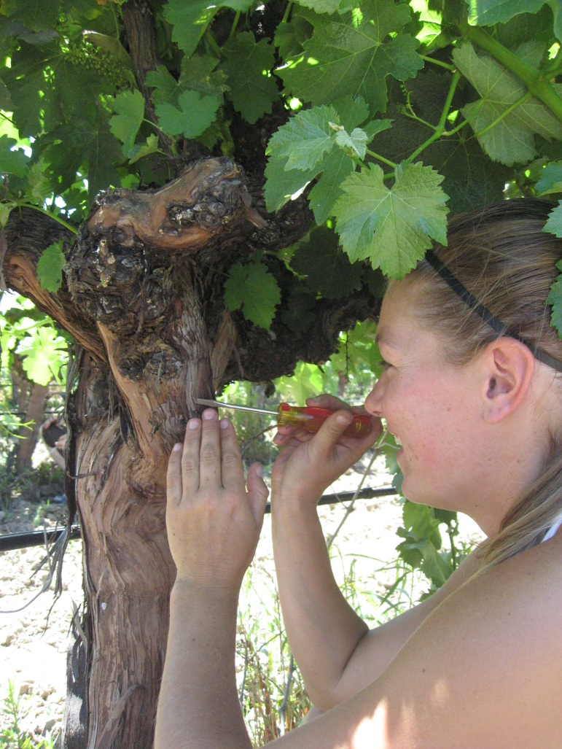
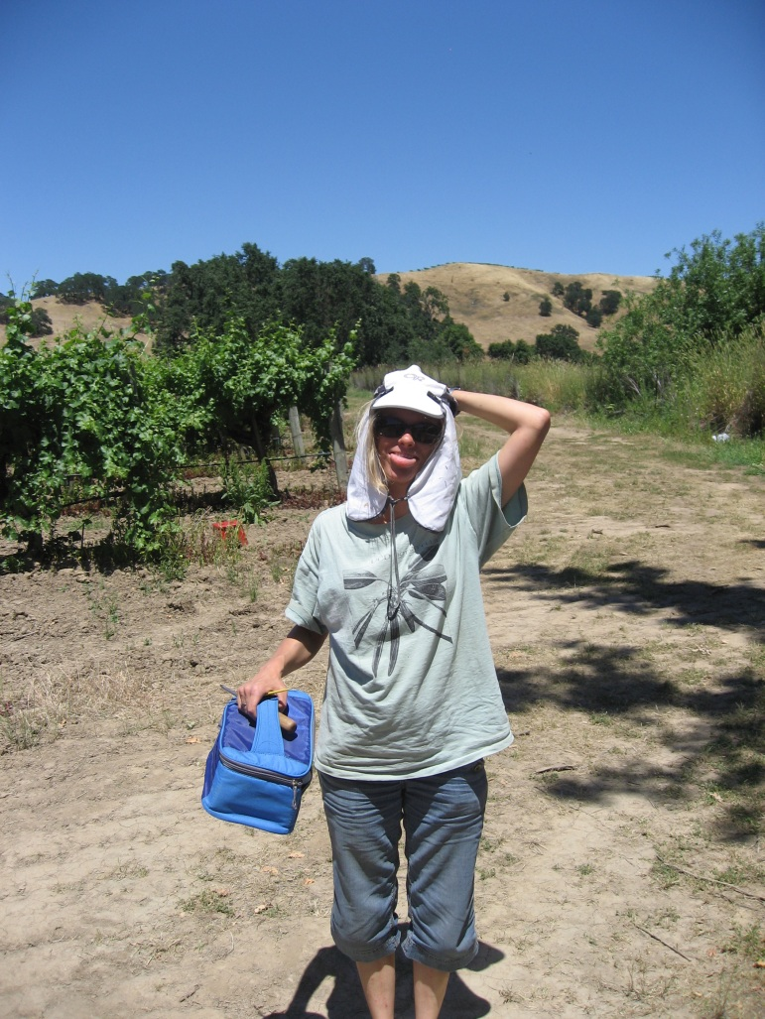
Collect grape mealybug mature females
Put in petri dishes until ovisacs are produced

Slide 42
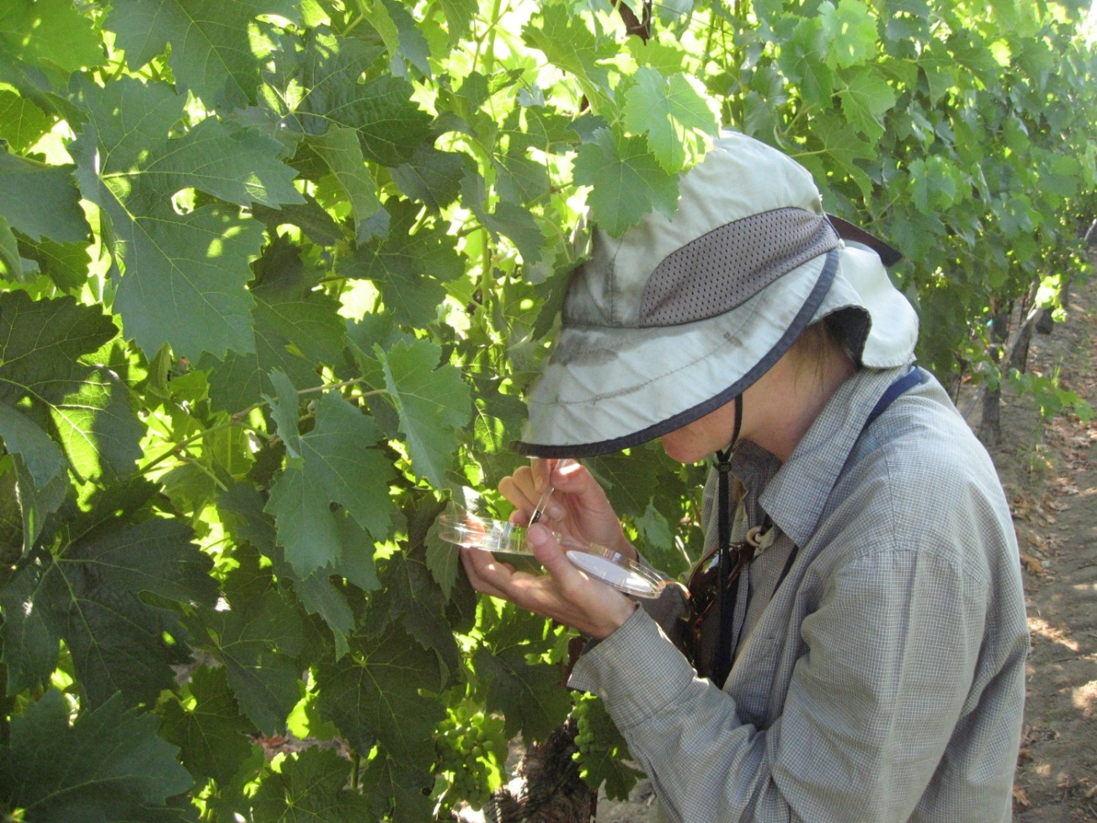
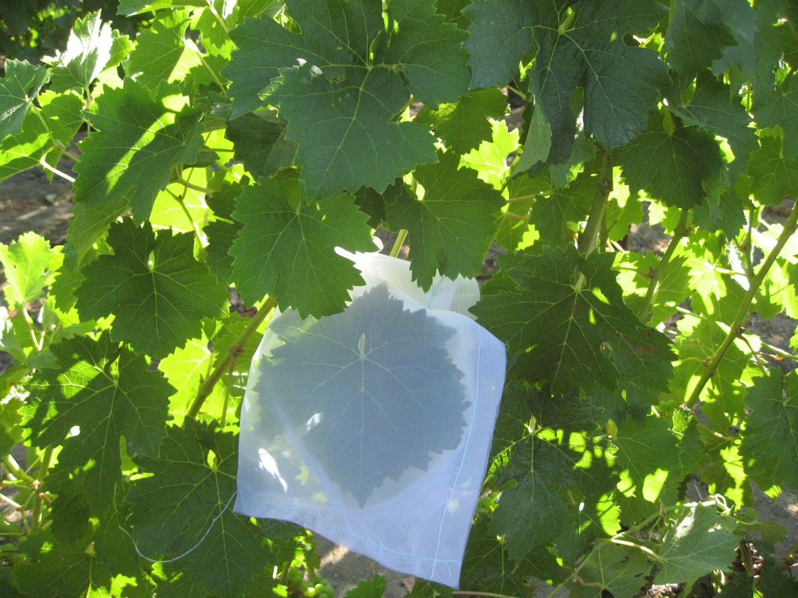
Field Inoculation
July 14, 2011
IAP 48 hours
10 GMB per plant on one leaf
Caged and Uncaged
Simultaneous parallel greenhouse inoculations for comparison
Symptoms in field monitored every 2 weeks

Slide 43
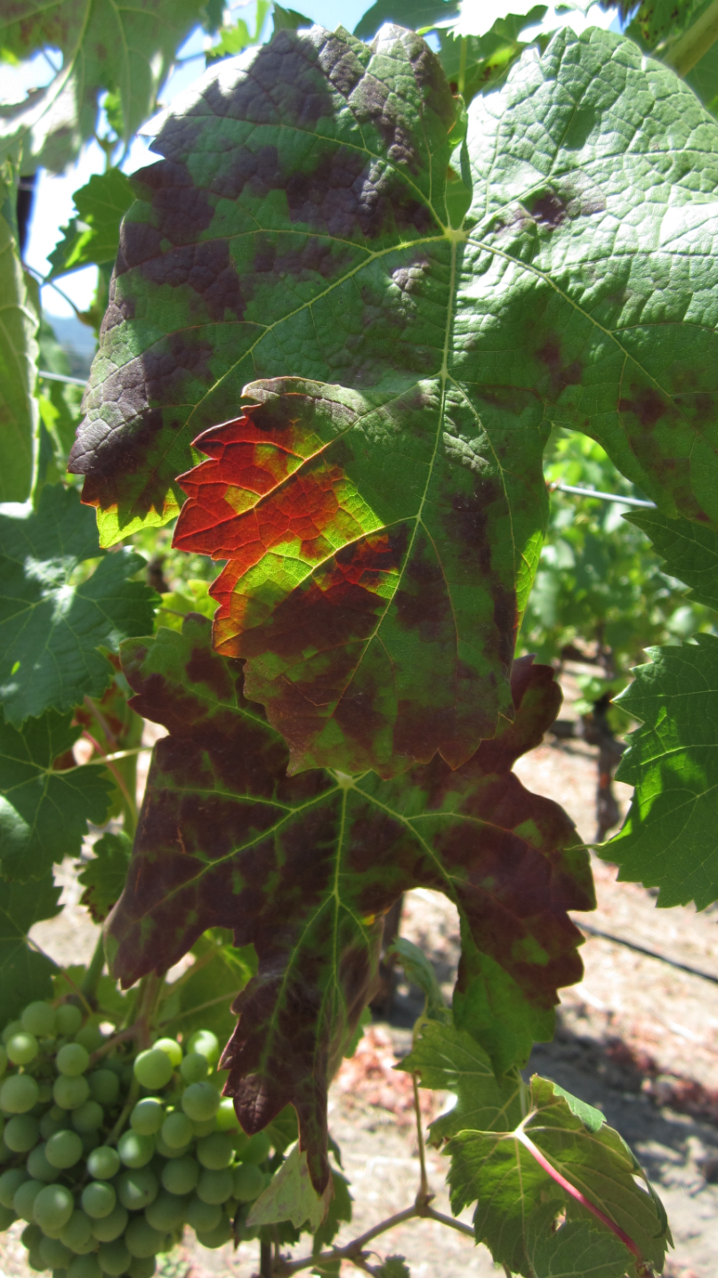
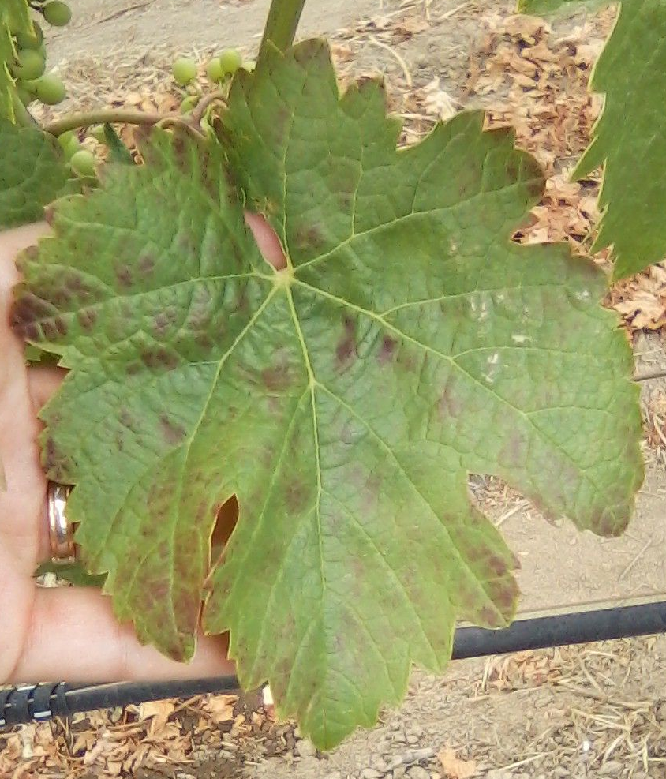
Symptoms 2012
June 22 2012 July 13 2012

Slide 44
Transmission, symptoms, and lab tests
Treatment | Replicate vines | PCR Positive October 2011 | Symptom 2012 | PCR Positive June 2012 | PCR Positive May 2013 | Symptom 2013
Inoculate July 2011 | 60 | 20 | 29 | 24 | 29 | 29
Negative control | 30 | 0 | 0 | 0 | 0 | 0
Total Plants | 90 | 20 | 29 | 24 | 29 | 29

Slide 45
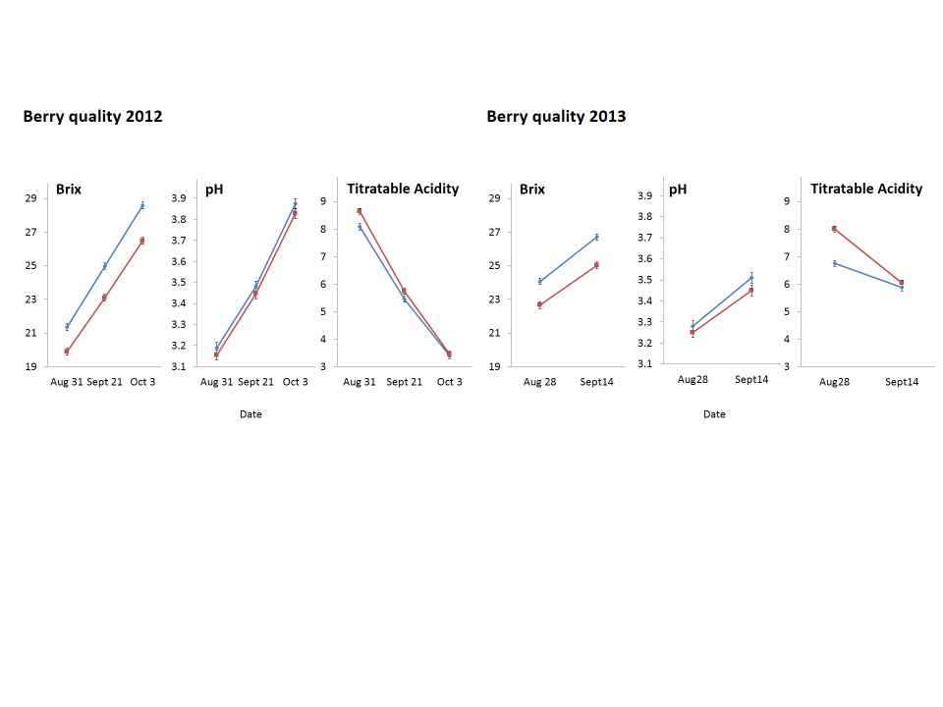
Berry quality was affected within one growing season

Slide 46
Greenhouse inoculations
Proportion of plants infected

Slide 47
Unknowns
Transmission rates in vineyards vs. greenhouse experiments
Slightly higher in gh experiments
Time after inoculation to:
Virus detection, lab assay (3 months)
Virus symptoms (1 year)
Transmission to other vines (~1 year)
Grape quality affected by next growing season

Slide 48





Field Inoculation Expt. 2: Virus, Vector, and Host
GLRaV-3a
GLRaV-3e
GLRaV-3a
GLRaV-3e
1
2
3
4
+ mixed infections
& negative controls
1
2
3
4
+ mixed infections
& negative controls
Grape mealybug
Vine mealybug
Grape mealybug
Vine mealybug
Chardonnay
Pinot Noir

Slide 49
PCR lab
results,
two months
after
inoculation
Grape Variety | Mealybug Species | Leafroll 3 variant | PCR positive/Number tested
Chardonnay | Vine | A | 0/25
 |  | E | 4/28
 |  | A and E | 4/25 (A:1, E:4)
 | Grape | A | 4/25
 |  | E | 6/28
 |  | A and E | 6/27 (E:4, A+E:2)
 | Negative Control | None | 0/24
Pinot Noir | Vine | A | 2/28
 |  | E | 3/27
 |  | A and E | 5/24 (A:2, E:3)
 | Grape | A | 1/27
 |  | E | 2/29
 |  | A and E | 6/30 (A:4, E:1, A+E:1)
 | Negative Control | None | 0/30
Total |  |  | 43/377

Slide 50
Single GLRaV-3 variant inoculations
Transmission

Slide 51
Mixed GLRaV-3 variant inoculations
Transmission
3a 3e 3a+3e 3a 3e 3a+3e
Chardonnay Pinot Noir

Slide 52
Outline:
Background and history highlights: Viruses (mostly Leafroll), spread, and vector transmission studies
Recent results: Leafroll 3 and GVA, Leafroll 3 variants and mealybugs species, Leafroll 3 field inoculations
Transmission studies in progress

Slide 53


Red Blotch, experimental transmission studies in progress
?
Red Blotch
Erythroneura ziczac
Photo: Poojari et al. 2013

Slide 54
Red Blotch: Testing in progress of common vineyard pests as potential vectors
No transmission found (yet?)
Common name | Scientific Name | Distribution | # Insects per test plant | # Test plants | # NC test plants
Western grape leafhopper | Erythroneura elegantula | North Coast | 32 | 14 | 2
Variegated leafhopper | Erythroneura variabilis | Central Valley | 25 | 10 | 5
Virginia creeper leafhopper | Erythroneura ziczac | Northern CA | 37 | 15 | 10
Vine mealybug | Planococcus ficus | California vineyards | 63 | 12 | 8
Blue-green sharpshooter | Graphocephala atropunctata | Northern CA | 26 | 5 | 3
Grape whitefly | Trialeurodes vittatas | California | 34 | 8 | 5

Slide 55
Summary-
GVA- transmitted by mealybugs (with or without Leafroll)
Leafroll- Vector species vary in efficiency,
LR3 variants interact during transmission,
Symptoms show in growing season following initial infection, Greenhouse studies and field studies are fairly comparable
Red blotch- lots of unknowns, many people are working on it

Slide 56
FPS: Deborah Golino, Adib Rowhani, Maher Al Rwahnih,
Vicki Klassen, Sue Sim, and others
Constellation: Katey Taylor, Jessica Fuentes, and others
Emily Kuhn
UCB : Jenny Bratburd, Brandy Chavez, Jean-Francois Darrigrand, Megan Fu, Michelle Gantos, John Hutchins, Kyle Ingraham, Ruth Lopez, Hannah Oh, Preethi Padmanaban, Barb Rotz, Cecilia Prator, Lucas Senegas, Tina Wistrom, Michelle Wong, Siming Zhang

