Slide 1
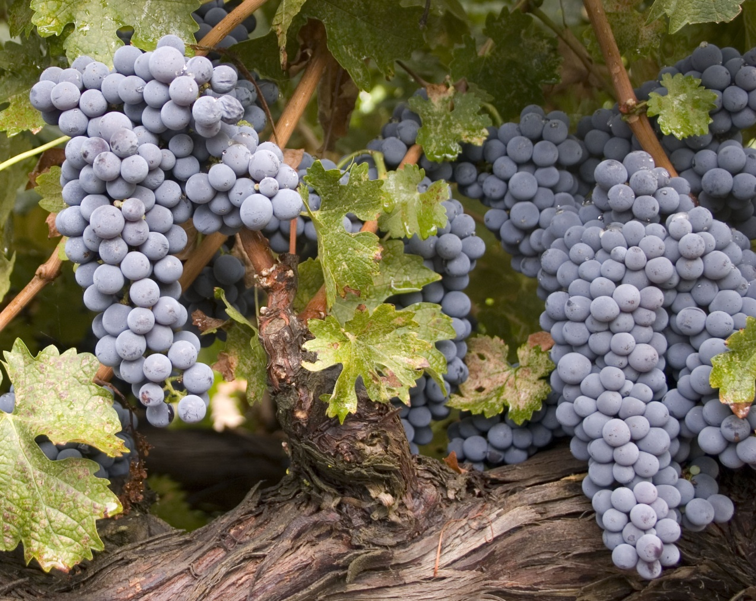
THE HISTORY OF RED LEAF DISEASES
Current Issues: An In-Depth Look
At Red Leaf Viruses
Deborah Golino
UC Davis

Slide 2
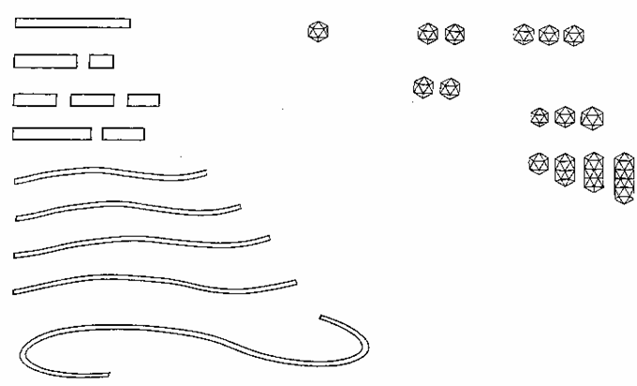
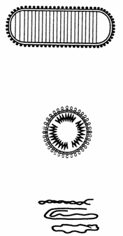
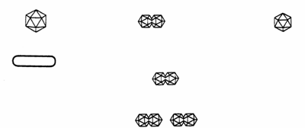

(+) ssRNA
(-) ssRNA
Tobamovirus
Sesquiviridae
Tombusviridae
Dianthovirus
Luteovirus
Machlomovirus
Marafivirus
Necrovirus
Sobemovirus
Tymovirus
Comoviridae
Bromoviridae
Cucumovirus
Bromovirus
Tobravirus
Hordeivirus
Enamovirus
Idaeovirus
Rhabdoviridae
Cytorhabdovirus
Nucleorhabdovirus
Ilarvirus
Furovirus
Potexvirus
Alfamovirus
Capillovirus, Trichovirus
Carlavirus
Types of Plant Viruses
Bunyaviridae
Tospovirus
Potyviridae
Closterovirus
Tenuivirus
dsDNA
ssDNA
dsRNA
Caulimovirus
Geminiviridae
Geminivirus
Isometric
Banana buchy top virus group
Badnavirus
Reoviridae
Phytoreovirus
Fijivirus
Oryzavirus
Partitiviridae
Alphacryptovirus
Betacryptovirus
Subgroup l,ll
Subgroup lll

Slide 3
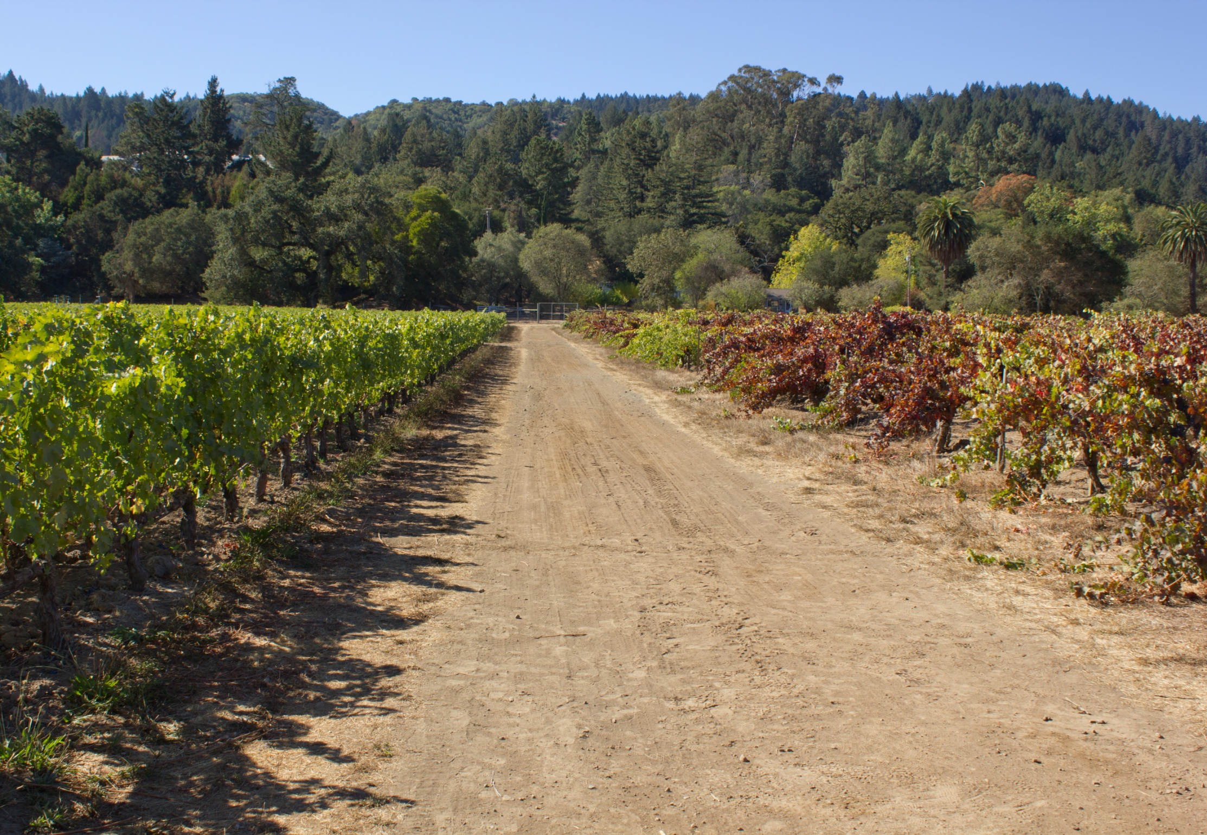
A Short History of the Redleaf Grapevine Virus Diseases*
* With much thanks to Dr. Marc Fuchs at Cornell University

Slide 4
Discovery of Fanleaf Disease
First description in France (Cazalis-Allut, 1841)
Implication of a pathogen similar to the contagium vivum fluidum (Baccarini, 1902)
Fanleaf degeneration contracted from disease vineyard soil (Petri, 1918)
Identification of Xiphinema index, the dagger nematode vector (Hewitt et al., 1958)
Identification and characterization of Grapevine fanleaf virus as the causal agent (Baldacci et al., 1960; Cadman et al., 1960; Vuittenez, 1960)
Koch’s postulates fulfilled (Hewitt et al., 1962)
Andret-Link et al. J. Pathol. 86:183 (2004)

Slide 5
Discovery of Leafroll Disease
Description of “rougeau” in France (Ravaz and Roos, 1905; Pacottet, 1906) and ”rossore” in Italy (Arcangeli, 1907)
Graft-transmission (Scheu, 1935)
Association of a virus (Namba et al., 1979)
Serologically distinct viruses associated with the disease (Gugerli et al., 1984; Rosciglione and Gugerli, 1986)
Mealybug transmission (Rosciglione and Gugerli, 1987)
Koch’s postulates have yet to be fulfilled
Maree et al. Frontiers in Microbiology 4:82 (2013)

Slide 6
Discovery of Red Blotch Disease
First description in Napa Valley (Calvi, 2008)
A new DNA virus sequence (Krenz et al., 2012)
Diagnostic tools made available (Krenz et al., 2012; Al Rwahnih et al., 2012)
High correlation between virus presence and diseased vines (Al Rwahnih et al. 2013)
Graft transmissibility (Al Rwahnih et al. 2013)
Koch’s postulates have yet to be fulfilled

Slide 7
Red Blotch: Challenges and opportunities
Fanleaf
First description 1841
Graft transmission 1962
Virus recognition 1960
Vector transmission 1958
Diagnostic assays 1960
Koch’s postulates 1962

Slide 8
Red Blotch: Challenges and opportunities
Fanleaf Leafroll
First description 1841 1905
Graft transmission 1962 1935
Virus recognition 1960 1979
Vector transmission 1958 1984
Diagnostic assays 1960 1984
Koch’s postulates 1962 n/a

Slide 9
Red Blotch: Challenges and opportunities
Fanleaf Leafroll Red blotch
First description 1841 1905 2008
Graft transmission 1962 1935 2012
Virus recognition 1960 1979 2012
Vector transmission 1958 1984 2013
Diagnostic assays 1960 1984 2012
Koch’s postulates 1962 n/a 2013

Slide 10
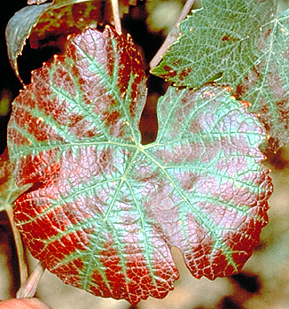
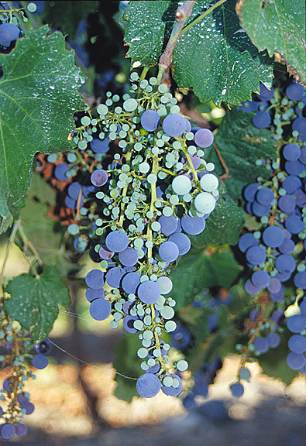
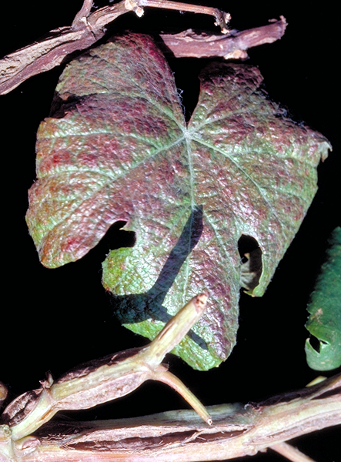
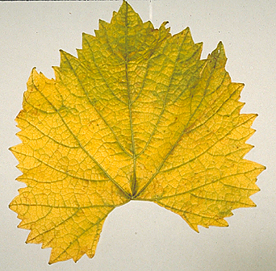
FPS Target Grapevine Diseases
Grapevine Degeneration
➢ Fanleaf
Grapevine Decline
➢ Tomato Ringspot Virus
Leafroll
Rugose Wood Complex
➢ Kober Stem Grooving
➢ Corky Bark
➢ LN33 Stem Grooving
➢ Rupestris Stem Pitting
Fleck
Minor Viruses

Slide 11
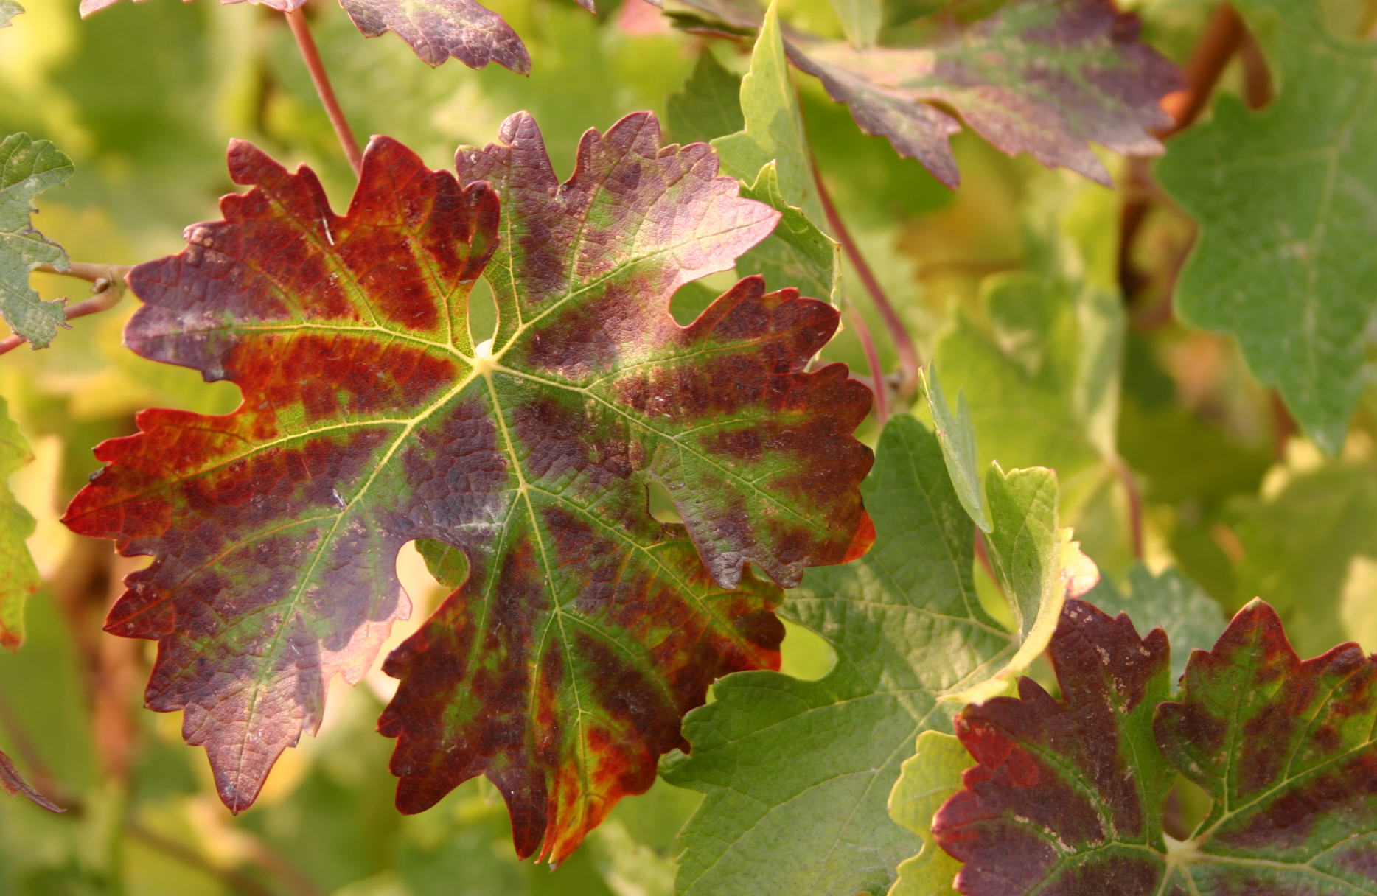

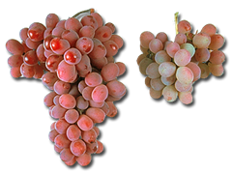
Leafroll Virus

Slide 12
Early Leafroll History in California
Virus first hypothesized by Olmo as cause of ‘White Emperor Disease (Olmo and Rizzi, 1943)
Graft-transmissibility of WED demonstrated (Harmon and Snyder, 1946)
1948, Olmo release ‘Ruby Cabernet’ found to be infected with Leafroll virus due to contaminated rootstock (Olmo 1975)
Hewitt writes W&V article urging Grape Certification Program (Hewitt 1949)
1950, University and USDA researcher begin meeting with industry and planning a grape clean plant program
July 1952, the California Grape Certication Associate is formed
1956, CDFA created the California Grapevine Registration and Certification Program

Slide 13
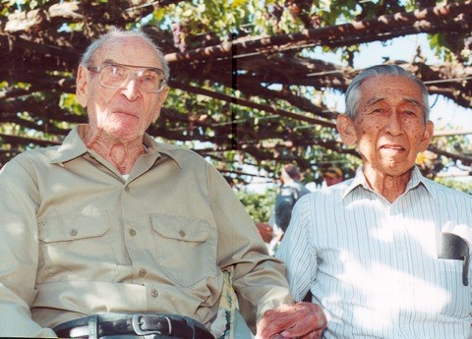
Harold Olmo and student Al Kayama
Notes:
As a part of improving quality of grape plant material, FPS acquired land and improved it to establish a new vineyard called the RR vineyard in 2010.

Slide 14
Proposed new taxonomy for the leafroll viruses
Genus | Virus | Acronym
Closterovirus | Grapevine leafroll associated virus 2 | GLRaV-2
Ampelovirus Subgroup I | Grapevine leafroll associated virus 1 | GLRaV-1
 | Grapevine leafroll associated virus 3 | GLRaV-3
Ampelovirus Subgroup II | Grapevine leafroll associated virus 4 | GLRaV-4
 | Grapevine leafroll associated virus 4 strain 5 | GLRaV-5
 | Grapevine leafroll associated virus 4 strain 6 | GLRaV-6
 | Grapevine leafroll associated virus 4 strain 9 | GLRaV-9
 | Grapevine leafroll associated virus 4 strain Car. | GLRaV-Car
 | Grapevine leafroll associated virus 4 strain Pr | GLRaV-Pr
 | Grapevine leafroll associated virus 4 strain De | GLRaV-De
Velarivirus | Grapevine leafroll associated virus 7 | GLRaV-7
Notes:
Now LR5, 6, 9, Car, Pr, and De are genetically divergent variants of GLRaV-4.

Slide 15
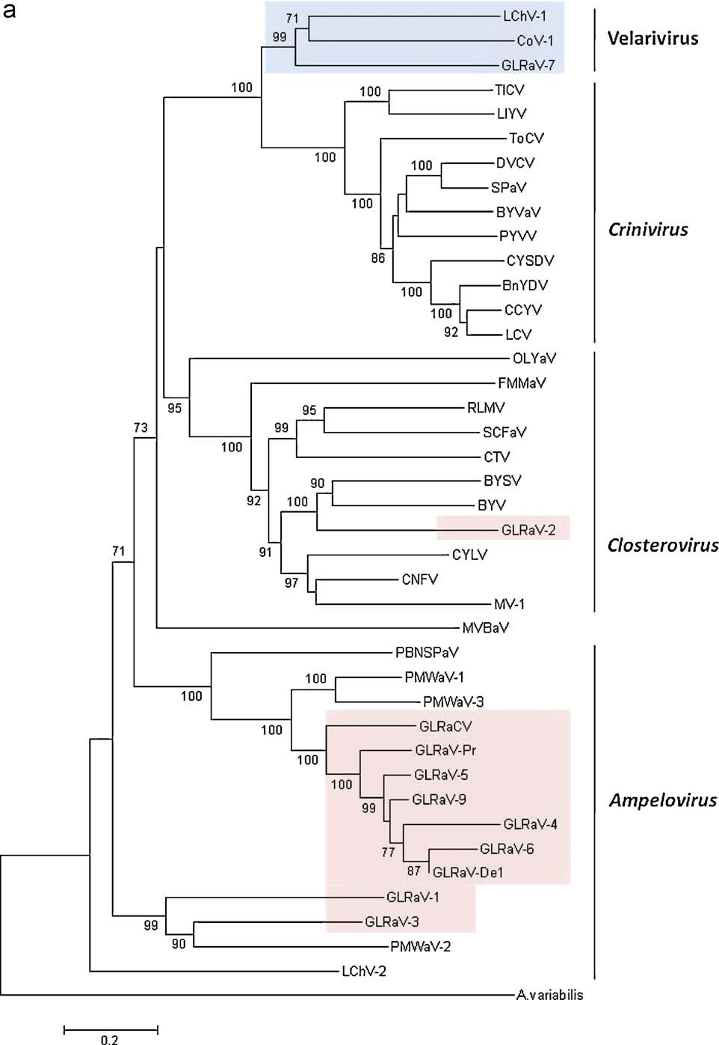

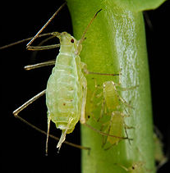
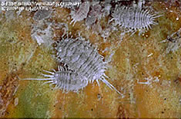
Closteroviridae family insect vector
Velarivirus
Unknown ??
Crinivirus
Whiteflies
Closterovirus
Aphids
Ampelovirus
Mealybugs,
soft scale, &
sacle incest

Slide 16
Leafroll Virus Effects

Slide 17
Lider, L.A., A.C. Goheen, N.L. Ferrari. 1975. A comparison between healthy and leafroll-affected grapevine planting stocks. Am J. Enol Vit. 26:144-147.
cv. Burger/ Dogridge
Year | Parameter | H | LR-infected | Change | Percent difference
1971 | Yield (kg/vine) | 16.5 | 12.5 | -4 | -24%
 | Pruning weight (kg/vine) | 1.87 | 1.5 | -0.37 | -20%
 | Brix | 19.6 | 16.8 | -2.8 | -14%
 | TA | 0.65 | 0.79 | 0.14 | 21%
1972 | Yield (kg/vine) | 23.2 | 19.8 | -3.4 | -15%
 | Pruning weight (kg/vine) | 1.42 | 0.97 | -0.45 | -32%
 | Brix | 16.3 | 13.9 | -2.4 | -15%
 | TA | 0.67 | 0.79 | 0.12 | 18%

Slide 18
Walter and Legin, 1986. Connaissances actuelles sur les viroses
de l’enroulement de la Vigne. Le Vigneron champenois, 9,436-446.
Clone | Parameter | Not inoculated | LR-inoculated | Difference | Percent difference
Chardonnay 1 | Yield (kg/vine) | 1.49 | 0.85 | -0.64 | -43%
 | Probable alcohol content | 10.1 | 8.2 | -1.9 | -19%
Chardonnay 3 | Yield (kg/vine) | 1.6 | 0.8 | -0.8 | -50%
 | Probable alcohol content | 11 | 9.5 | -1.5 | -14%
Pinot noir 3 | Yield (kg/vine) | 1.26 | 0.49 | -0.77 | -61%
 | Probable alcohol content | 9.6 | 8.6 | -1 | -10%
Pinot noir 98 | Yield (kg/vine) | 0.57 | 0.36 | -0.21 | -37%
 | Probable alcohol content | 9.5 | 9.2 | -0.3 | -3%

Slide 19
Borgo, M. 1991. Influence of grapevine leafroll virus on some production parameters. Riv. Vitic. Enol 2:21-30.
Mean of 3 years data; 5BB, 420A; LR- infected = LR-3, KSG, RSP, Vein necrosis
Variety | Parameter | Healthy | LR-infected | Difference | Percent difference
Merlot | Yield (kg/vine) | 12.85 | 9.77 | -3.08 | -24%
 | Brix | 18.5 | 17.4 | -1.1 | -6%
 | TA, g/l | 6.76 | 6.97 | 0.21 | +3%
Cabernet franc | Yield (kg/vine) | 6.8 | 5.6 | -1.2 | -18%
 | Brix | 19.2 | 18.1 | -1.2 | -18%
 | TA, g/l | 5.27 | 5.78 | 0.51 | +10%
Cabernet Sauvignon | Yield (kg/vine) | 8.4 | 8.7 | 0.3 | +4%
 | Brix | 19.3 | 18.2 | -1.1 | -6%
 | TA, g/l | 8.69 | 9.79 | 1.1 | +13%

Slide 20
Credi, R., A.R. Babini. 1997. Effects of virus and virus-like infections on growth, yield and fruit quality of Albana and Trebbiano Romagnolo Grapevines. Am J. Enol. Vitic. 48:7 - 12.
Mean of 7 years data; Albana/ 5BB; Trebbiano Romagnolo/ SO4; LR- infected = LR-3, KSG, RSP, Vein necrosis
Variety | Parameter | Healthy | LR-infected | Difference | Percent difference
Albana | Yield (kg/vine) | 46.7 | 12.65 | -34.05 | -73%
 | Pruning weight (kg/vine) | 8.08 | 2.59 | -5.49 | -68%
 | Brix | 16.55 | 19.08 | 2.53 | +15%
 | TA, g/l | 7.19 | 6.55 | -0.64 | -9%
Trebbiano Romagnolo | Yield (kg/vine) | 45.5 | 25.1 | -20.4 | -45%
 | Pruning weight (kg/vine) | 7.27 | 4.41 | -2.86 | -39%
 | Brix | 16.31 | 15.46 | -0.85 | -5%
 | TA, g/l | 6.74 | 7.41 | 0.67 | +10%

Slide 21
Golino, DA. J. Wolpert, ST Sim, J Benz, M Anderson, A Rowhani. 2009. Virus effects on vine growth and fruit components of three California ‘heritage’ clones of Cabernet Sauvignon. Progres Agricole et Viticole. 16th meeting of the ICVG. Extended Abstracts.243-244 . Cabernet Sauvignon/101-14; LR-infected = LR-3, GVB, GFkV
Clone | Parameter | Healthy | LR-infected | Difference | Percent difference
29 | Yield (kg/vine) | 3.1 | 1.6 | -1.5 | -48%
 | Pruning weight (kg/vine) | 0.84 | 0.35 | -0.491 | -59%
 | Brix | 24.2 | 19.9 | -4.3 | -18%
 | TA, g/l | 6.6 | 6.9 | 0.3 | +5%
30 | Yield (kg/vine) | 3 | 2.9 | -0.1 | -3%
 | Pruning weight (kg/vine) | 0.77 | 0.89 | 0.118 | 15%
 | Brix | 24.8 | 22 | -2.8 | -11%
 | TA, g/l | 6.6 | 6.9 | 0.3 | +5%
31 | Yield (kg/vine) | 1.7 | 1.2 | -0.5 | -29%
 | Pruning weight (kg/vine) | 1.08 | 0.82 | -0.252 | -23%
 | Brix | 24.8 | 19.9 | -4.9 | -20%
 | TA, g/l | 6.3 | 7.7 | 1.4 | +22%

Slide 22
Golino, DA. J. Wolpert, ST Sim, J Benz, M Anderson, A Rowhani. 2009. Virus effects on vine growth and fruit components of Cabernet Sauvignon on six rootstocks. Progres Agricole et Viticole. 16th meeting of the ICVG. Extended Abstracts.245-246 .
Cabernet Sauvignon clone 5; LR-infected = LR-3, GVB, GFkV
Rootstock | Parameter | Healthy | LR-infected | Difference | Percent difference
101-14 Mgt | Yield (kg/vine) | 2.21 | 1.16 | -1.05 | -48%
 | Brix | 26.1 | 23.9 | -2.2 | -8%
 | TA, g/l | 6.76 | 6.72 | -0.04 | -1%
1103P | Yield (kg/vine) | 2.42 | 2.06 | -0.36 | -15%
 | Brix | 26.3 | 24.3 | -2 | -8%
 | TA, g/l | 7.07 | 7.42 | 0.35 | 5%
110R | Yield (kg/vine) | 2.31 | 2.12 | -0.19 | -8%
 | Brix | 26 | 23.5 | -2.5 | -10%
 | TA, g/l | 7.18 | 7.52 | 0.34 | 5%

Slide 23
Golino, DA. J. Wolpert, ST Sim, J Benz, M Anderson, A Rowhani. 2009. Virus effects on vine growth and fruit components of Cabernet Sauvignon on six rootstocks. Progres Agricole et Viticole. 16th meeting of the ICVG. Extended Abstracts.245-246 .
Cabernet Sauvignon clone 5; LR-infected = LR-3, GVB, GFkV (continued)
Rootstock | Parameter | Healthy | LR-infected | Difference | Percent difference
3309C | Yield (kg/vine) | 2.29 | 2.24 | -0.05 | -2%
 | Brix | 26.1 | 23.5 | -2.6 | -10%
 | TA, g/l | 7.18 | 7.17 | -0.01 | 0%
5BB | Yield (kg/vine) | 2.71 | 0.33 | -2.38 | -88%
 | Brix | 26.5 | 24 | -2.5 | -9%
 | TA, g/l | 7.49 | 7.13 | -0.36 | -5%
St. George | Yield (kg/vine) | 1.61 | 1.75 | 0.14 | 9%
 | Brix | 26.4 | 23.9 | -2.5 | -9%
 | TA, g/l | 6.45 | 6.92 | 0.47 | 7%

Slide 24
Komar, V. E. Vigne, G. Demangeat, O. Lemaire, M. Fuchs. 2010. Comparative Performance of Virus-Infected Vitis vinifera cv. Savignin rose Grafted onto Three Rootstocks. Am J. Enol Vitic. 61:68-73. LR- infected = LR-1, GVA, RSPaV, Vein mosaic, Vein necrosis
Rootstock | Parameter | H | LR-infected | Difference | Percent difference
5BB | Yield (kg/vine) | 17.2 | 9.9 | -7.3 | -42%
 | Pruning weight (kg/vine) | 3.58 | 1.76 | -1.82 | -51%
 | Brix | 19.3 | 19.8 | 0.5 | +3%
 | TA, g/l | 5.5 | 5.08 | -0.42 | -8%
161-49 C | Yield (kg/vine) | 14.98 | 6.84 | -8.14 | -54%
 | Pruning weight (kg/vine) | 2.79 | 1.76 | -1.03 | -37%
 | Brix | 19.4 | 19.7 | 0.3 | +2%
 | TA, g/l | 4.77 | 4.61 | -0.16 | -3%
V. rupestris | Yield (kg/vine) | 17.19 | 9.01 | -8.18 | -48%
 | Pruning weight (kg/vine) | 3.78 | 3.06 | -0.72 | -19%
 | Brix | 19.5 | 20.2 | 0.7 | +4%
 | TA, g/l | 5.07 | 5 | -0.07 | -1%

Slide 25
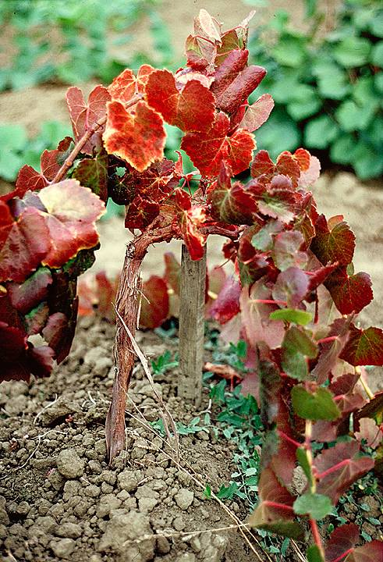
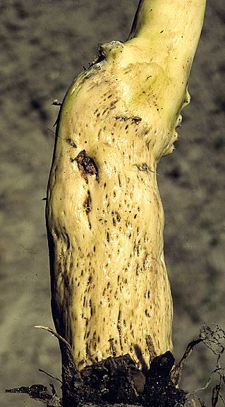
Corky Bark

Slide 26
Tanne et al, 1990. Preliminary data on the effect of corky-bark disease on Thompson seedless vines grafted on various rootstocks. Proc.10th ICVG Volos, 1991,386-389
Rootstock | Parameter | Non-infected | Infected | Difference | Percent difference
own root | Yield (kg/vine) | 28 | 15.7 | -12.3 | -44%
41B | Yield (kg/vine) | 19.1 | 12.9 | -6.2 | -32%
1103P | Yield (kg/vine) | 43.1 | 20.1 | -23 | -53%
110R | Yield (kg/vine) | 24.8 | 10.5 | -14.3 | -58%
1613C | Yield (kg/vine) | 40.7 | 2.8 | -37.9 | -93%

Slide 27
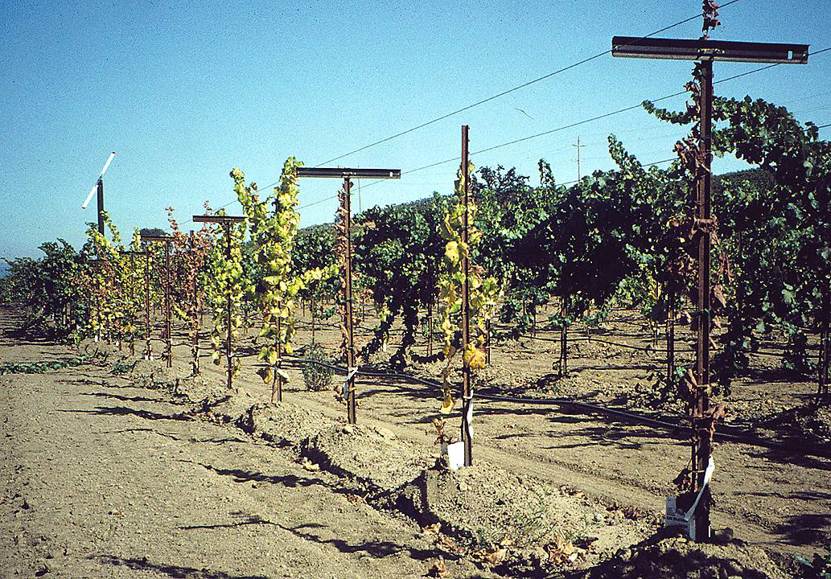

Slide 28
“A little virus”

Slide 29
Hypothesis:
Latent virus diseases were epidemic in California in the 1990’s because new, alternative rootstocks were susceptible to common grapevine viruses.

Slide 30
AXR-1
V. vinifera ‘Aramon’ x V. rupestris
was the most widely used rootstock in California until the “phylloxera crisis”

Slide 31
Symptoms of young vines which
may be caused by virus infection:
Stunting
Shortened internodes
Leaf discoloration
Leaf rolling
Graft union disorders

Slide 32
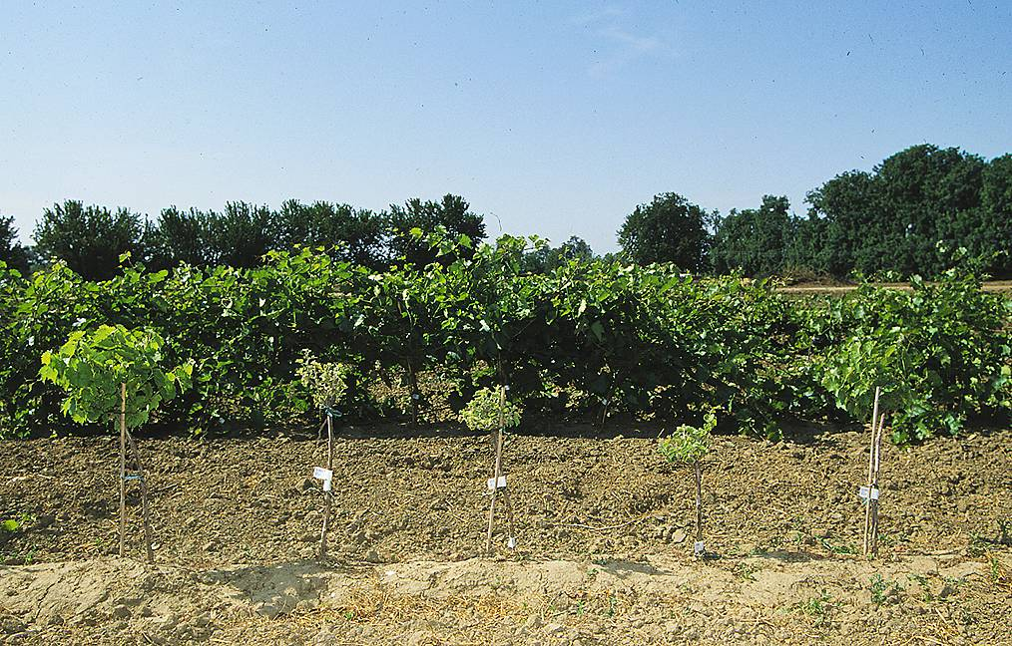
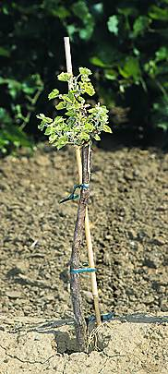
Latent Virus Trials - Freedom Rootstock

Slide 33
Length of longest shoot of 2-year old Freedom rootings inoculated with 22 virus isolates

Slide 34
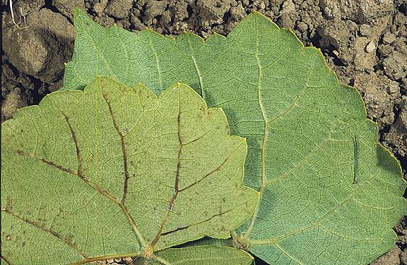
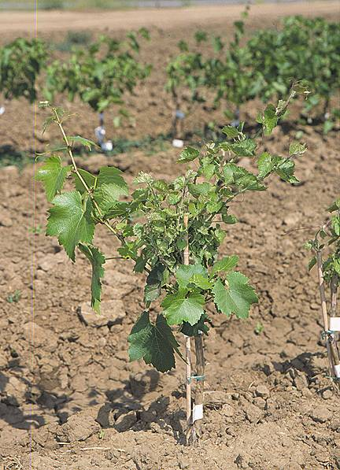
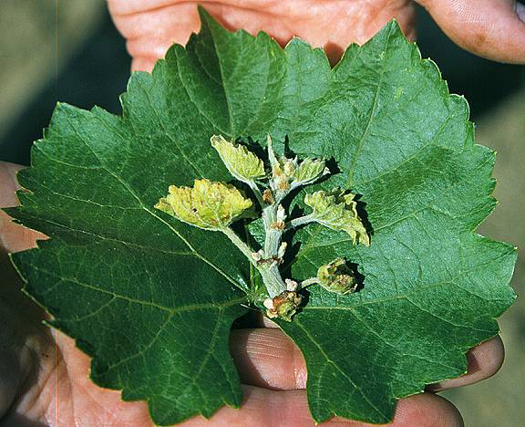
Healthy
Vein necrosis
Freedom shows stunting effects
Symptomless scion growth
Symptoms on shoot tip

Slide 35
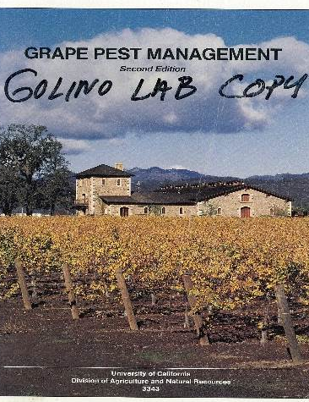
Corky Bark
‘Corky bark symptoms resemble Leafroll but their effect is more pronounced
…small stunted plants…
leaves turn reddish or bronzish yellow… vines showdeep grooves or pits in the wood.’
1992
Notes:
As a part of improving quality of grape plant material, FPS acquired land and improved it to establish a new vineyard called the RR vineyard in 2010.

Slide 36

Corky Bark
‘Corky bark disease is associated with a vitivirus, grapevine virus B, GVB. When GVB is present with GLRV-2, the disease is much more serious than if either virus were present as a single infection.’
2013
Notes:
As a part of improving quality of grape plant material, FPS acquired land and improved it to establish a new vineyard called the RR vineyard in 2010.

Slide 37


Association of a Circular DNA Virus in Grapevines
Affected by Red Blotch Disease in California
M. Al Rwahnih¹, A. Dave^{1,2}, M. Anderson³, J. K. Uyemoto² and M.R. Sudarshana^{1,2}
¹Dept. of Plant Pathology, ²USDA-ARS, ³Dept. of Viticulture and Enology,
University of California, Davis, CA 95616, USA

Slide 38
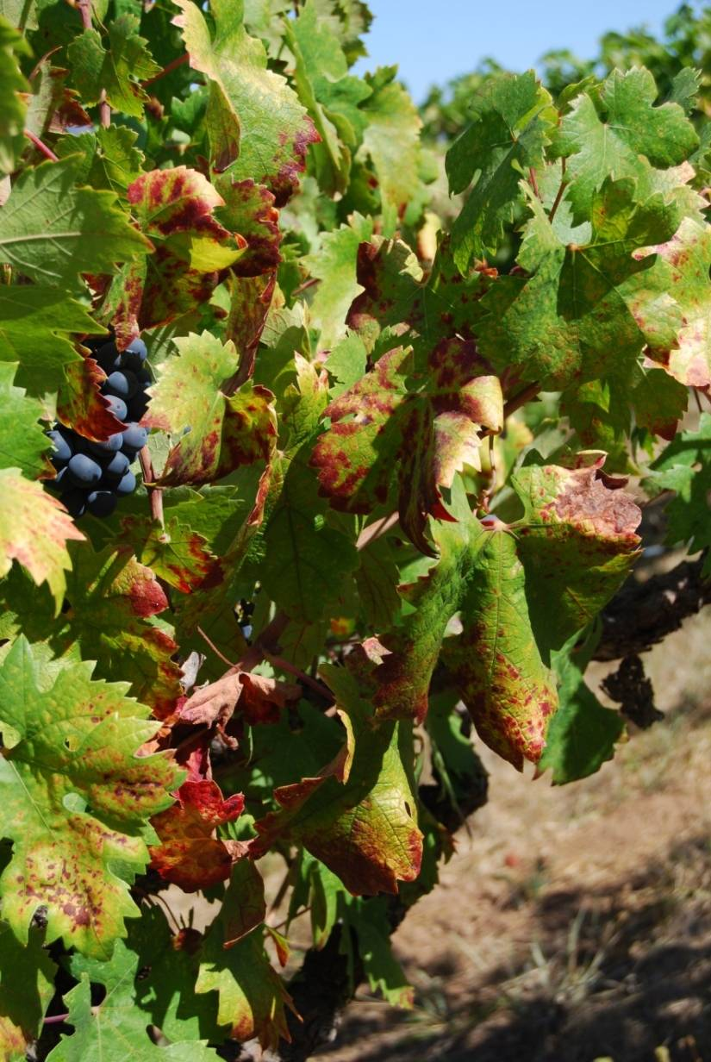
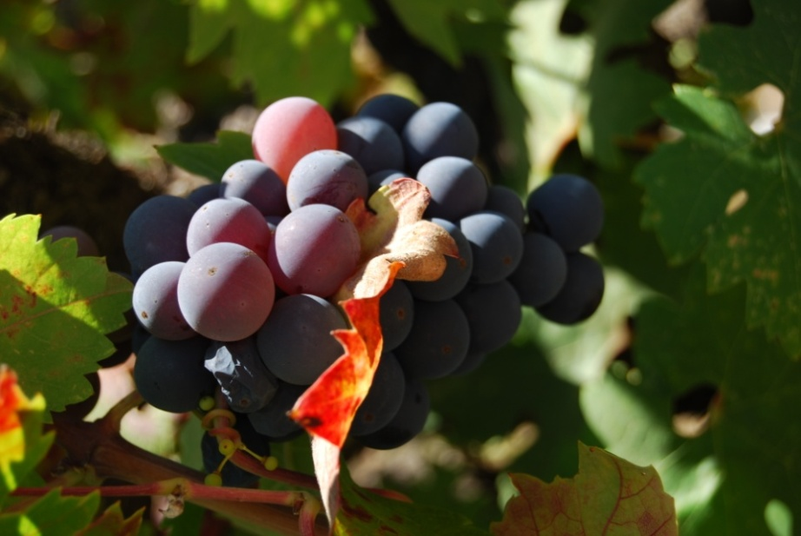
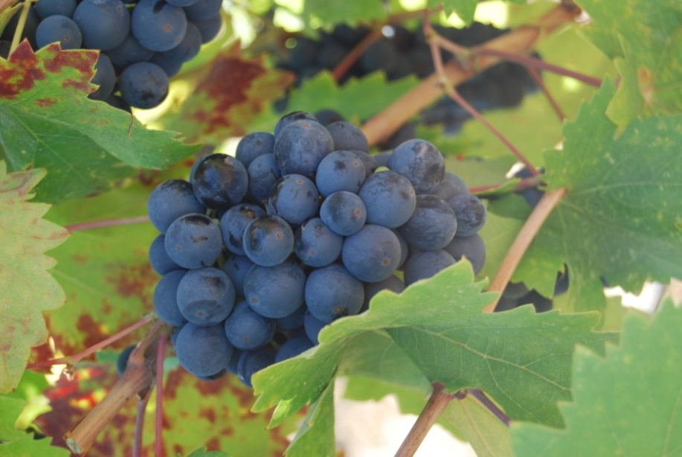
Zinfandel 1A on AXR, Fall 2011

Slide 39
Distribution of GRBaV
Wine grapes
  Red
  White
Table grapes
Raisin grapes
Rootstocks

Slide 40
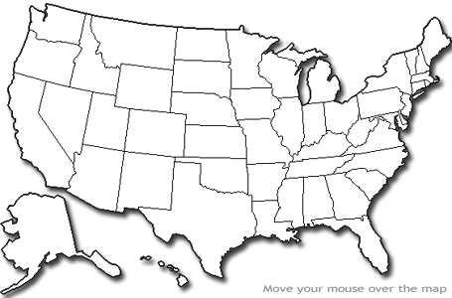
Distribution of GRBaV-infected vines

Slide 41


Slide 42

Foundation Plant Services:
Produces, tests, maintains and distributes elite disease-tested plant propagation material
Provides plant importation and quarantine services, virus testing and elimination
Coordinates release of UC patented horticultural varieties
Links researchers, nurseries, and producers
College of Agricultural & Environmental Sciences

Slide 43
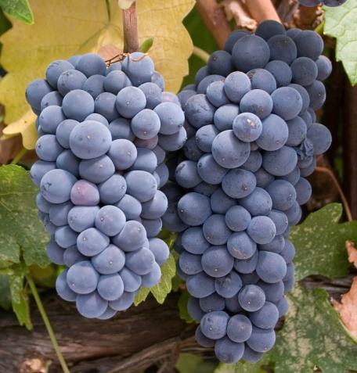
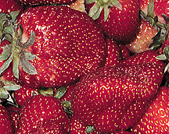
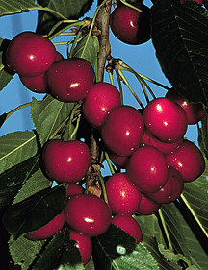
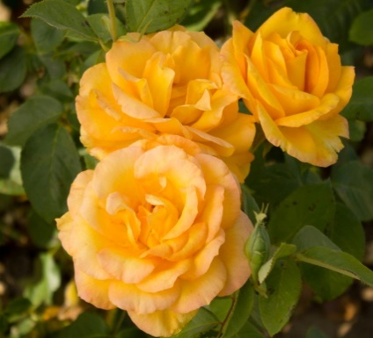
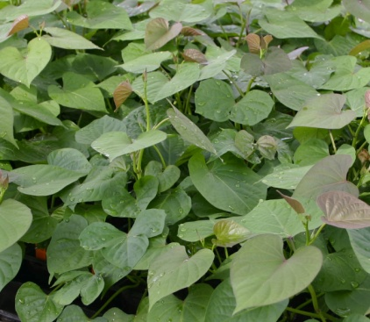
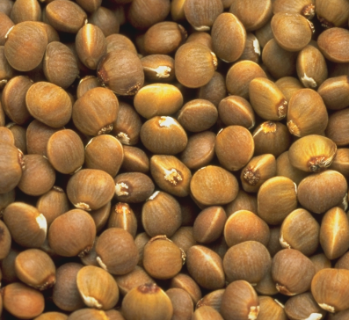
CROP PROGRAMS AT FPS
Grape
Strawberry
Tree
Rose
Sweet potato
Pistachio

Slide 44
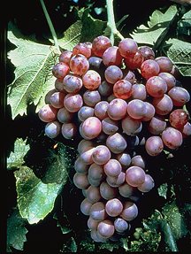


CALIFORNIA REGISTRATION & CERTIFICATION PROGRAMS
GRAPES
FRUIT & NUT TREES
STRAWBERRIES

Slide 45
Why do you need clean plant material?
Notes:
As a part of improving quality of grape plant material, FPS acquired land and improved it to establish a new vineyard called the RR vineyard in 2010.

Slide 46
FPS Target Grapevine Diseases
Grapevine Degeneration
➢ Fanleaf
Grapevine Decline
➢ Tomato Ringspot Virus
Leafroll
Rugose Wood Complex
➢ Kober Stem Grooving
➢ Corky Bark
➢ LN33 Stem Grooving
➢ Rupestris Stem Pitting
Fleck
Minor Viruses

Slide 47
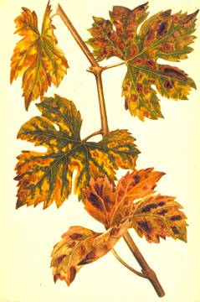
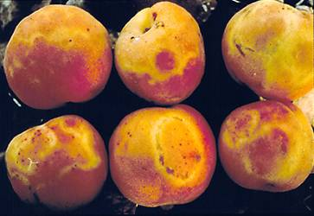
THE DANGERS OF
SAMSONITE IMPORTATION
PPV on nectarine
Pierce’s Disease

Slide 48
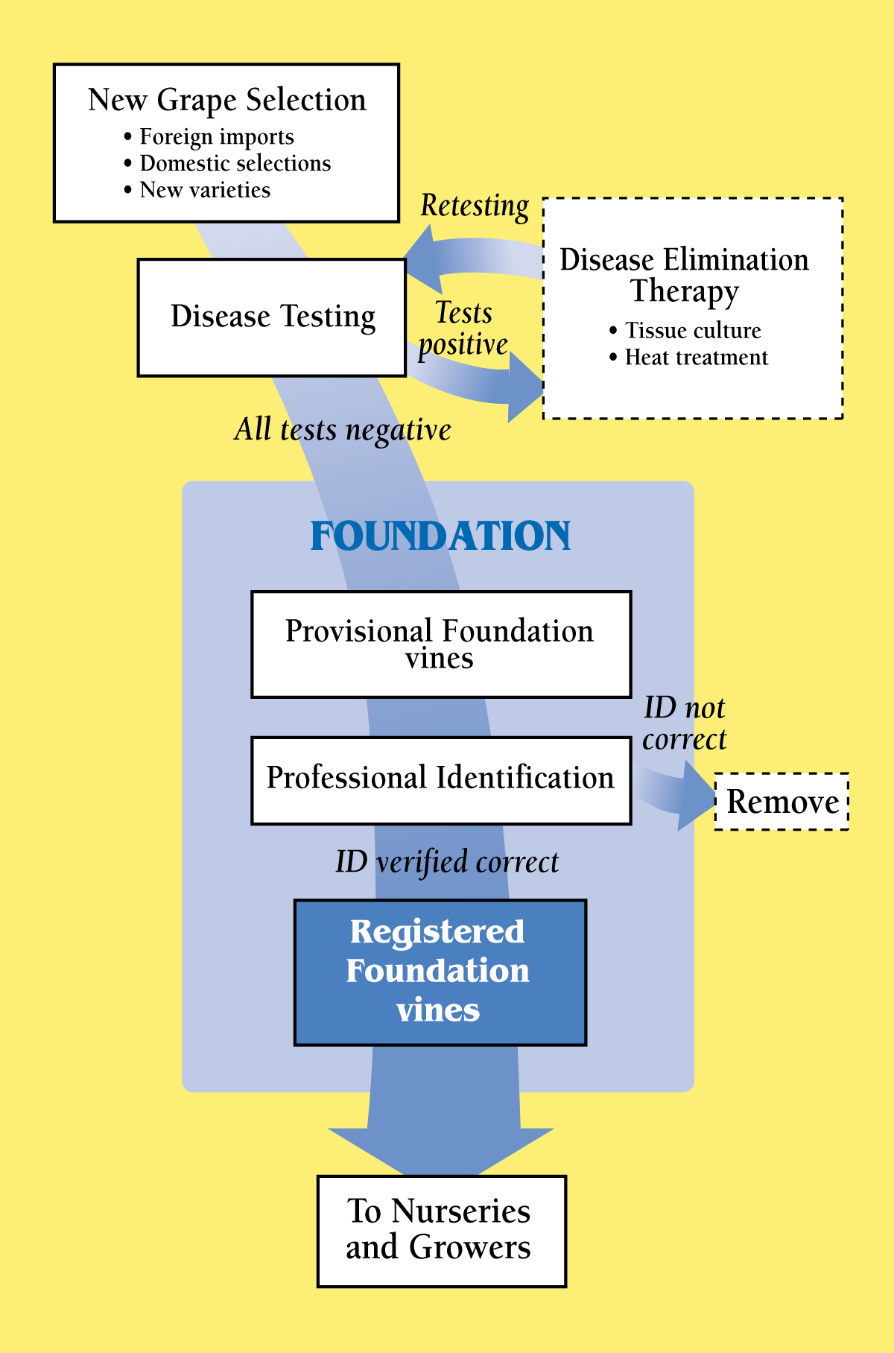

Slide 49
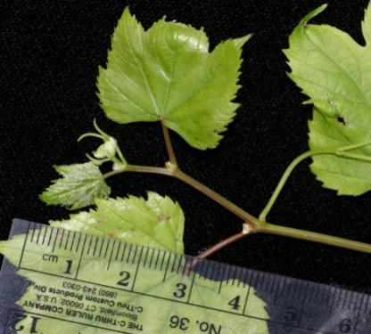
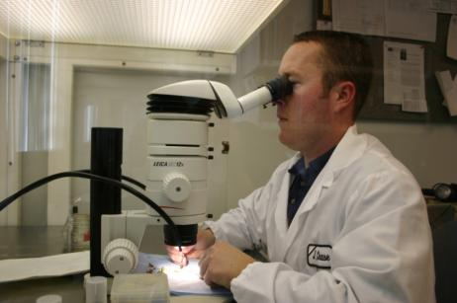
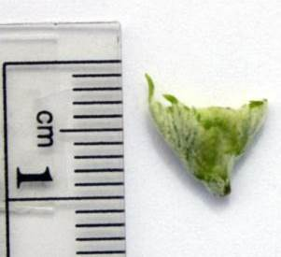
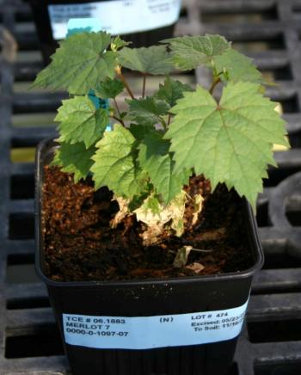
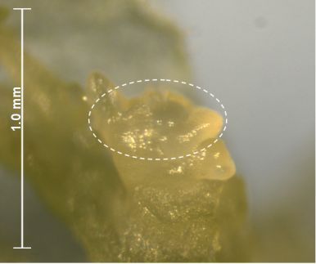
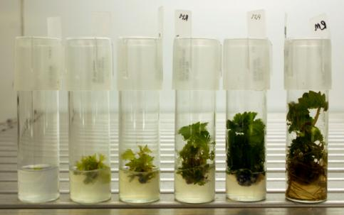
Pathogen Elimination
Meristem shoot tip culture
10.0 mm
Cut to < 0.5 mm
7 months

Slide 51
What about Red Blotch in Russell Ranch or the Classic Foundation Vineyard?
Notes:
As a part of improving quality of grape plant material, FPS acquired land and improved it to establish a new vineyard called the RR vineyard in 2010.

Slide 52
Classic Foundation Vineyard
Notes:
As a part of improving quality of grape plant material, FPS acquired land and improved it to establish a new vineyard called the RR vineyard in 2010.

Slide 53
GRBaV-Infected Plants at FPS Vineyards
Variety | Area | Block | Row # | Plant #
Chardonnay 68 | BKN | D | 3 | 8
Thomcord 02 | BKN | E | 8 | 3
Ruby Cabernet 02 | NYL | D | 3 | 3
Orange Muscat 02 | BKN | A | 15 | 2
Chardonnay 49 | NYL | C | 17 | 8
Chardonnay 39 | NYL | C | 17 | 16
Chardonnay 41 | NYL | C | 18 | 7
Chardonnay 37 | NYL | C | 18 | 16
Marsanne 574 | NYL | I | 13 | 2
Total vines tested: RR = 1102 and Classic Vineyards = 3068 vines

Slide 54
Variety | Area | Block | Row | Plant # | RB-PCR | pH | Brix
Orange Mus. 02 | BKN | A | 15 | 1 | Neg | 4.2 | 26.5
Orange Mus. 02 | BKN | A | 15 | 2 | Pos | 4.2 | 27.0
Chardonnay 68 | BKN | D | 3 | 7 | Neg | 3.9 | 31.5
Chardonnay 68 | BKN | D | 3 | 8 | Pos | 3.9 | 27.0
Thomcord 02 | BKN | E | 8 | 4 | Neg | 3.8 | 26.0
Thomcord 02 | BKN | E | 8 | 3 | Pos | 3.9 | 19.0
Chardonnay 49 | NYL | C | 17 | 9 | Neg | 4.0 | 29.0
Chardonnay 49 | NYL | C | 17 | 8 | Pos | 4.0 | 30.0
Chardonnay 39 | NYL | C | 17 | 15 | Neg | 3.9 | 28.0
Chardonnay 39 | NYL | C | 17 | 16 | Pos | 4.1 | 28.0
Chardonnay 41 | NYL | C | 18 | 6 | Neg | 4.0 | 28.0
Chardonnay 41 | NYL | C | 18 | 7 | Pos | 4.1 | 29.0
Chardonnay 37 | NYL | C | 18 | 15 | Neg | 4.0 | 28.5
Chardonnay 37 | NYL | C | 18 | 16 | Pos | 4.1 | 29.0
Ruby Cab. 02 | NYL | D | 3 | 4 | Neg | 3.6 | 25.0
Ruby Cab. 02 | NYL | D | 3 | 3 | Pos | 3.6 | 23.0
Marsanne 574 | NYL | I | 13 | 1 | Neg | 4.0 | 23.0
Marsanne 574 | NYL | I | 13 | 2 | Pos | 4.1 | 24.5
Notes:
Used 30 berries per plant.

Slide 55
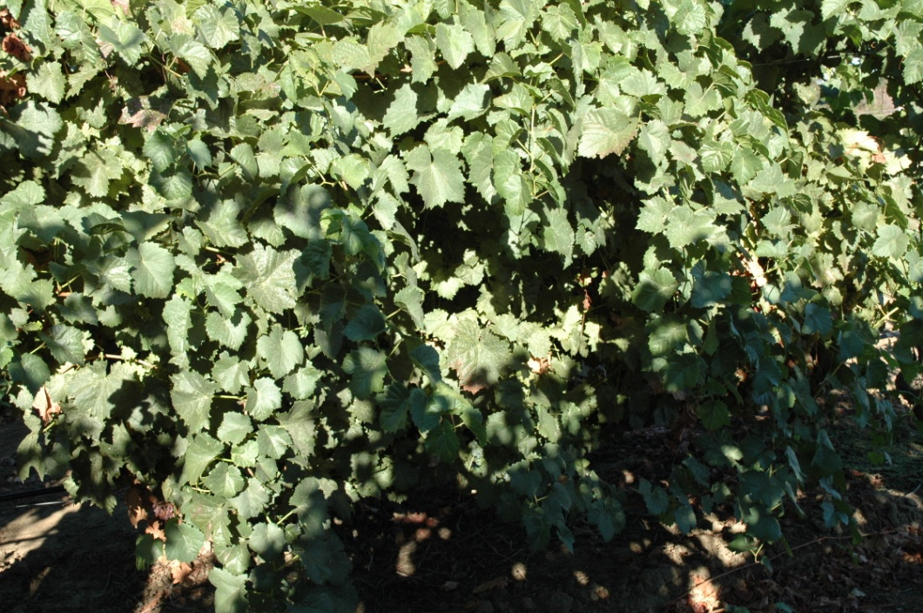
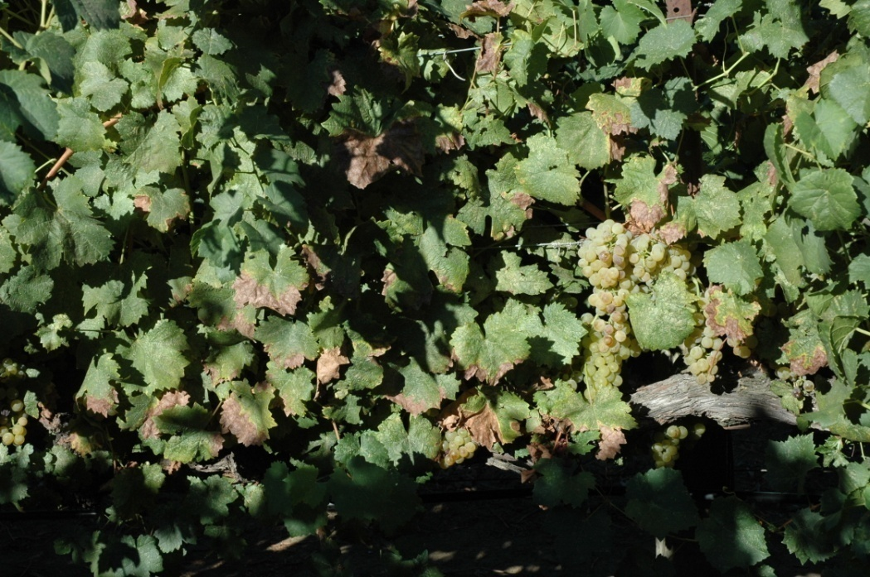
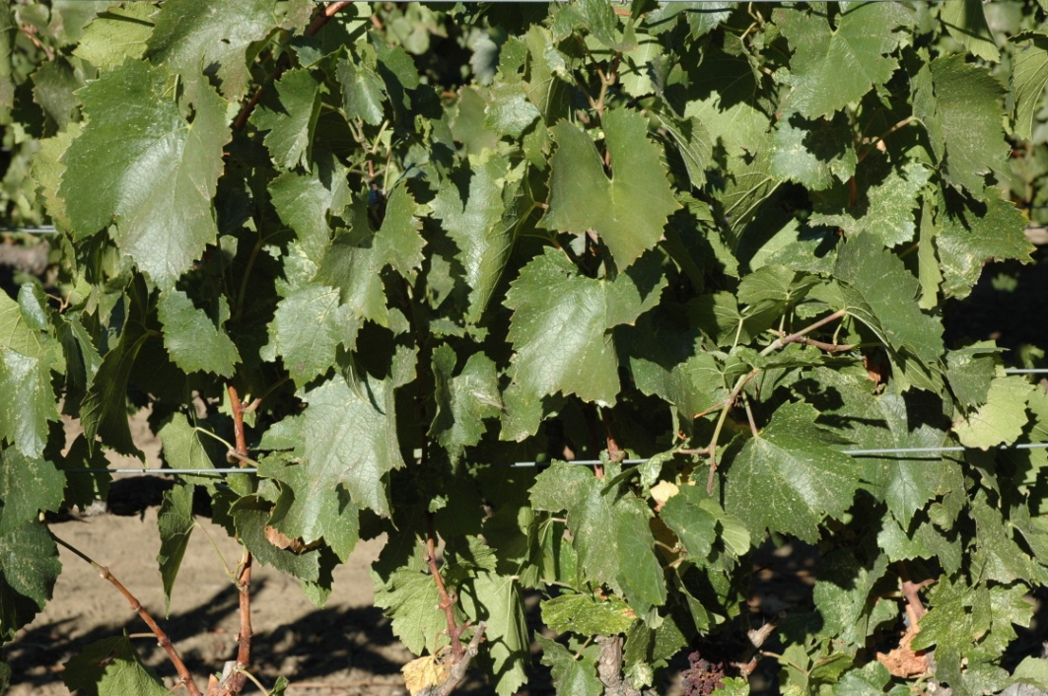
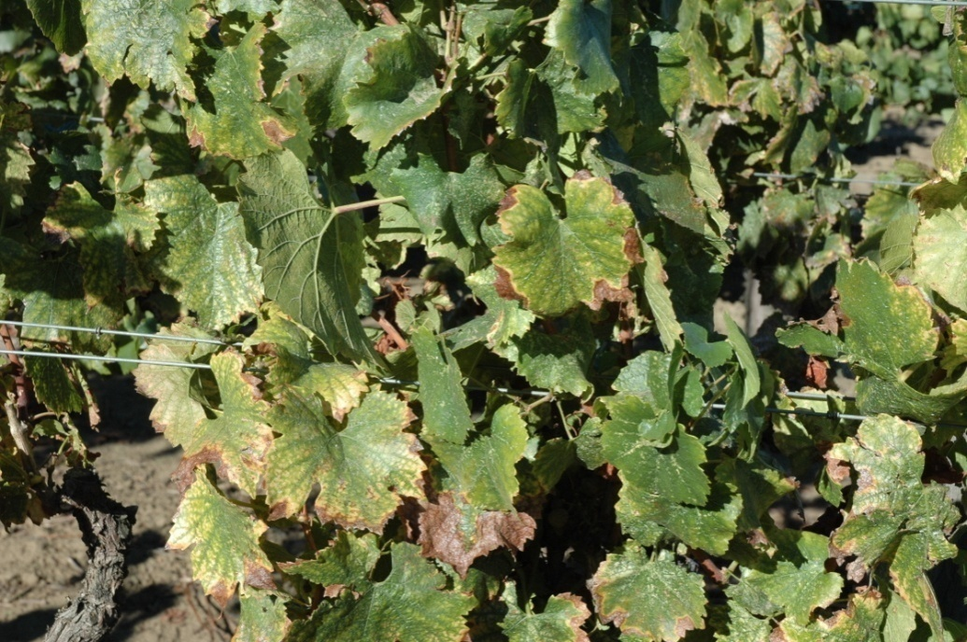
H, A15V1
RB, A15V2
Orange Muscat
H, D3V7
RB, D3V8
Chardonnay 68

Slide 56
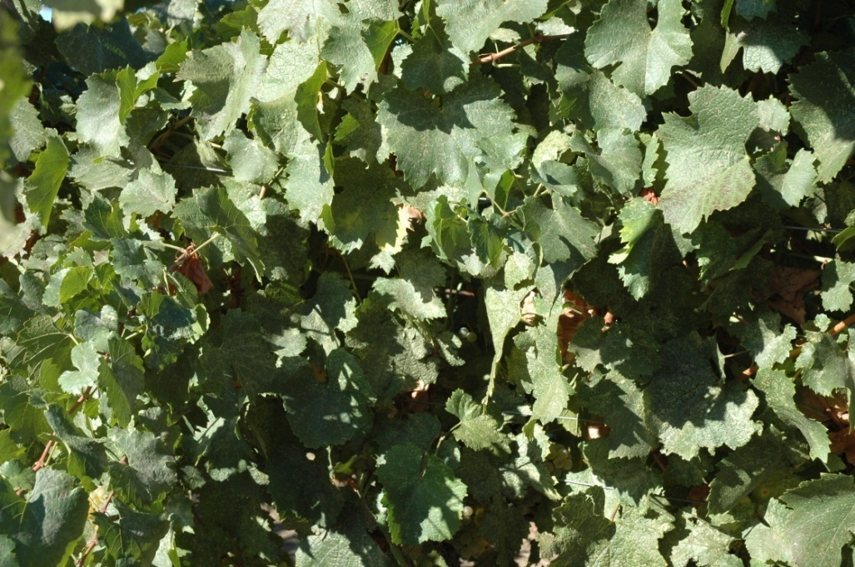
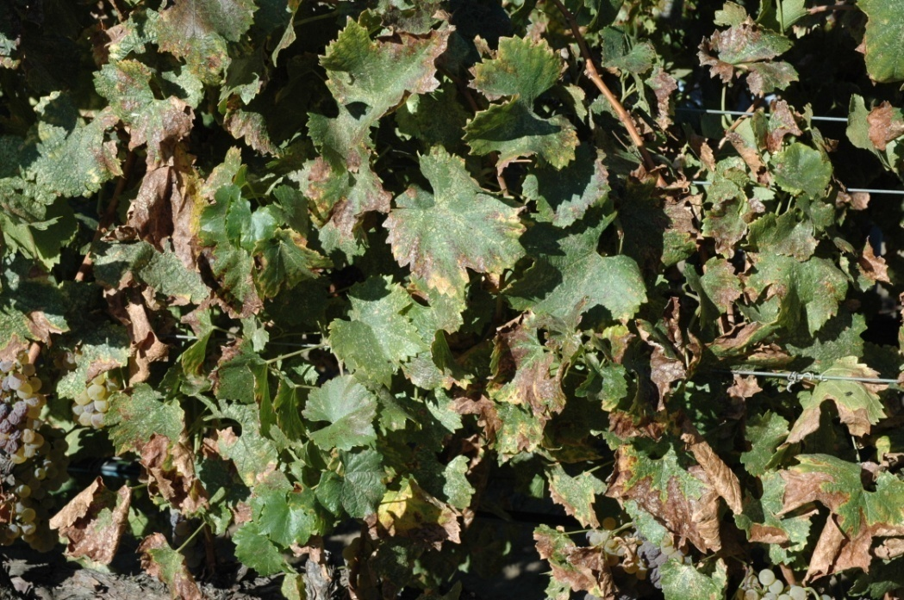


H, C18V8
RB, C18V7
Chardonnay 41
H, D3V4
RB, D3V3
Ruby Cabernet 02

Slide 57

Woody index = Field index
Woody index done at FPS since 1950’s.
Developed by Austin Goheen, USDA, UC Davis.
Index, heat treatment and distribution of clean stock were the primary reasons FPS was formed.
Goheen found specific grape varieties that were good indicators of virus by trial and error.
Notes:
By premier planting stock we mean…

Slide 58
Woody index Procedure
Chipbud 2 buds each into minimum of 6 indicator plants per variety
  St. George
  Cabernet franc
  LN-33
Plant in field
Observe leaf and trunk symptoms
Notes:
By premier planting stock we mean…

Slide 59




Woody index Procedure
Disbud, wax, root and pot up indicator plants
Notes:
By premier planting stock we mean…

Slide 60

Woody index Procedure
Chipbud 2 buds/plant, 6 plants/variety
Notes:
By premier planting stock we mean…

Slide 61


Woody index Procedure
Cut buds off of dormant canes of candidate variety.
Notes:
By premier planting stock we mean…

Slide 62

Woody index Procedure
Cut matching notch in indicator plant
Notes:
By premier planting stock we mean…

Slide 63

Woody index Procedure
Place candidate bud into notch
Notes:
By premier planting stock we mean…

Slide 64


Woody index Procedure
Wrap with tape, once over the bud
Notes:
By premier planting stock we mean…

Slide 65

Woody index Procedure
Wrap with budding rubber bands
Notes:
By premier planting stock we mean…

Slide 66

Woody index Procedure
Let heal in 1 month
Notes:
By premier planting stock we mean…

Slide 67

Woody index Procedure
Harden off
Notes:
By premier planting stock we mean…

Slide 68

Woody index Procedure
Read budtake
Rub off candidate buds
Plant in field
Notes:
By premier planting stock we mean…

Slide 69



Woody index Procedure
Spring yrs 1 & 2- Observe St. George for leaf symptoms 2-3 times within 4 weeks
GFLV, Fleck
Notes:
By premier planting stock we mean…

Slide 70


Woody index Procedure
Early Fall yr 2 – Observe LN-33 and St. George for trunk symptoms
Notes:
By premier planting stock we mean…

Slide 71

St. George indicator plants after 18 months in the field
RSP+
Inoculum buds
Pitting and grooving symptoms
HEALTHY

Slide 72


Woody index Procedure
Fall yr 2 – Read trunk symptoms in LN-33 – Corky bark

Slide 73

Pitting and grooving in trunk of LN-33 – Corky Bark
Notes:
By premier planting stock we mean…

Slide 74


Late Fall yrs 1 &2 – Observe Cabernet franc for leaf symptoms
Notes:
By premier planting stock we mean…

Slide 75


Slide 76

Leafroll symptoms on Cabernet Franc indicator

Slide 77
Examples of Cabernet Franc field index positives with positive lab tests
Notes:
As a part of improving quality of grape plant material, FPS acquired land and improved it to establish a new vineyard called the RR vineyard in 2010.

Slide 78


A32 Cabernet franc/own roots
I-CabF | E- LR1 | P- LR1 | E- LR2 | P- LR2 | P- LR2RG | E- LR3 | P- LR3 | E- LR4 | P- LR4 | E- LR5 | P- LR5 | E- LR6 | P- LR6 | E- LR7 | P-LR7 | P-LR9 | P- Car
POS | neg | neg | neg | 16.9 | neg |  | 34.9 |  | neg |  | neg | neg | neg |  | neg | neg | neg
I- StG N | E-GFLV | P-GFLV | E-ArMV | P-ArMV | E-ToRSV | P-ToRSV | I- C. a. | I- C. q. | I- Cuc. | I- Tob | P- TobRSV | I-StG Fk | E-GFkV | P- GFkV
POS | POS | POS | neg | neg | neg | neg | neg | POS | neg | neg |  | neg | neg | neg
I- LN-33 | E- CB | P-GVB | I- 5BB | E- GVA | P- GVA | I-StG RSP | P- RSP | P- GVD | P-phyt. | P- XF | Photo taken 10-28-09. LCAI#50
neg |  | neg | neg | neg | rpt | neg | POS | neg | neg | neg

Slide 79


A33 Cabernet franc/own roots
I-CabF | E- LR1 | P- LR1 | E- LR2 | P- LR2 | P- LR2RG | E- LR3 | P- LR3 | E- LR4 | P- LR4 | E- LR5 | P- LR5 | E- LR6 | P- LR6 | E- LR7 | P-LR7 | P-LR9 | P- Car
POS | neg | neg | neg | 22.6 | neg | POS | 25.5 |  | 27.8 |  | neg | neg | neg |  | neg | neg | neg
I- StG N | E-GFLV | P-GFLV | E-ArMV | P-ArMV | E-ToRSV | P-ToRSV | I- C. a. | I- C. q. | I- Cuc. | I- Tob | P- TobRSV | I-StG Fk | E-GFkV | P- GFkV
neg | neg | neg | neg | neg | neg | neg | neg | neg | neg | neg |  | POS | POS | POS
I- LN-33 | E- CB | P-GVB | I- 5BB | E- GVA | P- GVA | I-StG RSP | P- RSP | P- GVD | P-phyt. | P- XF | Photo taken 10-28-09.LCAI#51
neg |  | neg | POS |  | POS | neg | POS | neg | neg | neg
A33

Slide 80


A34 Cabernet franc/own roots
I-CabF | E- LR1 | P- LR1 | E- LR2 | P- LR2 | P- LR2RG | E- LR3 | P- LR3 | E- LR4 | P- LR4 | E- LR5 | P- LR5 | E- LR6 | P- LR6 | E- LR7 | P-LR7 | P-LR9 | P- Car
POS | neg | neg | neg | POS | neg | neg | POS |  | neg |  | neg | neg | neg |  | neg | neg | neg
I- StG N | E-GFLV | P-GFLV | E-ArMV | P-ArMV | E-ToRSV | P-ToRSV | I- C. a. | I- C. q. | I- Cuc. | I- Tob | P- TobRSV | I-StG Fk | E-GFkV | P- GFkV
neg | neg | neg | neg | neg | neg | neg | neg | neg | neg | neg |  | POS | POS | POS
I- LN-33 | E- CB | P-GVB | I- 5BB | E- GVA | P- GVA | I-StG RSP | P- RSP | P- GVD | P-phyt. | P- XF | Photo taken 10-28-09. LCAI#52
POS |  | POS | neg |  | neg | POS | POS | neg | neg | neg
A34

Slide 81


A35 Cabernet franc/own roots
I-CabF | E- LR1 | P- LR1 | E- LR2 | P- LR2 | P- LR2RG | E- LR3 | P- LR3 | E- LR4 | P- LR4 | E- LR5 | P- LR5 | E- LR6 | P- LR6 | E- LR7 | P-LR7 | P-LR9 | P- Car
POS | neg | neg | neg | POS | neg | neg | POS |  | neg |  | neg | neg | neg |  | neg | neg | neg
I- StG N | E-GFLV | P-GFLV | E-ArMV | P-ArMV | E-ToRSV | P-ToRSV | I- C. a. | I- C. q. | I- Cuc. | I- Tob | P- TobRSV | I-StG Fk | E-GFkV | P- GFkV
neg | POS | POS | neg | neg | neg | neg | neg | POS | neg | neg |  | neg | neg | neg
I- LN-33 | E- CB | P-GVB | I- 5BB | E- GVA | P- GVA | I-StG RSP | P- RSP | P- GVD | P-phyt. | P- XF | Photo taken 10-28-09.LCAI#53
neg |  | neg | POS |  | POS | POS | POS | Rpt | neg | neg
A35

Slide 82


A36 Cabernet franc/own roots
I-CabF | E- LR1 | P- LR1 | E- LR2 | P- LR2 | P- LR2RG | E- LR3 | P- LR3 | E- LR4 | P- LR4 | E- LR5 | P- LR5 | E- LR6 | P- LR6 | E- LR7 | P-LR7 | P-LR9 | P- Car
POS | neg | neg | neg | neg | neg | neg | POS |  | neg |  | neg | neg | neg |  | neg | neg | neg
I- StG N | E-GFLV | P-GFLV | E-ArMV | P-ArMV | E-ToRSV | P-ToRSV | I- C. a. | I- C. q. | I- Cuc. | I- Tob | P- TobRSV | I-StG Fk | E-GFkV | P- GFkV
POS | POS | POS | neg | neg | neg | neg | neg | neg | neg | neg |  | neg | POS | POS
I- LN-33 | E- CB | P-GVB | I- 5BB | E- GVA | P- GVA | I-StG RSP | P- RSP | P- GVD | P-phyt. | P- XF | Photo taken 10-28-09. LCAI #54
neg |  | neg | POS |  | POS | POS | POS | neg | neg | neg
A36

Slide 83


A37

Slide 84
A37 Cabernet franc/own roots
I-CabF | E- LR1 | P- LR1 | E- LR2 | P- LR2 | P- LR2RG | E- LR3 | P- LR3 | E- LR4 | P- LR4 | E- LR5 | P- LR5 | E- LR6 | P- LR6 | E- LR7 | P-LR7 | P-LR9 | P- Car
POS | neg | neg | neg | POS | neg | POS | POS |  | neg |  | neg | neg | neg |  | neg | neg | neg
I- StG N | E-GFLV | P-GFLV | E-ArMV | P-ArMV | E-ToRSV | P-ToRSV | I- C. a. | I- C. q. | I- Cuc. | I- Tob | P- TobRSV | I-StG Fk | E-GFkV | P- GFkV
neg | neg | neg | neg | neg | neg | neg | neg | neg | neg | neg |  | neg | neg | neg
I- LN-33 | E- CB | P-GVB | I- 5BB | E- GVA | P- GVA | I-StG RSP | P- RSP | P- GVD | P-phyt. | P- XF | Photo taken 10-28-09.LCAI#55
POS |  | POS | neg |  | POS | POS | POS | neg | neg | neg

Slide 85


A38

Slide 86
A38 Cabernet franc/own roots
I-CabF | E- LR1 | P- LR1 | E- LR2 | P- LR2 | P- LR2RG | E- LR3 | P- LR3 | E- LR4 | P- LR4 | E- LR5 | P- LR5 | E- LR6 | P- LR6 | E- LR7 | P-LR7 | P-LR9 | P- Car
POS | neg | neg | neg | neg | neg | neg | neg |  | POS |  | neg | neg | neg |  | neg | neg | neg
I- StG N | E-GFLV | P-GFLV | E-ArMV | P-ArMV | E-ToRSV | P-ToRSV | I- C. a. | I- C. q. | I- Cuc. | I- Tob | P- TobRSV | I-StG Fk | E-GFkV | P- GFkV
neg | neg | neg | neg | neg | neg | neg | neg | neg | neg | neg |  | neg | neg | neg
I- LN-33 | E- CB | P-GVB | I- 5BB | E- GVA | P- GVA | I-StG RSP | P- RSP | P- GVD | P-phyt. | P- XF | Photo taken 10-28-09.LCAI#56
neg |  | neg | neg |  | neg | neg | neg | neg | neg | neg

Slide 87


A39 Cabernet franc/own roots
I-CabF | E- LR1 | P- LR1 | E- LR2 | P- LR2 | P- LR2RG | E- LR3 | P- LR3 | E- LR4 | P- LR4 | E- LR5 | P- LR5 | E- LR6 | P- LR6 | E- LR7 | P-LR7 | P-LR9 | P- Car
POS | neg | neg | neg | neg | neg | neg | neg |  | POS |  | neg | neg | neg |  | neg | neg | neg
I- StG N | E-GFLV | P-GFLV | E-ArMV | P-ArMV | E-ToRSV | P-ToRSV | I- C. a. | I- C. q. | I- Cuc. | I- Tob | P- TobRSV | I-StG Fk | E-GFkV | P- GFkV
neg | neg | neg | neg | neg | neg | neg | neg | neg | neg | neg |  | neg | neg | neg
I- LN-33 | E- CB | P-GVB | I- 5BB | E- GVA | P- GVA | I-StG RSP | P- RSP | P- GVD | P-phyt. | P- XF | Photo taken 10-28-09. LCAI#57
neg |  | neg | neg |  | neg | neg | neg | neg | neg | neg

Slide 88


A40 Cabernet franc/own roots
I-CabF | E- LR1 | P- LR1 | E- LR2 | P- LR2 | P- LR2RG | E- LR3 | P- LR3 | E- LR4 | P- LR4 | E- LR5 | P- LR5 | E- LR6 | P- LR6 | E- LR7 | P-LR7 | P-LR9 | P- Car
POS | neg | neg | neg | POS | neg | POS | neg |  | neg |  | neg | neg | neg |  | neg | neg | neg
I- StG N | E-GFLV | P-GFLV | E-ArMV | P-ArMV | E-ToRSV | P-ToRSV | I- C. a. | I- C. q. | I- Cuc. | I- Tob | P- TobRSV | I-StG Fk | E-GFkV | P- GFkV
neg | neg | neg | neg | neg | neg | neg | neg | neg | neg | neg |  | neg | neg | neg
I- LN-33 | E- CB | P-GVB | I- 5BB | E- GVA | P- GVA | I-StG RSP | P- RSP | P- GVD | P-phyt. | P- XF | Photo taken 10-28-09. LCAI#58
neg |  | neg | neg |  | neg | neg | POS | neg | neg | neg

Slide 89
Example of Cabernet Franc field index red leaf positives with negative lab tests
Notes:
As a part of improving quality of grape plant material, FPS acquired land and improved it to establish a new vineyard called the RR vineyard in 2010.

Slide 90

Index example from 2008 showing Cab franc results positive; PCR tests negative
I-CabF | E- LR1 | P- LR1 | E- LR2 | P- LR2 | P- LR2RG | E- LR3 | P- LR3 | E- LR4 | P- LR4 | E- LR5 | P- LR5 | E- LR6 | P- LR6 | E- LR7 | P-LR7 | P-LR9 | P- Car
POS | neg | neg | neg | neg | neg | neg | neg | neg | neg | neg | neg | neg | neg |  | neg | neg | neg
I- StG N | E-GFLV | P-GFLV | E-ArMV | P-ArMV | E-ToRSV | P-ToRSV | I- C. a. | I- C. q. | I- Cuc. | I- Tob | P- TobRSV | I-StG Fk | E-GFkV | P- GFkV
neg | neg | neg | neg | neg | neg | neg | neg | neg | neg | neg | neg | neg | neg | neg
I- LN-33 | E- CB | P-GVB | I- 5BB | E- GVA | P- GVA | I-StG RSP | P- RSP | P- GVD | P-phyt. | P- XF | Photo taken 11-03-09.
neg |  | neg | neg | neg | neg | neg | neg | neg | neg | neg

Slide 91
Example of field red leaf positives with negative lab tests
Notes:
As a part of improving quality of grape plant material, FPS acquired land and improved it to establish a new vineyard called the RR vineyard in 2010.

Slide 92


B6 none/O39-16
LR1 | LR2 | LR2RG | LR3 | LR4 | LR5 | LR6 | LR7 | LR9 | LRCar
neg | neg | neg | neg | neg | neg | neg | neg | neg | neg
GVA | GVB | GVD | RSP | Red leaves only in areas near ground. Possible frost damage. Photo taken 11-16-09.LCAI#20
neg | neg | neg | neg
#20

Slide 93

B8 Cabernet franc-327/ 101-14 MGT
LR1 | LR2 | LR2RG | LR3 | LR4 | LR5 | LR6 | LR7 | LR9 | LRCar
neg | neg | neg | neg | neg | neg | neg | neg | neg | neg
GVA | GVB | GVD | Senescing leaf, necrotic margin, possible water stress. Photo taken 11-5-09.LCAI#15
neg | neg | neg

Slide 94

B9 Cabernet Sauvignon-7/ Teleki 5C
LR1 | LR2 | LR2 RG | LR3 | LR4 | LR5 | LR6 | LR7 | LR9 | LRCar
neg | neg | neg | neg | neg | neg | neg | neg | neg | neg
GVA | GVB | GVD | Senescing leaves. Note that the tertiary veins are yellow. Photo taken 11-16-09. LCAI #21
neg | neg | neg

Slide 95

B11 Zinfandel/ St. George
LR1 | LR2 | LR2RG | LR3 | LR4 | LR5 | LR6 | LR7 | LR9 | LRCar
neg | neg | neg | neg | neg | neg | neg | neg | neg
GVA | GVB | GVD | RSP | Possible potash deficiency. Photo taken 10-20-09. LCAI#37
neg | neg | neg

Slide 96

B12 Petit Verdot/O39-16
LR1 | LR2 | LR2RG | LR3 | LR4 | LR5 | LR6 | LR7 | LR9 | LRCar
neg | neg | neg | neg | neg | neg | neg | neg | neg | neg
GVA | GVB | GVD | RSP | Possible mite damage and drought stress. Photo taken 10-6-09. LCAI#23
neg | neg | neg

Slide 97
Field Index on Cab. Franc
Plant ID | LR-PCR | GRBaV- PCR | Cab. F. Index
52429 | Pos | Pos | Pos
52289 | Neg | Pos | Pos
52415 | Neg | Pos | Pos
52674 | Neg | Pos | Pos
52702 | Pos | Pos | Pos
52814 | Pos | Pos | Pos
52345 | Neg | Pos | Pos
52373 | Neg | Pos | Pos
52856 | Neg | Pos | Pos
52940 | Pos | Pos | Pos
52387 | Pos | Pos | Pos

Slide 98






The National Clean Plant Network

Slide 99

New Russell Ranch
Foundation Vineyard
established 2010, Davis California
October, 2012
Notes:
As a part of improving quality of grape plant material, FPS acquired land and improved it to establish a new vineyard called the RR vineyard in 2010.

Slide 100
Qualification of Russell Ranch Foundation Vines – Grapevine Disease Testing Protocol 2010
Microshoot tip tissue culture therapy
Negative test results - long list of pathogens - index, herbaceous, ELISA and PCR tests

Slide 101
What about Red Blotch in Russell Ranch Foundation Vineyard?
Notes:
As a part of improving quality of grape plant material, FPS acquired land and improved it to establish a new vineyard called the RR vineyard in 2010.

Slide 102

Thank you
American Vineyard Foundation
Fruit Tree, Nut Tree and Grapevine Improvment
Advisory Board (IAB)
California Grape Nurseries

