Slide 1

chasing dense soft reds
Steve Peck
Red Winemaker
J. Lohr Vineyards & Wines
Paso Robles, California

Slide 2
Color Density: CD = A420 + A520
- typical range 5 to 30
Tannin Index: TI = A280
- typical range 40 to 80
Softness Ratio: CD/TI*10
- typical range 1.2 to 3.0
Enologix :
Style Map Total Phenols
Quality Index Tannin
Aging Index Monomers
Total Antho
Free Antho
Complex Antho
Jar Test: mock fermentation
200 berries, overnight extraction with enzymes, followed by addition of alcohol and heating. Measure CD and TI of extract.

Slide 3
Phenolic Interfaces:
- Grape Maturity
- Grapes at Harvest
- During Fermentation
- Drain and Press lots
- Blend consolidation
Classic Control Variables:
- Hang time
- Crop thinning
- Bleeding
- Cold Soaks
- Crush vs. Whole Berry
- Enzymes
- Fermentation Temperature
- Cap Management
- Maceration Time
Newer Variables:
- Shade Cloth at Veraison
- Flash Détente

Slide 4
Phenolic Interfaces:
- Grape Maturity
- Grapes at Harvest
- During Fermentation
- Drain and Press lots
- Blend consolidation
Classic Control Variables:
-
- Crop thinning
-
-
-
-
- Fermentation Temperature
-
- Maceration Time
Newer Variables:
- Shade Cloth at Veraison
- Flash Détente

Slide 5
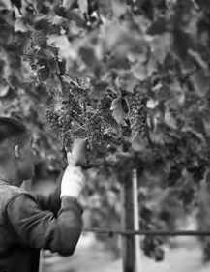
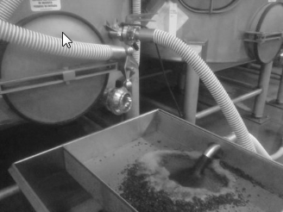
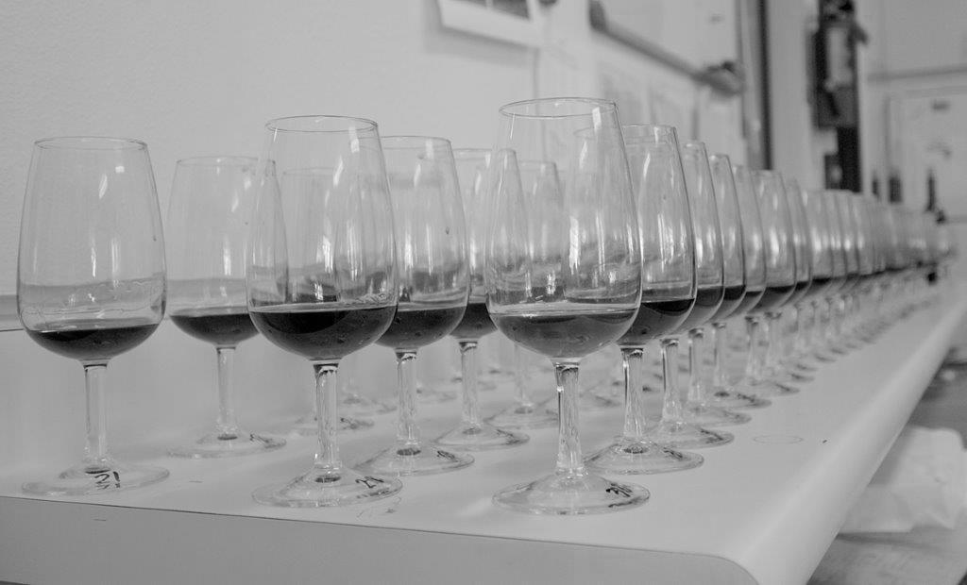
Fruit Maturity:
-Enologix
select lots
Harvest Assessment:
“Jar Test”
CD, TI
all lots
Drain Downs:
CD, TI
all lots
Enologix:
select lots
Adams Harbertson:
select lots
Blending:
- Enologix
Fermentation:
CD, TI
all lots daily
Enologix annual audit

Slide 6
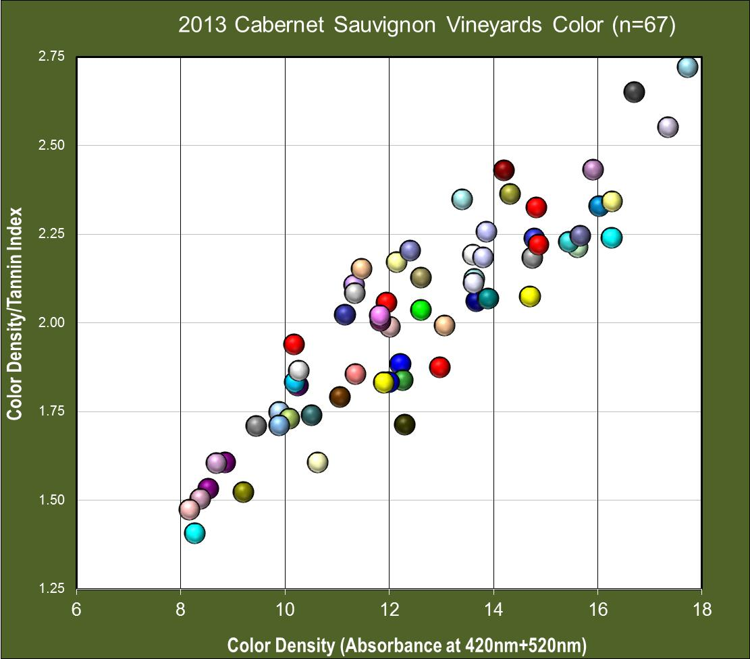
Vineyard Block Assessment

Slide 7
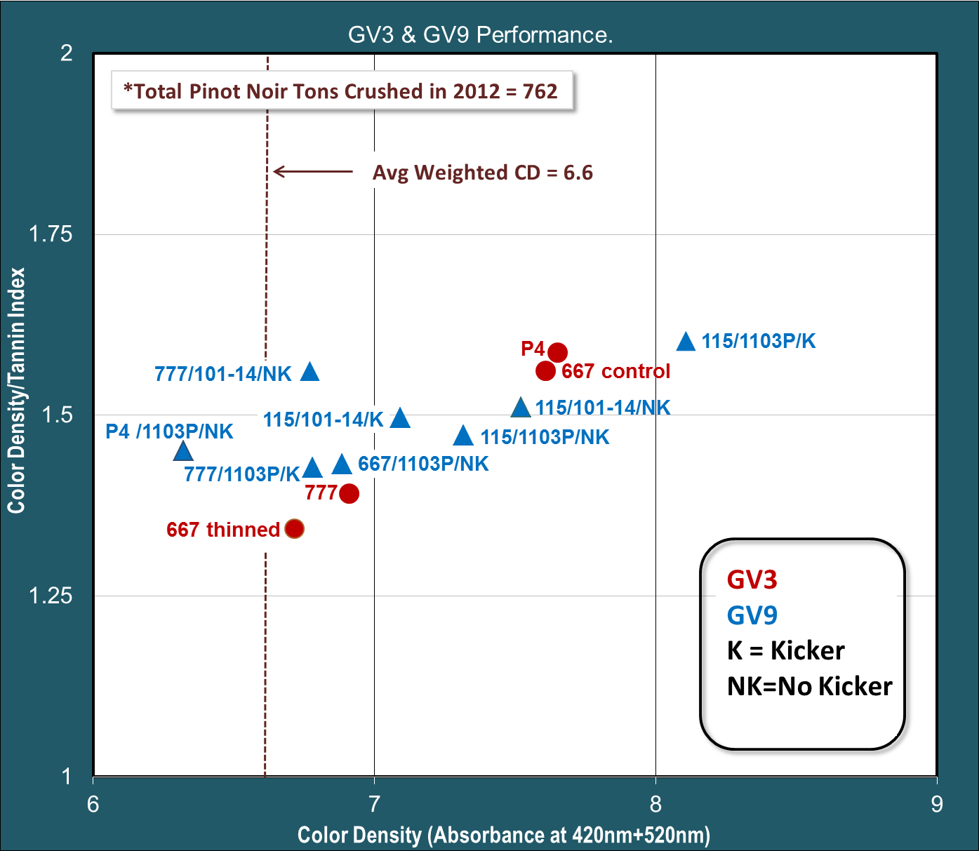
Vineyard Trials: Pinot Noir
Softer →
Darker →

Slide 8
Vineyard Trials: Pinot Noir
made top blend
Softer →
Darker →

Slide 9
Fermentation Management

Slide 10
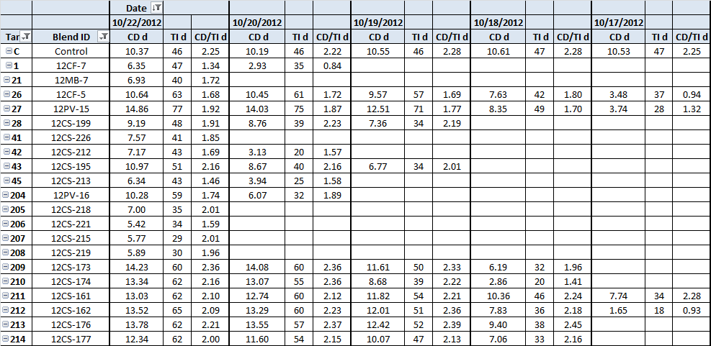
Daily Fermentation Report

Slide 11
Daily Fermentation Report

Slide 12
Days

Slide 14
Days

Slide 15
“90 by 20”

Slide 16
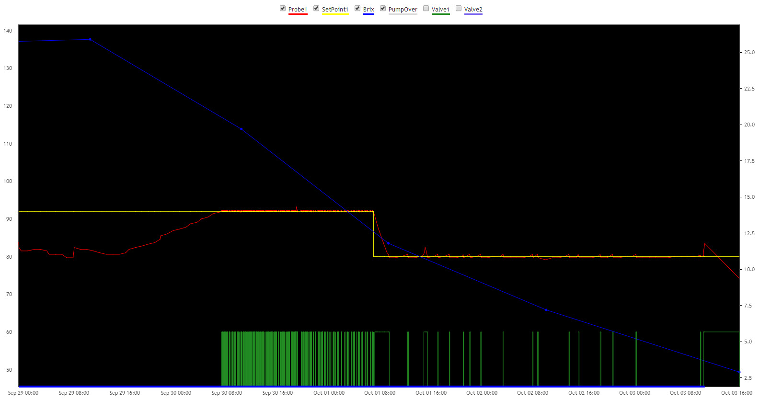
“90 by 20”
Brix = 20 >
Temp = 90F >
1
2
3
4
5
Days

Slide 17
Lot Selection and Blend Assembly

Slide 18
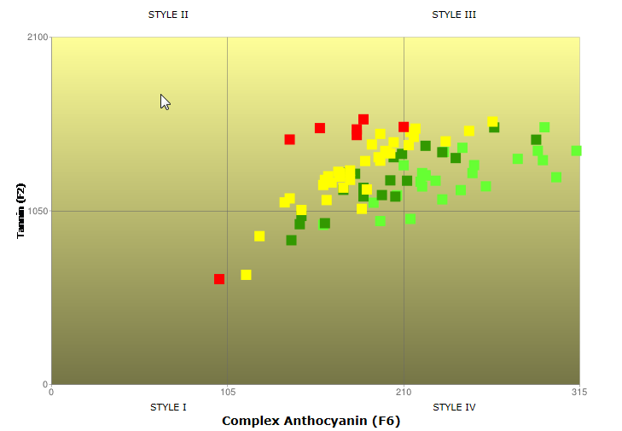

Style Map for Blending Decisions – 2013 Cabernet Sauvignon

Slide 19
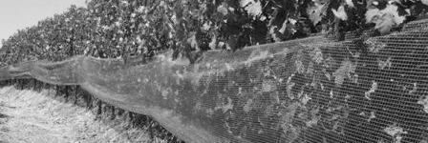
Shade Cloth Trials
Apply shade cloth over fruit zone at onset of veraison
40 to 65% shade factor tested
Reduce cluster temperature
Increase color development
Increase yield

Slide 20
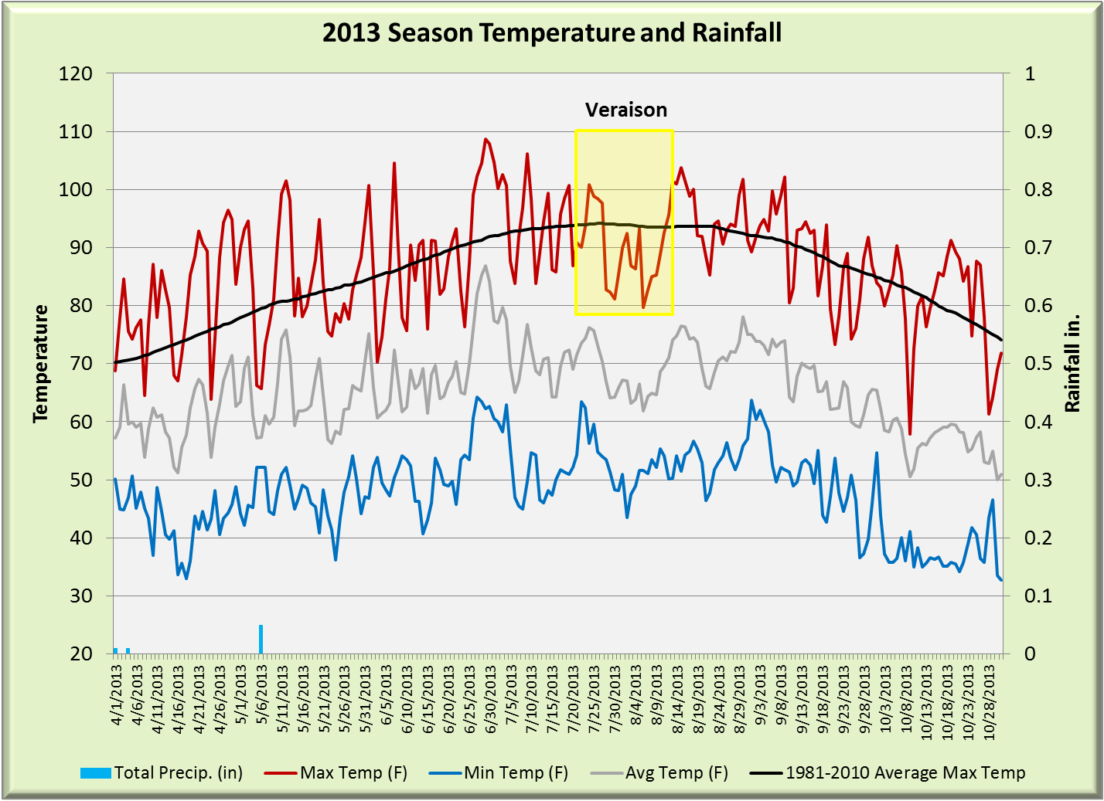
Paso Robles

Slide 21
Clusters 4 degrees cooler from 11 to 2 pm (East-West rows)

Slide 22
2013 Shade Cloth Trial Results

Slide 23
2013 Shade Cloth Trial Results: Darker Color and Similar Softness

Slide 24
Clusters 6 degrees cooler from 3 to 6 pm (North-South rows)

Slide 25
2013 Shade Cloth Trial Results

Slide 26
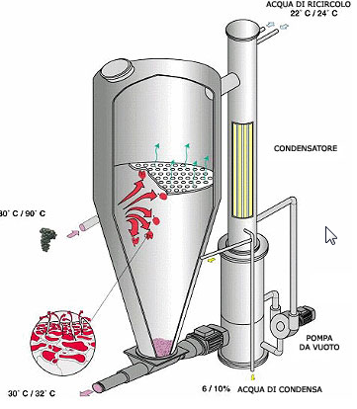
Flash Détente:

Slide 27
Flash Détente: Petite Sirah
tannin in balance

Slide 28
Flash Détente: Cabernet Sauvignon
Example 1: thinner, but softer

Slide 29
Flash Détente: Cabernet Sauvignon
Example 2: Darker and Softer Complex Antho not developed

Slide 30
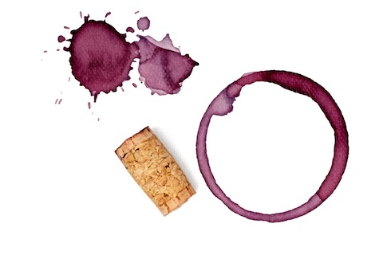
Vega Sicilia Issues Recall for 500,000 Bottles of Wine
By Joseph Hernandez Published: 04.07.2014
After receiving complaints of excess sediment…,Spanish wine estate Vega Sicilia is recalling the 2009 vintage... The problems affect more than 500,000 bottles of wine and will cost the winery an estimated $13 million.
…analyses have shown an excess of anthocyanins,’…

Slide 31
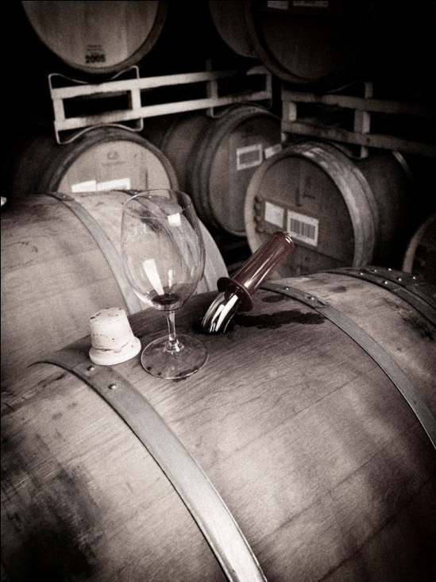
Thank you to:
Anji Perry
Brenden Wood
Briana Heywood
Doris Francis
John Pierini
Jeff Meier
Doug McKesson
The Lohr Family

