Slide 1
Controlling Redox Potential During Wine Fermentations
Roger Boulton
Stephen Scott Professor of Enology
Department of Viticulture and Enology
University of California, Davis
RAVE, Dec 9th 2016

Slide 2
Outline
Redox Potential
The Redox Potential of Juice and Wine
The Redox Potential during Wine Fermentation
Earlier Studies
Controlled Redox Potential Fermentations
Elemental Sulfur case
Regular Wine Fermentations
Next Steps

Slide 3
Redox Potential During Fermentation
Starting Condition Depends on Juice
Juice, Temperature and Yeast strain determine the Change

Slide 4
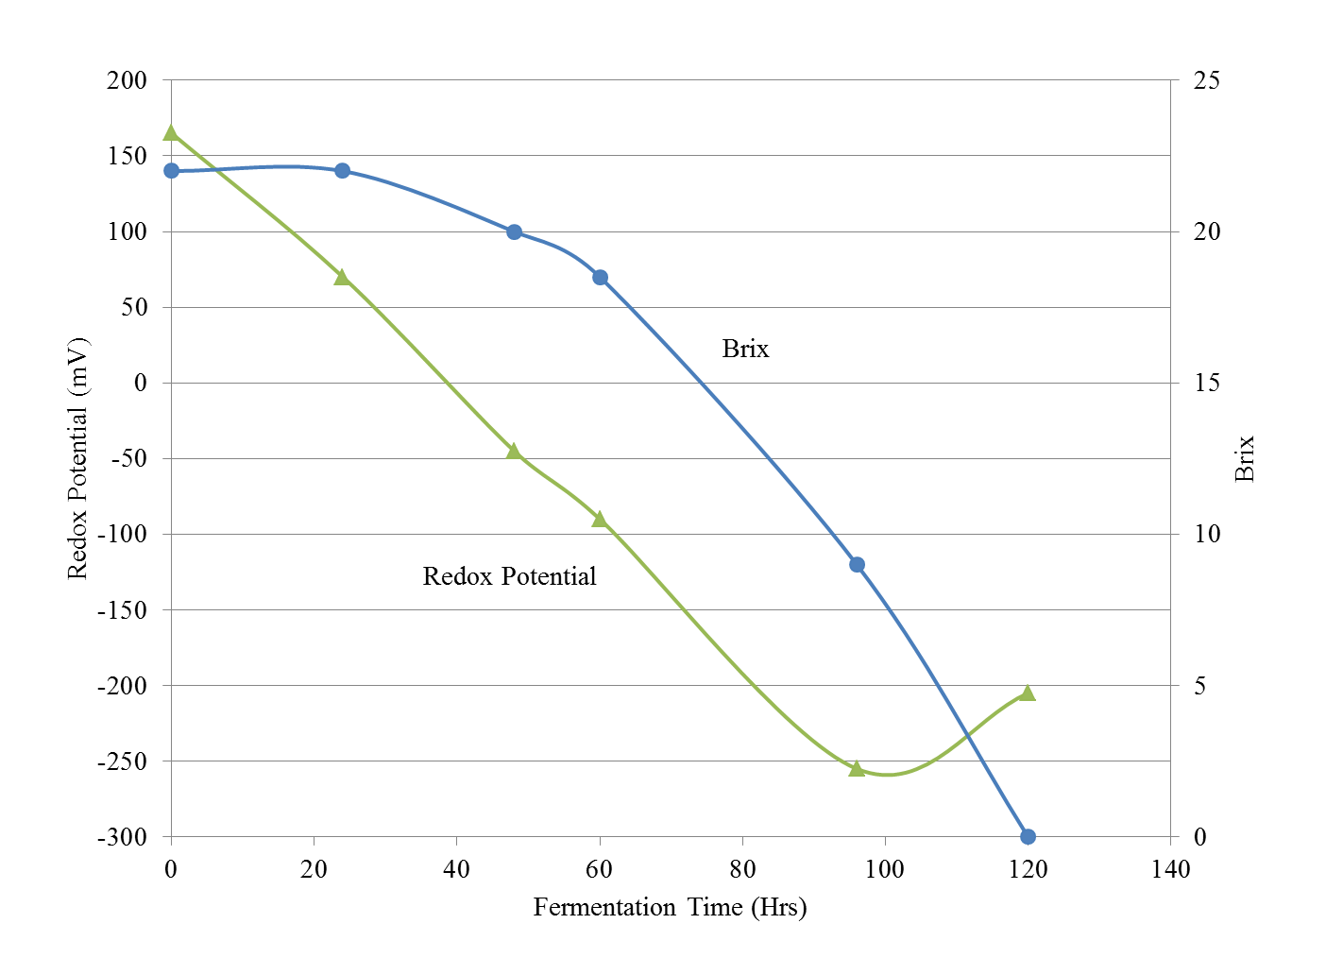
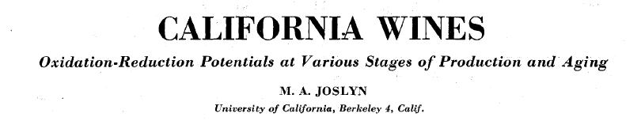
Tokay, T=24 C

Slide 5
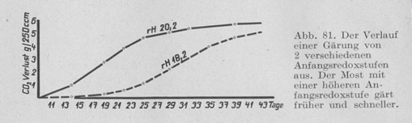
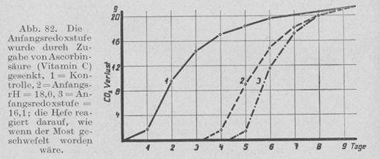
435 mV
375 mV
435 mV
370 mV
313 mV
Schanderl, H. Mikrobiologie des Weines (1959)

Slide 6
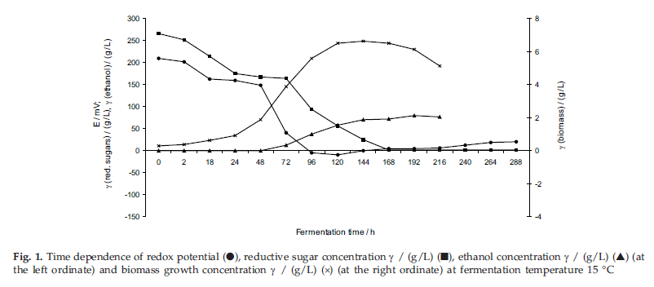
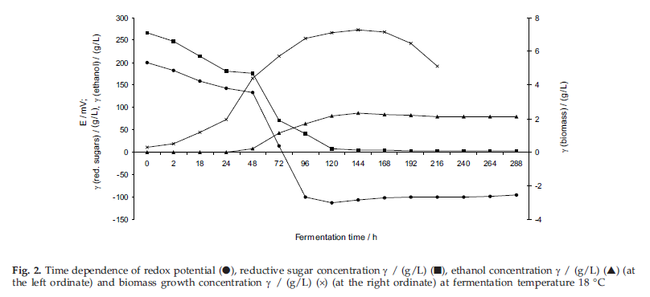
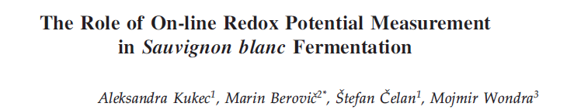
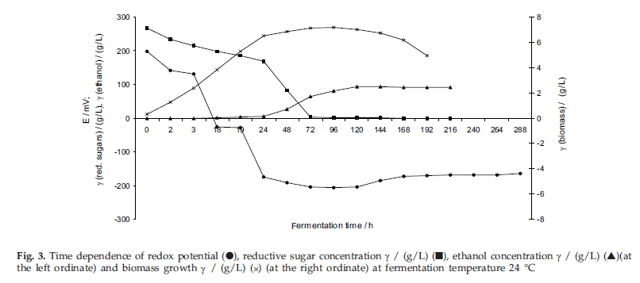
Brix
Cell Mass
Redox
Ethanol
Brix
Cell Mass
Ethanol
Redox
Brix
Cell Mass
Ethanol
Redox

Slide 7
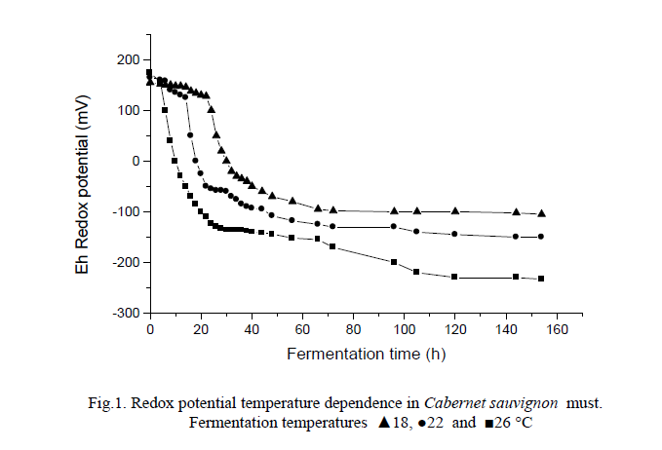
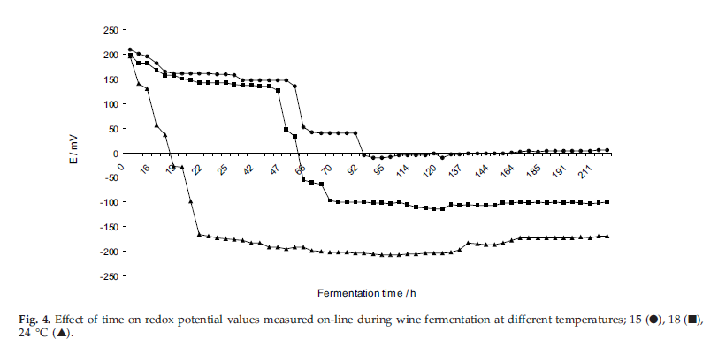
Cabernet Sauvignon
18 C
22 C
26 C
Sauvignon Blanc
15 C
18 C
24 C

Slide 8
Redox Potential
pH and [H+], immediate change to equilibrium
pe and [e], slow to recover to equilibrium
pe will determine the extent of all redox reactions

Slide 9
Redox Potential-pH Diagrams
Michaelis (1931) - Complex Potentials
Pourbaix (1958)– Metal Oxidation Diagrams
Zajic (1969) – Microbial Growth Limits

Slide 10
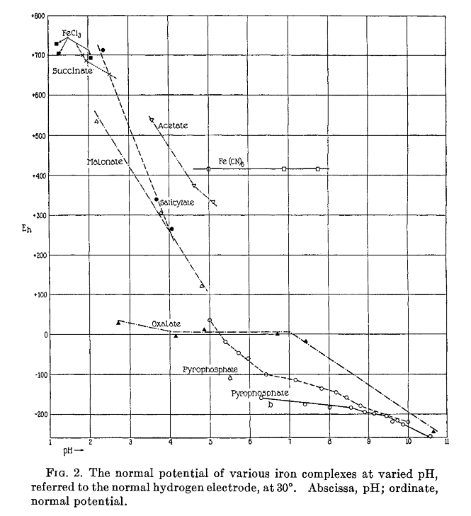
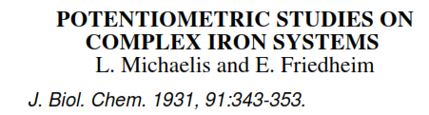

Slide 11
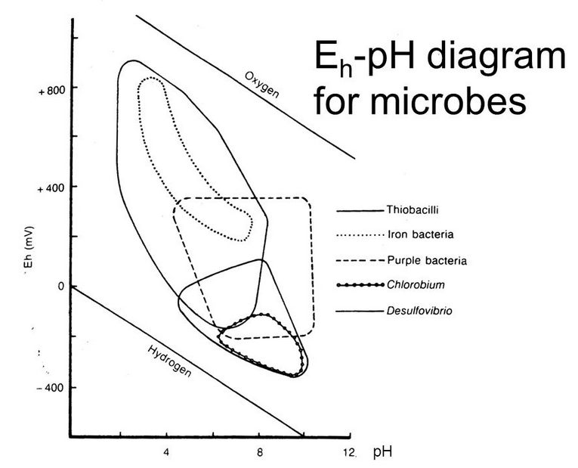
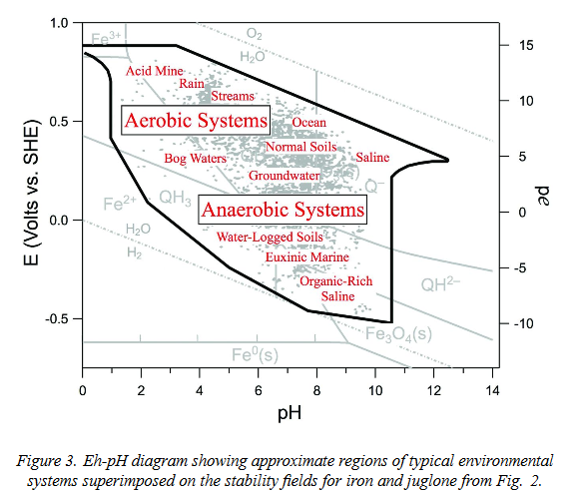

Slide 12
Fe(II)/Fe(III) = 770 mV
Fe(II)Ta/Fe(III)Ta = 500 mV
Wine Aging
Cu(I)/Cu(II) = 160 mV
Wine Fermentation

Slide 13
Redox Potential and H₂S Formation During Fermentation
Maximum Formation at Redox Potential Minimum

Slide 14
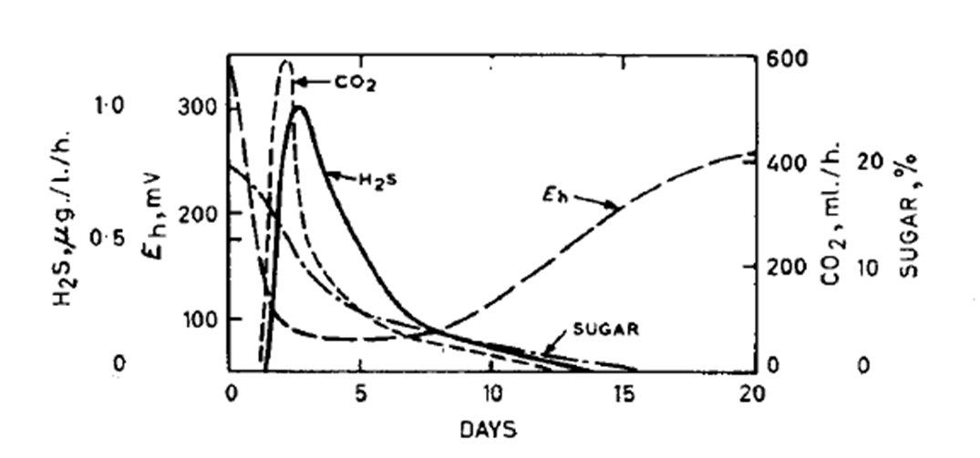

J. Sci. Fd. Agric. (1963) 14:79-91

Slide 15
Controlled Redox Fermentations
2016 Results
White Wine with Elemental Sulphur
White Wine
Red Wine

Slide 16
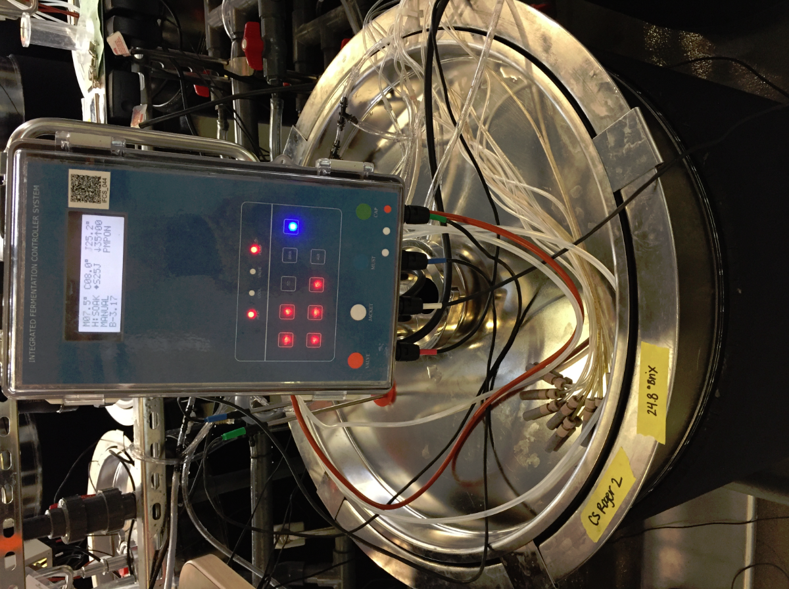

Slide 17
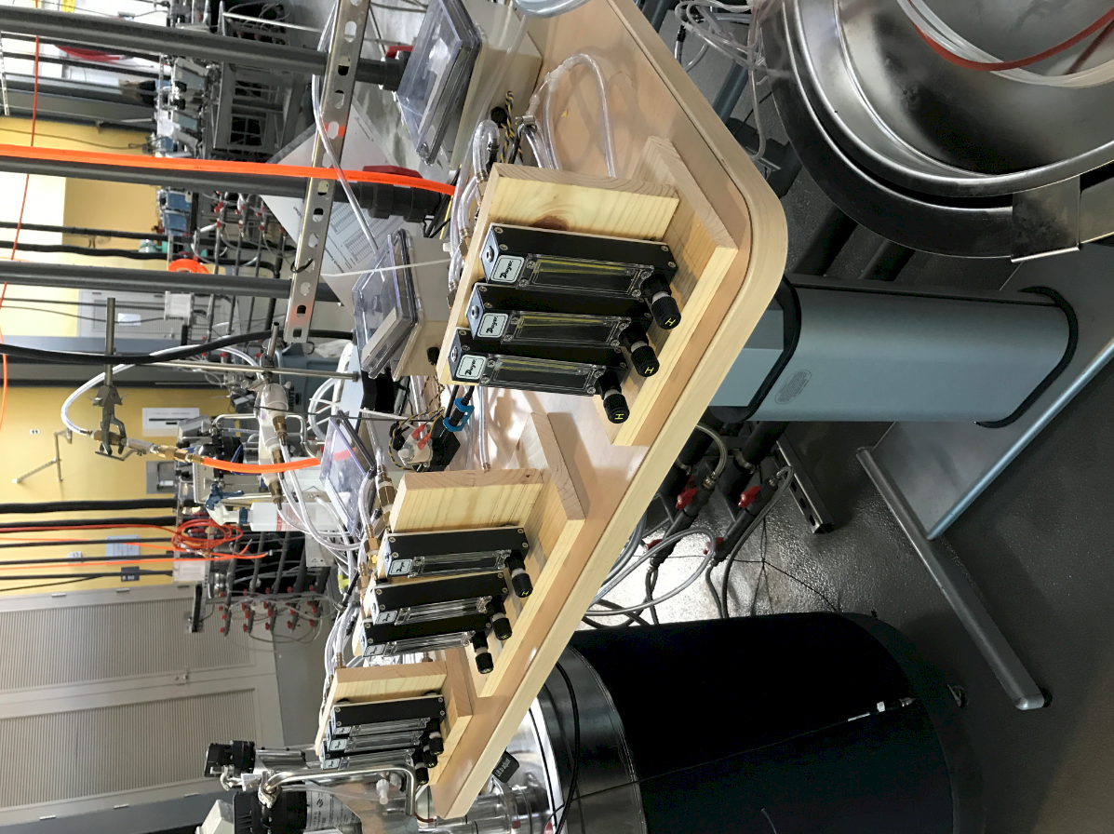

Slide 18
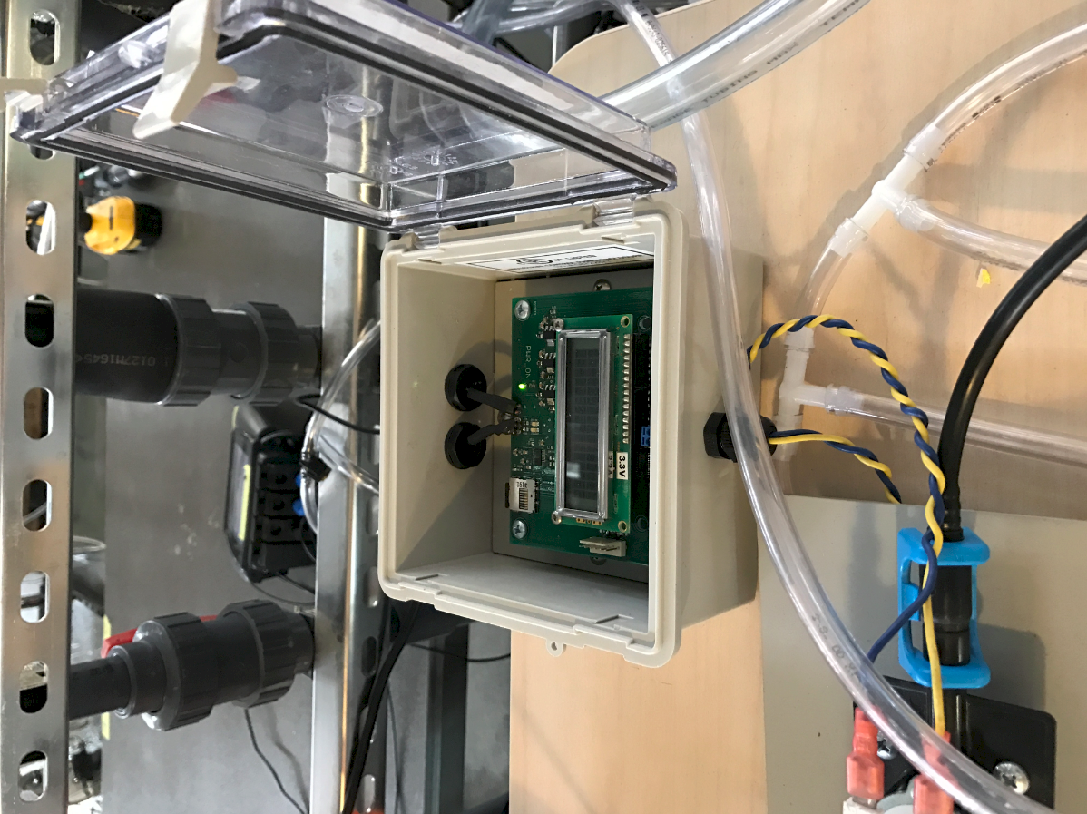

Slide 19
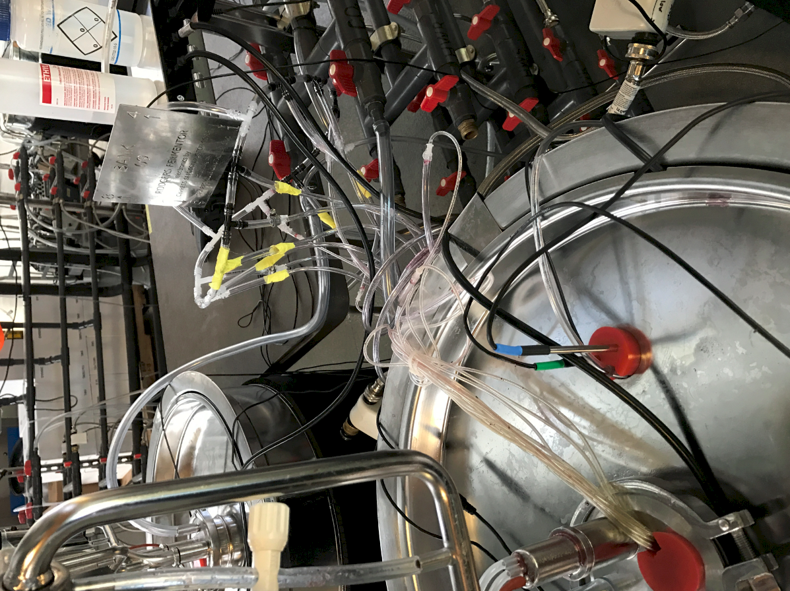

Slide 20
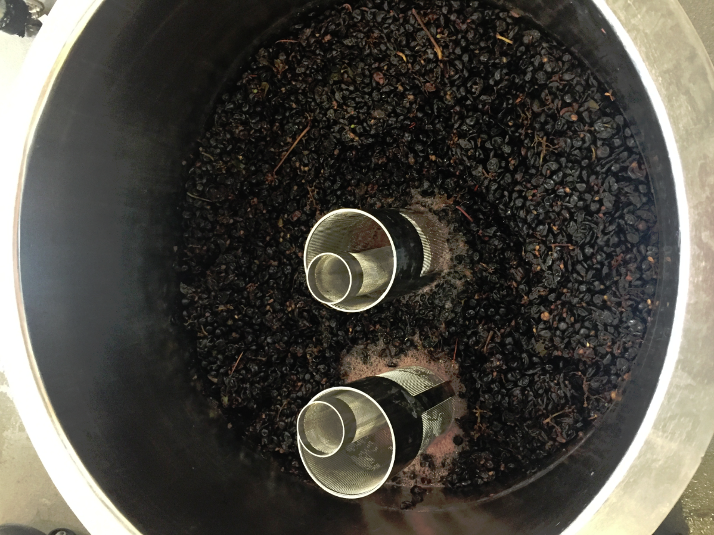

Slide 21
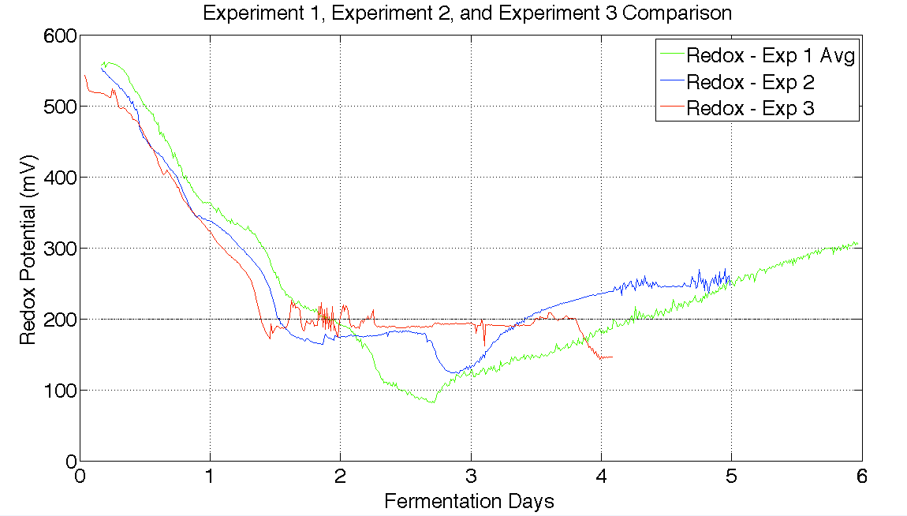

Slide 22
Next Steps
Sulfide and Thiol Analysis of Existing Wines
Model Solution Standard Fermentation
  At various Potentials (300, 200, 100, 0, -100, -200 mV)
  At various Temperatures (15, 20, 25, 30, 35C)
  At various pHs (2.5, 3.0, 3.5, 4.0, 4.5)

Slide 23
Acknowledgments
T J Rodgers Fellowship (David Killeen)
Stephen Scott Endowment
UC Davis Winemaking Team
University of California

