Slide 1
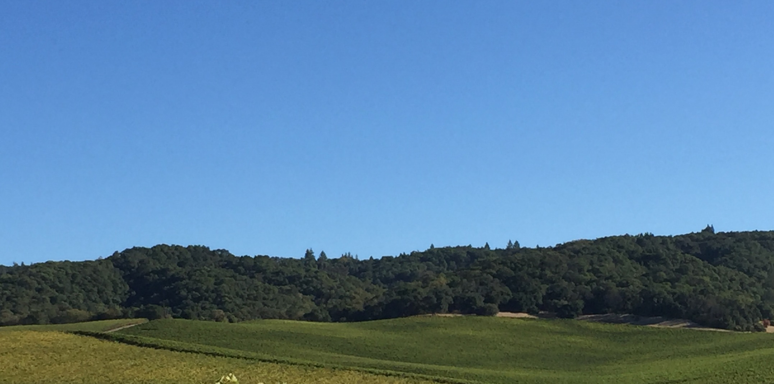
Grapevine Red Blotch-Associated Virus May Reduce Carbon Translocation Leading to Impaired Grape Berry Ripening
J. Martinez, C Plank, M Cooper, R Smith, M Al-Rwahnih, L Brillante , and S Kaan Kurtural

Slide 2

Acknowledgements
Department of Viticulture and Enology
Harold P. Olmo Research Funds
Allied Grape Growers
American Vineyard Foundation
University of California Foundation Plant Services
University of California ANR
Verizon Foundation

Slide 3
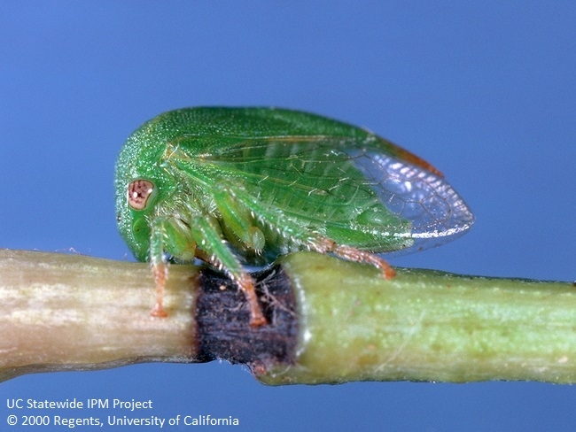
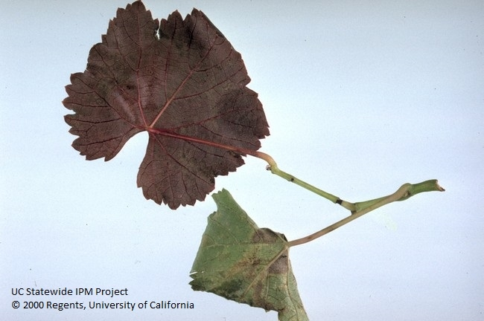
Grapevine Red Blotch Associated Virus (GRBaV)
Reported in 2008
Circular ssDNA virus with resemblance to geminiviruses
Spread through:
  Propagation of infected stock
  Vector:
    Three-cornered alfalfa hopper (Spissistilus festinus (Say))
Bahder et al., Phytopathology, 2016
Notes:
TCAH, which in the field causes girdling injury. Under the same laboratory conditions, TCAH was successful at transmitting the virus, while three proposed leafhoppers could not

Slide 4
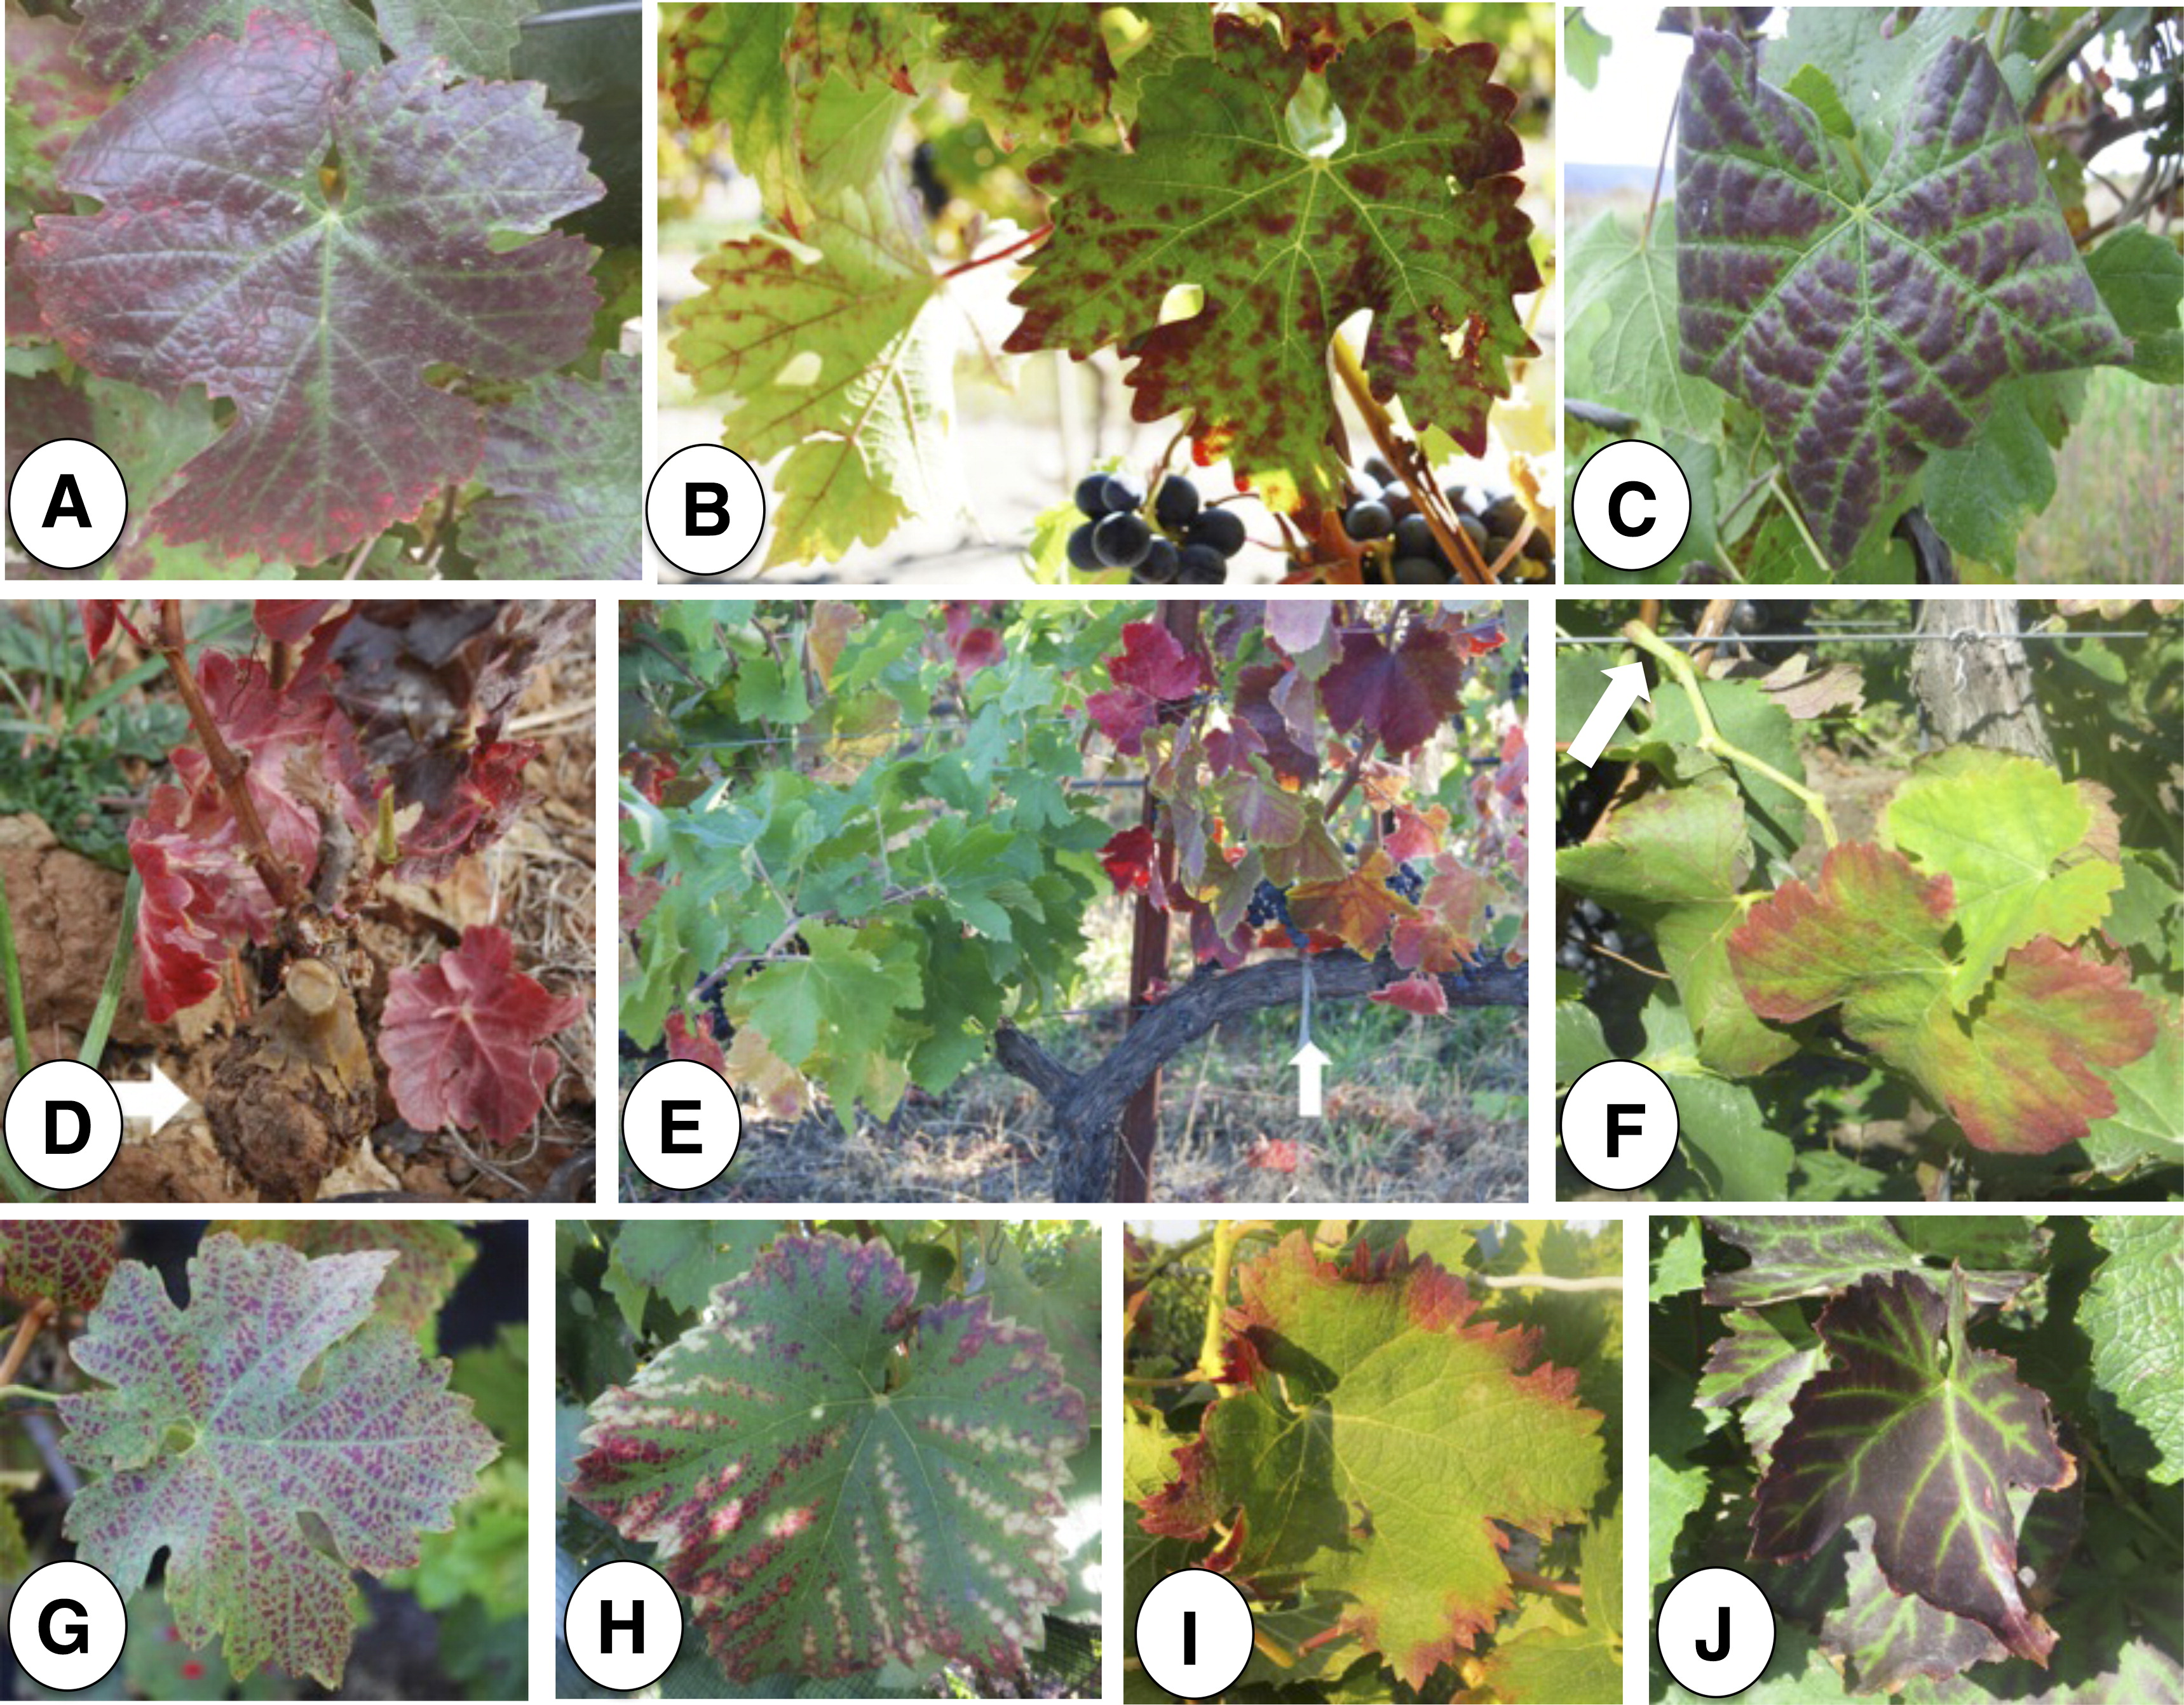
Not all discolorations are the same!
Fig. 4. Biotic and abiotic factors associated with leaf reddening and foliar symptoms in grapevine. A, Grapevine red blotch-associated virus on Cabernet Franc; B, Grapevine leafroll-associated virus 3 on Cabernet Franc; C, Grapevine leafroll-associated virus 1 on Pinot noir; D, Crown gall on Barbera (arrow points to the tumor); E, cordon of a Syrah vine constricted by a tied plastic twine (arrow points to the twine); F, broken shoot of a Tempranillo (arrow points to the point of physical injury); G, mite damage on Cabernet Franc; and nutritional disorders on H, Sangiovese; I, Grenache, and J, Cabernet Franc.
Mysore R. Sudarshana; Keith L. Perry; Marc F. Fuchs; Phytopathology 2015, 105, 1026-1032.
Notes:
Red blotch can be confounded with other diseases and physical damage. So far the best way to confirm infection is submitting samples for qPCR analysis. For example, out of all of these images only image A has confirmed red blotch.

Slide 5
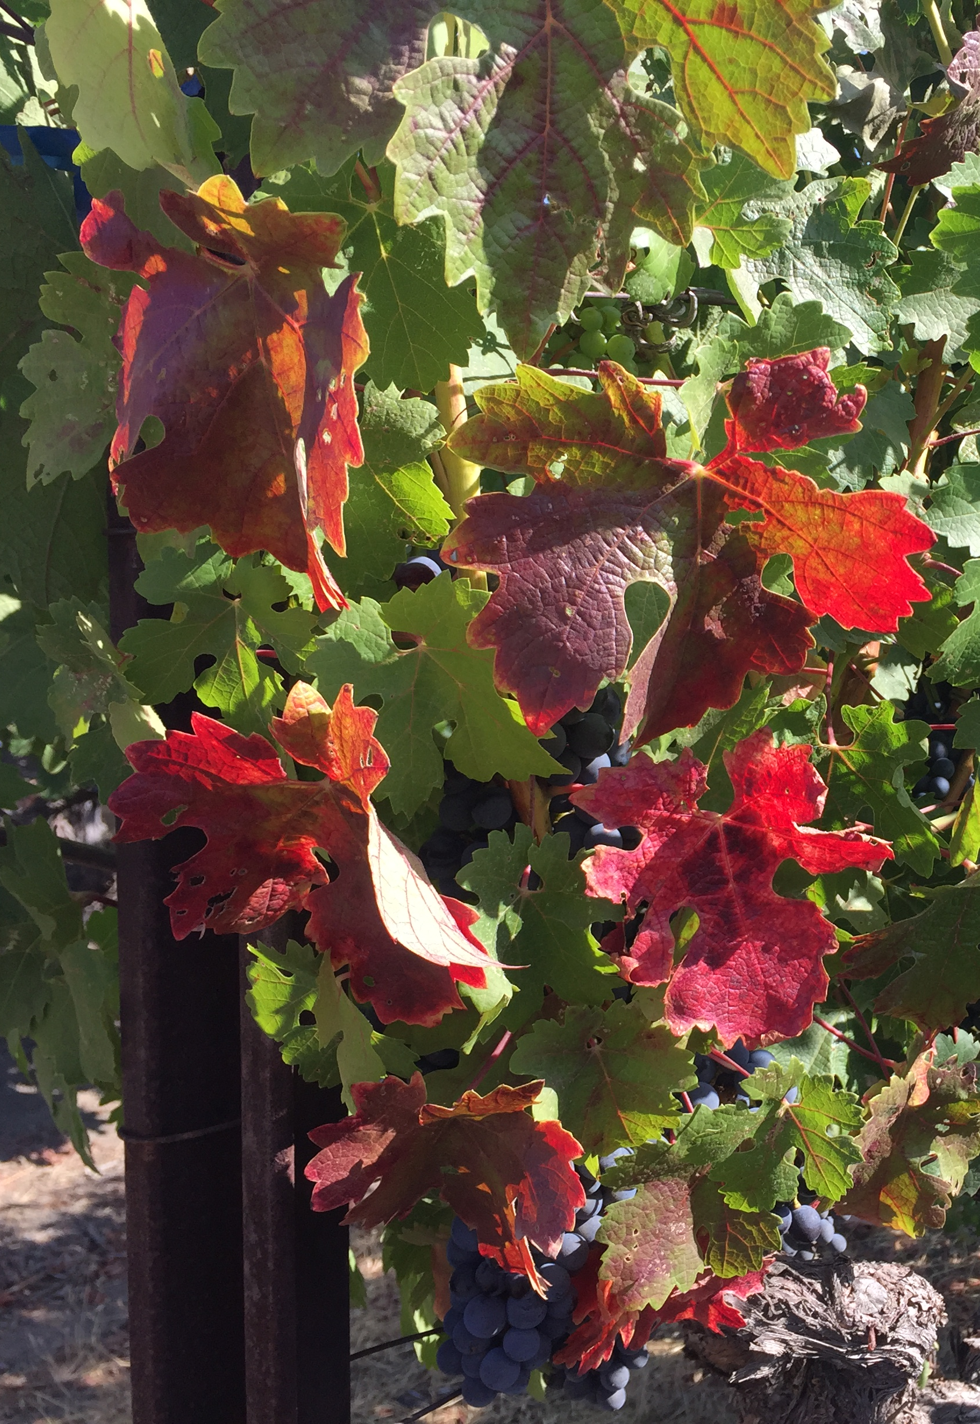
Symptoms of Grapevine Red Blotch Disease
Incidence and severity
  Grape cultivar
  Environmental conditions
Effects on red-skinned berry
Lack of knowledge on:
  Carbon fixation to changes in grape composition
Red Veins
Flat Margins
Red Blotches
Notes:
Affects on berry physiology are well documents and include: higher titratable acidity, lower sugar, lower anthocyanin content, and uneven ripening
Currently there is a lack of knowledge on how plant physiology is linked to berry chemistry in infected vines

Slide 6
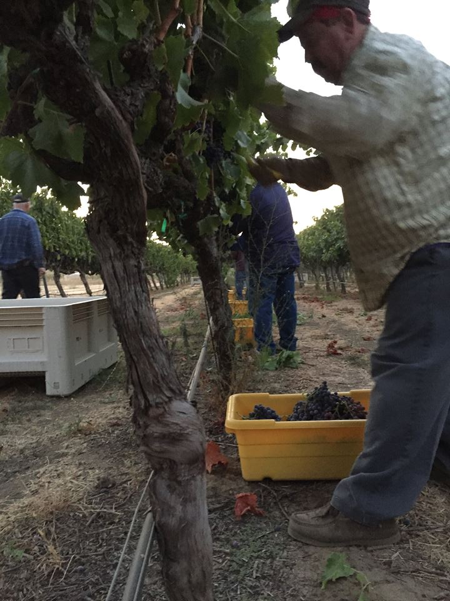
Experiment site and conditions
UC Davis Oakville Experimental Vineyard
Cabernet Sauvignon #8/110R and 420A
NE-SW orientation, 1.8 m x 2.4 m spacing
Plants tested with primers specific to:
  GLRaV (1-10)
  Rupestris stem pitting
  GRBaV
Completely randomized design
  6 GRBaV (-), 6 GRBaV (+) per rootstock
  Four replications
Objective: Physiological characterization of GRBaV (+) infected grapevine, carbon fixation to changes in grape composition

Slide 7
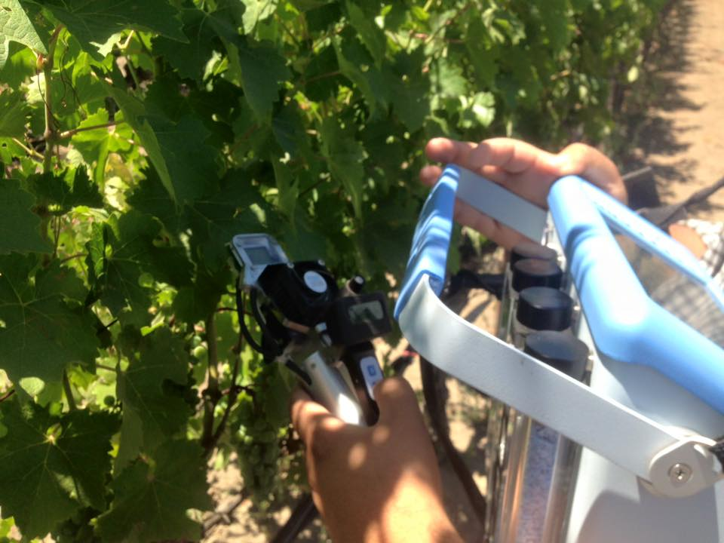
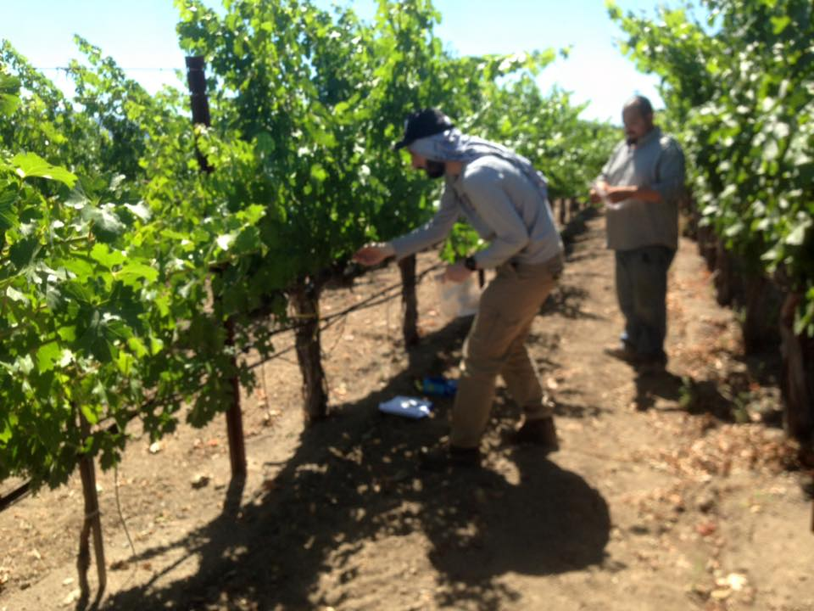
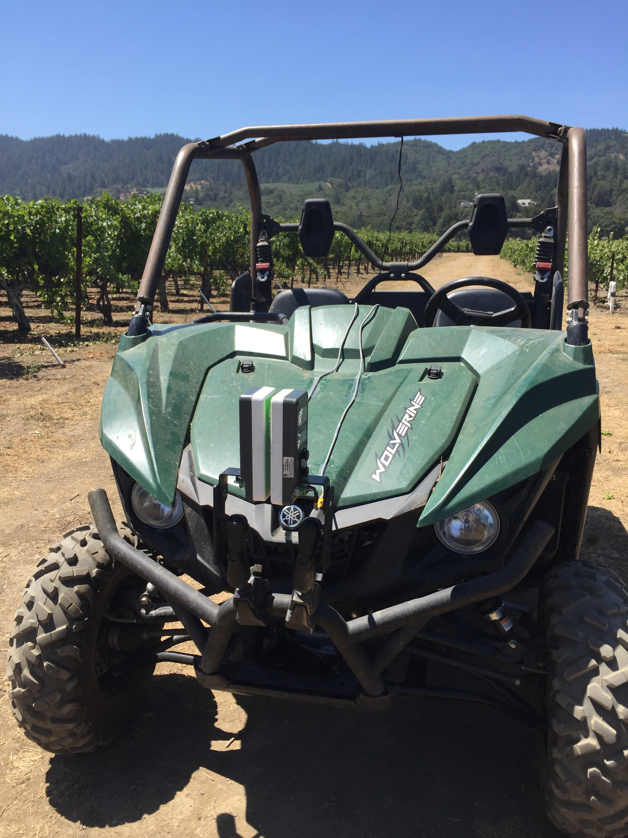
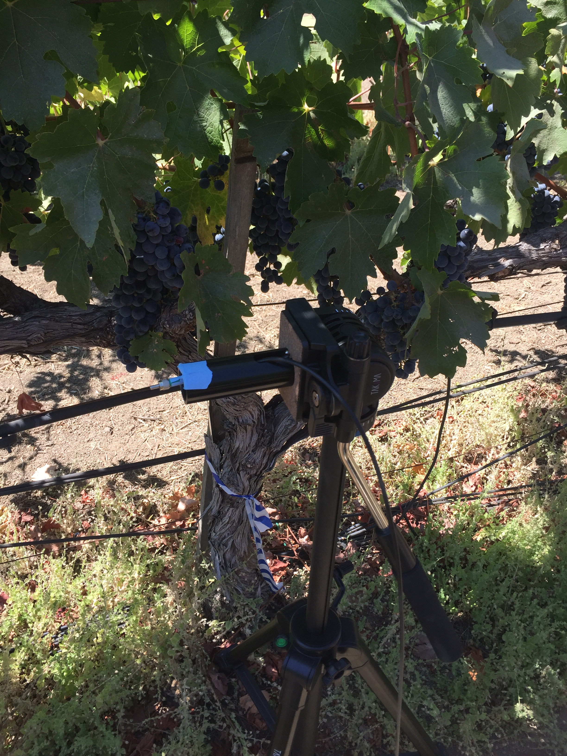
Vineyard measurements
Macronutrients of petioles at bloom
Mid-day stem water potential
Net gas exchange
Yield
Pruning mass
Notes:
Crop Circle measures reflectance in 3 bands: 670, 730, and NIR, a mobile platform

Slide 8
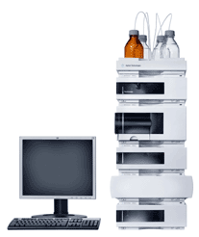
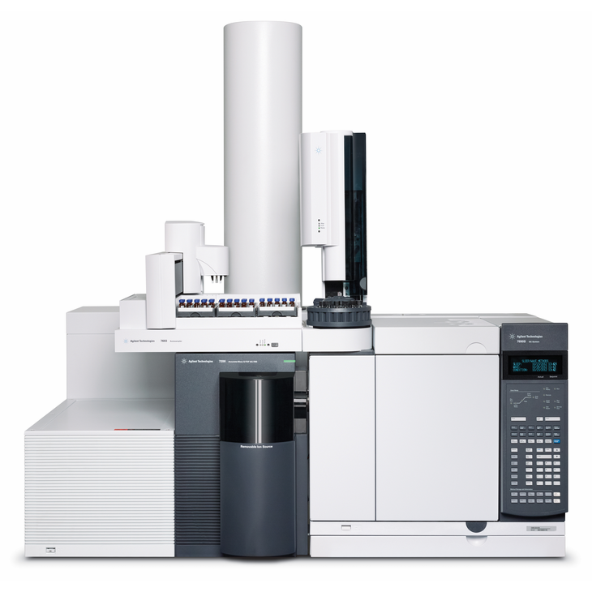
Laboratory measurements
  Berry composition
  Berry skin flavonoid assessment
    Anthocyanins
    Flavonols
    Proanthocyanidins
  Foliar anthocyanins
  Foliar sugar accumulation
HPLC-DAD
GC-MS

Slide 9
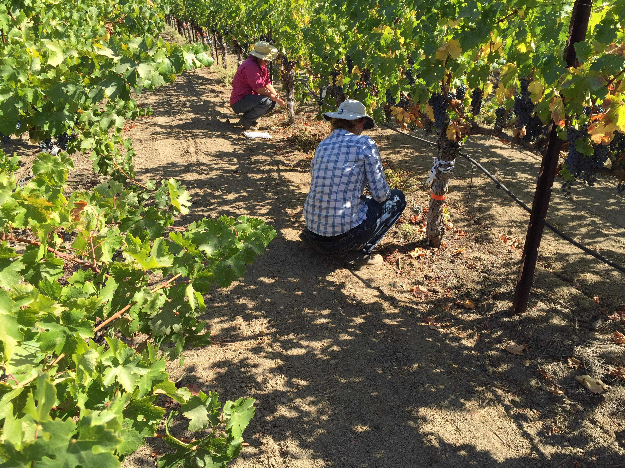
Results

Slide 10
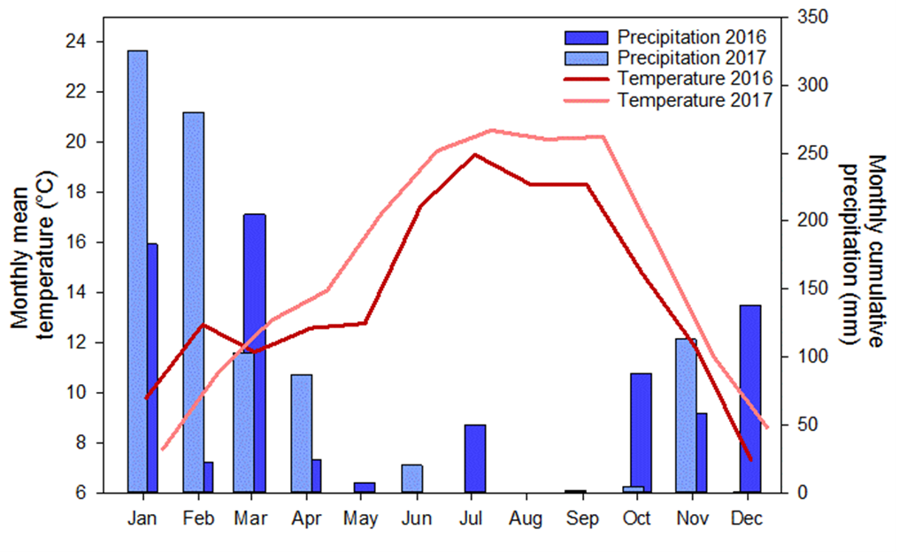
Weather at the site

Slide 11
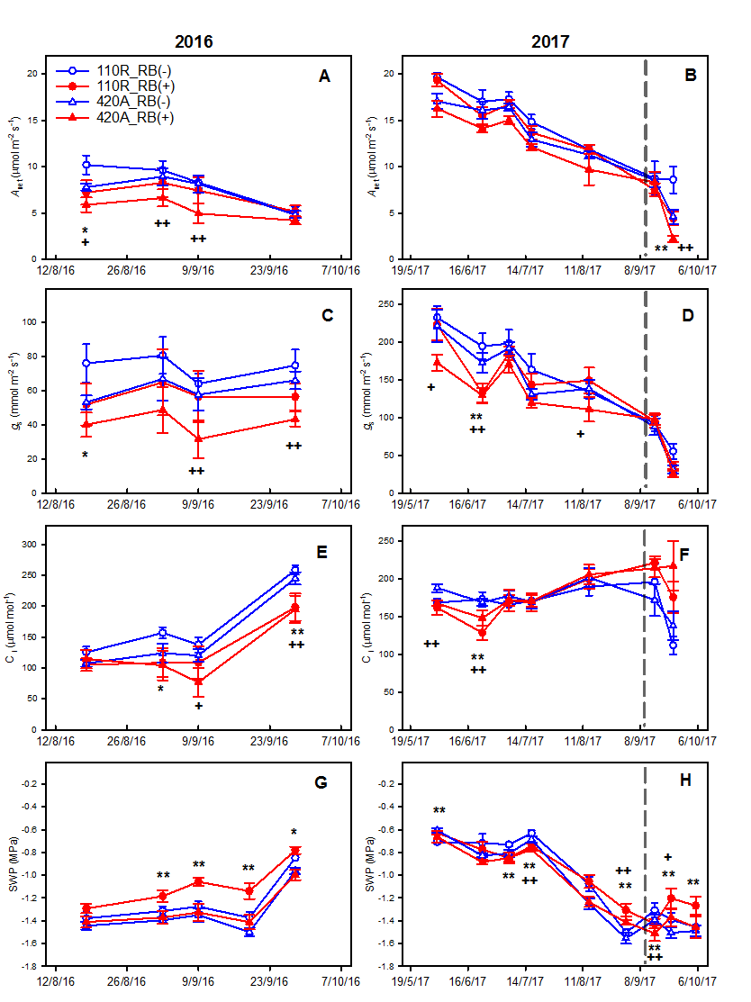
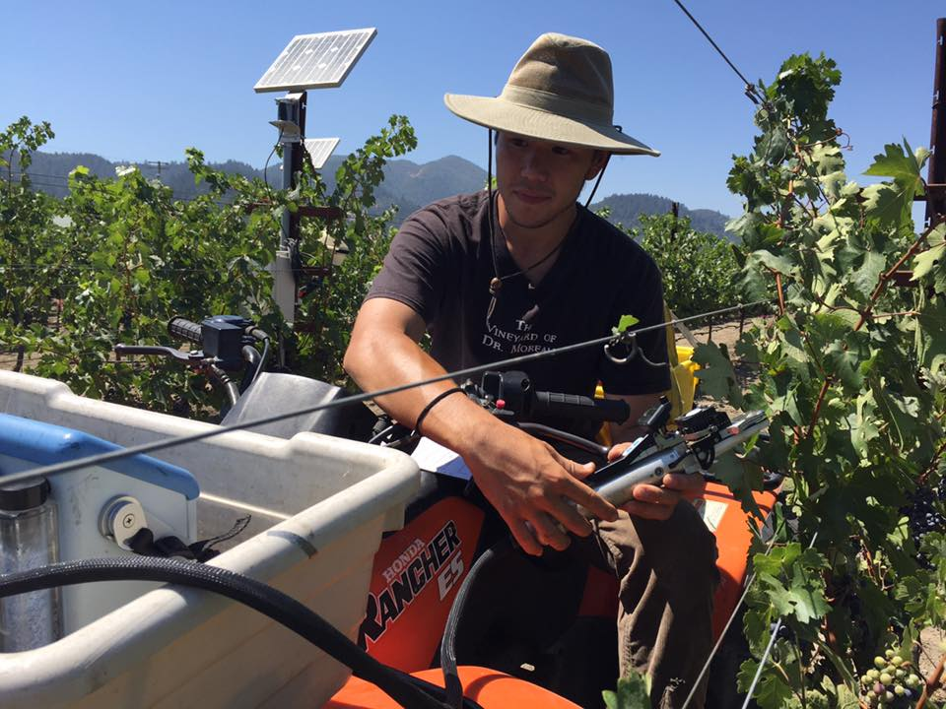
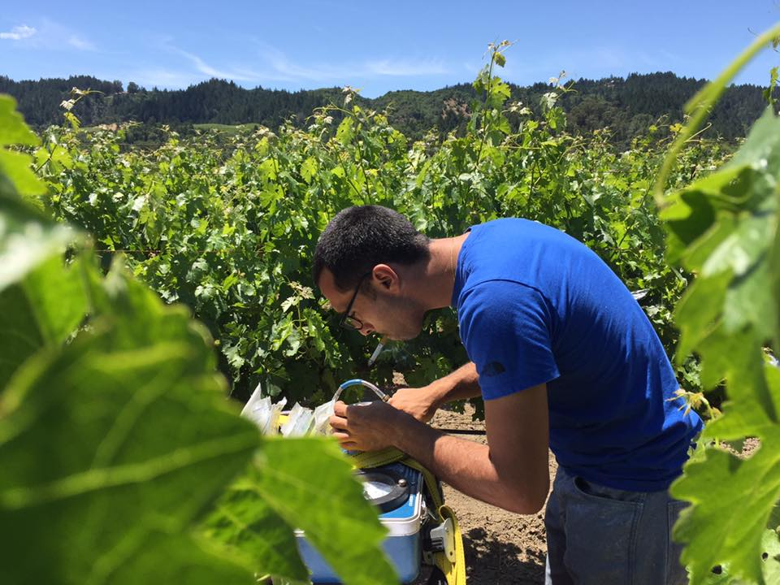
Primary metabolism (A_{net}, g_{s}, C_{i}, Ψ_{stem})

Slide 12
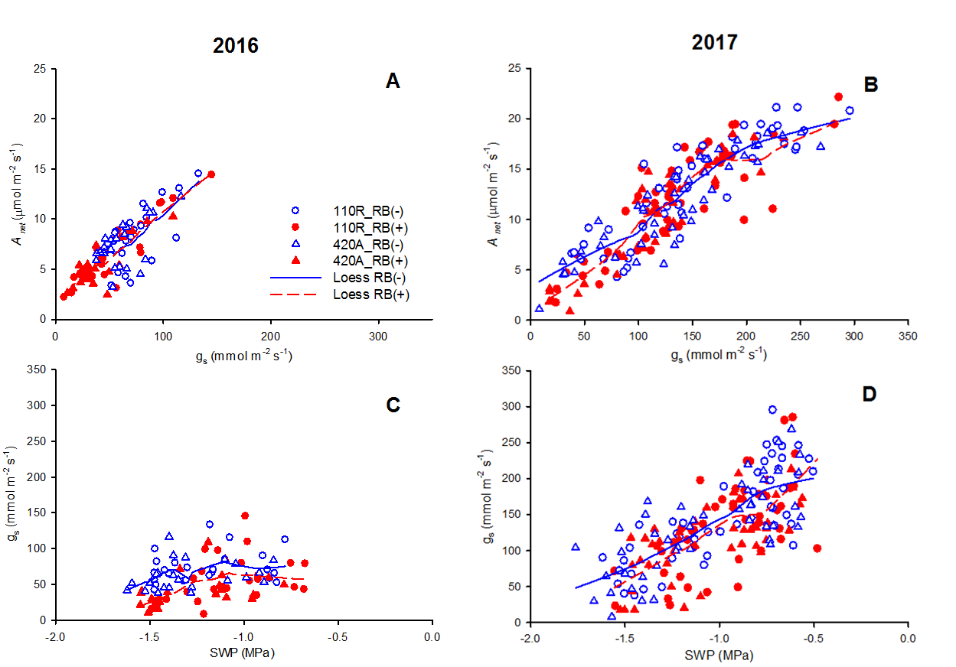
Relationship between A_{net}, g_{s}, and Ψ_{stem}

Slide 13
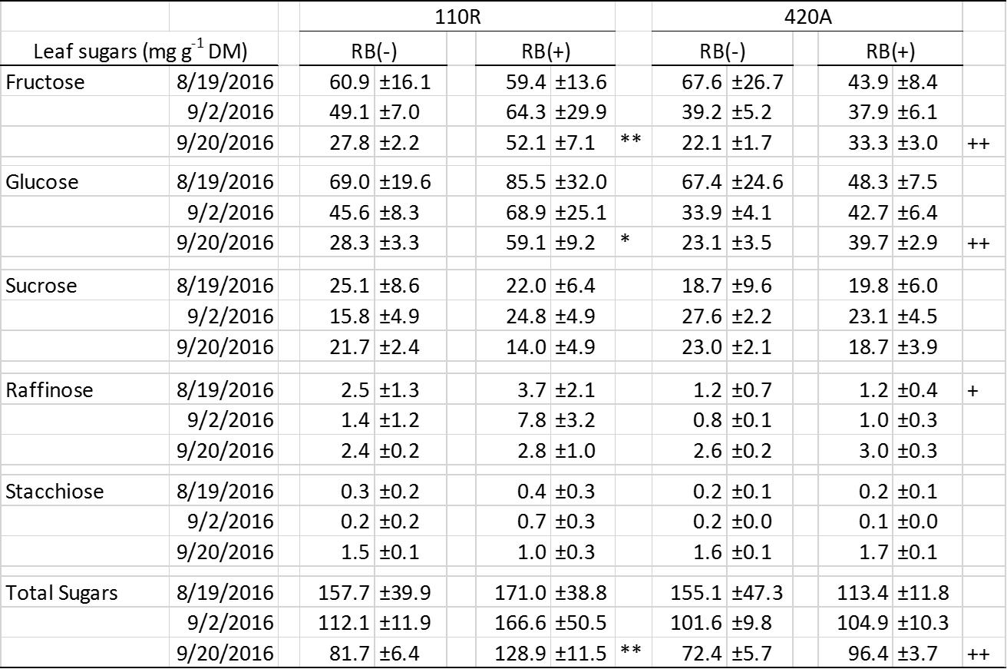
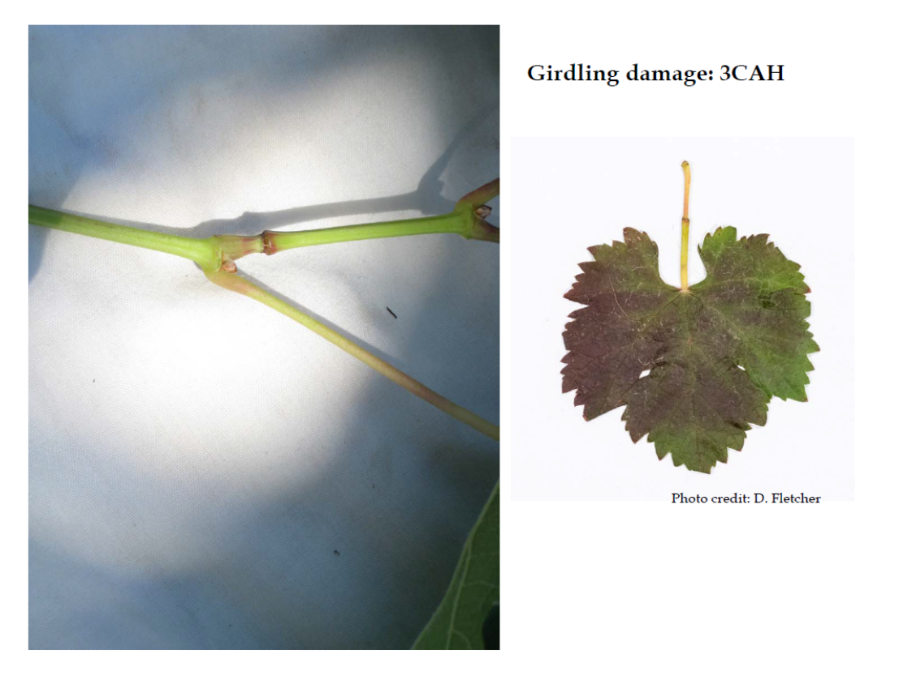
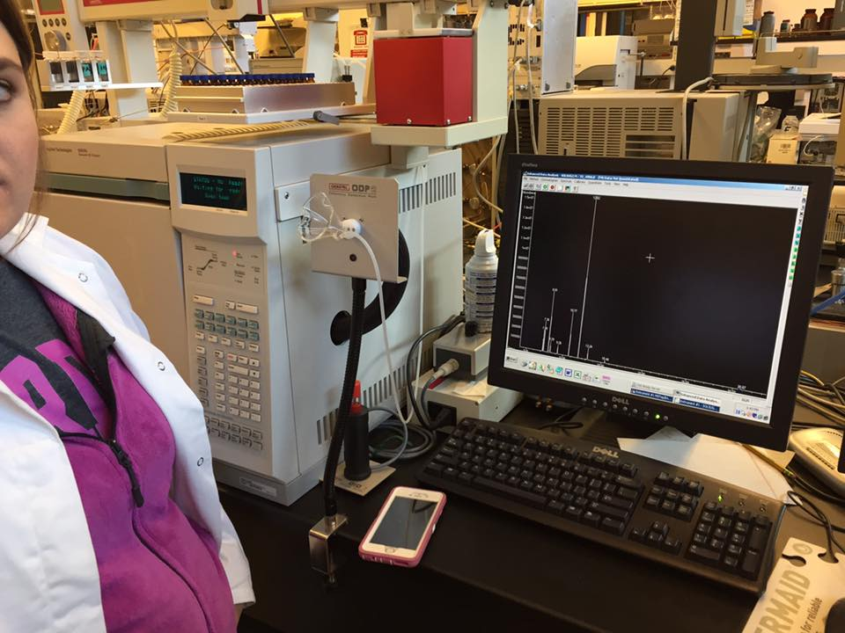
Effect of GRBaV on leaf sugar content

Slide 14
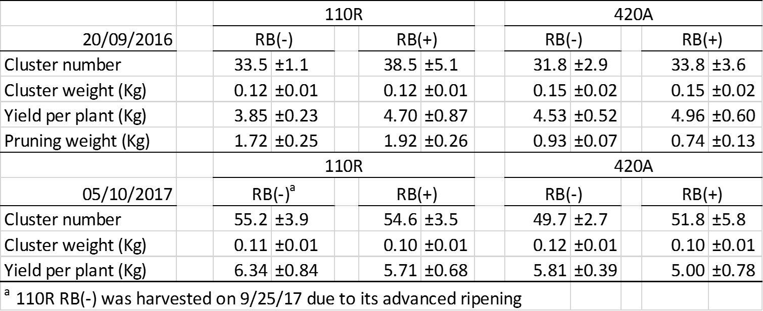
Components of yield

Slide 15
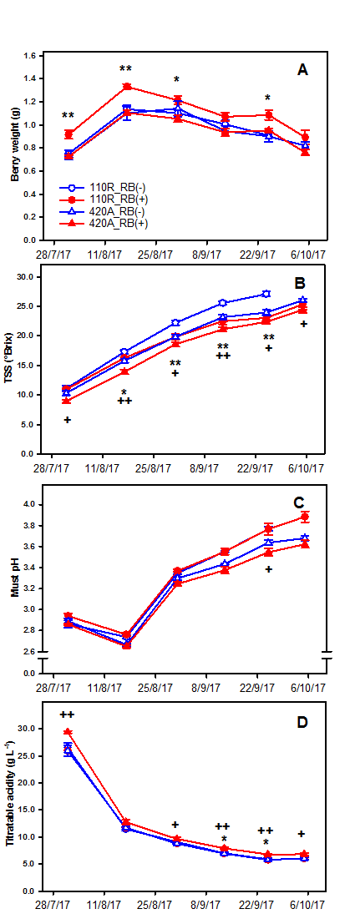
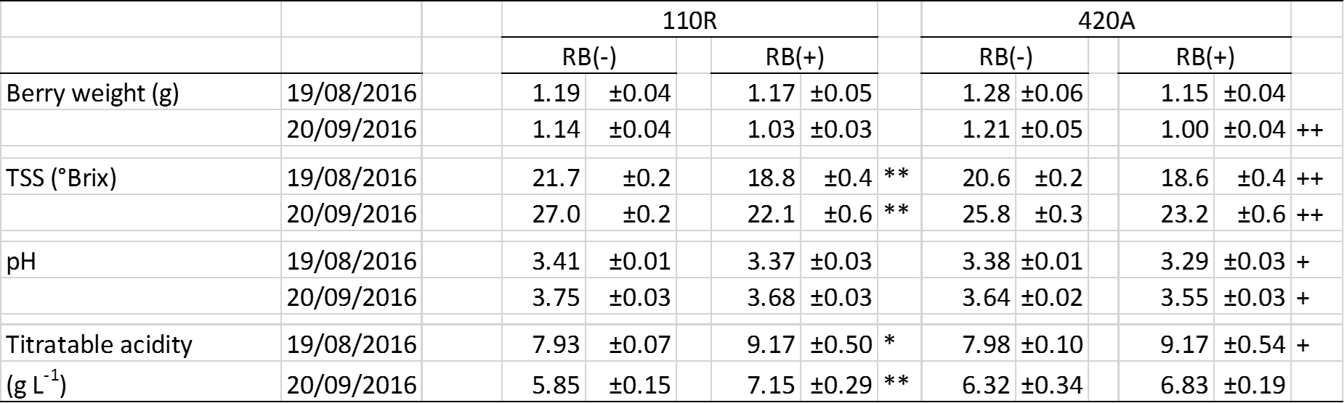
Effects of GRBaV on berry composition
2016
2017

Slide 16
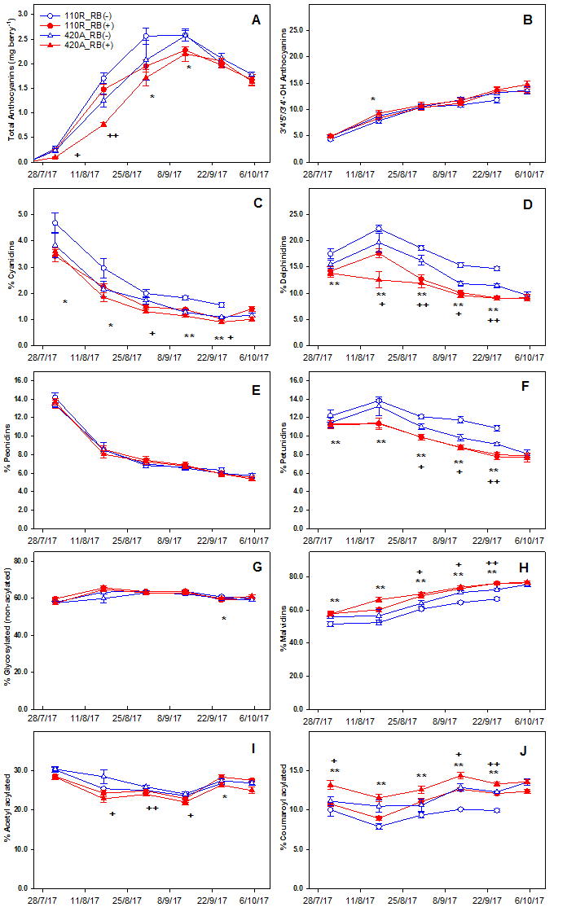
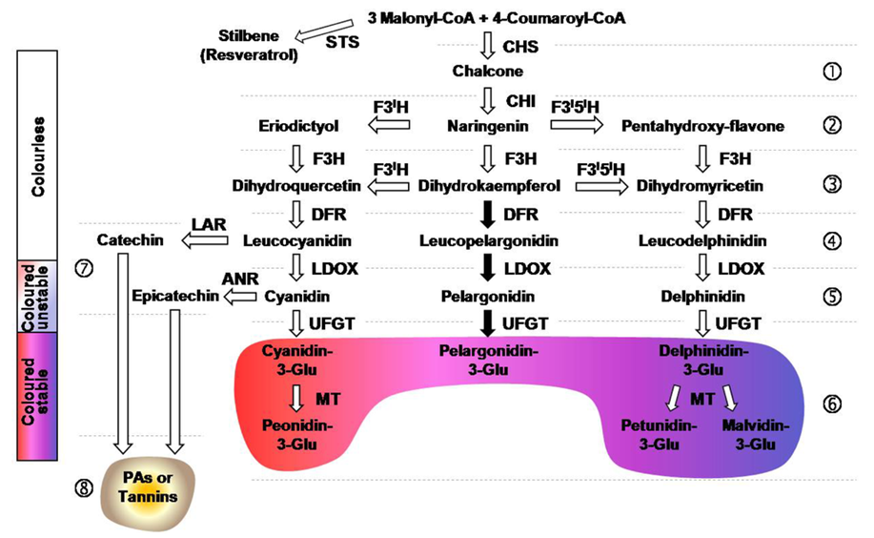
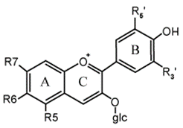
Anthocyanin concentration and profile 2016-2017

Slide 17
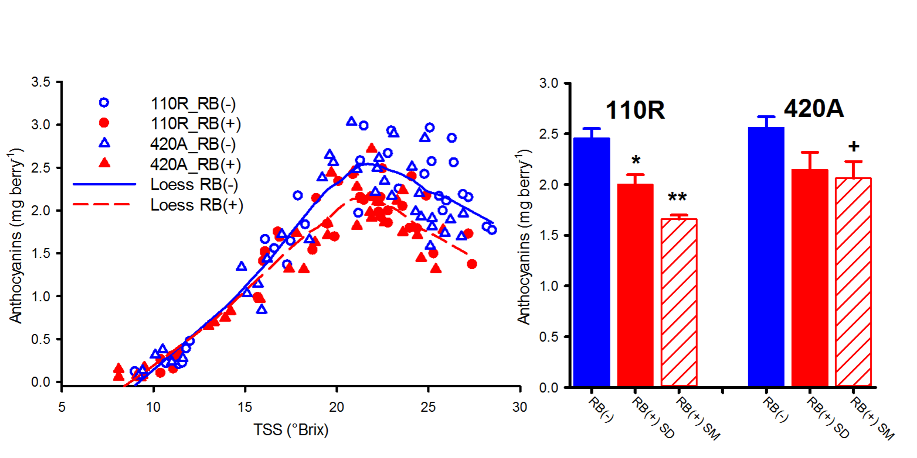
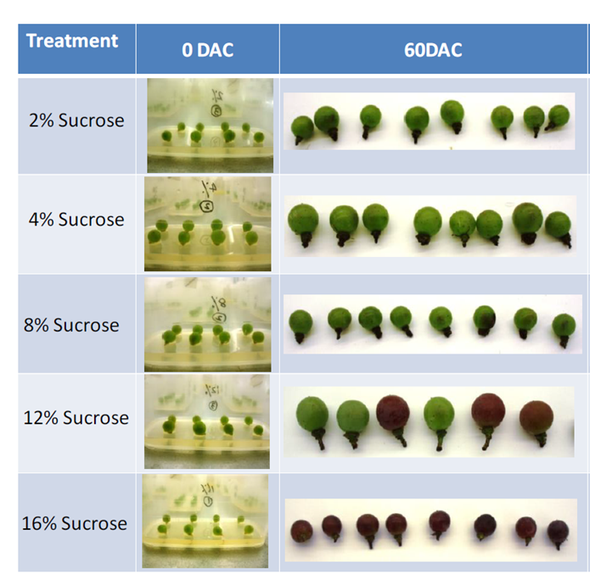
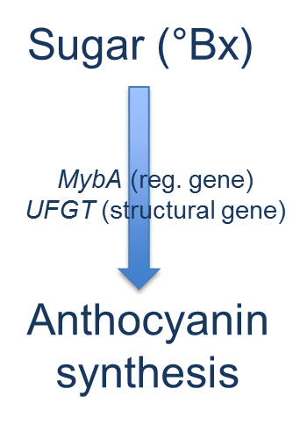

Relationship between TSS and anthocyanin concentration

Slide 18
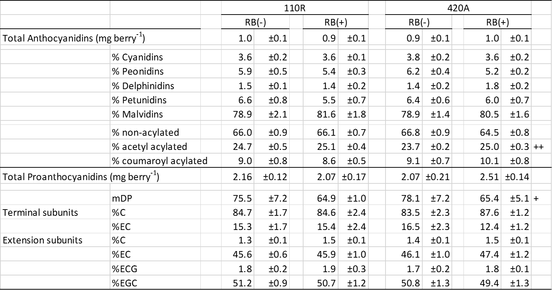
Effect of GRBaV on anthocyanidin and proanthocyanidin composition in 2016

Slide 19
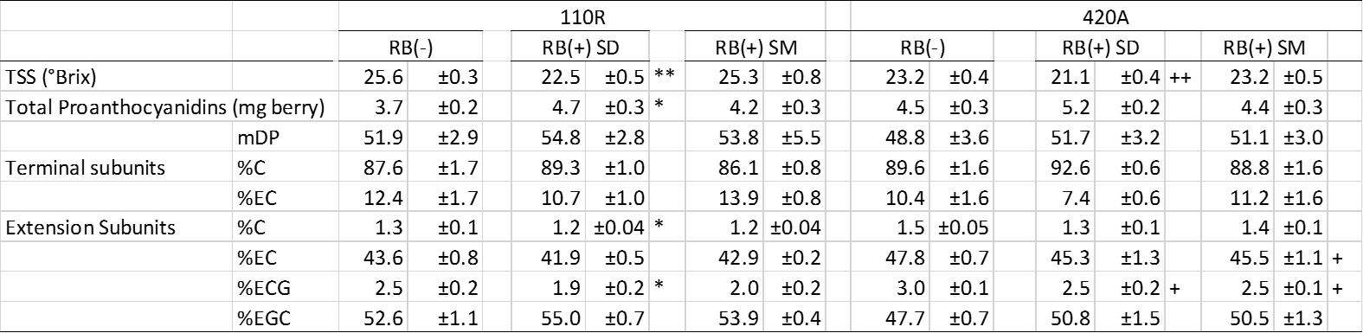
Effect of GRBaV on proanthocyanidin concentration on Same Date (SD) Harvest or Same Maturity (SM) Harvest in 2017

Slide 20
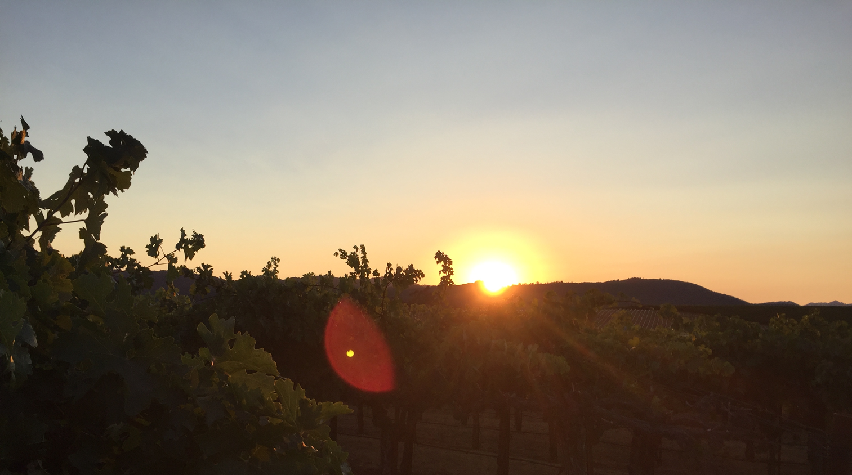
Discussion

Slide 21
Altered plant water status in GRBaV (+) grapevine
GRBaV resulted in stomatal limitation
  GRBaV (+) periods of lower carbon assimilation
  GRBaV (+) lower g_{s}
Ψ_{stem} GRBaV (-) suggested reduction in g_{s} was not mediated by worsened plant water status.
GRBaV infection decoupled stomatal response from whole plant water status.
Lower g_{s} (not induced by water deficits) in GRBaV (+) is what led to better plant water status.
Reduced gs in GRBaV (+) was due to impairment of carbohydrate export

Slide 22
Sugar translocation impairment by GRBaV leads to delayed grape berry ripening
Sugar translocation: From sources to sinks through phloem
  Mainly as sucrose, lesser extent as polyols or raffinose family
  Up to 18% grape berry FW: Glucose+Fructose
In two year study:
  GRBaV (+) less A_{net}, seldom significant
  GRBaV (+) reduction in TSS consistently significant
Carbon assimilation reductions circumstantial with GRBaV (+)
Impairment of sugar translocation from leaf to berry underlying mechanism
  Red blotches on leaves and slower ripening
GRBaV (+) limited the capacity of source:sink exchanging carbon, energy and plant hormones simultaneously, yielding complex symptomology.

Slide 23
GRBaV desynchronizes ripening-related processes
Primary metabolism
Vacuolar import of sugars depletes cytosolic sugars, leading malate respiration and loss of acidity in grape berry.
TA experienced a delay similar to the delay in TSS accumulation
  Not evident with juice pH: Deleterious pH when similar TSS were compared
Must pH influenced by [K⁺]: Disassociate relationships between [OA] and must pH.
  K⁺ import into berry xylem dependent
Impairment of phloem transport: desynchronization of OA breakdown (mediated by sugar transport) and K+ accumulation; also reported with GLRaV infection.

Slide 24

GRBaV desynchronizes ripening-related processes
Secondary metabolism
GRBaV (+) led to decoupling between sugar loading and anthocyanin biosynthesis.
  Reduction in anthocyanin content could not be explained by delay in TSS accumulation
  GRBaV(+) suggested a net synthesis downregulation
  Although biosynthesis induced by sugar:
    Modulated by hormone signaling
    Limited by substrates and reducing power
  Biosysnthesis down-regulation :
  Hyphothetical limitation of phloematic transport with GRBaV (+)

Slide 25
Conclusion
GRBaV(+) lower g_{s} and this was associated with poor translocation of sugar.
Inhibition of sugar translocation from leaves into berries were concomitant to altered kinetics of TA, anthocyanins and proanthocyanidins.
Comparison of berry with similar TSS did not results in same berry chemistry;
Selective harvest (same TSS maturity) anthocyanin content and pH may be substantially different with GRBaV (+)
Our results provided evidence that GRBaV (+) resulted in decoupling of metabolic processes crucial of sustainable production of wine grape.

Slide 26
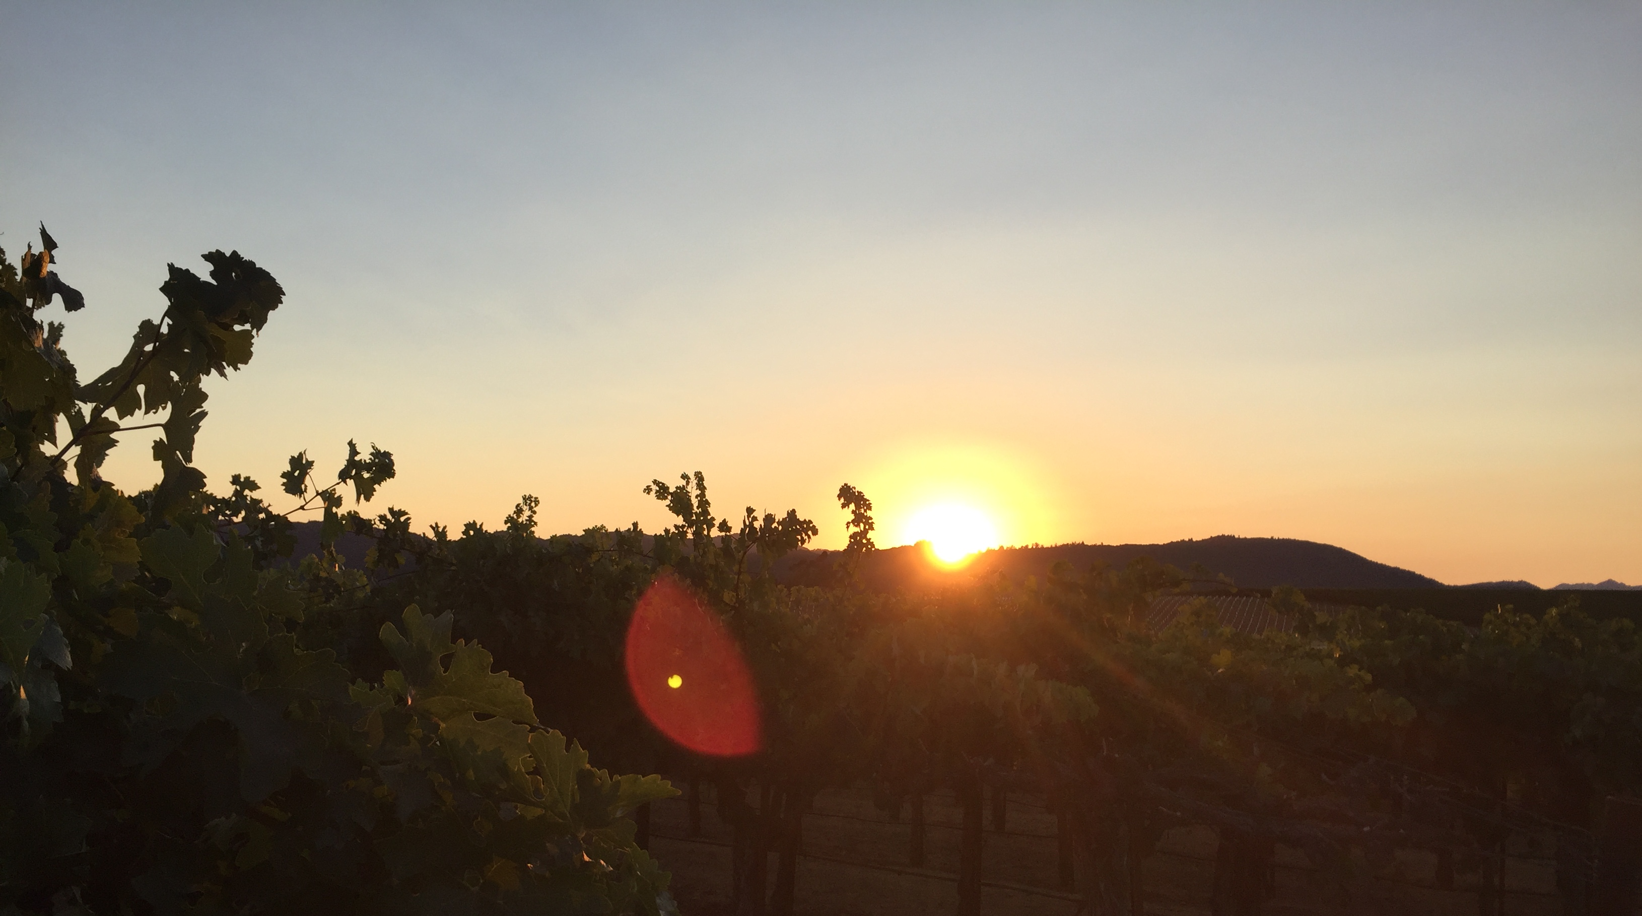
Acknowledgements
Andrew Beebe
Luca Brillante
Derek Baljeu
Christopher Chen
Wei-Chao Cheng
Constance Cunty
August D’Amato
Johann Martinez
Marshall Pierce
Katie Rouse
Cliff Yu
Longjiao Zhang

Slide 27
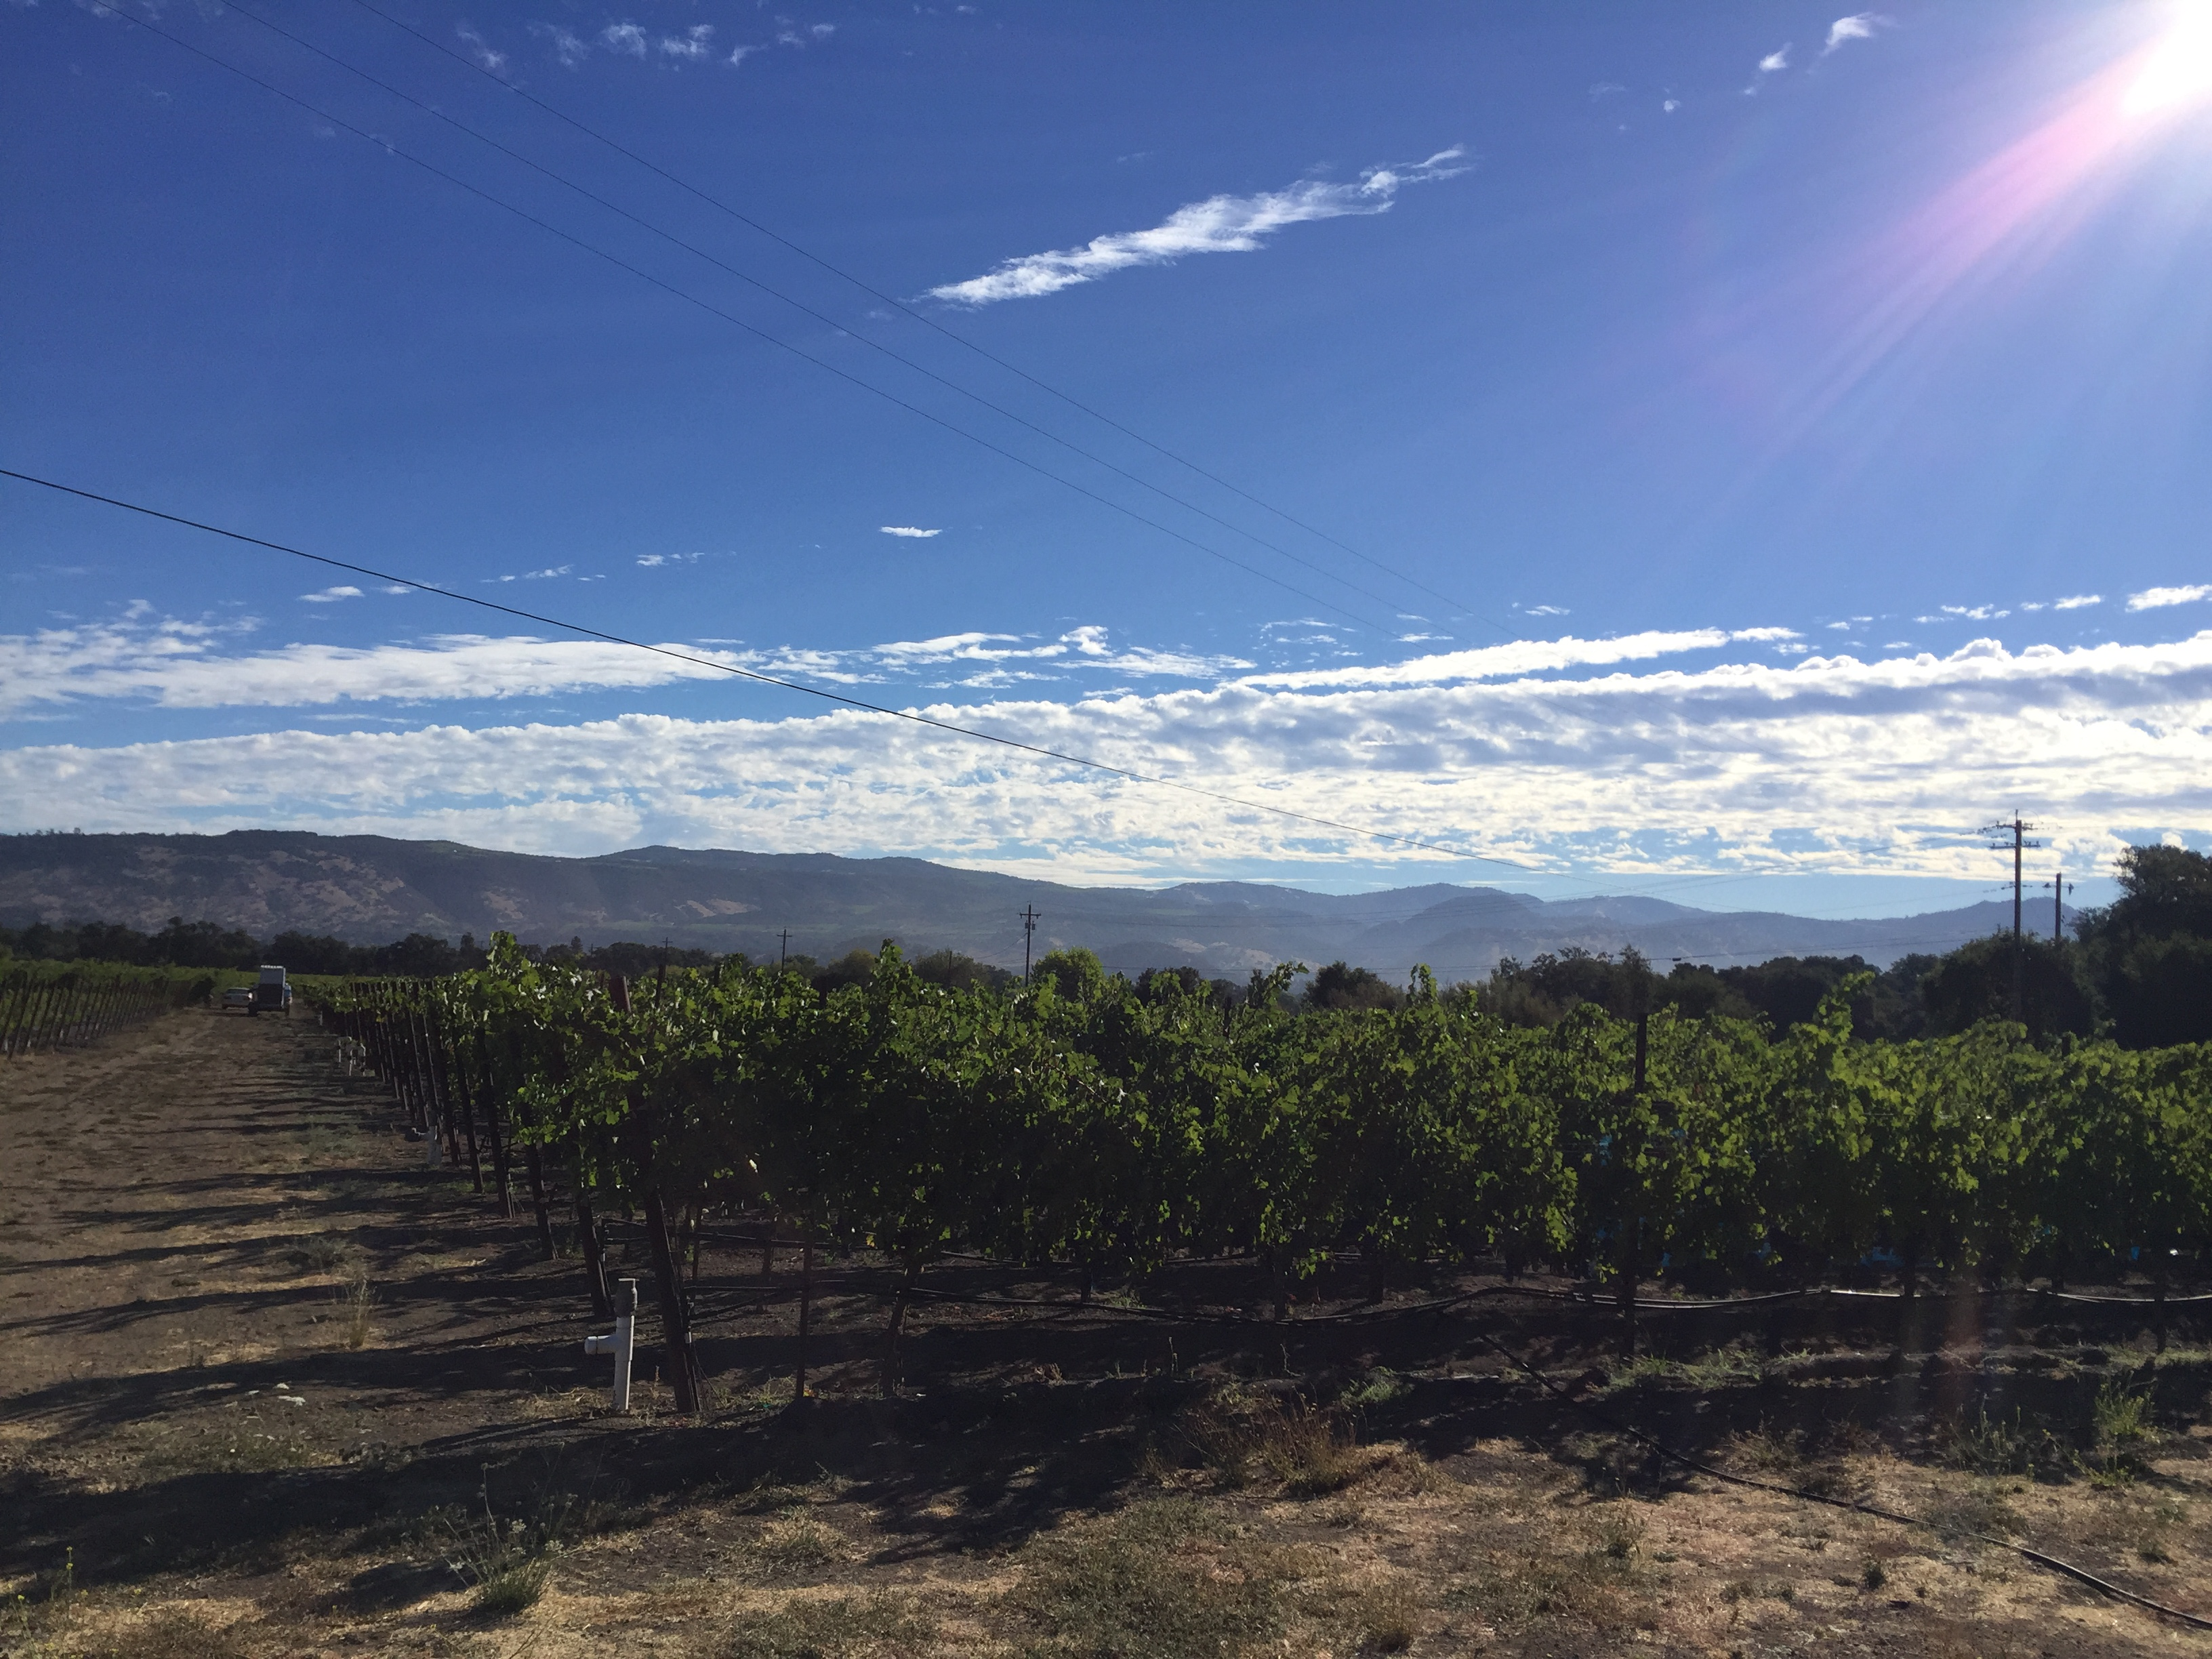
Thank you!

Slide 28
Effects of GRBaV on macronutrient content of petioles at bloom (CS/110R and CS/420A)
Virus status | Total N (%) | Total P (%) | Total K (%) | Total Ca (%) | Total Mg(%)
 | 110R
GRBaV (-) | 0.65 | 0.49 | 3.24 | 1.98 | 0.42
GRBaV (+) | 0.72 | 0.44 | 2.89 | 1.66 | 0.43
Pr>F | 0.2204 | 0.4132 | 0.1547 | 0.1566 | 0.8518
 | 420A
GRBaV (-) | 0.64 | 0.40 | 1.85 | 1.62 | 0.45
GRBaV (+) | 0.63 | 0.30 | 2.21 | 1.88 | 0.45
Pr>F | 0.7462 | 0.7953 | 0.3117 | 0.2889 | 0.8593

