Slide 1
Alison Crowe
Director of Winemaking,
Plata Wine Partners

Slide 2
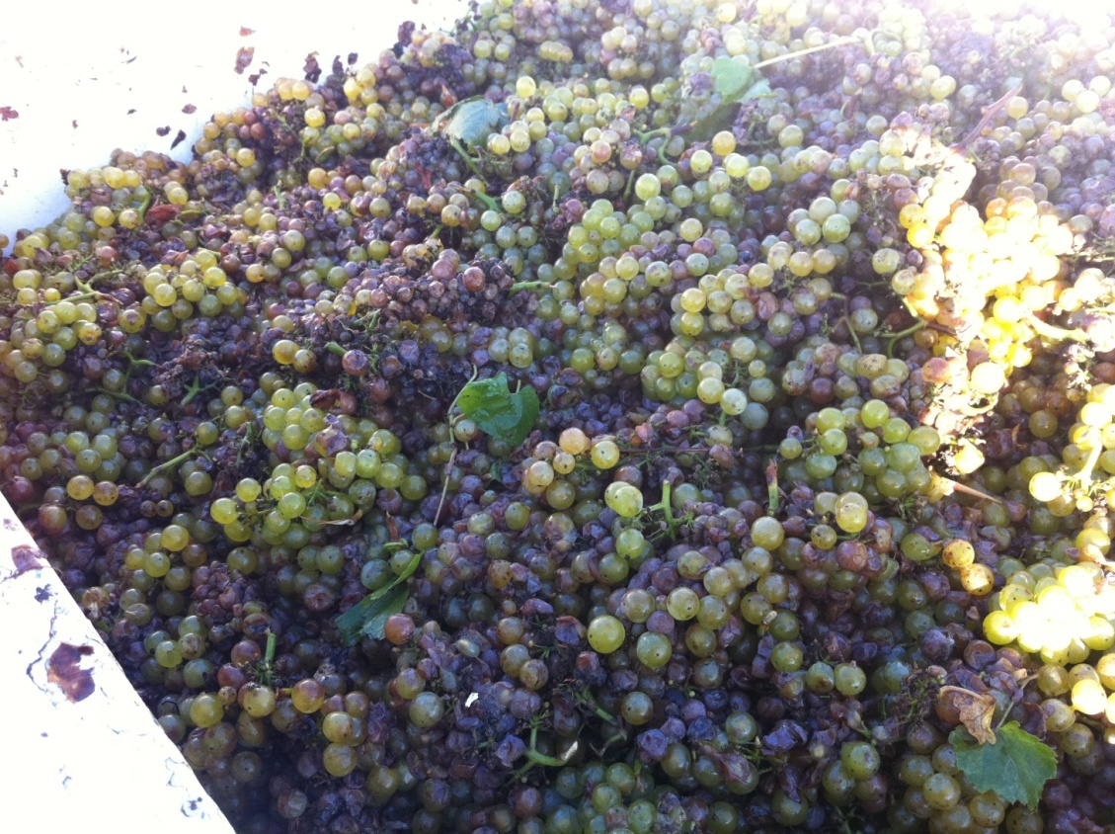
Hey, Nice Pinot!
(Wait…that’s Chardonnay)….

Slide 3
Throwing the Book at 2011
After all that rain, it’s probably not just Botrytis you’ve got out there…..
Fast and Furious (do you have time to sort?)
Night pick (low temps slow down chemical reactions)
Stat! (+ 30 ppm SO2 and 0.2 g/L Galalcool tannin in the vineyard against laccase, antioxidant)
SO2 is your friend (add more than normal)
Inoculate at high rate w/ strong yeast (2.5 #/K gal of PDM, K1, etc)
DON’t MESS AROUND!!!

Slide 4
Bot and Rot and Crud, Oh My! -Whites
70 ppm SO2 at crusher (or 50 in field, 20 at crusher)
Take press cut at 165 gal/ton and treat hard press with additional pvpp, bento and carbon
Endozyme Antibotrytis (sold by AEB Group)
200 ppm Lysozyme (controls gram positive bacteria only) 2 hrs after SO2
1-3#/K gal Bentonite >4 hrs after enzyme
1-3#/K gal PVPP
Carbon trials post ferm as needed
Beware of stinky lees, oxidation, general bad behavior……….be proactive!

Slide 5
And for Reds…..
Get the fermentation going asap
Up the SO2 to at least 50 ppm
Add extra fermentation tannins, oak dust
Adjust pH under 3.60 to help control spoilage bacteria
Inoculate w/ strong fermentor, don’t over-feed the “bad guys” extra nutrients
Max out warm (85 F+) but don’t stick it
Thermovinification – do it if you can!
  “Flash Détente” denatures laccase, kills all microbes!

