Slide 1
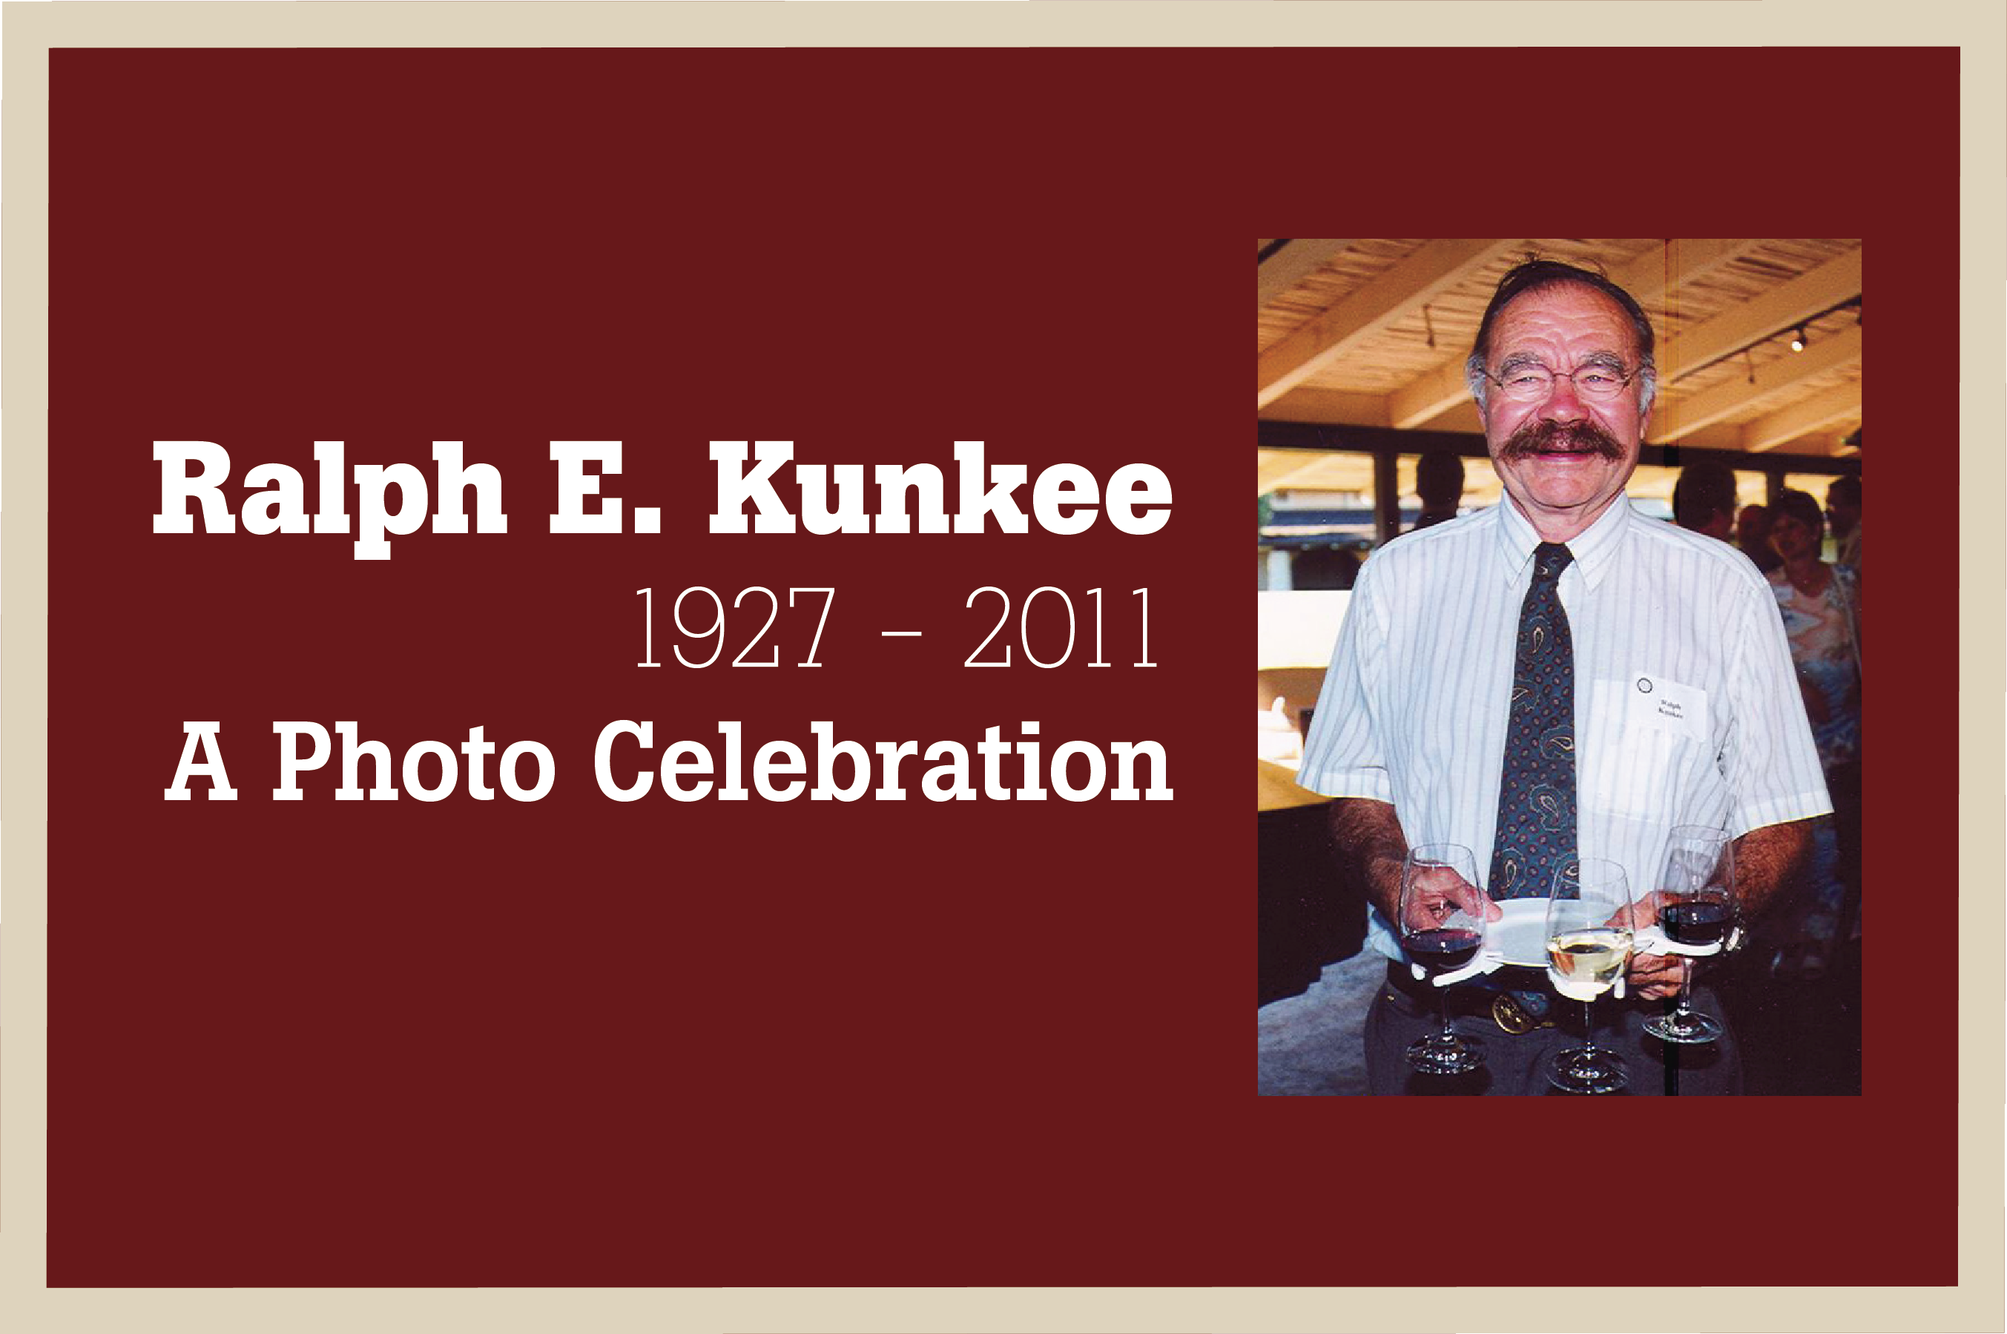

Slide 2
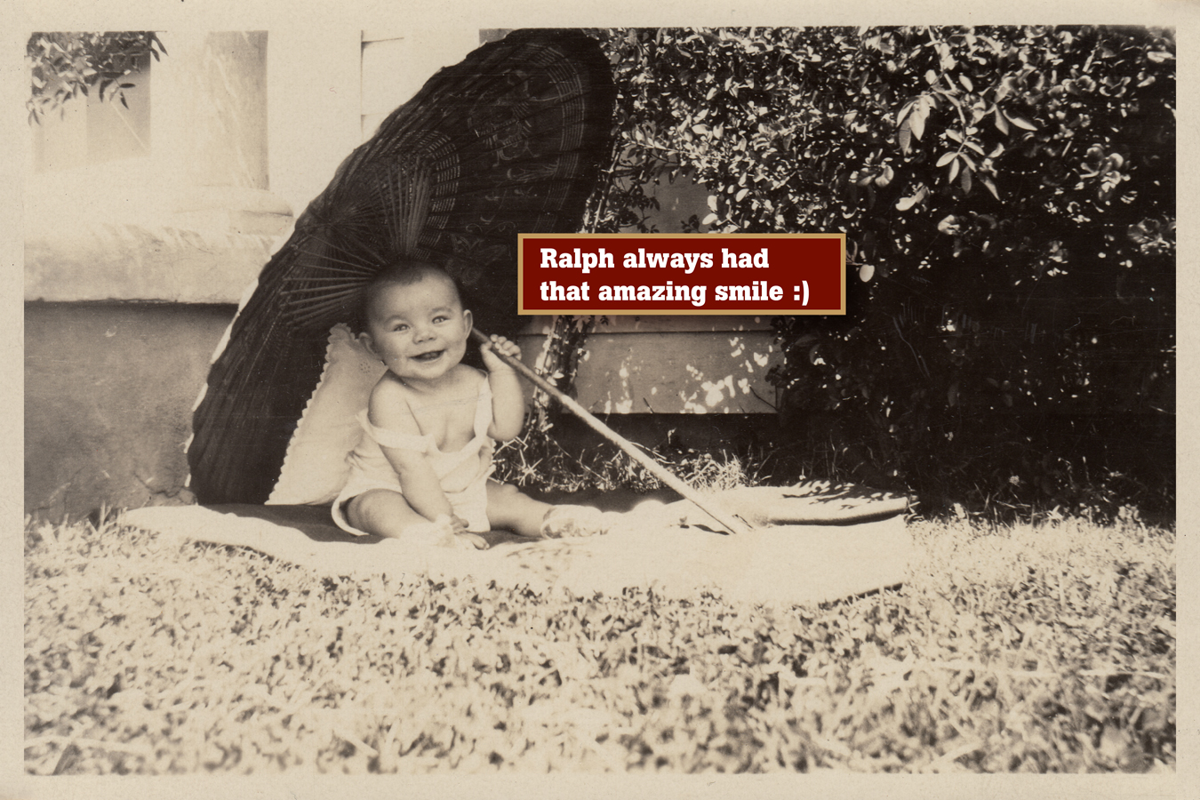

Slide 3
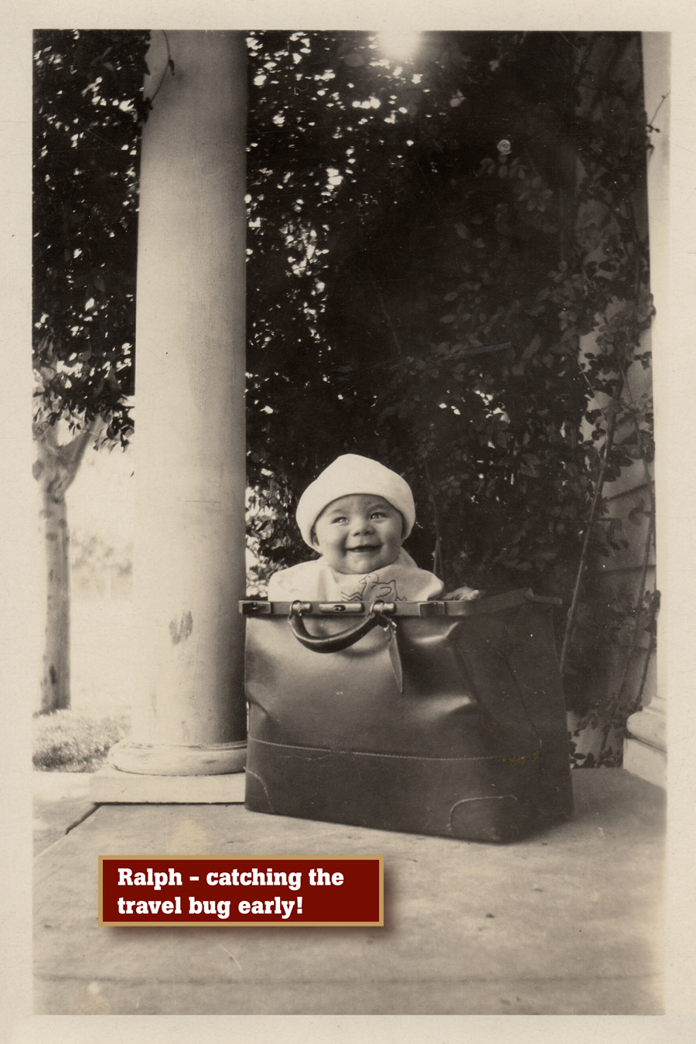

Slide 4
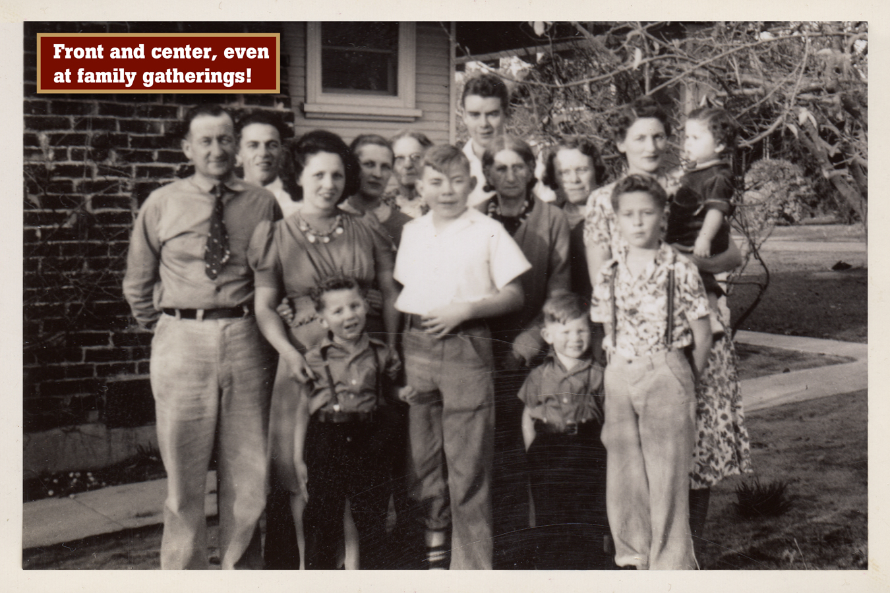

Slide 5
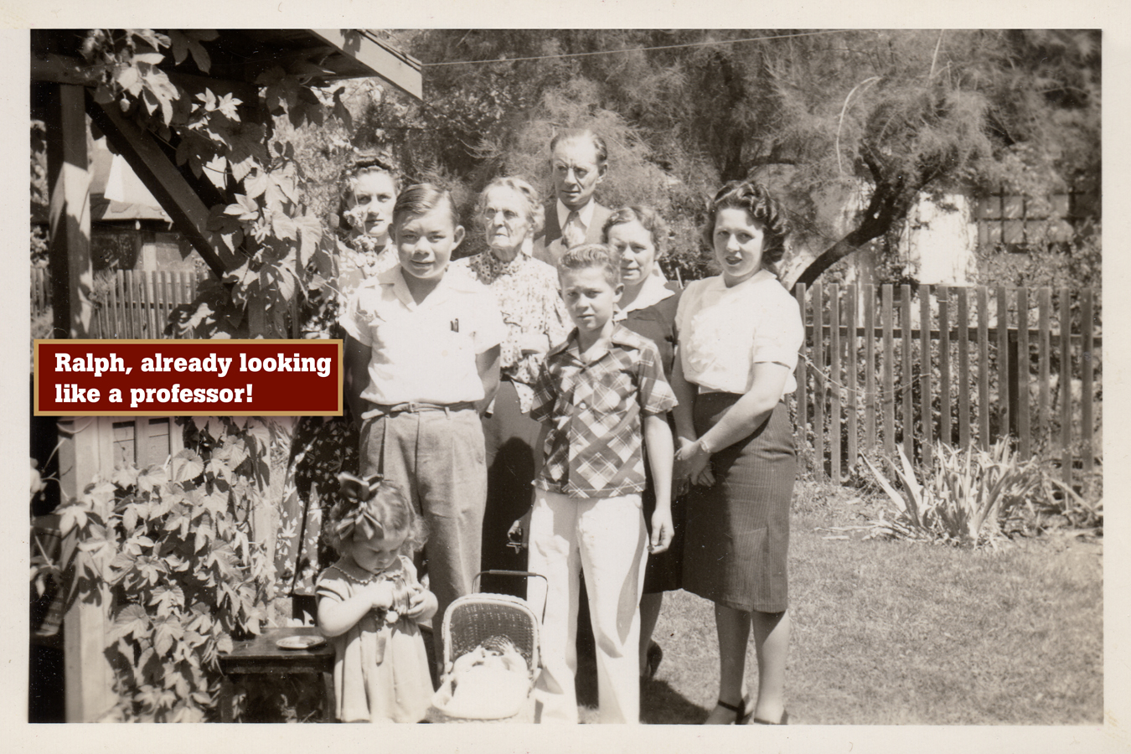

Slide 6
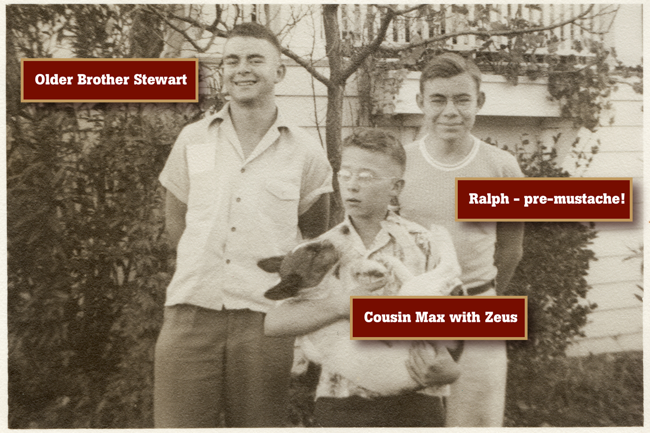

Slide 7
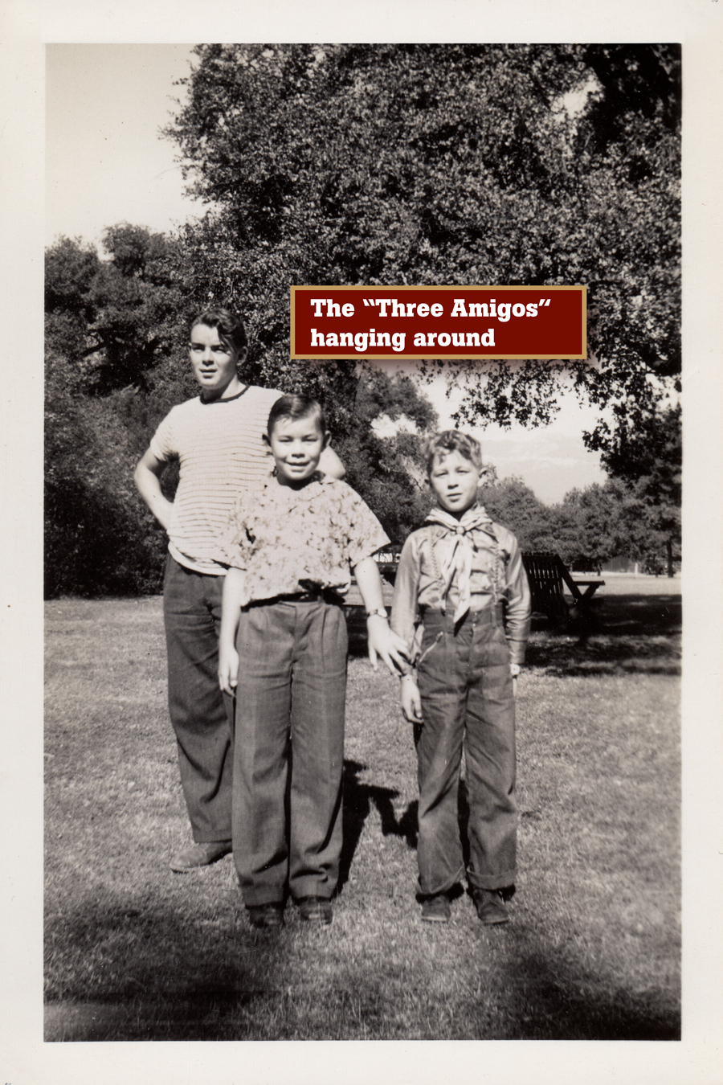

Slide 8
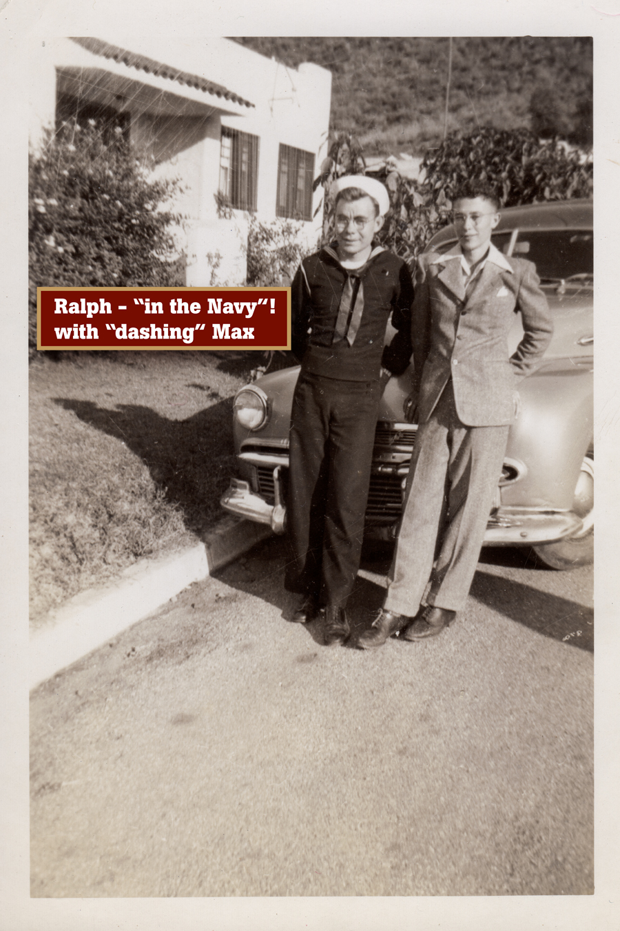

Slide 9
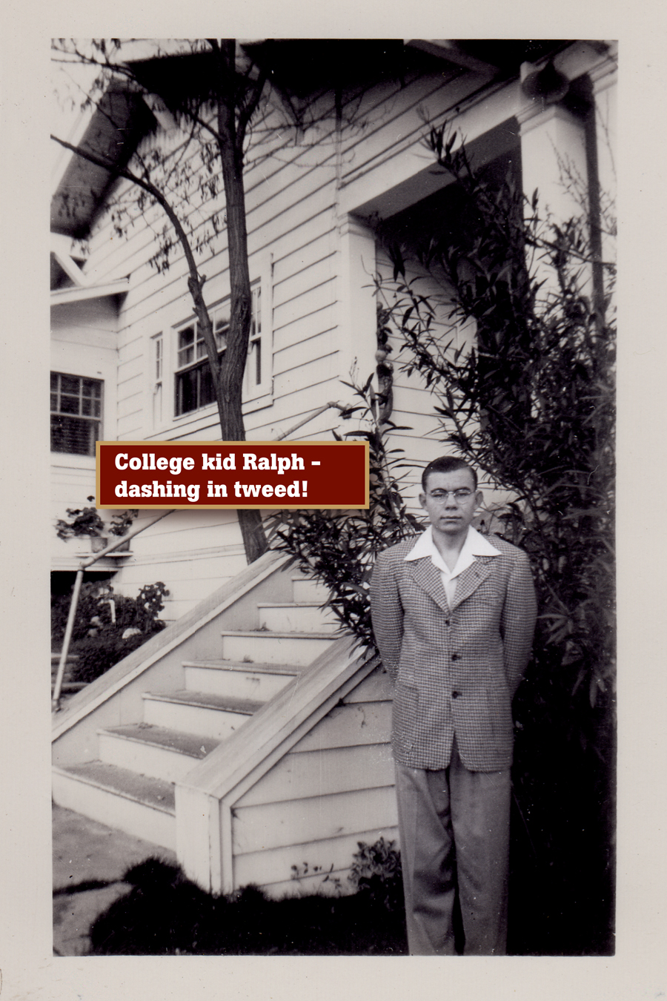

Slide 10
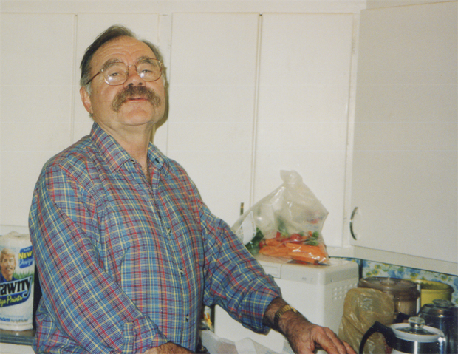
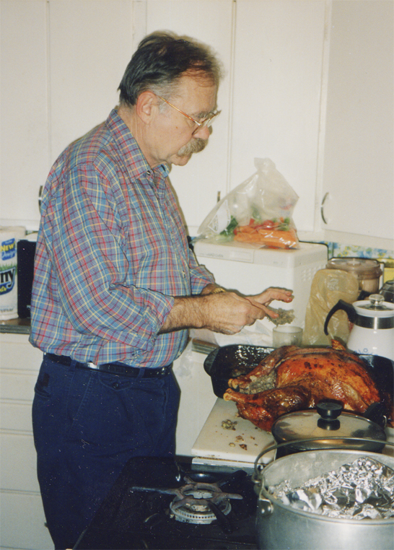
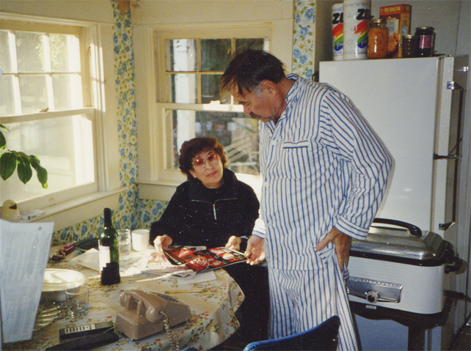
Holding “Thanksgiving court” in the Atascadero kitchen
With sister-in-law Ruby

Slide 11
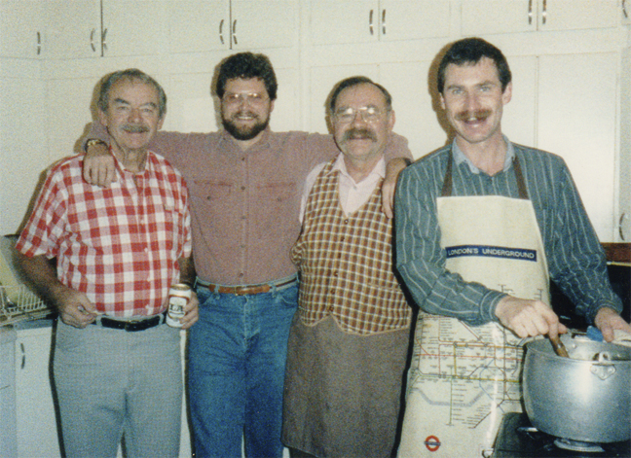
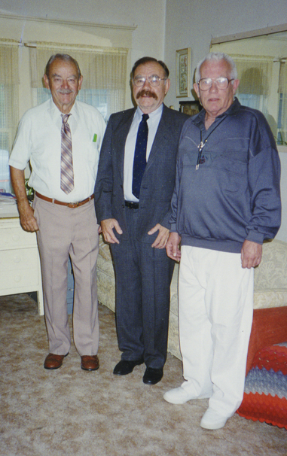
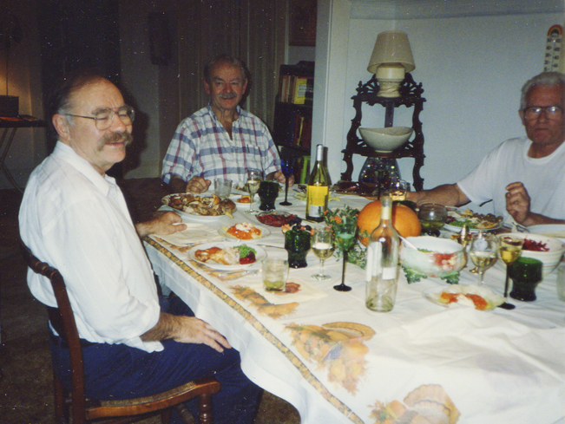
With brother Stewart, nephew-in-law Jon and partner Tommy
One of those awesome holiday dinners in Atascadero
Yup, the “Three Amigos”!

Slide 12
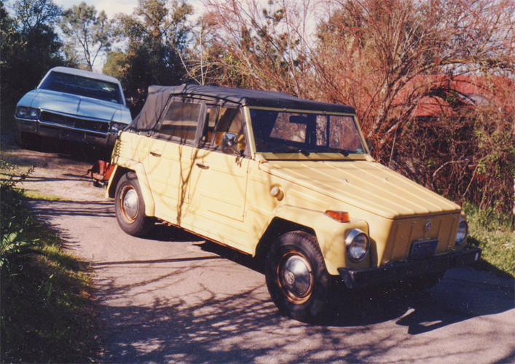
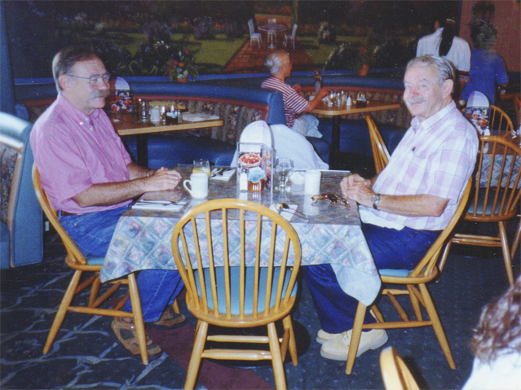
Ralph’s famous “Thing”
Breakfast at Carrow’s with brother Stewart

Slide 13
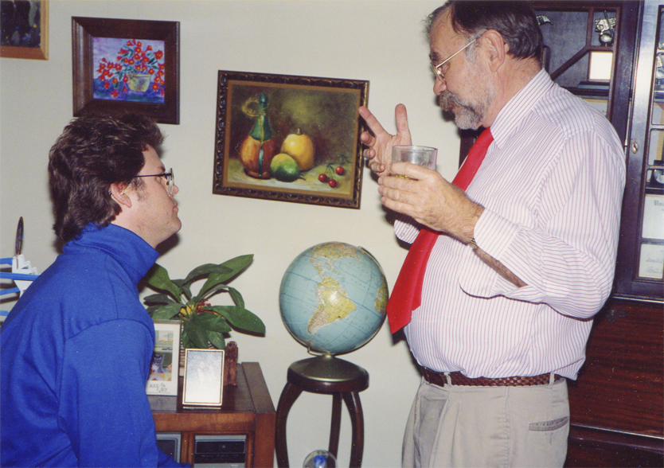
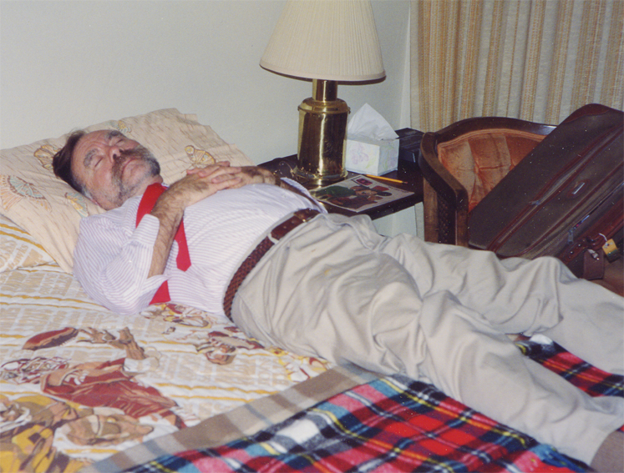
A little post-dinner advice
Finally, that elusive nap!

Slide 14
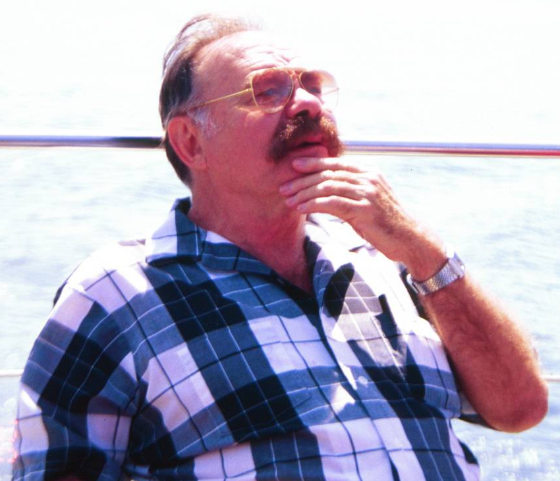
Seattle, 2000 (thanks to Lisa VdW)

Slide 15
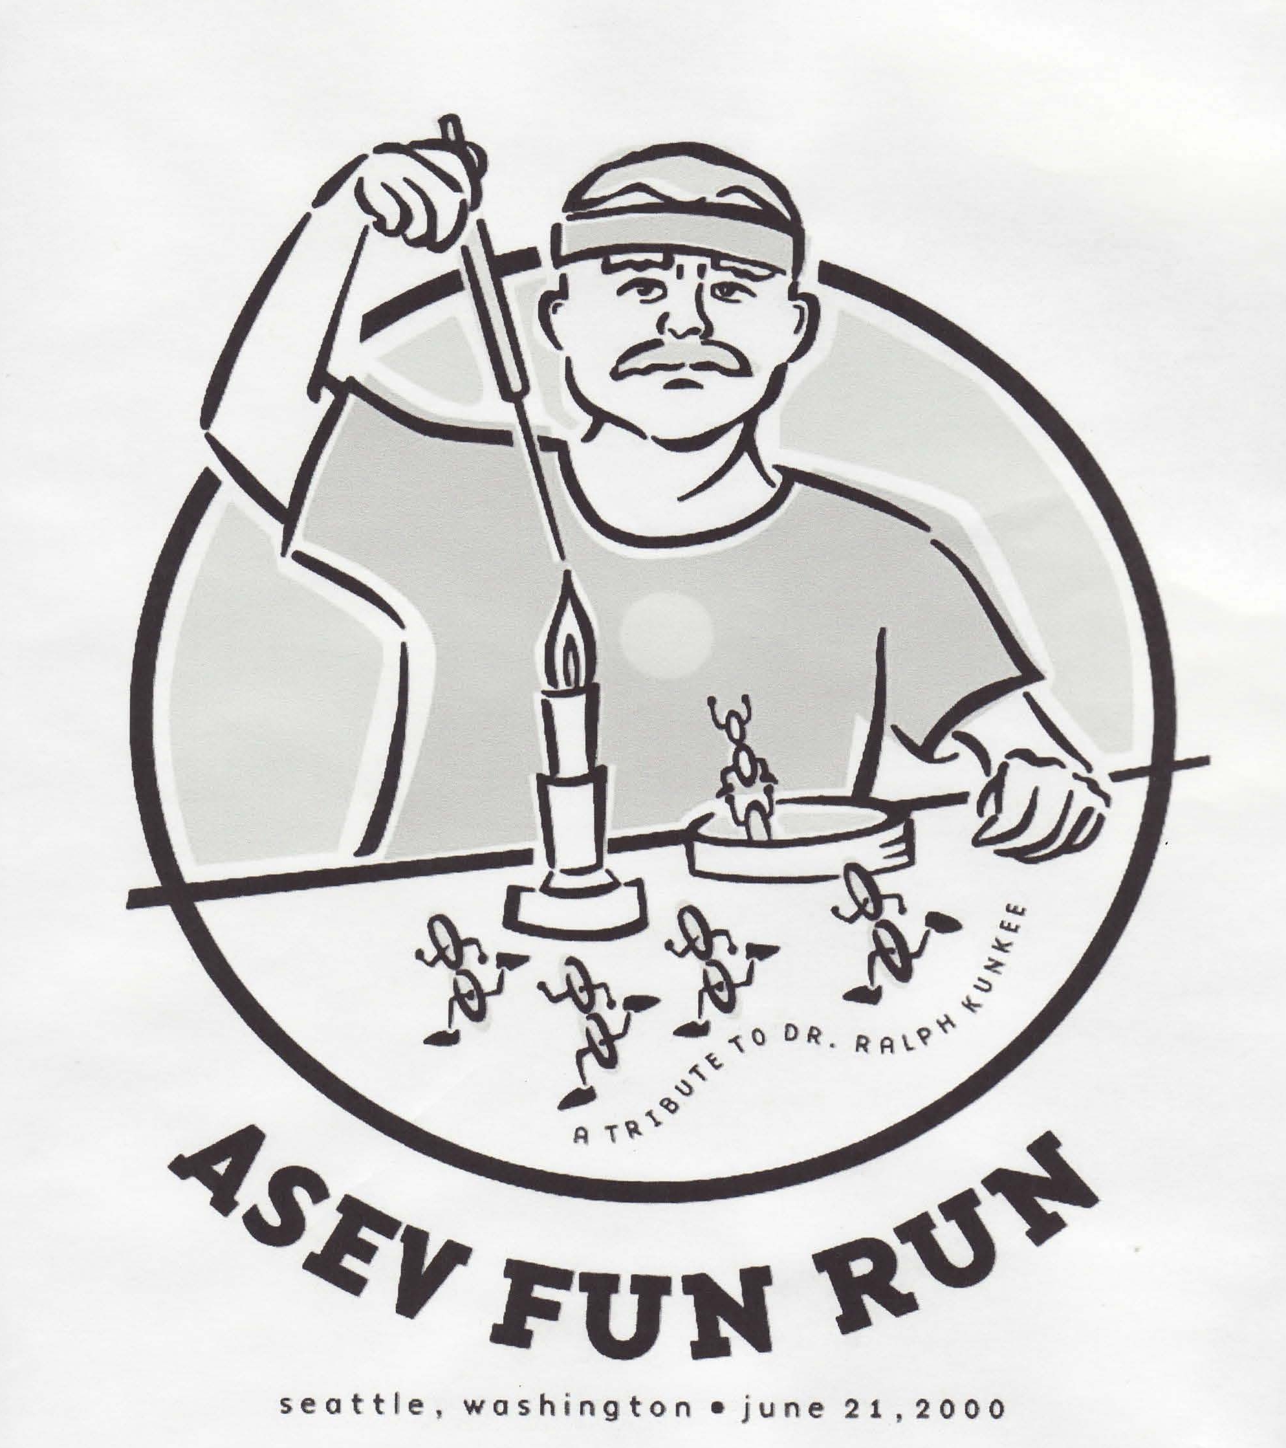
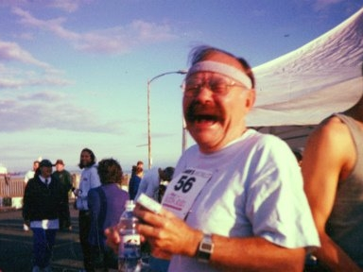
ASEV Fun Run, Seattle, 2000: A Tribute to Dr Ralph Kunkee

Slide 16
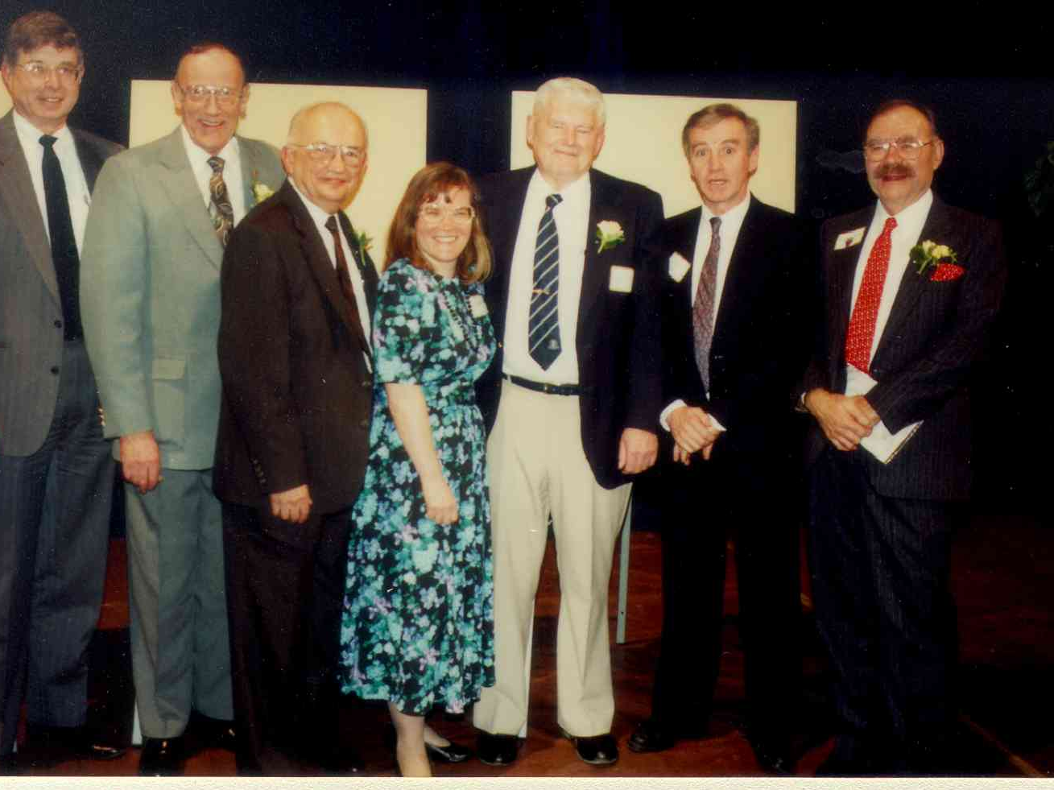
1992 Retirement

Slide 17
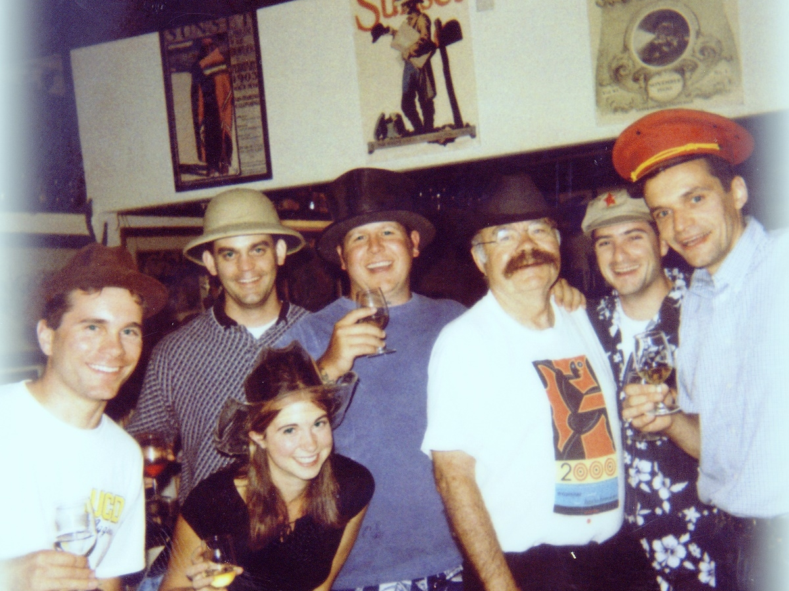
Famous hats!

Slide 18
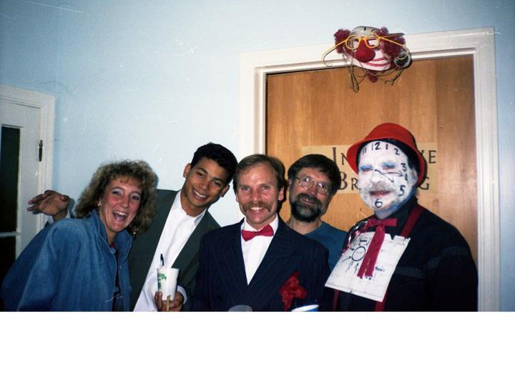
Repeal of Prohibition party, 1989

Slide 19
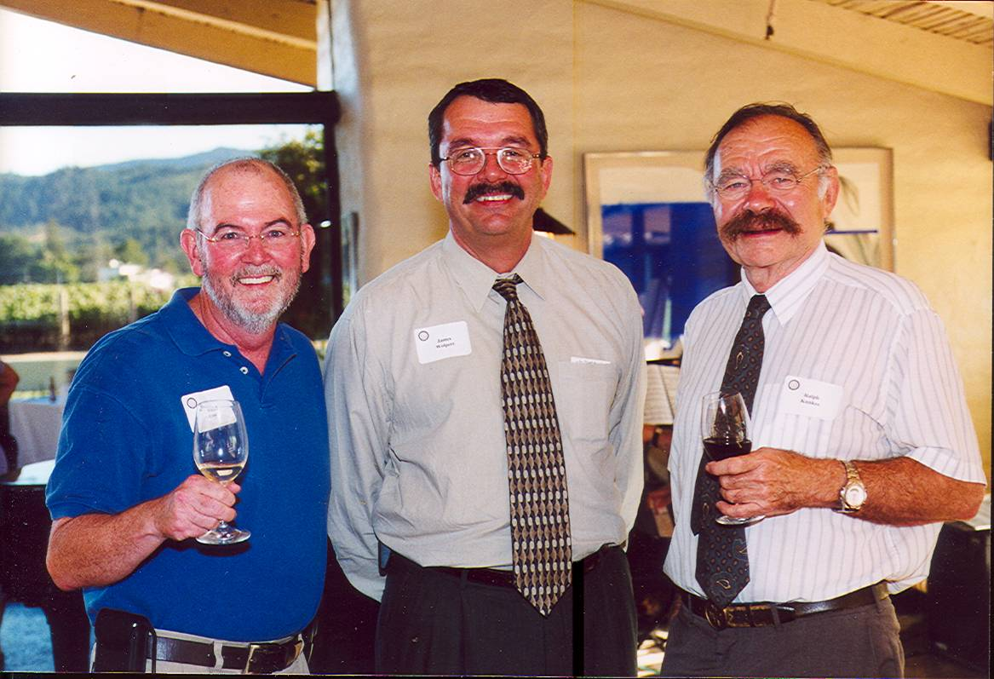
Chip Cassidy, Jim Wolpert and Ralph at Robert Mondavi Winery in Oakville, 2002

Slide 20
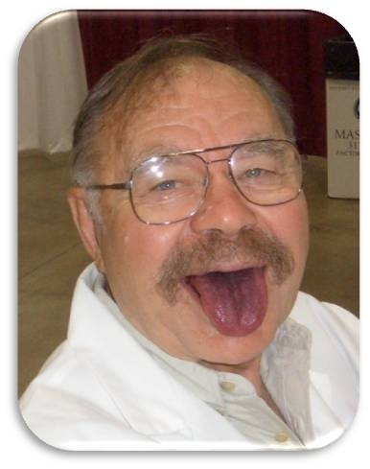
At Indy Wine Competition

Slide 21
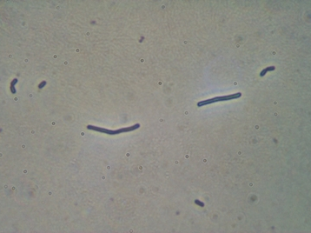
Ralph’s namesake: Lactobacillus kunkeei

Slide 22
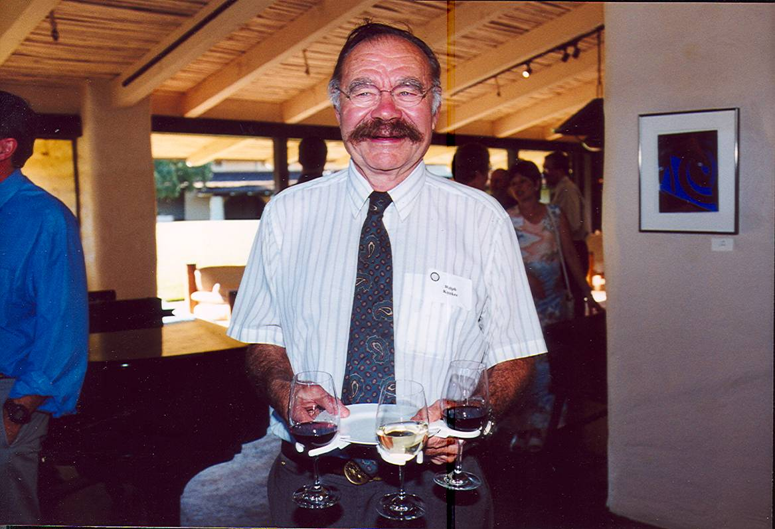
Quintessential Ralph: huge smile, laughing eyes and lots of wine!

Slide 23
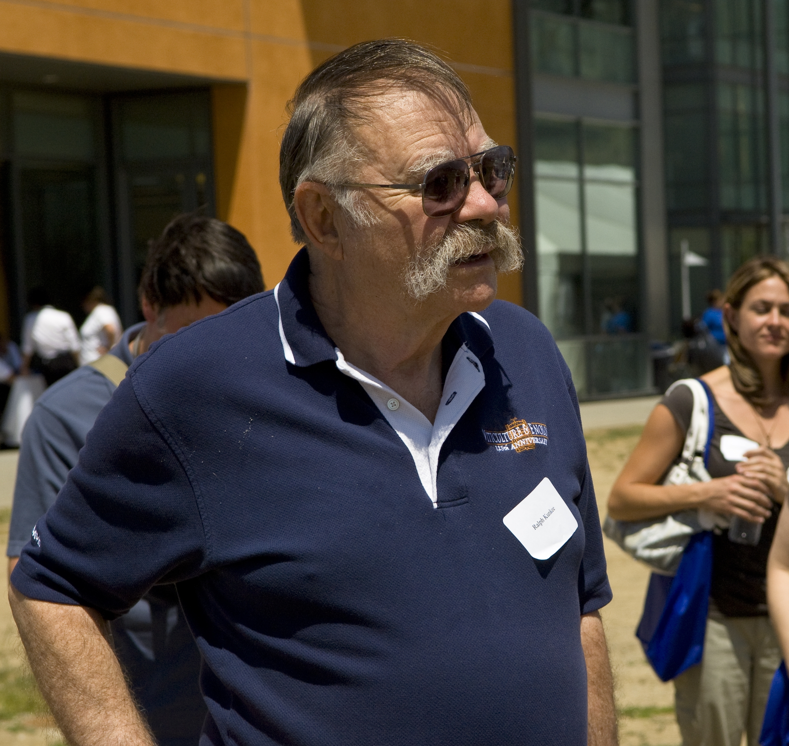
Alumni Celebration, May 2009

Slide 24
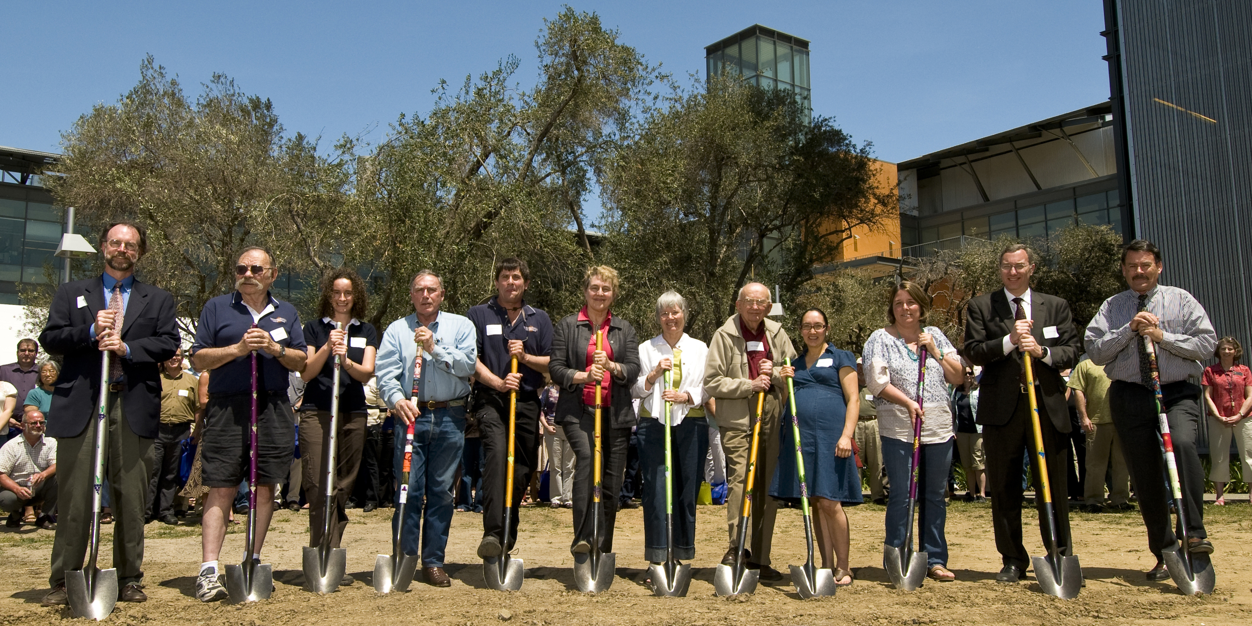
Alumni Reunion and Celebration, May 2009

