Slide 1
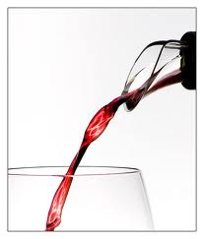
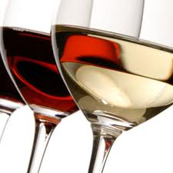
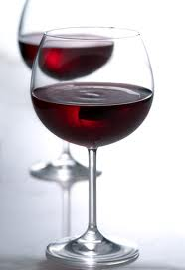
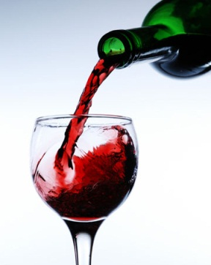
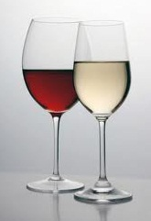
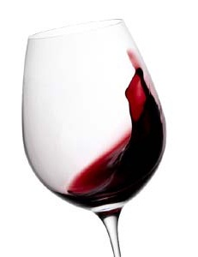
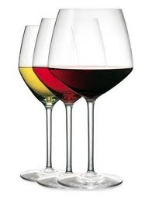
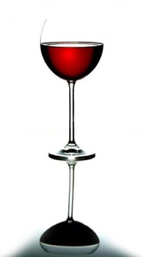

Impact of Oak on Wine Composition and Chemistry
Anita Oberholster

Slide 2
Introduction
Oak compounds extracted in to wine
  Volatile
  Non-volatile
Influence of oak and wine composition on extraction
Major wine compounds
Interaction of oak compounds with wine constituents
  Role of oxygen
  Sensory impact

Slide 3
Compounds Extracted from Oak: Non-volatile
Hydrolyzable tannins
  Ellagitannins (up to 100 mg/L)
  Most important monomers are vescalagin, castalagin, less important are grandinin, roburin (Fig)
  More bitter then astringent, present in wine below detection limit, perhaps synergistic effect (Puech et al., 1999)

Slide 4
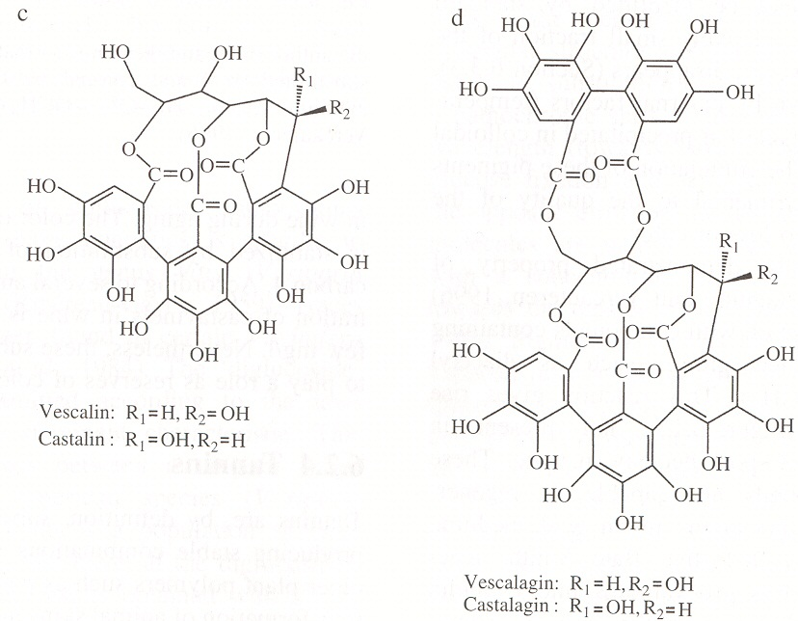
Figure: Ellagitannins

Slide 5
Non-volatile Extracts from Oak
Lignins
Triterpenes
  Identified as the compounds contributing sweetness to barrel-aged wines
Coumarins
  Bitter glycosides → aglycones – slightly acidic with seasoning
Phenolic acid – gallic acid (50 mg/L)
  Produced from ellagitannins and possibly lignin
Polysaccharides – hemicellulose

Slide 6
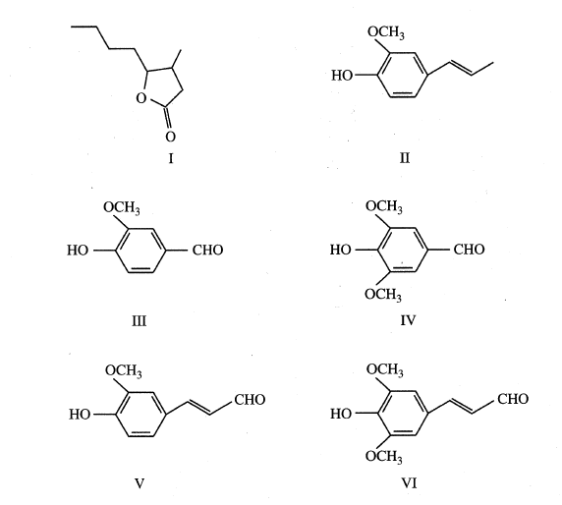
Compounds Extracted from Oak: Volatile
Methyloctalactone
Eugenol
Vanillin
Syringaldehyde
Coniferaldehyde
Sinapaldehyde

Slide 7
Compounds Extracted from Oak: Volatile
  Furanic aldehydes
  Thermal degradation of polysaccharides (hemicellulose)
  Toasted almond aromas – below threshold
Enolic compounds
  Cyclotene, maltol, isomaltol
  With heating, derived from hexoses
  Caramel-toasty character
  Contributions likely small due to high aroma thresholds

Slide 8
Compounds Extracted from Oak: Volatile
Furfural
Methyl-5-furfural
Hydroxymethyl-5-furfural
Cyclotene
Maltol
Isomaltol

Slide 9
Compounds Extracted from Oak: Volatile
Volatile phenols
  Degradation of lignan and polyols
  Eugenol
    Main volatile phenol
    Smoky and spicy, reminiscent of cloves
Phenol aldehydes
  Relatively low amounts
  Vanillin (vanilla and oaky notes)
  Syringaldehyde, coniferaldehyde and sinapaldehyde (small amounts)

Slide 10
Compounds Extracted from Oak: Volatile
β-methyl-γ-octalactones
  (cis and trans – coconut)
Trans-2-nonenal, with trans-2-octanal and 1-decanal = “plank smell”
  Attributed to unseasoned wood

Slide 11
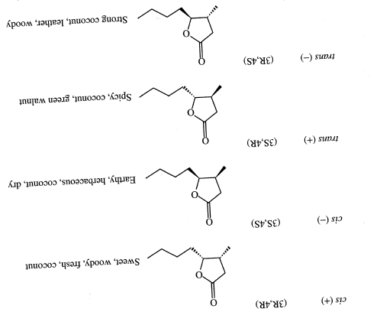
Compounds Extracted from Oak: Volatile

Slide 12
Influence of Wine and Oak Composition
Wine composition
  Alcohol content
    Higher alcohol ↑ extraction of volatile compounds
Oak composition
  Depends mostly on geographical origin, then specie and the tree itself
    Only generalization is that American oak extract higher cis/trans-oak lactone ratio compared to European species
  Seasoning, toasting and amount of times use
    Much larger effect on oak composition

Slide 13
Influence of Oak Composition
Allier vs Limousin (Ribéreau-Gayon et al., 2006)
  Ellagitannin Allier < Limousin
  Volatiles Allier > Limousin
  Limousin vs Vosges vs Tronςais vs Ohio (Spillman et al., 2004)
  Oak lactones + Eugenol Vosges > Tronςais > Limousin
  Little diffr between Allier vs American (Pérez-Prieto et al., 2002)
  Except American ↑ oak-lactones

Slide 14
Influence of Oak Composition
Generally with toasting
  Furans ↑ with toasting level
    Still mostly below aroma threshold
  Phenol aldehydes ↑ with toasting level
  Oak lactones ↓ with toasting

Slide 15
Influence of Winemaking on Oak Extracts
Red wine – barrel aged
White wine – barrel fermented, aged on lees
  Lees limit ellagic tannin conc in wine
    Tannins fixed on yeast cell walls and mannoproteins released from lees
Barrel fermented wines – less wood aroma than barrel aged wines
  Reduction of vanillin to vanillic alcohol

Slide 16
Influence of Barrel Size and Storage Time
Different barrel sizes (225, 300, 500, 1000 L)
  Smaller barrels > oak-related aroma compounds, higher sensory scores
Rate of extraction depends on wine composition and oak wood composition
  Vanillin max 10-12 months
    Transformed into vanillyl alcohol – less odoriferous
  Other volatile phenols max 10-12 months although mostly below aroma threshold

Slide 17
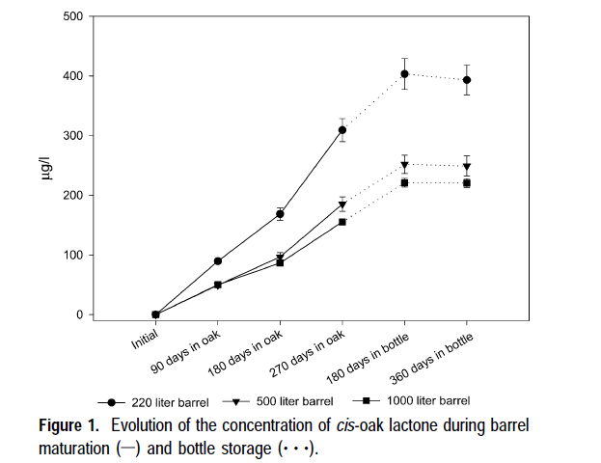
Influence of Barrel Storage Time

Slide 18
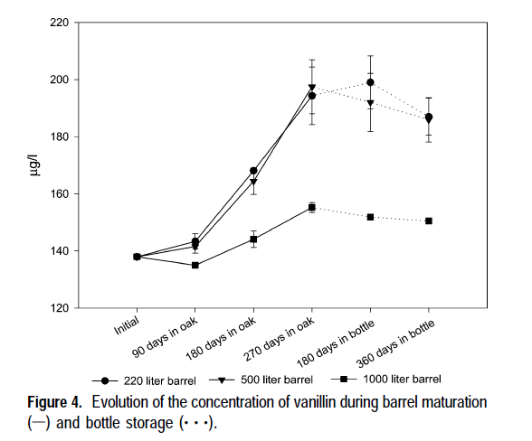
Influence of Barrel Storage Time

Slide 19
Influence of Barrel Storage Time
Formation of ethylphenols
  Ethylphenols, 4-ethyl phenol and 4-ethylguaiacol
    Produced by Brettanomyces/Dekkera contaminant yeast
    Decarboxylation of ferulic and coumaric acids
    Higher conc in used barrels, increase with aging
    4-ethylphenol (horse, Band-aids)
    4-ethylguaiacol (smoky, spicy, cured bacon-like)

Slide 20
Influence of New vs Used Barrels
Greatest sensory diffr between used vs new barrels
  ↓ lactones and vanillin conc
  In used barrels – diffr size barrels less important

Slide 21
Oak: New Technologies
  Entire surface area usable, not just 40% as in the case with barrels
Comparing barrels, staves and oak chips
  Additions according to similar surface area
  Vanillin chips>staves∼barrel
Oak chips vs barrel aged
  Chips > coconut and vanilla character
  Chips > bitterness and astringency
  Oak chips wines > grassy and vegetal notes compared to same wine barrel aged

Slide 22
The Use of Oak Chips
Alternative to give young wines woody tones – similar to wine aged in barrels for ∼ 3 months
  Similar phenol and color composition
MOX + oak chips – similar color advantages to barrel
  Lasting effect?
Recommended for short aged red wine

Slide 23
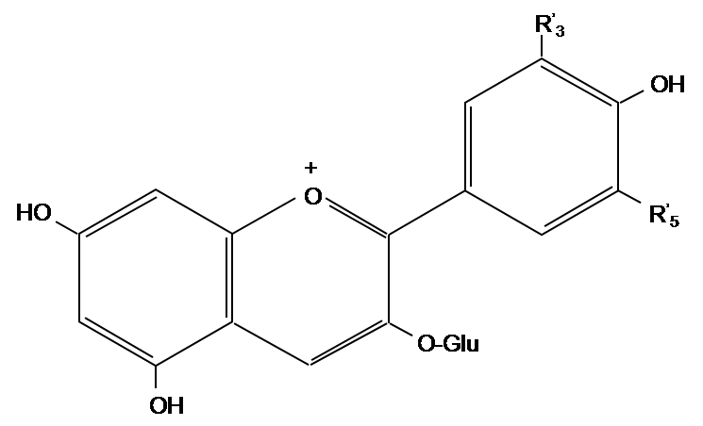
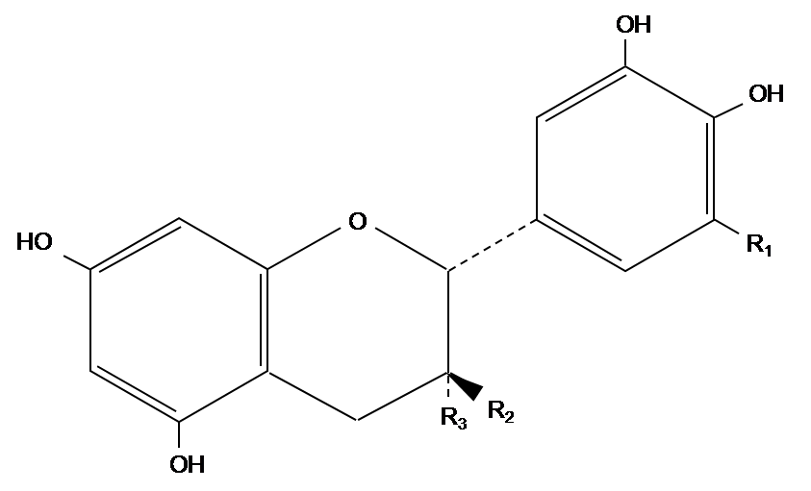
Most Important Grape Phenols
Flavonoids
  Anthocyanins in skins
    Red color, no taste
  Flavan-3-ols in skins and seeds
    Oligomers and polymers of flavan-3-ols; proantho-cyanidins (PA) or condensed tannins
    Main contributors to bitterness
    and astringency

Slide 24
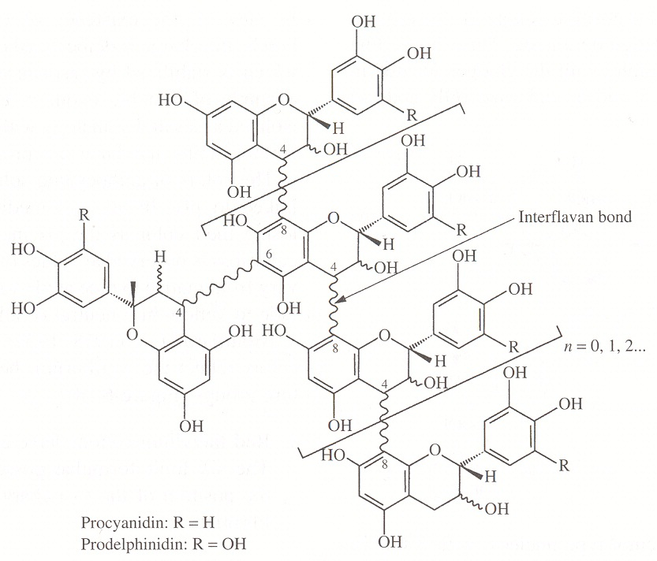
Figure: Proanthocyanidins

Slide 25
Wine tannin
Depends on grape composition
Extraction
Presence of wood or oenological (commercial/exogenous) tannin addition – ellagitannin and/or gallotannin
Main polymerization reactions
  Oxidation reactions
  Condensation with aldehydes (Fig. 4)
  Direct reactions

Slide 26
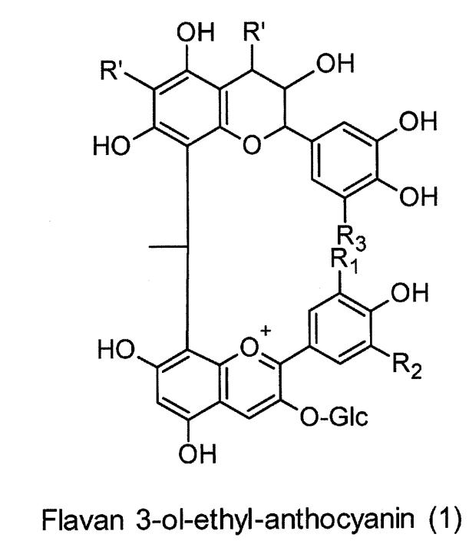
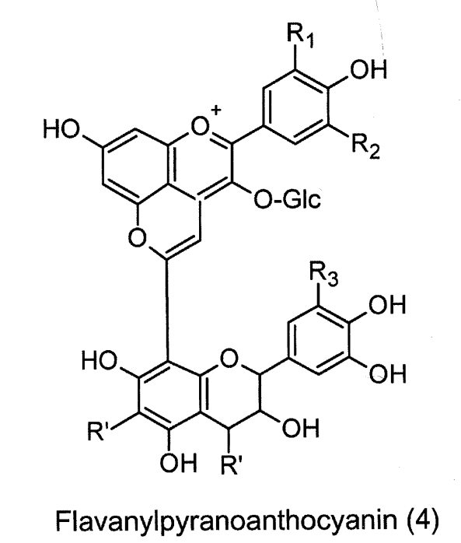
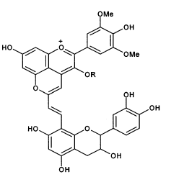
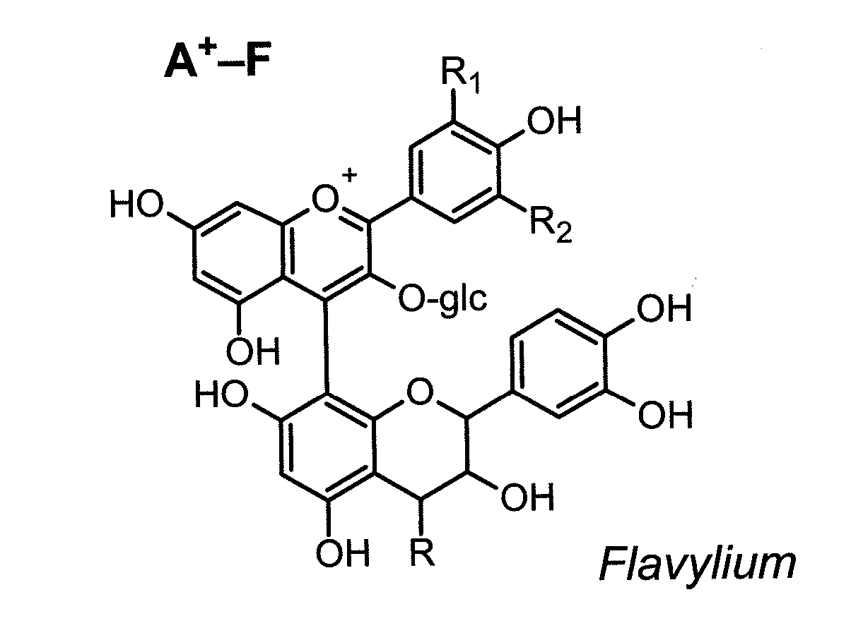
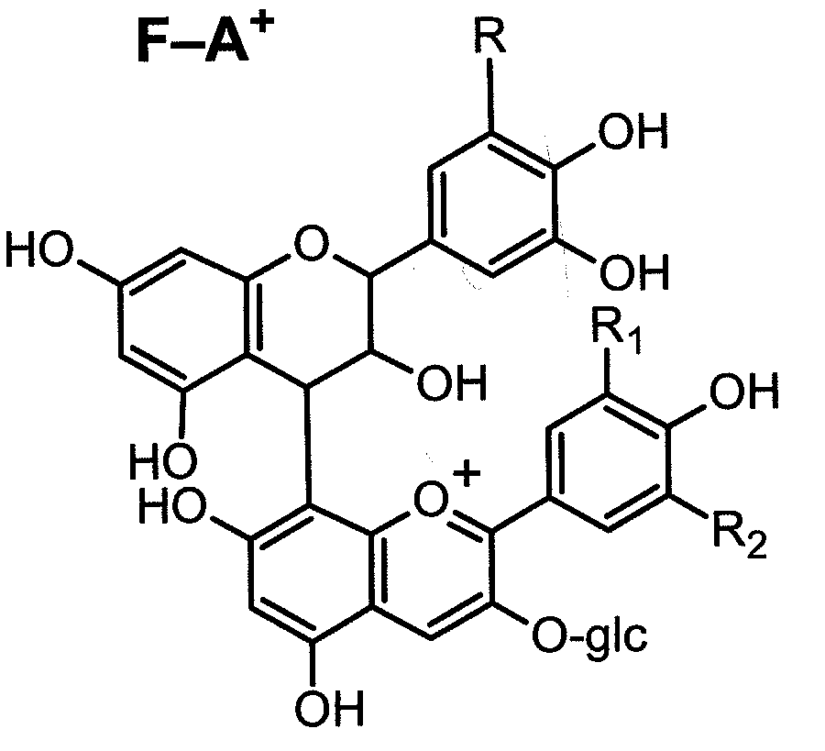
Figure: Wine pigments
Flavanyl-vinyl-pyranoanthocyanin
Direct condensation

Slide 27
Role of Oxygen during Barrel Aging
O₂ initial filling of barrel up to 6 mg/L (0.5 mg/L)
O₂ penetration through the barrel estimated at 1.66 and 2.5 ml.L⁻¹.month⁻¹ (1st month 1-5 mgL⁻¹.month⁻¹, < 1 ml.L⁻¹.month⁻¹ )
  Difficult to determine – used by phenols in wine + ellagitannins
  Age of barrel will effect O₂ diffusion rate
    Slow down due to plugging of wood pores with wine deposits
  Topping up barrels – 0.25 mg/L (very little)
  * Values in italics – my own measurments

Slide 28
Influence of Ellagitannnin on Wine Tannin
[Ellagitannins] low in wine due to
  Wood seasoning and toasting ↓ ellagitannins
  Chemical transformation in wine due to oxidation, polymerization and hydrolysis (8 - 21 mg/L castalagin and 2 - 7 mg/L vescalagin )
↑Pyranoanthocyanins and other polymeric pigments with barrel maturation (Cano-López et al., 2010; Del Ãlamo et al., 2010)
  Malv-3-gluc and cat mediated reactions by oak-derived furfural, methyl-furfural and vanillin – model solutions (Sousa et al., 2010 and Pissarra et al., 2004)

Slide 29
Influence of Ellagitannnin on Wine Tannin
Saucier et al. (2006) also identified 5 ellagitannin derivatives in oak aged Bordeaux wine
  Total 2 mg/L, catechin- and epicatechin-ellagitannin derivatives

Slide 30
Influence of Ellagitannnin on Wine Tannin
Barrel aging enhances color stability and decrease astringency
  Protecting grape phenols against oxidation
  Slow O₂ exposure, ↑ formation of acetaldehyde
  ↑ anthocyanin-tannin interaction by ↑ CH₃CHO, furfural and other compounds that mediate polymerization reactions

Slide 31
Influence of Ellagitannnin on Wine Tannin
Micro-oxygenation (MOX)
  ↑ Color density, similar to barrel aging (Gómez-Plaza and Cano-López, 2011)
  No wood aromas
Comparison between MOX and barrel aging (Cano-López et al., 2010)
  Similar color density (CD) after 3 months
  After 6 months bottle aging: barrel> MOX
  MOX > hue or tint

Slide 32
Concluding remarks
No easy answers on best choice of barrel for specific wine
Personal experience and some rough guides
  Light toasting – more coconut, oaky aromas
  Medium toasting best for most well-balanced wines
  Heavy toasting cover herbaceous notes best

Slide 33
Concluding remarks
Chips alternative for short aged red wines in lower price range
  No data available on comparison between MOX + chips/stave and barrel aging
  MOX alone give similar color advantages, but not long term

