Slide 1
Nitrogen Trials and Aroma Production
Linda F. Bisson
Department of Viticulture and Enology
UC Davis
April 18, 2014

Slide 2
Nitrogen Composition of Grapes
Variety of nitrogenous compounds in grape juice
Nitrogen compounds vary by variety and with environmental conditions
Young fruit – higher % of Nitrogen is present as ammonium ion; active biosynthesis of amino acids
Ripened fruit- higher % total nitrogen free amino acids, arginine and proline present in highest concentration; amino acids in steady-state
Over-ripe fruit- lower % nitrogen, lose amino acid content (arginine); degradation of amino acids

Slide 3
Nitrogen Assessment
Yeast use free alpha amino acids and ammonium as nutrients to conduct alcoholic fermentations
Free Alpha Amino Acids = FAN
Ammonium
FAN + Ammonium = YAN
Measured using NOPA method or formol titration

Slide 4
Typical YAN Levels
120 mg N/L: minimum for complete fermentation depending on yeast strain
200-500 mg N/L: optimal YAN levels depending upon initial sugar content of juice
600 mg N/L: upper range, can result in microbiological spoilage of wine, strong yeast signature

Slide 5
DAP Additions
Diammonium phosphate
Used to increase YAN levels when needed
21% Ammonium
Disadvantages
  Simple nitrogen source requires cells retain ability to synthesize all amino acids
  Also increasing phosphate
  Not as effective as amino acid addition if there is an underlying secondary nutrient limitation or stress

Slide 6
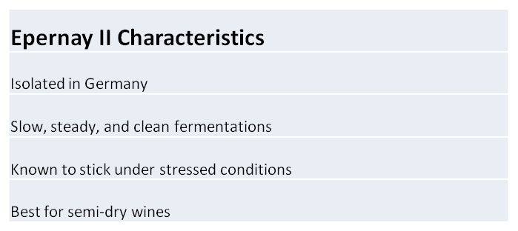
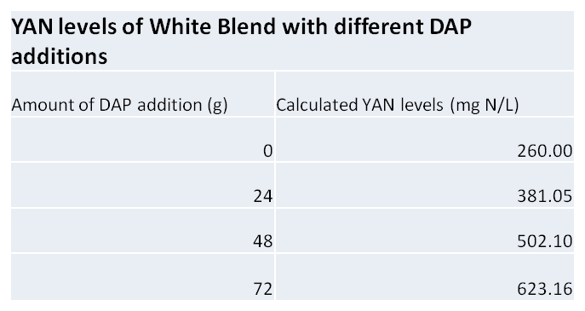
Materials and Methods
Chardonnay-Vermentino Blend (measured YAN of 200)
Starting Brix: 25.5
Yeast :CEG (EPERNAY II)
Nitrogen added simultaneously with yeast addition

Slide 7
Comparison of Changes of Brix with Differing Nitrogen Content
0 addition took ~ 6days longer to finish

Slide 8
Wine Analysis: Post Fermentation
RPM2 Wine Analysis
Treatment | Alchohol (% v/v) | pH (unit) | Residual Sugar (g/L) | Malic Acid (mg/L) | Acetic Acid (g/L)
Control (0 g DAP) | 15.5 | 3.62 | 0 | 84 | 0
Medium (24 g DAP) | 15.71 | 3.58 | 0 | 86 | 0
High (48 g DAP) | 15.9 | 3.68 | 0 | 87 | 0
Overshoot (72 g DAP) | 15.92 | 3.79 | 0 | 86 | 0

Slide 9
Acknowledgements
The Students who did the work: RPM2
  Nate Kane
  Jen Lincoln
  Sean Sweeny
Chik Brenneman for making a blend of the right starting nitrogen content and Brix!

Slide 10
DAP Addition Trial Tasting
Glass 1: control
Glass 2: 24 g/12 gallon DAP
Glass 3: 48 g/12 gallon DAP
Glass 4: 72 g/12 gallon DAP

