Slide 1

Why Nitrate Matters:
AGRICULTURE AND ITS NEXUS TO
NITRATE in CALIFORNIA DRINKING WATER
Thomas Harter & Jay Lund, Principal Investigators
Jeannie Darby, Graham Fogg, Richard Howitt, Katrina Jessoe, Jim Quinn, Stu Pettygrove, Joshua Viers,
Co-Investigators
http://groundwaternitrate.ucdavis.edu
Aaron King, Allan Hollander, Alison McNally, Anna Fryjoff-Hung, Cathryn Lawrence, Daniel Liptzin, Danielle Dolan, Dylan Boyle, Elena Lopez, Giorgos Kourakos, Holly Canada, Josue Medellin-Azuara, Kristin Dzurella, Kristin Honeycutt, Megan Mayzelle, Mimi Jenkins, Nicole de la Mora, Todd Rosenstock, Vivian Jensen, Researchers
Watershed Science Center
University of California, Davis
Contact: ThHarter@ucdavis.edu
Notes:
In March 2012, a team of UC Davis scientists – hydrologists, engineers, soil scientists, economists, water policy experts and GIS technicians -- submitted this report to the State Water Resources Control Board. I was a member of the team. This was widely covered in by the media. I will summarize the highlights. If you want to see this report, you can find it online at groundwaternitrate.ucdavis.edu. There is a 2-page brief, an 8 page executive summary, the 80-page main report, and 8 technical reports that provide documentation of the findings in the main report.

Slide 2
Nitrate Drinking Water Standard
Maximum contaminant level (MCL):
= 45 ppm NO₃
Notes:
I’ll start with two nitrate science lessons to bring everyone to same starting line. First is that number 45, which has for many years stood in the US as the nitrate drinking water standard – in parts per million, which is the same as milligrams per liter. This is also called the MCL or maximum contaminant level. And that is in units of nitrate, which are the units used by your city water supply department or agency, as well when discussing public health issues. But in discussing nitrogen in the environment or in an agricultural field where N cycles among different forms, it is more convenient to describe nitrate concentration on an elemental basis, in which case the drinking water standard for nitrate is 10 ppm, often stated as “nitrate-nitrogen”. The two numbers 45 and 10 are the same standard, expressed as a concentration, but on a different atomic basis.

Slide 3
Nitrate Drinking Water Standard
Maximum contaminant level (MCL):
= 45 ppm NO₃ = 45 mg/L NO₃
Notes:
I’ll start with two nitrate science lessons to bring everyone to same starting line. First is that number 45, which has for many years stood in the US as the nitrate drinking water standard – in parts per million, which is the same as milligrams per liter. This is also called the MCL or maximum contaminant level. And that is in units of nitrate, which are the units used by your city water supply department or agency, as well when discussing public health issues. But in discussing nitrogen in the environment or in an agricultural field where N cycles among different forms, it is more convenient to describe nitrate concentration on an elemental basis, in which case the drinking water standard for nitrate is 10 ppm, often stated as “nitrate-nitrogen”. The two numbers 45 and 10 are the same standard, expressed as a concentration, but on a different atomic basis.

Slide 4
Nitrate Drinking Water Standard
Maximum contaminant level (MCL):
= 45 ppm NO₃ = 45 mg/L NO₃
= 10 ppm NO₃-nitrogen*
*NO₃-nitrogen, or NO₃-N, is NO₃ expressed on elemental basis => the mass of “N” only in the “NO₃” molecule)
Notes:
I’ll start with two nitrate science lessons to bring everyone to same starting line. First is that number 45, which has for many years stood in the US as the nitrate drinking water standard – in parts per million, which is the same as milligrams per liter. This is also called the MCL or maximum contaminant level. And that is in units of nitrate, which are the units used by your city water supply department or agency, as well when discussing public health issues. But in discussing nitrogen in the environment or in an agricultural field where N cycles among different forms, it is more convenient to describe nitrate concentration on an elemental basis, in which case the drinking water standard for nitrate is 10 ppm, often stated as “nitrate-nitrogen”. The two numbers 45 and 10 are the same standard, expressed as a concentration, but on a different atomic basis.

Slide 5
Nitrate Drinking Water Standard
Maximum contaminant level (MCL):
= 45 ppm NO₃ = 45 mg/L NO₃
= 10 ppm NO₃-nitrogen*
= 10 mg/L NO₃-nitrogen*
*NO₃-nitrogen, or NO₃-N, is NO₃ expressed on elemental basis => the mass of “N” only in the “NO₃” molecule)
Notes:
I’ll start with two nitrate science lessons to bring everyone to same starting line. First is that number 45, which has for many years stood in the US as the nitrate drinking water standard – in parts per million, which is the same as milligrams per liter. This is also called the MCL or maximum contaminant level. And that is in units of nitrate, which are the units used by your city water supply department or agency, as well when discussing public health issues. But in discussing nitrogen in the environment or in an agricultural field where N cycles among different forms, it is more convenient to describe nitrate concentration on an elemental basis, in which case the drinking water standard for nitrate is 10 ppm, often stated as “nitrate-nitrogen”. The two numbers 45 and 10 are the same standard, expressed as a concentration, but on a different atomic basis.

Slide 6
The Challenge
Healthy People
Groundwater Quality
Healthy Economy
Healthy Environment
Adopted from: Marylou Shockley, CSU Monterey Bay
Notes:
…but it is not just SDWA/CDPH. For communities much more is at stake: While water supplies are NOT safe and reliable => more infrastructure needed => more institutional capacity needed => community power DACs and SDACs struggle with these

Slide 7
Understanding Challenges to
Addressing Nitrate Issue
Breaking down the issue:
Stakeholders
Science
Law
Environmental
Issue
Regulator
Legislature
Notes:
In understanding challenges around any env issue, we need to understand the science behind the issues, the law, the regulatory agencies, and the various stakeholders. Let me begin with the science (SBX2 1 study).

Slide 8
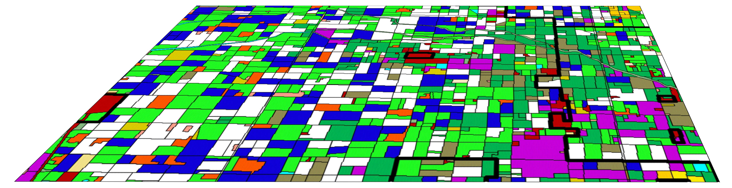
#1: Sources of Nitrate
N Loading / Sources
Notes:
EXPLAIN THIS SHOEBOX FIRST, then go for the SBX2 1 key tasks

Slide 9
#2: Nitrate Source Reduction
N Loading Reduction Options / Source Control

Slide 10
#3: Groundwater Nitrate
Nitrate distribution in groundwater / spatial and temporal trends

Slide 11
#4: Groundwater Remediation
Remediation of groundwater

Slide 12
#5: Drinking Water Treatment
N treatment options

Slide 13
#6: Alternative Supplies
Alternative supplies
X
X
X
X
X

Slide 14

#7: Costs of Actions
Economic Cost
Notes:
Critical for all these outcomes: METHODS development! => apply to improved data on sources and gw nitrate distribution; => apply to other regions

Slide 15


#8: Funding and Policy

Slide 16
Understanding Challenges to
Addressing Nitrate Issue
Breaking down the issue:
Stakeholders
Science
Law
Environmental
Issue
Regulator
Legislature
Notes:
In understanding challenges around any env issue, we need to understand the science behind the issues, the law, the regulatory agencies, and the various stakeholders. Let me begin with the science (SBX2 1 study).

Slide 17
#1: Sources of Nitrate
N Loading / Sources
Notes:
The board is using this report to advise the state legislature on what to do about excess levels of drinking water nitrate. The board asked UC Davis to address several questions. The first is what are the sources of nitrate found in GW?

Slide 18
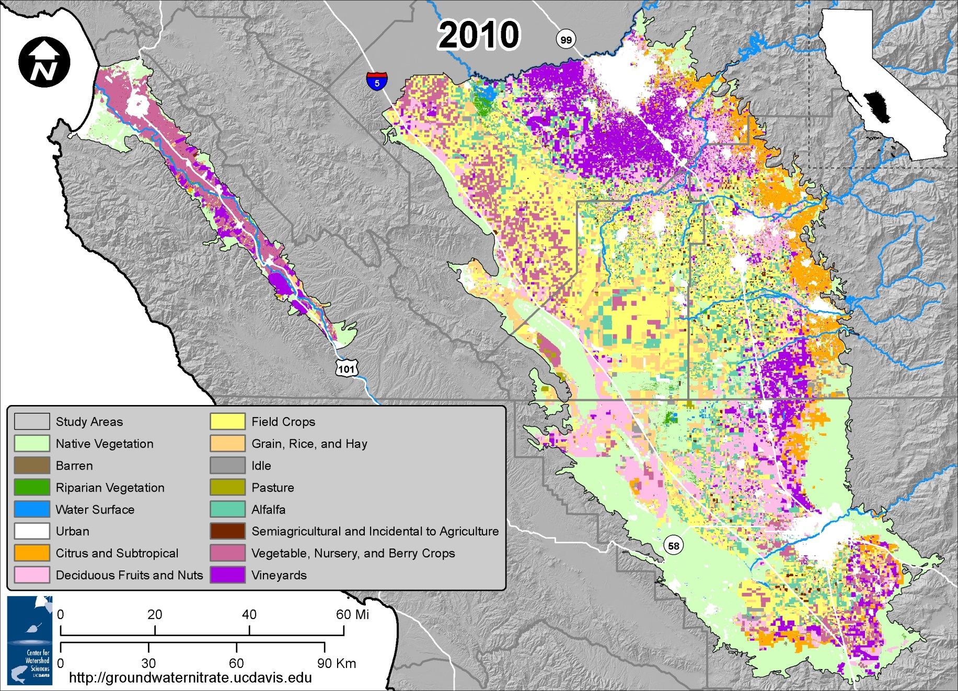
Nitrate Contamination Study Area
Notes:
SBX2 1 study focused on TLB and SV => representative for many ag-rural areas in CA
4 million acres of irrigated agriculture, 2.6 million people, 58 different crop groups

Slide 19
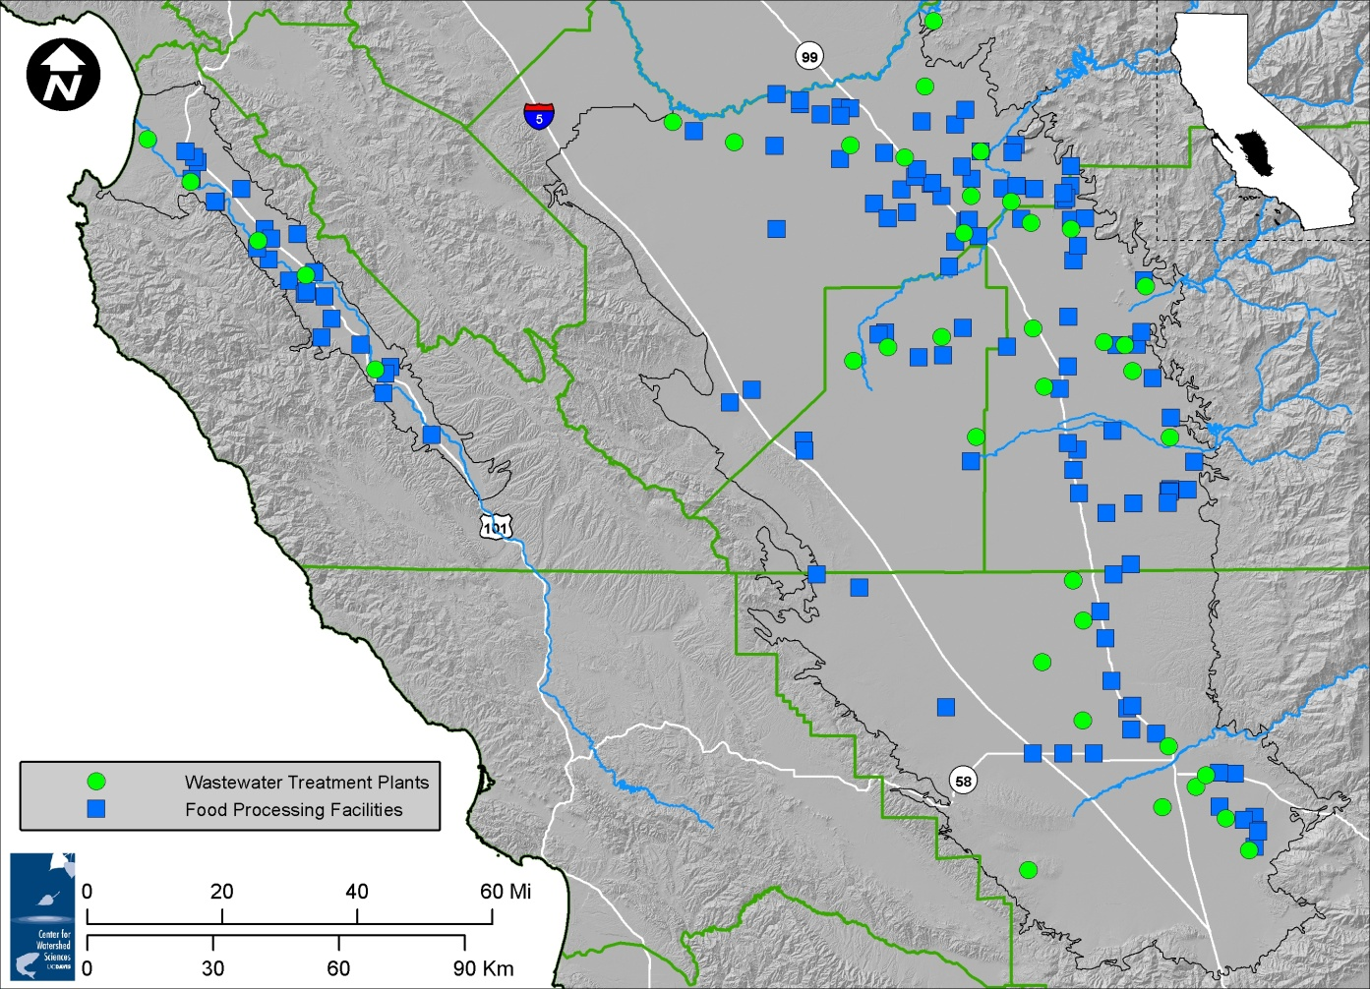
Wastewater Treatment Plants and Food Processors

Slide 20
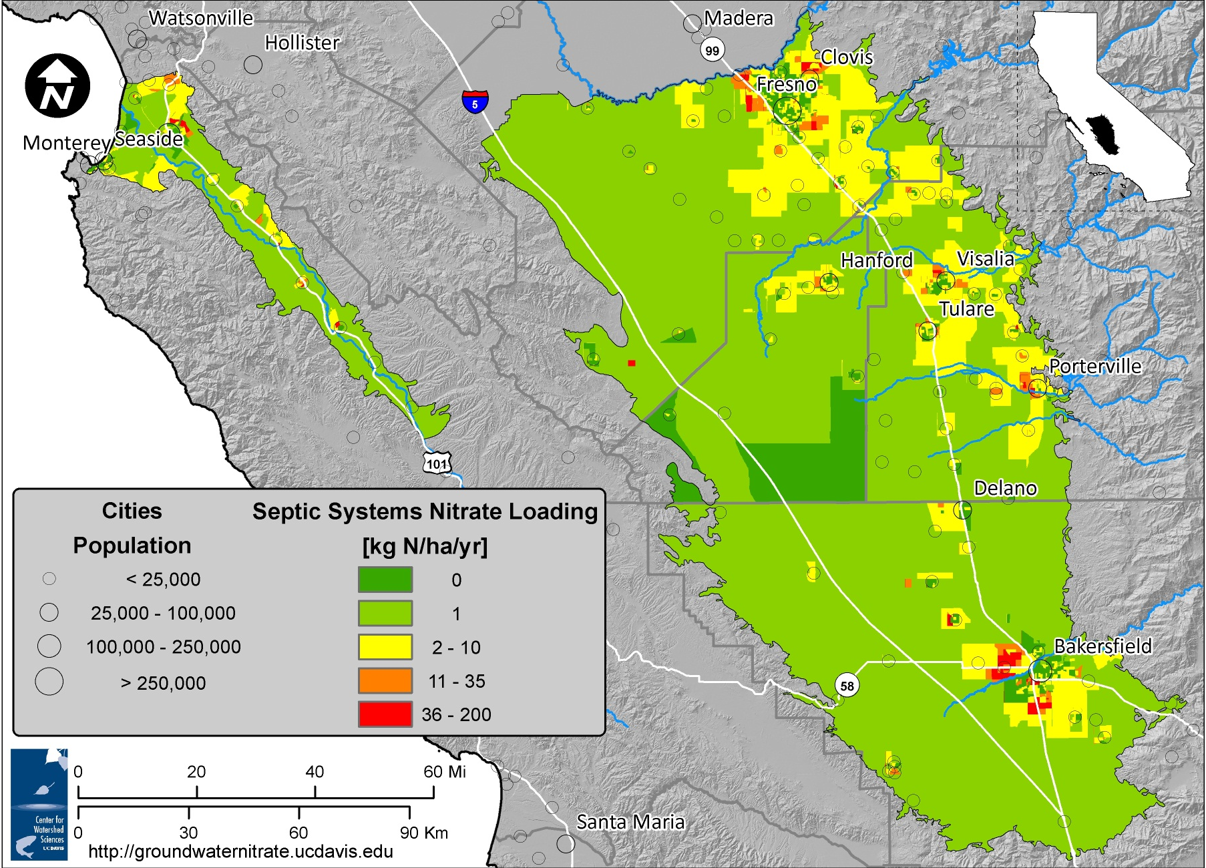
Septic Systems

Slide 21
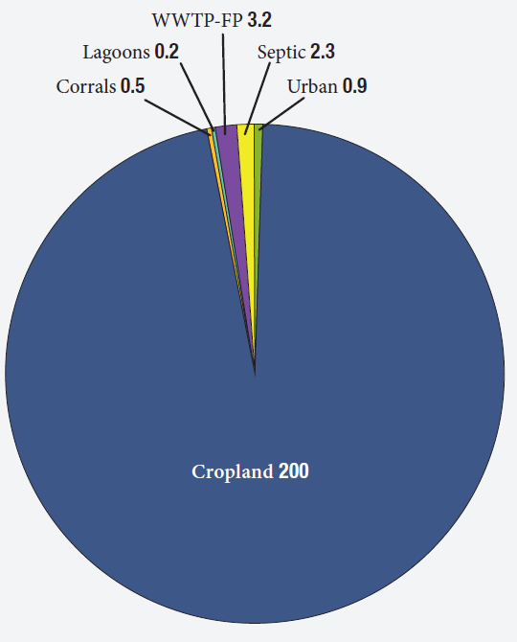
Sources of Groundwater Nitrate
1 Gigagram
= 1,000 metric tons
= 1,100 US tons
Cropland – 200 Gg N/yr
Notes:
Lets now switch to N sources and the distribution over time and spatially. And in that area – actually if you add the Salinas Valley and the Tulare Lake Basin together – cropland has generated about 95% of the nitrate in GW, with septic tanks, ww treatment facilities, corrals, and dairy waste lagoons accounting for a very small portion of the GW NO3, though they may be locally important.

Slide 22
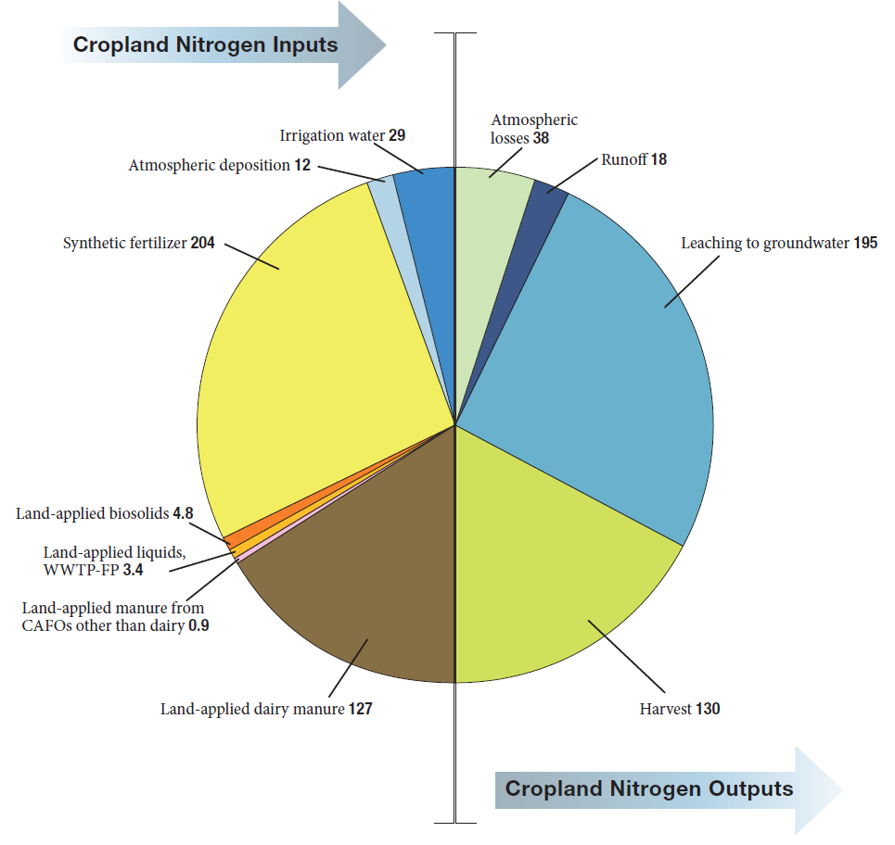
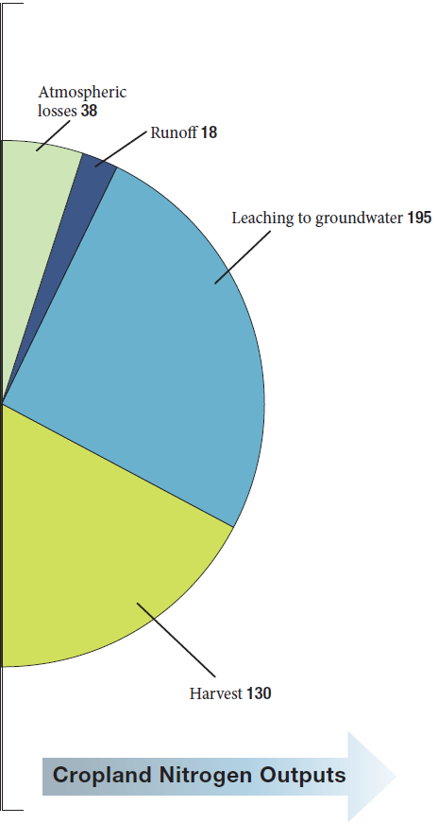

Cropland Mass Balance
Total Nitrogen Inputs:
420,000 tons N/yr
Irrigation water
Atmosphere
Atmosphere
Runoff
Leaching to Groundwater
Synthetic
Fertilizer
Biosolids
Effluent
Poultry, Swine
Dairy Manure
Harvest
Total Nitrogen Outputs:
420,000 tons N/yr
18
Notes:
Key Points:
Brown needs to take on the color of yellow: manure is a difficult fertilizer (like a wild teenager for a delicate task; or like trying to drive under the speed limit without a speedometer, while trying to keep up with everyone else on the freeway).
This is NOT about abandoning agriculture in California. Globally, we need agriculture. 70% more food/feed/fiber/fuel producion by 2050.
Consumers need a choice => make nitrogen footprint part of the food label to give sustainable ag a market value
DON’T TALK ABOUT UNCERTAINTY.

Slide 23
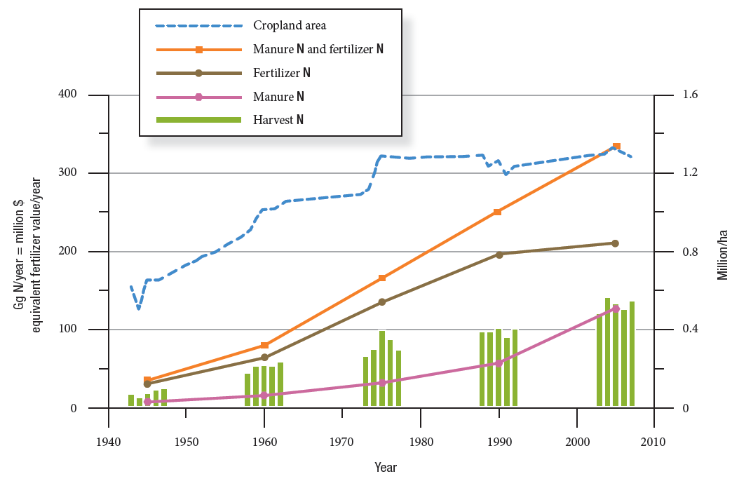
Historic Nitrogen Fluxes
tons N/yr
Cropland Area
(without Alfalfa)
Cropland Area
440,000
4M ac
330,000
3M ac
Total Fertilizer
Synthetic Fertilizer
220,000
2M ac
110,000
Harvest
1M ac
Manure
1940
1950
1960
1970
1980
1990
2000
2010
Notes:
What about over time? – from a 60-year period 1945 to 2005, we compared inputs of N as fertilizer and manure with N removed in the harvested crops. These are totals for the entire study area – SV plus TLB. The top line in blue shows the trend in crop acreage, doubling during the 60 years, but actually reaching a plateau in the mid 1970s. Both inputs and harvest removal of N continued to increase up to the present, and especially note the accelerating increase in manure N beginning in about 1990 with dairy expansion, and the resulting dramatic imbalance between N inputs and crop harvest removals.

Slide 24
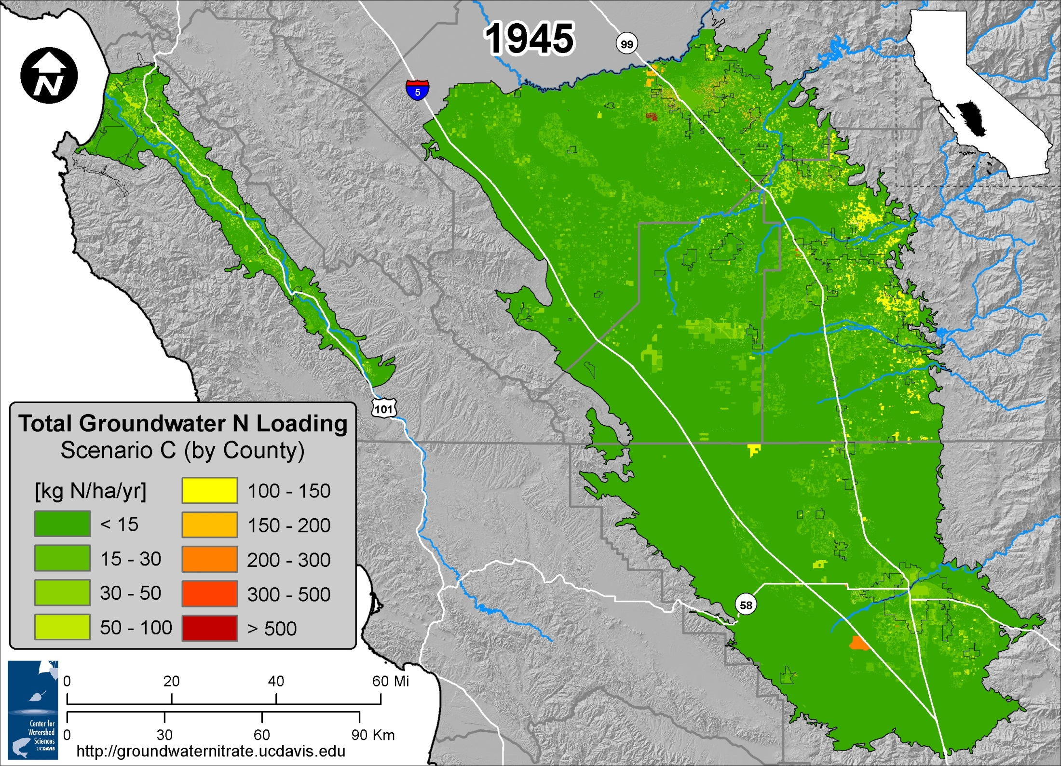

Slide 25


Slide 26
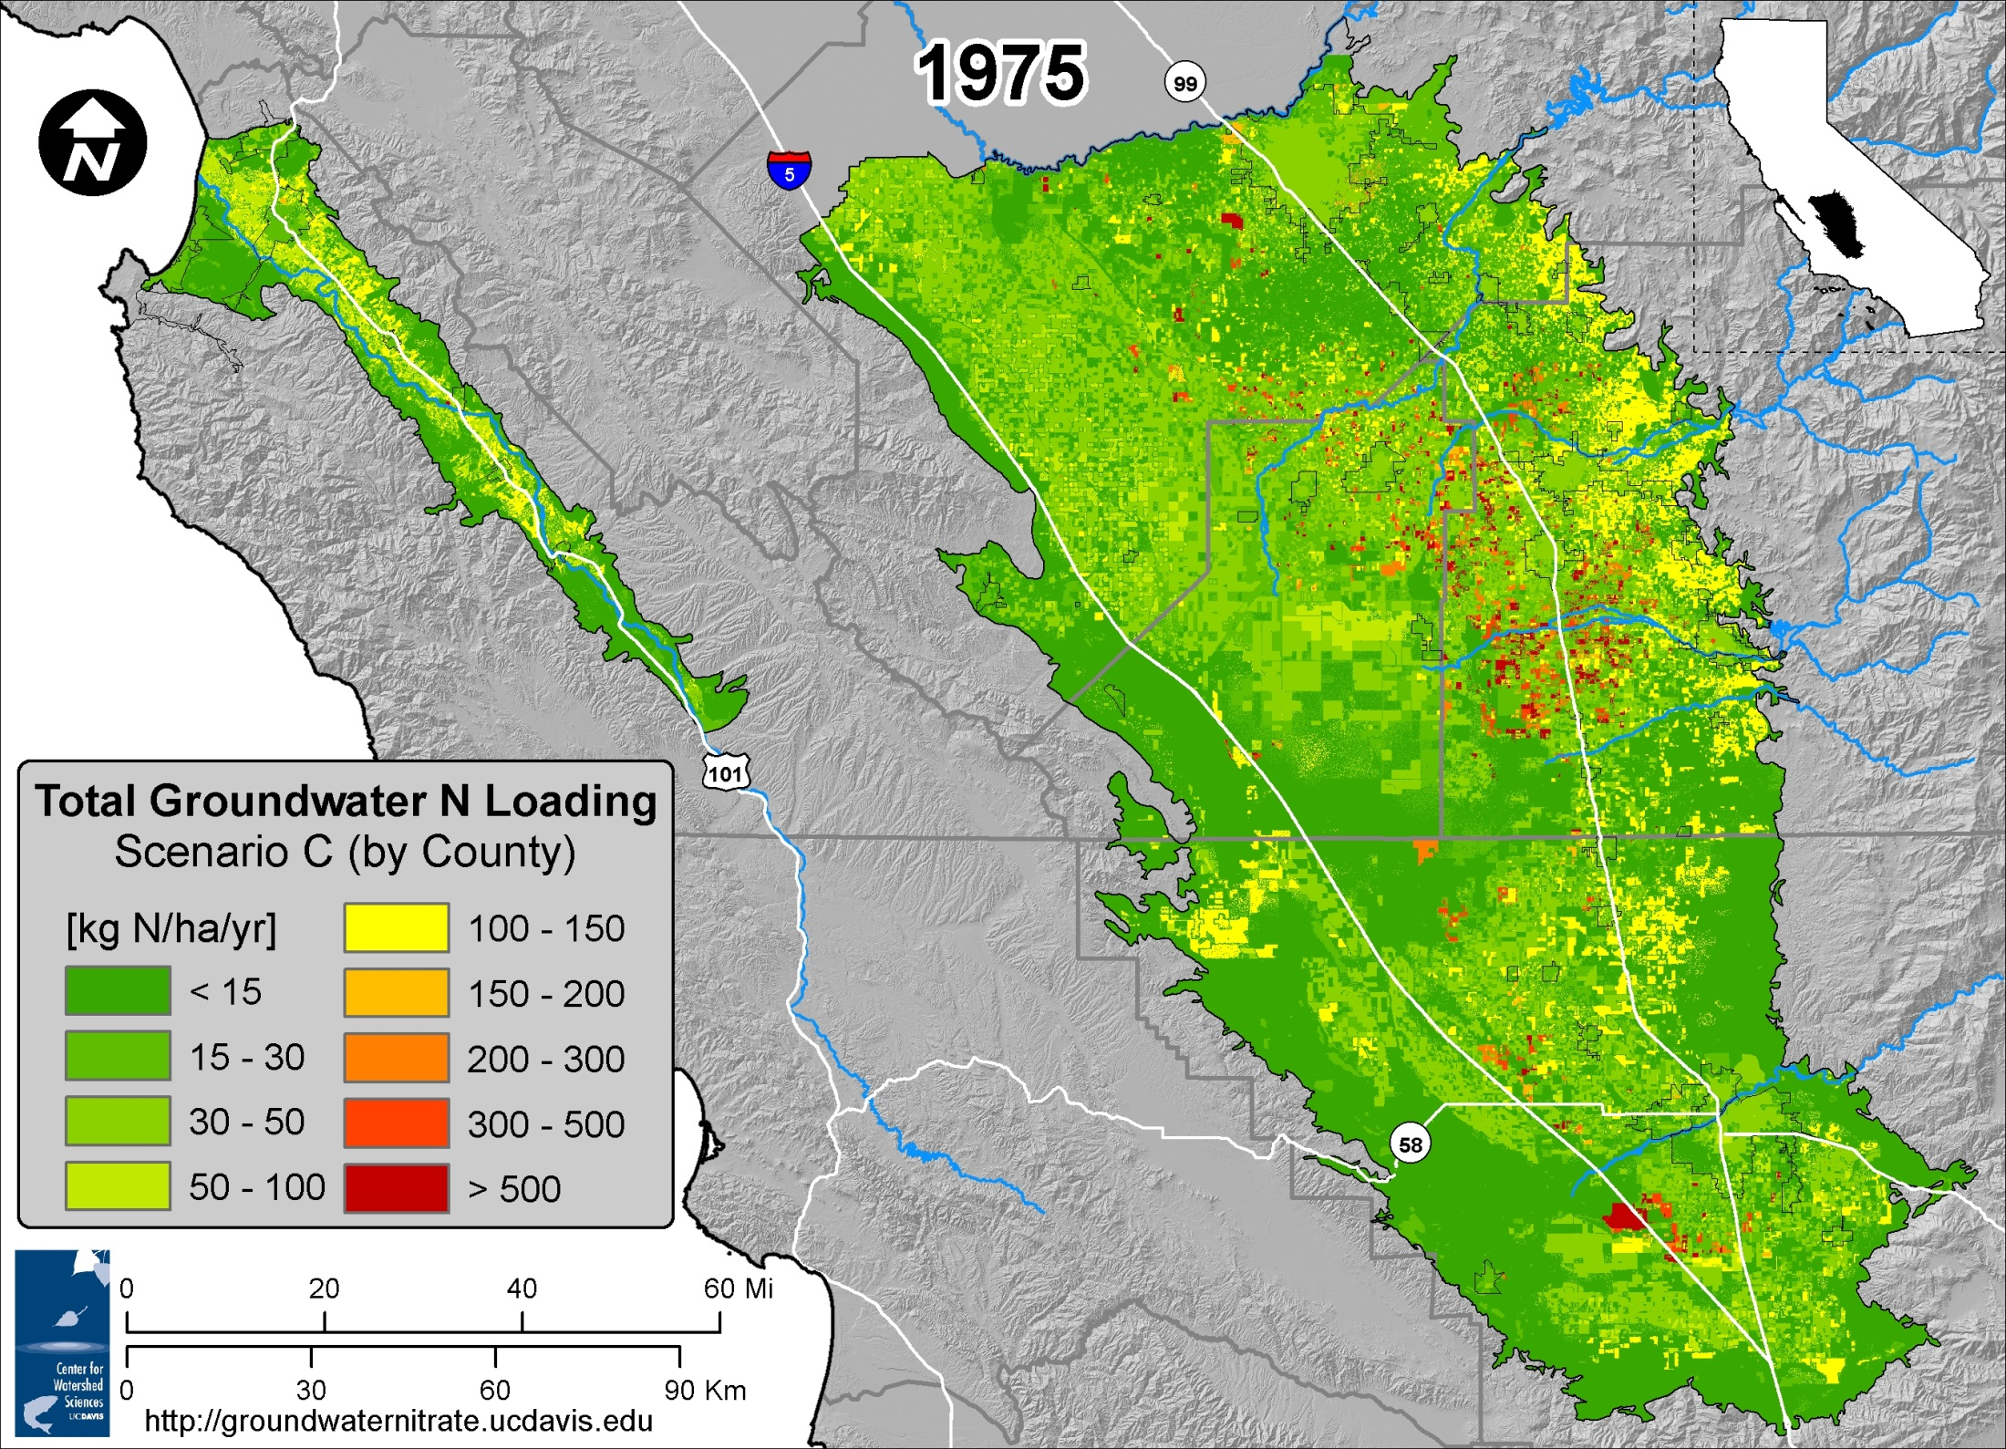

Slide 27
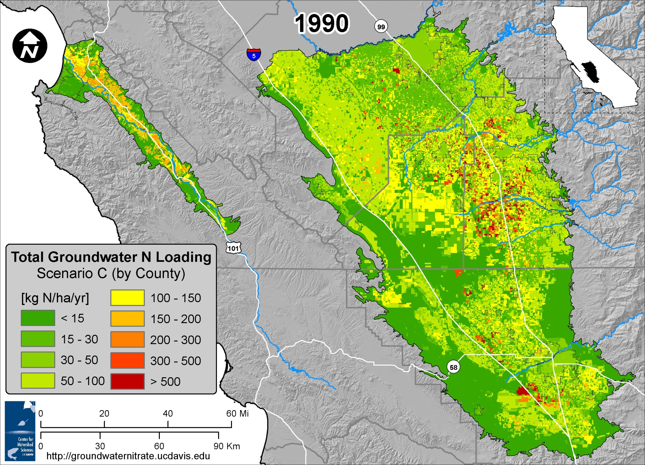

Slide 28
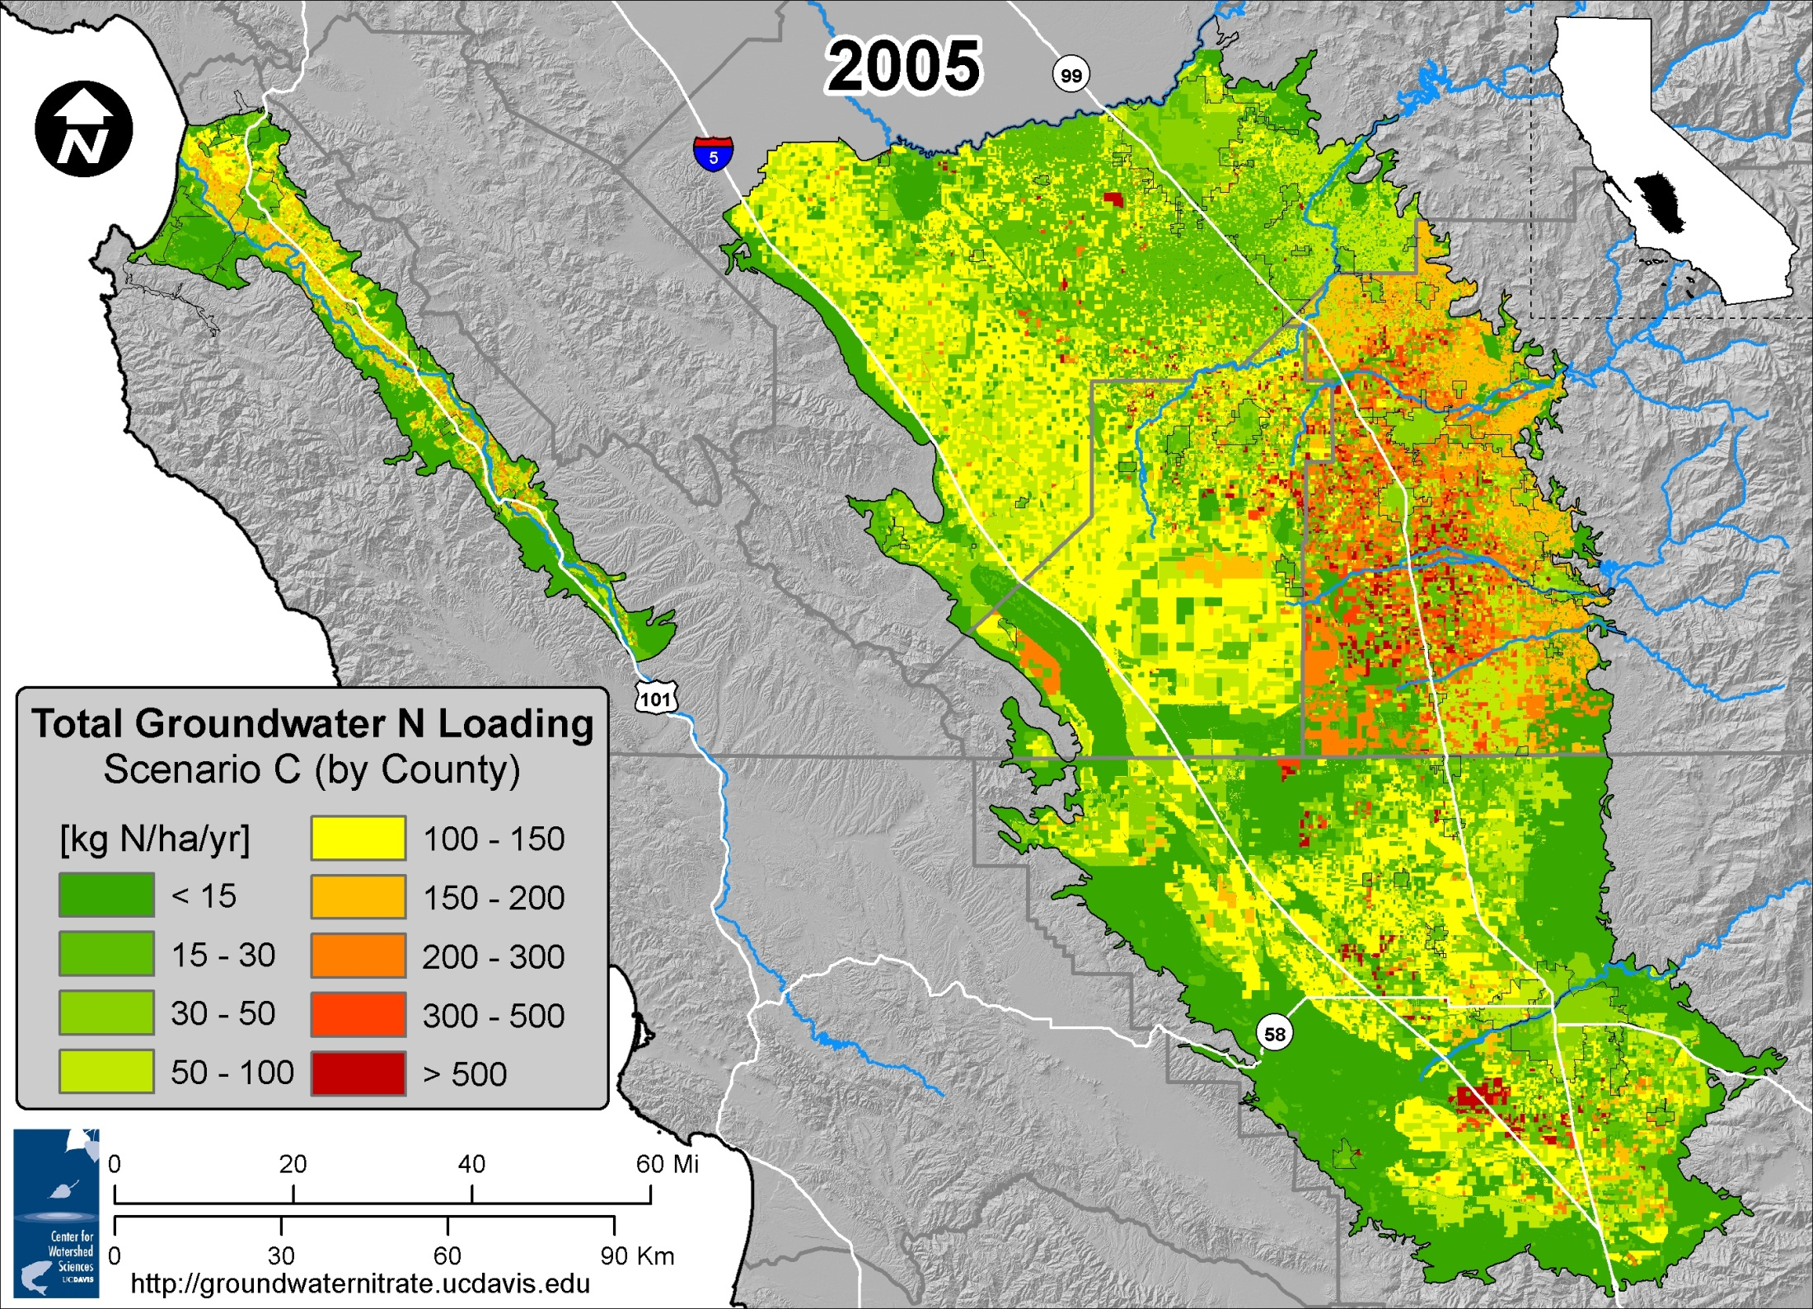

Slide 29
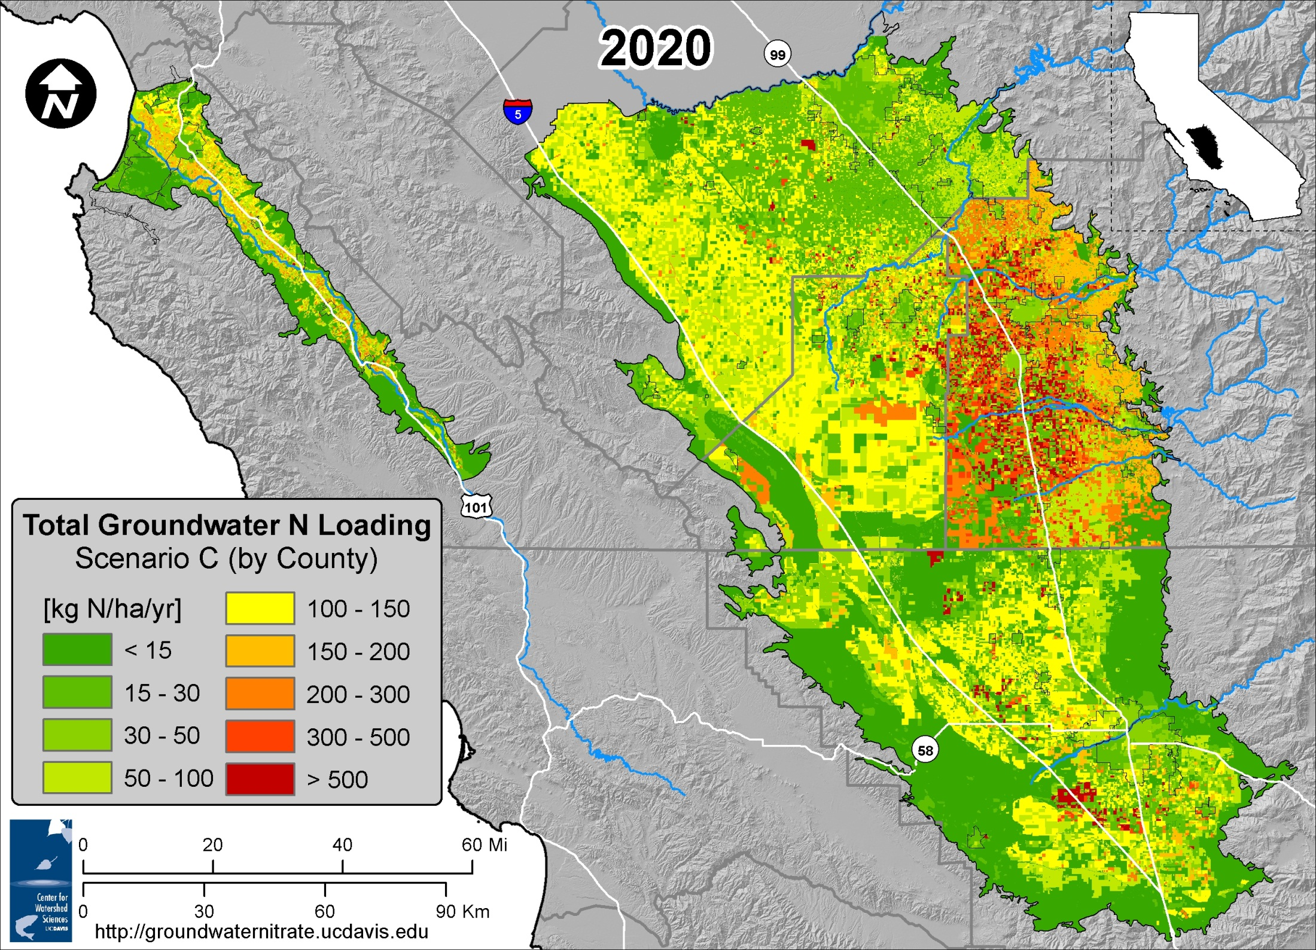

Slide 30


Slide 31
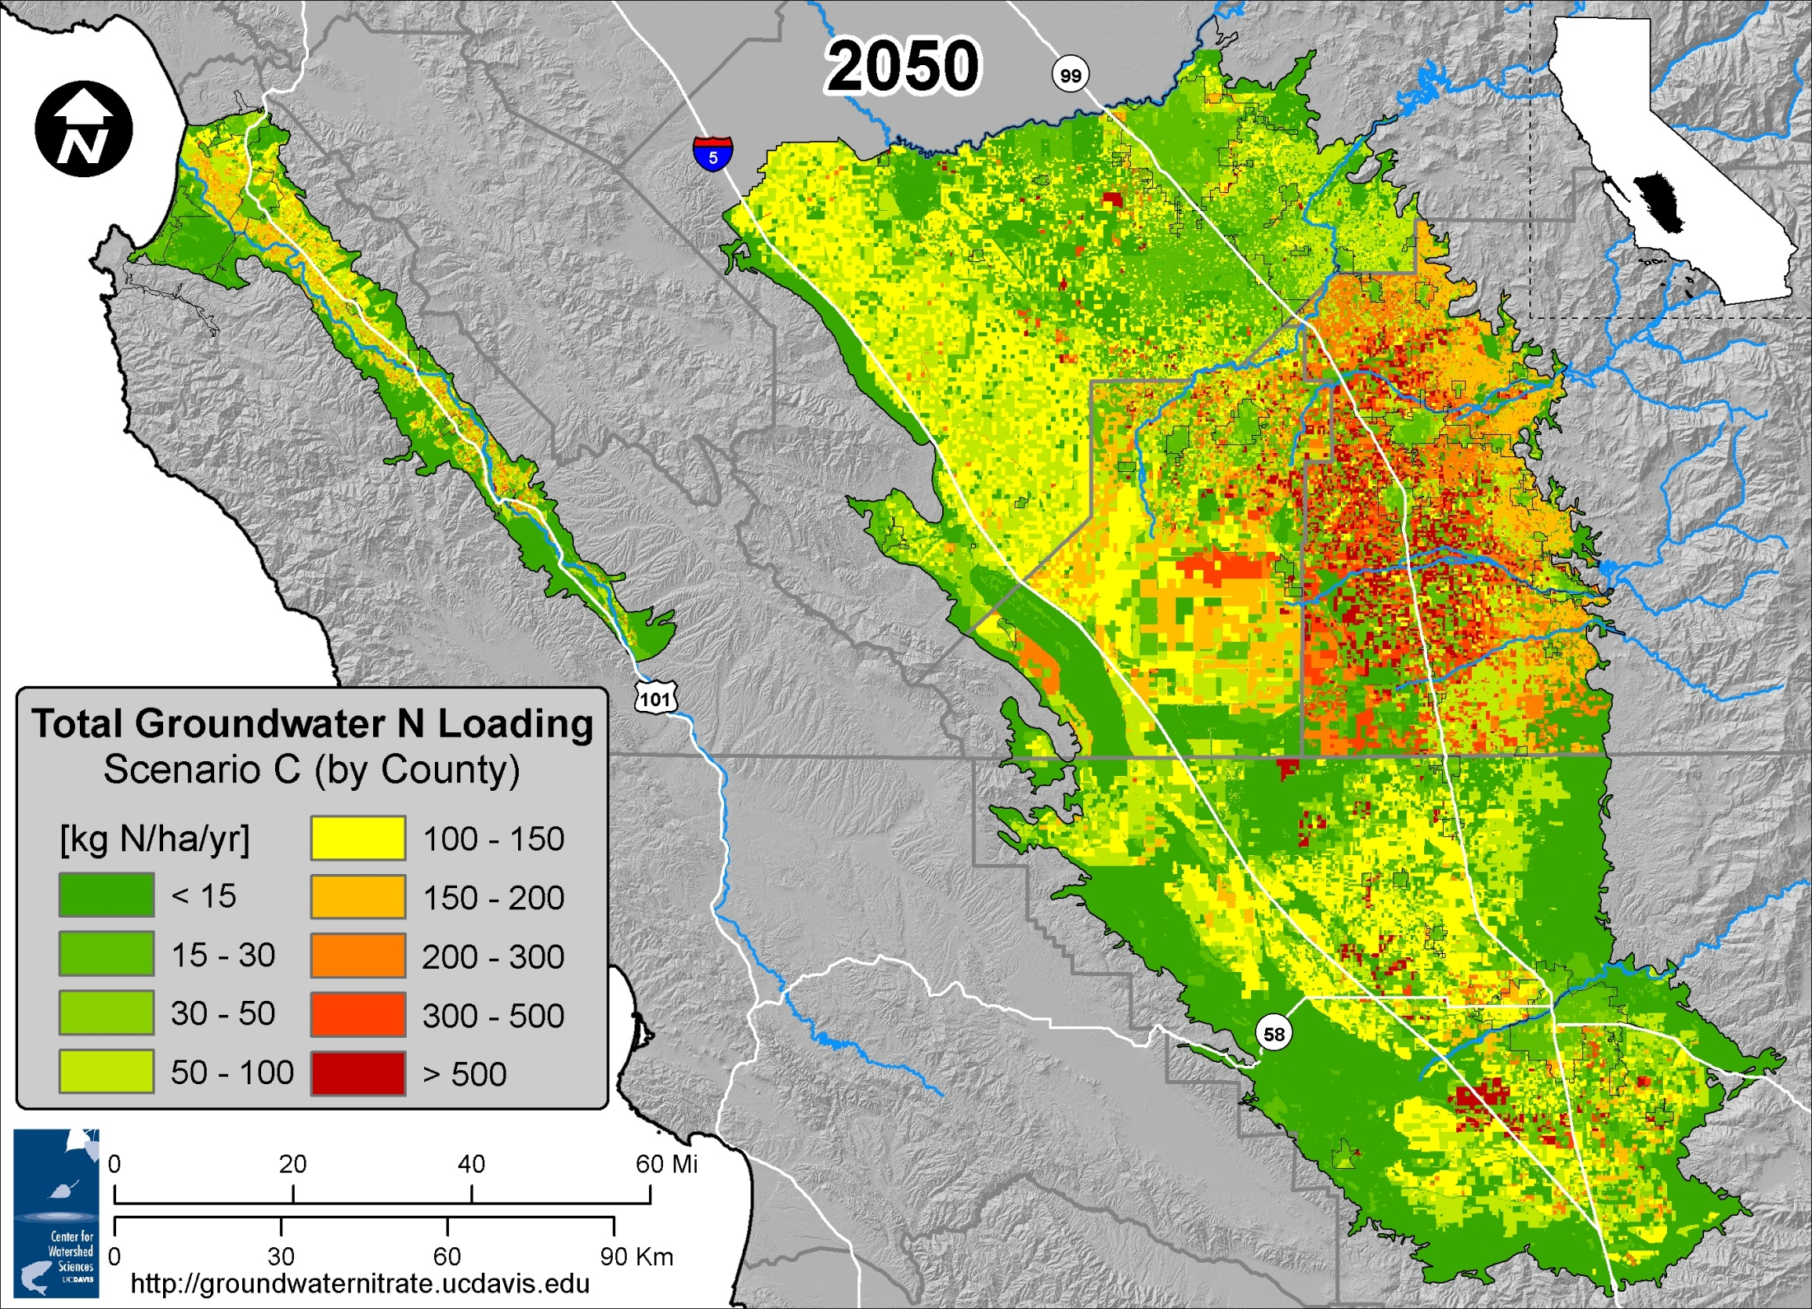

Slide 32
#2: Nitrate Source Reduction
N Loading Reduction Options / Source Control
Notes:
Secondly, what are the source control options.

Slide 33
Agricultural Source Reduction
Increase crop N-use efficiency -- Decrease deep percolation
Basic Components | Management Measures | 50 Practices
Improve irrigation and drainage systems | Perform system evaluation and monitoring | 3
 | Improve Irrigation scheduling | 4
 | Improve irrigation system design and operation | 13
 | Other irrigation infrastructure improvements | 2
Improve fertilizer and manure use | Improve rate, timing, and placement | 15
Change crop rotation | Modify crop rotation or grow cover crops | 4
Improve storage and handling | Avoid fertilizer material and manure spills during transport, storage and application | 9
Notes:
The SBX2 1 study outlined a wide range of potential source reduction actions in agriculture.
[[1]] Agriculture. Reducing the amount of N that moves past the rootzone comes down to two things: increasing the N use efficiency of the crop and decreasing the deep percolation of water. In our report, we outline 50 so called bmps that can help reduce leaching of nitrate from fields. These practices can be used to achieve one of 10 MM such as [improving irrigation scheduling to match crop demand]. All of these practices fall into one of 4 categories:
Decreasing deep percolation by Improve irrigation and drainage system design and operation: water is carrier of nitrate molecule to gw so reducing excessive water applications plays important role in reducing N losses.
Improve rate timing placement of fert and manure to better match crop need—a practice used to achieve this might be to use the results of a soil test to guide application decisions.
Alter crop rotation to capture more N and decrease deep percolation—for example cover crops
Improve storage and handling of fertilizer and manure

Slide 34
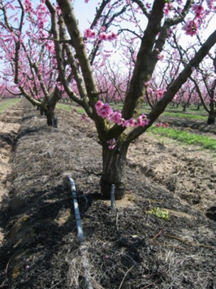
FINDINGS:Cropland Source Reduction
Recommended practices can increase N in the harvested crop to ~60-80% of N inputs
  Current averages as low as ~30-40%
Some practices are already in use:
  Rate of adoption, regional impact unknown
Suite of practices will be the most effective:
  Tailored to specific soils and crops
Barriers to expanded adoption:
  Logistics, education, costs
Notes:
We can see from multi year studies that [read 1st bullet], and we know that farmers already are using practices that should lead to less NO3 leaching, e.g., growing almonds with micrsprinkler irrigation rather than basin, furrow, or even overhead sprinklers.
But there are barriers to adoption, and those outside agriculture may view farming as “factory farming” and not appreciate why farmers cannot achieve 100% N use efficiency. Obviously the cost – for example of breaking up large fields and irrigating each acre optimally where soil types don’t fall in a rectangular pattern. Or that you only have so much pumping capacity so cannot fine tune the timing of irrigation. But some of the barriers can be addressed including the need for education and adaptive R&D.

Slide 35
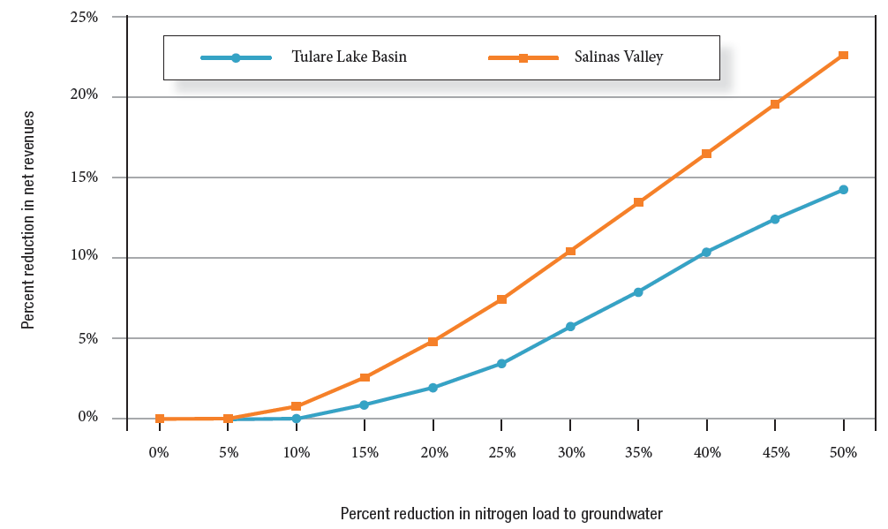
Economics of Source Reduction
25%
farm net revenue reduction
at constant crop yield rates
20%
15%
Salinas Valley
Percent Reduction in Farm Net Revenue
10%
Tulare Lake Basin
5%
0%
10%
20%
30%
40%
50%
Percent Reduction in Nitrate Load to Groundwater
nitrate
Notes:
Cost of improving crop N use efficiency is uncertain but likely low for small improvements.
Load reductions of half or more may come at a significant cost, potential reduction in irrigated crop area.

Slide 36
#3: Groundwater Nitrate
Nitrate distribution in groundwater / spatial and temporal trends
Notes:
#3 what is the distribution of nitrate in GW spatially and what are the trends over time – will it get worse?

Slide 37
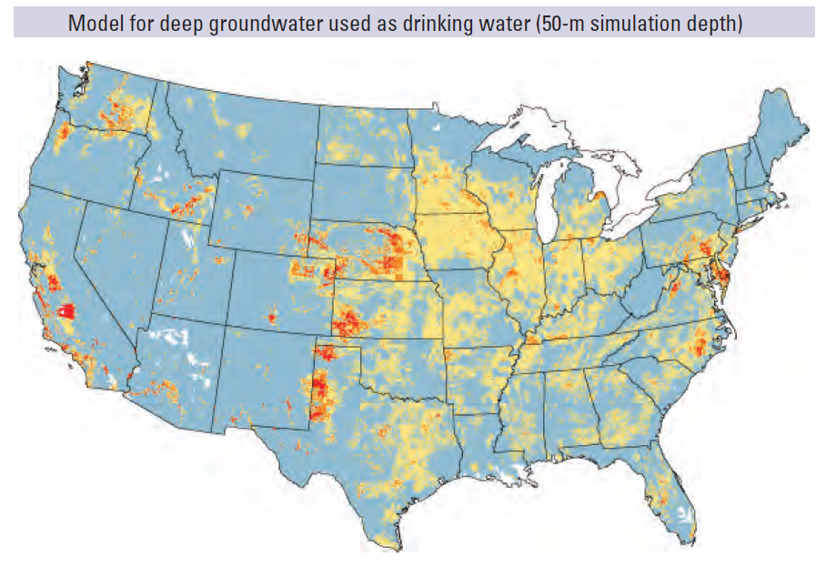
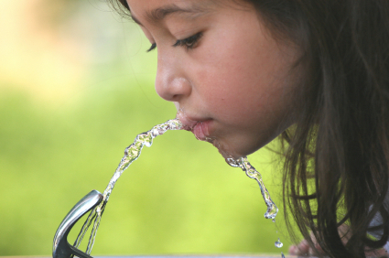
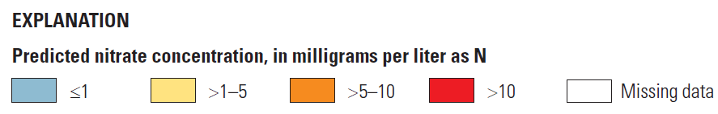
Dubrovsky et al., USGS, 2010

Slide 38
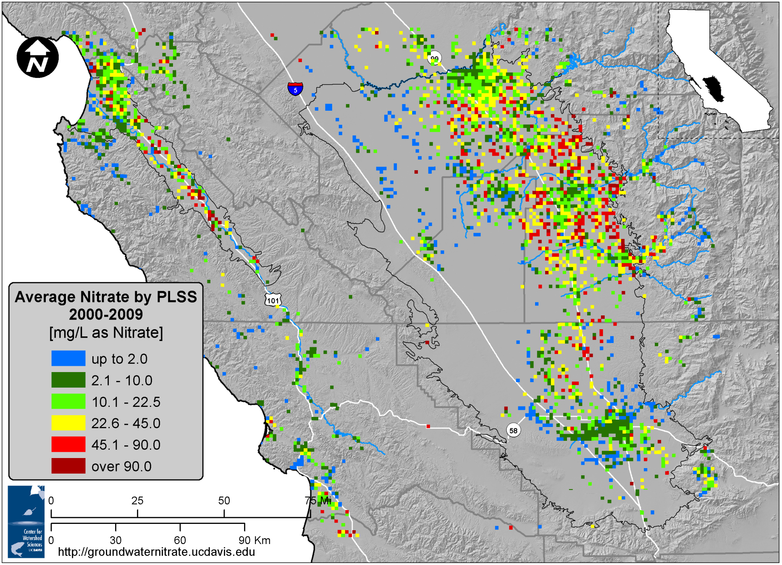
Average Nitrate Concentrations
by Section
Notes:
The Excessive NO3 in wells is well documented in both the Salinas Valley and TLB. The red dots are wells above the MCL averaged by land section and averaged over the years 2000-2009. Note red dots in the TLB especially on the east side of the valley.

Slide 39
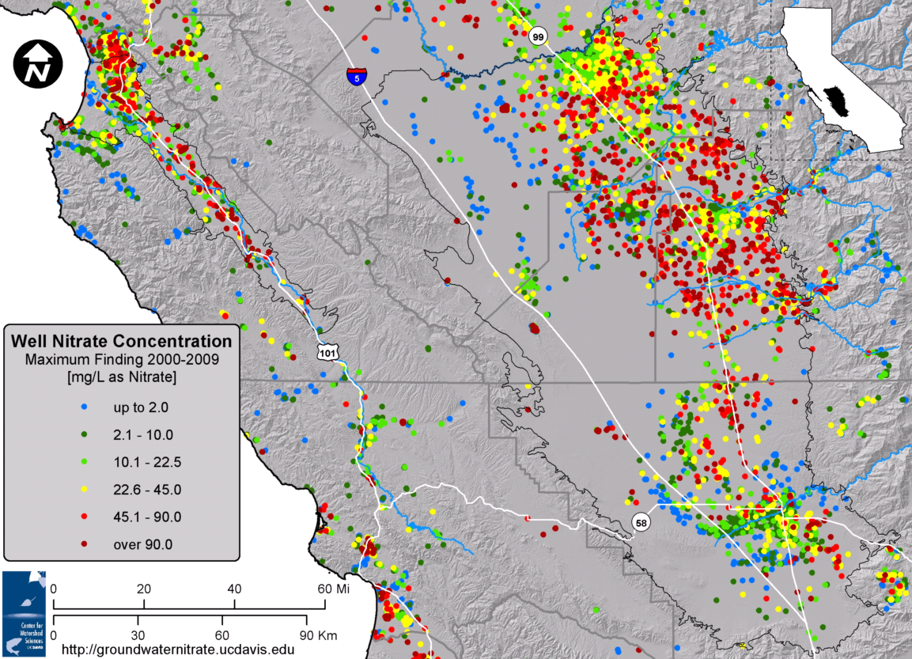
Nitrate Contamination Will Persist
Nitrate contamination will worsen for years/decades
Direct remediation of groundwater is extremely costly
RED: ABOVE THE NITRATE MCL (45 mg/L)
DARK RED: ABOVE TWICE THE NITRATE MCL (90 mg/L)
Notes:
…and confirmed that there is a widespread risk for nitrate above MCL in raw water supplies,….

Slide 40
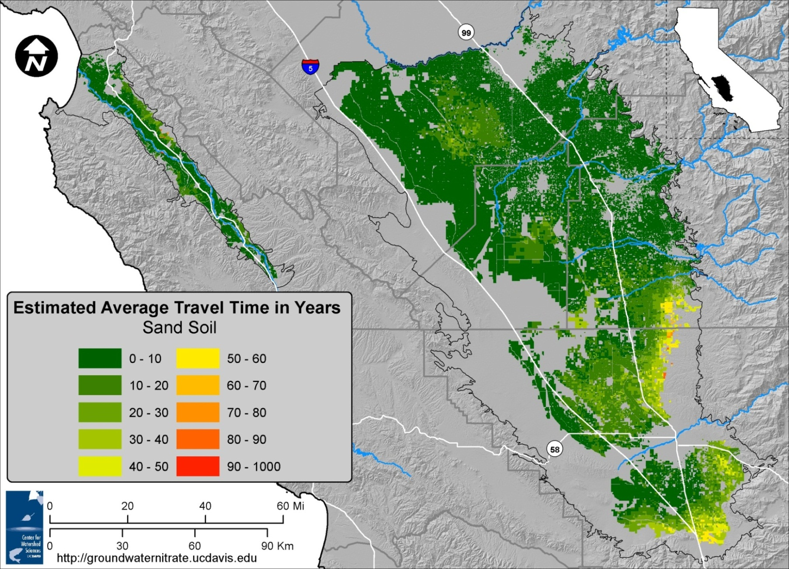
Vadose Zone Travel Time

Slide 41
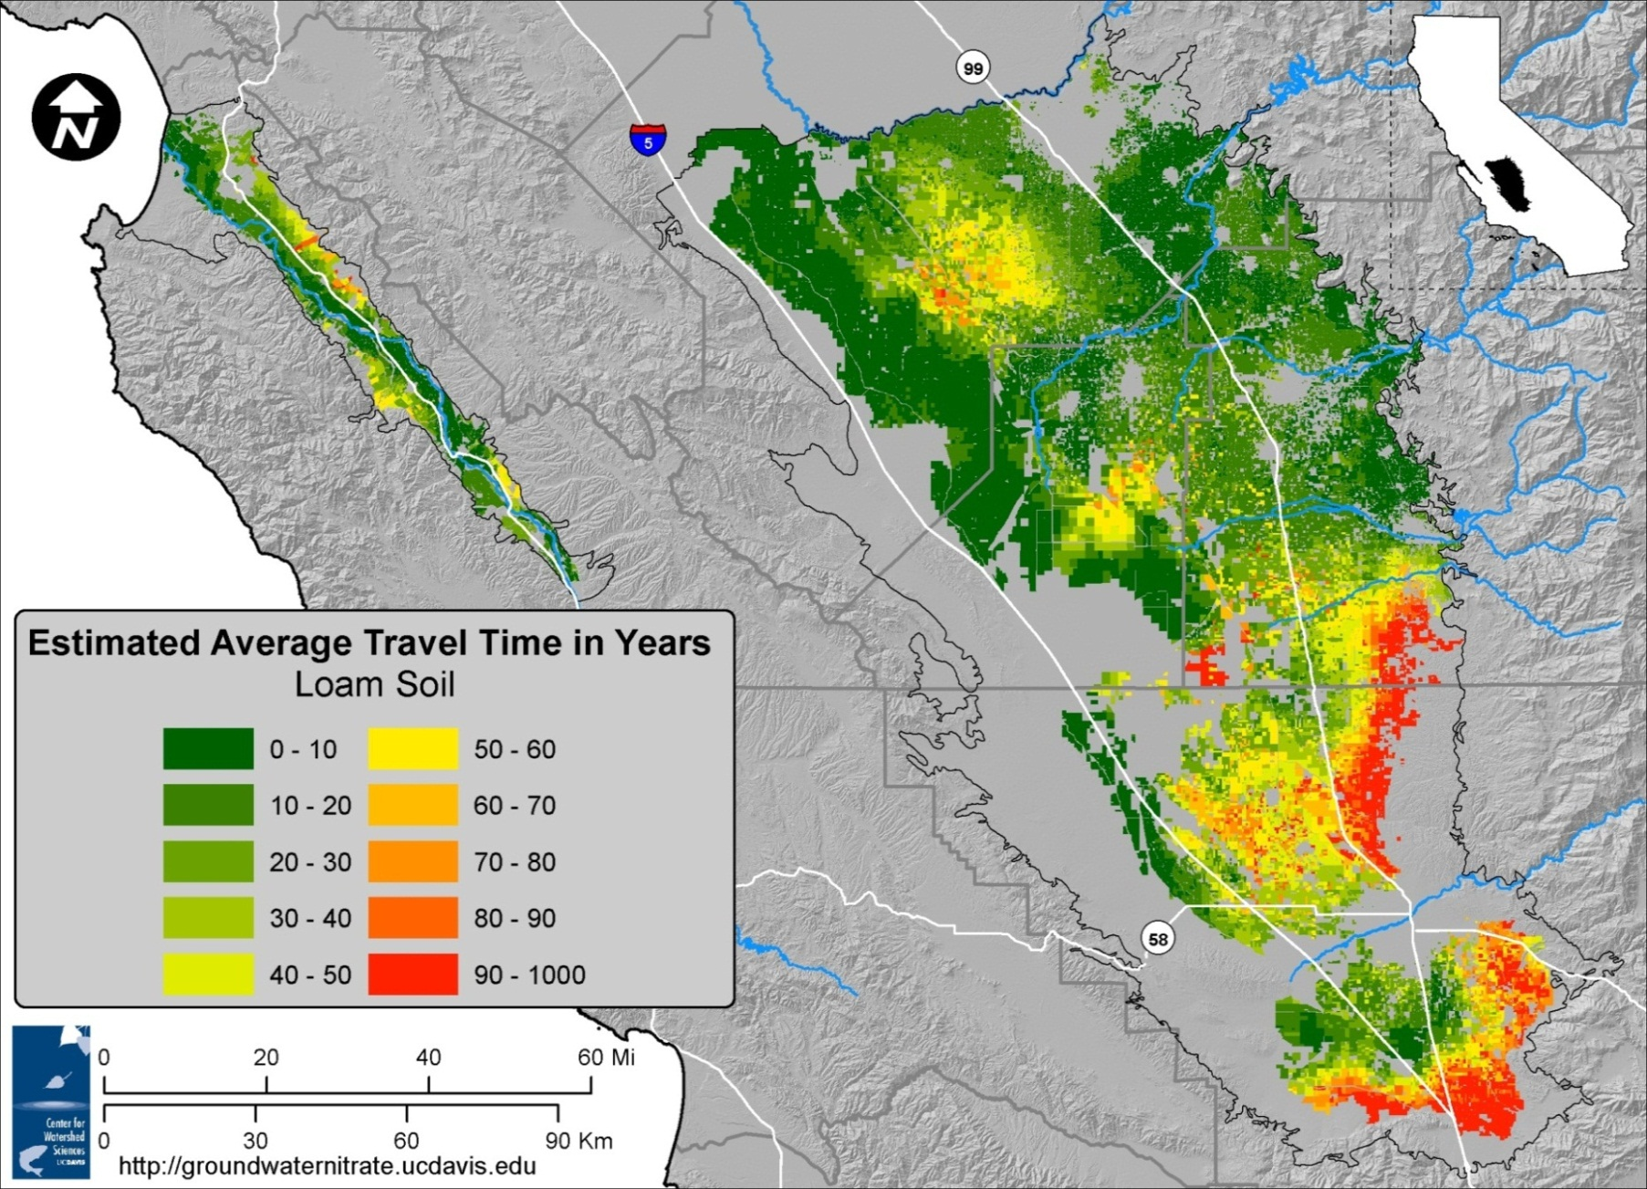
Vadose Zone Travel Time

Slide 42
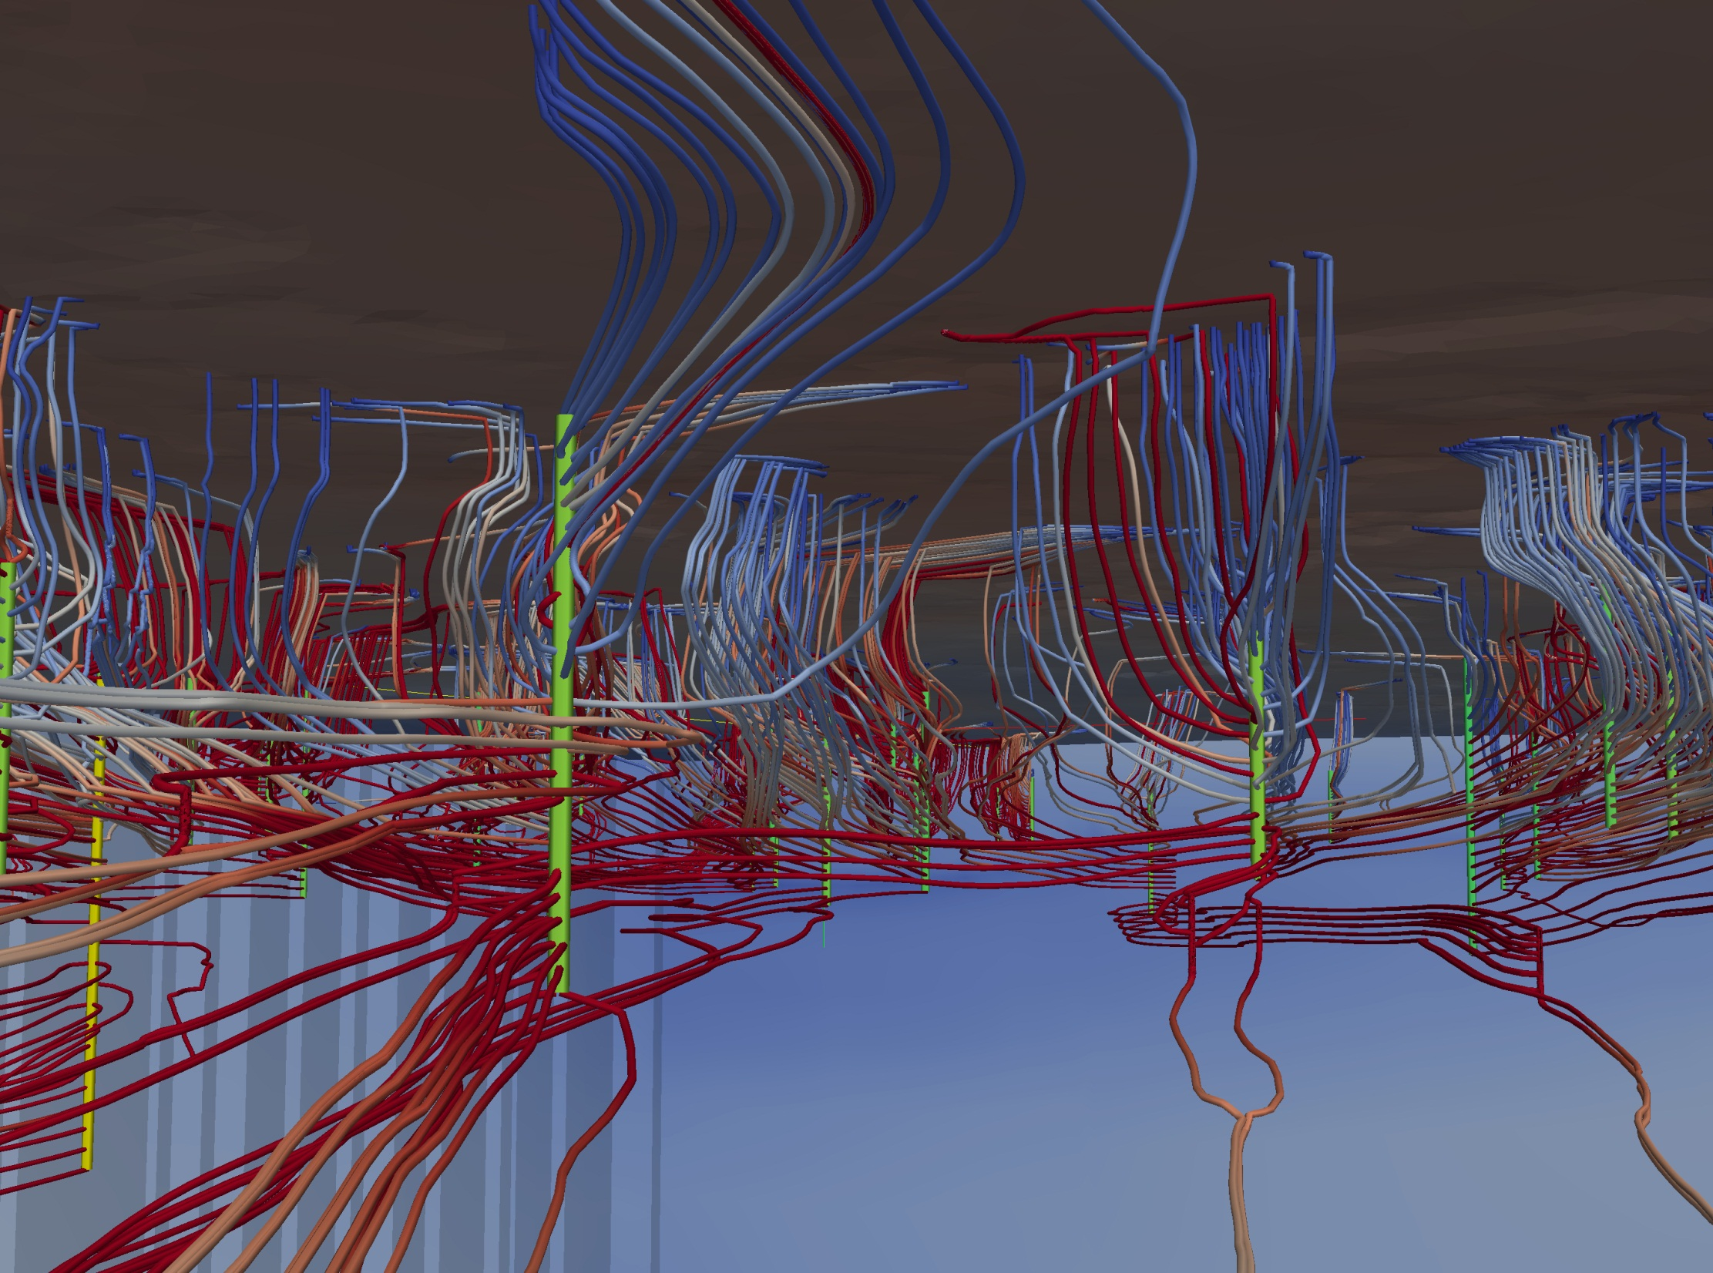
Kourakos et al., WRR 2012

Slide 43
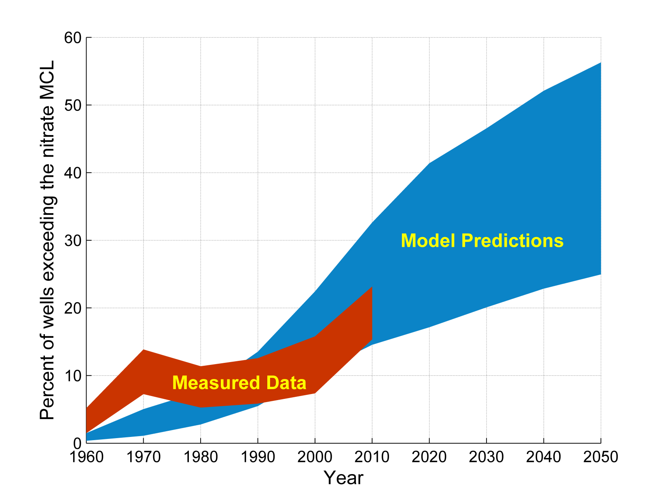
Predictions Using
Groundwater Nitrate Loading
Exceedance Probability,
Nitrate above 45 mg/L (MCL)
Eastern Tulare Lake Basin
Notes:
…a problem that has been around and increased for decades, and that will continue to increase for some time until source control actions begin to take hold. A decadal effort.
=========================
Based on highly detailed groundwater flow and transport models for the Tulare Lake Basin → All wells including deep and shallow and data shown is for the Eastern Alluvial/Fluvial Fans.
Thickness of the swath shows the confidence interval for percent exceedance. Dip in the measured data in the 1980’s reflects Public Supply wells being tested and reported
→ % of wells below MCL increases. Also much less data in the 60’s and 70’s.
The data shows 10-20% exceedance rates, and this is projected to increase through time. Projections show that exceedance rates will increase in the fugure. By 2050, we predict that 25-50% of wells in the Eastern TLB will exceed the MCL.
See up and down, but little data, 1972 is when reporting came in!!!!

Slide 44
#4: Groundwater Remediation
Remediation of groundwater
Notes:
Fourth, can GW NO3 be remediated? And a simple answer to that is that that is not practical.

Slide 45
Key Findings
Basin-wide conventional remediation is not feasible
  Expensive (>$14-30 billion) (volume: 35 million acre feet)
  Technically infeasible – time, inefficiency
Local remediation is appropriate
  Clean up of nitrate hot spots with plume-scale remediation methods
    In situ (e.g. Permeable Reactive Barriers)
    Ex situ (e.g. Pump and Treat)
Basin-wide groundwater quality management needed
  Source reduction
  Regional adoption of “Pump and Fertilize” (part of nutrient mgmt.)
  Recharge with higher quality water

Slide 46
#5: Drinking Water Treatment
N treatment options
Notes:
5th, what are the treatment options to reduce NO3 concentrations to meet the drinking water standard?

Slide 47
#6: Alternative Supplies
Alternative supplies
X
X
X
X
X
Notes:
6th, What about alternative supplies as a solution – e.g.,switching sources to low nitrate water?

Slide 48
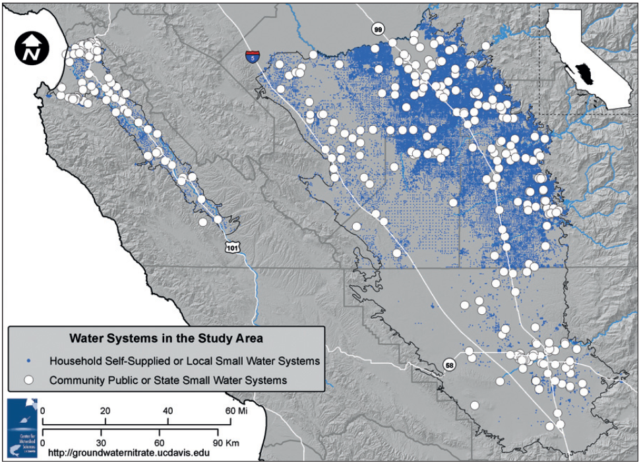
All Water Systems
Estimated locations of the area’s roughly 400 regulated community public and state-documented state small water
systems and of 74,000 unregulated self-supplied water systems. Source: Honeycutt et al. 2012; CDPH PICME 2010.
Notes:
Kristin
Here we have a map of all water systems in the study area, with the white markers indicating community public and state small water systems , and the blue smaller markers indicating our estimated location of household self-supplied and local small water systems

Slide 49
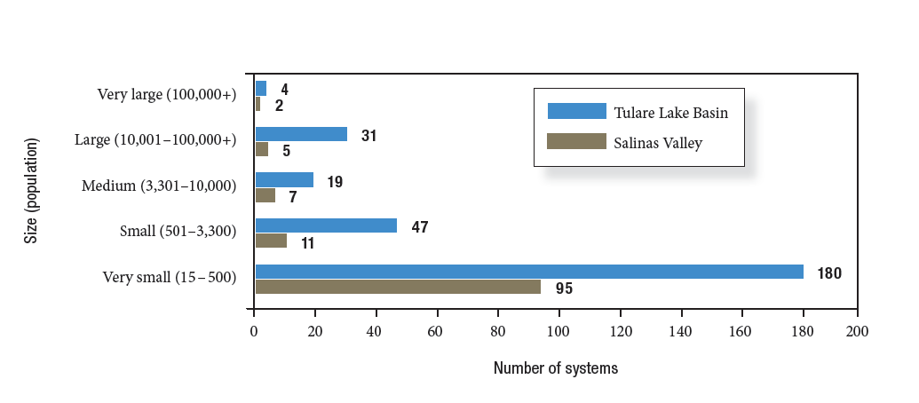
Community Public & State
Small Water Systems
Community public and state-documented state small water systems of the Tulare Lake Basin and Salinas Valley.
Source: CDPH 2010.
Notes:
Kristin

Slide 50
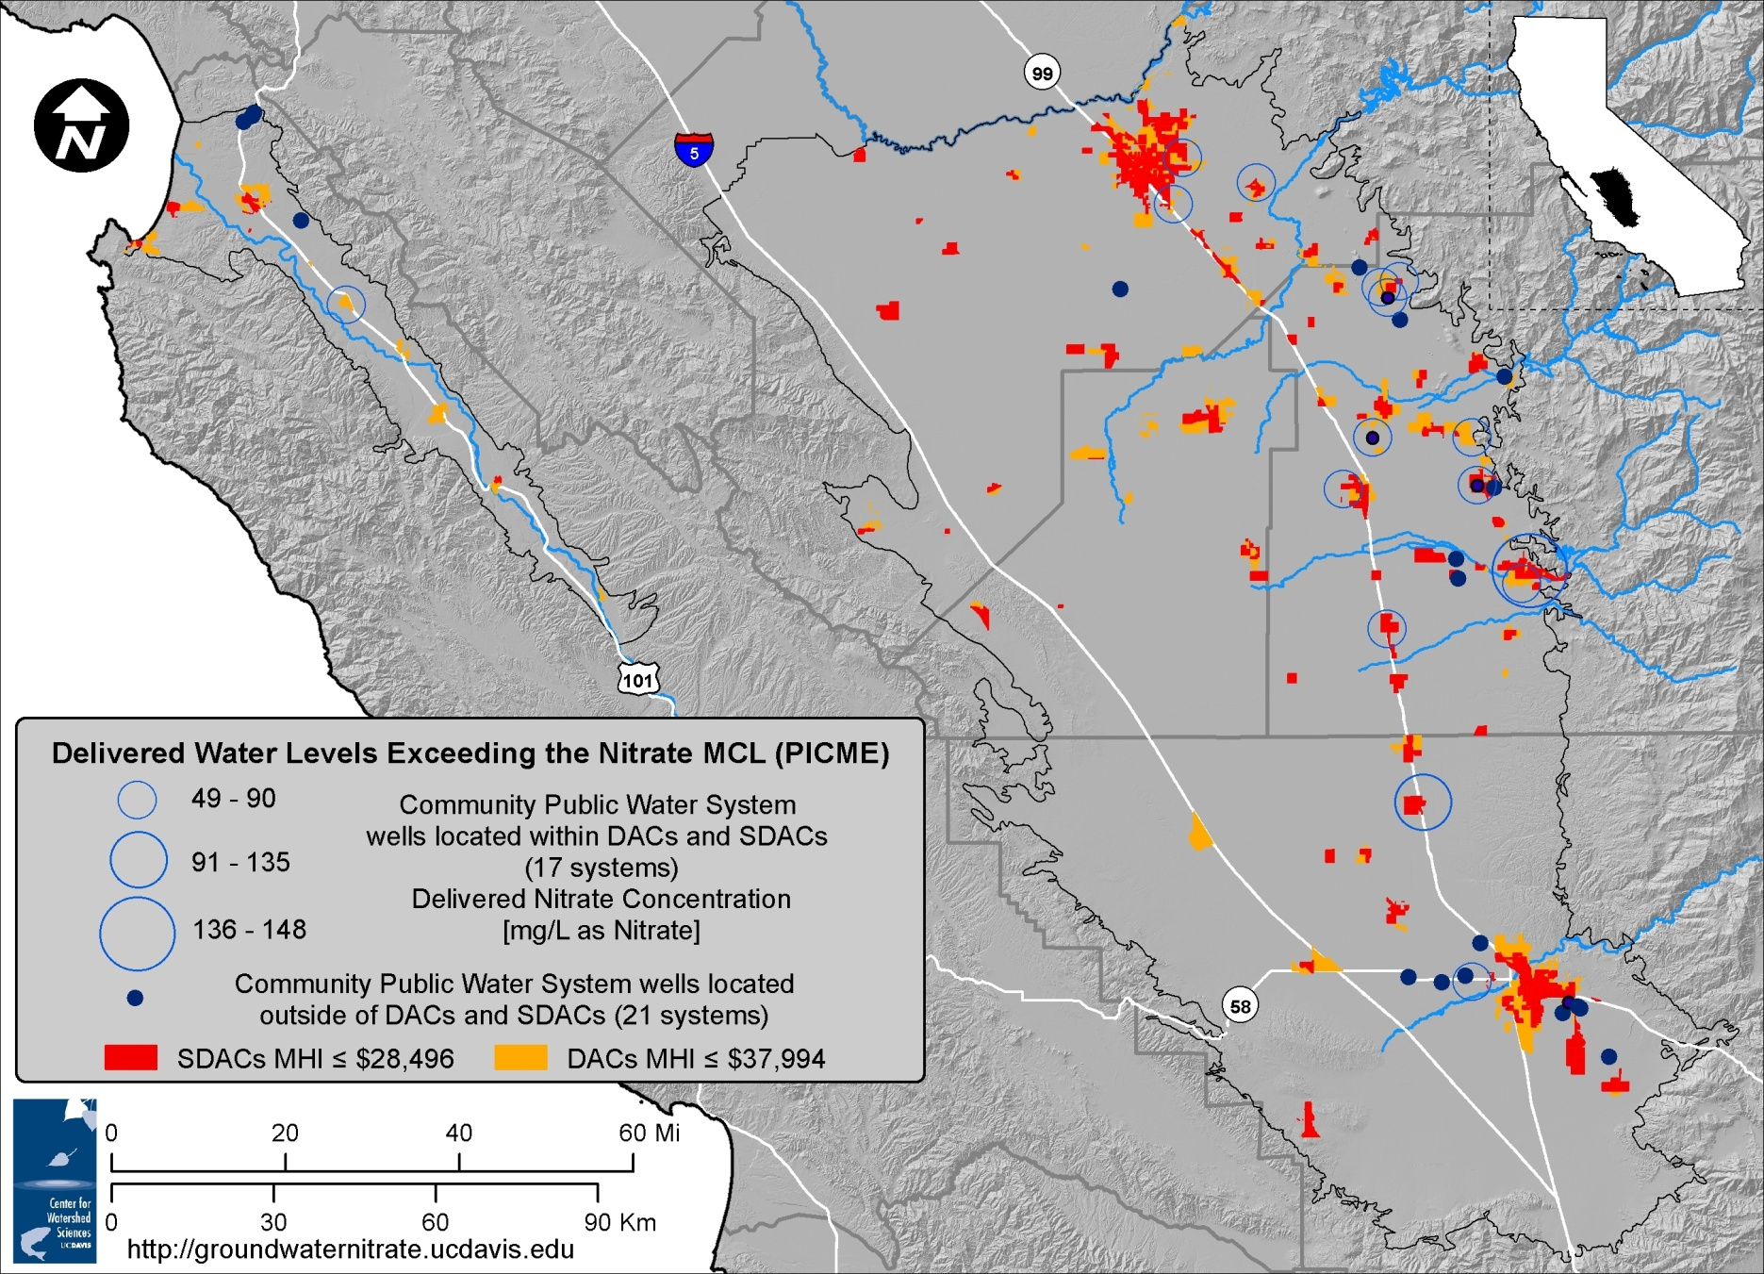
DACs and Delivered Water Quality
% of Domestic Wells > 45 mg/L
8%
12%
30%
7%
7%
Notes:
Kristin

Slide 51
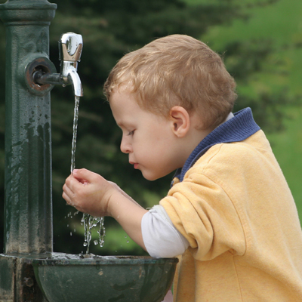
Cost of Safe Drinking Water:
$20 - $36 Million / Year (Study Area)
Most cost-effective drinking water supply actions:
  Blending
  Treatment (community, point-of-use)
  Consolidation/regionalization
  Other alternative supplies
Affordability difficult for small communities
Most promising revenue source:
  Fee on nitrogen fertilizer use
  Fee on water use
  Local compensation under Section 13304 of CA Water Code
http://www.frugalbits.com/food-drink/say-no-to-bottled-water-and-yes-to-charity-wate/
http://www.middlebrookhealth.org/Summer%20Safety.html
Notes:
Technical solutions to treat contaminated water are available and meet a wide range of needs/capacities.
Estimated Cost Ranges for all alternative water supply options on a self-supplied household level and a small water system level. Costs are from literature found, interviews conducted, or survey responses.

Slide 52
#8: Funding and Policy
Notes:
Finally, what are the potential funding sources to pay for mitigation; and what are the policy options? Two long-standing pieces of legislation – the Safe Drinking Water Act and the Porter Cologne Act require the state to act on this probloem.

Slide 53
Funding and Regulatory Framework
SDWA
N Loading
Reductions
Treatment / Alternative Supply
Porter-
Cologne
Decade(s) later
Groundwater
Remediation

Slide 54
The Source Control Challenge
Point Sources of Pollution
Surface Water Quality
Ground Water Quality
Nonpoint Sources of Pollution
Notes:
To understand the challenges faced by these new regulatory programs, I need to provide a historic perspective

Slide 55
Challenges to Regulating Nitrate
Point Sources of Pollution
1970s - now
Clean Water Act /
CA Porter-Cologne: NPDES Permits
Surface Water Quality
Ground Water Quality
Nonpoint Sources of Pollution

Slide 56
Challenges to Regulating Nitrate
Point Sources of Pollution
1970s - now
Clean Water Act /
CA Porter-Cologne: NPDES Permits
1980s - now
Superfund, TSCA, RCRA
Surface Water Quality
Ground Water Quality
Nonpoint Sources of Pollution

Slide 57
Challenges to Regulating Nitrate
Point Sources of Pollution
1970s - now
Clean Water Act /
CA Porter-Cologne: NPDES Permits
1980s - now
Superfund, TSCA, RCRA
Surface Water Quality
Ground Water Quality
2000s - now
Clean Water Act /
CA Porter-Cologne: TMDL
Nonpoint Sources of Pollution

Slide 58
Challenges to Regulating Nitrate
Point Sources of Pollution
1970s - now
Clean Water Act /
CA Porter-Cologne: NPDES Permits
1980s - now
Superfund, TSCA, RCRA
Surface Water Quality
Ground Water Quality
2010s - future
CA Porter-Cologne:
Dairy Order
ILRP/Ag Orders
CV-SALTS
2000s - now
Clean Water Act /
CA Porter-Cologne: TMDL
Nonpoint Sources of Pollution

Slide 59
Why is Nonpoint Source Pollution Different from Point Source Pollution of Groundwater?
Scale
  Millions of acres vs. 1-10 acres
Intensity
  Within ~1 order magnitude above MCL vs. many orders of magnitude above MCL
Hydrologic Function
  Recharge vs. non-leaky
Frequency
  Ongoing/seasonally repeated vs. incidental
Heterogeneity & Adjacency

Slide 60
Challenges to Regulating Nitrate
Point Sources of Pollution
1970s - now
Clean Water Act /
CA Porter-Cologne: NPDES Permits
1980s - now
Superfund, TSCA, RCRA
Surface Water Quality
Ground Water Quality
2010s - future
CA Porter-Cologne:
Dairy Order
ILRP/Ag Orders
CV-SALTS
2000s - now
Clean Water Act /
CA Porter-Cologne: TMDL
Nonpoint Sources of Pollution

Slide 61

Focus: Enforcement Monitoring
Example of Working with a Regulation: Speed Limit
Responsible Party:
Driver
Feedback:
Speedometer
Enforcement:
Radar Controls
Management Tool:
Brakes
Notes:
This is the key tool!!

Slide 62
Focus: Enforcement Monitoring
Applying Point Source Approach to Nonpoint Source:
Responsible Party:
Landowner
Feedback:
missing
Enforcement:
Monitoring Wells
Management Tool:
$$$ “agronomic”
Notes:
Problem with Monitoring Wells as “Radar Gun” or as “Speedometer”: its not a gun, its an old-fashioned cannon
Not specific to one car in determining the speed => potentially many cars at once
Measurement not available until a months or a few years later / reflective of speed months/a few years ago

Slide 63
Focus: Enforcement Monitoring
Alternative Monitoring Approach to Nonpoint Source:
Responsible Party:
Landowner
Feedback:
Nutrient/Water Monitoring
& Assessment
Enforcement:
Annual Nitrogen Budget
Management Tool:
Water and Nutrient Management
Notes:
Problem with Monitoring Wells as “Radar Gun” or as “Speedometer”: its not a gun, its an old-fashioned cannon
Not specific to one car in determining the speed
Measurement not available until a months or a few years later / reflective of speed months/a few years ago

Slide 64
Key Elements to Future
“Groundwater” Monitoring of NPS
Three-track monitoring:
  Enforcement: Monitor/report key outcomes of farm management practices, e.g., annual nitrogen budgets – “proxy” for measuring “groundwater discharge”
  Research: link “proxy monitoring” to actual groundwater discharge at intensely monitored sites & using models (mgmt practice evaluation)
  Assurance: Regional trend monitoring network (e.g., GAMA)
Notes:
Nitrogen budget or other relevant farm management practices, consider audits and more detailed record keeping for those
Research needs to target key representative sites, preferably most vulnerable sites (crop / hydrogeology matrix), best coordinated by major crops, includes detailed farm management practice/nitrogen budget/soil nitrogen/groundwater nitrate monitoring
Regional trend monitoring in domestic wells such that a random, but representative sample can be obtained, consistent across a region
Records should all be submitted electronically!

Slide 65
Challenges for Regulating Nonpoint Sources of Groundwater
SCIENCE
  NPS source control
  NPS pollution soil/groundwater fate, transport
  NPS pollution assessment, monitoring
REGULATORY FRAMEWORK
  Enforcement: Paradigm shift in monitoring approaches
AGRICULTURE (largest NPS)
  Socio-cultural change needed to work within new regulatory framework

Slide 66
State Action
SWRCB: Recommendations to the Legislature (2/2013)
  http://www.waterboards.ca.gov/water_issues/programs/nitrate_project/index.shtml
Governor’s Office: Drinking Water Stakeholder Group Consensus Action Plan (1/2013)
  http://www.waterboards.ca.gov/water_issues/programs/groundwater/drinkingwater_stakeholders.shtml
CDFA: Nitrogen Tracking Task Force (11/2013)
  http://www.cdfa.ca.gov/environmentalstewardship/PDFs/NTRSTFFinalReport122013.pdf
SWRCB: Expert Panel to Review Agricultural Regulations (ongoing)
  http://www.itrc.org/swrcb/

Slide 67
Key Take Home Messages
Safe drinking water is the most pressing issue
    Challenges: organization and funding
Nitrate loading can be reduced, long-term
    Challenges: training, research, investment, compliance, and funding
State needs to collect and organize data to allow for better assessment
    Challenges: institutional silos, organization, privacy issues/data security, and funding
Notes:
So here are the key messages from the report. There actually are 8, but here they are boiled down to 3 : First, The most pressing need is to provide safe drinking water to people, and the challenges are mostly related to organization and funding, i.e., not the technical solutions. Second, nitrate loading can be reduced but due to long travel times, only over the long term. Here “loading” means not discharge or application of N to the land but rather transfer to the GW aquifer. And this reduction in transfer of NO3 requires training, research, investment, compliance with regulations, and money.
Third, for the state to assess the extent of the problem and whether progress has been achieved, there needs to be …

Slide 68
Water Quality Legal Framework
FEDERAL:
  Clean Water Act, 1972
    NDPDES: national pollutant discharge elimination system – POINT SOURCE DISCHARGE CONTROL
    TMDL: total maximum daily load – includes NONPOINT SOURCES (ag runoff, urban stormwater runoff, road erosion)
    Surface water only
STATE (CA):
  Porter-Cologne Water Quality Control Act, 1969
    Implements CWA in CA
    Includes surface water AND groundwater
    Since 2007: new regulations on nonpoint source of groundwater contamination (including nitrate and salts)

Slide 69
Water Quality Legal Framework
FEDERAL:
  FIFRA, federal insecticicde, fungicide, and rodenticide act (registration, use, reporting)
  TSCA, toxic substances control act
  RCRA, resources control and recovery act: gas station underground storage tanks, dry cleaner disposal, landfills
  SUPERFUND /CERCLA: cleanup of groundwater contamination
  SDWA (1974), Safe Drinking Water Act
    “”public water supply systems” – systems with at least 15 connections
CALIFORNIA
  Under Porter-Cologne: salts and nitrate are beginning to be regulated
  Porter Cologne: SWRCB
  SDWA: CDPH

