Slide 1
The Evolution of Detection Strategies for Grapevine Viruses
Maher Al Rwahnih Ph.D.
Foundation Plant Services
University of California, Davis
Notes:
1

Slide 2
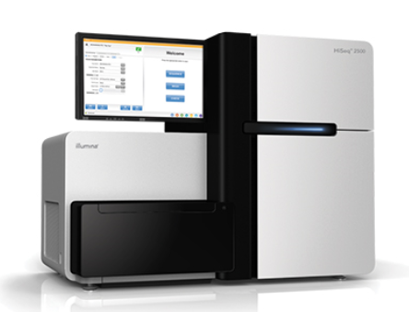
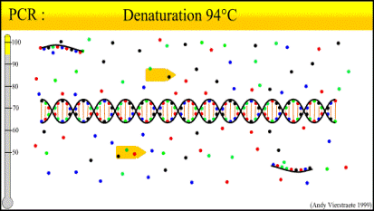
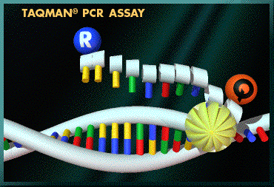
Conventional tools
Diagnostics tools
High-throughput Deep sequencing
Next generation Sequencing (NGS)
Biological Indexing
    Herbaceous indexing
    Woody indexing
Serological techniques
    ELISA
    Nucleic acid-based Assays
    RT-PCR
    Real-time qPCR

Slide 3
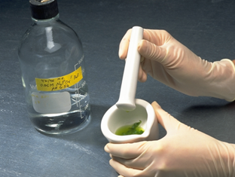
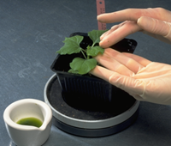
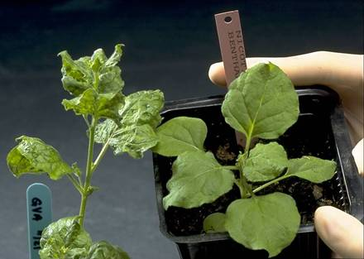
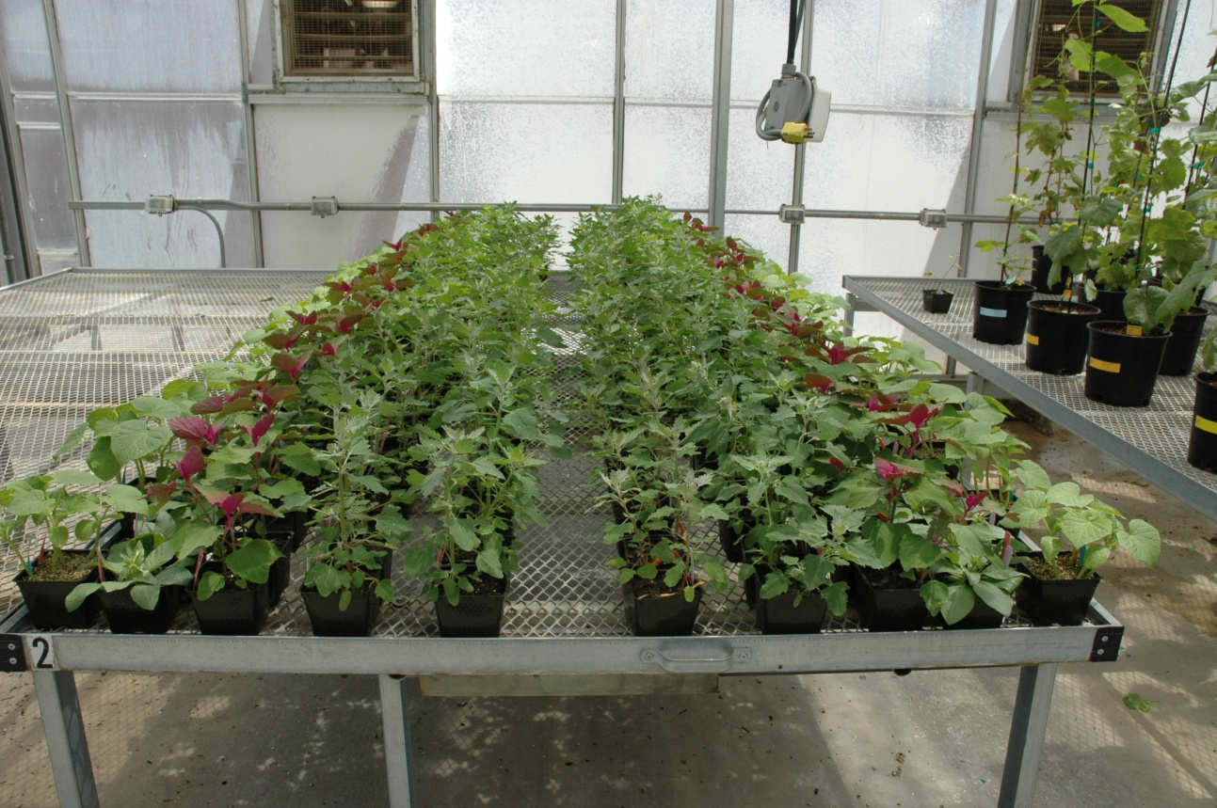
Biological assays using herbaceous hosts
Virus infected
Healthy
Chenopodium amaranticolor
C. Quinoa
Nicotiana clevelandii
Cucumis sativus

Slide 4
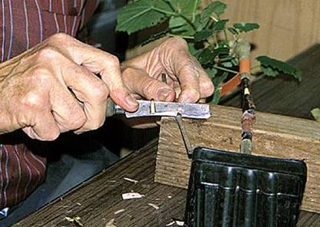
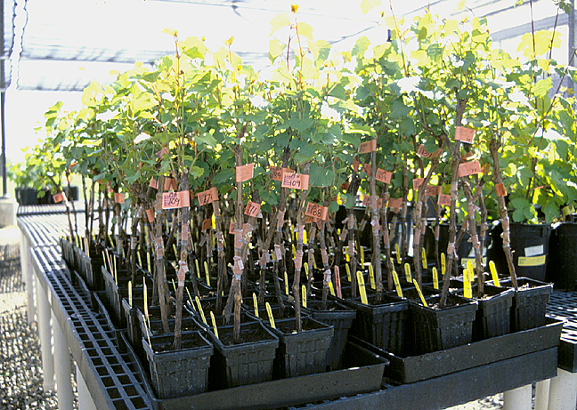
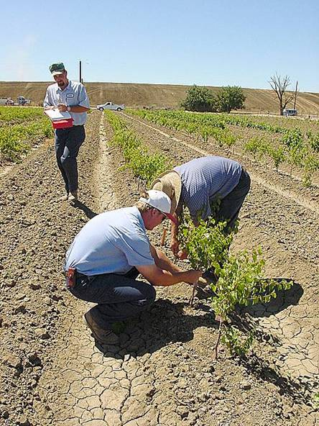
Woody (Field) Indexing
.
Grafting to an indicator vine
Grafted indicator plants
Woody indicator | Disease(s) Detected
Rupestris St. George | Grapevine Fanleaf Virus Grapevine Fleck Virus Grapevine Rupestris Stem Pitting Associated Virus
LN33 | Corky bark
Cabernet franc | Leafroll disease, Red Blotch
Kober 5BB | Kober Stem grooving

Slide 5
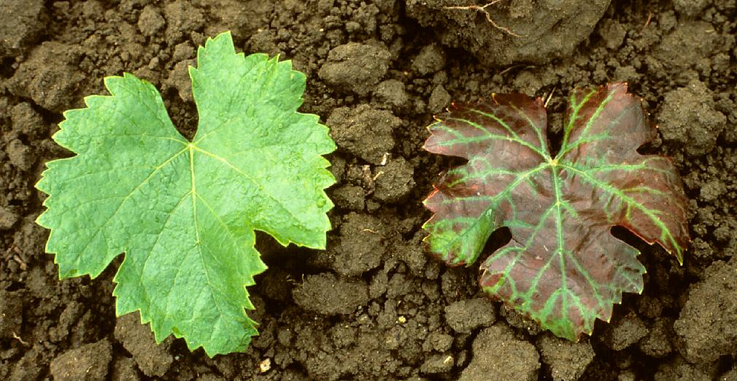
Leafroll Symptoms on Cabernet Franc
Healthy control
Leafroll infected

Slide 6
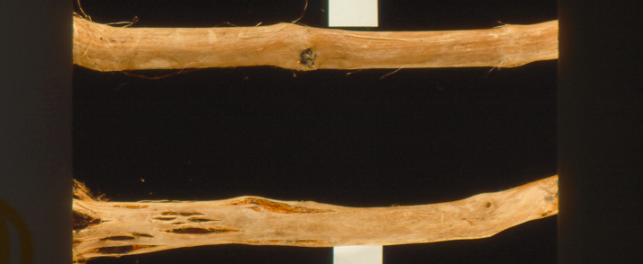
Corky bark symptoms on LN33
Healthy
CB-infected

Slide 7
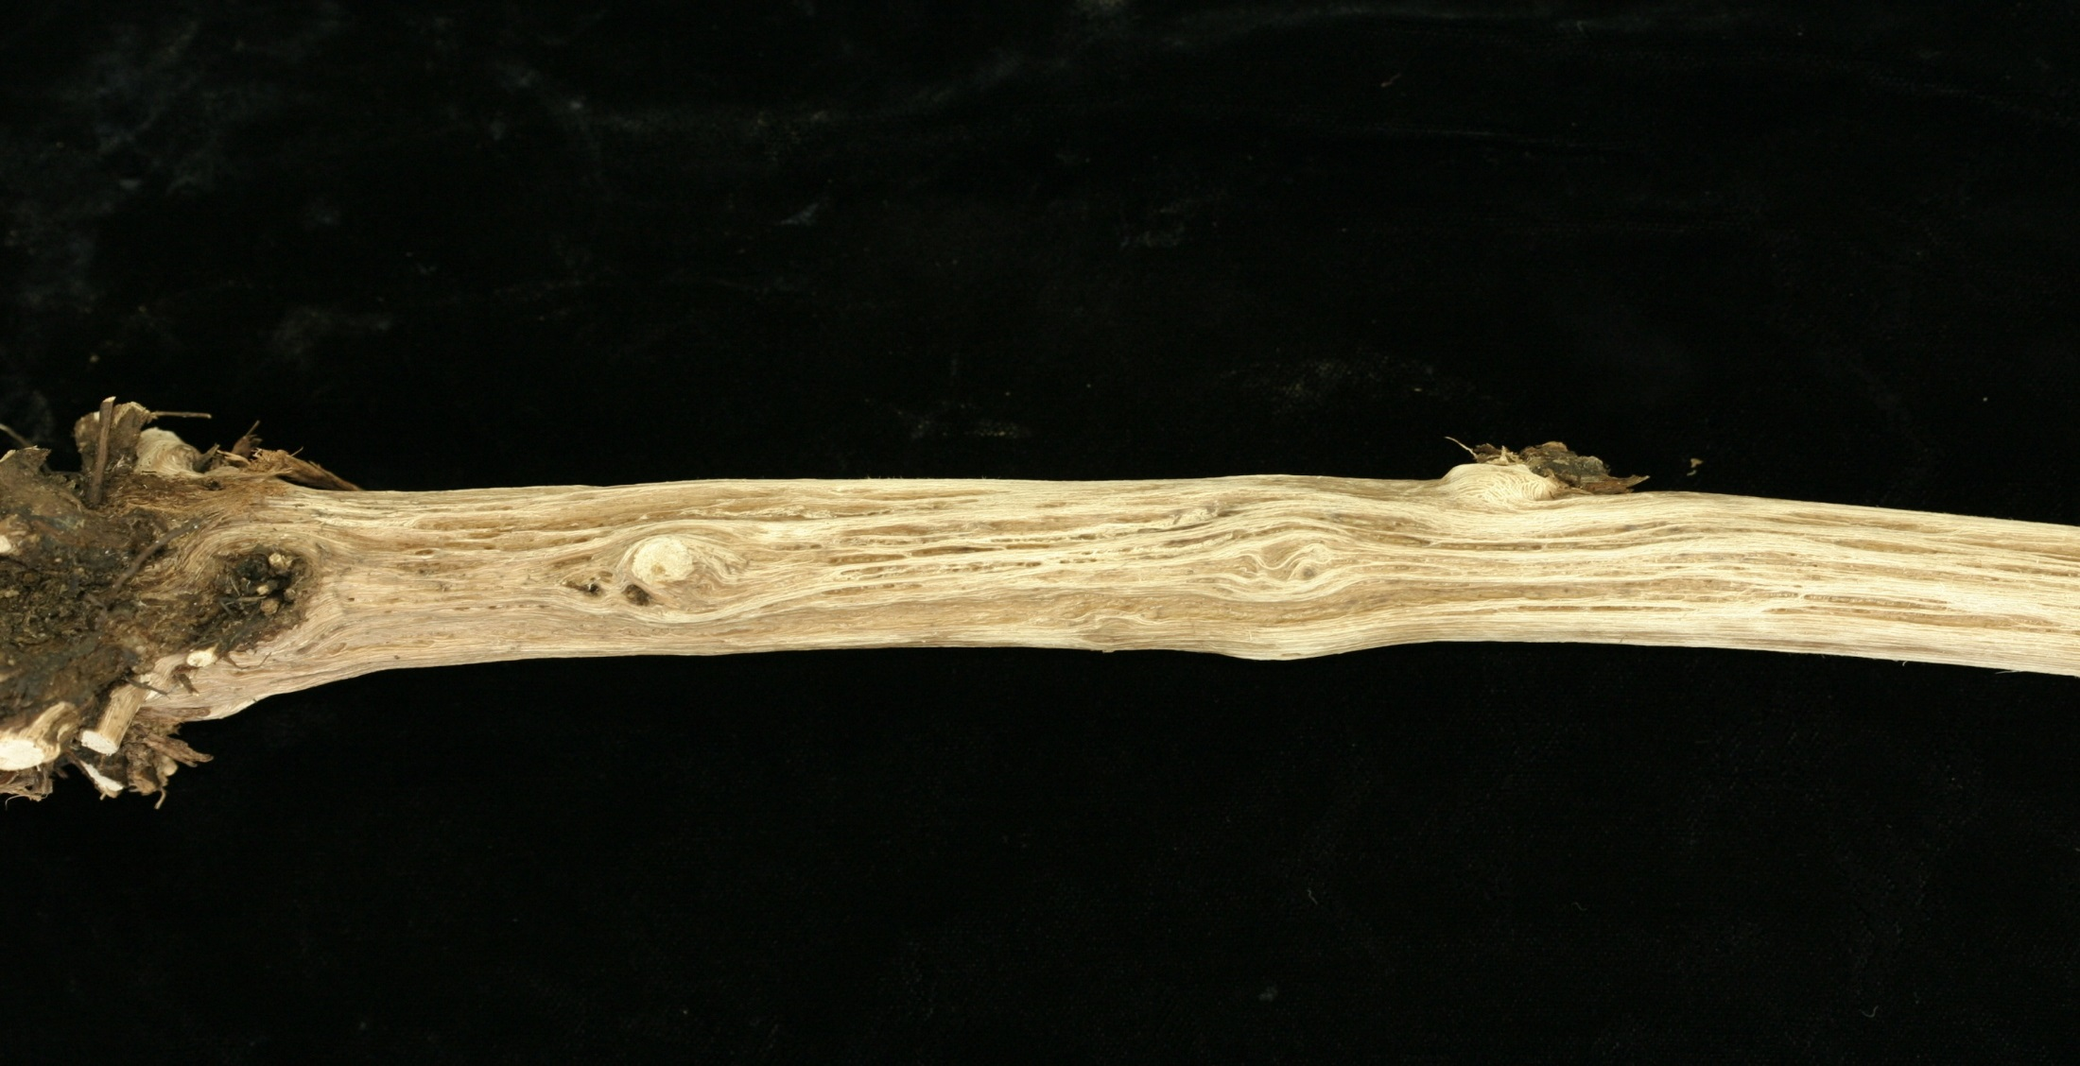
Kober stem grooving symptoms on Kober 5BB

Slide 8
Biological indexing
Advantages:
Broad spectrum; Detects majority of pathogens, including previously unknown agents
Does not require sophisticated laboratory equipments
Does not require technical personnel
Drawbacks:
Does not detect all pathogenic viruses, e.g., can miss GLRaV-2RG, GLRaV-7, some vitiviruses.
Time consuming: takes 2-3 years to complete.
High cost in greenhouse and field space, and labor
Cannot specifically identify pathogenic viruses (further steps required)

Slide 9
Woody indexing reliability
Reliability is variable, e.g., it can be conditional on:
The success of bud-take
The transmission of the virus from the bud to the indicator vine
Effects of climatic conditions on symptom expression
The virus species, and strain

Slide 10
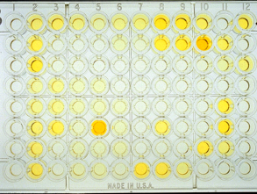
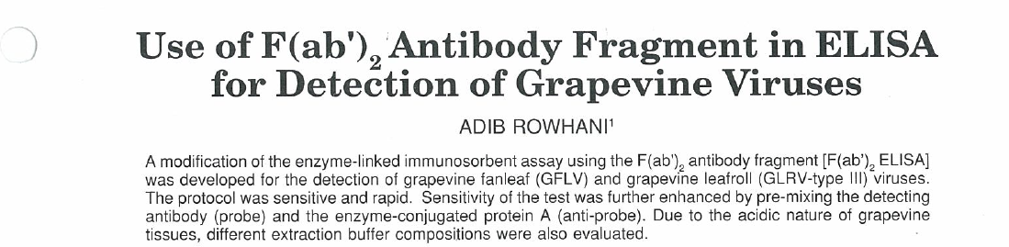
Serological techniques:
Enzyme-linked immunosorbent assay (ELISA)
Since early 1990s
Leafrolls and Nepoviruses (GFLV, ToRSV)
Yr 2000 added (ArMV)
Most antibodies are produced at FPS

Slide 11
ELISA
Advantages:
Fast
Reliable
Less technical
Low cost
Limitations:
Difficult to Produce Reliable Antibodies
Reagents/Antibodies Availability
Effect of low seasonal Virus Titer
Non Specific
Notes:
11

Slide 12
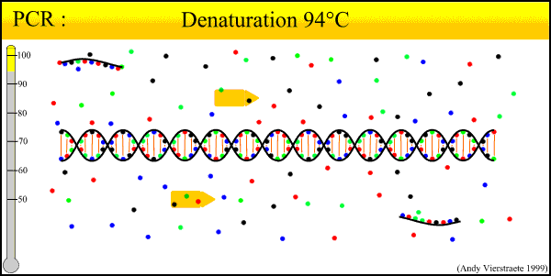
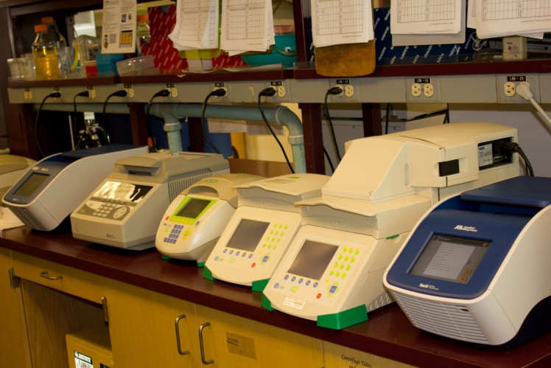
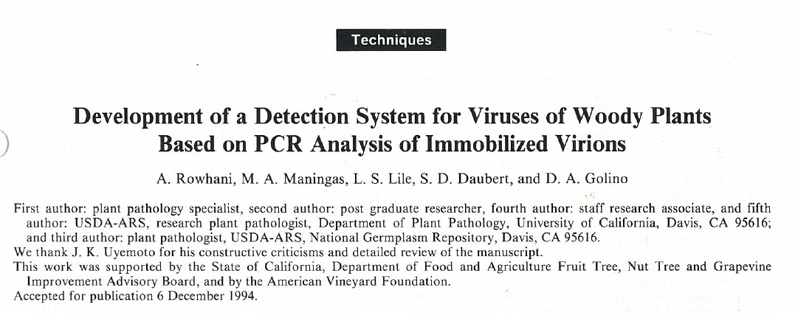
NUCLEIC ACID-BASED ASSAY
Conventional Reverse Transcription-Polymerase Chain Reaction (RT-PCR)
1993 Fanleaf and Leafrolls
Currently FPS has developed and validated assays for 31 grapevine pathogens

Slide 13
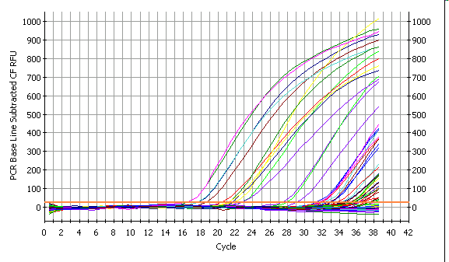
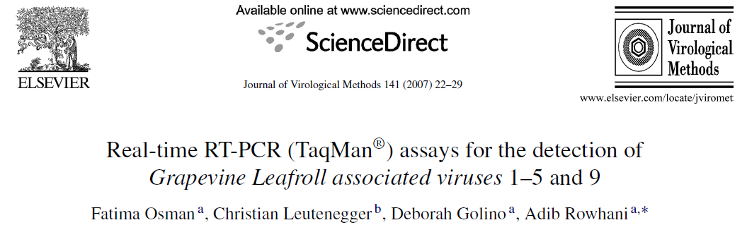
qPCR (real-time quantitative PCR)
Started using in 2001
Able to run more samples faster than ELISA and conventional PCR
qPCR is more than 300 times more sensitive than conventional PCR
Currently is the routine detection method at FPS

Slide 14
MOLECULAR METHODS
Advantages:
Fast
Very sensitive
Specific or universal
Quantitative (Real-time)
High throughput
Limitations:
Requir prior knowledge of the pathogen
Incapable of detecting variants
Trained Technicians
Specialized Equipments .
Risk of Cross Contaminations

Slide 15
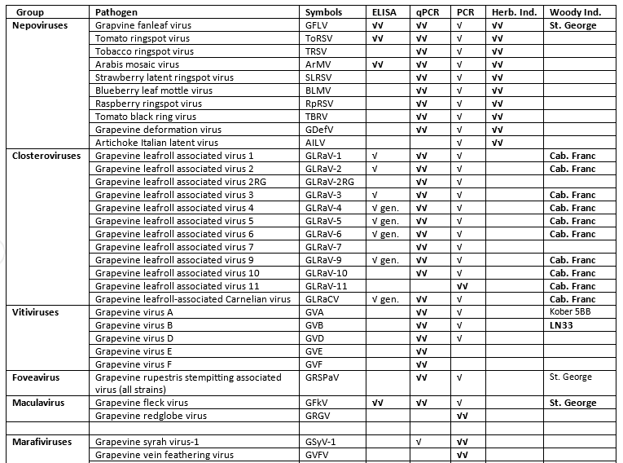
LIST OF AVAILABLE TESTS FOR
(PROTOCOL 2010)

Slide 16
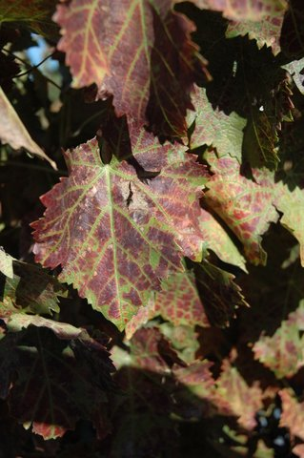
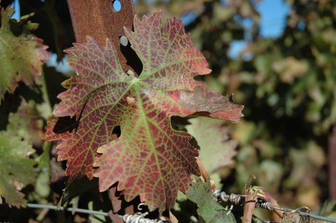

All Standard Detection tests results were negative
Test Type/ # pathogens | Cab Franc 01 | Ruby Cabernet 03
ELISA/ 12 pathogens | negative | negative
Conventional PCR/33 pathogens | negative | negative
qPCR/21 pathogens | negative | negative
Move to broader techniques

Slide 17
Next Generation Sequencing (NGS)
This new technology involves high throughput DNA sequencing
NGS gives a comprehensive picture of the entire microbial profile in a sample

Slide 18
NGS Sequencing Revolution
Millions of short sequences generated for a given DNA sample
Comprehensive picture of the entire microbial profile.
Can sequence 600 Gb of DNA per run Enough to fully sequence complete genomes.

Slide 19




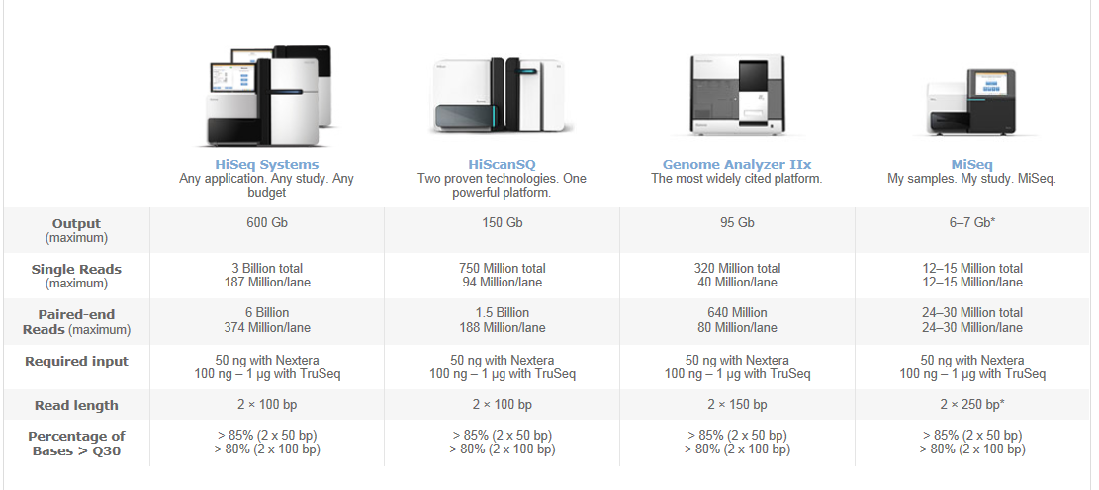
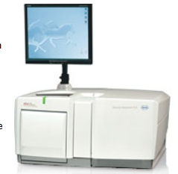
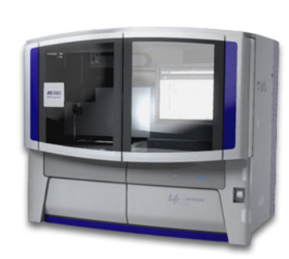
Second Generation Sequencers
 | New GS FLX Titanium XL+ | Illumina HiSeq 2000 | SOLiD 5500xl System Wildfire
Read Length | Up to 1,000 bp | 2 × 100 bp | 50 bp
Throughput | 700 Mb | 600 Gb | 240 Gb
Reads per Run | ~ 1 Million | 6 Billion | 2.4 Billion
Accuracy | 99.997% | 99.99 | Up to 99.99%
Run Time | 23 hours | 8 days | 10 days
limitations | Difficulty to read through repetitive or homopolymer regions | Short reads | Short reads

Slide 20
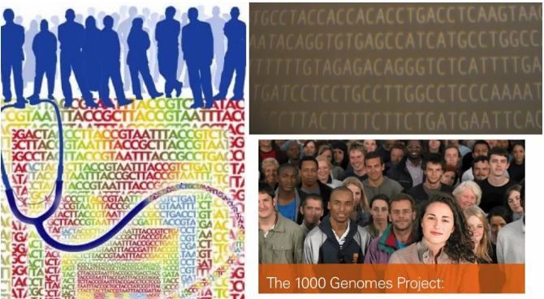
Human genome sequencing project
 | Using traditional methods | Using NGS sequencing
Time | 13 years (1990-2003) | One day (2013)
Cost | 3 billion USD | 1000 USD
The primary goal is to identify what gene variants are involved in different
human diseases

Slide 21
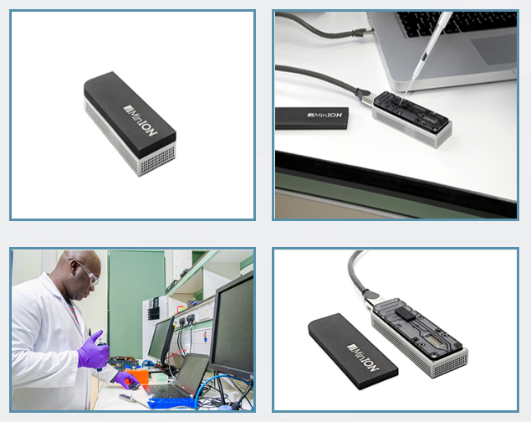

Third generation sequencers
The MinION device is a miniaturized single-molecule analysis system, designed for single use and to work through the USB port of a laptop or desktop computer

Slide 22
Why use NGS technologies? because it’s rapid, accurate and efficient
Advantages:
Extremely rapid: Generates millions of reads in a few hours
Very efficient: Sequences produced from an infected plant will include sequences from any pathogens present (viruses, viroids, phytoplasma,
fungi and bacteria)
Very sensitive: Unknown viruses or very low titer asymptomatic species can be seen for the first time.
Cost effectiveness: More than 150 million reads for less than $1000

Slide 23
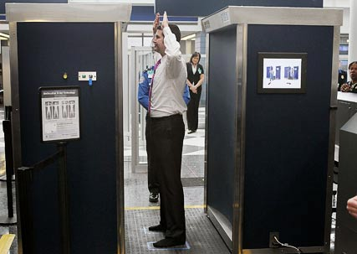
Full Body Scanner

Slide 24
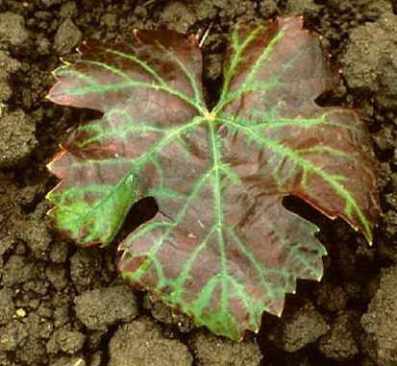
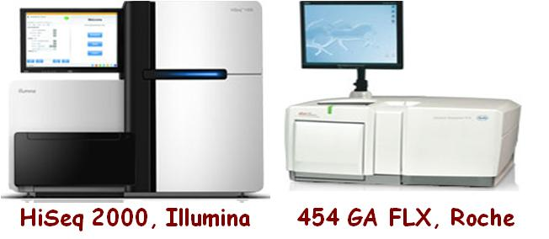
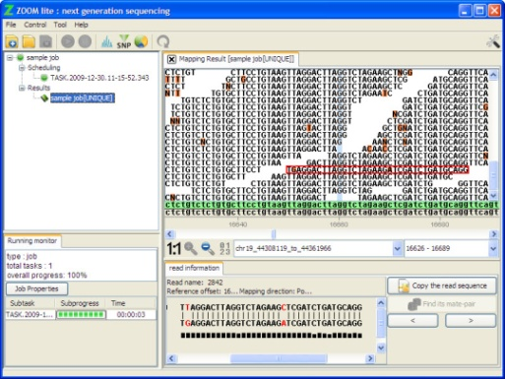
Next generation Sequencing (NGS)
Infected plant material
cDNA Synthesis
Isolated RNA, siRNA, dsRNA
Category
Input | 7,105,243 Reads
Unique Reads | 1,974,507 Reads
Total assembled contigs | 264 ctgs
Ctgs length | 100 nt-9724 nt
Blast Results
Viruses & Viroids | 3,877,117 Reads
Others: Grapevine, Fungal, Bacteria | 3,228,726
Bioinformatics analysis

Slide 25
NGS Current applications
We need to be ready to:
Study new diseases of unknown etiology
Study diseases caused by new strains of known viruses
Further characterize existing undiagnosed diseases:
  Syrah decline diseases
  Red blotch disease
  Graft-incompatibility symptoms
  Leafroll like diseases ( Red leaf)
  Grapevine Vein-Clearing

Slide 26
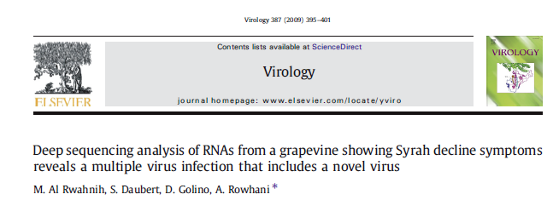
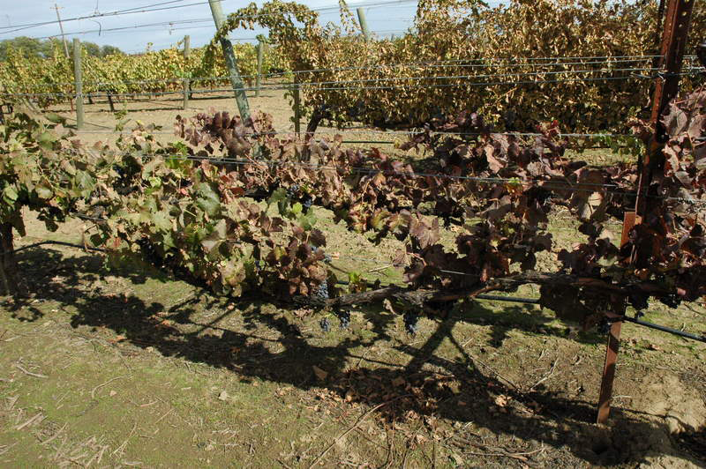
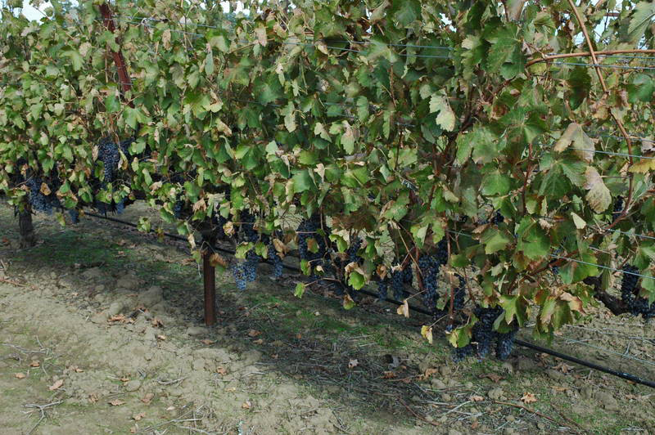
Syrah 08 Syrah 06
Syrah Decline Disease
dsRNAs were used to synthesis cDNA libraries from a declining vine and an (apparently) healthy vine.
We identified a new virus, Grapevine syrah virus-1 (GSyV-1), a tentative member of the genus Marafivirus.
Using the NGS technology, we found seven pathogens, where we only knew of two before.
Notes:
26
26

Slide 27
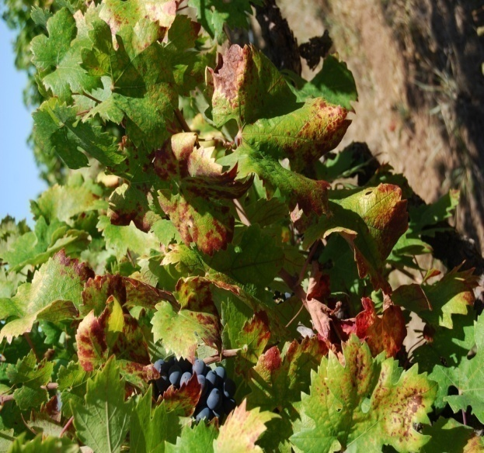
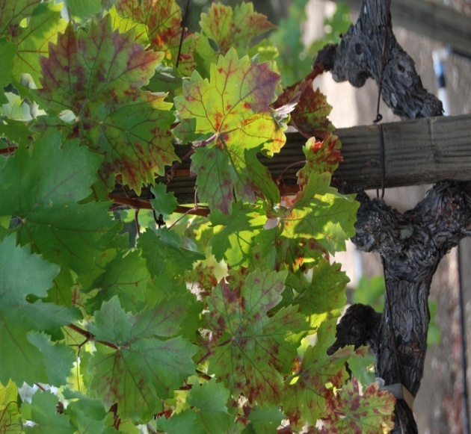
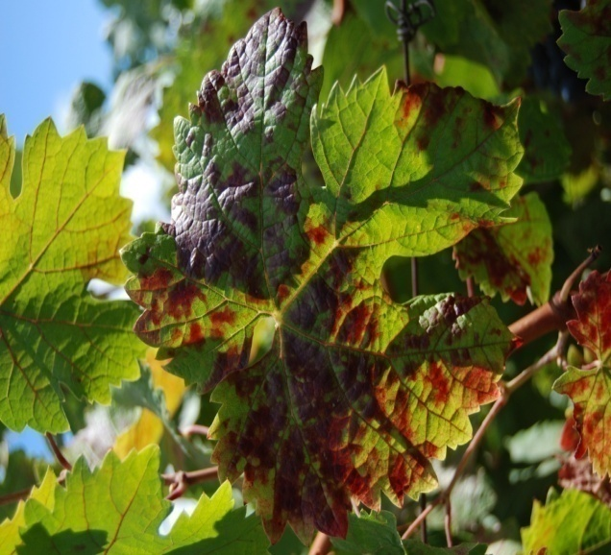
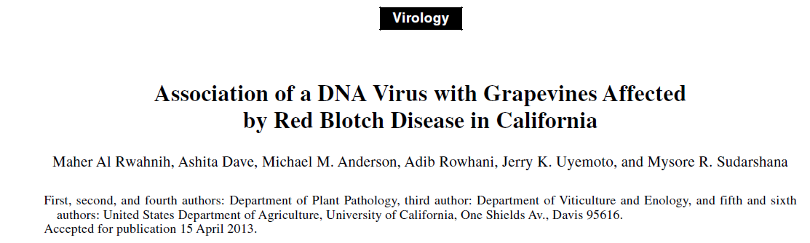
Grapevine red blotch-associated virus (GRBaV)
Red blotches along leaf margin and red veins in red grapevine varieties
Cab Franc 214/101-14
Zinfandel 1A on AXR
dsRNAs were used to synthesis DNA libraries.
discovery of the second DNA virus in grapevine Grapevine red blotch-associated virus (GRBaV) DNA virus

Slide 28
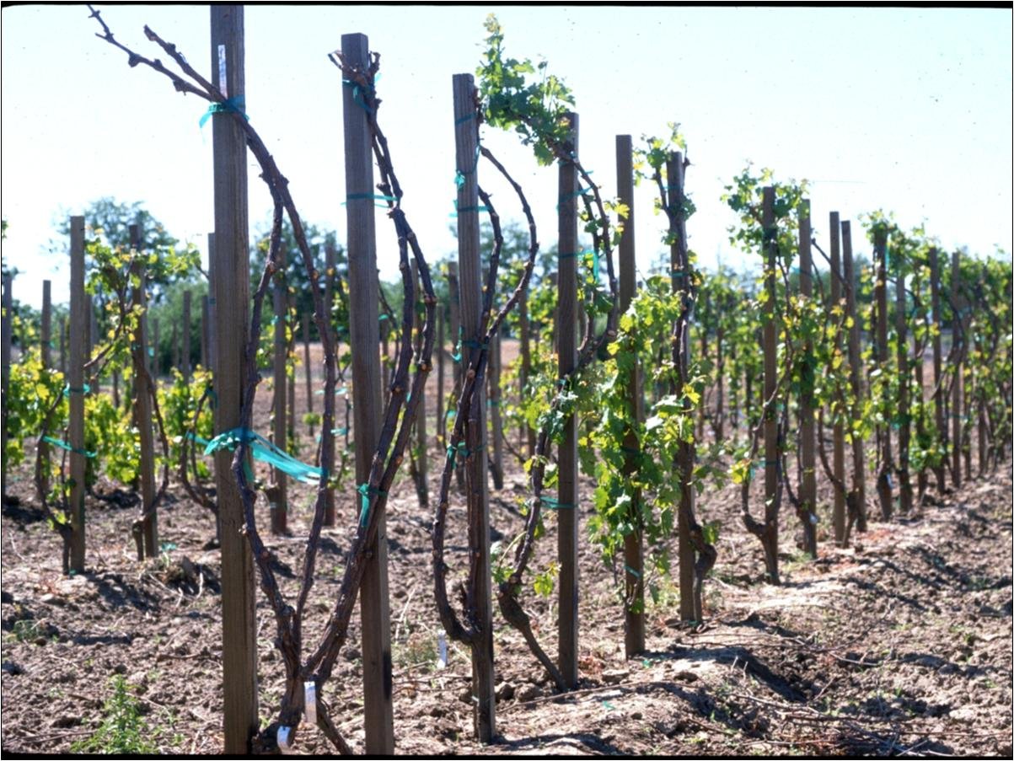
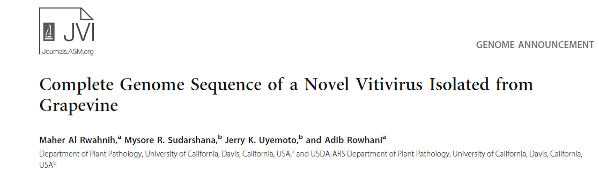
Discovery of new viruses
Graft incompatibility resulting in
death of the Cabernet Sauvignon
plants was observed in four different rootstocks.
dsRNA was used to synthesis DNA libraries
Discovery of a new (Grapevine Virus F; GVF). Family: Betaflexiviridae; Genus: Vitivirus
Dead vines, 2 years post inoculation

Slide 29
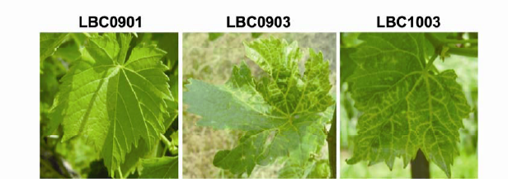
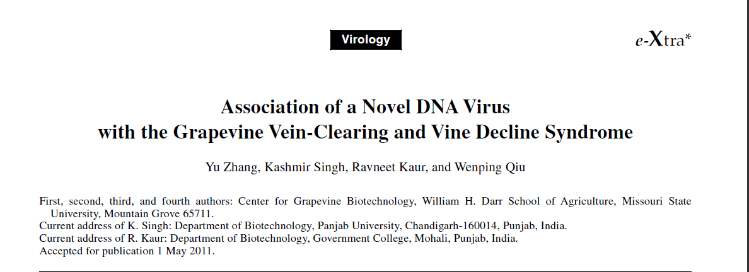
Discovery of new viruses
Healthy
Infected
Infected
Vein-clearing infection from the Midwest region of the U S.
small RNAs were used to synthesis DNA libraries.
The discovery of the first DNA virus of grapevine Grapevine vein clearing virus (GVCV) Family: Caulimoviridae, Genus: Badnavirus
PHYTOPATHOLOGY, Vol. 101, No. 9, 2011 1081-1090

Slide 30
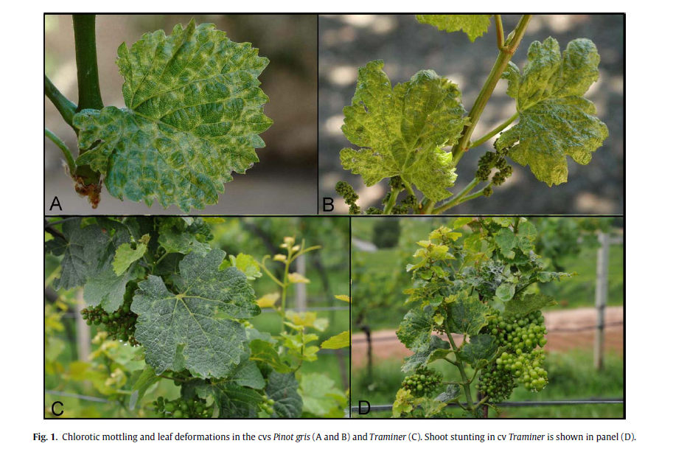
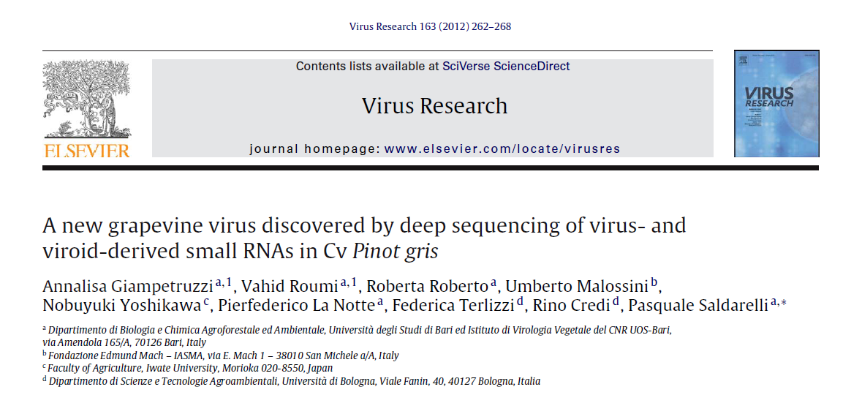
Discovery of new viruses
Chlorotic mottling and leaf deformations were observed on the cv Pinot gris (PG) in the Trentino region (Italy).
small RNAs were used to synthesis DNA libraries
Discovery of a new virus species: Grapevine Pinot gris virus (GPGV). Family: Betaflexiviridae; Genus: Trichovirus

Slide 31
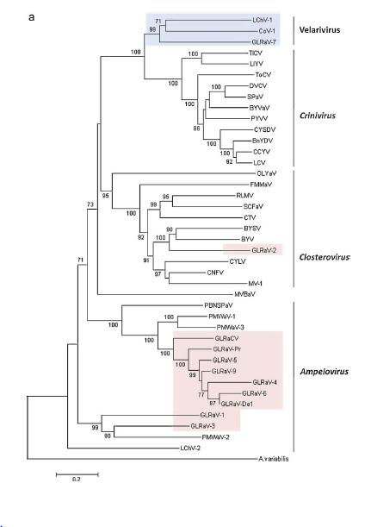
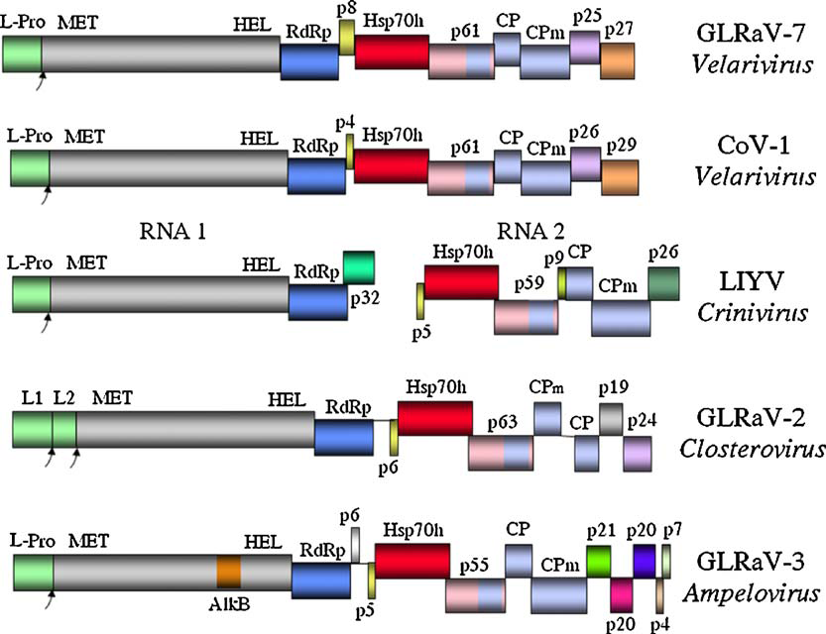
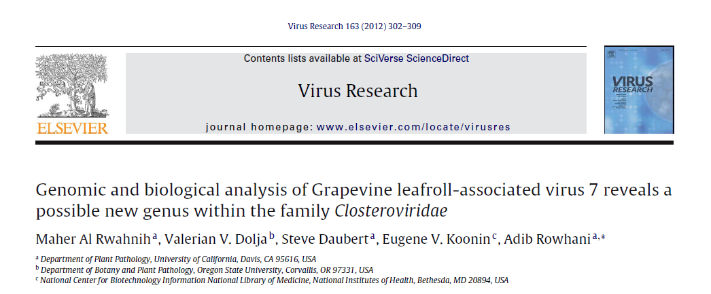
Re-sequencing of known viruses
Hsp70h gene
dsRNA from GLRaV-7 strain Swi was identified in
Pinot Noir clone 23 (PN23)
The average coverage depth was 16, 891-fold per nt

Slide 32
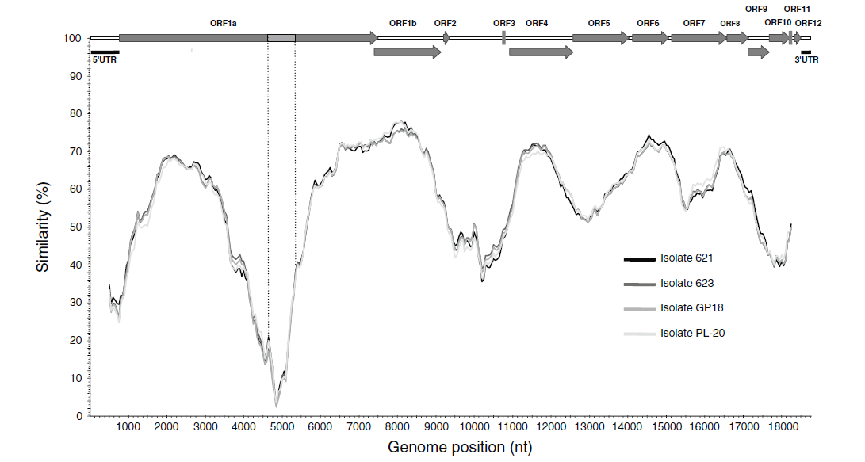
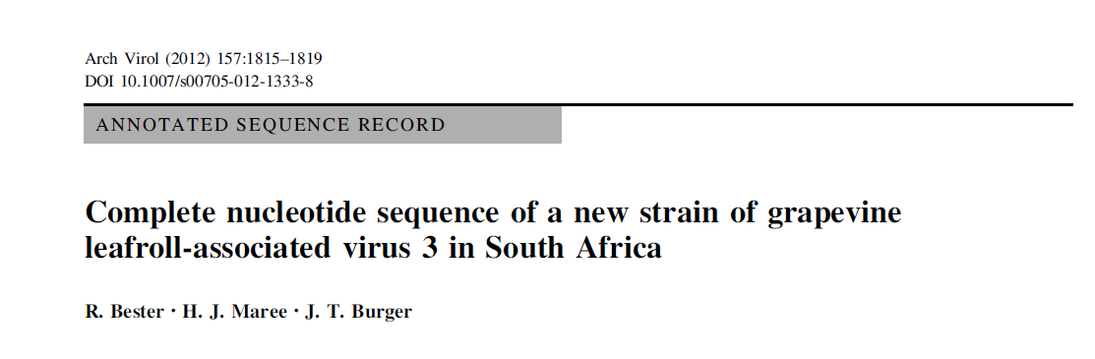
A new strains of GLRaV-3
Re-sequencing of known viruses
The complete genome sequences of two newly identified genetic variants of GLRaV-3 isolates, GH11 (18671 nt) and GH30 (18576 nt) were sequenced and found to be less than 70 % similar to other South African GLRaV-3 variants.

Slide 33
NGS as a routine diagnostic tool for grapevine pathology

Slide 34
The use of NGS as a routine diagnostic tool
Technological challenges:
Developing efficient sample preparation methods for large scale application.
Developing Bioinformatics algorithms to efficiently separate pathogen and host sequences

Slide 35



Sample Preparation
Success of any NGS platform begins with optimal sample preparation
We need to:
Develop and validate new sample preparation protocols (TNA, siRNAs, dsRNA)
Improve efficiency
Decrease cost
Increase throughput
Decrease sample tracking errors
Sciclone® NGS Workstation
Complete library production
Agilent Bravo
VERSA 1100 NGLP

Slide 36

Bioinformatic challenges
Dealing with data management
The POWER of NGS is in the sheer volume of sequence data generated
The PROBLEM with NGS is also in the sheer volume of sequence data generated
TMI!!!
What to do next??
NGS platforms

Slide 37




Bioinformatic challenges
Bioinformatics resources
Online open-source bioinformatics software
University bioinformatics Cores
Bioinformatics companies
User friendly bioinformatic tools for data analysis:
Genome browsing and annotation;
Alignment of sequence reads to a reference;
SNPs detection;
De novo assembly

Slide 38
Limits to NGS based characterizations

Slide 39
Limits to NGS based characterizations
Bioinformatic treatments cannot prove patholgocial causality.
Detection of a given pathogen sequence does not mean that the given pathogen is responsible for the disease.
Koch’s postulates cannot be satisfied using only NGS-based data.

Slide 40

NGS based characterizations:
Discovery of some insignificant background background viruses:
Cryptic viruses
Latent viruses
Asymptomatic viruses
Our main goal is to single out the viruses with high economic impact

Slide 41

Limits to NGS based characterizations
Mixed infection
The most pathogenic viruses in a mixed infection cannot be distinguished from the rest by NGS data.
Grapevine syrah virus-1 (GSyV-1)
Grapevine vein clearing virus (GVCV)
Grapevine Pinot gris virus
(GPGV)
mixed infection with:
GRVFV, GRSPaV, GLRaV-9
AGVd, GYSVd HSVd
GFLV, GRSPaV, ToRSV
GRVFV, GRSPaV, GSyV-1
GYSVd1, HSVd

Slide 42
Limits to NGS based characterizations
Identifying the causal agent
Correlative association is not enough
Finding the putative pathogen in symptomless plants
Finding symptomatic plants free of the putative pathogen
Survey for GSyV-1:
variety | Tested | Infected | %
Syrah & Shiraz | 154 | 30 | 19%
We found GSyV-1 in both symptomatic and health looking vines

Slide 43



Limits to NGS based characterizations
The problem of the unidentified reads
10% Unidentified
7% Unidentified
12% Unidentified
Syrah-B1
Syrah-6
PN-2A
We cannot know if there are any hidden pathogens in the "unknown reads category”

Slide 44

Possible solutions??
Limits to NGS based characterizations
New methods that do not depend on BLAST homology searches:
Separate sequences into clusters based on physical characteristics of the sequences (e.g., di-, tri- or tetranucleotide counts or inter nucleotide distances).
Machine learning (New Algorithms like in the one used for the GHVd RNA example)

Slide 45
Summary
Grapevine virus diagnostics at FPS is constantly updated, by implementing newly optimized sample preparation protocols and improving downstream high throughput detection.
NGS is the most sensitive, comprehensive diagnostic tool available for the study of grapevine diseases.
Nonetheless, NGS is limited in its potential: Bioinformatic treatments ALONE cannot prove patholgocial causality.

Slide 46
Acknowledgments
The following funding agencies:
  American Vineyard Foundation (AVF)
  Fruit Tree, Nut Tree and Grapevine Improvement Advisory Board (IAB)
All my colleagues at FPS

Slide 47
Thank you

Slide 48


Cab Franc 01
NYL Row E9 Vine 3
NYL Row E9 Vine 1

Slide 49

Ruby Cabernet 03
NYL Row E6 Vine 4

Slide 50
NEXT GENERATION SEQUENCING ANALYSIS
Nucleic Acids found | Cab Franc 01 NYL E9 V3 | Ruby Cabernet 03 NYL E6 V4
Viruses infecting grapes (pathogenic and non-pathogenic) | none | Grapevine rupestris vein feathering virus
Viruses infecting fungi (Mycoviruses) | Grapevine associated mycovirus-1 Aspergillus fumigatus chrysovirus Grapevine associated chrysovirus-4 | none
Viroids | none | none
Phytoplasmas | none | none
Host (Grapevine) | Grapevine sequences | Grapevine sequences

Slide 51

Rupestris Stem Pitting on St. George
Healthy control
RSPaV infected

Slide 52


Corky Bark Symptoms on LN33

Slide 53
TECHNIQUES COMPARISON
Criteria | Bio. Index | ELISA | PCR
Speed | Very Slow | Fast | Fast
Efficiency | Low | High | High
Sensitivity | Med. to High | High | High
Specificity | Low | High | Low to High
Labor | High | Low | Low

Slide 54
TECHNIQUES COMPARISON
(Contd.)
Criteria | Bio. Index | ELISA | PCR
Space | High | Low | Low
Equipment | Low | High | High
Training | Low | Medium | High
Envir. Effect | High | Low | Low

Slide 55




Serological techniques
Purified antigen (virus)
Antigen injected into animal
Several weeks later blood collected
Clotted blood centrifuged and clear antiserum separated
Antiserum - serum plus antibodies - kept in vials; glycerin usually added then frozen for storage

Slide 56

Corky bark symptoms on LN33 indicator host

Slide 57

Serological techniques: ELISA
Enzyme-linked Immunosorbent Assay (ELISA)
Specific antibody adsorbed to
plate.
2. Add test samples containing
virus.
3. Add enzyme-labeled specific
antibody.
E
E
4. Add enzyme substrate.
E
E

Slide 58
RT-PCR
RNA
Reverse Transcription
RTase
RNA/cDNA Hybrid
Taq
cDNA
5’
3’
Double-Stranded DNA
3’
5’
Denaturation
Primer Annealing/Extension
Taq
3’
5’
5’
3’
Taq
Polymerization
(Cycle 1)

Slide 59
RT-Polymerase Chain Reaction (PCR)
RNA
RTase
Reverse Transcription

Slide 60
RT-PCR detection of GLRaV-2-RG
1 kb
Healthy 1
Healthy 2
Sample 1
Sample 2
nt
1000
1000
850
650
551 nt
500
400
300
200
100

Slide 61

REAL TIME TAQMAN RT-PCE
Reverse Transcription
RNA
DNA
R
Probe
Q
Probe Annealing
3’
5’
5’
3’
R
Probe
Q
Primer Annealing/Extension
Taq
3’
5’
5’
3’
R
Probe
Probe cleavage
Q
Taq
R
Probe
Polymerization
Fluorescence absorbed
Q
Taq

Slide 62
GLRaV-1 TaqMan assay
Protocol
Cycle 1: ( 1X)
Step 1: 45.0ºC for 35:00
Cycle 2: ( 1X)
Step 1: 95.0ºC for 10:00
Cycle 3: ( 40X)
Step 1: 95.0ºC for 00:15
Step 2: 60.0ºC for 01:00
Data collection and real-time analysis enabled.
Cycle 4: ( 1X)
Step 1: 4.0ºC HOLD
PCR Quantification Spreadsheet Data for FAM-490
Well Identifier Ct
A01 1-LDA-TC 5 18.9
A02 2-LDA-TC 5 22.7
A03 3-LDA-TC 5 20.7
A04 4-LDA-TC 5 18.2
A05 5-LDA-TC 5 19.8
A06 6-LDA-TC 5 N/A
A07 7-LDA-TC 5 N/A
A08 8-LDA-TC 5 N/A
A09 9-LDA-TC 5 20.7
A10 10-LDA-TC 5 22.1
A11 11-LDA-TC 5 20.5
A12 12-LDA-TC 5 27.8
B01 13-LDA-TC 3 16.5
B02 14-LDA-TC 5 27.1
B03 15-LDA-TC 5 29.0
B04 16-LDA-TC 5 21.7
B05 17-LDA-TC 5 18.5
B06 18-LDA-TC 5 17.6
B07 19-LDA-TC 5 29
B08 20-LDA-TC 5 21.8
B09 21-LDA-TC 5 23.7
B10 22-LDA-TC 5 15.6
B11 23-LDA-TC 5 27.3
B12 24-LDA-TC 5 17.6
C01 25-LDA-TC 5 22.6
C02 26-LDA-TC 5 21.9
C03 27-LDA-TC 5 22.8
C04 28-LDA-TC 5 24.3
C05 29-LDA-TC 5 N/A
C06 30-LDA-TC 5 15.4
C07 31-LDA-TC 5 N/A
C08 32-LDA-TC 5 15.4
F06 66-+ve virus-TC 5 16.1
F07 67-water-LDA-TC 5 N/A

Slide 63

Real-Time qPCR
PCR Quantification Spreadsheet Data for FAM-490
Well Identifier Ct
A01 1-LDA-TC 5 18.9
A02 2-LDA-TC 5 22.7
A03 3-LDA-TC 5 20.7
A04 4-LDA-TC 5 18.2
A05 5-LDA-TC 5 19.8
A06 6-LDA-TC 5 N/A
A07 7-LDA-TC 5 N/A
A08 8-LDA-TC 5 N/A
A09 9-LDA-TC 5 20.7
A10 10-LDA-TC 5 22.1
A11 11-LDA-TC 5 20.5
A12 12-LDA-TC 5 27.8
B01 13-LDA-TC 3 16.5
B02 14-LDA-TC 5 27.1
B03 15-LDA-TC 5 29.0
B04 16-LDA-TC 5 21.7
The increase in fluorescent signal is directly proportional to the quantity of amplicons produced

