Slide 1
The Impact of Microbial Dynamics on Fermentation Progression
RAVE 2015
Linda F. Bisson
Department of Viticulture and Enology
University of California, Davis

Slide 2
Causes of Fermentation Arrest
    Nutrient limitation
    Nutrient imbalance
      Potassium versus pH
      Nitrogen versus vitamins
      Sterols versus lipids
    Physical intolerances (Abiotic stress)
      Temperature
      pH
    Biotic Stress
      Oxidative
      Ethanol

Slide 3
Causes of Fermentation Arrest
    Microbial competition
    Microbial inhibition

Slide 4
Microbial Competition
For growth nutrients
  Macronutrient: Nitrogen
  Micronutrients
  Oxygen
For environmental modification
  Redox potential
  pH levels

Slide 5
Microbial Inhibition
Production of toxins
  Organic acids
  Fatty acids
  Peptides
  Other toxins: killer factors
Modification of biological activity
  Removal of essential nutrients redirecting metabolism
  Induction of novel metabolic states

Slide 6
Sources of Microbial Competitors
Vineyard: grapes at harvest
Winery surfaces
Inoculation practices

Slide 7
Inhibitory Microbiota
Lactic acid bacteria
Acetic acid bacteria
Killer factor producing yeast
  Saccharomyces
  Non-Saccharomyces

Slide 8
Challenging Microbiota during Fermentation
May arise in vineyard
May produce inhibitors early that have no impact until later in fermentation
Evidence toxin is present: difficulty in restarting

Slide 9
Research Protocol
Identify sluggish and arrested fermentations with evidence of non-yeast microbial proliferation
Characterize microorganisms for:
  Inhibition (causative of arrest)
  Neutral (opportunistic growth)
  Induction of altered metabolic states of Saccharomyces
Determine if isolates impact growth or fermentation of Saccharomyces
Evaluate impact of presence of microbe during juice fermentation

Slide 10
Previously Known Challenging Microbiota
Lactobacillus species
  Pediococcus
  Lactobacillus kunkeei
  Lactobacillus sp.(strains)

Slide 11
Problematic Fermentations
Lactobacillus microbiota of fruit characterized by:
  Low numbers of Lactobacillus kunkeei,
  Low to high numbers of other Lactobacillus species
  Low to high numbers of Pediococcus

Slide 12
Emerging Problematic Microbiota
Acetic acid bacteria
Prion-inducing bacteria

Slide 13
Emerging Problematic Microbiota
Acetic acid microbiota of fruit characterized by high populations of one or more:
    Acetobacter orientalis
    Acetobacter ghanensis
    Acetobacter malorum
    Gluconobacter cerinus
    Gluconobacter japonicus
Persistence of Acetic Acid Bacteria
  During fermentation
  Viable in finished wine
  Acetic acid levels creep up
  Early tests suggest high SO₂ tolerance levels of some of these bacteria

Slide 14
Reasons for Fermentation Arrest
Competition for nutrients
Microbial inhibitors present
Induction of [GAR⁺] prion: heritable reduction in glucose metabolic rates

Slide 15
The GAR⁺ Prion
GAR= Glucose Associated Repression Resistant
Reduction of sugar transport
Reduction of fermentation activity
Loss of competitiveness for nutrient uptake

Slide 16
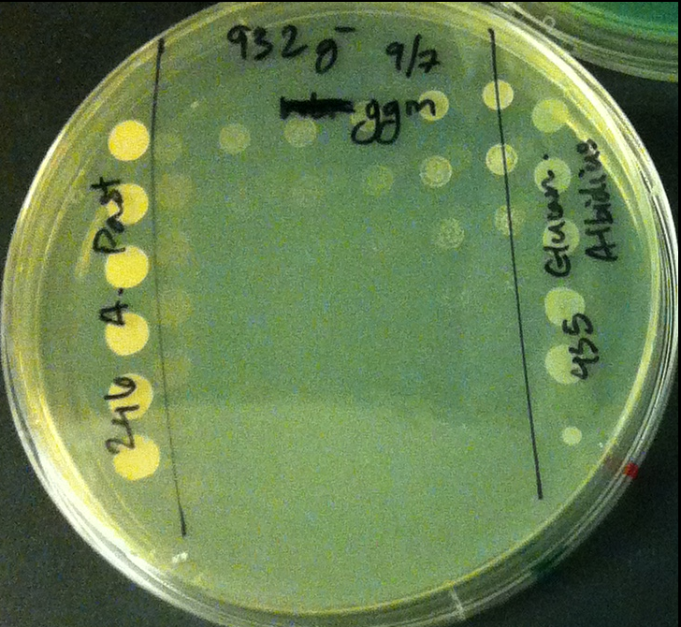
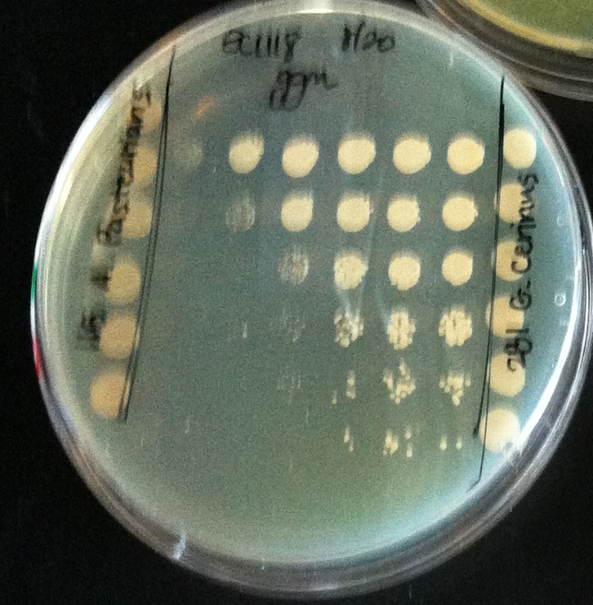
Acetobacter pasteurianus: inhibition
Gluconobacter cerinus: Induction of GAR⁺ phenotype

Slide 17
Impacts on Yeast
Factors are diffusible
Induction of prion enables cells to use compounds other than glucose: acetic acid?: Inhibition decreases
Acetobacter inhibition for some species is strain dependent: not acetic acid?

Slide 18
Future Goals:
Assessing over 130 wine samples from incidences of fermentation arrest in the 2014 harvest
All show bacterial issues
  Arose before or after arrest?
  Multiple bacteria present
  Identifying viable bacterial species
  Tests of bacteria for inhibition/induction
  Tests of bacteria for sulfur dioxide sensitivity
Assessment of metabolites secreted by microbes
  Inhibitory
  GAR⁺-inducing

Slide 19
Acknowledgements
Funding:
American Vineyard Foundation
VEN Department Scholarships
Researchers:
  Lucy Joseph
  Yan Luo
  Peter Luong
  Vidhya Ramakrishnan
  Gordon Walker

