Slide 1

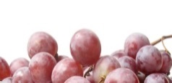
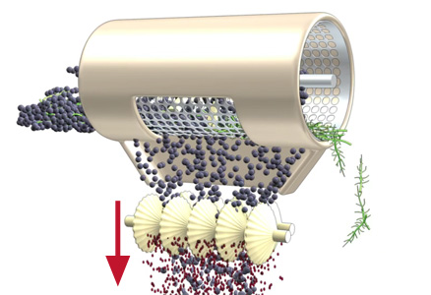
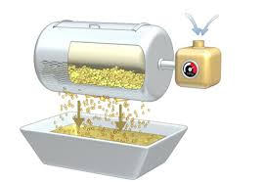
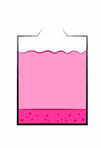
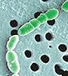
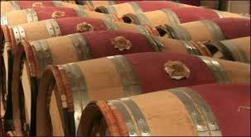
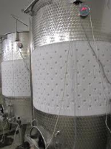
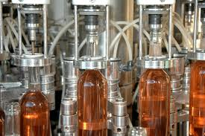
Blending Innovative Technology with Unparalleled Service
Optimizing the Sustainability of Winery Processing
Fining and Filtration Strategies to Reduce Final Waste:
Integrative Approach
Maria Navarro
Enartis Vinquiry USA

Slide 2
Finning - improving wine organoleptic quality and stability
Possible strategies:
  SUBTRACTIVE APPROACH
  Use of fining agents
    Sometimes is the only solution
    Not selective, removal of positive attributes
    Requires more cellar work
    Waste
  ADDITION APPROACH
  Use of additives (tannins, polysaccharides, enzymes)
    Improves and maintains wine quality and keeps wine positive attributes
    Improves colloidal stability
    Improves oxidation potential and shelf life
    Reduces processing time
    May help to avoid the use of fining agents
Notes:
The approach Enartis has is to provide tools that use throughout the winemaking process to achieve wine organoleptic quality and complete stability

Slide 3
Integrative winemaking
Enartis provides strategies to reduce the need of final treatments
Harvest
Ageing
Fining
Complete wine stability throughout
Filtration
Notes:
Chill out program
Color stability
SLI
What can we do at each stage to improve wine stability?
What can we do at each stage to improve wine organoleptic qualities?

Slide 4
Alternatives to fining
Protein Stability
Protease activity enzymes at maceration
Yeast Polysaccharides during fermentation and ageing
Enological tannins during fermentation
Bentonite additions during Fermentation
Notes:
Alternatives

Slide 5
Alternatives to fining
Tartrate Stability
Yeast Polysaccharides during fermentation
Colloidal stabilizers prior to bottling
  CMC
  Gum Arabic
Notes:
Potassium bi-tratrate contact seeding
Chilling
ED

Slide 6
Alternatives to fining
Color Stability
Enzymatic preparations with protease activity
Antioxidant protection
Condensed grape seed tannins to favor condensation
Mannoproteins and tannins to favor co-pigmentation
Micro-ox regimes to favor color stability
Notes:
Alternatives

Slide 7
ALTERNATIVES TO FINING
Overall Mouthfeel and structure
Use of enological tannins
Use of oak alternatives
Use of polysaccharides
Mico-ox regimes

Slide 8
ALTERNATIVES TO FINING
Conclusion
Use of integrative approach:
Better quality
Less need for final treatments
Less waste
Reducing cost and time of production

