Slide 1
Brettanomyces Wine Spoilage
Lucy Joseph
Department of Viticulture and Enology
U.C. Davis

Slide 2
Introduction
Brettanomyces is considered to be the primary spoilage yeast in finished wine
Usually a problem of aging in barrels
Especially undesirable in bottles
However, many consumers and critics like the complexity that is derived from Brett growth in wine

Slide 3
History - Wine
In the late 1940’s Brettanomyces was found in Italian wines by Onorato Verona and Gino Florenzano.
In the late 1950’s Brettanomyces was identified as a spoilage problem in South African wines by van der Walt and van Kerken.
Since that time it has been found in all wine making regions.

Slide 4
History
Was first isolated and named in beer
Used in Belgian style and coolship ales
In Belgium these beers can only be made when the prevailing winds are from North Africa
Outside of fermentations, grape berries is the only other niche where B. bruxellensis was found

Slide 5

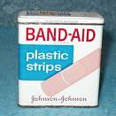
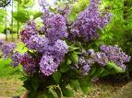
Brettanomyces Aromas in Wine
Horse sweat - Leather
Earthy
Medicinal
Band Aid
Smoky
Tobacco
Barnyard
Putrid
Lilac

Slide 6
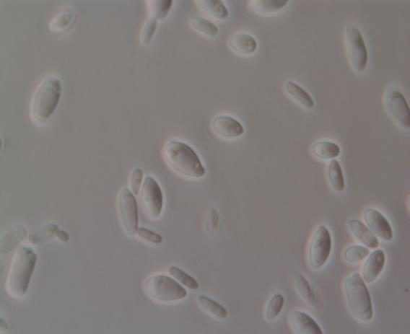
Typical small spheroidal budding yeast. Variable morphology with ogival, elongated cells, sometimes boat or spoon shaped.

Slide 7
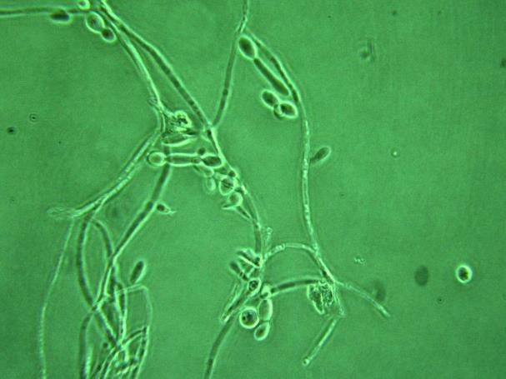
Forms non-septate or pseudomycelia especially on solid media.

Slide 8
Brettanomyces Genetics
Very different from Saccharomyces but there are some similarities probably due to the environments where they are found
Triploid strains appear to be more common than in other yeasts
Most strains appear to reproduce clonally
Genes for use of methanol as a substrate are present in sequenced strains
Spore formation is rare or non-existent and a related genus show more than 2 mating types

Slide 9
Brettanomyces Metabolism
Most Brett strains ferment better with oxygen (Custers affect)
Nitrate can stimulates growth anaerobically
Brettanomyces can produce high levels of acetic acid compared to Saccharomyces
Brett tends to be a scavenger of nutrients especially amino acids
Brett survives for long periods in wine and has been isolated from wine that was nearly 100 years old

Slide 10
Methods of Detection
Plating with cycloheximide (WLD)-slow
Microscopic evaluation-subjective
Chemical indicators: 4-ethyl phenol and 4-ethyl guaiacol-tells you if you had Brett
Antibody based methods
  ELISA: specific antibodies-phenolics interfere
  Fluorescence probe, fluorescence microscope
Sensory based methods-subjective
Q-PCR-rapid, expensive but prices dropping
  Scorpion- ETS
  Veriflow – Invisible Sentinel
  GeneDisc - Pall

Slide 11
Greatest Odor Impact by GC-O

Slide 12
Ageing Alters Flavor
Brettanomyces has high esterase activity
Vinyl phenols are converted to ethyl phenols
Volatile phenols suppress perception of other flavors

Slide 13
Fusel Alcohols
Phenethyl alcohol – floral, rose, rose water, sweet, bready with a rosy honey nuance
2-methyl-1-butanol – roasted, wine, onion, fruity
3-methyl-1-butanol (isoamyl alcohol) - pungent, ethereal, cognac, fruity, banana, molasses, whiskey
2-ethyl-hexanol – fatty, fruity, citrus, fresh, floral, oily, sweet
2-methoxy phenethyl alcohol – aromatic, chemical, white glue, vinyl

Slide 14
Esters
Butyric acid ethyl ester– fruity, juicy fruit, pineapple, cognac, tutti frutti, apple, fresh and lifting, ethereal
Formic acid n-amyl ester – ethereal, fruity, unripe banana, green, earthy
Ethyl isovaleric acid – fruity, sweet, apple, pineapple, tutti frutti, spice, metallic and green, sharp
Ethyl valerate – sweet, fruity, apple, pineapple, green, tropical, acidic, pineapple, apple, green, berry, tropical
2-methyl butyric acid ethyl ester – sharp, green apple, berry, fresh tropical nuances, grape, pineapple, mango and cherry notes
Phenethyl formic acid – rose, green, hyacinth, watercress, herbal
Octyl butyrate – fresh, waxy, fruity, oily, earthy, jasmin, with a green creamy nuance
Caprylic acid n-amyl ester – orris, sweet, winey, cognac, elderflower, fatty

Slide 15
Ethyl and Vinyl Phenols
4-ethyl phenol – phenolic, BandAid, castoreum, smoke, guaiacol, creosote, savory
4-ethyl guaiacol – spicy, smoky, bacon, phenolic, clove, medicinal, woody and sweet vanilla nuances
2-methoxy-4-vinyl phenol – dry, woody, fresh, amber, cedar, roasted peanut, smoky, bacon

Slide 16
Terpene
Ocimene – fruity, floral, wet cloth, citrus, tropical, green, woody with vegetable nuances
Bisabolene – balsamic, woody, citrus, myrrh, sweet myrrh, spicy, citrus, tropical, floral, fruity, astringent and green
Aldehyde
Nonyl aldehyde – waxy, aldehydic, rose, fresh, orris, orange peel, fatty, effervescent, aldehydic, cucumber, melon rind, raw potato, oily, green lemon peel, nutty and coconut like nuances

Slide 17
Fatty Acids
Undecanoic acid – waxy, creamy, cheese, fatty coconut, fatty dairy mouthfeel
Heptanoic acid (caprylic acid) – rancid, sour, cheesy, sweaty, waxy, fermented, dirty and fatty, pineapple and fruity
N-butyric acid – sharp, acetic, dairy-like, cheesy, buttery with a fruity nuance, sour

Slide 18
Control Strategies
Sulfite - optimal in barrel is 0.6 mg/L molecular
Temperature – 15ºC may slow Brett growth
Vitamin supplements may increase Brett spoilage but nitrogen has little affect
Low oxygen during aging decreases Brett
New oak barrels may increase Brett as does contaminated barrels

Slide 19
Spoilage Mitigation Strategies
Sulfite use – maintain optimal levels
DMDC use at bottling
B-glucanase, peptides, lactoferrin – killer yeast, high concentration required
Chitosan – commercial preparation available
Filtration and fining – alone and in combination
Sanitation – overall winery and barrel

Slide 20
Is There a “Good” Brett?
Defined medium was used
Supplemented with amino acids
All strains will make 4EP and 4EG with coumaric and ferulic acids

Slide 21
Important Compounds That Determine Differences
With Amino Acids

Slide 22
Relative Concentration of Compounds in “Most Liked” Strains – Amino Acid Supplemented
⬇Phenethyl acetate – Sweet, honey, floral rosy
⬆Ethyl decanoate – sweet, waxy, fruity, apple
⬇Ethyl hexanoate – sweet, fruity, pineapple, waxy green banana
⬇Ethyl octanoate – fruity, wine, waxy, sweet
⬇2-phenylethanol – floral, rose, rose water
⬇Octanoic acid – fatty, rancid oil, cheesy
⬆Ethyl acetate – nail polish remover, solvent
⬇3-methylbutanoic acid – sour, stinky feet, sweaty, cheese
⬆Decanoic acid – rancid, sour, fatty, citrus
⬆2-phenylacetaldehyde – honey, sweet, rose, green, grassy

Slide 23
Important Compounds That Determine Differences
With Cinnamic and Amino Acids

Slide 24
Relative Concentration of Compounds in “Most Liked” Strains – Amino Acid and Phenolic Acid Supplemented
⬇Ethyl octanoate – fruity, wine, waxy, sweet
⬇2-phenylethanol – floral, rose, rose water
⬇Ethyl decanoate – sweet, waxy, fruity, apple
⬇4-ethylphenol – medicinal, Band-Aid, barnyard
⬇4-ethylguaiacol – spicy, smoky, phenolic, clove
⬇Octanoic acid – fatty, rancid oil, cheesy
⬇Decanoic acid – rancid, sour, fatty, citrus
⬇Phenethyl acetate – Sweet, honey, floral rosy
⬇Ethyl acetate – nail polish remover, solvent
⬇Decanol – waxy, floral, orange, sweet

Slide 25
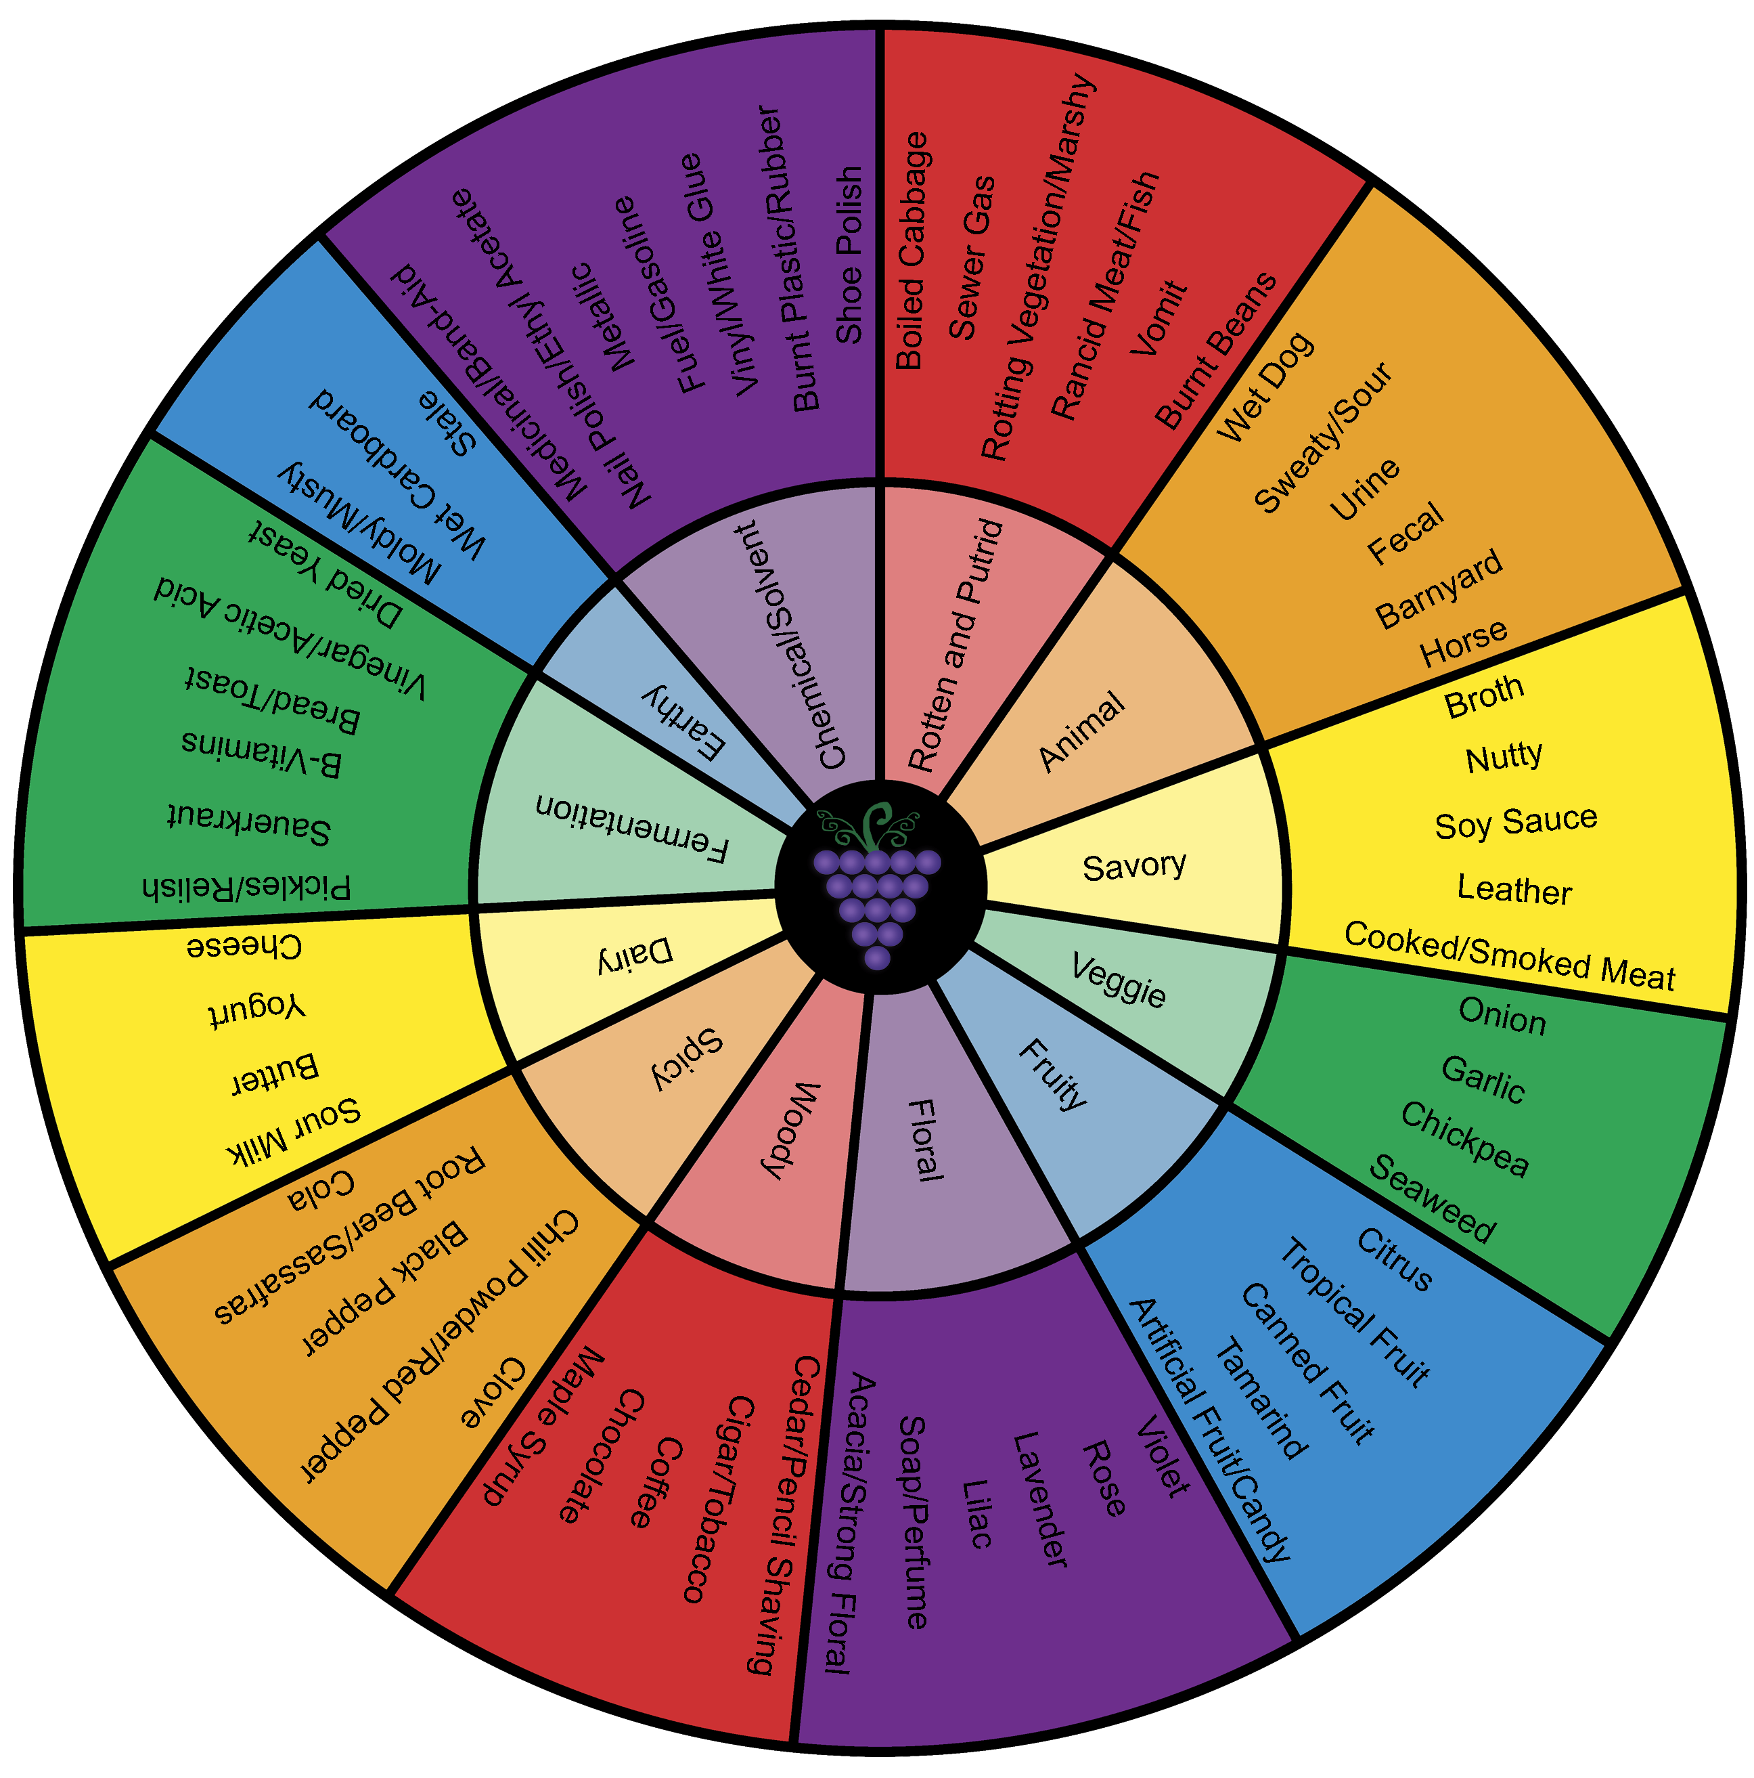

Slide 26
Using Descriptors
Wines were purchased from an online site by searching using descriptors from the aroma wheel
These wines were tested for the presences of microbes by plating, microscopy, and qPCR
Wines were also analyzed for 4EP and 4EG

Slide 27
What We Found
30 wines were selected
57% had lactic acid bacteria contamination
27% showed evidence of Brettanomyces
16% had both Brett and LAB contamination
All of the wines were positive for microbial contamination

Slide 28
Vintage | Variety | Microbes Present | Descriptors | Descriptor Categories
2004 | Red Bordeaux Blend, France | LAB, Brett | cedar, tobacco, underbrush, smoke/burning embers, toast, cigar smoke, Asian spices | savory, spicy, woody
2006 | Sangiovese Grosso, Italy | LAB, Brett | cooked meat, tar, smoke, new leather, forest floor and root beer | savory, chemical, spicy, earthy
2007 | Sangiovese, Italy | LAB, Brett | musky, black truffle, roses, spice, tobacco, ginger, cola, leather and game | earthy, floral, spicy, woody, savory, animal
2007 | Red Bordeaux Blend, Australia | Brett | spice box, violets, pencil lead, leather, warm earth, and sweet tobacco | spicy, floral, woody, savory, earthy,
2010 | Grenache-Syrah-Mourvedre Blend, France | LAB, Brett | spices, smoked meat, acacia flowers, graphite, scorched earth | spicy, savory, floral, earthy
2010 | Cabernet Franc, France | Brett | spicy, savory herbs | spicy, savory
2007 | Pinot Noir, California | LAB | funky/wild, game, earth, forest floor, loam, truffles, spice, graphite | animal, earthy, spicy
2004 | Tempranillo, Spain | LAB | leather, cinnamon, ox-blood, smoked meat | savory, spicy, animal
2007 | Cabernet Franc, New Zealand | Brett | cooked meats, wild game, violets, herbs, spice and mineral | savory, animal, spicy, earthy, floral
2009 | Red Bordeaux Blend, France | Brett | black tea, earth, mocha, spice, tobacco and mineral | earthy, woody, spicy
2010 | Mourvedre-Grenache Rhone Blend, France | LAB | rose, lavender, Asian spices, forest floor and truffle, tarry | floral, spicy, earthy, chemical
2010 | Merlot-Cabernet Sauvignon Blend | LAB | earth, tobacco and roasted cedar | earthy, woody, savory

Slide 29
Brett vs LAB Aroma

Slide 30


