Slide 1
OAK AROMA CHARACTERS
Wine Flavor 101 February 2017
Linda F. Bisson
Department of Viticulture and Enology
University of California, Davis, CA

Slide 2
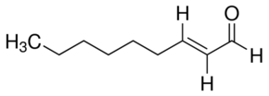
A. 2-NONENAL
Responsible for the plank or sawdust off aroma in oak-treated wines
Has a low aroma threshold (180-200 ppt)
Associated with rancid character in beer
Decreases with toasting level

Slide 3
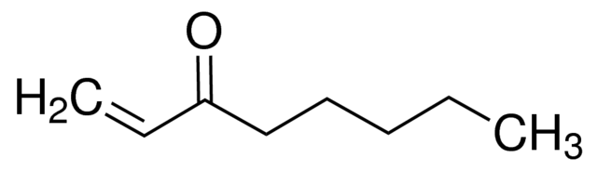
B. 3-OCTEN-1-ONE
Off-character in Oak
Described as earthy, mushroom, fishy, vegetal
May amplify other off-odors

Slide 4
C. METHYL OCTALACTONE
Specific to Quercus genus
Responsible for oak’s typical aroma
Also called whiskey lactone
Characteristic aroma: peach and/or coconut
Concentration varies with geographical origin of the wood 8-fold
Concentration increases with seasoning of the wood

Slide 5
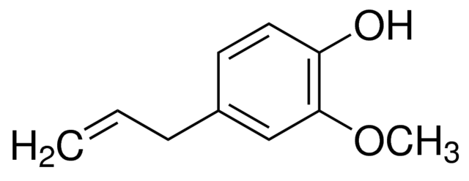
D. EUGENOL
Concentration varies with geographical origin of the wood 10-fold
Increases with seasoning
Increases then decreases with toasting intensity
Characteristic aroma: clove, perfume

Slide 6
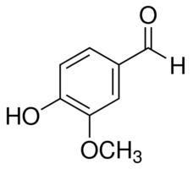
E. VANILLIN
Increases with seasoning
Increases with toasting
Characteristic aroma: vanilla, candy

Slide 7
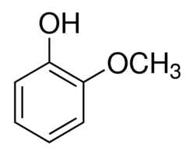
F. GUAIACOL
Increases with toasting intensity
Characteristic aroma: phenolic, chemical, woody

Slide 8
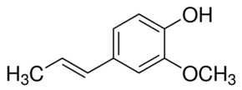
G. ISOEUGENOL
Increases with toasting level
Characteristic aroma: woody, “sweet”

Slide 9
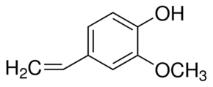
H. 4-VINYLGUAIACOL
Characteristic aroma: phenolic, pleasant, nondescript
Increases then decreases with toasting level

Slide 10
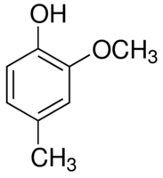
I. 4-METHYLGUAIACOL
Characteristic aroma: vanilla, spicy, clove, wood, leather
Increases with toasting level

Slide 11
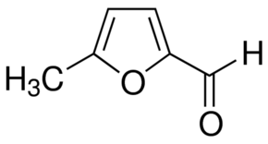
J. 5-METHYLFURFURAL
Characteristic aroma: sweet, caramel, bready, coffee-like
Increases then decreases with toasting level

Slide 12
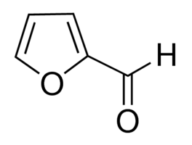
K. FURFURAL
Characteristic aroma: spicy, woody, bready, burnt, almond, incense
Increases with toasting level

Slide 13
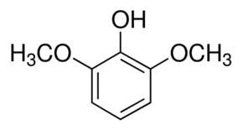
L. SYRINGOL
2,6-Dimethoxyphenol
Characteristic aroma: phenolic, chemical, incense, perfume

Slide 14
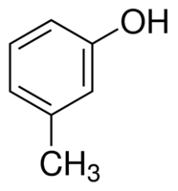
M. m-CRESOL
Characteristic aroma: woody, smoky

Slide 15
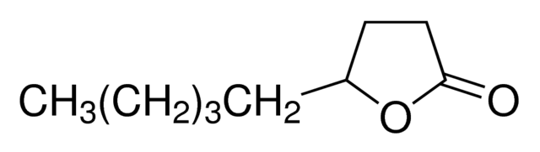
N. NONALACTONE
Characteristic aroma: coconut, butter, oil, cream

Slide 16
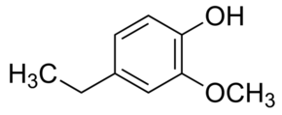
O. 4-ETHYLYGUAIACOL
Characteristic aroma: phenolic, chemical
Increases with toasting level

Slide 17
Reference
Chatonnet, P. 1999. Volatile and odoriferous compounds in barrel-aged wines: Impact of cooperage techniques and aging conditions. Chemistry of Wine Flavor (AL Waterhouse and SE Ebeler, eds) American Chemical Society

