Slide 1
Harry Hansen
Sterling Vineyards
University of California, Davis
December 9, 2011

Slide 2
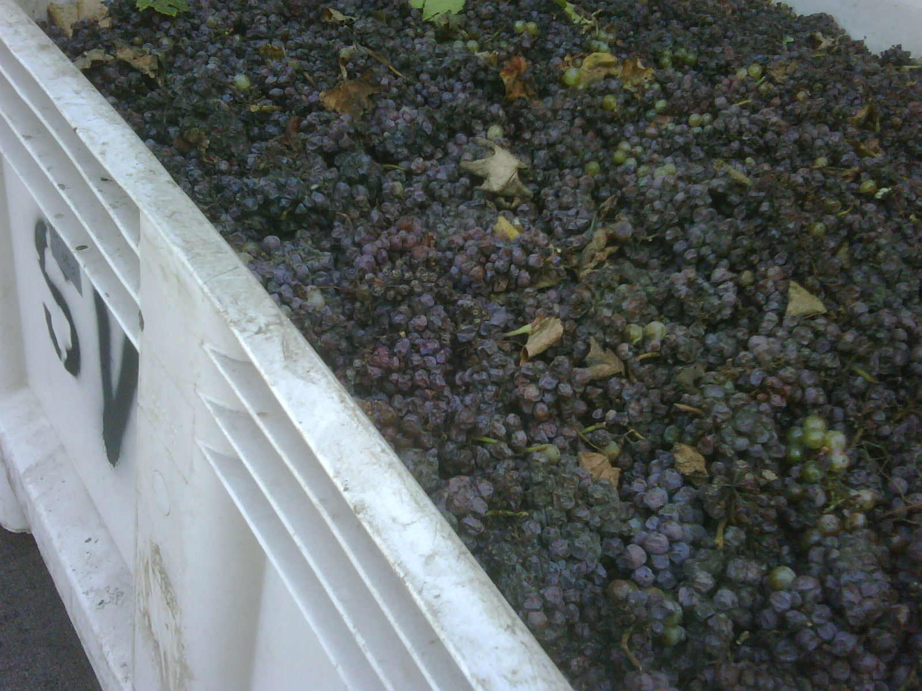

Slide 3
Botrytis Rising
Rainfall (2011 Napa, 2010 SLO, 2006 Santa Maria)
  Once is serious (watch the vyds)
  Twice is very bad (your grower isn’t kidding)
  Don’t wait for three (you lose)
  Embrace underripe fruit (Robt. Mondavi did) but understand its limitations
Harvest considerations
  Hand vs machine
  Vineyard chemical adds (SO2, ascorbic, tannin)

Slide 4
Now You’ve Done It
Rapid processing of whites
    Settle with pectinase and β-glucosidase
    Chase with bentonite, gallnut tannins
    Milk fine (TTB special permit), carbon fine post-rack
    Possible HTST treatment to kill residual laccase
    Raise standard SO2 adds
    Use vigorously fermenting yeast
    Be aware of strong reductive behavior of lees postferm
    Copper is not evil
    Skip malolactic fermentation?

Slide 5
Again, With Feeling
Red processing is more difficult
    Thermoflash?
    High SO2 adds
    Oak chips, tannins
    Good luck sorting
    Skim the top
    Inoculate immediately
    Lots of pumpovers, lots of aeration
    High temp fermentation, press off early
    Push quick malolactic fermentation

