Slide 1
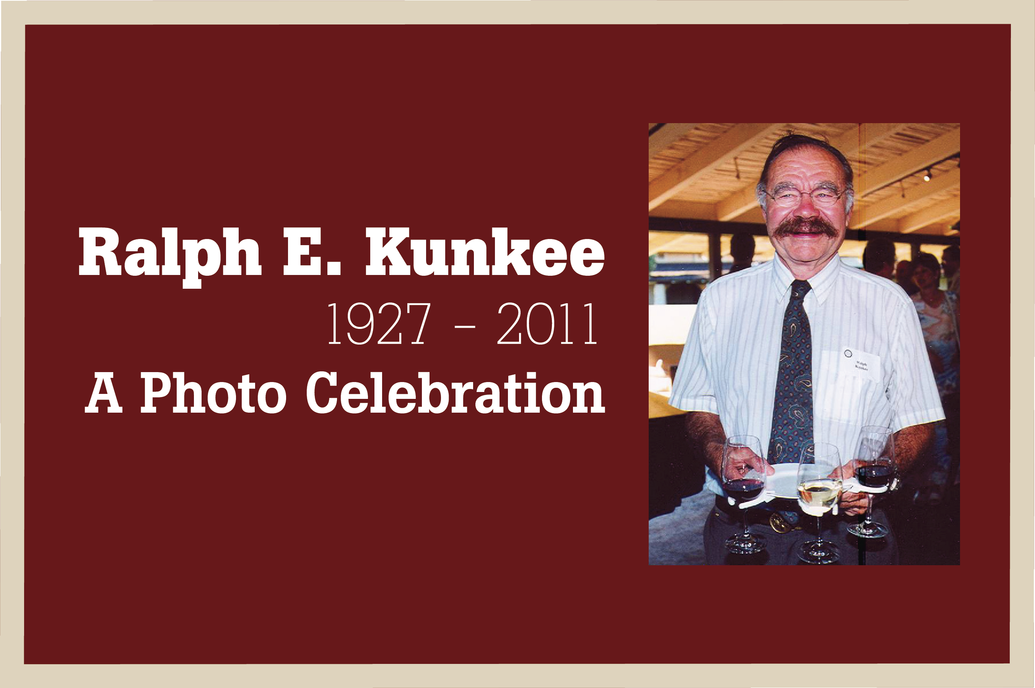

Slide 2
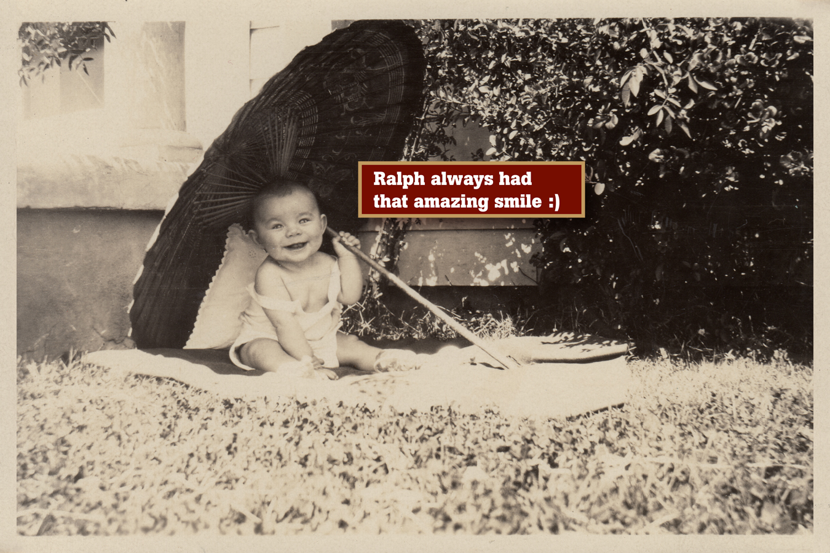

Slide 3
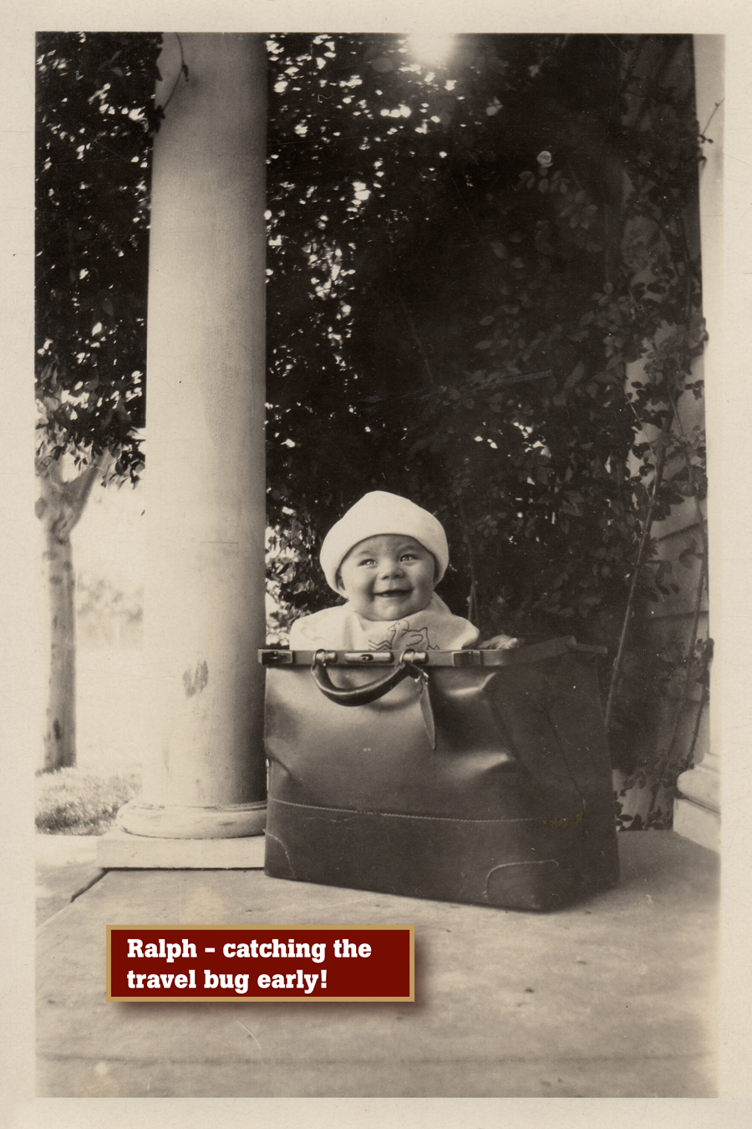

Slide 4
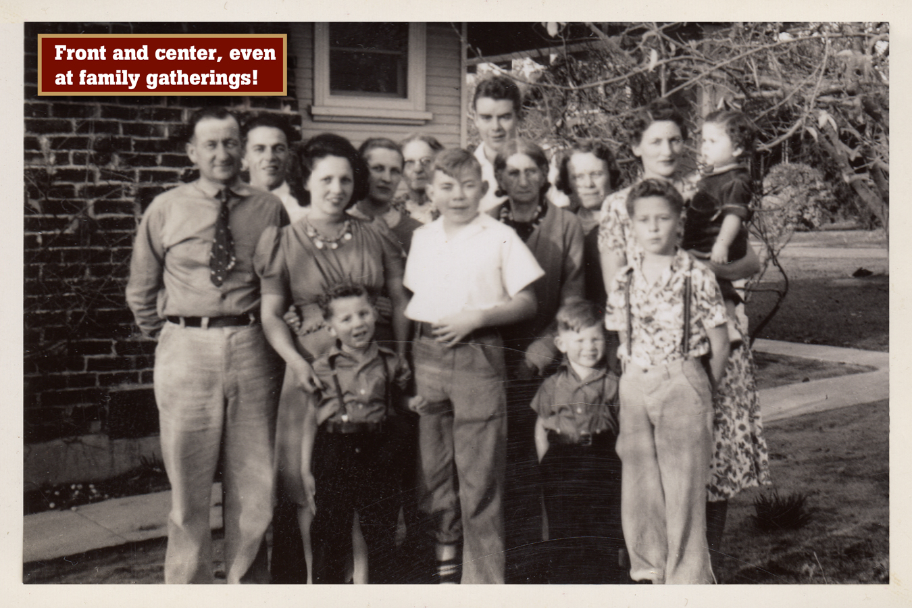

Slide 5
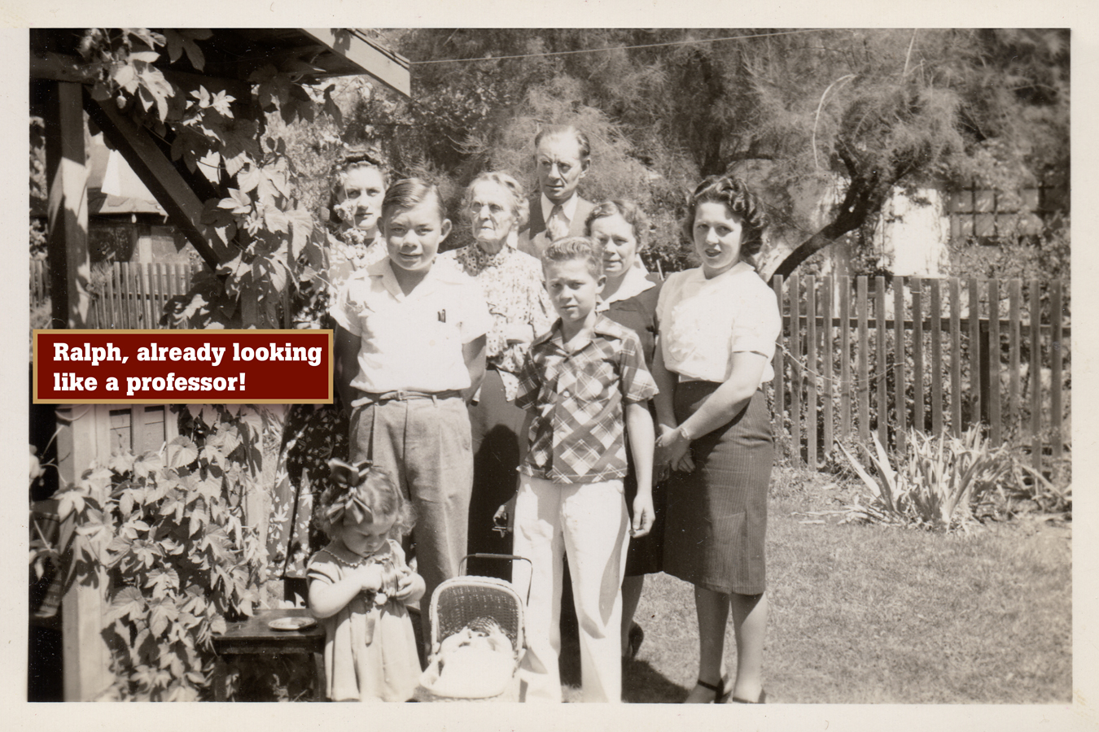

Slide 6
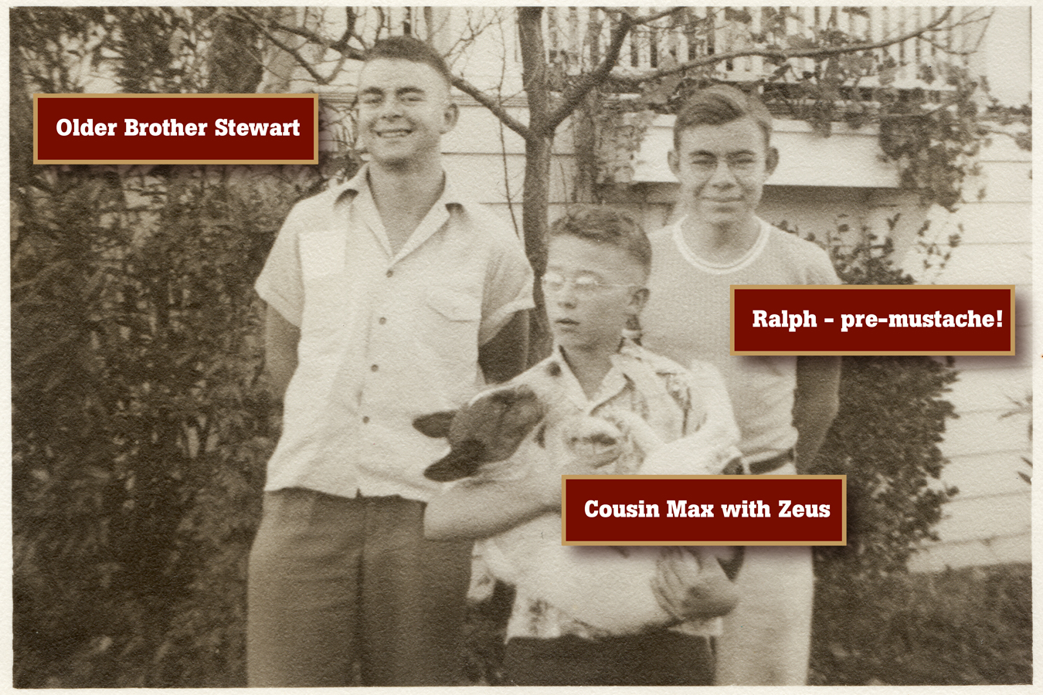

Slide 7
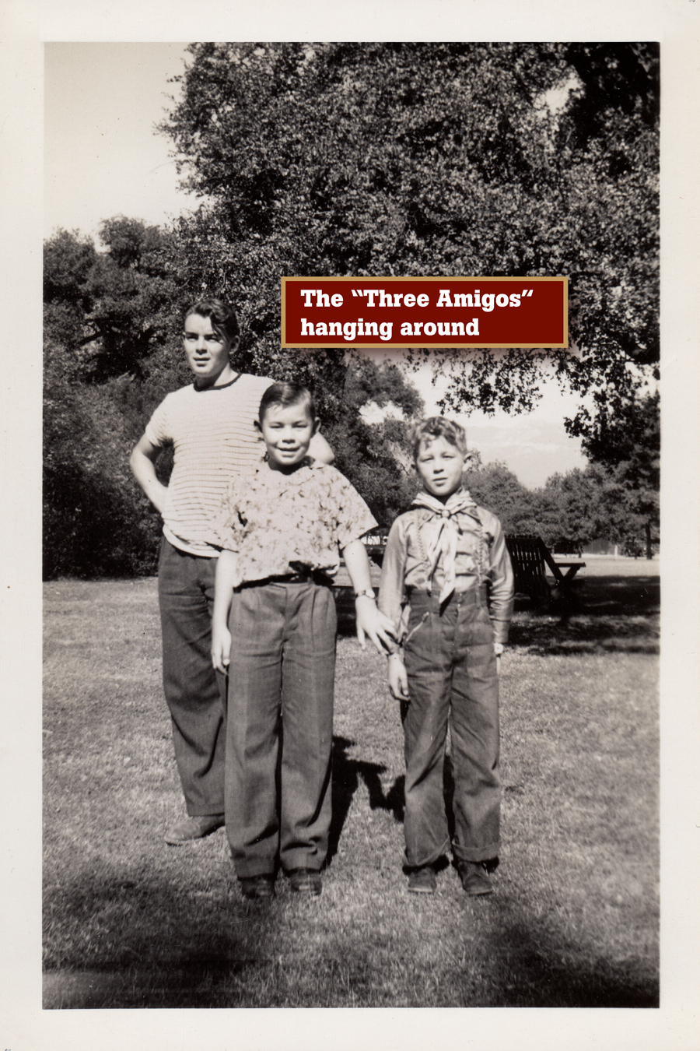

Slide 8
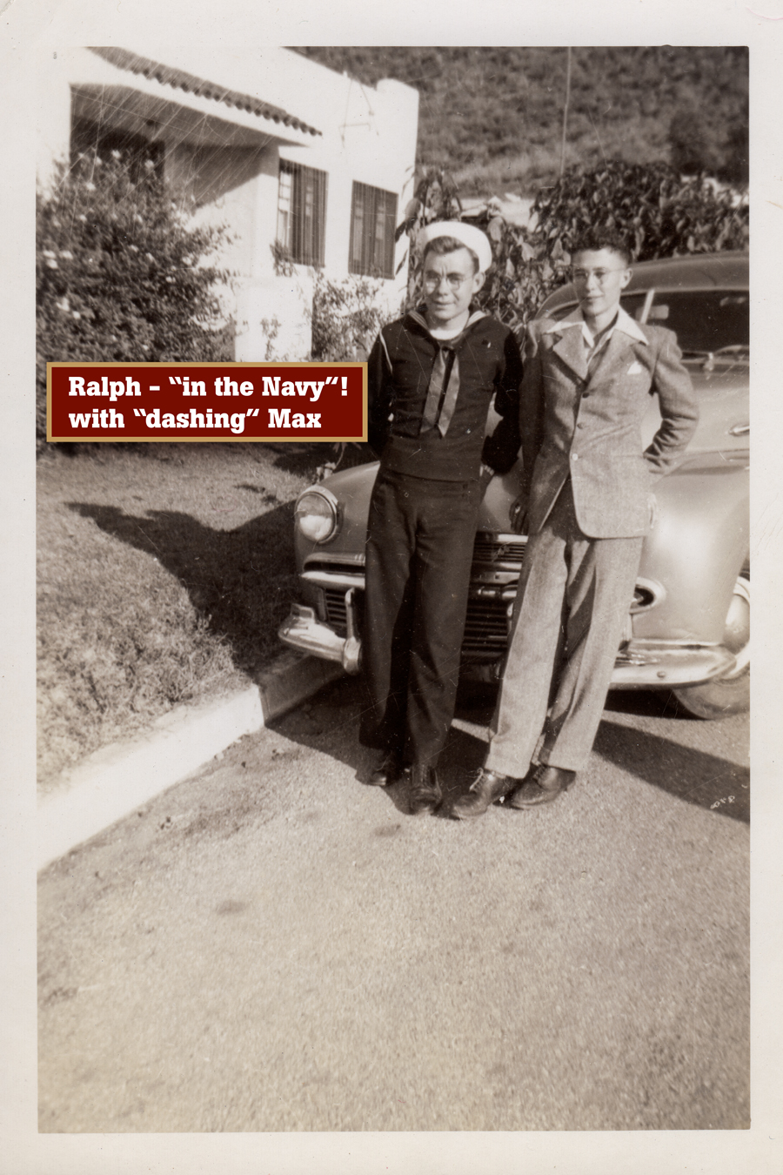

Slide 9
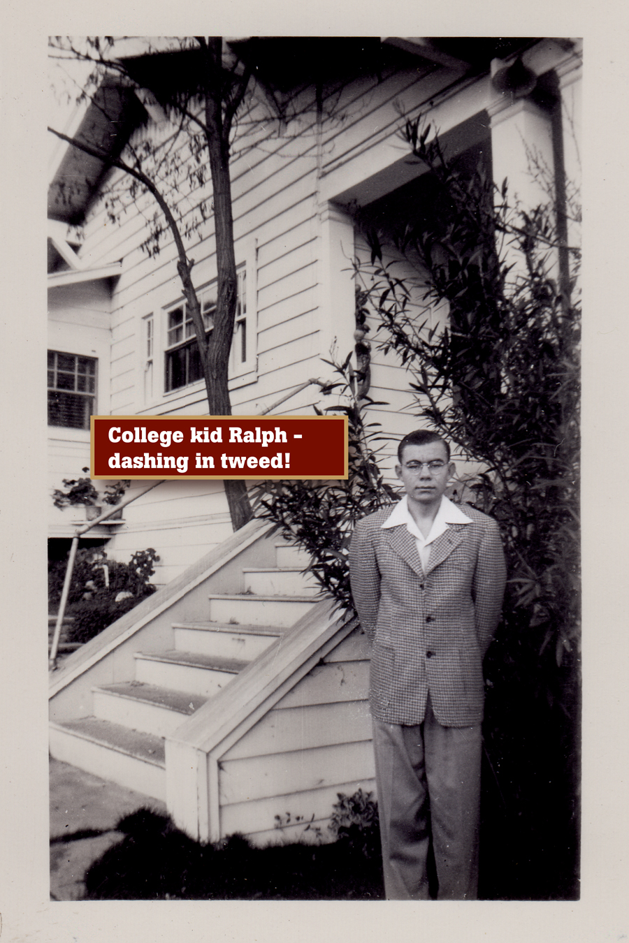

Slide 10
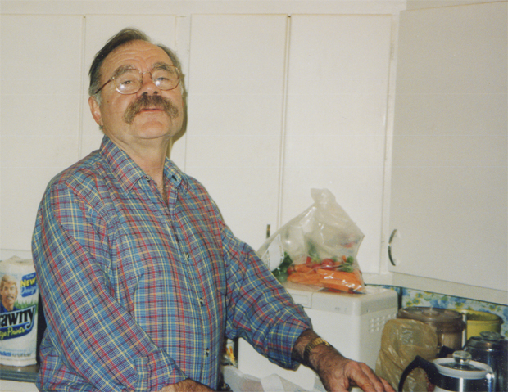
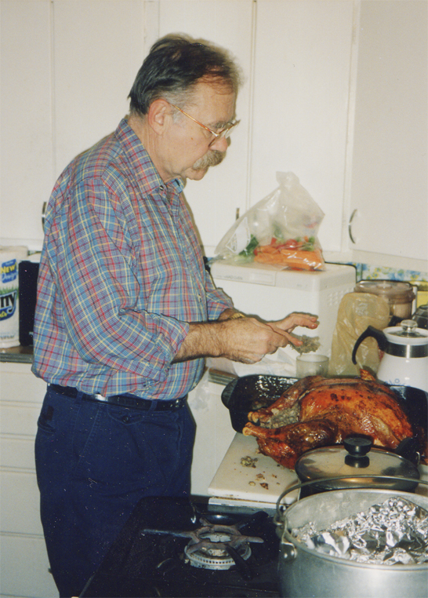
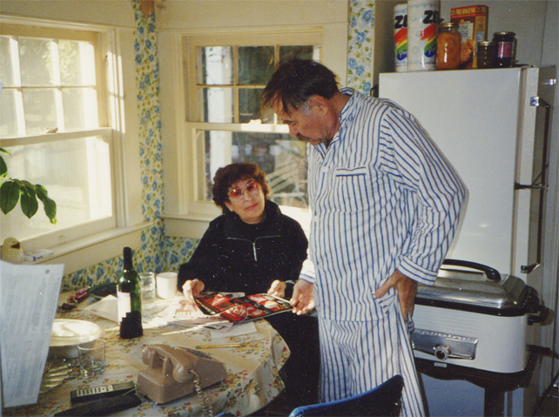
Holding “Thanksgiving court” in the Atascadero kitchen
With sister-in-law Ruby

Slide 11
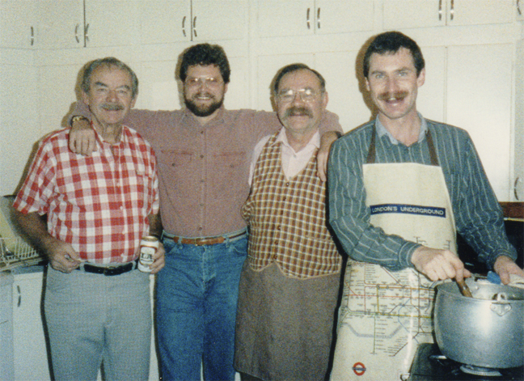
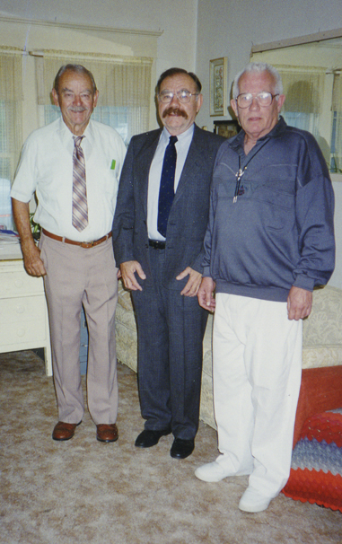
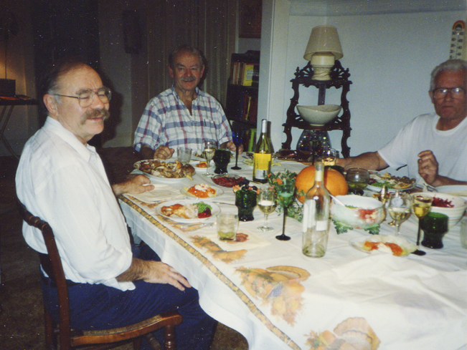
With brother Stewart, nephew-in-law Jon and partner Tommy
One of those awesome holiday dinners in Atascadero
Yup, the “Three Amigos”!

Slide 12
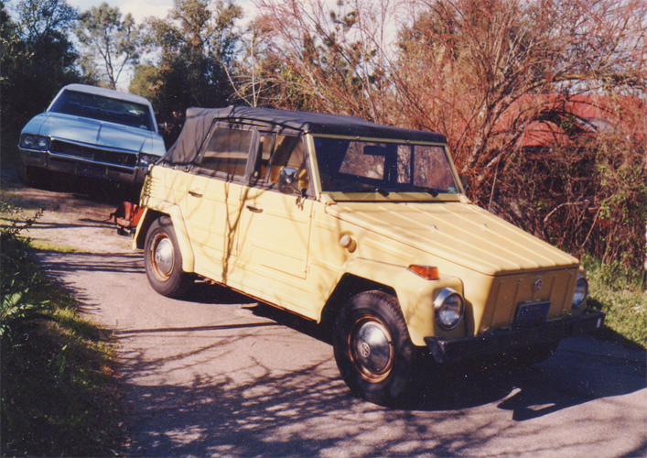
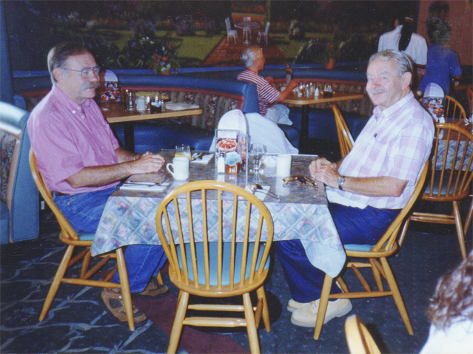
Ralph’s famous “Thing”
Breakfast at Carrow’s with brother Stewart

Slide 13
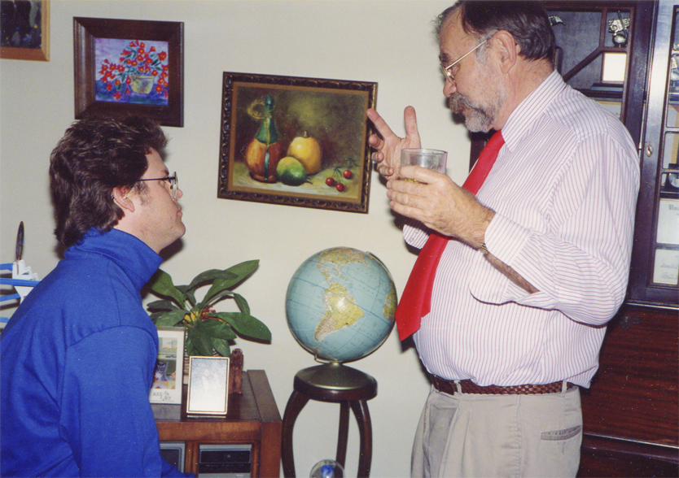
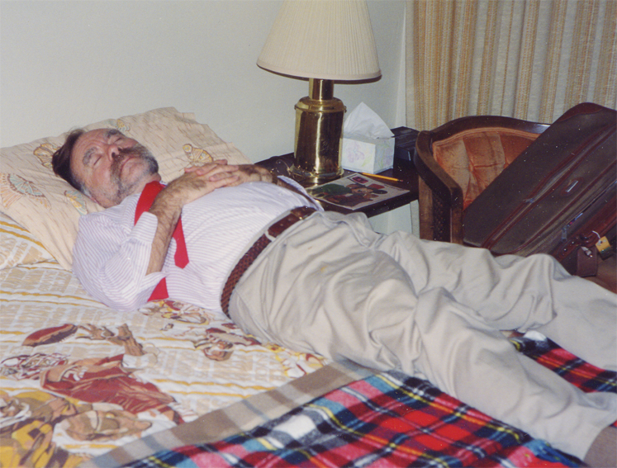
A little post-dinner advice
Finally, that elusive nap!

Slide 14
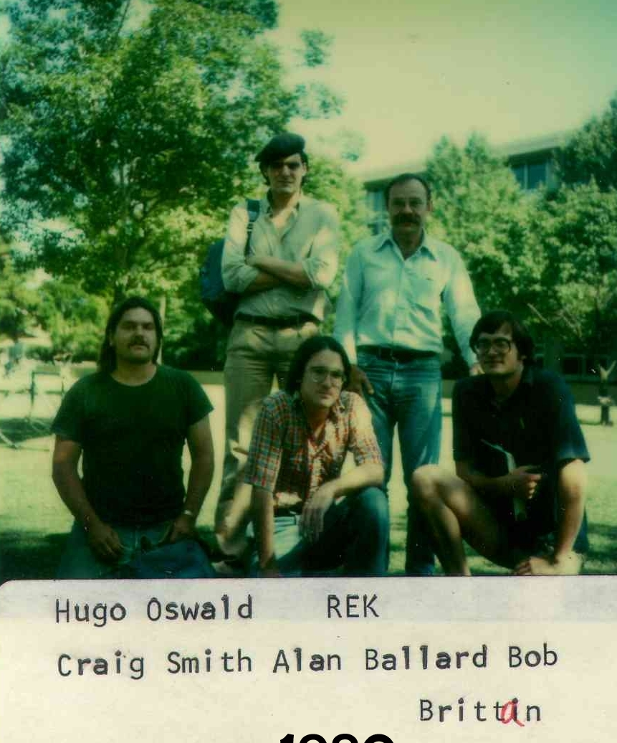
Ralph took hundreds of these Polaroids of his students over 25+ years, but this is the only one we found that he appears in. The year is 1980.

Slide 15
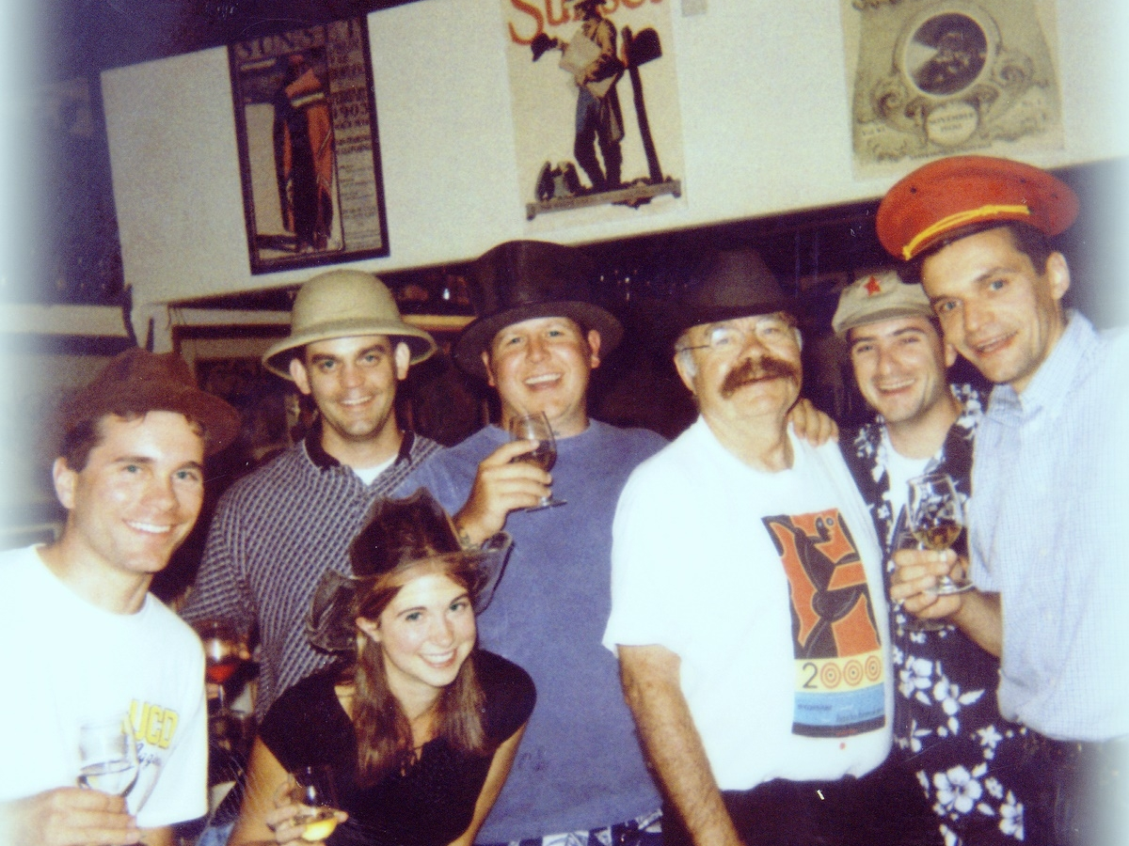
One of many famous Kunkee hat parties. You couldn’t matriculate without attending one; that was the rule.

Slide 16
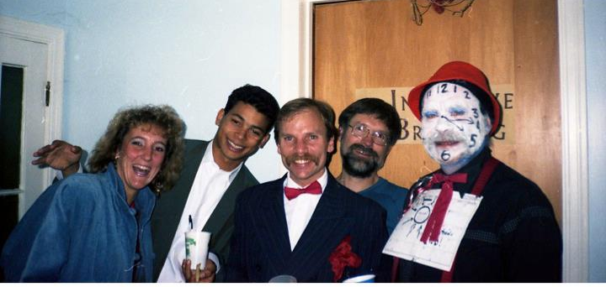
Repeal of Prohibition party, circa1989

Slide 17
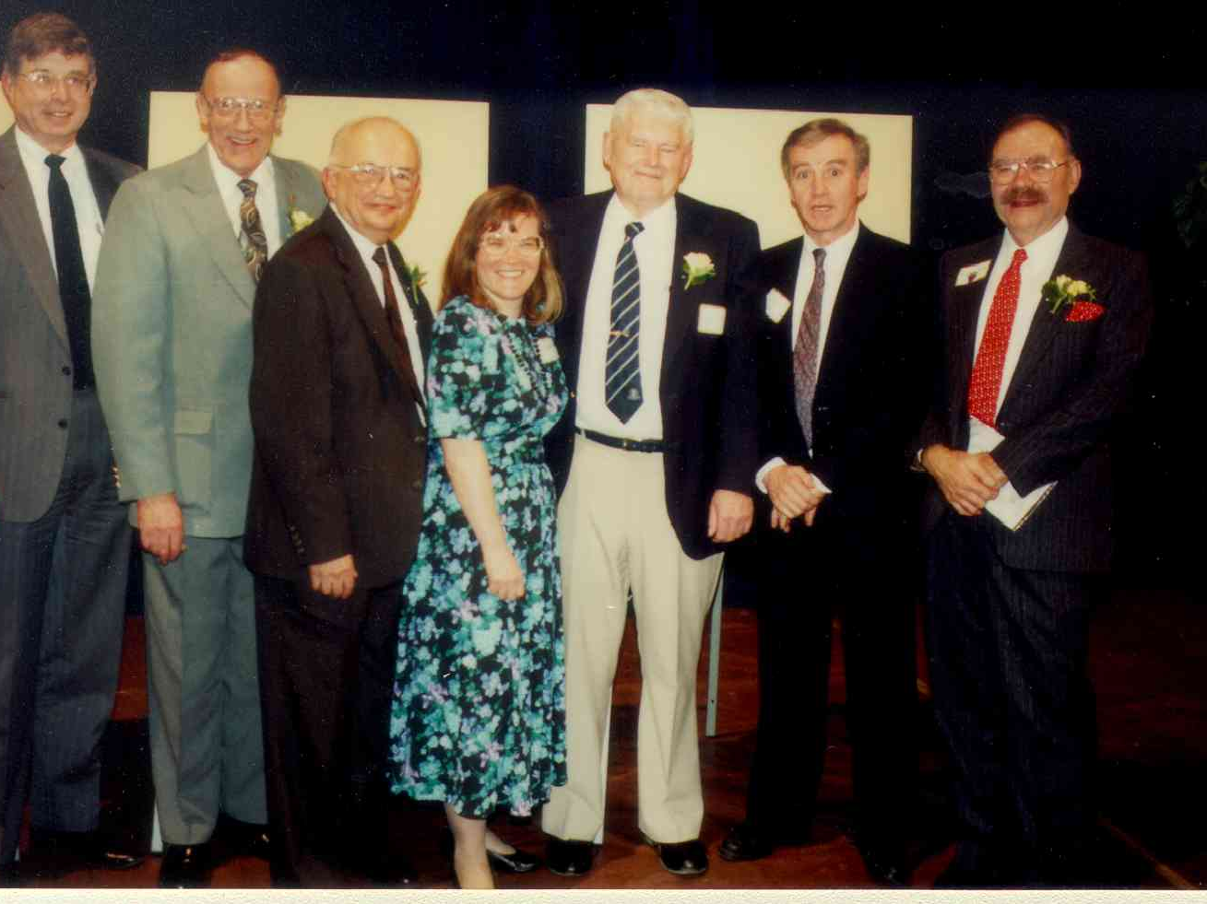
1992 Retirement

Slide 18
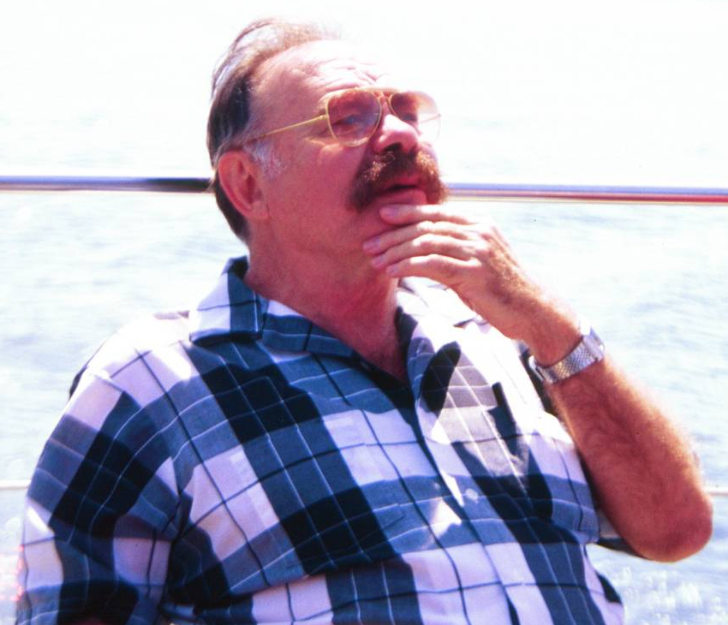
Seattle, 2000 (thanks to Lisa VdW)

Slide 19
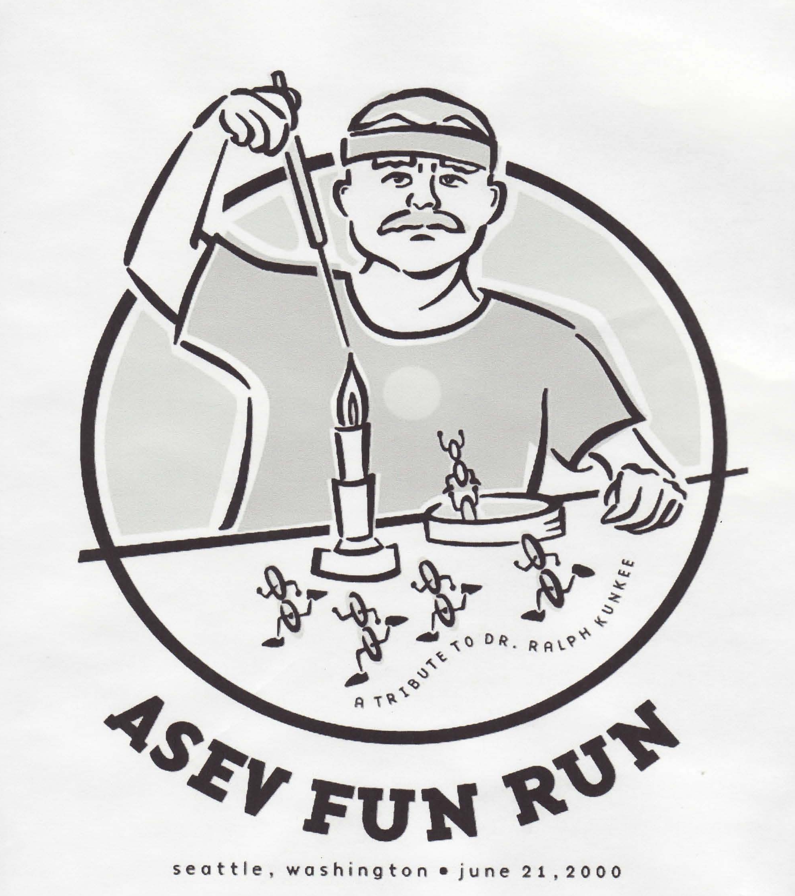
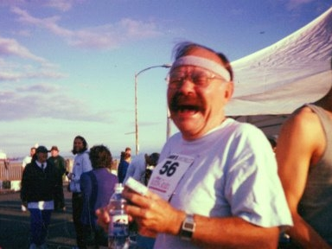
ASEV Fun Run, Seattle, 2000: A Tribute to Dr Ralph Kunkee

Slide 20
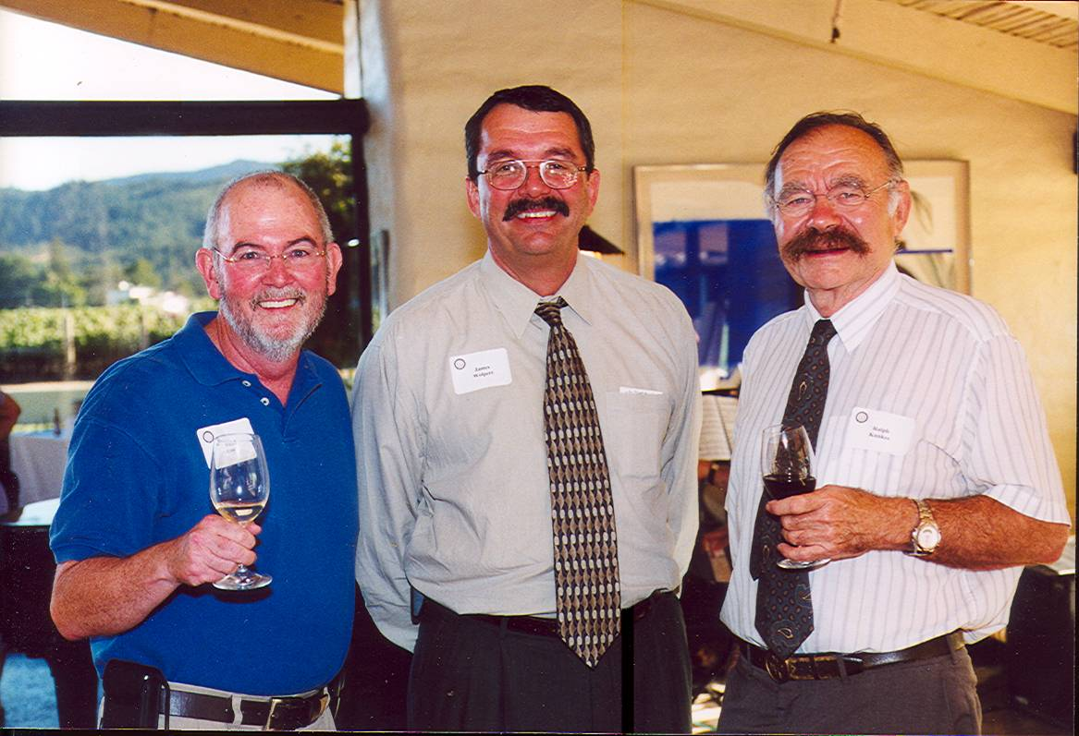
Chip Cassidy, Jim Wolpert and Ralph at Robert Mondavi Winery in Oakville, 2002

Slide 21
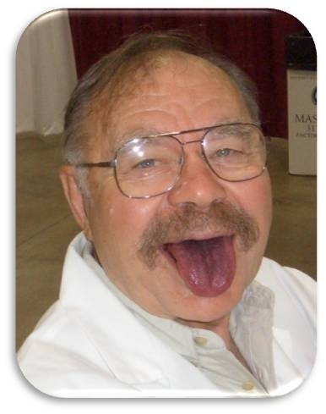
At Indy Wine Competition

Slide 22
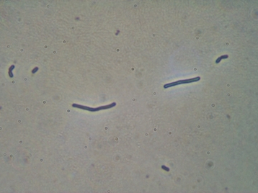
Ralph’s namesake: Lactobacillus kunkeei

Slide 23
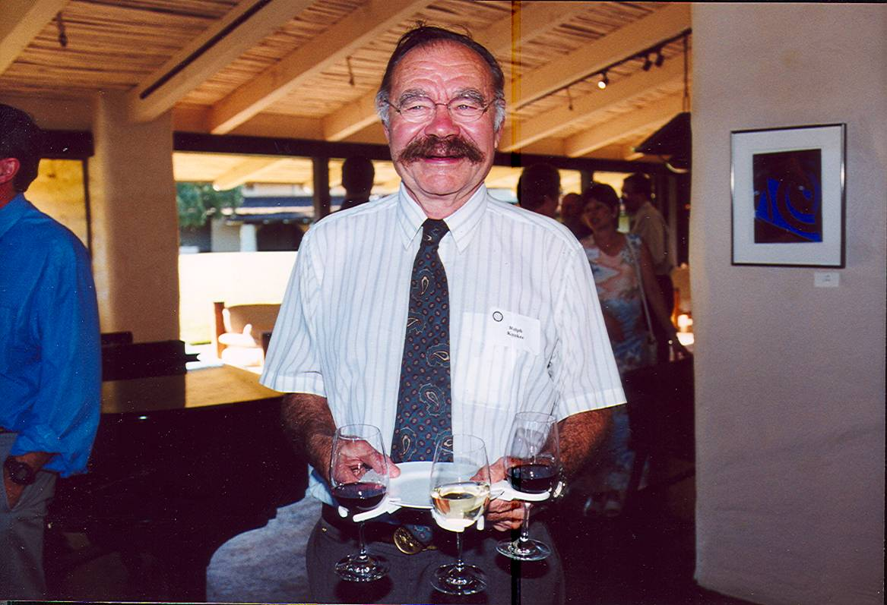
Quintessential Ralph: huge smile, laughing eyes and lots of wine!

Slide 24
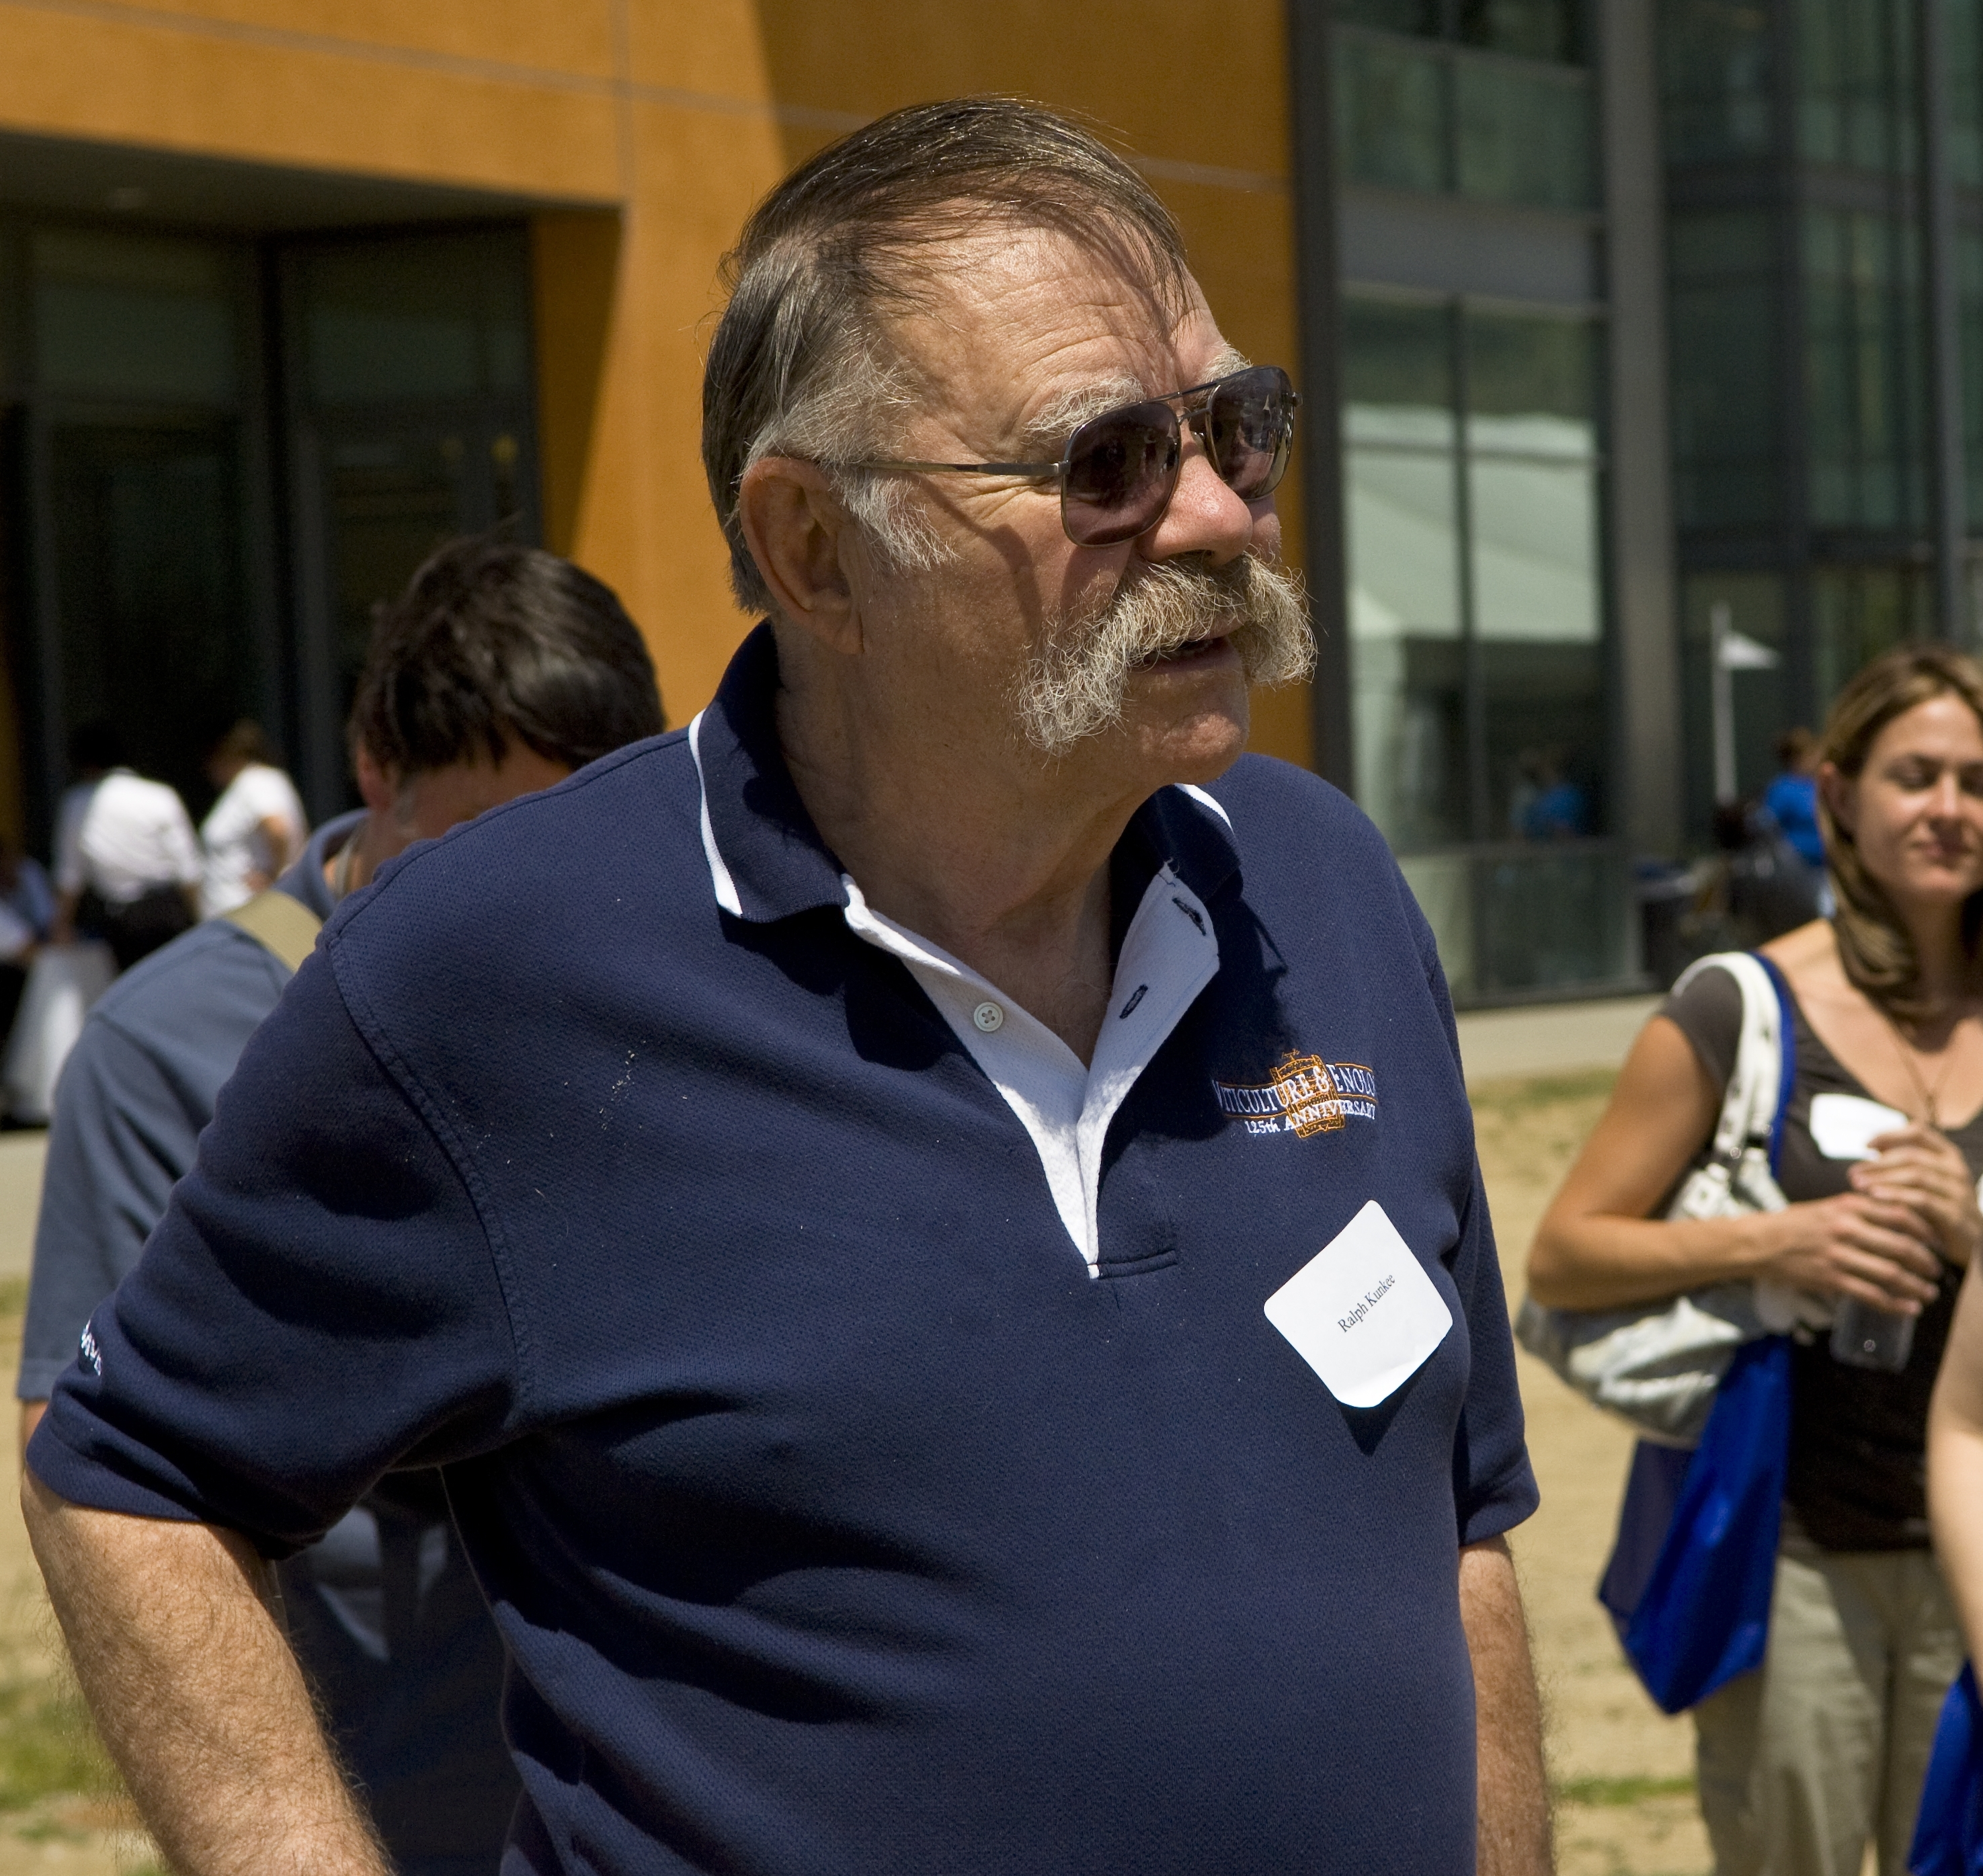
Listening and learning

Slide 25
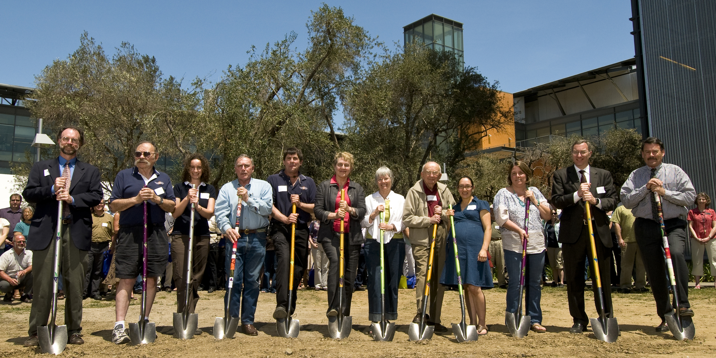
Alumni Reunion and Celebration, May 2009

Slide 26
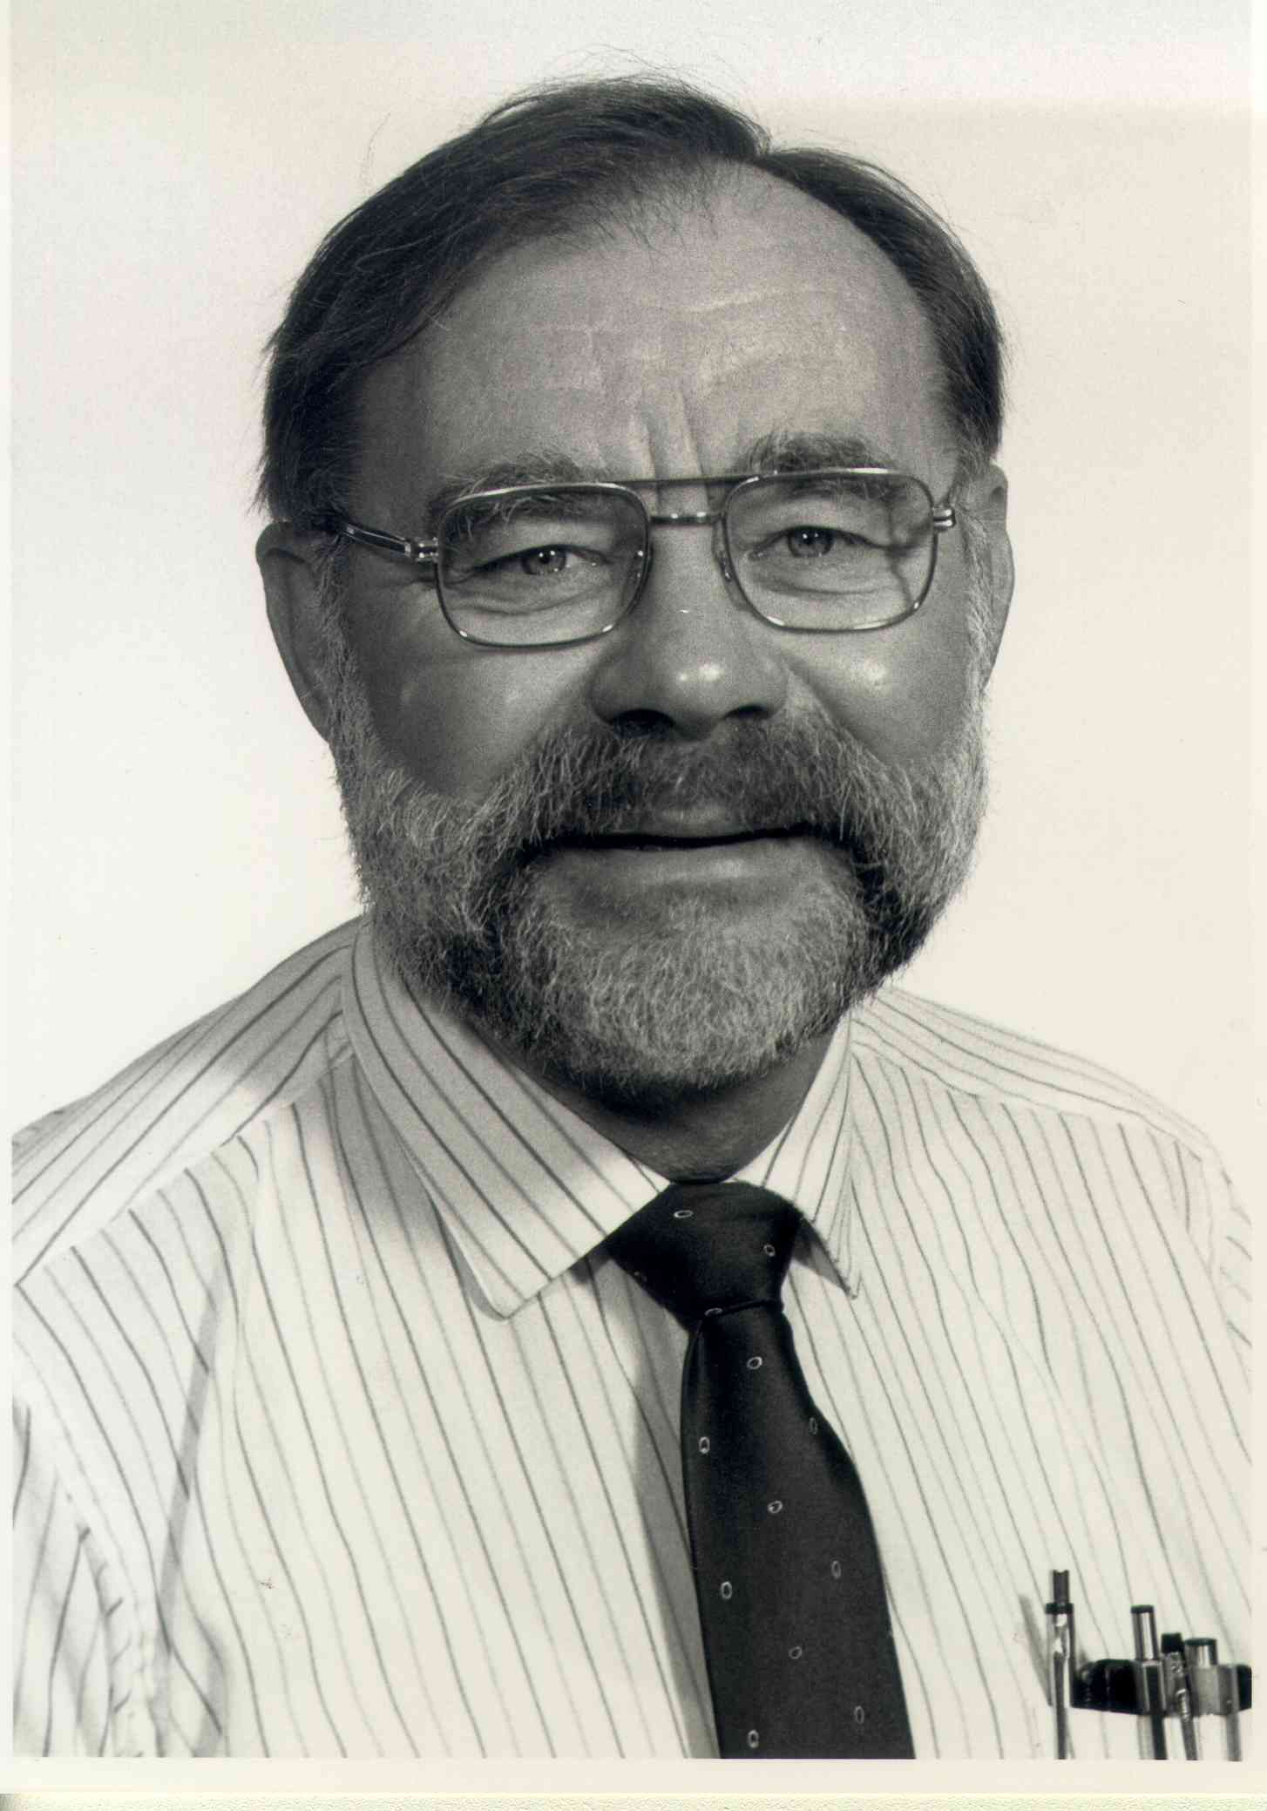
You are loved....
“Godspeed, Ralph Kunkee, in the journey to your next destination. I know the company will be warm, as you’ll be there: and I’m sure, once you arrive, everyone will have a great story to tell…..”

Slide 27
In Loving Memory……….
“With many thanks, Ralph, for sharing your sensational spirit, wily wit, and zealous zest for life with us. You were absolutely one of a kind, and your legacy will long live in your students and their wines. Arriba, abajo, al centro, apa'dentro!” Hugh Davies
“I will always remember his smile.” – Roy Adams
“He was the unofficial ambassador of the UCD V&E Department and he was so much fun!” – Lise Asimont
“Ralph always had time for the students and always was interested in what (and how) we were doing. His zest for life was infectious,his hospitality legendary and his ability to make us all feel welcome and a part of something- whether it be a party at his house or the Department of Viticulture & Enology- will be greatly missed.” – Alison Crowe
” Ralph was one of the most student-friendly professors! He always greeted you with a smile and left you with something to think about. A man curious on all levels; always a joy to share a conversation or even a nice easy paced run. Some of the best moments in my life were shared with Dr. Kunkee; and most likely that would include quaffing on a beer...or two. The world is a much better place because of Ralph. A genuine article of a man.” – Rob Davis
“Ralph was so caring, his love of microbes and patience in teaching will always be remembered.The rabbit 6 ways at the end of quarter party was lots of fun!” – Karen Ernsberger
“He just knew how to make you laugh!!” – David Fenech

Slide 28
In Loving Memory…………
“Ralph had a wonderful combination of intensity and sense of humor. His lectures were a rapid fire delivery of information, and I remember one in which as he finished up, all of us coming up for air after madly writing notes for an hour, he asked if there were any questions. One student spoke up: I have just one question: what's up with the shoes? Ralph looked down, and for the first time noticed he was wearing two mismatched running shoes, sharing a good laugh with the whole class. What a smart man, who loved to have good time, and not afraid to laugh at himself.” – Bill Dyer
“A very memorable teacher and person whose contributions to enology went beyond the classroom and laboratory.” – Tom Foster
“Always the inquisitive wine chemist, I always appreciated your thoughtful input during every seminar and talk. Also a staunch supporter of grass-roots California winemaking, one of my fondest memories was when a student handed you a glass of wine that he had made and asked you, what do you think of this? Ralph replied, Did you make it? Student replied, Yes, and then Ralph took a tentative sip, and his face lit up and he declared with a big smile Double Gold!!! – Nick Gislason
“Ralph was brilliant and a leader in his field of science, yet had a kindness and great sense of humor that made all of his students his friends.” – Mark Greenspan
“Ralph's boundless enthusiasm was an inspiration to all who had a chance to work with him. He embodied the spirt of discovery at U.C. Davis.” – John Williams
“He was a man of many hats!” – Sid Stafford

Slide 29
In Loving Memory…………..
“Ralph was the great human factor in the Department. In that oh so serious academic ambience, you could always count on him for a giggle. He was lavishly generous with his appreciation and support for his students. For me, Ralph was, all at the same time, a mentor, a cheerleader and a buddha.” – Clark Smith
“Always a smile on your face, such a caring heart, the life of the party, I'll always remember you my friend.” - Ruby Smith
“Ralph was an amazing person, a can do person, always so full of life and with a story to tell! A pure delight! I will never forget the twinkle in his eye and his grand smile beneath his bushy mustache. He will be missed!” – Sharon Shoemaker
“It wasn't a party 'til Ralph put on the plexiglass cowboy hat....” – Joe Shirley
“Ralph's enthusiasm for all things wine and microbial was so contagious...he inspired me to try new yeasts and ML's, to be better at feeding the beasties properly, and also better at sanitation to keep them under control...and I loved our endless debates over whether yeast strains really made a lasting difference in sensory profiles or not--I said yes, he said no! I loved that he kept a copy of the Clan O'Myces poem I wrote for him while at UCD, in 1978! We will miss your bubbly laugh at ASEV, Ralph!” – Carol Shelton
“Unlike bankers - Ralph was the kind of guy that would lend you his umbrella when it started to rain.” – Oded Shakked
“Goodbye to a very special long time friend. Clayton” – George Cone

Slide 30
In Loving Memory…………..
“Ralph had the amazing ability to change his facial hair configuration at will. One day a mustache, next day a full beard, next day goatee and sideburns, next day mustache and goatee, next day, mustache, next day full beard, etc. Unbelievable!!!” – Michael Weis
“Ralph is my uncle: so lucky I am to have enjoyed his stories and explanations all my life.” – Marlena Weden
“There was never a dull moment in the 21 years that I worked with Ralph. He enjoyed life. He enjoyed teaching and the students. He was the best person period. “ - Marilynn Vilas
“He was the most uncomplicated man I ever knew. Nothing got him mad...everything excited him. I feel very fortunate to have had him in my life.” – Paul Watwood
“This comes from someone who just one of his many undergrad students, not an MS or Ph.D who worked under him. I took exactly one course from Ralph. Ralph was one of the most memorable teachers ever. He took a complex subject and made it interesting and approachable. What I learned from him helped me throughout my career. He inspired me (a shy kid back then) to want to contribute to the fun nature of the classroom. So one day I showed up to class dressed up in an ogive shaped Brettanomyces costume that I made myself. (You still can't find them in stores.) I also fondly remember his really fun end of the year parties at his home.” - Andy Starr
“Hats!” – Devin Jones

Slide 31
In Loving Memory…………..
“I treasure many happy memories of the ever-ebullient Dr. Kunkee” – Matthew Reid
“I am indebted to Ralph for his support during my undergraduate career. He provided me with several very interesting VEN 198 projects for much needed units and arranged my meeting both M.W. Miller and H. J. Pfaff.” – Michael Ramsey
“Just thinking of Ralph always makes me smile. He was a genuinely great person, mentor, teacher with a wonderful sense of fun.” – Katie Quinn
“Ralph, your illness has caused me to reflect on the importance of living with joy and sharing it with others. You were one of a kind. You are dearly missed.” – Heather Pyle
“Ralph, I'm reminded of the time we traveled to the Finglerlakes Competition from Sacramento and we changed planes in Chicago. We got a couple beers and sat down near where our plane for Rochester was suppose to take off. I was so enthralled with talking with you and asking questions and you entertained me with your stories, humor and your knowledge. I was like a kid in a candy store. I was in the presence of GREATNESS! (and I knew it) I couldn't get enough! You so entertained me. Well, as you remembered, our plane took off on time ? unfortunately, they changed gates and we never did make that one!!! If I remember correctly, we got a couple more beers, moved to where ever the next flight for Rochester was leaving and kept on talking! What a day! What a trip! Ralph, you are one beautiful man! I never did take any classes from you during your tenure, except for that one wonderful day in Chicago.Thank you for being who you are! Pooch” – Pooch Pucilowski

Slide 32
In Loving Memory…………..
“Ralph celebrated life, as most publicly demonstrated by his legendary parties. He had a wide range of interests and loved to travel.” – Ann Noble
“Ralph made me smile every time I heard him speak!!” – Jeff Meier
“A great educator, judge & lover of wine and a person we all loved to be around! funny and will be missed. Thankful to have been a student!” – Tim McDonald
“Ralph had a great sense of humor, a hearty laugh and learned to say one more beer please in french before anything else. Our paths crossed in 1977-1978 when he was on sabbatical in France and I was en stage. We enjoyed fine wine, great food, and many stories during that year. Two years ago Ralph, my twin sons, Jack and Will, and I went to a basketball game together at UCD (Ralph's first ever). After just one afternoon together my kids fell in love with him and still talk about making memories with Ralph.” – Betsy McCort
“Ralph and I would share a bottle of Sauvignon Blanc each year at the ASEV convention or when we judged at Indiana. He love SB and telling stories. I will miss this special time with him.” – Judy Matulich Weitz

Slide 33
In Loving Memory…………..
“The first time I met Ralph was at a champagne tasting at Tucos. One of his students was pouring his own champagnes and Ralph was very proud of him. We sat at the same table and he was very kind to me. He even went so far as to mail me a UCD Extension catalog of the wine classes I should take all circled. I took those classes. Ralph taught one of them and he remembered me.” – Eloise Mares
“Ralph had a special way of being collegial with his students. I really always felt he was a friend first, and a teacher and mentor second. No one else from my academic years went out of his way to be in touch with me throughout my life as Ralph did.” – Steve MacRostie
“I am Carol Shelton's husband and enjoyed hearing her stories about Dr. Kunkee over the 26 years we have been together.” – Mitch Mackenzie
“Ralph should be commended for bringing California Wineries into the era of high quality wines. He also is greatly appreciated for taking photos of classmates graduating from the Enology program!” – Mark Lyon
“Ralph: great teacher, good humored, good fun, good mentor; good person.” - Zelma Long
“One of my favorite professors of all time. I will miss his infectious gaiety.” – Diane Kenworthy
“An inspiration to us all; I will miss his presence.” – James Kennedy

Slide 34
In Loving Memory…………..
“Ralph was a good friend of many decades, who informally taught me all I know and appreciate about good wine. I will miss him dearly, for many reasons.” - Lauretta Higgins
“My on going interest in wine microbiology begin 20 years ago as a graduate student and teaching assistant in Ralph's lab. Finally, after 20 years of trying, I convinced a winery to purchase a microscope. Hanzell Vineyards, where I am currently the associate winemaker, purchased one this year. I have named it Ralph in honor of the delightful man who taught me the importance of microorganisms and in having fun in winemaking.” – Lynda Hanson
“Ralph was my very good friend for many years, dating back to 1965. He was the best friend anyone could ever have. I miss him tremendously. one of a kind. i loved him. ” - Michael Hancock
“All of my favorite teachers and professors have had a passion for their field combined with humor and an engaging personality which is infectious to their students. Ralph is at the top of that list!” – Kevin Hamel
“Thank you for being such an enthusiastic teacher of wine micro!” – Nicole Haller-Wilson
“Ralph was brilliant and a leader in his field of science, yet had a kindness and great sense of humor that made all of his students his friends.” – Mark Greenspan

Slide 35
In Loving Memory…………..
“My favorite teacher of all time!! Dr. Kunkee's lectures were always informative as well as entertaining. Even after college, whenever I would see him, it was a highlight. His warm, friendly personality and wit always brought a smile to my face. You will be SO missed, Dr. Kunkee. I'm glad I was born at the right time and able to be in your classes.” – Carol Franzia
“A very memorable teacher and person whose contributions to enology went beyond the classroom and laboratory.” – Thomas Foster
“He just knew how to make you laugh!!” – David Fenech
“warm, welcoming and funny!” – Karen Block
“Enthusiasm for Life, A Passion for Learning and the Significance of Scholarship.” – S.R. Bedford
“He was the most fun professor we had and we all learned so much from him. I'll never forget trick or treating at his house when we were students for drinks!” – Heidi Barrett
“He will be truly missed for his tremendous patience as I tried to focus the microscope and for his great smile and joie de vivre.” – Kristen Barnhisel
“He was the unofficial ambassador of the UCD V&E Department and he was so much fun!” - Lise Asimont

Slide 36
In Loving Memory…………..
“The joy of working on the Daily Californian together and the continuing friendship beyond college which led to abundant wine and singing on Bastille Day.” – Elaine Anderson
“I will always remember his smile.” – Roy Adams
“I am so indebted to Ralph. Without his interest and encouragement I would never have finished school or found my way into a rich and rewarding career. More important than a mentor, he was a friend with whom I could share my most intimate thoughts, seek advice, share a story, and a laugh over a beer at Blakes or oysters at Swann's. I hope my son will run into someone like Ralph, who will push and influence him in ways his father can't. And I am so thankful I had an opportunity last week to tell him this and express how much he meant to me, I just wish I hadn't waited so long.” – Anonymous
“Ralph was a great Prof and one of his most amazing (although perhaps not well known??) attributes was his ability to name "great bars" regardless of the city we would throw at him. In 1987 he had us on the floor when he used the words "cat piss" to describe a sauvignon blanc while on Good Morning America. During that same year Ralph and another 10? of us did the Bay to Breakers all decked out as California raisins. Ralph was a very much loved original!” - David Hulley
“Ralph, rest in peace and godspeed.” - sharon dougherty
And so many more there that will ultimately appear in a special journal for our archives…..Thank you, all of you!!

