Slide 1
Position Management
Updates and Process Changes

Slide 2
Learning Objectives
Understand the new Position Management form and process (SPR replacement).
Have a clear understanding of the handoff and workflow of the position creation process.
Understand creating new positions and updating existing positions prior to UC Path Go-live.

Slide 3
Position Management
Position Management is the process of requesting a position and placing a selected or hired individual into a vacant position from beginning to end. This placement then creates a permanent record, which maintains the history ultimately binding the position, funding and organizational details together in UC Path.

Slide 4
Position Management
Key Changes
In UCPath funding is attached to the position, not the person​
If no funding is attached to the position, the incumbent will be paid from a default account ​
Funding is entered via a separate UCPath page called Funding Entry. (separate security role)​
Positions connect the position to funding chart fields that determine what fund source the employee is paid from, and allow for reporting on how labor costs are distributed.

Slide 5
Position Management
CURRENT:
A Job cannot exist without a Person​
Vacant Positions cannot be tracked in PPS
FUTURE:
A Job cannot exist without a Position and a Person​
A Position can exist without a Job or a Person (a Vacancy)

Slide 6
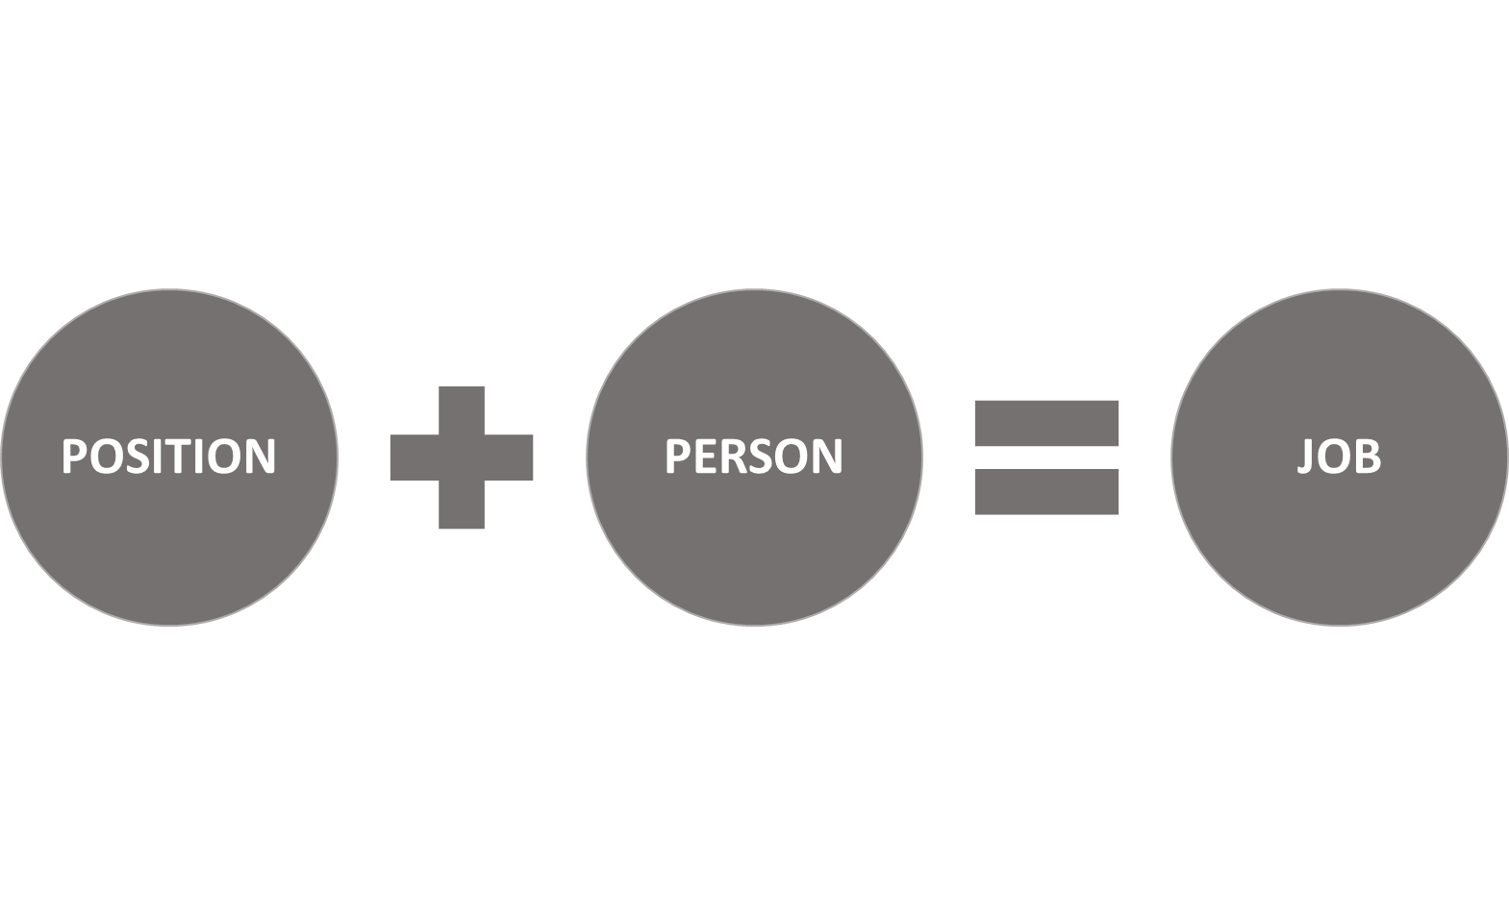
A job in UCPath is analogous to an Appointment in PPS. It is used to organize employment information, or job data, with an employee. A job is the combination of the position or “seat” and the person who has filled that seat.
A Position in UC Path, refers to a slot or “seat” in the organizational structure. All employees will have a position.
Once a person is identified, he/she is then attached to a Position in the UC Path system to create a whole Job.
A job is the combination of the position or “seat” and the person who has filled that seat.
Notes:
Position: A role independent of an employee
Person: Employee
Job: The union of a position and a person

Slide 7
Staff Position Request Form (SPR)
Effective July 01, 2019, the SPR is going away!

Slide 8
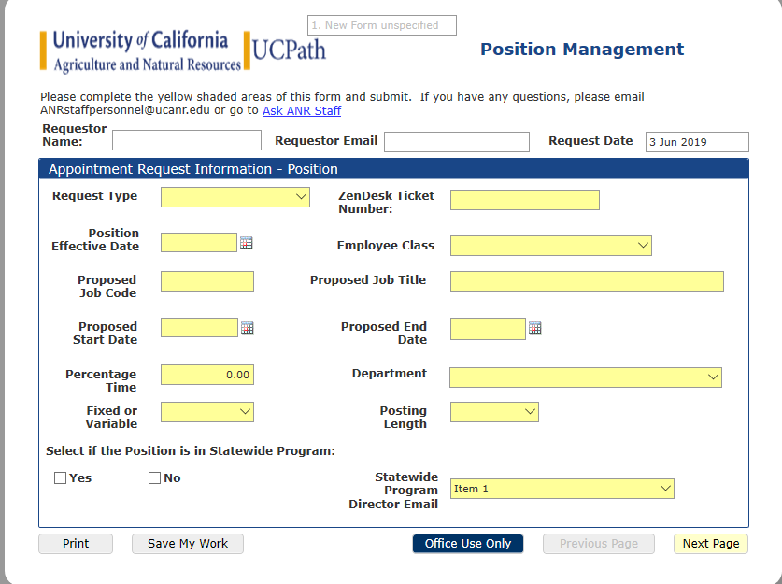
NEW: Position Management Form
Highlights
Online form (PerfectForms)
Automated workflow
Highlights required fields; provides appropriate dropdowns for information; smart form.
Notes:
Automated Workflow: Position management form will be completely electronic. Once the form is initiated and submitted by the supervisor or person initiating on the supervisors behalf it will begin the automated routing process.

Slide 9
Position Management: Staff
Hiring Manager
Initiates a request to create a position: Submits Position Management Form, PD & Zendesk Ticket.
Director
Reviews position request and PD, approves and sends it to the Business Officer/Financial Control point.
Financial Control (Business Officer)
Validates funding, signs and sends to RPM.
RPM
Reviews funding, validates accounts and submits final approval to HR.
HR Recruiter
Reviews title and PD for accuracy, approves and submits to Position Administrator.
Position Administrator
Enters position, sends confirmation and Position Number to appropriate chain of contacts (HR, HM/Director, BOC, BO).
Notes:
Following the position management process and once a person is identified, the hiring manager or his/her designated assignee will submit a pre-hire form via Zen Desk to the assigned HR Recruiter. HR will complete their portion and forward the request to HR Operations to place the person into the position.

Slide 10
Position Management: Academic
The positon management process for the Academics is slightly different from staff. The process is currently under review.
We will provide an updated training and workflow once the process has been finalized.

Slide 11
Changes in Approval Timing
Additional time to process and create the new position in the UCPath system is expected. During the initial learning phases we expect up to a 1 week increase in processing time.
However we expect this to reduce as we move towards our October go-live dates.
If an urgent request occurs, contact your HR Generalist and they will coordinate with you closely.
Future State: Any increase in the processing time will be more than made up for in reduced time spent on chasing paper forms!

Slide 12
Position Management Process Review
Notes:
https://app.perfectforms.com/player.htm?f=sDuFAgoE

Slide 13
The time spent on Q/A today means better FAQ’s tomorrow!

