Slide 1
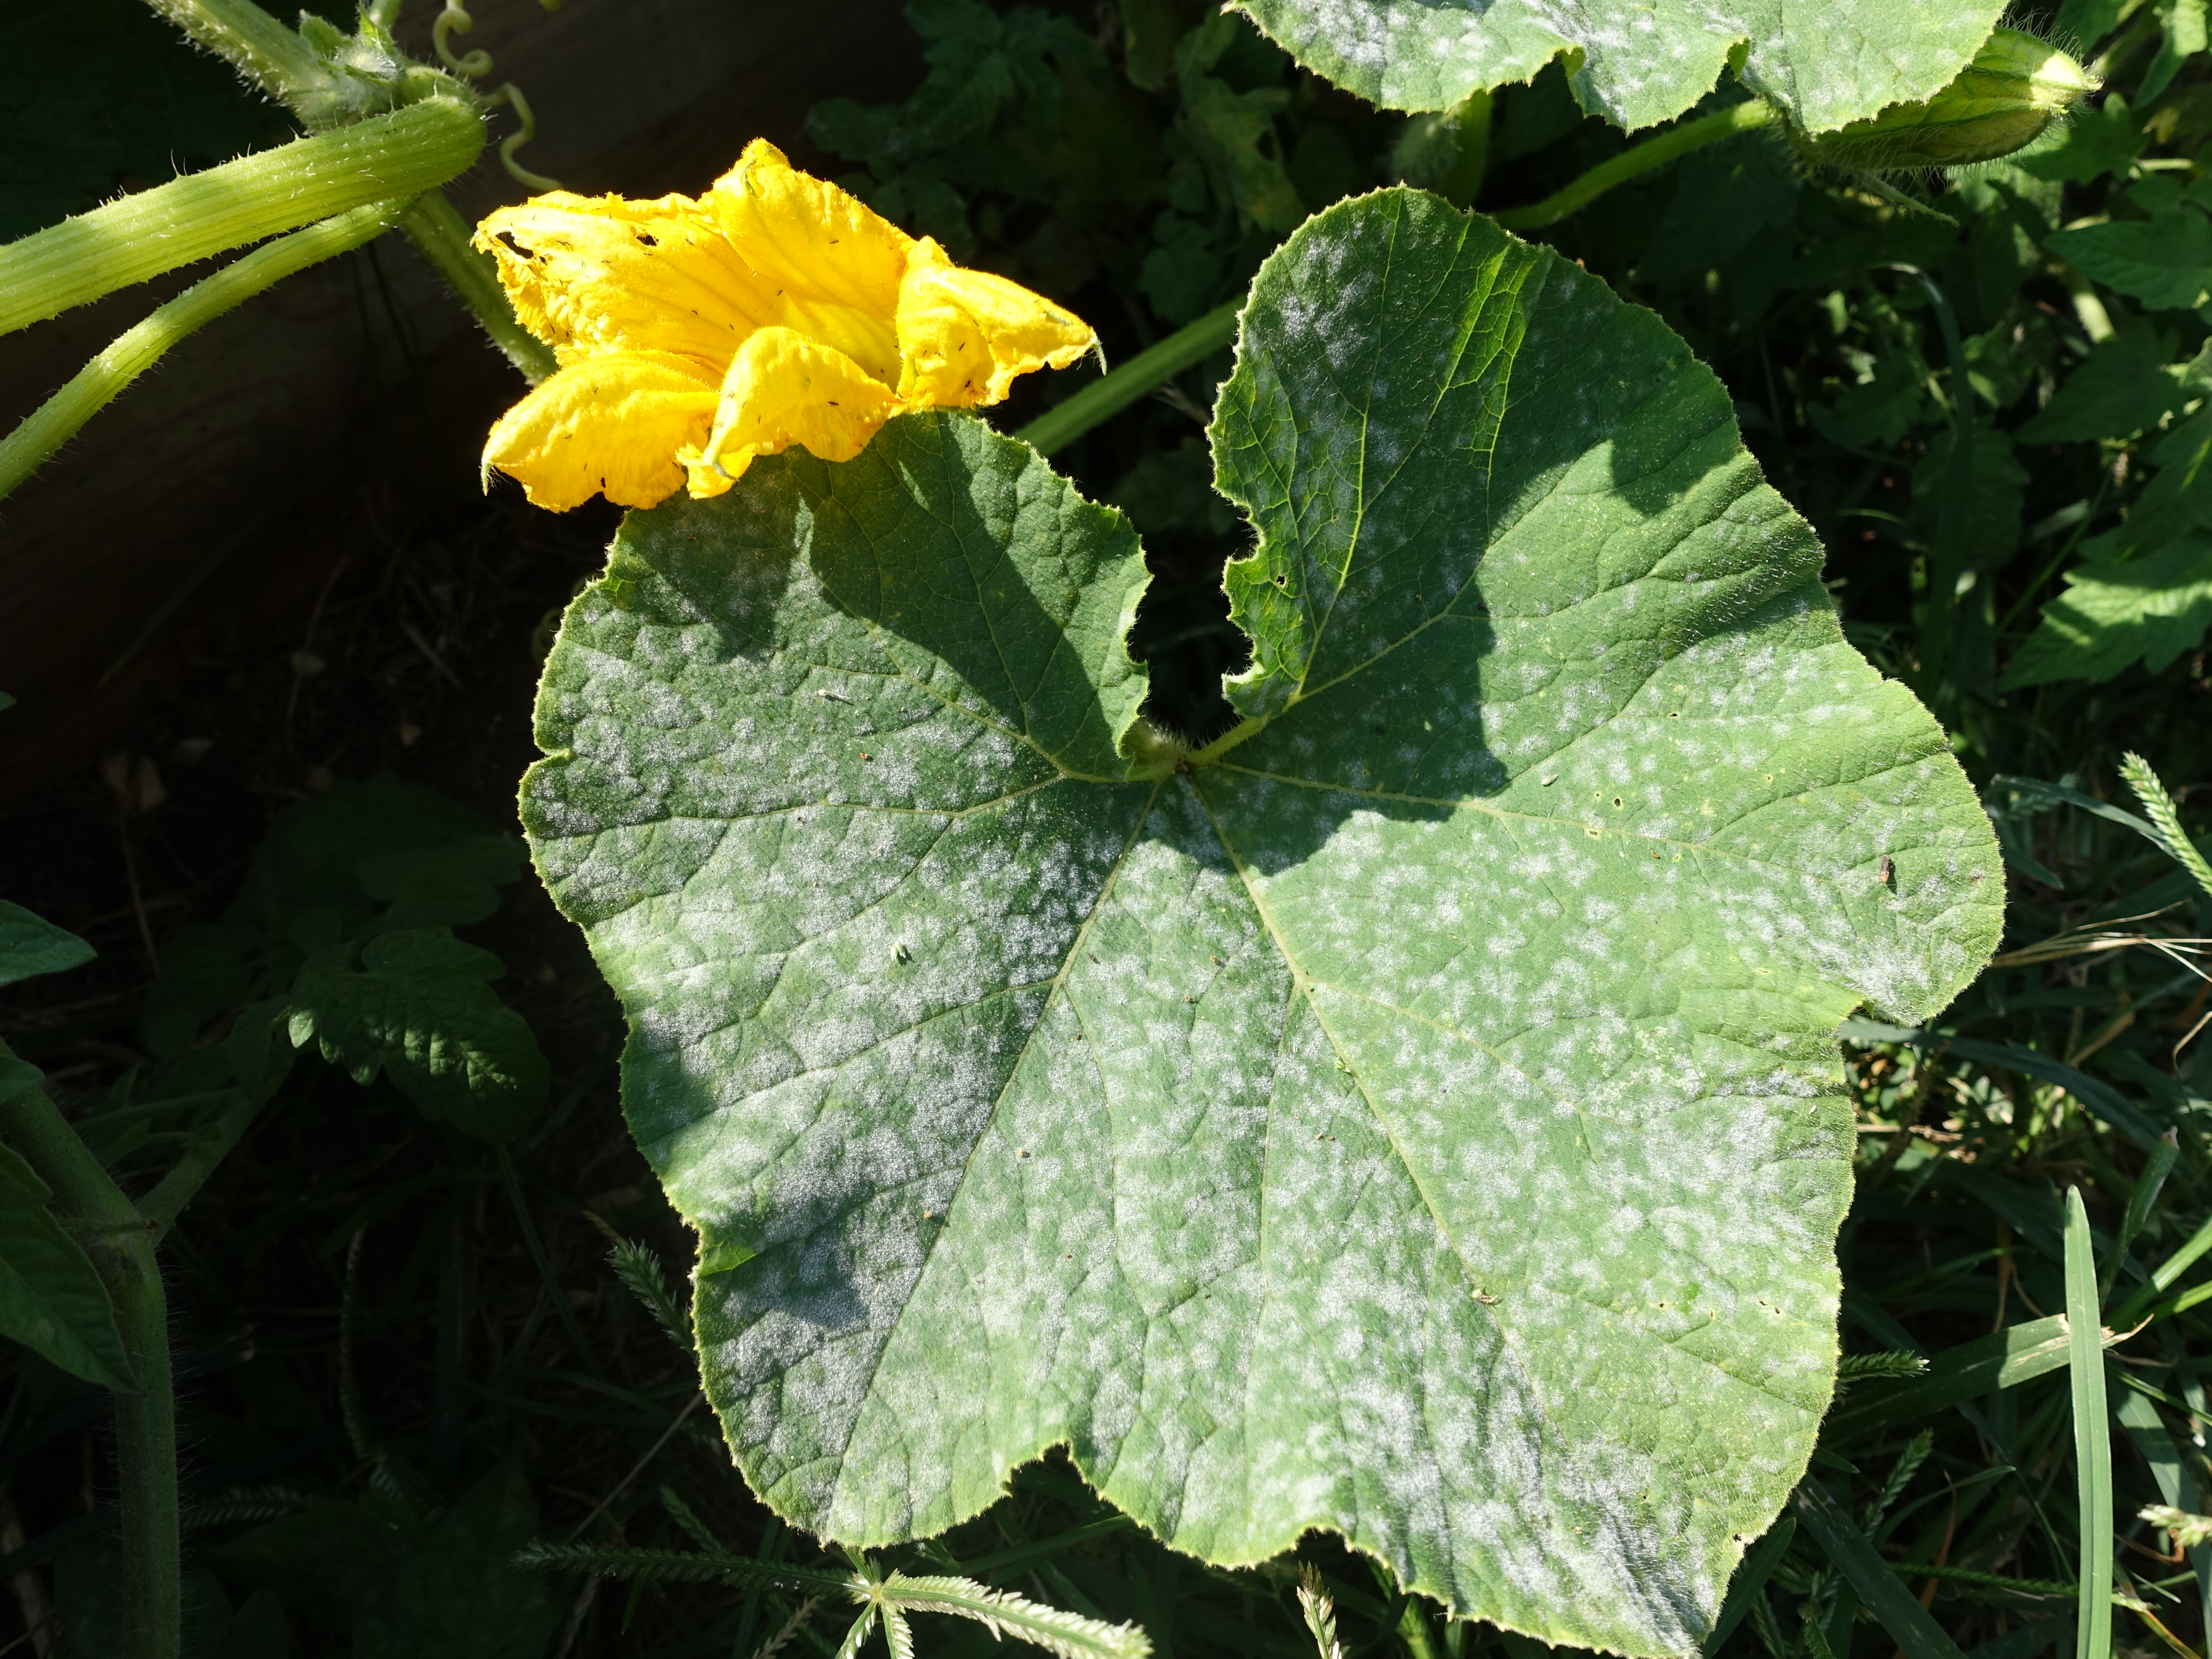
Diagnosing Plant Diseases and Abiotic Disorders of Vegetables
Notes:
Plant diseases and abiotic disorders are commonly found in home gardens. This presentation will help you diagnose plant diseases and disorders using physical signs and symptoms.
This method will not identify all diseases accurately. Consult with a plant testing laboratory when higher accuracy is needed.

Slide 2
Basics of Plant Disease
Signs versus symptoms
Disease triangle: susceptible host, virulent pathogen, and favorable environment
The disease cycle = interaction of pathogen and host
Notes:
Symptoms are useful in diagnosing a disease but are not definitive since many symptoms are common to more than one disease and symptoms can vary.
Seeing the actual pathogen is called a sign. Examples of signs include powdery mildew spores and mycelium or Southern blight sclerotia. Seeing physical evidence of the pathogen allows you to be more confident in your diagnosis.
A plant disease will only develop if a susceptible host, pathogen, and favorable environment occur simultaneously. Not all plants are going to be susceptible to all pathogens. Sometimes, the environment might not favor disease development, such as in cases where the pathogen needs free water in order to infect a host plant.
The severity of the disease depends on the virulence and abundance of the pathogen, the susceptibility of the plant, and conducive environmental conditions.
The disease cycle describes the interaction of a pathogen with its host. Knowing how the disease cycle works will give you an idea of how and when to manage the disease.

Slide 3
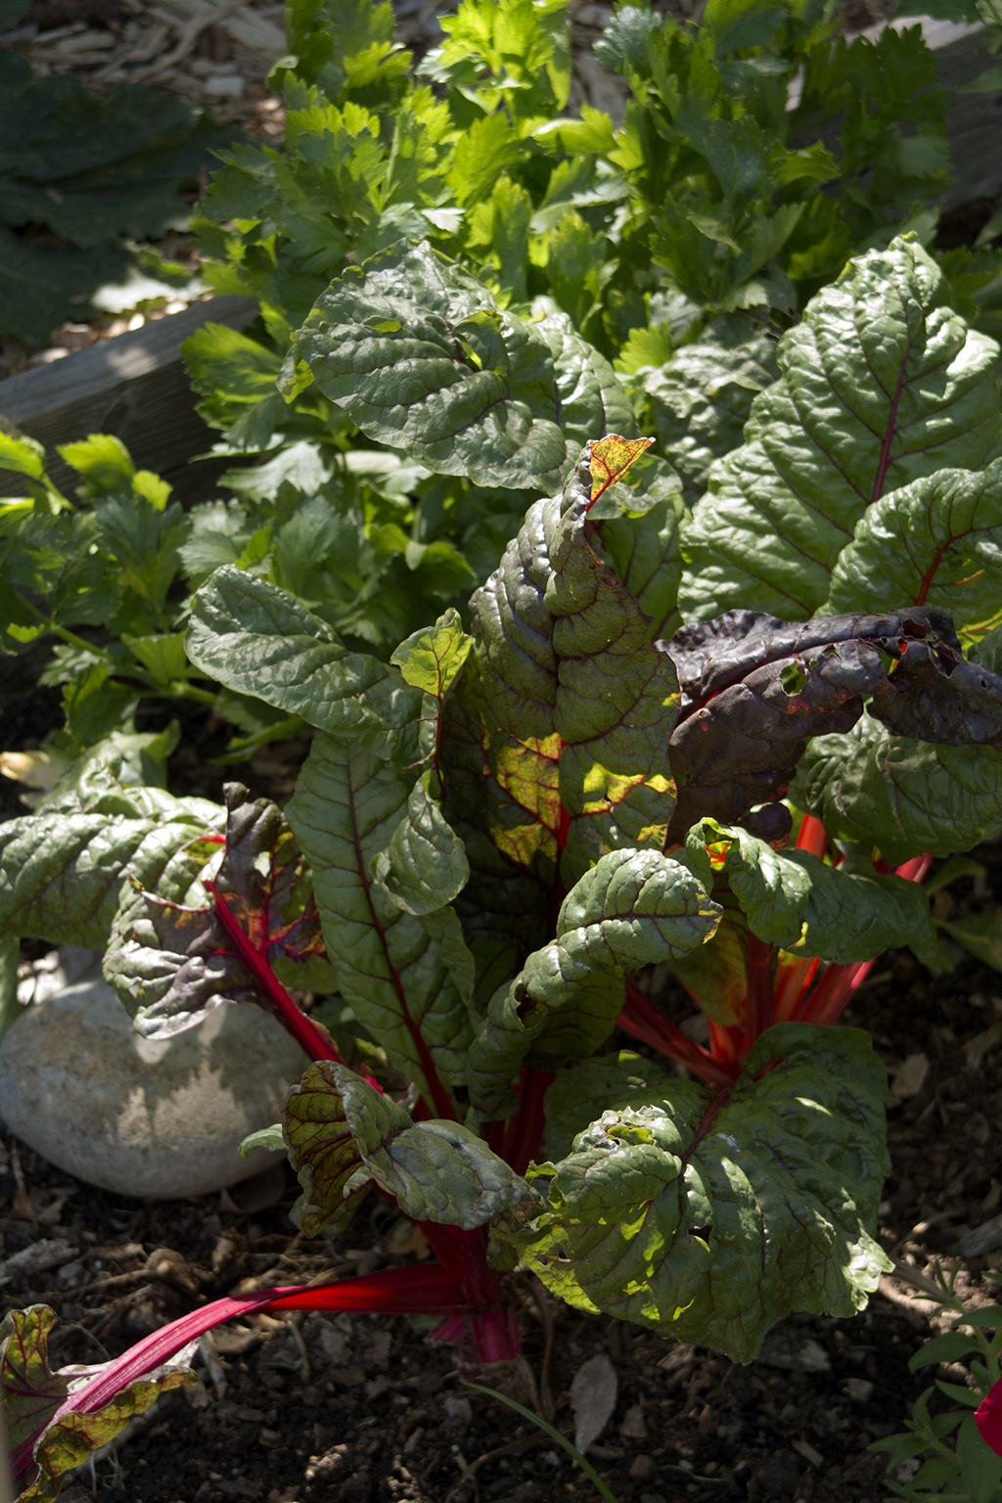
Diagnosis
Identify host plant
  Species, cultivar, age
  Preferred location?
Notes:
When you spot a problem, first identify the plant:
What is the species, cultivar, and age?
Where is the plant located? Full sun? Full shade? What is the plant’s preference based on the species or cultivar?

Slide 4
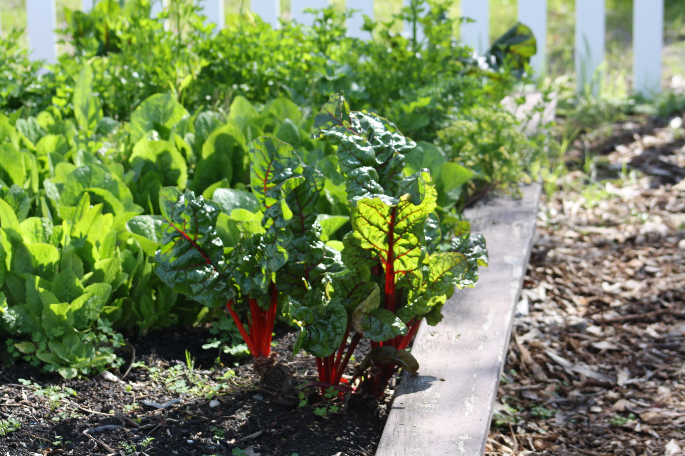
Diagnosis
Collect information
  Weather?
  Soil?
  History?
  Management?
Notes:
Collect information
Is it a single plant affected? All plants of this type? Plants only in one area?
How is the soil in the area of the plant? What has the management been? Have you fertilized recently or used any pesticides? Regular or irregular watering?

Slide 5
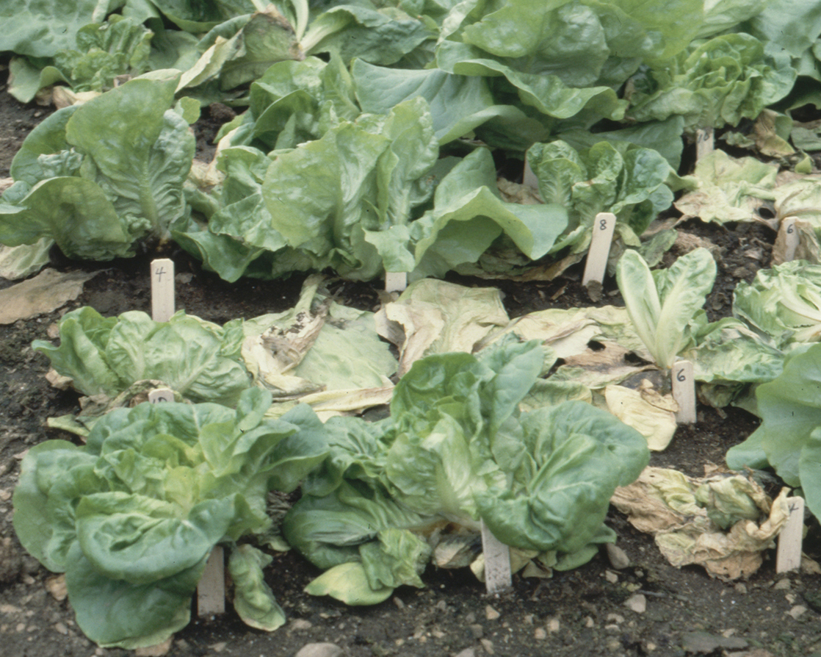
Diagnosis
Look for patterns
  Single plant or multiple?
  Compare to normal plants
  Symptoms over time?
Notes:
Look for patterns
How do these symptoms compare to normal plants? Are there similarities in the symptoms of certain plants compared with others?
How do these symptoms develop over time?

Slide 6
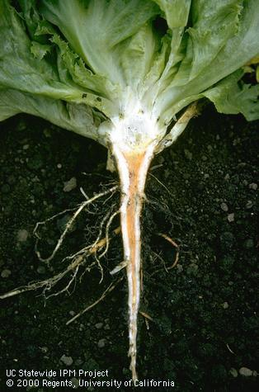
Diagnosis
Characterize signs and symptoms
  Other possible causes of damage?
  Abiotic or infectious?
Notes:
Identify your disease.
You have to identify the disease before you can appropriately solve the problem.
Correlate disease to damage: how much damage is caused by the disease?
Damage by different diseases and even some insect pests may look similar
Damage may be from abiotic causes including equipment injury, water mismanagement, over or under fertilizing, etc.
Disease levels: what is the threshold before taking action?

Slide 7
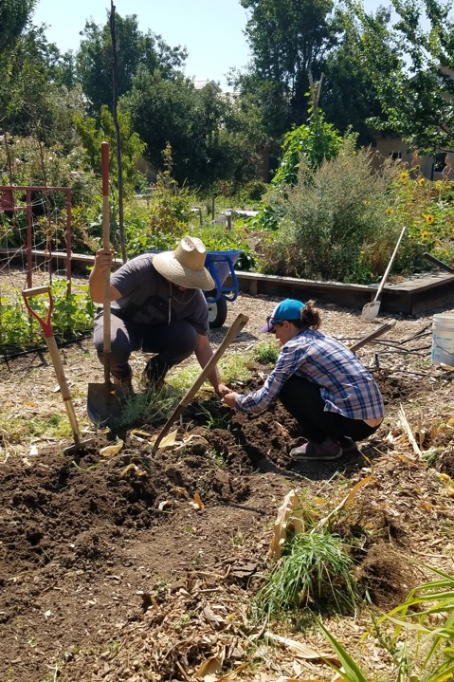
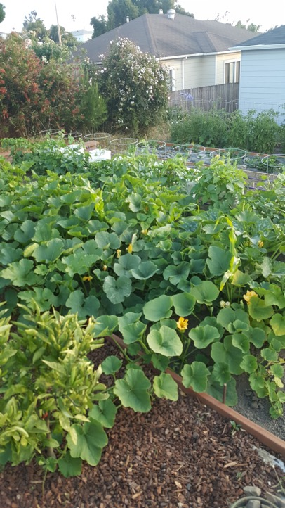

Common Plant Diseases in the Home Garden
Notes:
Let’s talk about a few common plant diseases in home vegetable gardens and compare them with similar diseases and disorders.

Slide 8
Powdery Mildews
Caused by various fungi
Hosts: many vegetables
Signs and symptoms: white patches, yellow blotches, brownish spots on leaves and shoots, sometimes on fruit
Spread: wind
Conducive environment: warm, dry, doesn’t need free water
Powdery mildew on melon, caused by Podosphaera xanthii
Notes:
Powdery mildew is a very common disease in vegetable gardens. Many plants are susceptible to this disease including grapes, cucurbits, cole crops, beans, peppers, peas, and tomatoes.
The disease creates white patches that develop on leaves and other plant parts. These patches are actually the mycelium, the branching cells, of the pathogen. This sign of the pathogen enables you to correctly identify this disease.
The environment, as always with plant diseases, is critical. The spores can be spread by wind. Free water on leaves kills germinating spores and mycelium of powdery mildew. This fungus overwinters in leaf litter.
The photograph shows powdery mildew on melon. The symptoms are what you’d expect in powdery mildew.

Slide 9
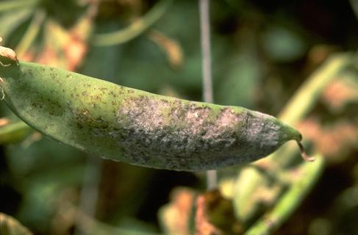
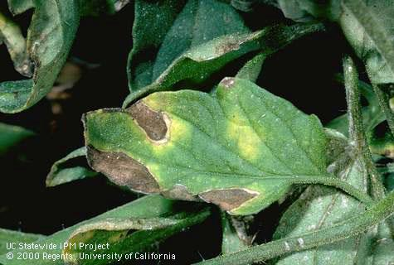
Powdery Mildews
Powdery mildew on pea, caused by Erysiphe pisi
Powdery mildew on tomato, caused by Erysiphe lycopersici
Notes:
Here are some different symptoms of powdery mildew on pea and tomato. The distinctive white patches commonly associated with powdery mildew are not present so these symptoms could be mistaken for another disease.

Slide 10
Downy Mildews
Caused by oomycetes
Hosts: many vegetables
Signs and symptoms: patches of spores on the underside of leaves that start white and turn brown, purple, or black, yellow blotches on top that turn brown
Spread: wind
Conducive environment: cool and wet
Downy mildew on broccoli leaf, caused by Hyaloperonospora brassicae
(=Peronospora parasitica)
Notes:
Downy mildew is caused by oomycetes, pathogens sometimes called “water molds.” Many vegetable plants are susceptible to downy mildew including cucurbits, cole crops, lettuce, onions and garlic, peas, and spinach.
Typical symptoms of downy mildew include downy masses of spores on the undersides of affected leaves with irregular yellow patches on top. These chlorotic lesions later turn brown.
The spores can be spread by wind. This oomycete overwinters in old roots and needs cool, moist weather for infection and disease development to occur.
The photograph shows downy mildew on collard leaf, caused by Hyaloperonospora brassicae (=Peronospora parasitica).

Slide 11
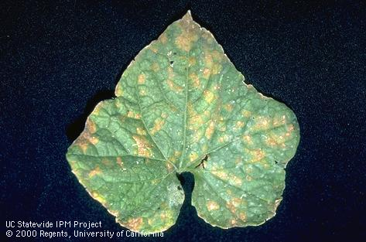
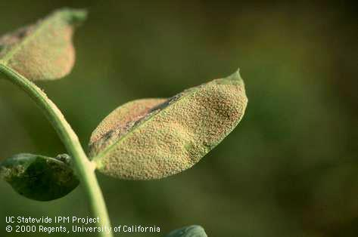
Downy Mildews
Downy mildew on cucurbits, caused by Pseudoperonospora cubensis
Downy mildew on pea, caused by Peronospora viciae (=pisi)
Notes:
Here are some different symptoms of downy mildew on cucurbit and pea. The symptoms on pea is reminiscent of rust but the growth is more cottony.
Downy mildew occurs in the Sacramento, upper San Joaquin, Imperial valleys, and in coastal areas. It attacks all cucurbits, although cucumber is the most commonly infected.

Slide 12
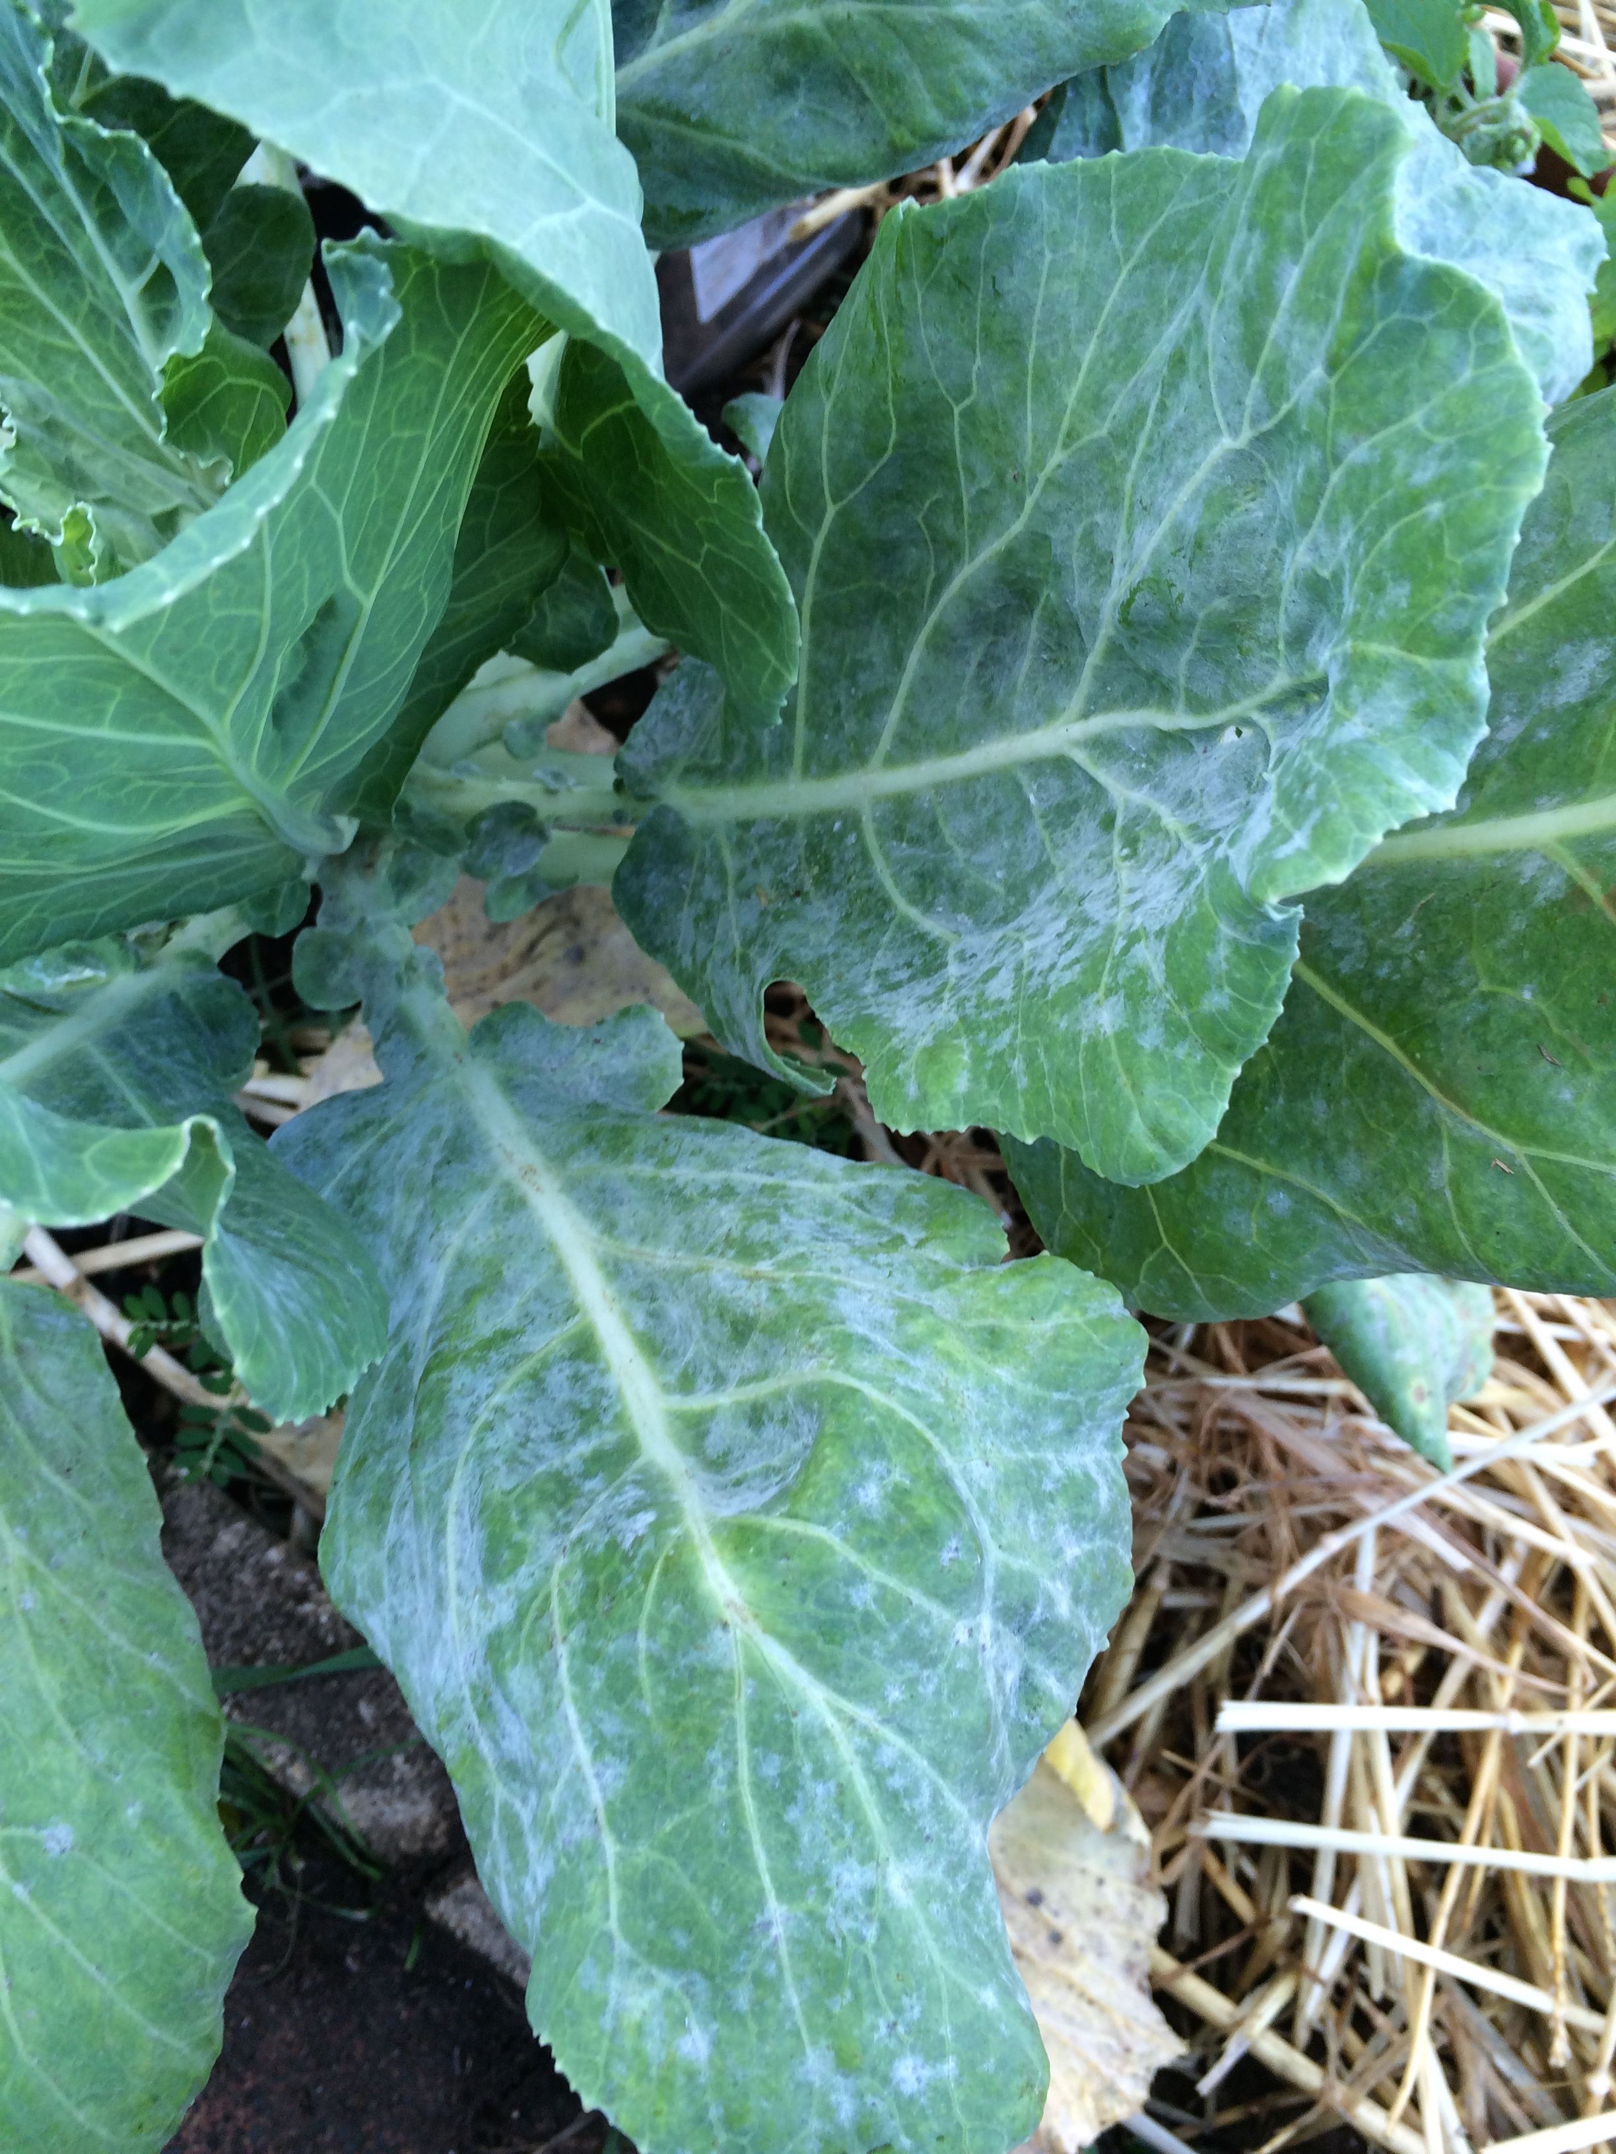
Is it Powdery Mildew or Downy Mildew?
Collect information
  Weather?
  Location of symptoms?
Notes:
Downy mildew initially may be confused with those of powdery mildew. However, the two diseases differ in several important ways. Downy mildew produces spores mostly on the undersides of leaves and only after rain or very heavy fog. Spores disappear soon after leaves dry out. Powdery mildew does not require water on the leaf surface for spore formation, and the powdery growth appears on both sides of leaves.
Powdery mildew thrives in warm weather whereas downy mildew is a cool weather disease.
This photo shows powdery mildew on cabbage.

Slide 13
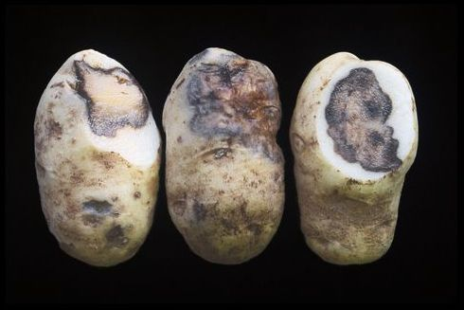
Bacterial Soft Rot
Caused by several different bacteria, including Erwinia, Pseudomonas, and Enterobacter spp.
Many vegetable hosts including onions, garlic, carrots, potatoes, corn, cauliflower, and broccoli
Symptoms: softening, water-soaked tissues that turn yellow then brown; foul-smelling
Spread: water splash, wounds
Bacterial soft rot of potato, caused by Erwinia spp.
Notes:
Bacterial soft rot can be caused by a variety of bacteria and can affect many vegetable hosts.
These diseases are characterized by softening and water soaking of fruit and other plant tissues. Affected tissue is yellow initially, turning brown as the disease progresses. Infected fruit may be soft when pressed.
In some hosts, the rot first appears in the young leaves or as a soft, watery slimy decay of the taproot.
A foul-smelling odor is also associated with these disorders.
Soft rot occurs most often with warm weather and standing water caused by poor drainage or low areas.

Slide 14
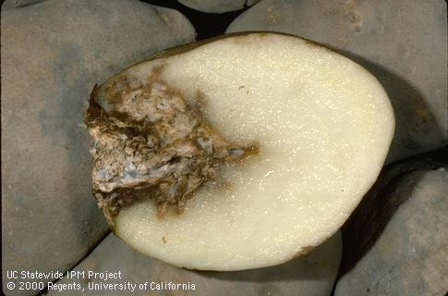
Fusarium Dry Rot
Caused by the fungus Fusarium (multiple species)
Potatoes
Symptoms: Brown flecks on the surface, progressing to deep cavities.
Spread: wounds
Fusarium dry rot of potato
Notes:
Fusarium causes a dry rot of infected tubers, although a moist rot may occur if secondary infection by soft rot bacteria is also involved. Initially, lesions appear as brown to black flecks on the tuber surface. Lesions later form large, hollow cavities. Frequently, the lesions appear wrinkled on the tuber surface with numerous white tufts of mycelium. Infected seed pieces may completely decay.

Slide 15
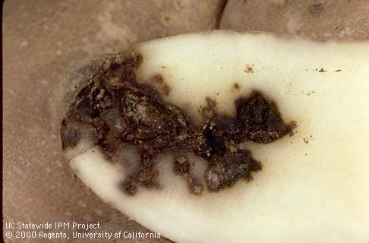
Is it Bacterial Soft Rot or Fusarium Dry Rot?
Define problem
  Symptom type and location
Bacterial soft rot of potato
Notes:
Bacterial soft rot and Fusarium dry mold both cause dark lesions but bacterial rots have a distinctive odor and are wet.

Slide 16
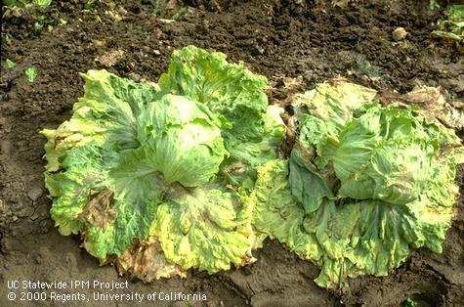
White Mold
Caused by fungi in the Sclerotinia genus
Symptoms: soft watery rot, white cottony mycelium on lower leaves and stem
Sign: hard black sclerotia on or in dead stems
Spread: sclerotia in soil
Conducive environment: cool and moist
Notes:
White mold is a distinctive disease that most often affects stems and foliage at the base of cole crops and lettuce plants. Affected tissue develops a soft, watery rot and white, cottony mycelium forms on the surface. Plants may wilt if stems are girdled by the decay. As affected tissue dries up, it turns yellow to white, and hard black sclerotia form on the surface or inside the dead stems.

Slide 17
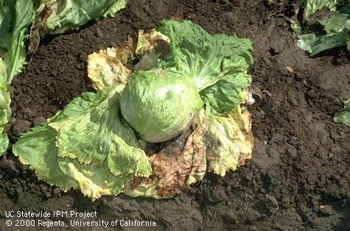
Botrytis Rot (Gray Mold)
Botrytis cinerea, a fungus
Symptoms: lower leaves yellow, watery, brown decay
Sign: gray or light brown sporulation, sometimes sclerotia
Spread: airborne spores, injury or dead/dying tissue needed
Conducive environment: cool and moist
Notes:
Symptoms of Botrytis crown rot are similar to sclerotinia rot: lower leaves of plants infected with Botrytis yellow, and eventually the whole head wilts and rots. A watery, brown decay develops on the underside of the head at the crown. A dense gray or light brown sporulation appears over the damaged areas when moisture is abundant.

Slide 18
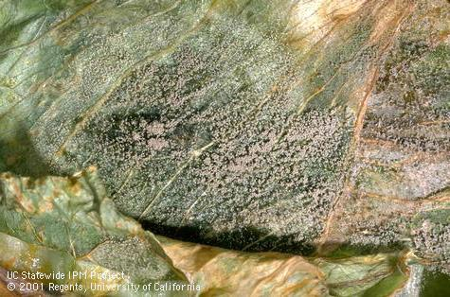
White mold or gray mold?
Look for a distinctive symptom or sign
Gray spores of Botrytis cinerea on a lettuce leaf.
Notes:
Gray sporulation distinguishes gray mold caused by Botrytis from lettuce drop or white mold caused by Sclerotinia.

Slide 19
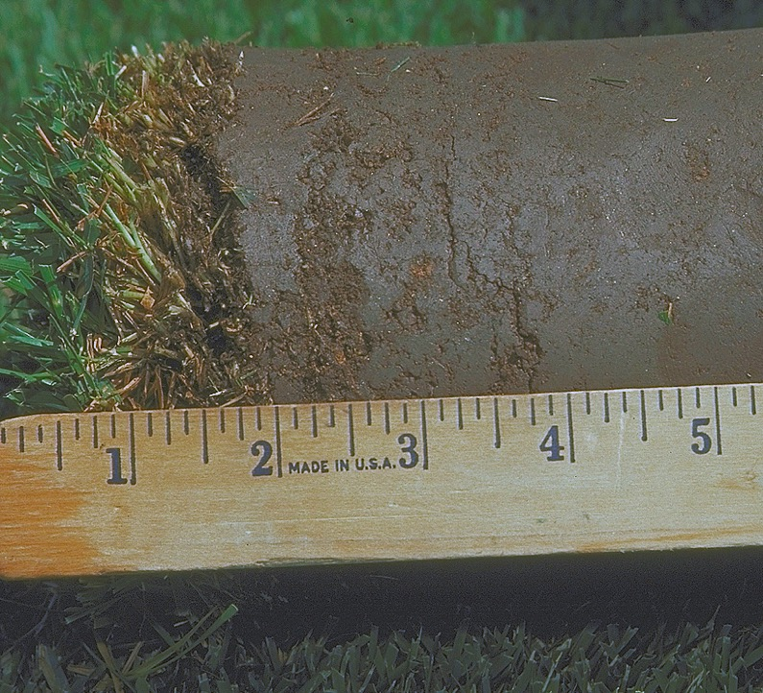

Common Abiotic Disorders
Plant disorders caused by environmental factors
Notes:
Most of the common abiotic disorders are due to issues with the soil. They are not caused by a pathogen so are not infectious but multiple plants can be affected.

Slide 20
Tips for Distinguishing Diseases and Disorders
Disorder (abiotic disease) | Disease (biotic)
No sign of a pest | Signs of a living pest like a mushroom or webbing
Symptoms develop suddenly over whole plant | Symptoms develop slowly and get worse over time
Symptom consistent on plant and similar plants | Symptoms uneven
Symptom on unrelated plants | Symptoms on one type of plant or closely related plants
Notes:
It may seem hard to distinguish a biotic disease from an abiotic one so here are some tips.
Are there signs of a living pest? That will indicate a disease.
Do the symptoms develop slowly or develop suddenly? Abiotic disorders often appear suddenly while infectious diseases usually have a slower progression.
Are the symptoms consistent on the plant and similar nearby plants? That points more to an abiotic cause.
Finally, are the symptoms on unrelated plants or only on closely related plants? Abiotic disorders will affect unrelated plants while infectious diseases are more likely to infect just one type.

Slide 21
Irrigation: Too Much and Too Little
Moisture imbalance most common abiotic disorder
Stunted, pale, drooping plants with few leaves and fruit
Deficit: wilt, fade, tip dieback, premature leaf drop
  Mild & prolonged deficit: reduced growth
  Salt buildup leading to leaf margin necrosis
Excess: not enough oxygen for roots, killing roots, increased disease susceptibility
Notes:
Moisture imbalances are the most significant abiotic disorders and can both mimic and trigger plant diseases.
Both not enough and too little moisture can cause stunted, pale, drooping plants.
A water deficit can cause plants to wilt, fade, drop leaves prematurely and can cause tip dieback.
A mild and prolonged water deficit can lead to reduced growth. This lack of water can cause salt to build up, leading to leaf margin necrosis.
Too much water will displace oxygen in the soil, killing roots, and making the plant more susceptible to root diseases.

Slide 22
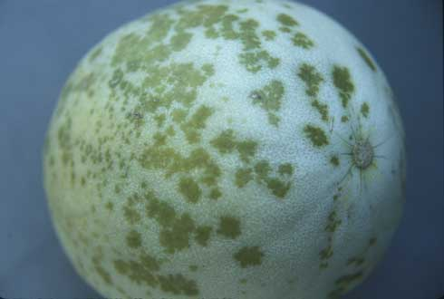
Too much water or a disease?
Collect information
  Single plant or multiple?
  Soil?
  Management?
Notes:
Collect information
Is it a single plant affected? All plants of this type? Plants only in one area?
How is the soil in the area of the plant? What has the management been? Have you fertilized recently or used any pesticides? Regular or irregular watering?
Pictured: Measles, an abiotic disorder caused by wet soils, causes melon fruit to have water-soaked spots with centers that will eventually become tan.

Slide 23
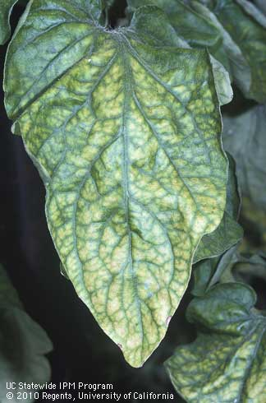
Nutrient Deficiencies
Macronutrients (Nitrogen, Phosphorus, Potassium)
  N: plants grown in containers or sandy soil. Check plant roots and soil conditions.
Micronutrients (Boron, Calcium, Copper, Iron, Manganese, Magnesium, Sulfur, Zinc)
  Most garden soil has adequate levels of micronutrients
  Adverse soil conditions (e.g. acidic) inhibit nutrient uptake
Notes:
Nitrogen is the most common macronutrient deficiency.
Plants in containers can become nitrogen deficient. Before adding nitrogen fertilizer, make sure the soil is draining properly and the plant roots are healthy.
The micronutrients Iron, Manganese and Zinc are the most common micronutrient deficiency. High soil pH is a common cause of nutrient deficiency symptoms. Soil pH affects nutrient availability in soil and inhibits nutrient uptake by plants. Most garden soil has adequate levels of micronutrients but soil conditions, such as too high or low pH can prevent plants from taking up these nutrients.
The photo shows potassium deficiency on tomato.

Slide 24
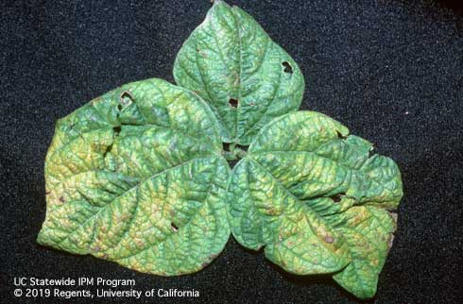
Virus or nutrient deficiency?
Identify disease
  Other possible causes of damage?
  Abiotic or infectious?
Notes:
Many viruses are difficult to distinguish from one another based on symptoms alone. In addition, for each particular disease, symptoms will vary greatly depending on stage of plant at time of infection and other factors. In general, virus symptoms consist of various leaf and plant deformities, stunting and poor growth, or yellowing or mosaic or mottling pattern in the leaves. Leaves may be crinkled or wavy. Dry, corky areas or necrotic streaks may be present.
These symptoms could be mistaken for nutrient deficiency symptoms.
Identification of the particular pathogenic agent can only be made with serological, inoculation, or other laboratory tests.
Photo shows mosaic virus on bean leaves.

Slide 25
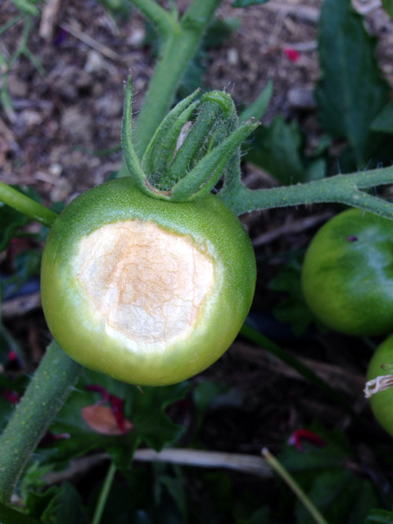
Sunscald
Cause: exposure to excess solar radiation
Injury most severe on south and west sides of plant
Symptoms: fruit and foliage glazed, silvery, reddish-brown leathery spots
Conducive environment: lack of adequate leaf cover
Notes:
Sunburn, also referred to as sunscald, is caused by too much sun exposure. It may look like a plant disease if all you have is a leaf or fruit. Find out what the rest of the plant and surrounding plants look like. The injury is most severe on the south and west sides of the plant where the sun’s radiation is strongest. Sunburn can cause a glazed, silvery look and brown leathery spots on both foliage and fruit.

Slide 26
Sun scald or black mold?
Identify host plant
  Species, cultivar, age
  Preferred location?
Notes:
Ask questions: is the plant growing in an overly sunny spot? Has it senesced and lost its leaves?
Sunscald may be confused with the disease black mold. Black mold, like sunscald, may cause large lesions on fruit, but with black mold, the lesions are usually covered with a black velvety layer of spores.
This photograph shows sunscald on peppers.

Slide 27
For information about managing vertebrate pests and other pests of homes, gardens, landscape, and turf, visit the UC IPM website
ipm.ucanr.edu
Developed by the University of California Statewide Integrated Pest Management Program (UC IPM)
Special thanks to UCCE Plant Pathology Specialists Dr. Beth Teviotdale (retired)and Dr. Alex Putman, and UCCE Area IPM Advisor Dr. Chris Greer for their contributions.

