Slide 1
The Power of Media in Policy Change
Mindy Romero, Ph.D.
Director

Slide 2
The CCEP’s mission…
A non-partisan research and outreach initiative for the state of California
The CCEP was established to engage public dialogue on representative governance in California

Slide 3
The CCEP’s vision…
CCEP research is intended to inform and empower a wide range of policy and organizing efforts to increase the engagement and well-being of all Californians

Slide 4
Why the CCEP?
Civic engagement by all Californians is critical to addressing disparities in state and regional patterns of well-being and opportunity

Slide 5
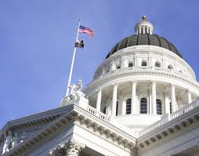
Who partners with the CCEP?
Legislators
Public agencies
Advocates
Researchers
Community leaders

Slide 6
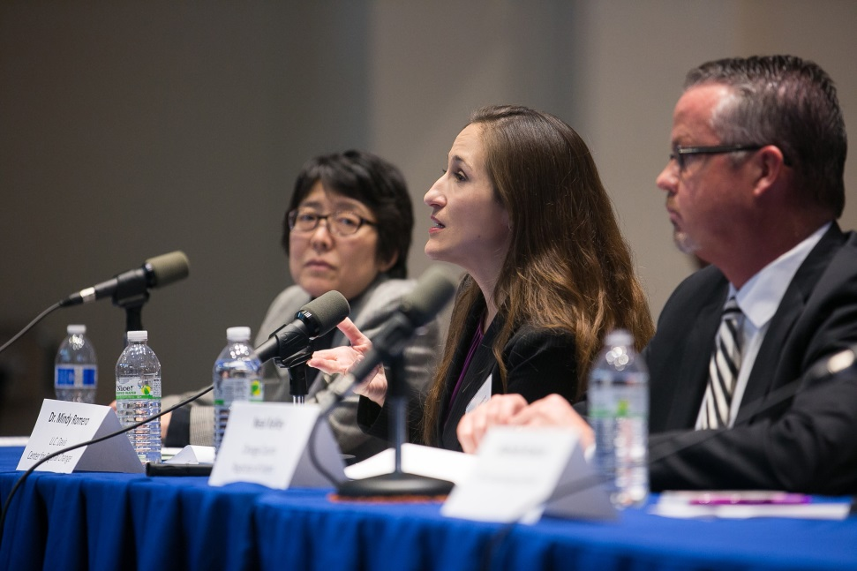
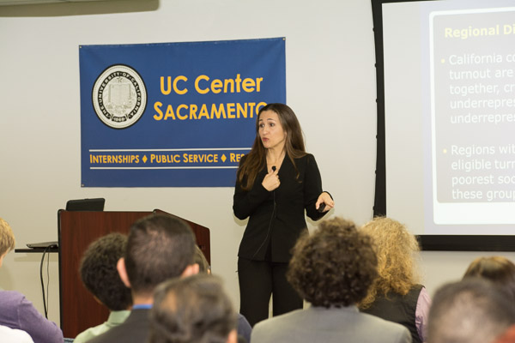
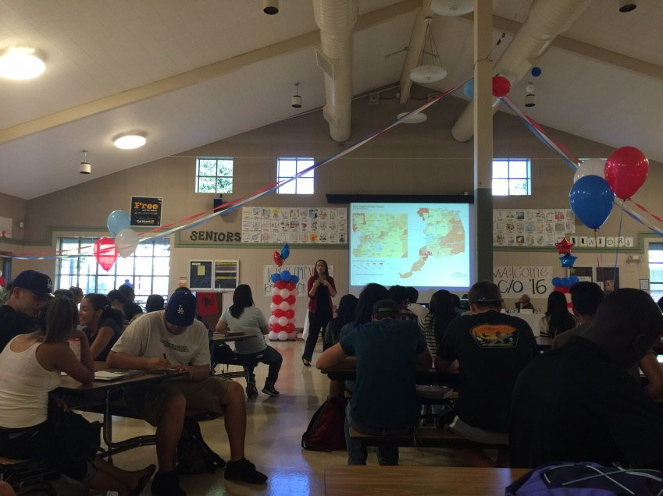
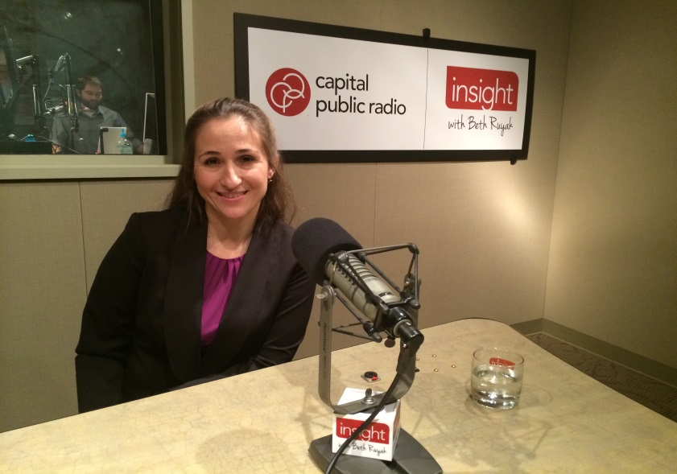
CCEP Outreach

Slide 7
CCEP Policy Brief Series
California Latino and Asian voter registration and turnout rates
California’s youth vote
2012 California online voter registration
Demographics and changes in CA’s political landscape

Slide 8
CCEP Impact
The CCEP has become a key source for electoral and broader civic engagement research
Cited in numerous major news outlets, including the New York Times, Washington Post, LA Times, SF Chronicle, Politico and the Huffington Post

Slide 9
CCEP Impact: Framing the Discussion
Through media, consultation and partnership we are experiencing increasing opportunities to “frame” the discussion around electoral participation of underrepresented groups

Slide 10
CCEP Impact: State Legislature
Introduced Legislation
ACA 7 (2016): 16 years of age to vote in elections for governing boards at
their local school or college.
SB 946 (2016): Makes it possible for high school students to serve as poll
workers in elections.
AB 2516 (2016): 16 or older to vote in elections for governing boards at their
local school or college.
AB 2455 (2016): College students to register to vote when they register for
classes.
SB 450 (2015): Vote centers and ballot drop-off locations in lieu of polling
places.
ACA 2 (2015): Allows 17 year-olds to vote in primary or special elections.
ACA 7 (2014): Allows 17 year-olds to vote in primaries.

Slide 11
CCEP Impact: State Legislature
Passed Legislation
AB 477 (2015): Fails to sign their vote-by-mail ballot envelope to complete and
sign a ballot statement
AB 700 (2015): Requires voter education in high school social studies classes.
SB 113 (2015): Allows youth as young as 16 to preregister to vote.
AB 1461 (2015): Automated voter registration at the California DMV
SB 415 (2015): Requiring cities to consolidate local, state and federal
elections.
AB 1817 (2014): Allows high school students to register their peers on
campus.
AB 1873 (2014): Allowed San Diego County to conduct an all vote-by-mail pilot
special election.
SB 897 (2014): New standards for high school and adult education courses in American government and civics

Slide 12
Media = Part of a Coordinated Communications Strategy

Slide 13
Its not just about the policy brief

Slide 14
Why Media?
Draws public and policy maker attention
Helps set an agenda
Issue framing

Slide 15
Why Media?
Bottom line =
Impact
But there can be drawbacks

Slide 16
Drawbacks
Journalist norms can lead to distortion or oversimplification
Media bias
Difficult to engage and sustain – flavor of the month

Slide 17
Who engages the media?

Slide 18
Who engages media?
media experts are the ones translating/mediating between the ‘slow and deep’ world of research and the ‘fast and shallow’ world of news
“designated media experts” should include researchers
Develop the brand of experts/leaders

Slide 19
Who engages media?
communication with the wider public is often understood to be a one-way street
where possible, “media experts” should not monopolize communications – offer people the concepts, tools and skills to generate their own hypotheses

Slide 20
How to engage the media?

Slide 21
How to engage the media?
What are your goals?
And how much media interaction are you willing to engage with in order to pursue policy change?

Slide 22
How to engage the media?
Every project should have ‘Nine Lives’
think creatively about how to use multiple forms of engagement
Example:
op-ed piece, social media, newspaper article, press release, webinar, presentation, email distribution, expert testimony, radio or television interview

Slide 23
How to engage the media?
Develop greater media-readiness:
respond to breaking news
write press releases
notify media in advance of events
media training
Appoint a staff person:
ad hoc photographer/videographer
record quotes, provide feedback
pursue innovative reporting formats

Slide 24
How to engage the media?
Identify your audience
different voices
Identify others in the field
Influencers, competition
Leverage the university brand
You are the unique expert

Slide 25
How to engage the media?
Curate your visual self-presentation
Create a consistent ‘brand’
Build communications into each project

Slide 26
How to engage the media?
Campus Resources:
Office of Government Relations
Strategic Communications
UC Center Sacramento

Slide 27
Policy Briefs that Engage the Media

Slide 28
Write policy briefs that engage the media
First person
Accessible language
Dynamic headline and subheadings
Highlights
Policy recommendations
Clear added value

Slide 29
Write policy briefs that engage the media
Review other briefs
Make your own brand
External review process
Campus resources
Find champions

Slide 30
Where to disseminate policy briefs?
Where is your media audience?
Web placement
Social media
Direct mail
Direct sends to news media
Op-eds
Blogs
Presentations

Slide 31
Where to disseminate policy briefs?
Relationships
Relationships
Relationships

Slide 32
Measurable Impact
How many media hits?
How many policy conversations?
How many relationships built?

Slide 33
Take-a-ways
Know your audience
Make it simple
Disseminate widely
Track your success!

Slide 34
Thank you
Mindy Romero, Ph.D.
Director, California Civic Engagement Project
UC Davis
msromero@ucdavis.edu
Twitter
@mindysromero
View my Tedx Talk on the Power of the Youth Vote!

