Slide 1
Introduction to Vermicomposting
with Cole B. Smith,
UC Coopertive Extension

Slide 2
Why Compost?

Slide 3
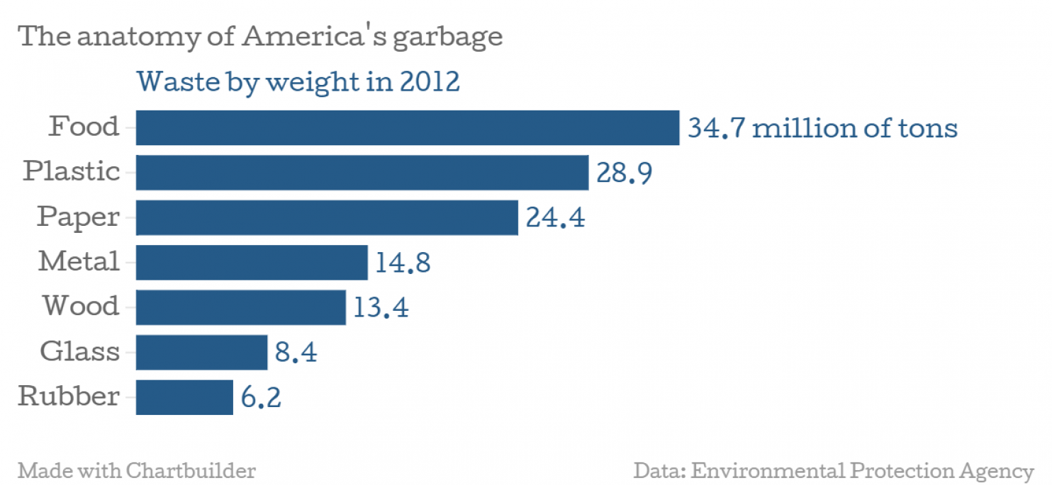

Slide 4
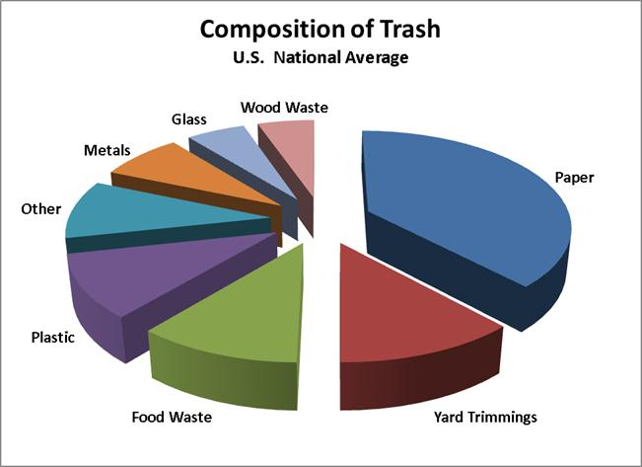

Slide 5
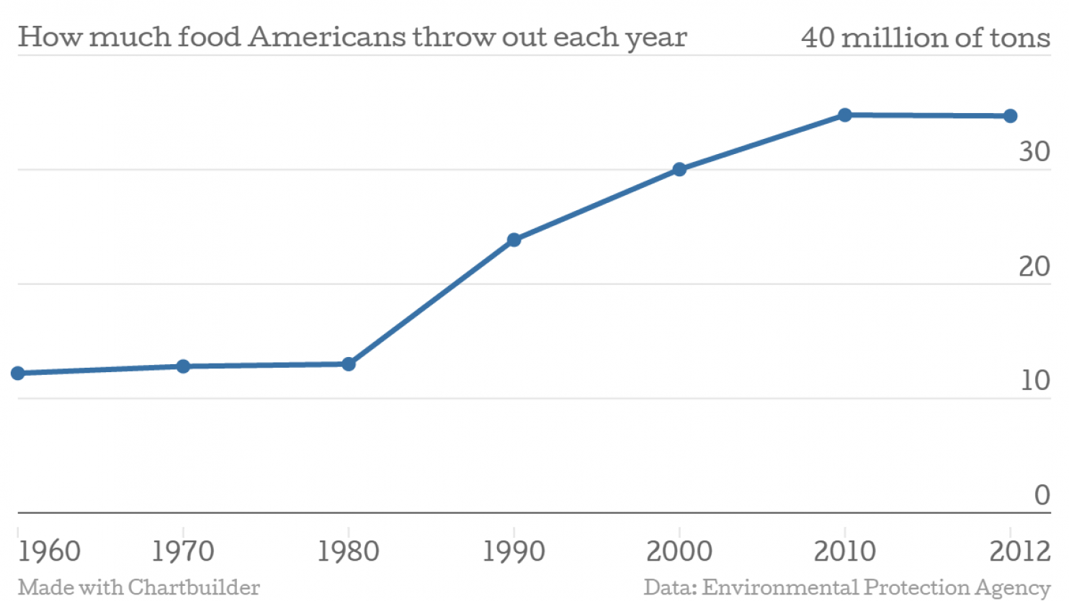

Slide 6
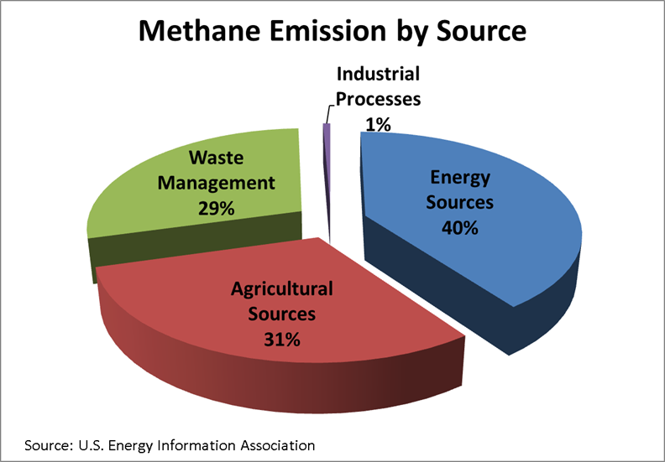

Slide 7
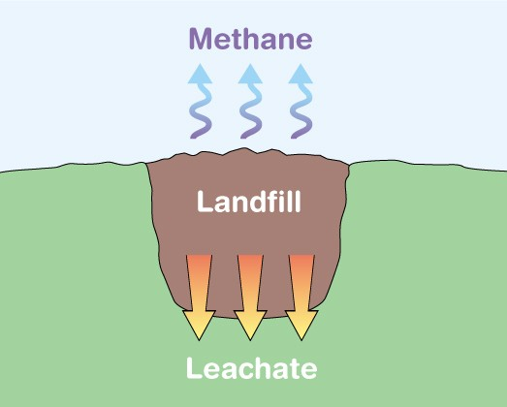

Slide 8
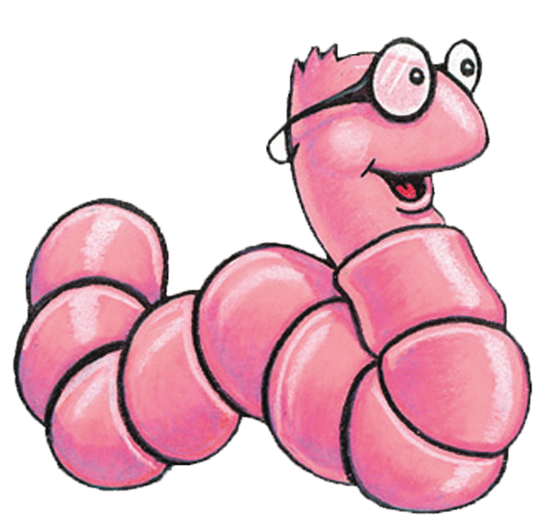
Worms to the Rescue!!

Slide 9
Composting using Worms
Most common composting worm: Red Wiggler (Eisenia fetida)
Feeds from the duff layer
Non borrowing
Often referred to as Manure Worms
Temperature range 55 – 77
Other worms: Red Worm (Lumbricus rubellus)
Soil dwelling
Requires more soil medium
Prefers broken down material

Slide 10
Building a Worm Box
Creating an ideal habitat:
Temperature – 40 - 95
Moisture – Wrung out Sponge
Bedding – Safe, digestible
Food – worm friendly
Light – too much, not good

Slide 11
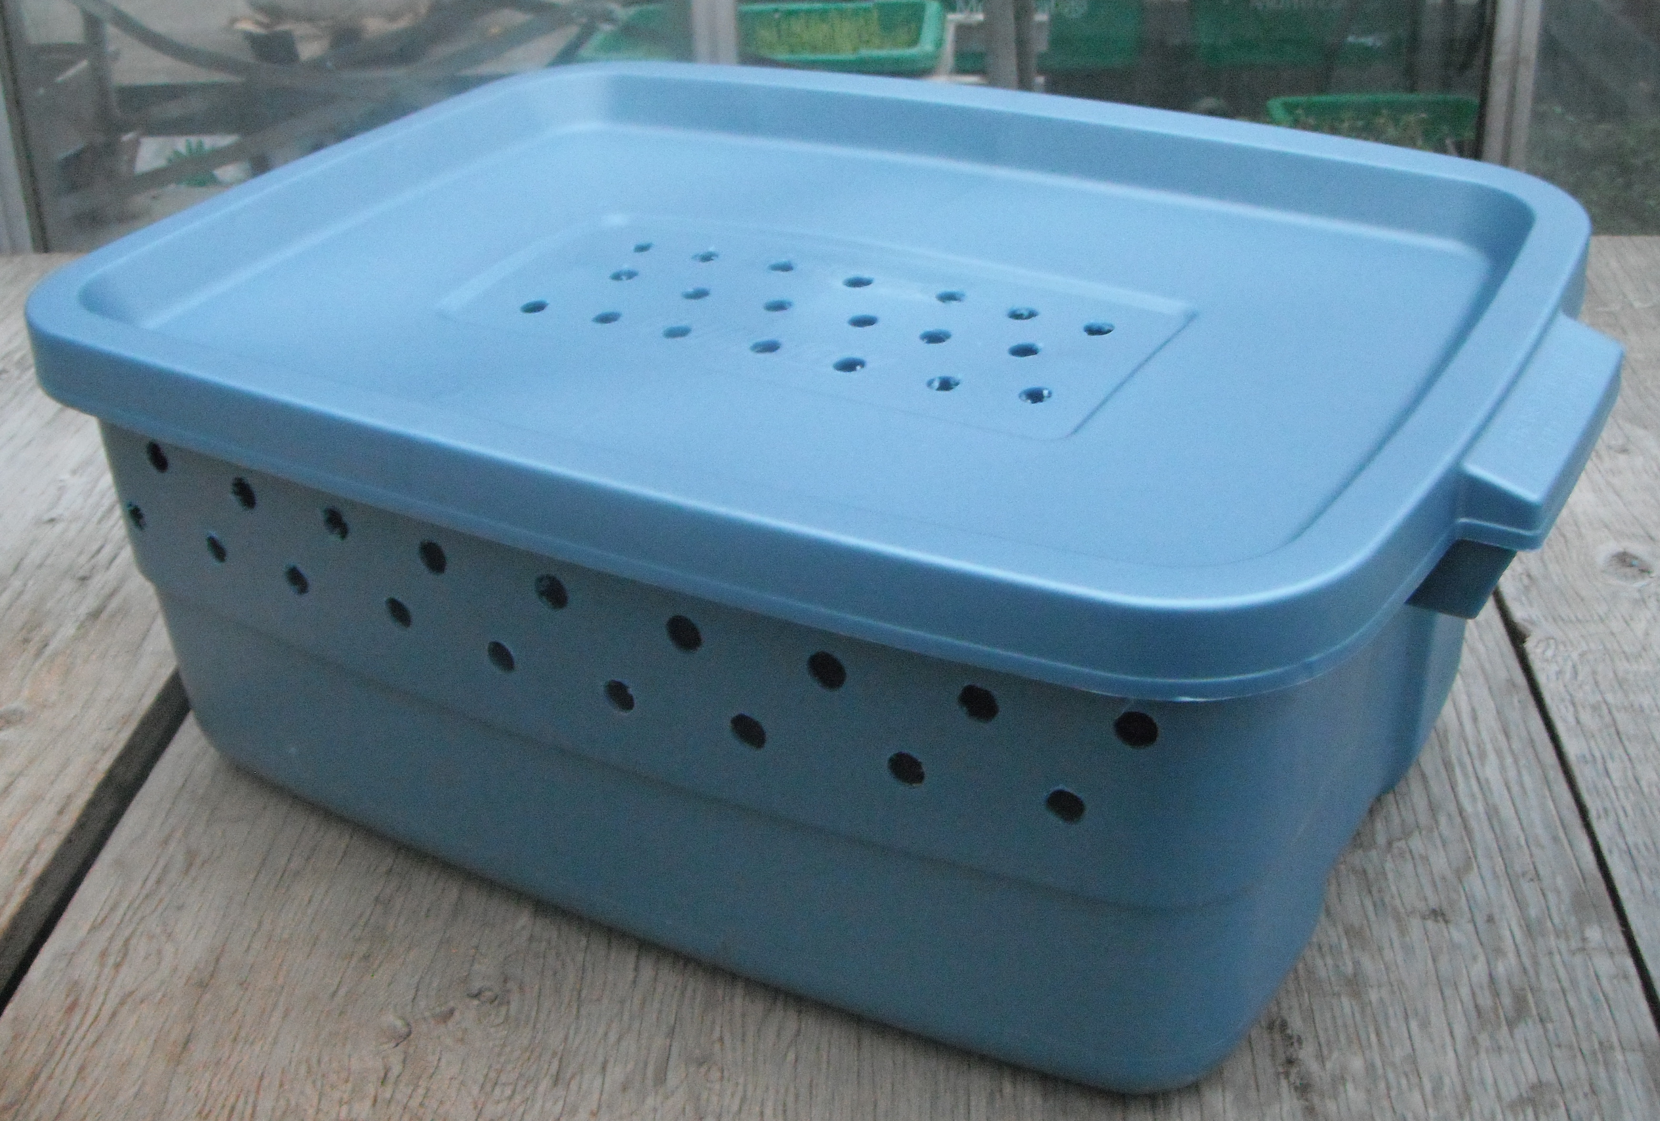
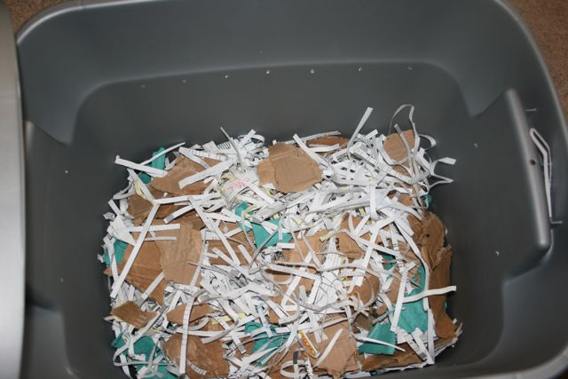
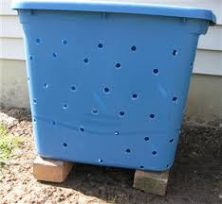

Slide 12
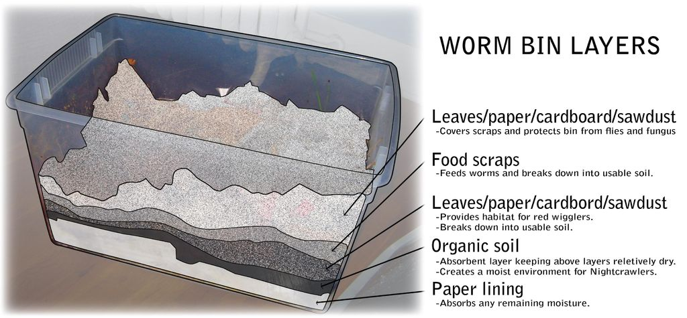

Slide 13
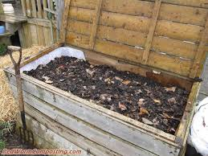
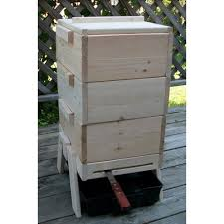
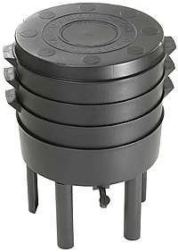
Other Bins

Slide 14
Troubleshooting
Lots of Flies
Keep food Covered
Cover with card board or newspaper
Limit Fruit
Smells Bad
Provide more air
Bottom Drains
Mix the bedding
Control Moisture
Worms all Died
Heat Wave
No Food
Too Many Castings

Slide 15
Thank You!
Cole B. Smith
Program Coordinator,
Composting Education Program
University of California Cooperative Extension
cbrsmith@ucanr.edu / 408-918-4640

