Slide 1
Composting
Cole Smith, Program Coordinator
UCCE Composting Education Program

Slide 2
Why Compost?
Waste Diversion
Soil Fertility
Water Retention & Quality
Carbon Sequestration

Slide 3
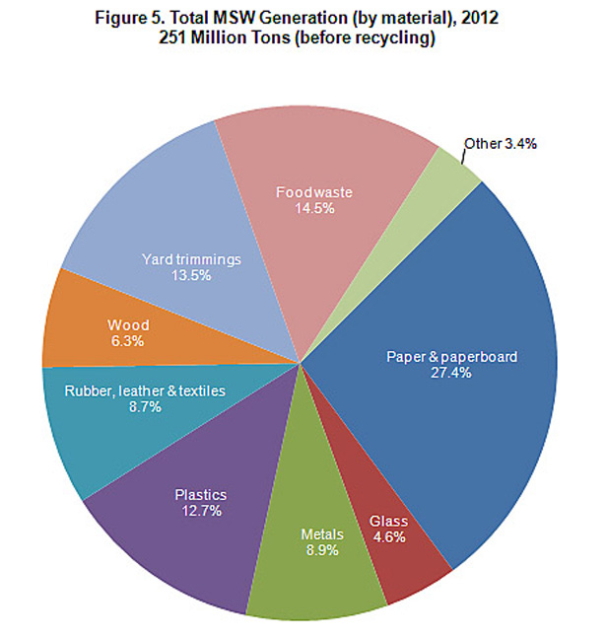

Slide 4
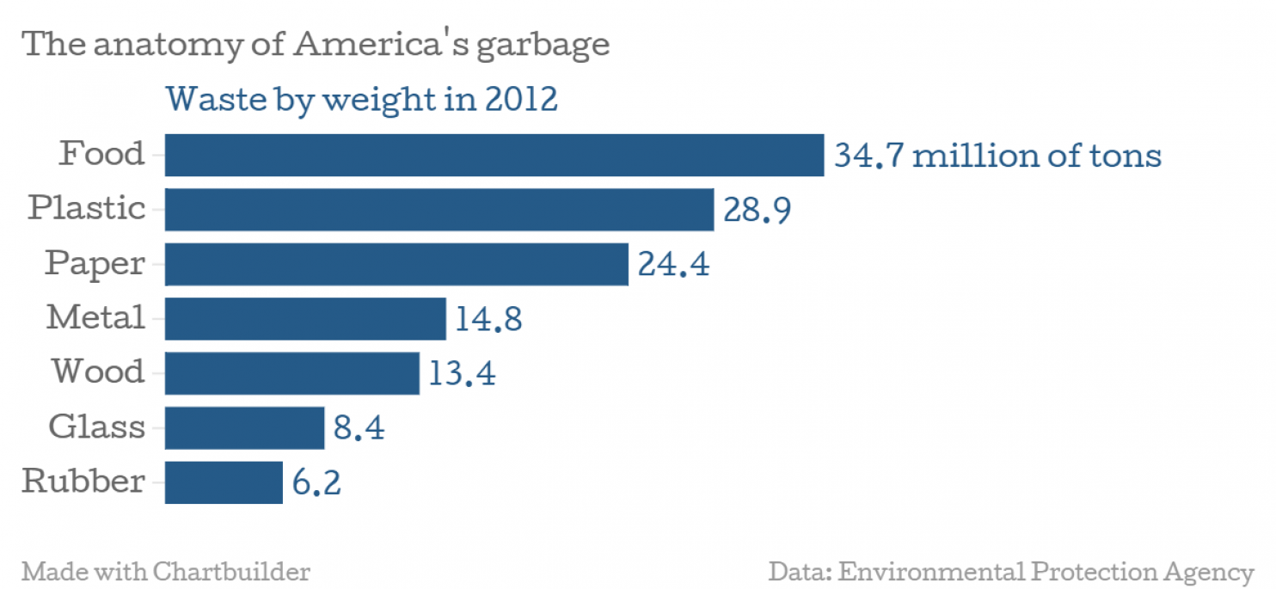

Slide 5
Source: Food and Agriculture Organization 2011

Slide 6
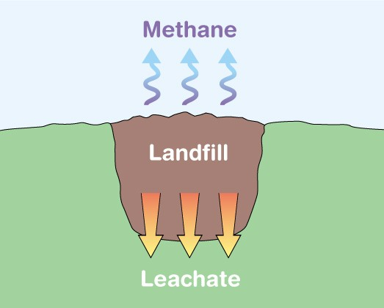

Slide 7
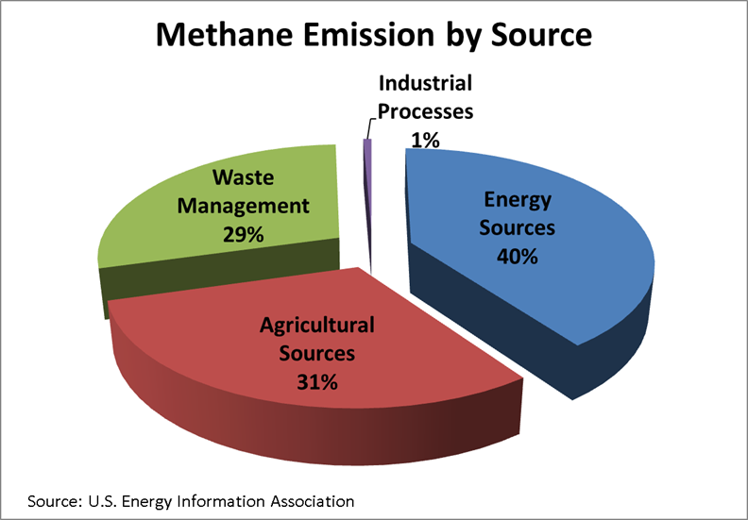

Slide 8
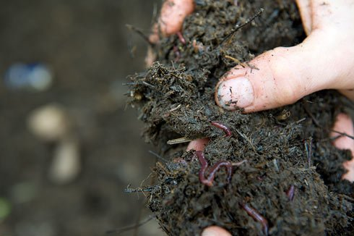
Soil Fertility
Nutrients
Minerals
Microbiology
Organic Matter
Humic Substances

Slide 9
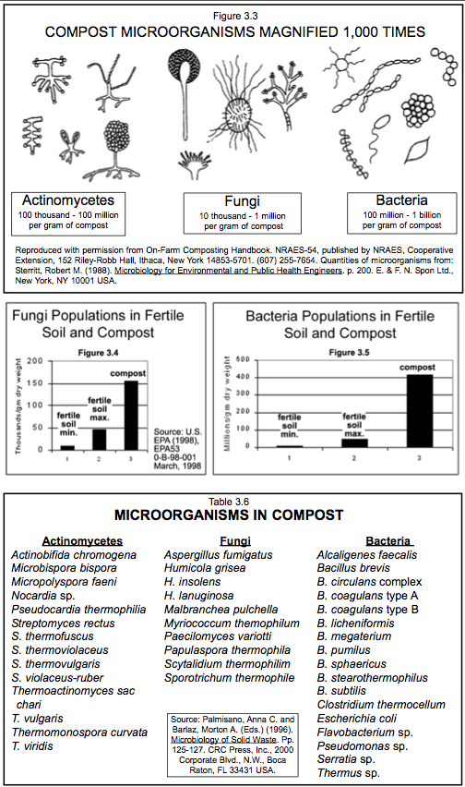
Compost Food Web

Slide 10
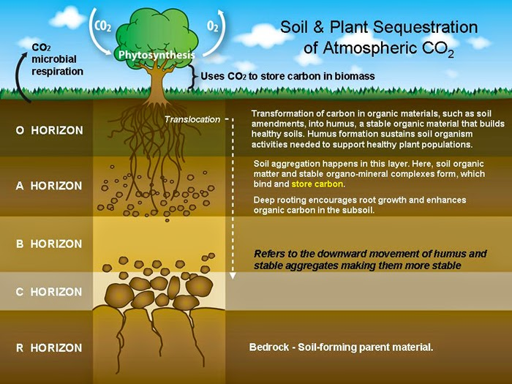

Slide 11
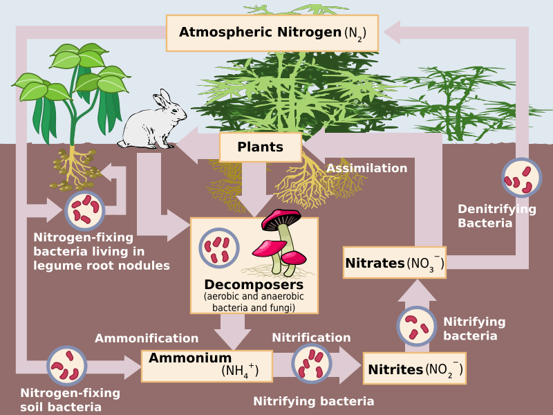

Slide 12
Water & Compost
Increased Water Holding Capacity
Reduced Irrigation Demand
Bio-filtration

Slide 13
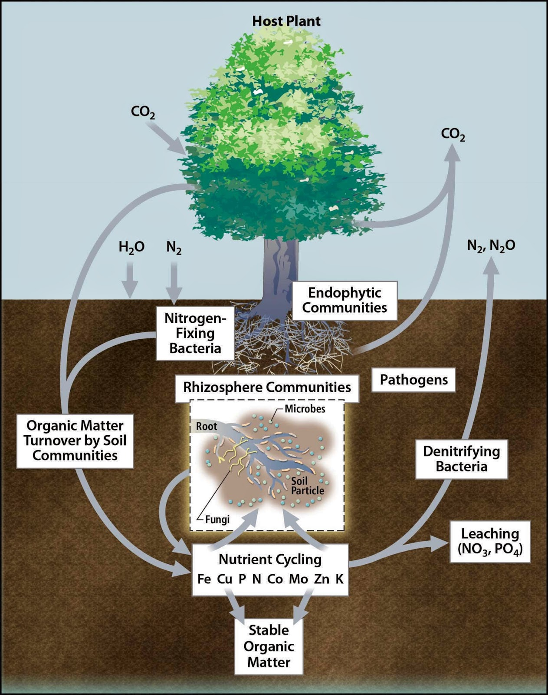
Composting & Climate Change
Uptake of both CO2 and CH4
Long term Carbon Storage
Reduced emissions

Slide 14
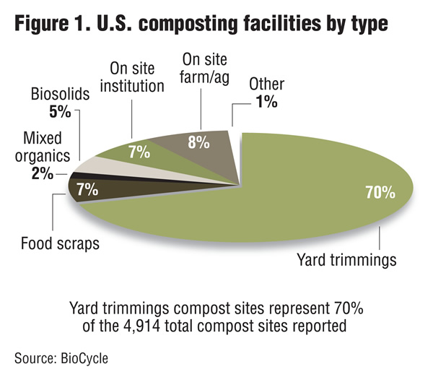

Slide 15
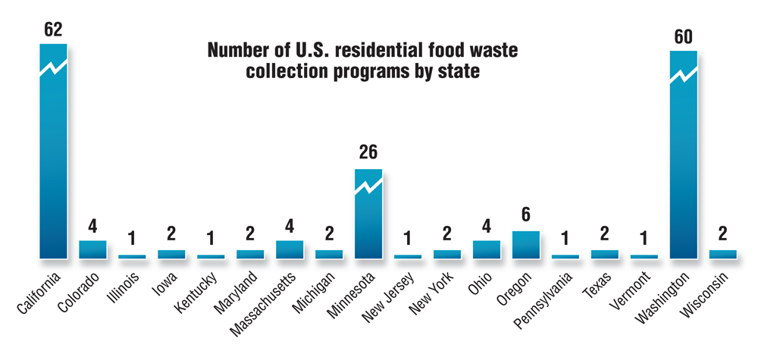
Source: Yepsen, Rhodes. “Residential Food Collection in the U.S.” BioCycle Magazine, March 2013. 23-28.

Slide 16
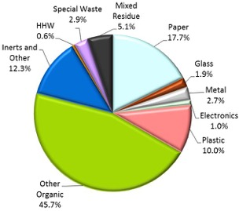
2014 CA Single Family Residential
Source: 2014 Waste Characterization, CalRecycle

Slide 17
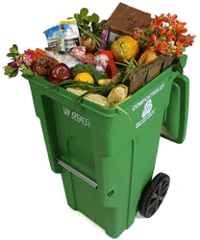
Composting in California
15 million tons of compostable organics
34% of the waste stream
115 Composting Facilities
100 + New Facilities
Healthy Soil Initiative
Organics Legislation

Slide 18
AB 939 – The Integrated Waste Management Act 1985
50% diversion by 2000 (mandate)
AB 341 - Mandatory Commercial Recycling 2011
75% diversion by 2020 (goal)
AB 1826 - Mandatory Commercial Organics 2014
April 1st 2016 8 tons a week or more
AB 876 – Organics Infrastructure 2015
Audit Organics processing capacity and generation
AB 1045 – Compost Development and Application 2015
Reduce greenhouse gases using compost
Notes:
2005 52% diversion rate

Slide 19
How to Make Compost

Slide 21
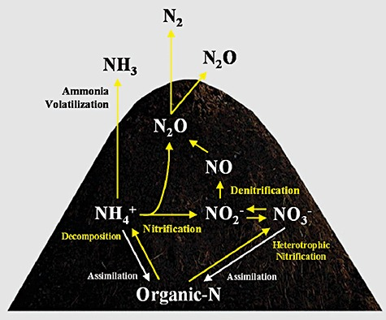

Slide 22
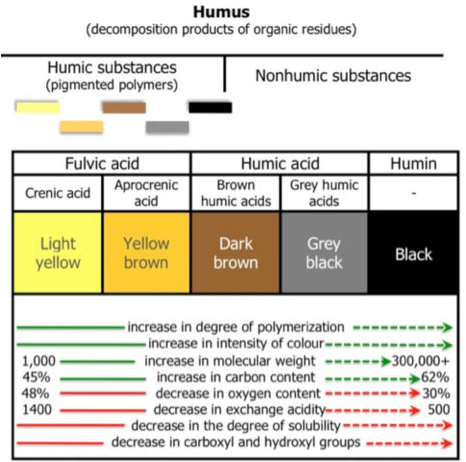

Slide 23
C/N Balance
50 %
50 %

Slide 24
Dos & Don’ts

Slide 25
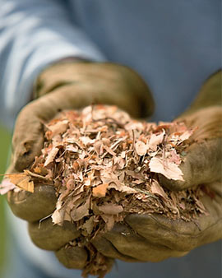
Material Preparation

Slide 26
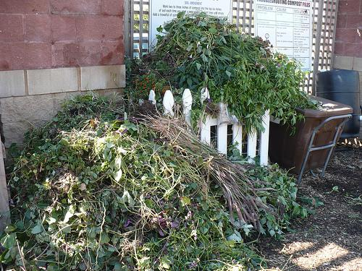
Location
Site Assessment
Too Wet
Too Sunny or Dry
Rodents
Traffic & Access

Slide 27
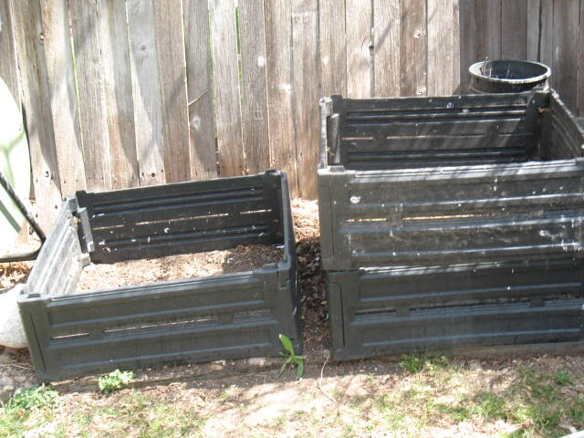
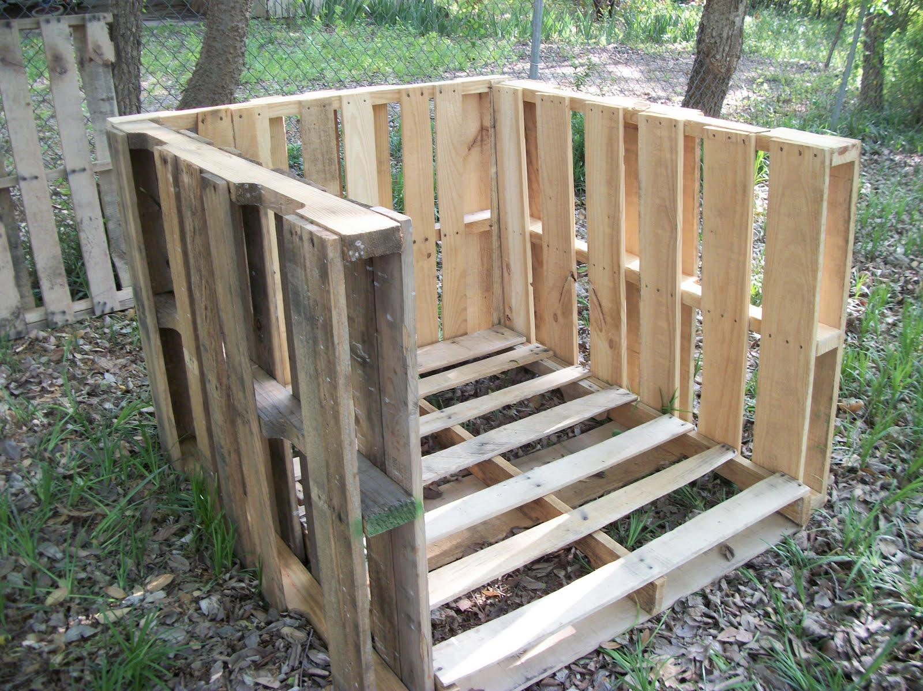
Infrastructure

Slide 28
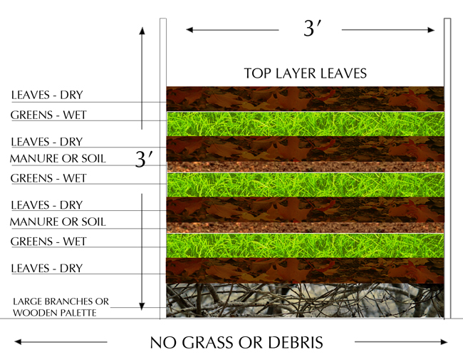
Construction

Slide 29
Safety

Slide 30
Troubleshooting
Rodents
Meat
Greasy, Oily foods
Cooked foods
Security
No ACTION!
Too dry
Balance
Living soil
A Smelly Pile
Excess Green
Too much water

Slide 31
Is Compost a Fertilizer?
N – P – K ≈ 1 – 1 – 1
Compost is a soil amendment, with time released nutrient benefits, that depends on microbial life present within the material for effect.

Slide 32
Application
Garden
½ in to 3 in per year during spring
Lawn
Work in to 6 in in depth
Trees and Landscape
1 to 2 in raked into topsoil

Slide 33
UCCE Santa Clara Composting Education Program

Slide 34
Thank You
Cole Smith, Program Coordinator
UCCE Composting Education Program

