Slide 1
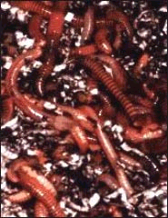
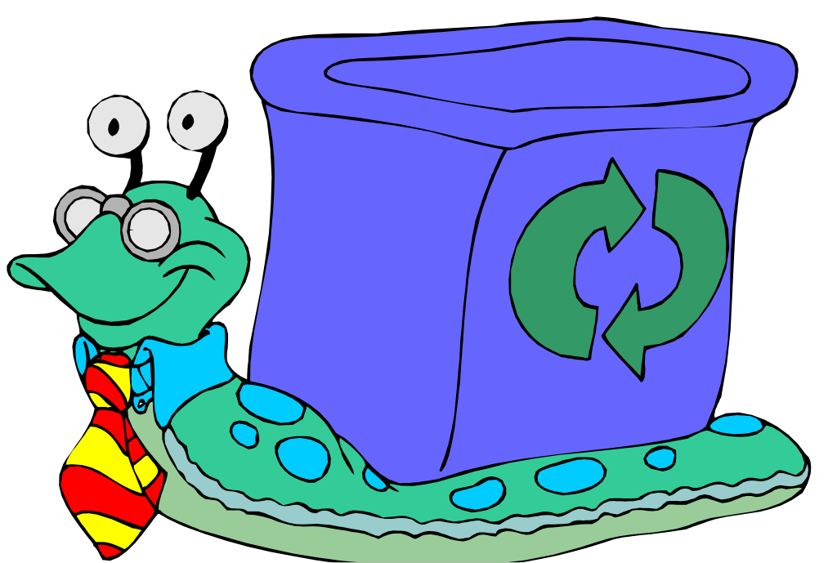
Vermicomposting
Eisenia fetida (red wiggler):
Thrives in rotting vegetation, compost, manure
Lumbricus rubellus (earthworm):
Naturally lives in soil high in organic matter

Slide 2
Vermicomposting
Create an environment for redworms
to eat vegetable and fruit food waste
dispose of un-recyclable paper products
Different than backyard compost pile
managing worms instead of bacteria
no turning or chopping required
Produces natural nitrogen rich fertilizer
Reduces food waste and recycles paper products
Neat, Easy, Odorless and Fun!

Slide 3
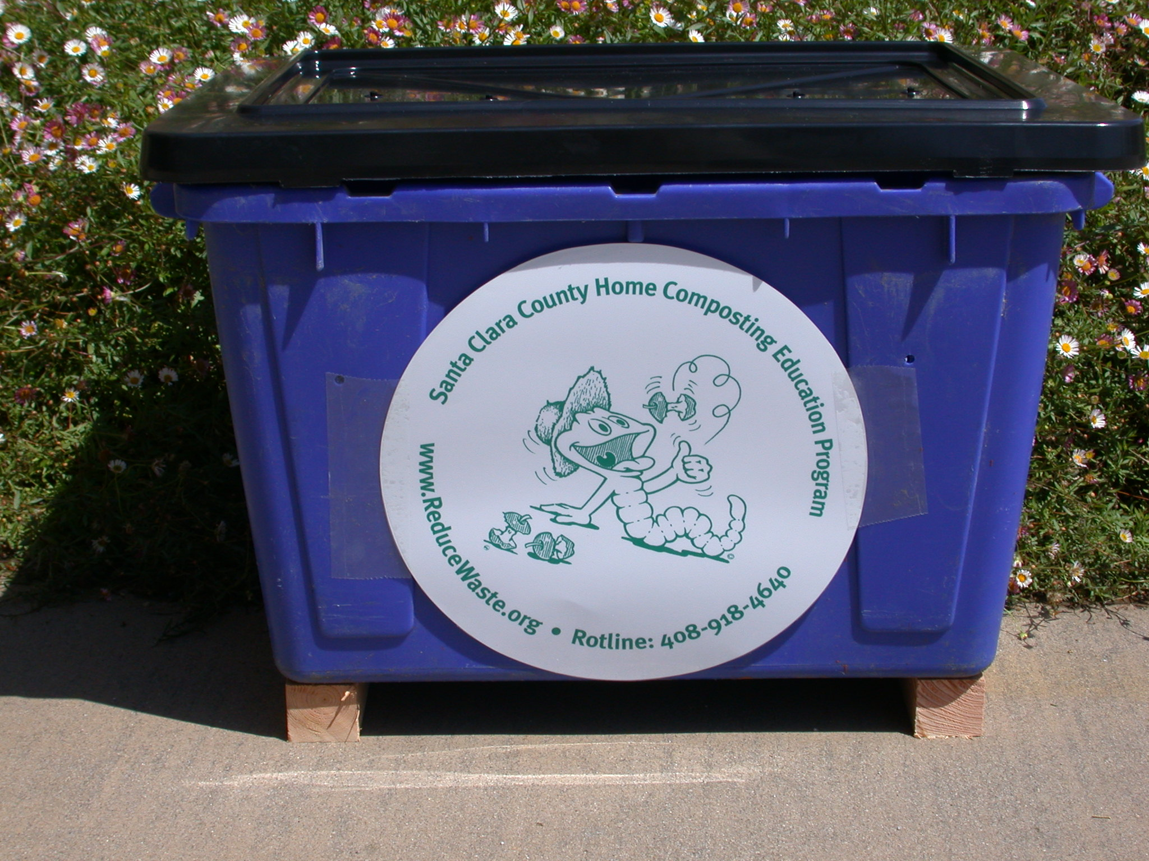
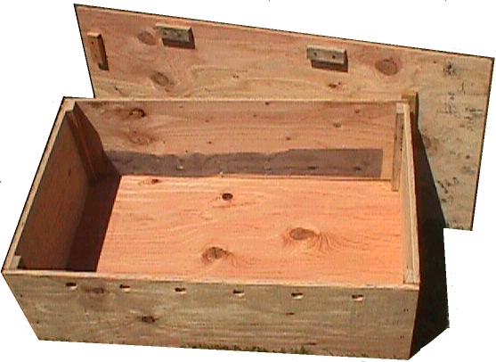
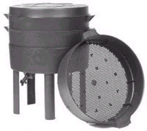
Selecting a bin
Wood
Plastic
Don’t use chemically
treated woods or
highly aromatic woods
Self Sorting Migrating Systems
Buy or build your own!

Slide 4
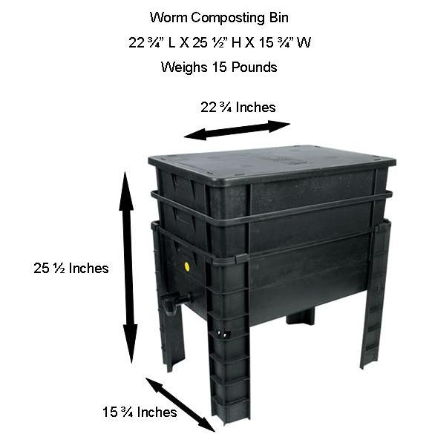
Selecting a bin

Slide 5
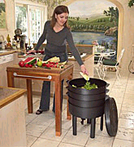
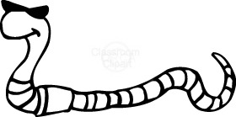
Locating the bin
Ideal temperature is between 55ºF and 77ºF
Plenty of air circulation
In the shade during summer especially if a plastic bin is being used
Good locations include under a shade tree, patio, garage, or north or east side of house
Some people likes to keep theirs in their home

Slide 6
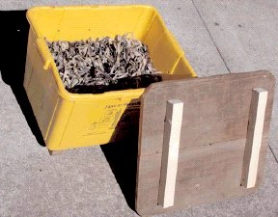
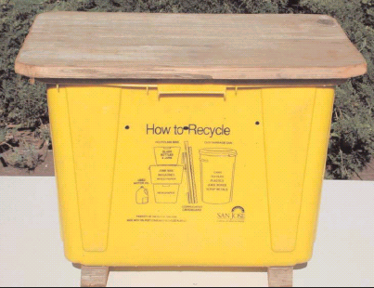
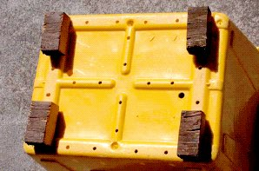
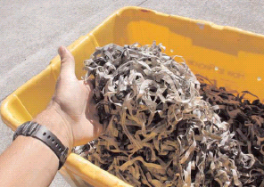
A Home Made Worm Bin from an Old Recycling Bin
Old fence
wood
Many 1/4” drain and
air holes
Old 2x4
from anything

Slide 7
Any size bin can work
Rule of thumb
two square feet of surface area per person OR
one square foot per pound of waste per week
Worms will reproduce to fill the box but will not overpopulate
hermaphrodites (both male and female organs)
reproduce at two months of age
Can double its population in 3 months
Should start with a pound of worms which must either be purchased or donated by a friend

Slide 8
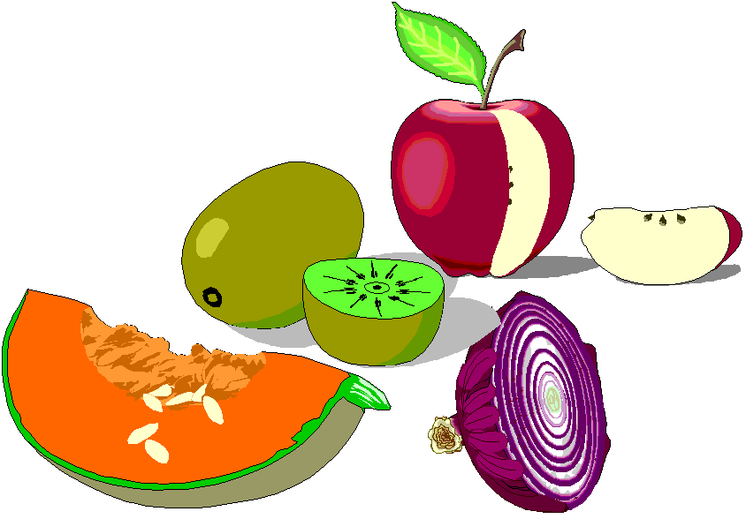
Organization of the bin
The bedding material should be damp but
not so wet one can squeeze water from it
cover
Dry Shredded Paper or
Leaves or Pine Needles
at least
four inches
Wet layer of
paper
8” to
16”
Food layer
Bedding material
mixed with coffee
grounds
greater than
four inches
air circulation

Slide 9
Organization of the bin
The bedding material should be damp.
As moist as a wrung out sponge.
cover
Shredded or multiple layers of paper
at least
four inches
8” to
16”
Bedding material
mixed with coffee
grounds OR a handful of soil
greater than
four inches
air circulation

Slide 10
Bedding material
Shredded office and junk mail paper
can dry easier than news print
Shredded boxes and newsprint
Pizza boxes, toilet paper rolls, newspaper, etc.
avoid glossy print
Dried partially decomposed leaves
No soil - these worms are litter dwellers

Slide 11
Worm Facts
Can eat ½ body weight per day
1 lb. worms can eat ½ lb. of food per day = 3 1/2 lb. of food per week

Slide 12
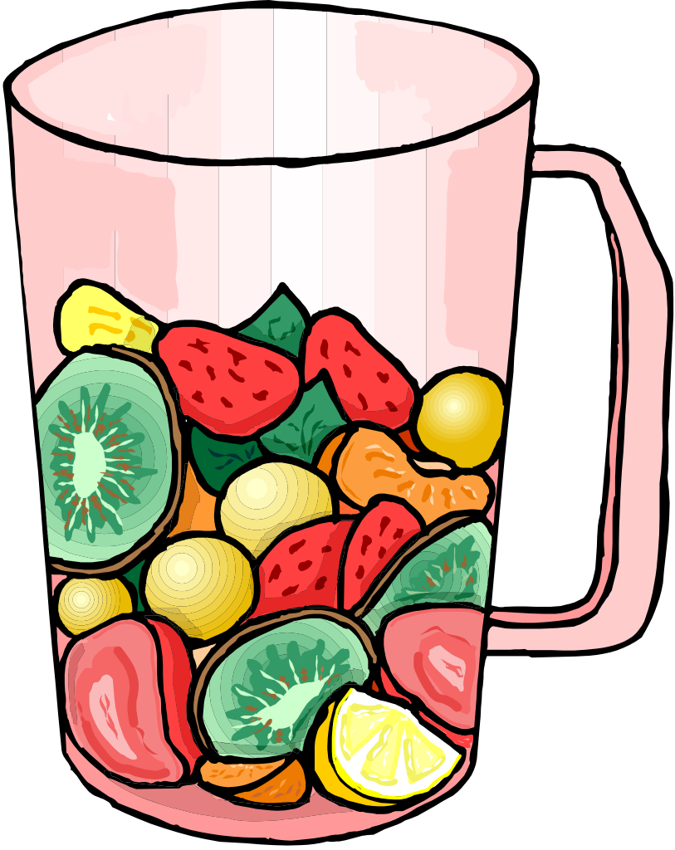
Worm Food
Vegetable and fruit scraps
Pasta, cooked beans
Coffee grounds complete with filters
Tea leaves, bags
Egg shells
Paper towels, napkins
Banana peels and egg cartons

Slide 13
What to avoid
No animal products - meats, bones
No dairy products - cheese
No citrus fruits
Be careful with breads (because of molds)
No seeds (because they won’t break down)
Yard clippings
No pet wastes, except from herbivores
No oils or plastics
No soil, except at the initial set-up

Slide 14
Source of Worms
- Order Online
- Plant Nurseries
- Fishing stores
- Friend

Slide 15
Harvesting Castings
Castings are toxic to worms and should be harvested when most of the bedding materials have become dark castings
There are many ways to harvest
vertical harvest -take lower layers
horizontal harvest - move finished materials to one side and feed on other side
dump and sort - spread out and pick out worms
variants of above
Keep the worms - use the castings

Slide 16
Self Sorting Migrating System
Food gets added to the top feeding tray
Harvest finish compost from middle processing tray
Excess moisture drip down to collection base
As worms process food in the lower tray, they will migrate upward to the newer food, sorting themselves from the lower tray

Slide 17
Using Worm Compost
Slow Release Nitrogen Rich Fertilizer
instead of fish emulsion on bedding plants
Spread around potted plants
Spread around vegetables or flowering plants in the garden
Can be sifted onto lawns
Incorporate into soil around shrubs and trees
Can be incorporated into a planting mix
Preferred compost for compost tea brewing applications

