Slide 1
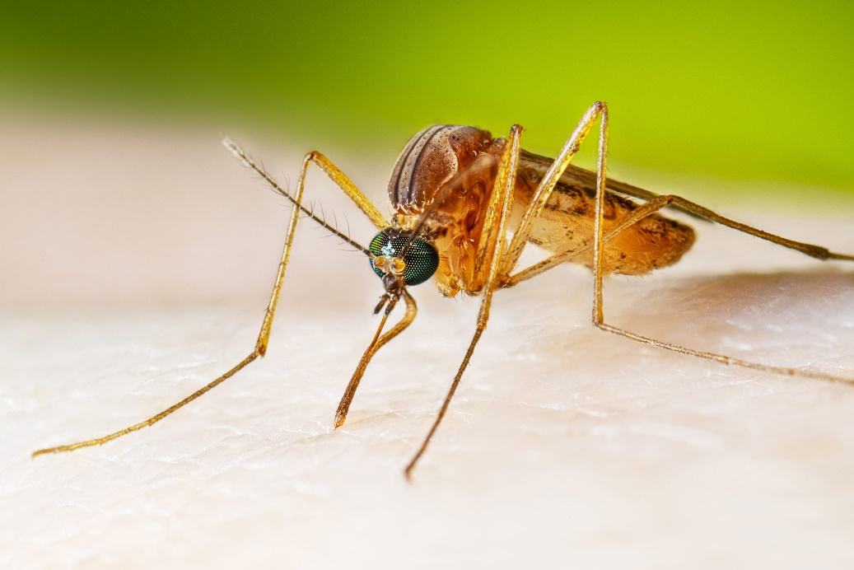
Mosquitoes & Public Health Pests
[your name]
[your title]
Culex quinquefasciatus mosquito

Slide 2
Outline
What is a public health pest?
Two common examples: rat and cockroach
Mosquitos: The most dangerous public health pest!
Life cycle
Species of concern: Culex, Anopheles, & Aedes
Prevention
Monitoring
Control
Resources

Slide 3
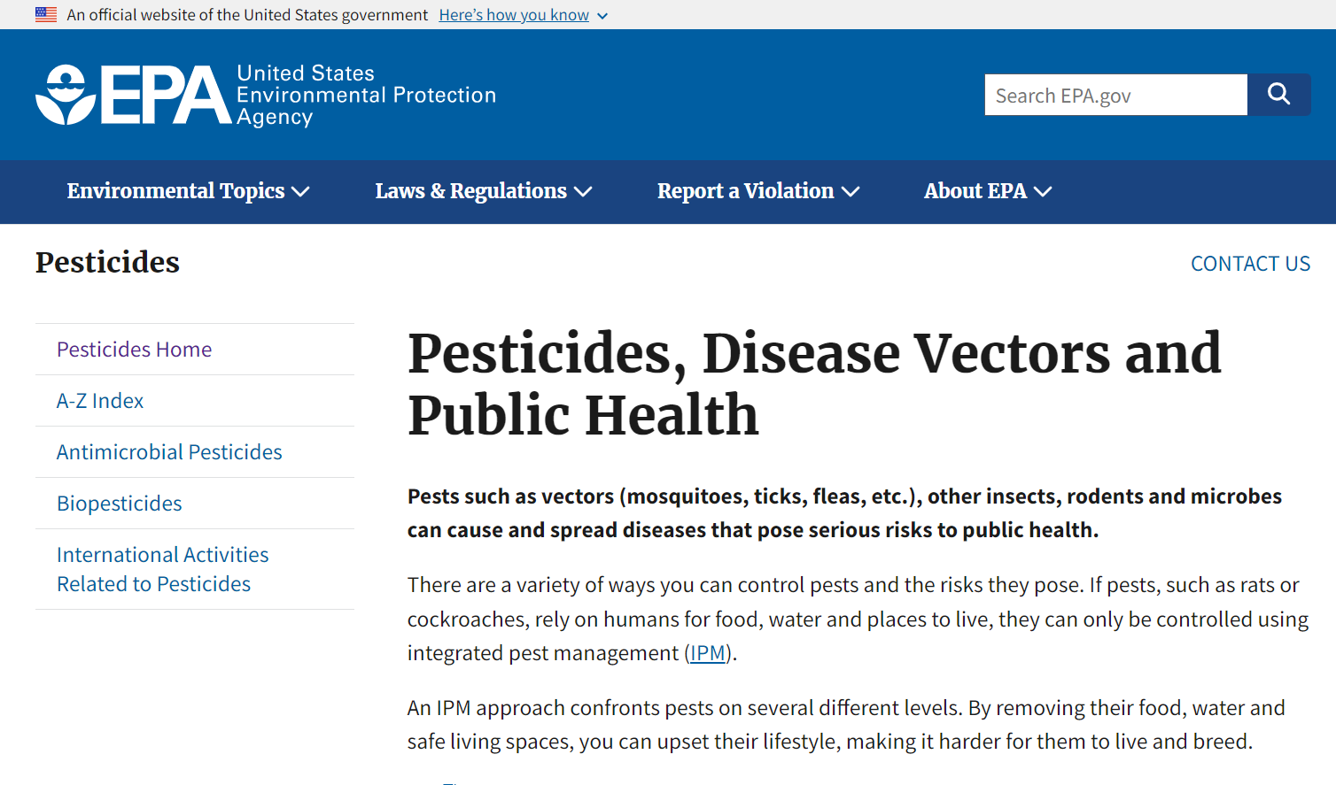
What is a public health pest?
Pests that vector or transmit human disease
Bite, sting (anaphylaxis), or injure
Damage community wellbeing
Notes:
Serious, even fatal, diseases and conditions can be spread or triggered by pests. Public health pests have the potential to negatively impact the health and well being of residents. Public health pests may vector (or transmit) human disease; these pests can bite, sting, injure, or damage community wellbeing. The US EPA maintains a list of public health pests (pictured). Before EPA registration can be granted, pesticides used against public health pests are subject to stringent efficacy testing as well as the usual tests for effects on human health and safety.
(https://www.epa.gov/pesticides/pesticides-disease-vectors-and-public-health)

Slide 4
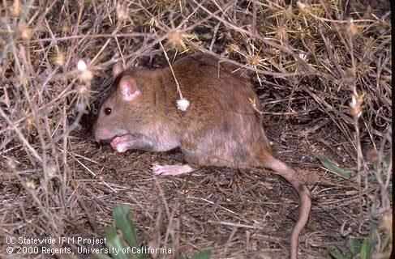
What is a public health pest? Rats!
Pests that vector or transmit human disease
Bite, sting (anaphylaxis), or injure
Damage community wellbeing
Norway rat (Rattus norvegicus)
Notes:
An example of a common public health pest is the Norway rat, Rattus norvegicus, pictured here. Rats directly and indirectly vector many human diseases, they can bite or scratch, may contaminate food and water, and may even chew through walls and electrical wiring, potentially causing fires. In addition, rodents are carriers of other public health pests; such as ticks, mites, and fleas.

Slide 5
Arthropods of significant public health importance:
Ticks, chiggers and other biting mites, scabies mites, dust mites, widow spiders, recluse spiders, scorpions, centipedes, cockroaches, lice, bed bugs, kissing bugs, biting flies, house flies, filth flies, mosquitoes, fleas, wasps and bees, fire ants, harvester ants
…arthropods of significant public health importance:
“cause asthma or trigger allergies, contaminate food, irritate skin, cause direct injury, or carry agents causing diseases”
Notes:
As mentioned, the US EPA maintains a list of pests of public health importance. Many of these are insects, arachnids, or other arthropods. These arthropods can cause asthma, trigger allergies, contaminate food, irritate skin, cause direct injury via physical wound or chemical venom, or carry agents causing diseases such as Lyme disease, epidemic typhus, trench fever, epidemic relapsing fever, malaria, encephalitis, yellow fever, dengue fever and many others.

Slide 6
German cockroach
German cockroach (Blattella germanica).
Photo credit: Luis Agurto, Jr. of Pestec, used with permission
The most common indoor insect pest of public health significance
Found in residential settings, restaurants, food service, break rooms, public indoor spaces, etc.
Breathing in cockroach feces and shed skins causes and exacerbates asthma and allergies
Notes:
The German cockroach is the most common indoor pest of public health significance. They can be found throughout the world in residential settings, restaurants, food service, break rooms, and public indoor spaces. This video clip shows a German cockroach walking across a table surface. German cockroaches are a significant source of allergies for many people and trigger asthma, especially in young children, when dust particles that contain cockroach droppings or shed skin parts become airborne and are inhaled. The photo on the bottom shows a house cabinet that is extremely soiled (feces, dirt, shed skin, etc..) from a cockroach infestation.

Slide 7
Mosquitoes
Notes:
Now let’s talk about the most important public health pests of all!

Slide 8
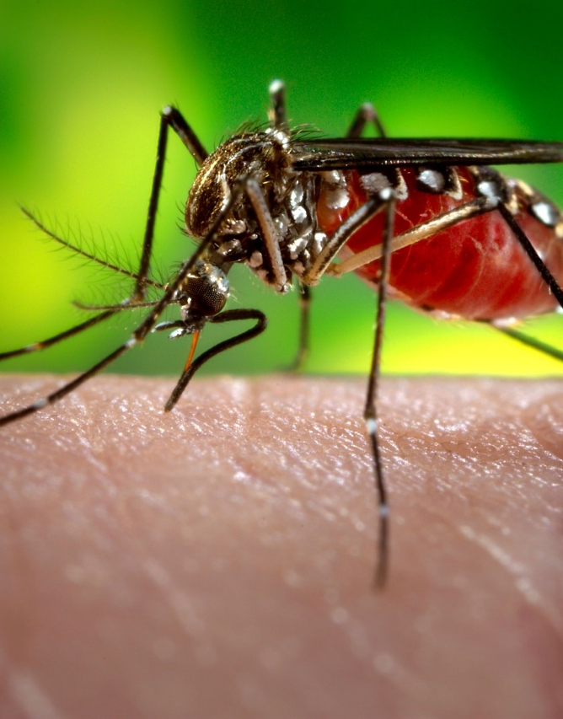
The most dangerous animal in the world
Female mosquitoes kill > 700,000 people annually
Vector human pathogens during blood-feeding:
Protozoa (malaria)
Viruses (west Nile, encephalitis, dengue, yellow fever, zika, chikungunya)
Nematodes (dog heartworm)
Aedes aegypti mosquito
Notes:
The most dangerous animal in the world is the mosquito, which indirectly kills more than 700,000 people worldwide every year. Female mosquitoes require blood from vertebrate animals such as people, pets, livestock, and wildlife. During blood-feeding, mosquitos can transmit a variety of dangerous pathogens, causing human diseases such as malaria, encephalitis, West Nile, yellow fever, Zika, chikungunya, and dengue. Mosquitos can also transmit diseases to livestock and pets. Western equine encephalomyelitis and West Nile viruses affect horses and occasionally other domestic animals. Dogs can get heartworms from mosquito bites through the transmission of parasitic nematodes (microfilaria) into the bloodstream. Even the presence of mosquitos can be a serious nuisance and a health problem to people, livestock, and wildlife. Mosquito bites can result in secondary infections, allergic reactions, pain, irritation, redness, and itching.
Pictured: Aedes aegypti mosquito, an invasive species of concern across California.

Slide 9
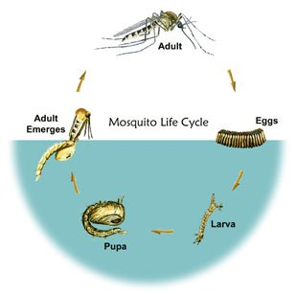
Classification and life cycle
Diptera: Culicidae
~ 50 species in California
Life cycle
Egg: laid on or above water)
Larva: four instars, omnivorous detritivores, wriggle to surface to breathe
Pupa: nonfeeding, also must surface to breathe
Adult: females: blood-feeding, males: nectar-feeding, may overwinter
Life cycle completed in 1 to 4 weeks.
Photo credit: EPA
Notes:
Mosquitoes are flies. As such, they have four stages in their life cycle (pictured): egg, larva, pupa, and adult. Adult mosquitos lay eggs on or near the water. Larvae hatch from the eggs and live in water, regularly coming to the surface to breathe, often through a specialized respiratory organ called a "siphon". Mosquito larvae, called "wrigglers", are filter feeders, feeding on decaying matter found in the water. After shedding their skin (molting) several times to grow larger, larvae develop into pupae, or "tumblers". Pupae do not have external mouthparts and do not feed, but they must regularly surface to breathe. An adult mosquito emerges from a mature pupa and flies away to mate and feed, beginning a new cycle.
(source: https://www.epa.gov/mosquitocontrol/mosquito-life-cycle)
Pictured: Graphic illustration of the lifecycle of the Culex mosquito.

Slide 10
Culiseta spp.
Video credit: Andrew Sutherland
Notes:
This video shows mosquito larvae of varying ages (as evident by different sizes) and at least one pupa (top center), showing how these juvenile stages move up and down in the water column.

Slide 11
The “house mosquito” or “encephalitis mosquito”
Genus: Culex
Common species: Cx. pipiens, Cx. tarsalis, Cx. quinquefasciatus
Vectors of West Nile fever, St Louis encephalitis, equine encephalitis
Breed in marshes, wetlands, stream edges & pools, rice fields, septic tanks, abandoned swimming pools
Notes:
One of the most common mosquito genera in California is Culex, commonly called the house mosquitoes or encephalitis mosquitoes. Adult female Culex mosquitoes lay eggs on the surface of stagnant or slow-moving water. They are especially common in freshwater or brackish marshes and wetlands, flooded rice fields, and abandoned swimming pools. Eggs stick together to form a raft of 100 to 300 eggs. The raft floats on the water. The culex mosquito is a vector of West Nile fever, St Louis encephalitis, and equine encephalitis.
(source https://www.cdc.gov/mosquitoes/about/life-cycle-of-culex-mosquitoes.html )
Pictured: Culex mosquito adult.

Slide 12
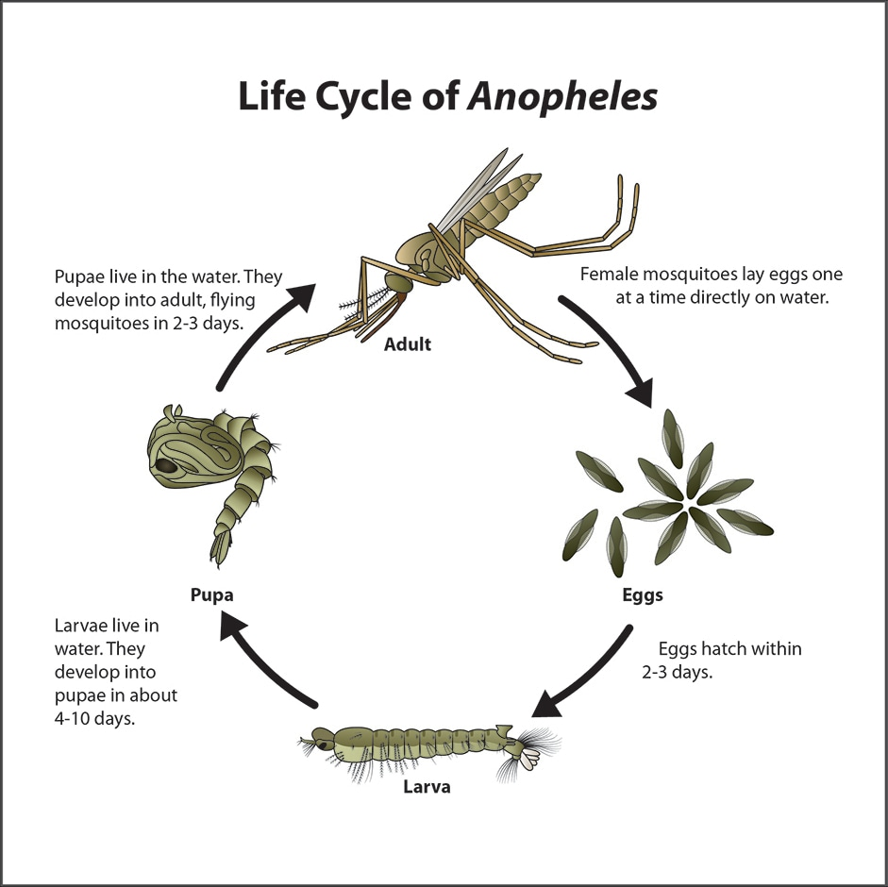
The “malaria mosquito”
Genus: Anopheles
Common species: A. freeborni, A. punctipennis, A. franciscanus
Vectors of malaria
Breed in wetlands, rice fields, ponds, lakes (prefer clean, sunlit water)
Larvae do not have a siphon
Photo credit: CDC
Notes:
Anopheles, the mosquitoes that spread malaria, lay their eggs in marshy areas or near the banks of shallow creeks and streams. They are often found in clean, sunlit water, demonstrating that mosquitoes may be present in even the cleanest and most pristine aquatic ecosystems. Anopheles mosquitoes lay eggs one at a time directly on the water surface. The female will lay 50-200 eggs at a time. The eggs float on the surface of the water and do not tolerate drying out. Anopheles larvae breathe by using special organs (called spiracles) located on their abdomen; they do not have a siphon like other species of mosquitos. (source https://www.cdc.gov/mosquitoes/about/life-cycle-of-anopheles-mosquitoes.html )
Pictured: Graphic illustration of the life cycle of the Anopheles mosquito.

Slide 13
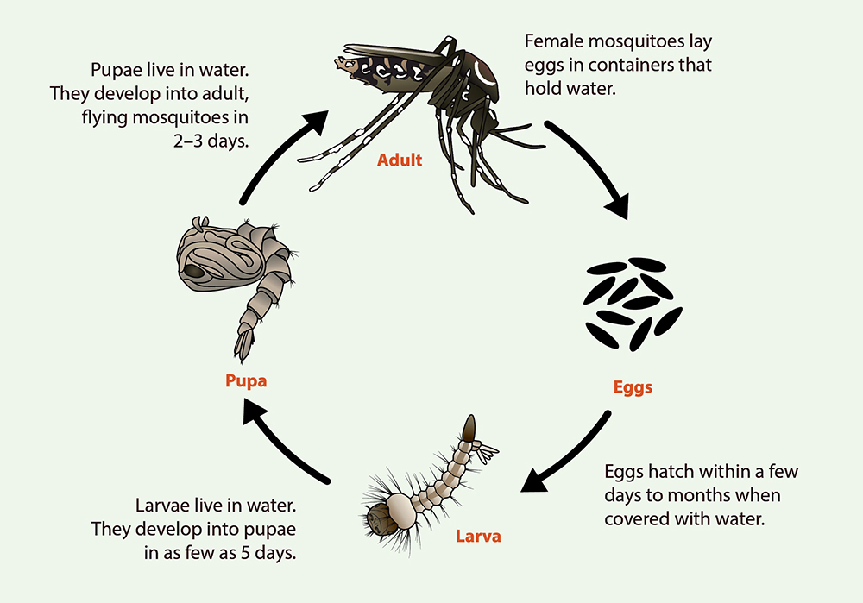
The “yellow fever mosquito” or “tiger mosquito”
Genus: Aedes
Common species: A. aegypti, A. albopictus, A. dorsalis, A. sierrensis
Vectors of yellow fever, dengue, zika, chikungunya, California encephalitis
Breed in plastic containers, saucers, bird bats, tree holes, clogged gutters, snow pools
Photo credit: CDC
Notes:
Adult Aedes mosquitoes lay eggs on surfaces just above the waterline. Eggs stick to container walls like glue and can survive long periods of time without water; they will hatch once water levels rise due to flooding or rainfall. Aedes larvae need only a very small amount of water (~ 1 oz!) to survive and so may be found in bowls, cups, saucers, fountains, old tires, rain barrels, vases, and any other container that has been filled by rain or irrigation. Some Aedes species are competent vectors of yellow fever, dengue, zika, chikungunya, and California encephalitis. (source https://www.cdc.gov/mosquitoes/about/life-cycle-of-aedes-mosquitoes.html )
Pictured: Graphic illustration of the life cycle of the Aedes mosquito.

Slide 14
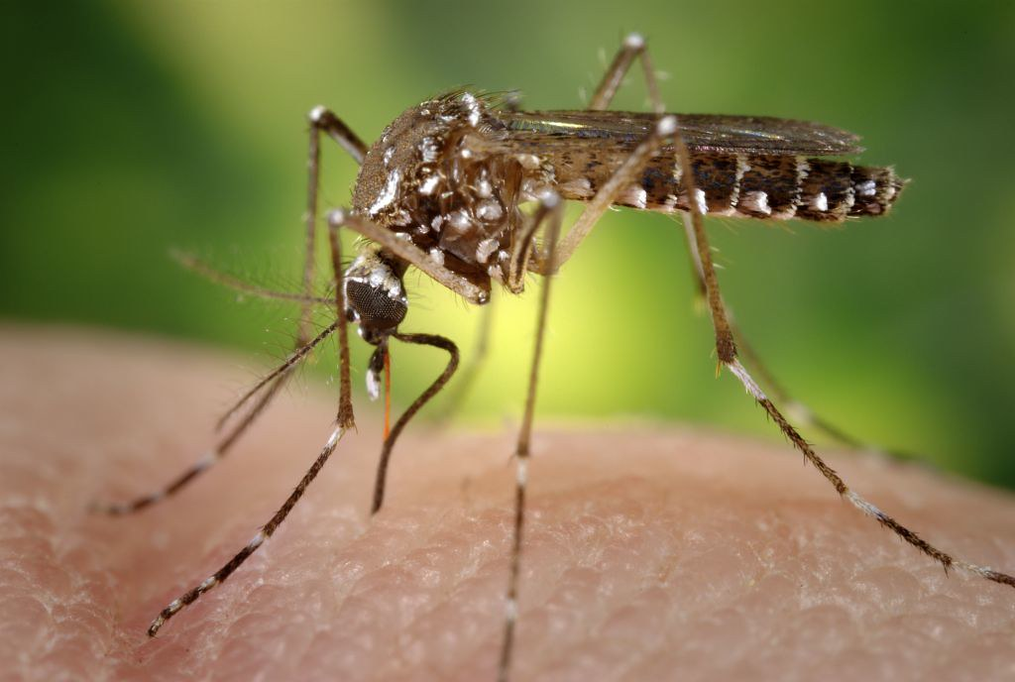
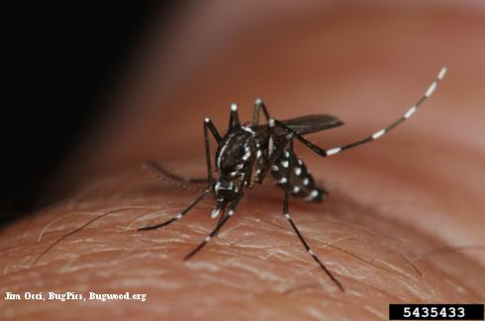
Invasive Aedes spp.
Aedes aegypti
Detected recently: Aedes notoscriptus
Aedes albopictus
Aedes eggs on wet cardboard.
Photo credit: Alexander Northey, Flickr
Notes:
There are two increasingly-common invasive Aedes species found in California: Aedes aegypti, commonly called the yellow fever mosquito, and Aedes albopictus, known as the Asian tiger mosquito. A third invasive species, Aedes notoscriptus, has also been detected. These invasive species are the primary vectors of four serious, sometimes fatal, diseases: yellow fever, dengue, Zika, and chikungunya. They can breed in very small containers and so may be commonly found in residential yards. The image on the left shows eggs deposited on a piece of cardboard that was partially submerged in water. After being moistened by the water as it wicked up the carboard, the eggs have begun hatching.
Pictured on the Right: Aedes aegypti adult (top) and Aedes albopictus adult (bottom)

Slide 15
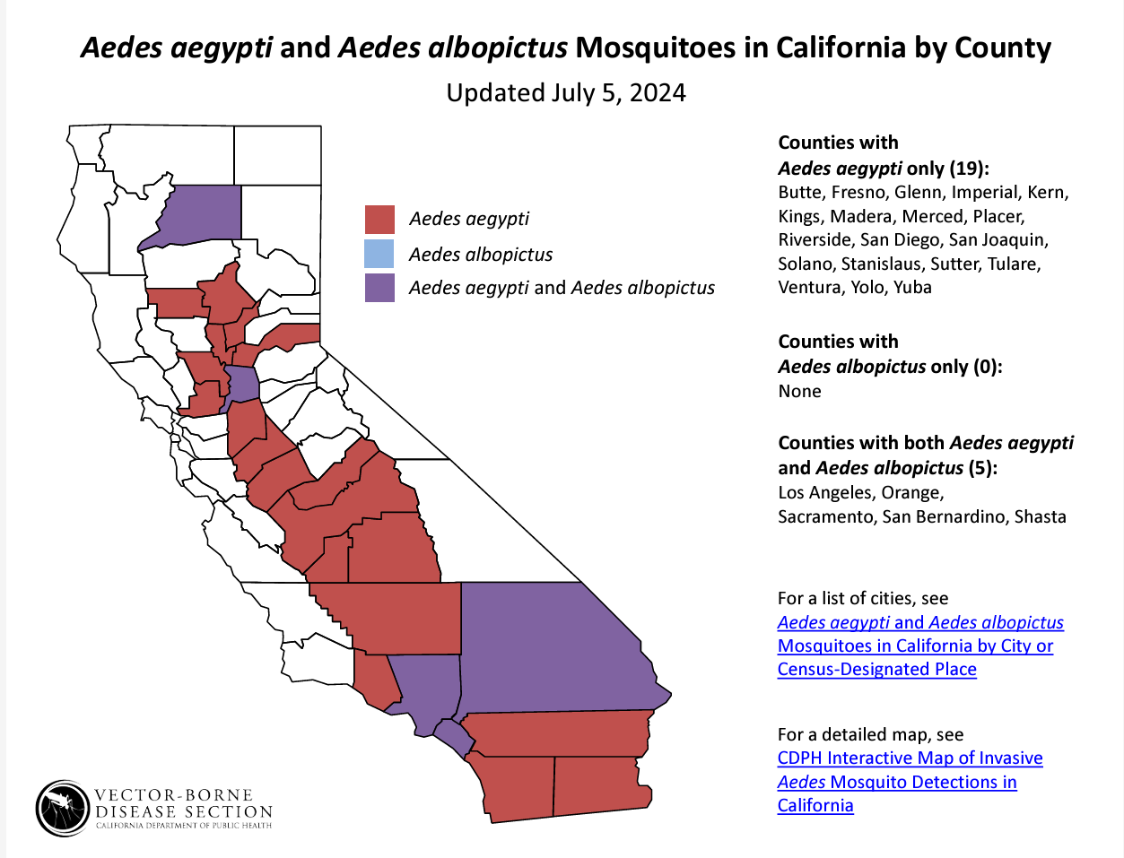
Notes:
Aedes aegypti and Aedes albopictus have established themselves in the warmer parts of southern and central California. Vector control agencies need cooperation and help from residents to prevent and control these mosquitoes. View the CDPH distribution map, list of cities, and a detailed map here: https://www.cdph.ca.gov/Programs/CID/DCDC/CDPH%20Document%20Library/AedesDistributionMap.pdf

Slide 16
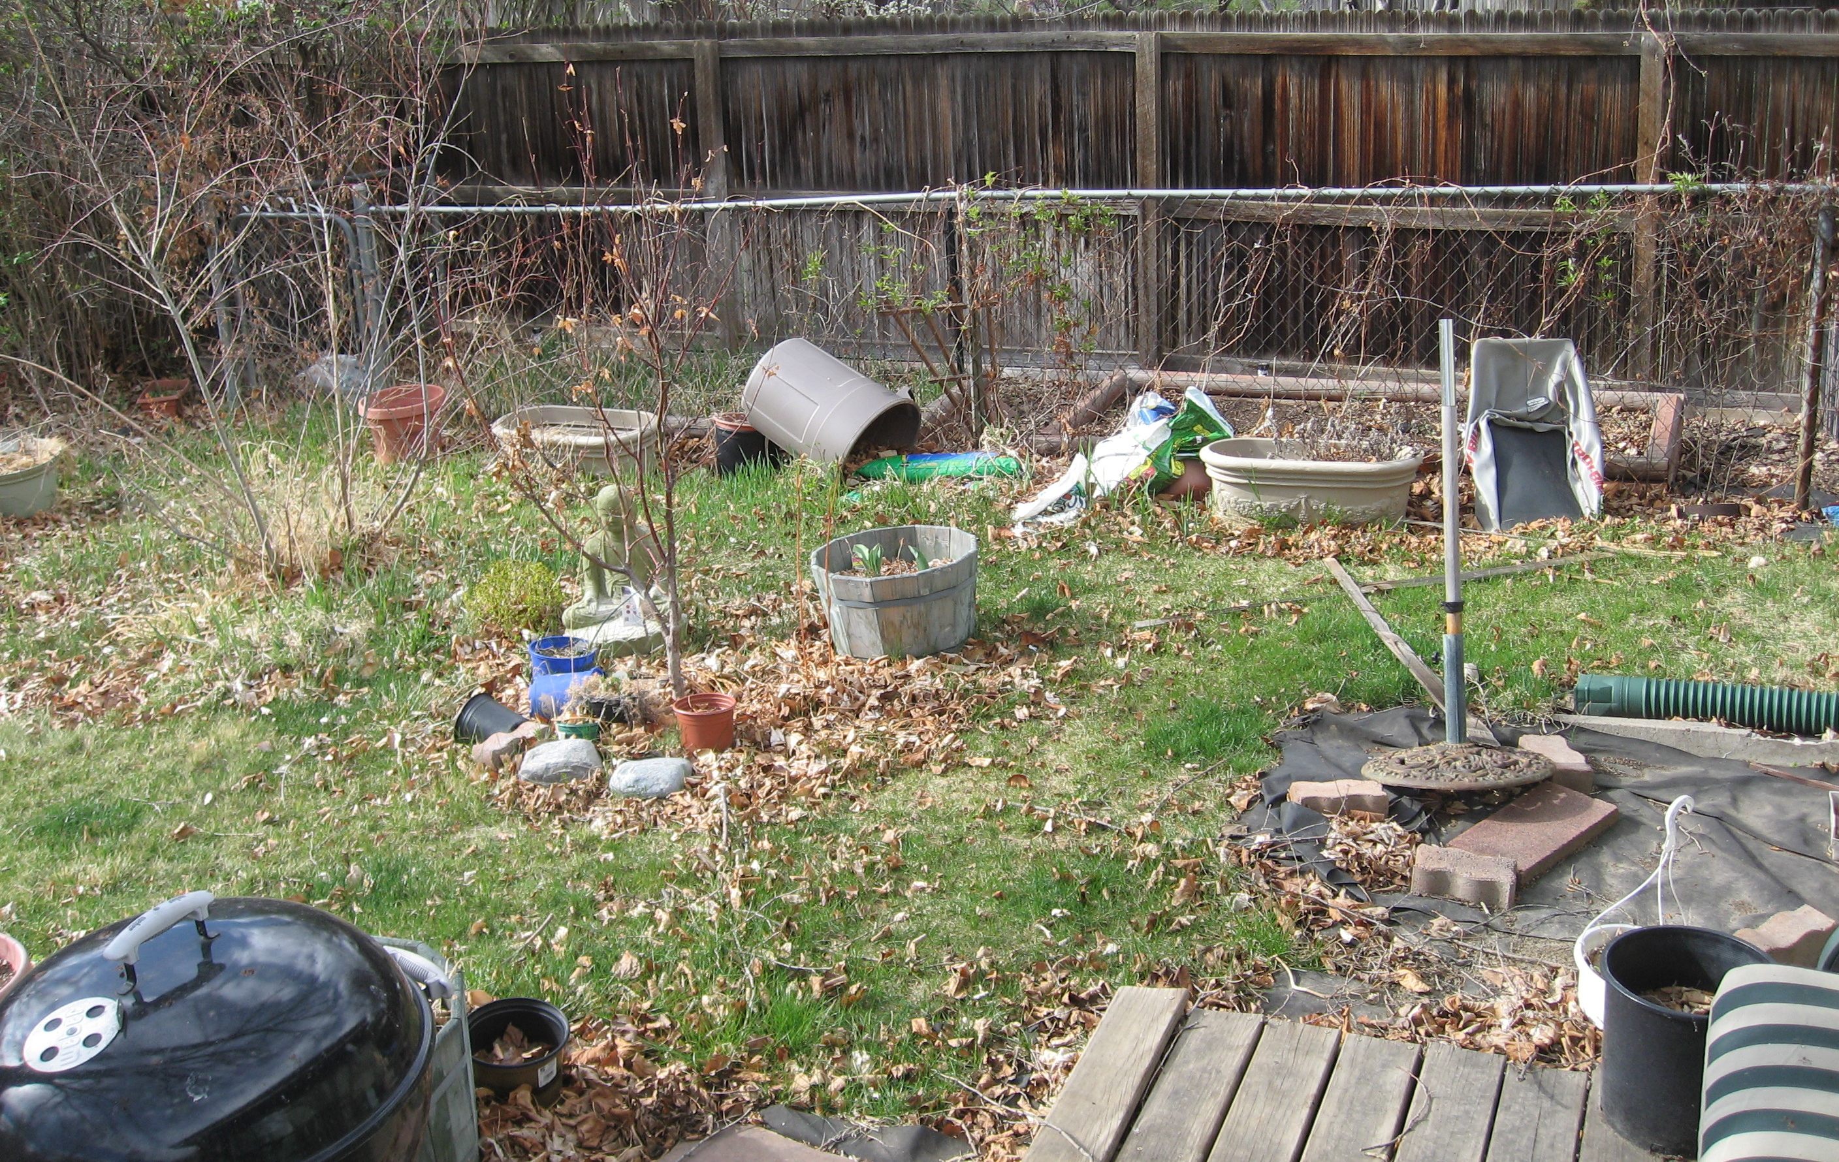
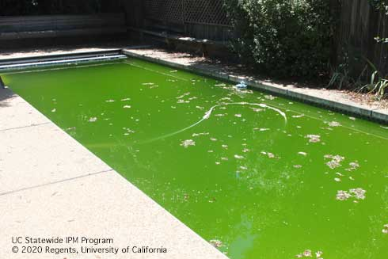
Mosquito prevention (breeding)
Target the larvae!
Eliminate standing water
Empty, drain, or fill with sand or concrete: containers (anything > 1 oz)
Maintain roof gutters & downspouts
Put screens on rain barrels or cisterns
Ponds, fountains, and water gardens:
Increase circulation, depth, remove excess vegetation and debris
Notes:
The most effective way to prevent and control mosquitoes is to target the larvae. First, eliminate standing water sources to make sure mosquitoes don't have a place to lay their eggs. If you have an area or object that can hold water for more than a few days, dump it out, drain it, or fill it with soil or cement. Even small containers such as soda cans, glass jars, flower pot saucers, and tree holes can provide habitat for mosquito development. Rain barrels should be mosquito-proofed by either covering with screens or closing openings with a sealant. Clean all gutters and downspouts, removing leaves, twigs, seeds, and other organic matter that may block water flow and create pools of standing water in which mosquito larvae can grow. Remove excess vegetation and debris from ponds and fountains, and keep water moving in ornamental water features by using waterfalls, fountains, or aerators.
(source https://ipm.ucanr.edu/PMG/PESTNOTES/pn7451.html )
Pictured: (Top) A residential back yard with many items that could hold water and provide habitat for mosquito development. (Bottom) A backyard swimming pool that has not been properly maintained, a prime location for mosquito breeding.

Slide 17
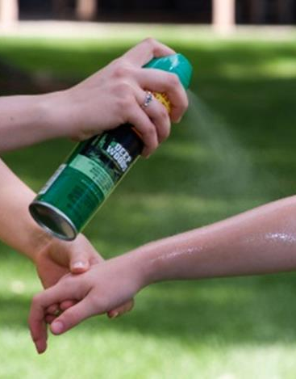
Mosquito prevention (bites)
No bites = no risk of disease!
Avoid places and times of day with high densities of biting mosquitoes
Wear long pants and long sleeves
Use mosquito repellents
Deet
Picaridin
Oil of lemon eucalyptus (OLE)
IR3535
Notes:
Preventing mosquito bites is the best way to limit your risk of disease. Avoid being outdoors at times of the day when mosquito activity is high in your area. Some mosquito species are active at dawn and dusk, others throughout the day. Wear long-sleeved shirts, long trousers, socks, and a hat if you must be outside when mosquitoes are present. Use insect repellents containing active ingredients recommended by the Centers for Disease Control and Prevention (pictured). These include DEET, picaridin, oil of lemon eucalyptus, and IR3535.
(source https://ipm.ucanr.edu/QT/mosquitocard.html )

Slide 18
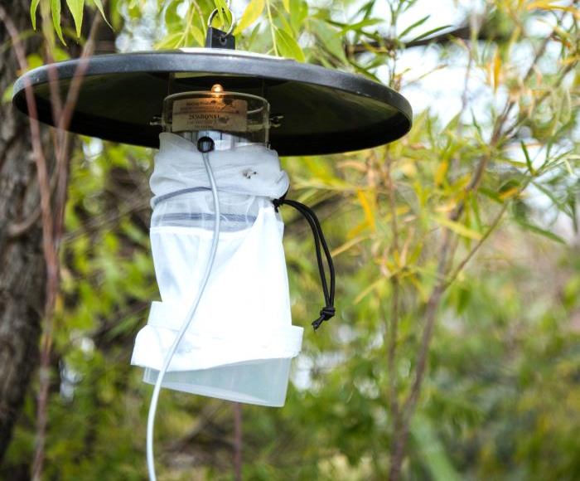
Mosquito monitoring (for adults)
Observe visitation rates (to you!)
Trap host-seeking females
CO², octenal, human odor
Trap gravid females
Stagnant water with decaying organic matter
Light (UV, full spectrum)
Not a target-specific tactic!
Electric “bug zappers” not effective
Notes:
There are various traps used by government agencies, pest control operators, and some residents to intercept adult mosquitoes and their eggs. Some traps, like the CDC light trap pictured here, use carbon dioxide or host odors and are attractive to female mosquitoes seeking hosts while other traps utilize colors and odors found in stagnant water to attract females ready to lay eggs. These traps will not eliminate mosquitoes and are best used for monitoring purposes. Light traps, including "bug zappers" that employ UV light, are not "host specific, will not reliably control mosquitoes, and may kill beneficial insects present in the area.
Pictured: A CDC light trap hangs from a tree (5 feet above the ground) and uses dry ice to release carbon dioxide that attracts host-seeking female mosquitoes.

Slide 19
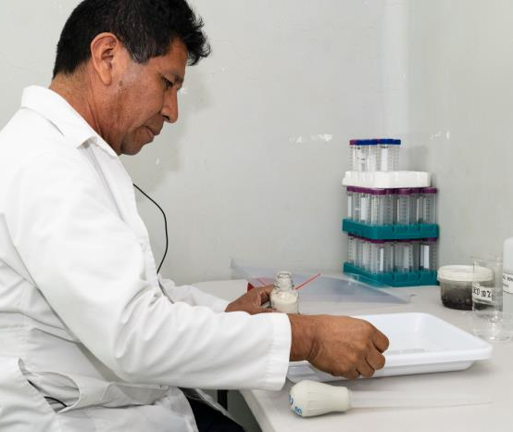
Mosquito monitoring (for disease)
Vector Control Districts / State agencies
Environmental factors
Abundance of adult females (trapping)
Infection rates (of adult females)
Sentinel chicken flocks (presence of viral antibodies)
Infection rates (of dead birds)
Human cases
Notes:
Vector control districts and state public health agencies have extensive mosquito-borne disease prevention and monitoring programs that use real time surveillance to detect problem areas, focus control efforts, and evaluate success. Vector control technicians search out mosquito larvae in standing water, collect adult mosquitoes to monitor the abundance of problematic species and determine the presence of disease-causing pathogens and use evidence from surveillance to choose control measures that are as cost-effective and environmentally friendly as possible. Surveillance includes the analysis of data on environmental factors, immature and adult mosquito abundance, and viral infection rates in humans, mosquitoes, sentinel chickens, dead birds and horses. California mosquito and vector control agencies aim to keep populations below levels where they become a nuisance or a public health problem that leads to an outbreak of disease. (source https://ipm.ucanr.edu/PMG/PESTNOTES/pn7451.html )
Pictured: Scientist working in a lab.

Slide 20
Biological control of mosquito larvae
Gambusia affinis
Mosquito fish (Gambusia affinis)
Native to southeast USA
May be provided by vector agencies
Best for small manmade bodies of water or containers
Should NEVER be released into connected waterways
Other fish, predatory insects
Dragonfly nymph eating a mosquito larva
Backswimmer
Notes:
There are many aquatic predators of mosquito larvae. Mosquito-eating fish may sometimes be used as biological control agents (pictured top). These fish are most effective in man-made bodies of water that don’t contain dense vegetation. You can obtain mosquitofish from most vector control districts. Mosquito fish should never be released into connected waterways because these fish are not native to California and will disrupt natural ecosystems. Consult with your local vector agency or the California Department of Fish and Wildlife regarding the proper use of mosquito fish. There are other naturally-occurring predators of mosquito larvae that may reduce populations, including aquatic insects like backswimmers (pictured bottom right) and dragonfly naiads (pictured bottom left) as well as native fish like the Arroyo chub.

Slide 21
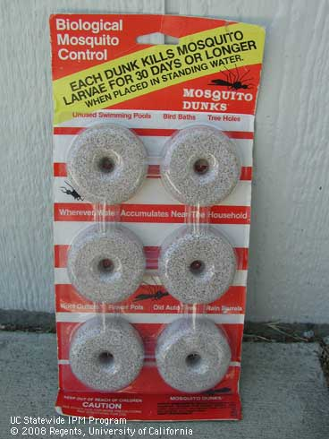
Mosquito control (for larvae)
Bacillus thuringiensis israelensis (Bti): “dunks”, “bits”
Must be consumed
Replace every 30 days
Methoprene (IGR): Altosid, “mosquito torpedo”
Spinosad: Natular DT
May also affect pupae
Oil films (vector agencies only)
Notes:
Insecticides used in water are an effective mosquito larvae control. Bacillus thuringiensis israelensis (Bti) is a naturally occurring soil bacterium that can effectively kill mosquito larvae present in water. "Mosquito Dunks" is a commonly available product sold for residential use (pictured). Bti must be eaten by the larvae to be effective, and should be replaced every 30 days. Bti is nontoxic to mammals, birds, and fish and can be applied to water bodies where mosquito larvae live. Other options for residents are methoprene and spinosad. Methoprene is an insect growth regulator (IGR) that is applied to standing water to inhibit the emergence of adult mosquitoes. Spinosad, sold as "Natular DT" for mosquitoes, is a neurotoxin produced naturally by some bacteria that can also be applied to standing water for mosquito control. There are different types of insecticides available for residential and professional use. Licensed mosquito control professionals can use petroleum-based oil films to kill mosquito larvae and pupae. A thin layer spread over the surface of the water blocks mosquito larvae and pupae from breathing.

Slide 22
Mosquito control (for adults)
Broad-spectrum insecticides
Pyrethrins, pyrethroids, organophosphates
Vector agencies: ultra low volume (ULV) applications
Pest control operators: backyard fogging treatments
Some consumer spray products available
Temporary control at best, significant nontarget and environmental effects
Notes:
When adult mosquito populations become so large they cause extreme annoyance to many people or when the threat of an outbreak of a disease is high it may be necessary to use chemical pesticides to kill adult mosquitoes. These broad-spectrum insecticides may provide temporary control, but they will also kill many other insects, including pollinators and other beneficials. Some of these pesticide products are available in both residential spray products and professional use concentrations. Professionals can apply these products on the ground with ultra-low volume (ULV) sprays on foot (pictured top left) or by truck-mounted sprayers (pictured bottom) and aerial sprays can be used to treat large areas. ULV sprayers dispense extremely small droplets (pictured top right), reducing drift of droplets to the ground, where they will impact nontarget organisms. Always read and carefully follow all precautions and directions provided on the container label.

Slide 23
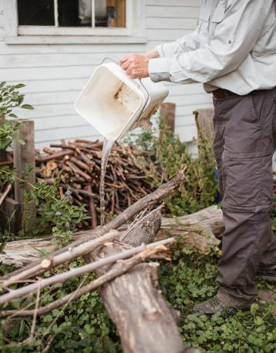
Take home messages
Mosquitoes threaten public health and must be managed
New (invasive) species may be breeding in your backyard!
Reduce larval habitat by emptying, draining, or treating water
Protect against bites (avoidance, clothing, repellents)
Learn about local vector agency services:
Mosquito fish, backyard inspections, disease monitoring, adulticides (adult insecticides)
Notes:
Mosquitos are serious threats to public health and must be managed. Vector control agencies across the state help to manage mosquito populations and provide many resources to residents and professionals. We can all help with reducing larval habitats by emptying (pictured), draining, or treating water. Information is consistently updated and available on new invasive species, how to prevent mosquito breeding, larvae control methods, and how to protect against bites. Contact your local vector control agency for more information or assistance.

Slide 24
Mosquito Resources

Slide 25
Find your local Mosquito & Vector Control District
Map of MVCAC by county
Search by your address
Notes:
https://www.arcgis.com/home/webmap/viewer.html?webmap=604a0fe9f2b74e98a53b53d192b2ac67&extent=-131.4442,32.5803,-108.7025,41.6862
https://www.mvcac.org/about/

Slide 26
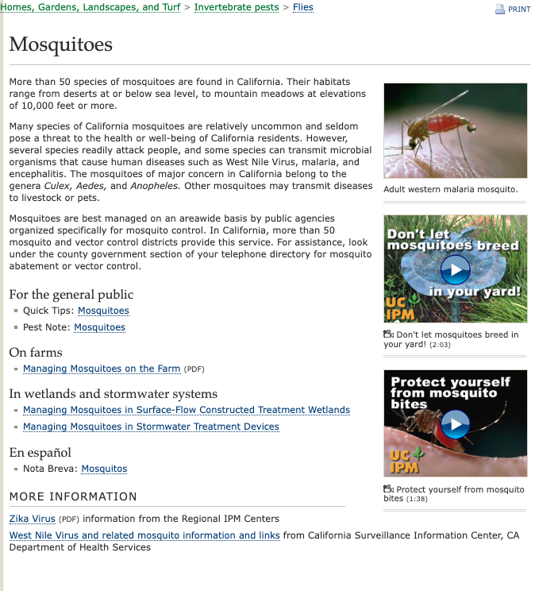
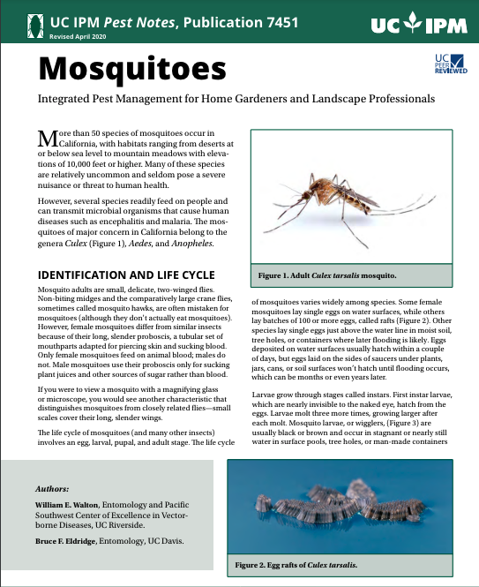
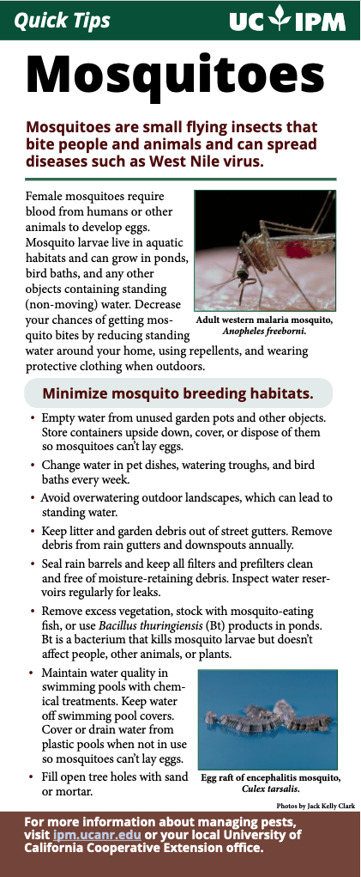
UC IPM mosquito resources
Notes:
UC IPM webpage with mosquito resources: https://ipm.ucanr.edu/PMG/PESTNOTES/mosquitoes.html

Slide 27
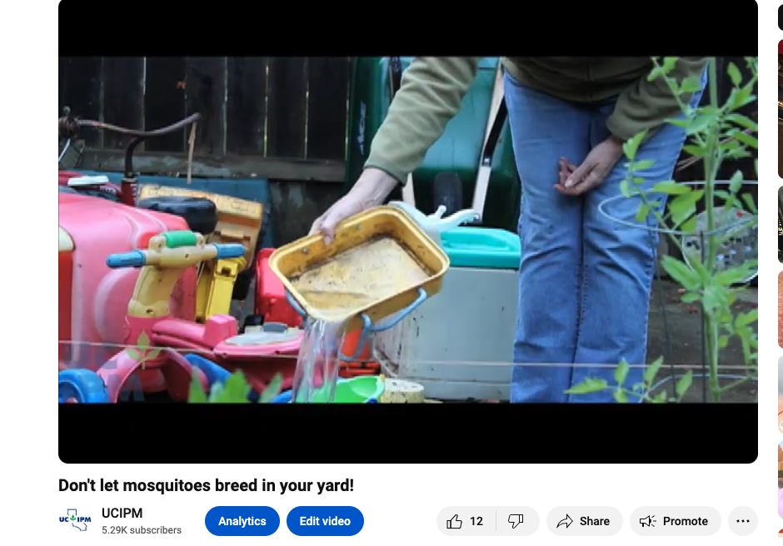
UC IPM mosquito videos
Notes:
Mosquitoes and ticks of public health concern (webinar) https://www.youtube.com/watch?v=H128XY3yFHY
Protect yourself from mosquito bites (video) https://www.youtube.com/watch?v=sqZhxcIeICM&list=PLo3rG4iqv4gHjjR2KRoesoN7yRy94YlbM&index=14
Don’t let mosquitoes breed in your yard (video) https://www.youtube.com/watch?v=eiQXLZnU7lA&list=PLo3rG4iqv4gHjjR2KRoesoN7yRy94YlbM&index=15

Slide 28
Thank you
[your name and email]

