Slide 1
Know Your Water
[your name]
[your title]

Slide 2
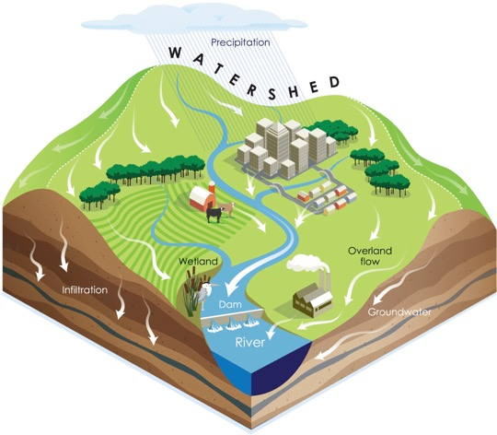
Watersheds
A land area that drains and stores water
Move precipitation (rainfall and snowmelt) to creeks, streams, and rivers
Eventually the water enters reservoirs, bays, and the ocean
Come in many sizes
Watersheds - Be Water Friendly
Notes:
Water sheds are defined as a land area that drains and stores water. These are vital in moving rainfall and snowmelt into area creeks, streams, and rivers. Watersheds range in size, small watersheds surrounding creeks and streams drain into progressively larger watersheds channeling water to the reservoirs, bays, and oceans.

Slide 3
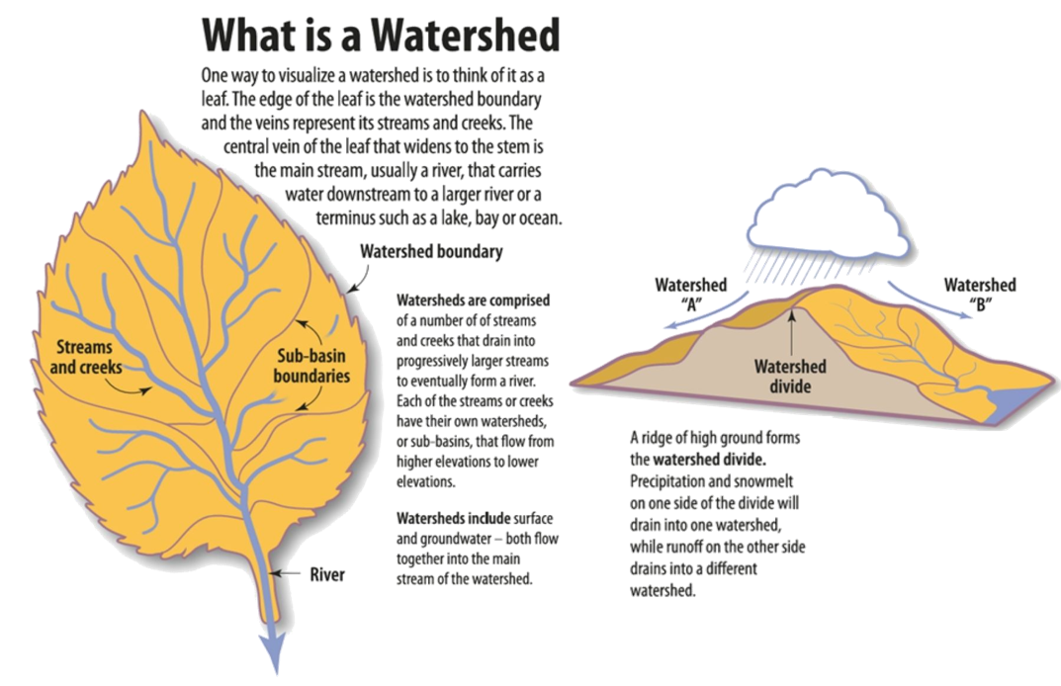
Notes:
A fun way to visualize a watershed, (especially when talking to youth) is to picture waterways like veins on a leaf. The smaller veins channel water to the larger veins, coming together at the main vein.
[Summarize the other words on the slide but don’t read all.]
(possible note to add: Urban engineering can direct waterflow to a specific basin, defying gravity and creating man made watersheds to serve the needs of a population. Example from Lodi graphic, and new housing developments)

Slide 4
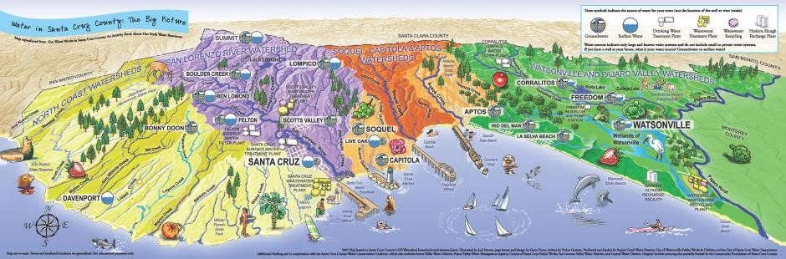
Water Sources in Santa Cruz
Local surface water and local groundwater basins
Limited recycled water (currently irrigation only)
All sources are overdrawn and/or stressed during droughts
Santa Cruz is not on any of the state water projects, we must solve our problems locally
Notes:
[This image shows the water source locations within Santa Cruz County. When giving this presentation, find a graphic of watersheds in your region. Explain where the water ends up. This Santa Cruz graphic clearly shows that watersheds empty into the ocean.]

Slide 5
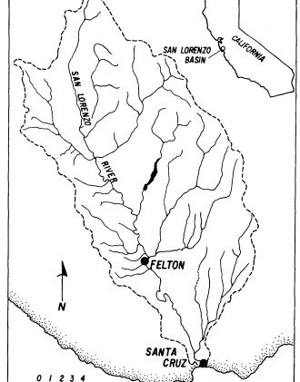
San Lorenzo River watershed
The San Lorenzo River watershed is 137 square miles and includes the cities of Santa Cruz, Boulder Creek, Ben Lomond, Felton and Scotts Valley.
The San Lorenzo River provides approximately 50% of the drinking water supply for Santa Cruz
Notes:
The San Lorenzo river watershed provides drinking water to Santa Cruz. This watershed encompasses 137 square miles moving water through the valley and eventually to the ocean.
https://coastal-watershed.org/san-lorenzo-river/about-the-river/
https://publishing.cdlib.org/ucpressebooks/view?docId=ft1c6003wp&doc.view=content&chunk.id=d0e22976&toc.depth=100&anchor.id=0&brand=ucpress

Slide 6
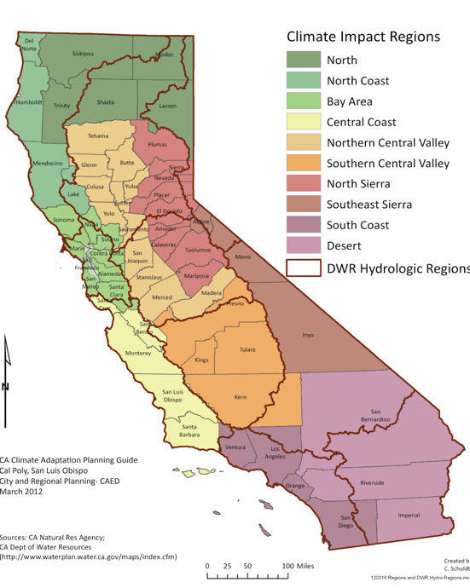
Hydrologic subregions of California
Region we are in today encompasses Santa Cruz to Santa Barbara
All rivers drain to the ocean
Notes:
California can be divided into hydrologic subregions. Each of our local watersheds drain to and have a direct impact on the region and the state as water moves to reservoirs and oceans.
[Find your local region and replace as needed.]

Slide 7
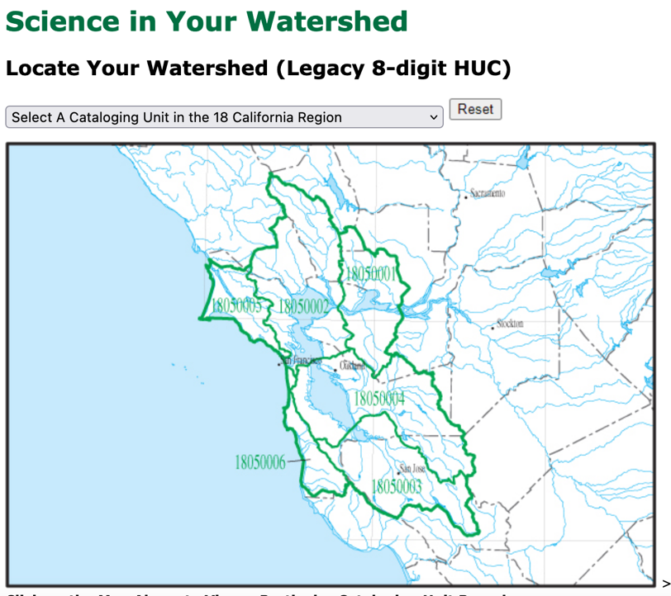
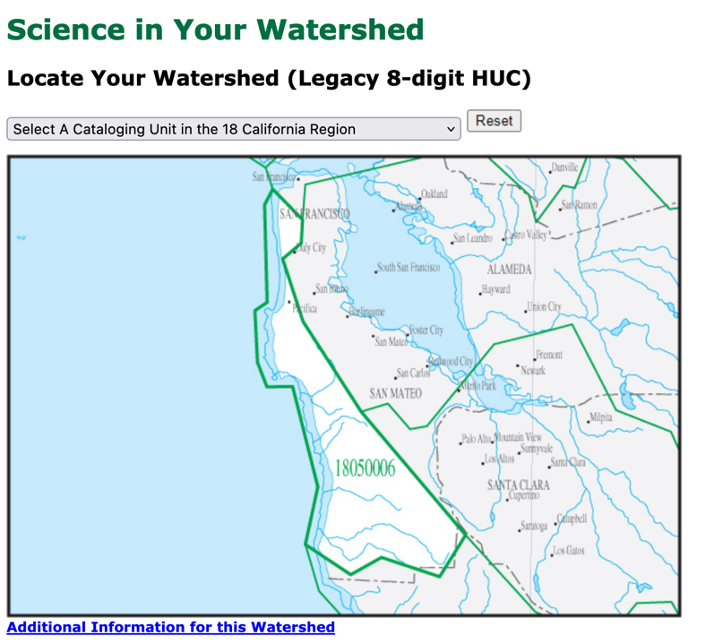
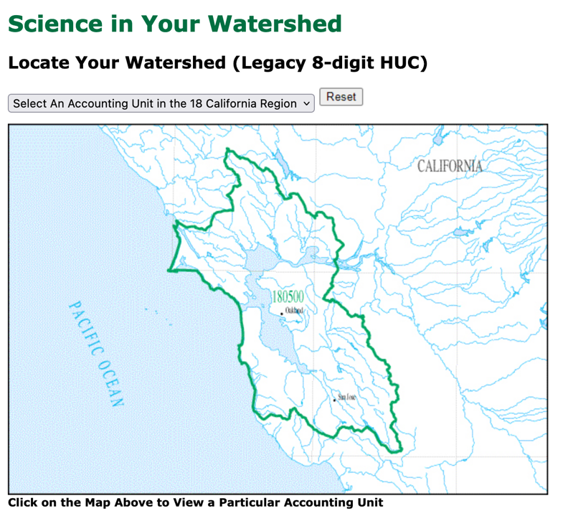
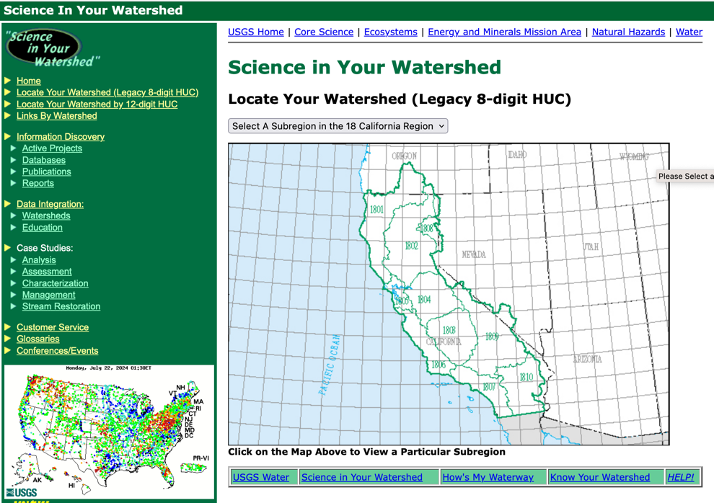
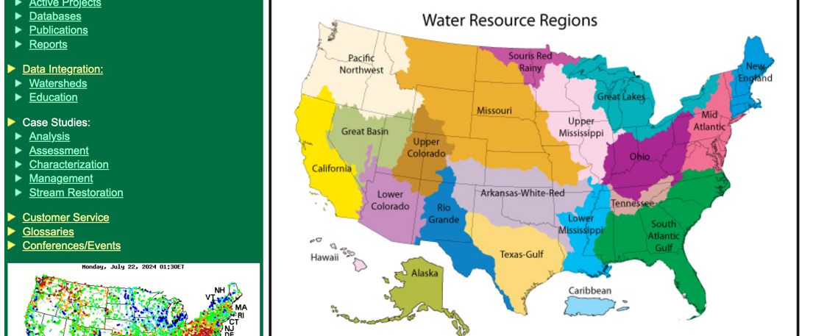
Find your watershed at https://water.usgs.gov/wsc/map_index.html
Notes:
Do you know your watershed? Use this resource to locate your local watershed and connected larger watersheds.
[These are screen shots from the USGS map of the region we were in during the Santa Cruz/Aptos training.]

Slide 8
Surface water and groundwater
Watersheds include water flowing aboveground such as streams and rivers
They also include water flowing belowground in the soil and gaps between rocks underground
Surface water and groundwater are interconnected
  As much as 60% of stream flow comes from groundwater
  Polluted surface waters can contribute to groundwater contamination
Notes:
Watersheds include surface water and groundwater that are interconnected, flowing together from higher elevations to lower elevations. Surface water flows above ground, like streams and rivers, while groundwater flows underground in the soil and through gaps between rocks under the surface. Polluted surface waters can contribute to ground water contamination, with as much as 60% of stream flow coming from groundwater.

Slide 9
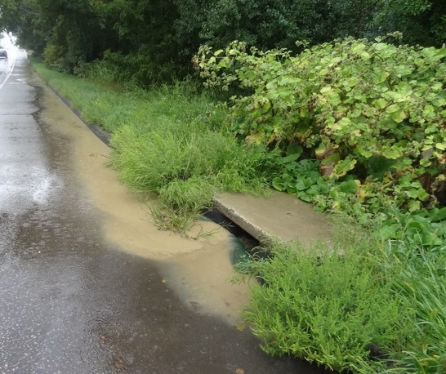
Surface water vs stormwater?
“Surface water” means the physical beds and boundaries of receiving waters (perennial, seasonal, and ephemeral streams, rivers, sloughs, wetlands, and lakes), including those natural drainage systems that have been altered by human actions.
“Stormwater” means runoff during and following precipitation and snowmelt events, including surface runoff and drainage.
This Photo by Unknown Author is licensed under CC BY-NC
Notes:
It is important to understand the difference between stormwater and surface water. Stormwater refers to the runoff and drainage that occurs during rainfall or following any precipitation event including snowmelt. Whereas surface water means the natural drainage systems, including the beds and boundaries of receiving waters. Examples of surface water are streams, rivers, sloughs, wetlands, and lakes.

Slide 10
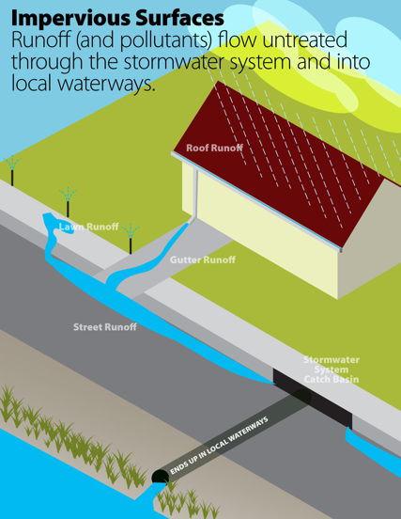
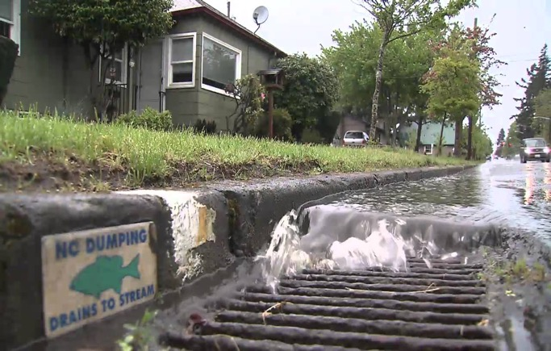
Stormwater is untreated water running off or draining from our landscapes, plus all the fertilizers, pesticides, sediments, dog waste, etc., which drains to the street storm system.
UNTREATED
Notes:
In urban areas stormwater includes water draining from our landscapes. This untreated water can contain fertilizers, pesticides, dog waste, and other sediment. These pollutants drain to the street storm system and into local waterways. Impervious surfaces, like driveways and rooftops, create more runoff. Look for opportunities to reduce runoff!

Slide 11
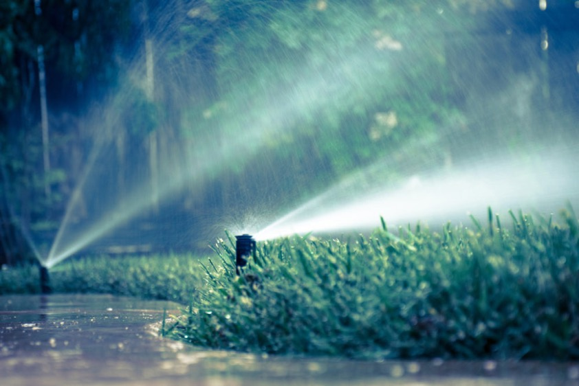
Stormwater often starts at home.
# 1 offender- over irrigating urban landscapes= “urban drool”.
Notes:
Over irrigating is the #1 offender of stormwater runoff in urban landscapes. This "Urban drool" can create a toxic brew draining from the streets.

Slide 12
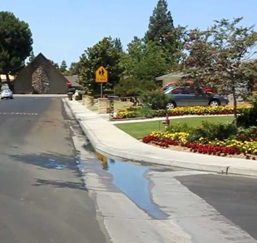
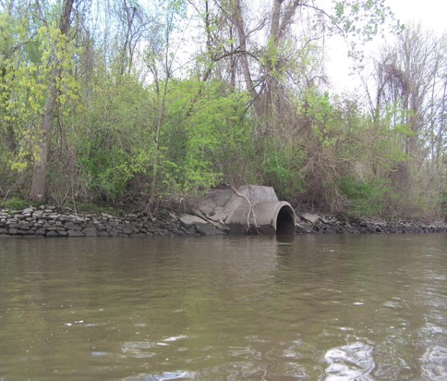
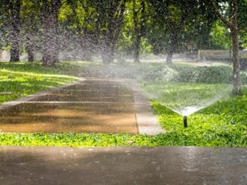
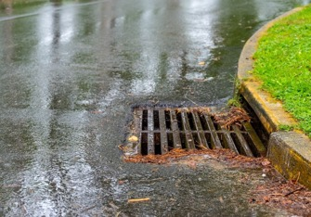
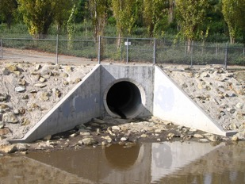
Stormwater systems lead to local waterways
Untreated stormwater often carries pollutants:
fertilizers, pesticides, trash, etc., which often
harm an ecosystem.
Notes:
Over watering our landscapes and gardens causes runoff on impervious surfaces. This the pathway for pesticides (such as insecticides and herbicides), fertilizers, trash, and other pollutants to enter a local waterway. These items can harm the aquatic ecosystem.

Slide 13
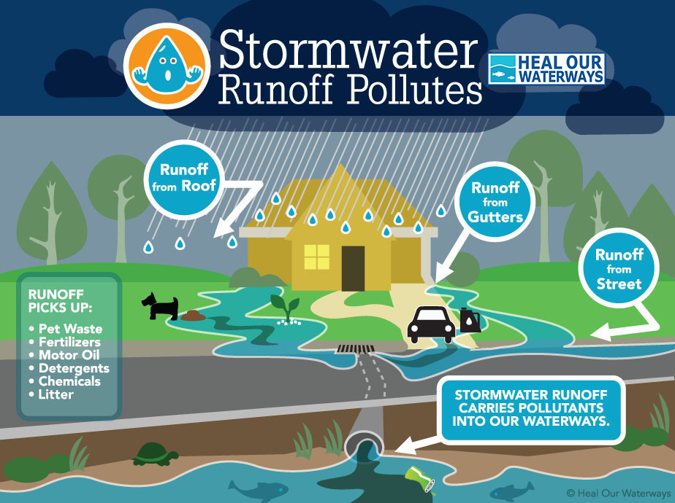
What is stormwater?
Untreated runoff!
UNTREATED
UNTREATED
UNTREATED
UNTREATED
UNTREATED!!!
UNTREATED
UNTREATED
UNTREATED
Notes:
This graphic shows many paths by which pollutants can be carried with stormwater runoff and into our water ways. Meet the pollutants- untreated!!!

Slide 14
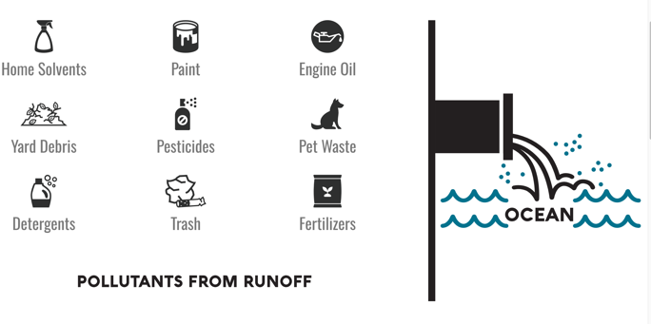
Nonpoint source pollution
Most common type of water pollution
Comes from a variety of sources, difficult to pinpoint
Examples:
  Septic systems
  Lawn fertilizers and pesticides
  Storm drains
  Agricultural runoff
Notes:
Here is another graphic showing Nonpoint source pollution occurs when runoff from rain and snowmelt carries pollutants into waterways such as rivers, streams, lakes, wetlands, and even groundwater. It is difficult to pinpoint the source of the pollution as this is a cumulative effect of small amounts of contaminants gathered from a large area. There are a variety of possible sources in and around our homes and neighborhoods.
Resources
https://h2oc.org/resources/runoff-101/what-are-common-pollutants/
https://www.epa.gov/nps

Slide 15
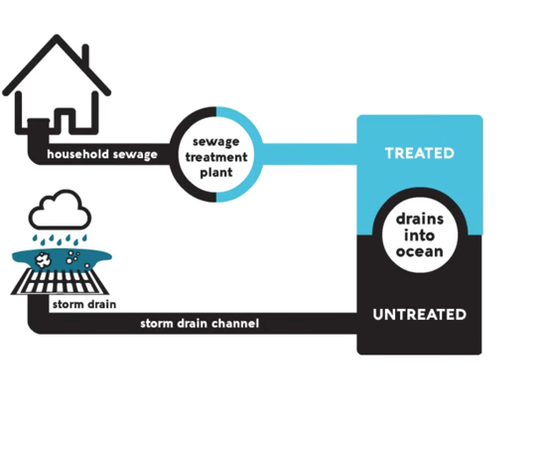
Where do drains flow?
Anything you dump down drains can end up in waterways
Drains in homes and buildings are often treated at wastewater treatment plants
Runoff and other water enter waterways untreated
Wastewater treatment plants can’t filter out every chemical
Notes:
We all must be aware of where the drains flow in order to protect our waterways. Wastewater treatment plants differ from the stormwater drainage system. In our homes and offices, the water that drains from our sink, tubs, and toilets flows to a wastewater treatment plant to be treated and filtered.
The stormwater system drains runoff water from driveways, streets, and through gutters where it may have picked up pollutants. The stormwater runoff is not treated and instead flows directly to a lake, river, or ocean.
Even water treatment plants cannot filer out every chemical.
https://h2oc.org/resources/runoff-101/sanitary-sewer-vs-storm-drain/

Slide 16
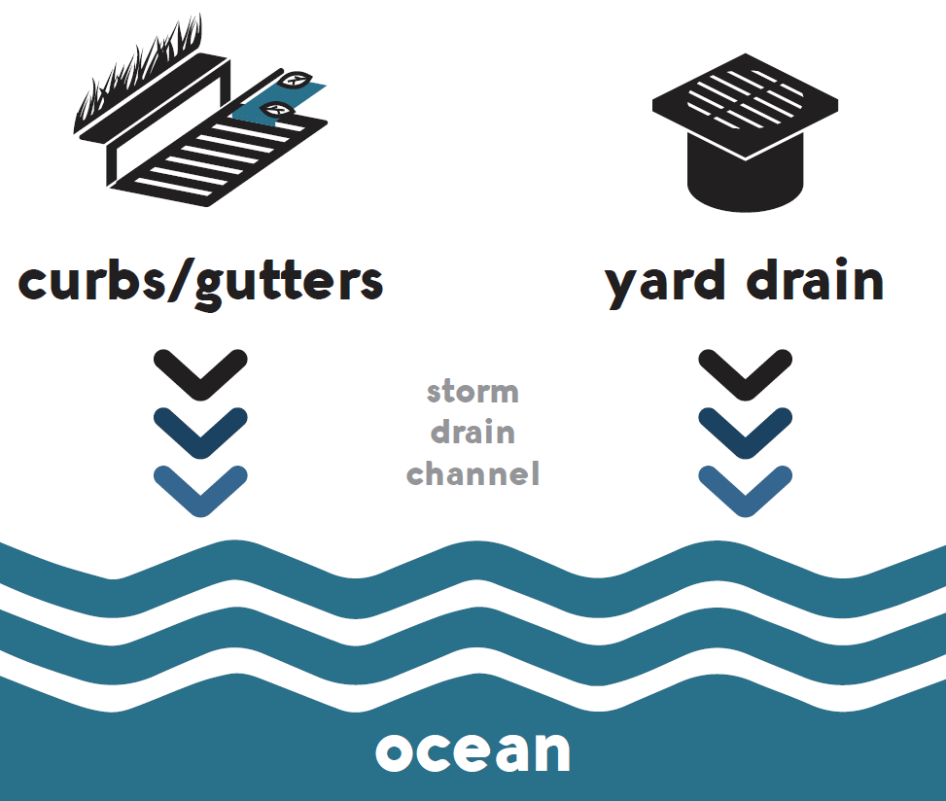
How do pesticide and fertilizers enter waterways?
Stormwater transports pollutants such as pesticides and fertilizers
Notes:
Pesticides and fertilizers enter the waterways through stormwater runoff. Yard drains, curbs, and gutters channel water to the storm drain.
https://h2oc.org/resources/runoff-101/where-does-runoff-go/

Slide 17
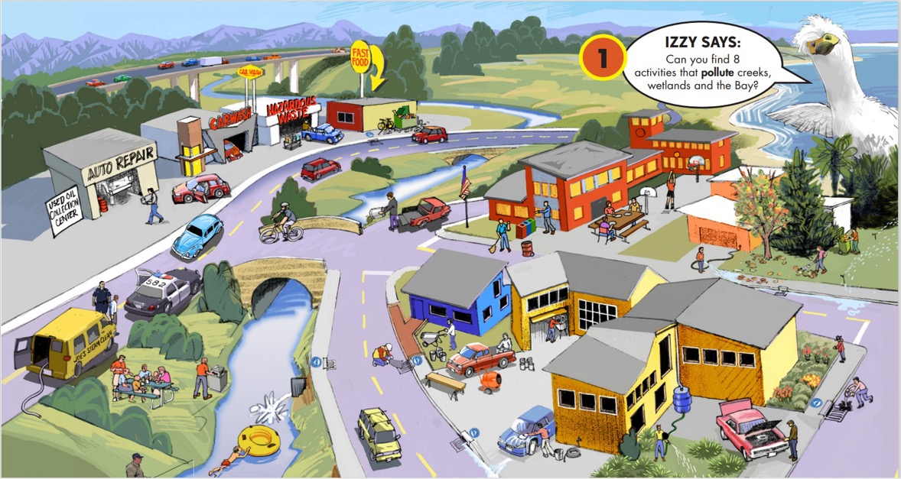
Cleanwater Program of Alameda County http://www.cleanwatergame.com/
Notes:
This is an outreach example from the Cleanwater Program of Alameda County. Ask the audience, “Can you find the pollution hazards?”
[Use a graphic or example from your local stormwater agency if you’d like.]

Slide 18
Water Quality

Slide 19
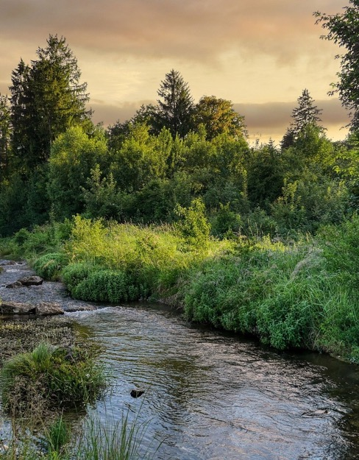
Water quality
Watershed pollution can degrade aquatic and terrestrial ecosystems, and water quality
The best way to maintain water quality is to limit the amount of
pollution going into the water.
Partner with your local water agencies, government agencies, and community
Image by Albrecht Fietz from Pixabay
Notes:
It is important to maintain our water quality for safe drinking and healthy ecosystems. Pollutants in stormwater runoff that enter the watershed can degrade aquatic and terrestrial ecosystems. Partner with your local water agency, government, and community to provide education about water quality and work together to limit the amount of pollution going into the water.

Slide 20
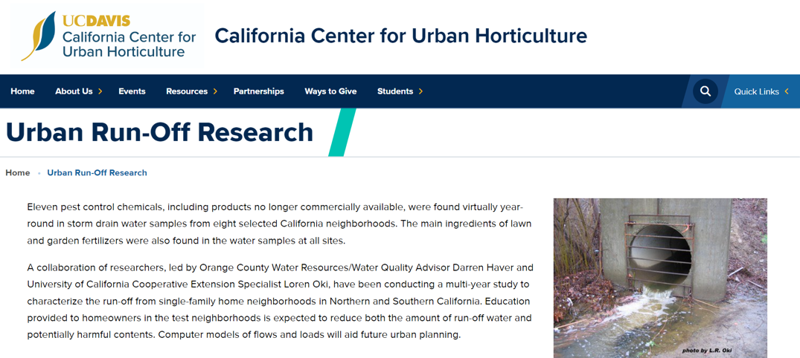
Learn more at UC Davis California Center for Urban Horticulture https://ccuh.ucdavis.edu/urban-runoff-research
Notes:
While agriculture runoff gets a lot of media attention, research shows that pollutants from urban runoff are far more prevalent in our watersheds. A collaboration of researchers have been conducting a multi-year study to characterize the run-off from single-family home neighborhoods in Northern and Southern California. The study aimed to educate homeowners in the water sampling area and analyze the differences in harmful contents.
[Read more about the issue at https://ccuh.ucdavis.edu/urban-runoff-research ]

Slide 21
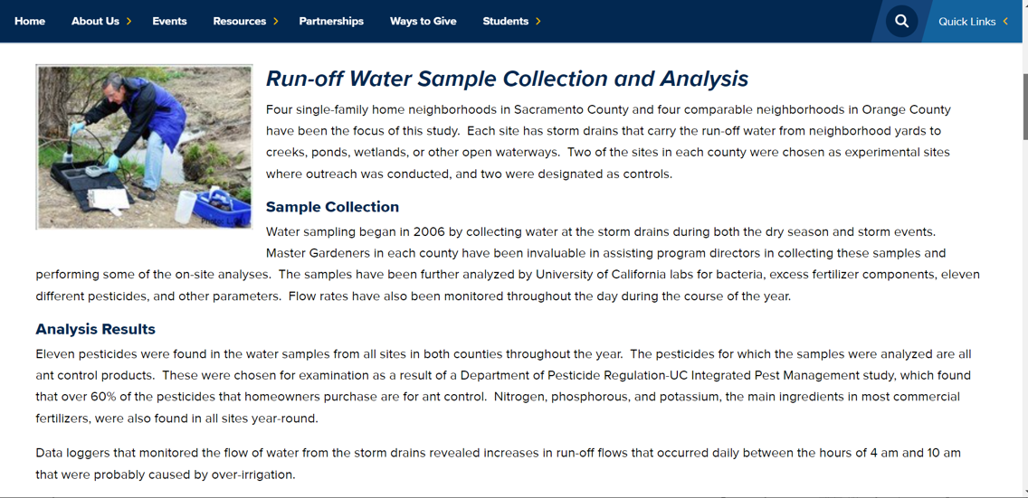
Urban runoff was the culprit, not agriculture to high pesticide loads in northern CA rivers.
Notes:
Upon analyzing the samples collected, researchers found that certain insecticides, common in consumer ant control products, were the worst culprit. Researchers also found fertilizers (NPK) in all samples. Data monitoring water flow showed that increased runoff occurred daily during the morning hours, most likely caused by over irrigation. Education provided to homeowners in the test neighborhoods was expected to reduce both the amount of run-off water and potentially harmful contents.

Slide 22
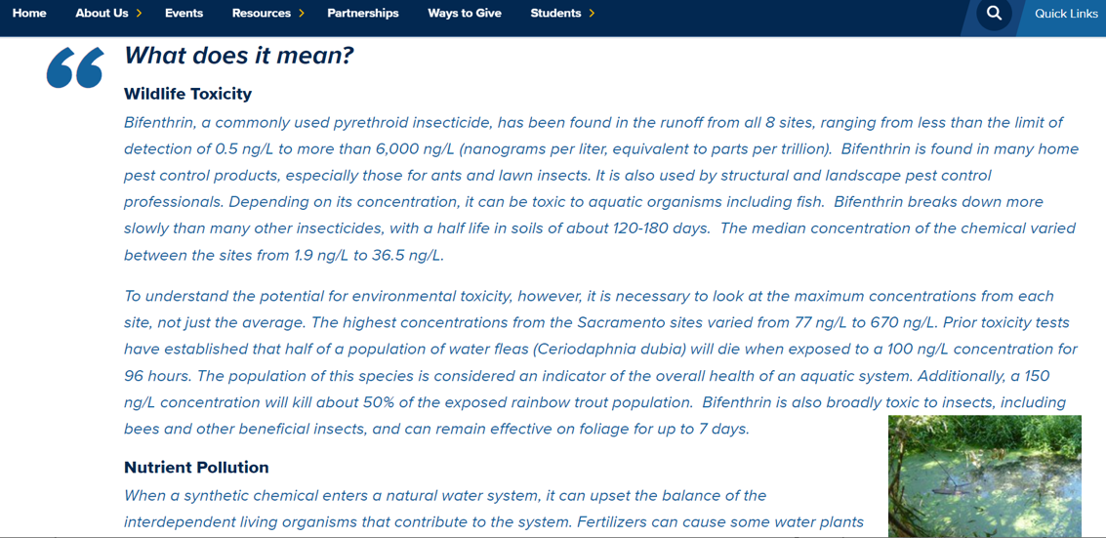
Notes:
Toxicity to bugs on land can mean toxicity to organisms in the water! Using pyrethroid insecticides, like bifenthrin, creates a potential for environmental toxicity. Concentrations found in the test samples ranged greatly amongst the locations and were found well above the safe limit and impacting indicator species. Indicator species are used to determine the health of an aquatic system. Pyrethroids are toxic to our ecosystem and must be used properly to avoid polluting our waterways.
Informational materials and training were provided to the homeowners on a wide variety of topics from installing and managing irrigation to controlling ants without polluting the water. Surveys were conducted by phone, mail, and door to door to evaluate the effectiveness of the outreach on homeowners' gardening practices.

Slide 23
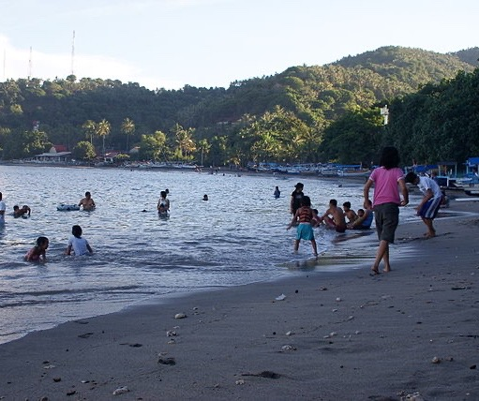
What you do in your home and landscape affects our water and health!
Minimize the use of pesticides that pollute our waterways and harm human health
Use nonchemical alternatives or less toxic pesticide products whenever possible
Read product labels carefully and follow instructions on proper use, storage, and disposal
This Photo by Unknown Author is licensed under CC BY-SA
Notes:
Top ten ways to keep our water clean: https://ccuh.ucdavis.edu/sites/g/files/dgvnsk1376/files/inline-files/top%2010%20ways%20clean%20water.pdf
Water quality education resources are available to our communities. Everything in our home and landscape can affect our water. We aim to minimize the use of pesticides by using nonchemical alternatives or less toxic products when possible. Always read pesticide product labels carefully and follow the instructions on proper use, storage, and disposal.

Slide 24
Resources

Slide 25
County Water Resources Program | http://scceh.com/Home/Programs/WaterResources.aspx
County Water Quality Map | http://scceh.com/waterquality.aspx
County Steelhead Monitoring Program | http://scceh.com/steelhead.aspx
Santa Cruz County Fire Recovery | http://www.co.santa-cruz.ca.us/FireRecovery.aspx
Central Water District | https://sites.google.com/view/centralwaterdistrict
City of Santa Cruz Water Department | https://www.cityofsantacruz.com/government/city-departments/water
City of Watsonville Public Works and Utilities | https://www.cityofwatsonville.org/590/Public-Works-Utilities
San Lorenzo Valley Water District | https://www.slvwd.com/
Scotts Valley Water District | https://www.svwd.org/
Soquel Creek Water District | https://www.soquelcreekwater.org/
Pajaro Valley Water Management Agency | https://www.pvwater.org/
Santa Cruz Mid-County Groundwater Agency | https://www.midcountygroundwater.org/
Santa Margarita Groundwater Agency | https://smgwa.org/
Resource Conservation District of Santa Cruz County | http://www.rcdsantacruz.org/
Santa Cruz Integrated Regional Water Management Plan | http://www.santacruzirwmp.org/
Water Conservation Coalition of Santa Cruz County | https://watersavingtips.org/
Notes:
Water agency contact list for the Santa Cruz area. [If you are presenting in a different location, look up your local water resources.]

Slide 26
Resources
https://resources.ca.gov/CNRALegacyFiles/docs/climate/APG_Understanding_Regional_Characteristics.pdf
UC IPM Urban Pesticides, Fertilizers, and Water Quality https://ipm.ucanr.edu/home-and-landscape/urban-pesticides-fertilizers-and-water-quality/#gsc.tab=0
Presentation on watersheds, water quality, and case studies https://www.conservation.ca.gov/dlrp/Educational%20Documents/California%20Watersheds.pdf
https://oceanservice.noaa.gov/facts/watershed.html
https://www.waterboards.ca.gov/water_issues/programs/stormwater/

