Slide 1

Integrated and Sustainable Pest Management
Karey Windbiel-Rojas
Image by Rosy / Bad Homburg / Germany from Pixabay

Slide 2
Outline
What is IPM
What is SPM & how is it different from IPM?
Why is effective pest management important?
Why choose IPM/SPM
Barriers to using IPM/SPM in urban communities
How the breakouts relate to IPM and sustainable gardening

Slide 3
What is IPM?
  A more sustainable way to manage pests
  Focuses on prevention of pests and their damage
  Scientific and ecosystem-based approach
  Reduces risks to people and the environment
  Combination of practices for long-term management
Notes:
Because it is science based, we are using methods that have PROVEN to be effective and because it is also ecosystem based, these methods are also better for people and the environment- our waterways, wildlife, & beneficial insects
Unlike traditional pest management programs that rely on one strategy, often chemical control, IPM uses a combination of management practices with the emphasis on long-term pest management, not temporary, one-time fixes
IPM also uses a combination of control methods because not all control methods work in all situations, on all plants, or for all pests- using a combination is more effective than a single control method
Where we get the term INTEGRATED from

Slide 4
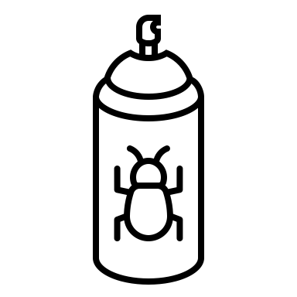
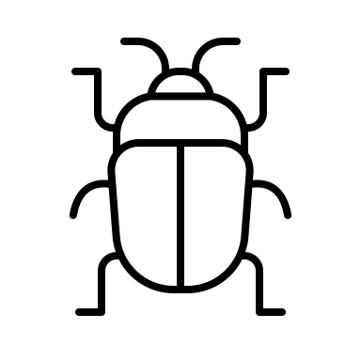
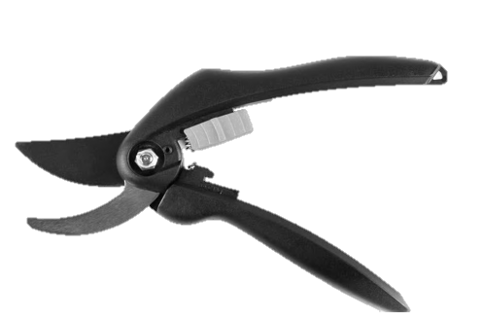
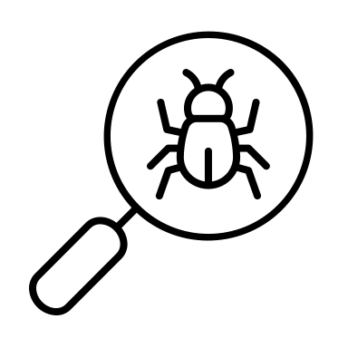
Components of Integrated Pest Management
Chemical
Control
Biological
Control
Physical
Control
Cultural
Control
Identification & Monitoring
Notes:
The components of IPM are often depicted in a pyramid such as this. The larger part is ID and monitoring which is where the focus of attention should be. The pyramid shows the relative amount of attention that should be paid to each of the control measures, with chemical control being the smallest portion.

Slide 5
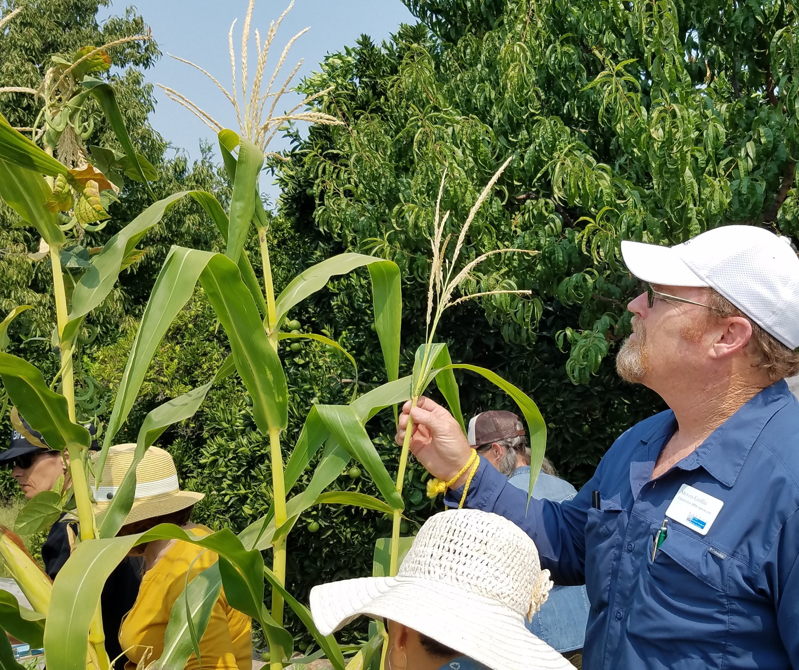
Identification & monitoring
Accurately identify the pest or problem
  Ask questions; know host plant
  Essential to determine appropriate next steps or management
Monitor often for pests or problems
  Catch infestations or problems early
  Determine if your management practices are working
Notes:
Be a detective! In order to solve a plant problem, you need to ID the cause of damage or the pest. Understanding the pests biology or reason for the damage are essential in choosing effective management strategies.

Slide 6
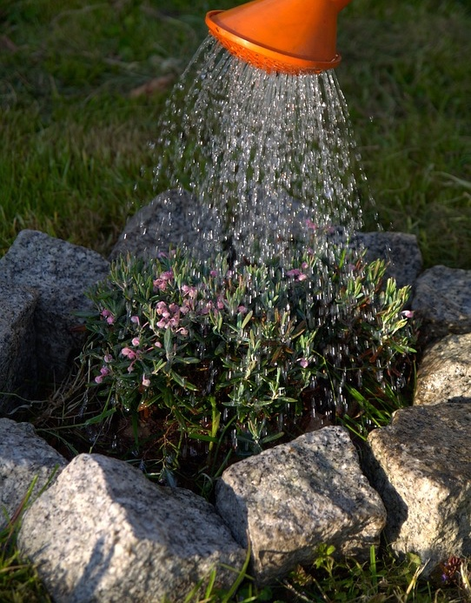
Cultural control
Practices that alter environment to make less suitable for pests to establish and reproduce
Proper horticultural care and site selection
  Irrigation, soil, sunlight, resistant plants
Sanitation
  Clean up mummies, rotate crops, vacuum up crumbs, fix leaks
Notes:
The next component of IPM is cultural controls
Make more favorable for plants
Allow plants to better tolerate pests or problems

Slide 7
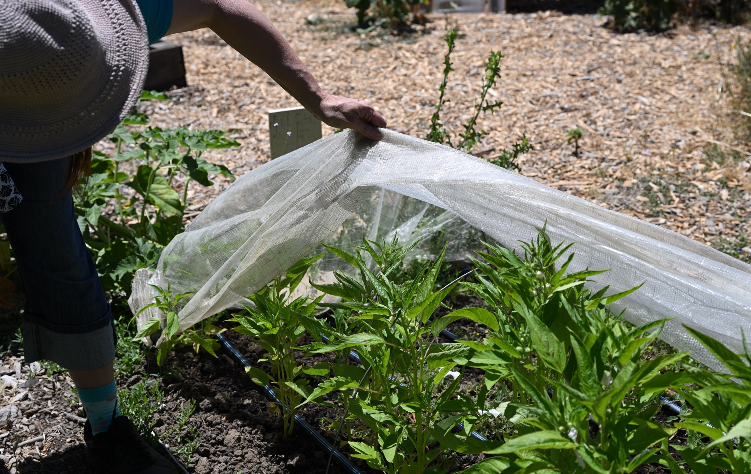
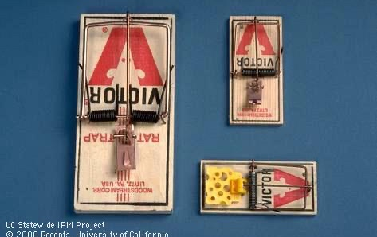
Physical / mechanical controls
Kill or remove; block pests out
Trapping
  Trap to kill or monitor
Exclusion
  Door sweeps, screens, weatherstripping, caulk
  Mulch, protective covers, fencing
Removal
  Pull/mow weeds, pick off diseased leaves, hose off insects
  Vacuum up, flyswatters
Notes:
Physical and mechanical controls are things that physicals block, trap, remove, or sometimes kill a pest.
Read the examples.

Slide 8
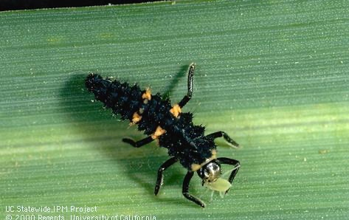
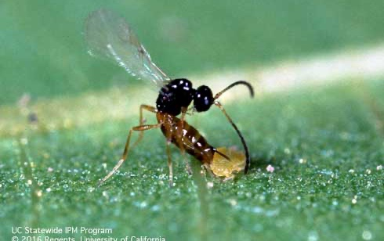
Biological control
Any activity of one species that reduces the adverse effects of another
Natural enemies are the agents of biological control
  Predators
  Parasites/parasitoids
  Pathogens
Notes:
Natural enemies, also known as beneficial insects or good bugs
Ladybug larvae eating an aphid
Adult Trioxys pallidus wasp laying her egg in a walnut aphid

Slide 9
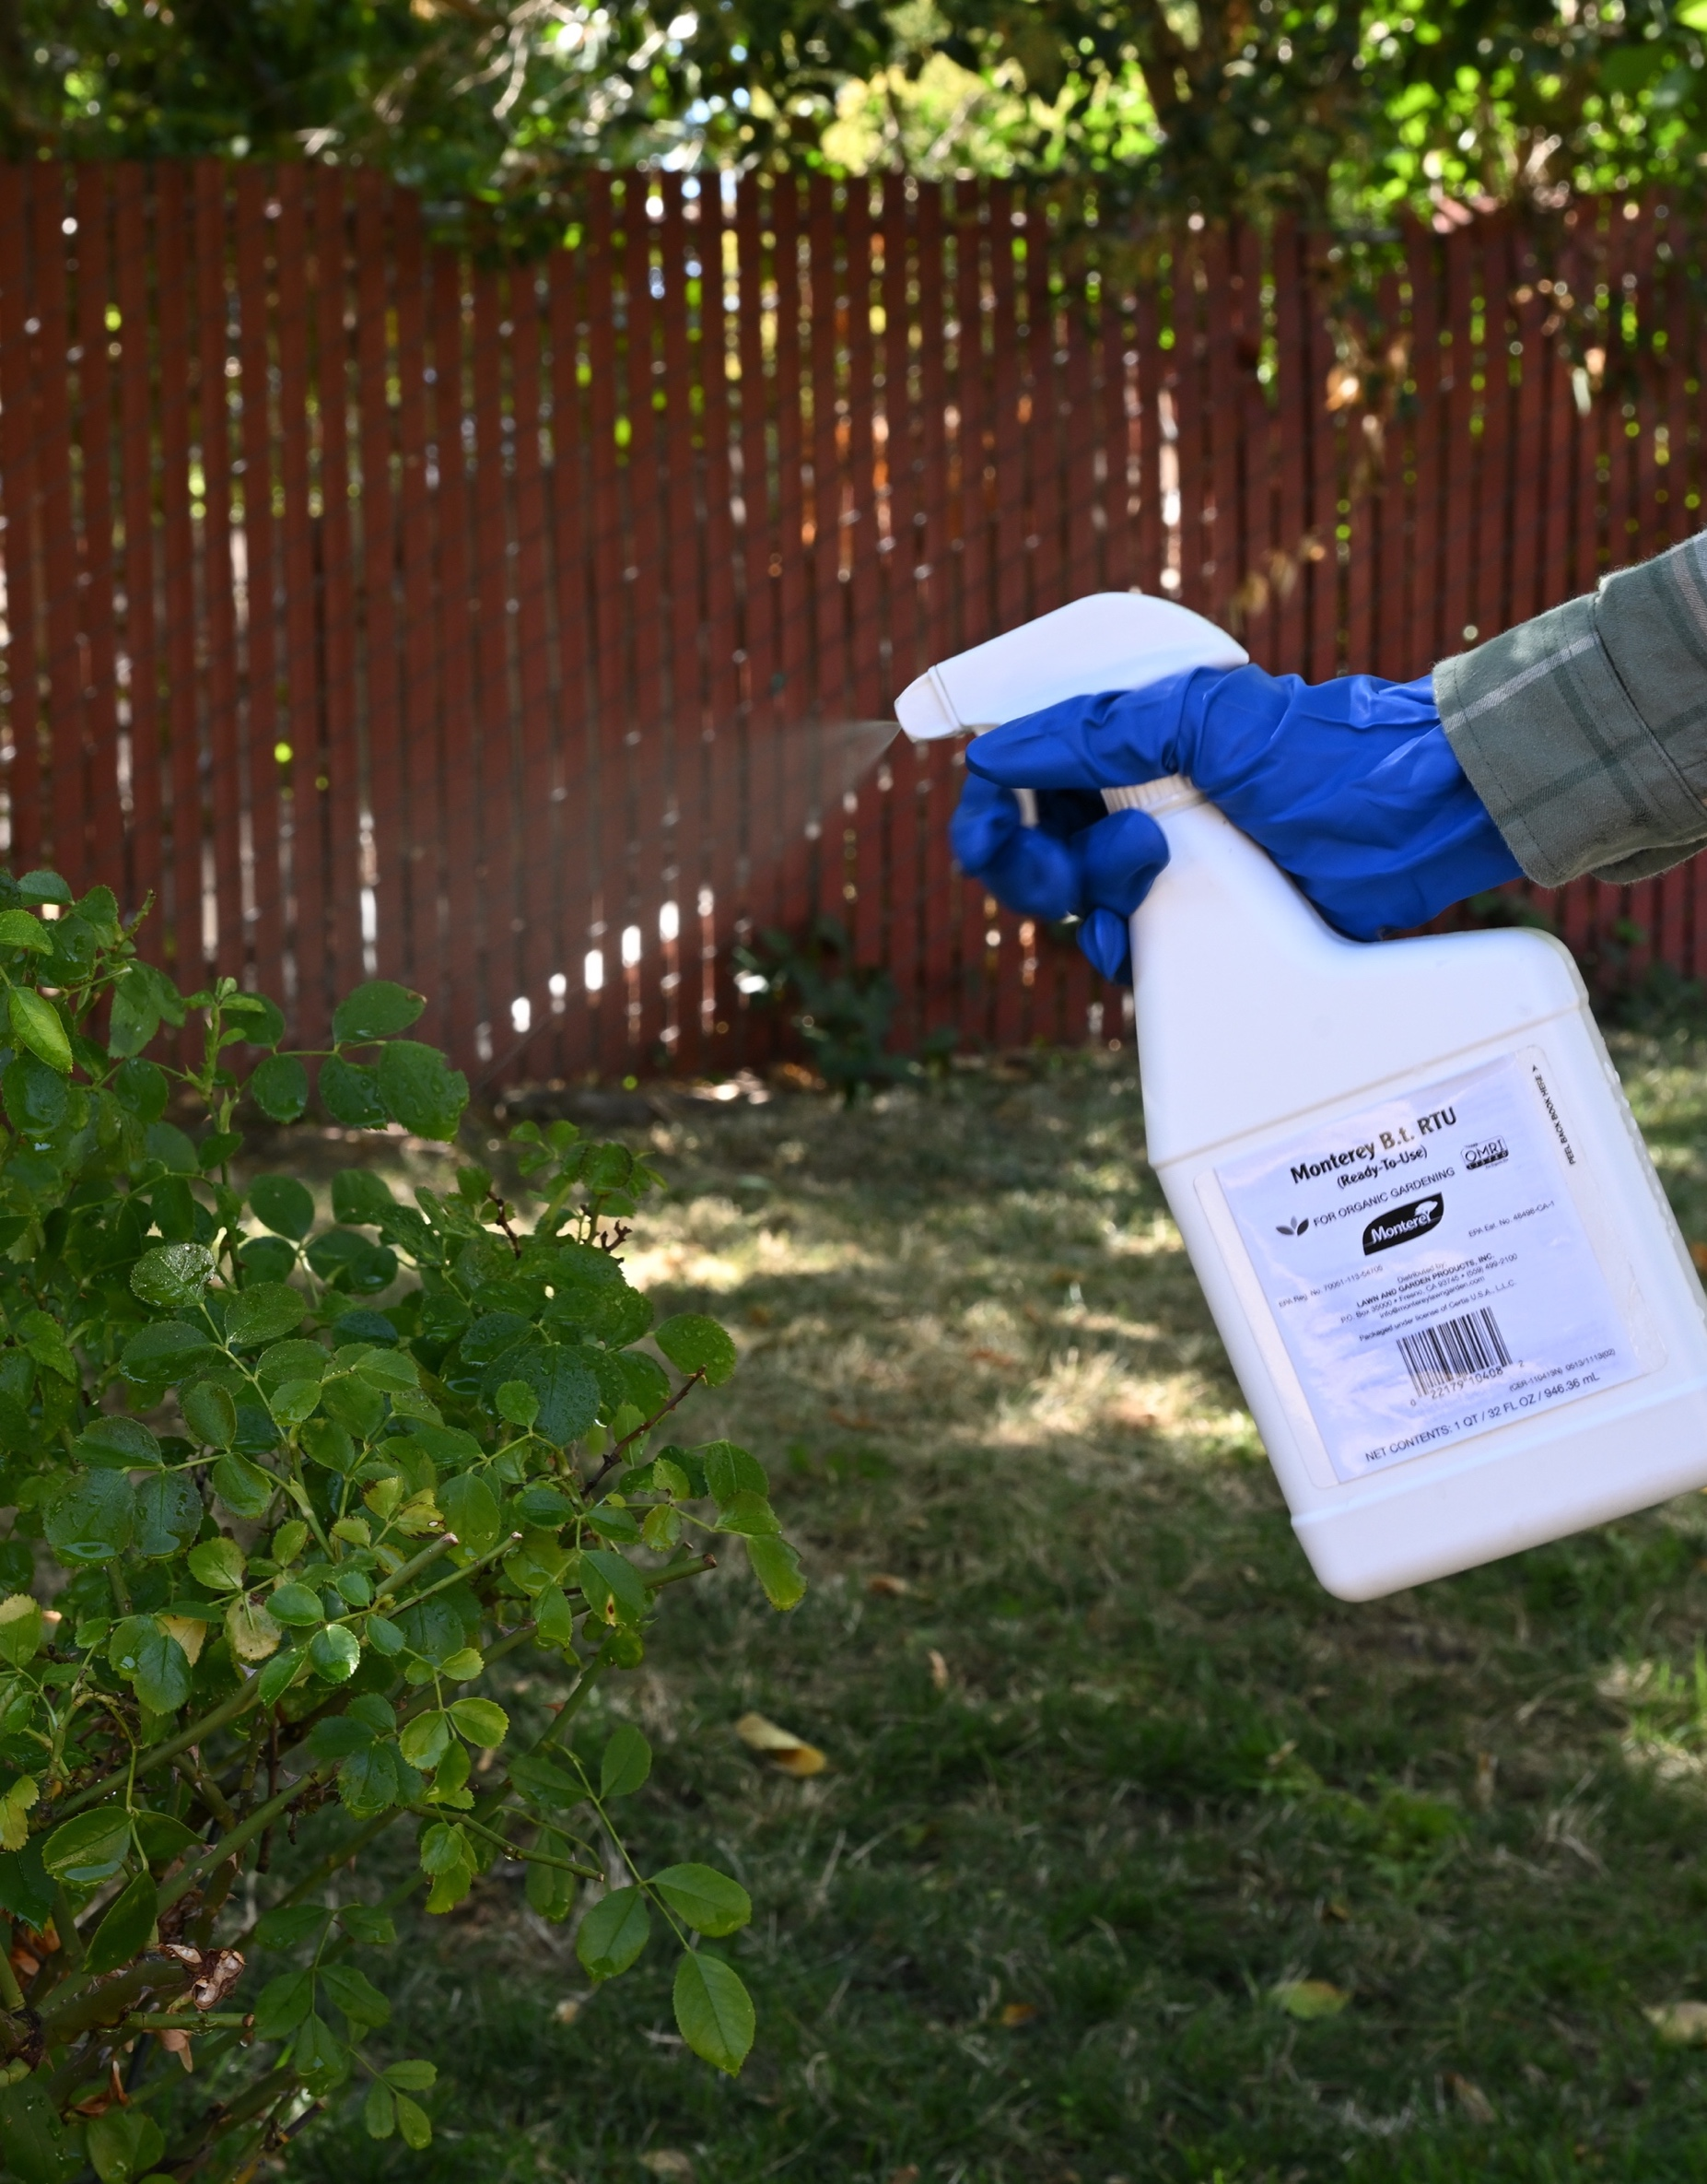
Chemical control
Pesticides can be important in IPM
Make sure you accurately ID pest
  Timing & type of chemical control
When to use:
  Nonchemical controls ineffective
  Severe infestation
  Public or structural concern
Use less toxic pesticides as needed
Notes:
In IPM we focus on controlling pests nonchemically, but sometimes pesticides may be needed
For example, if you can’t manage the pest using biological control, cultural control, or mechanical control, pesticides may help
Pesticides can help control severe infestations or knock pests down to populations that are more manageable
Sometimes pests pose a health risk like bedbugs or poisonous plants, or a structural risk like termites and pesticides can help control the situation
When we use pesticides in IPM, we rely on less toxic pesticides

Slide 10
What is sustainability?
Definition:
The quality of not being harmful to the environment or depleting natural resources, and thereby supporting long-term ecological balance.
As used in Sustainable Pest Management:
Impacts on communities and equity
Environmental issues like water conservation, biodiversity conservation, soil health, and climate impact
Consideration of economic benefits and impacts

Slide 11
Chemical Control
Physical Control
Cultural Control
Identification/Monitoring
Biological Control
Integrated Pest Management
Sustainable Pest Management
Sustainability Pillars
Notes:
Sustainable pest management (SPM) is a holistic, whole-system approach to managing pests in agricultural and other managed ecosystems and urban and rural communities that builds on the concept of integrated pest management (IPM) with broader consideration of human health and social equity, environmental protections and economic vitality
Sustainable pest management goes beyond a checklist of practices and products to address impacts on communities and equity, linkages to broader environmental issues like water conservation, biodiversity conservation, soil health, and climate impact, and a broader consideration of economic benefits and impacts.

Slide 12
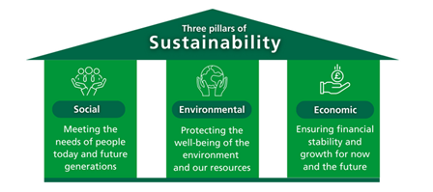
Pillars of Sustainability

Slide 13
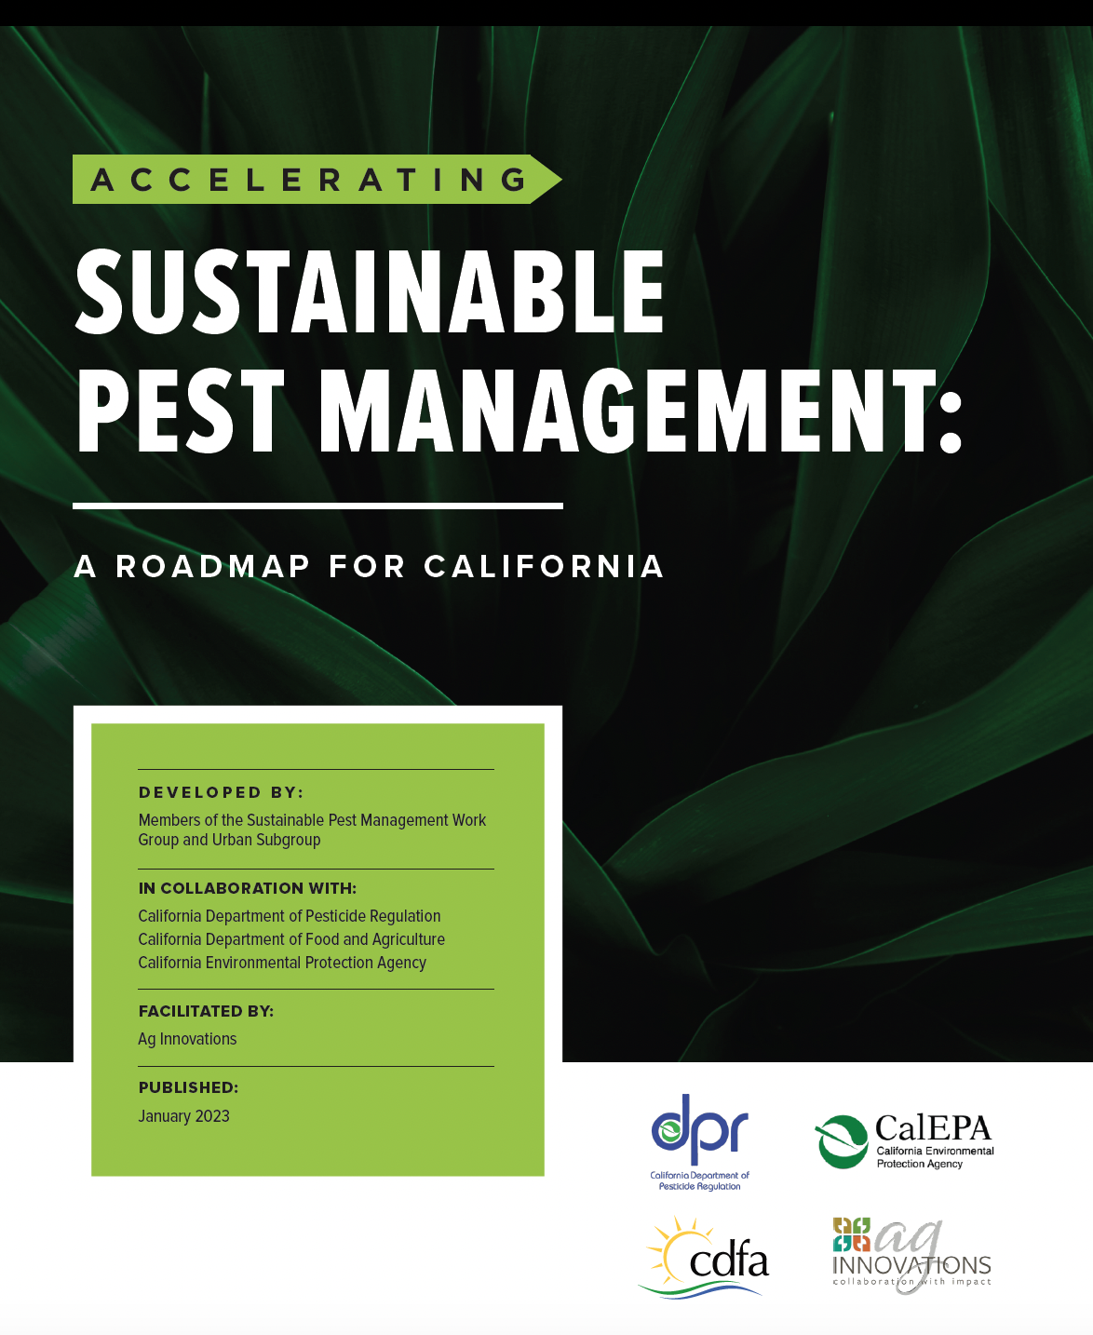
Notes:
California recently developed the Sustainable Pest Management Roadmap. Several groups were involved including CDFA, CDPR, CalEPA, and various stakeholders.

Slide 14
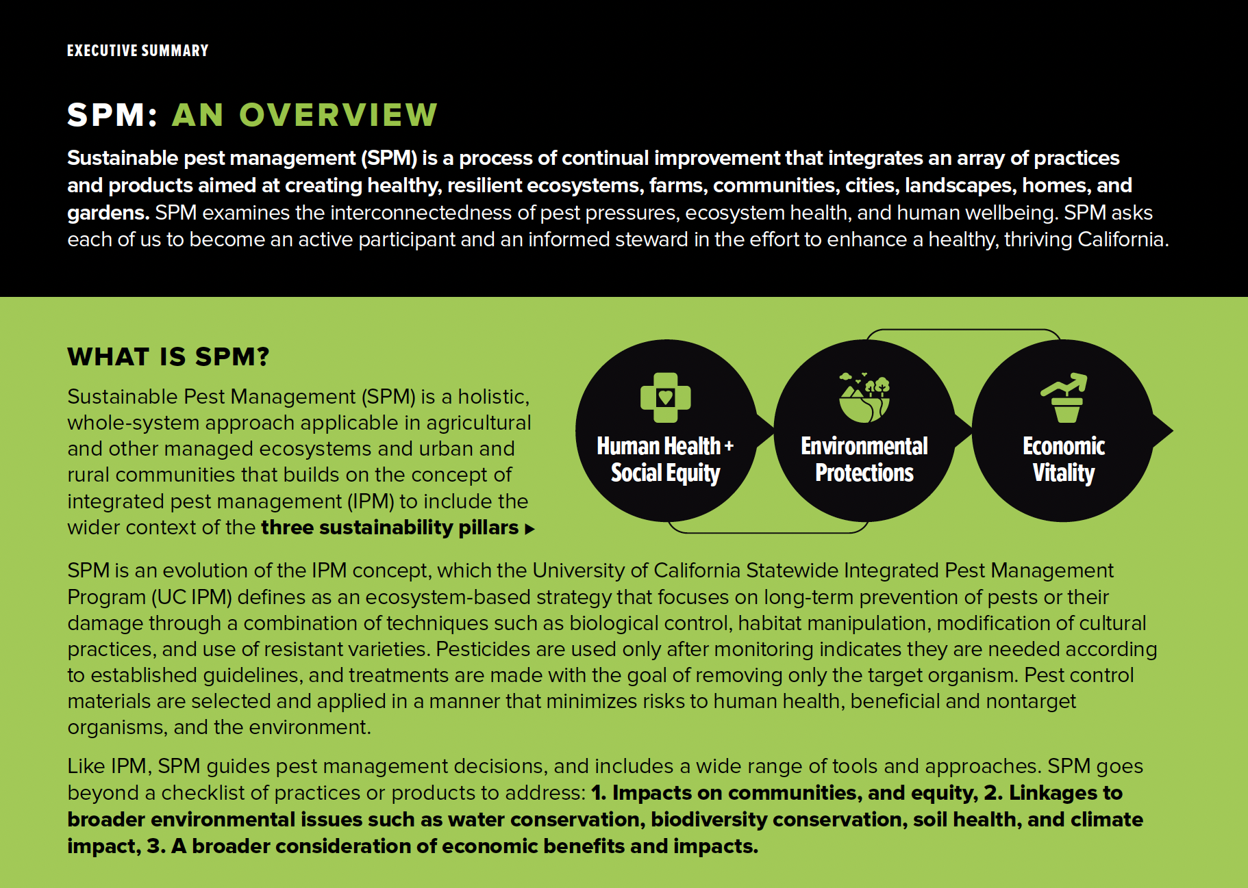

Slide 15
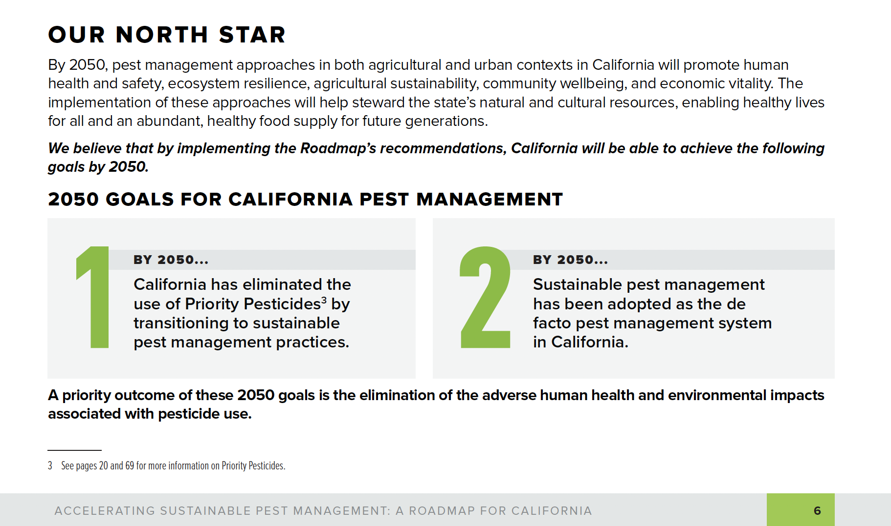
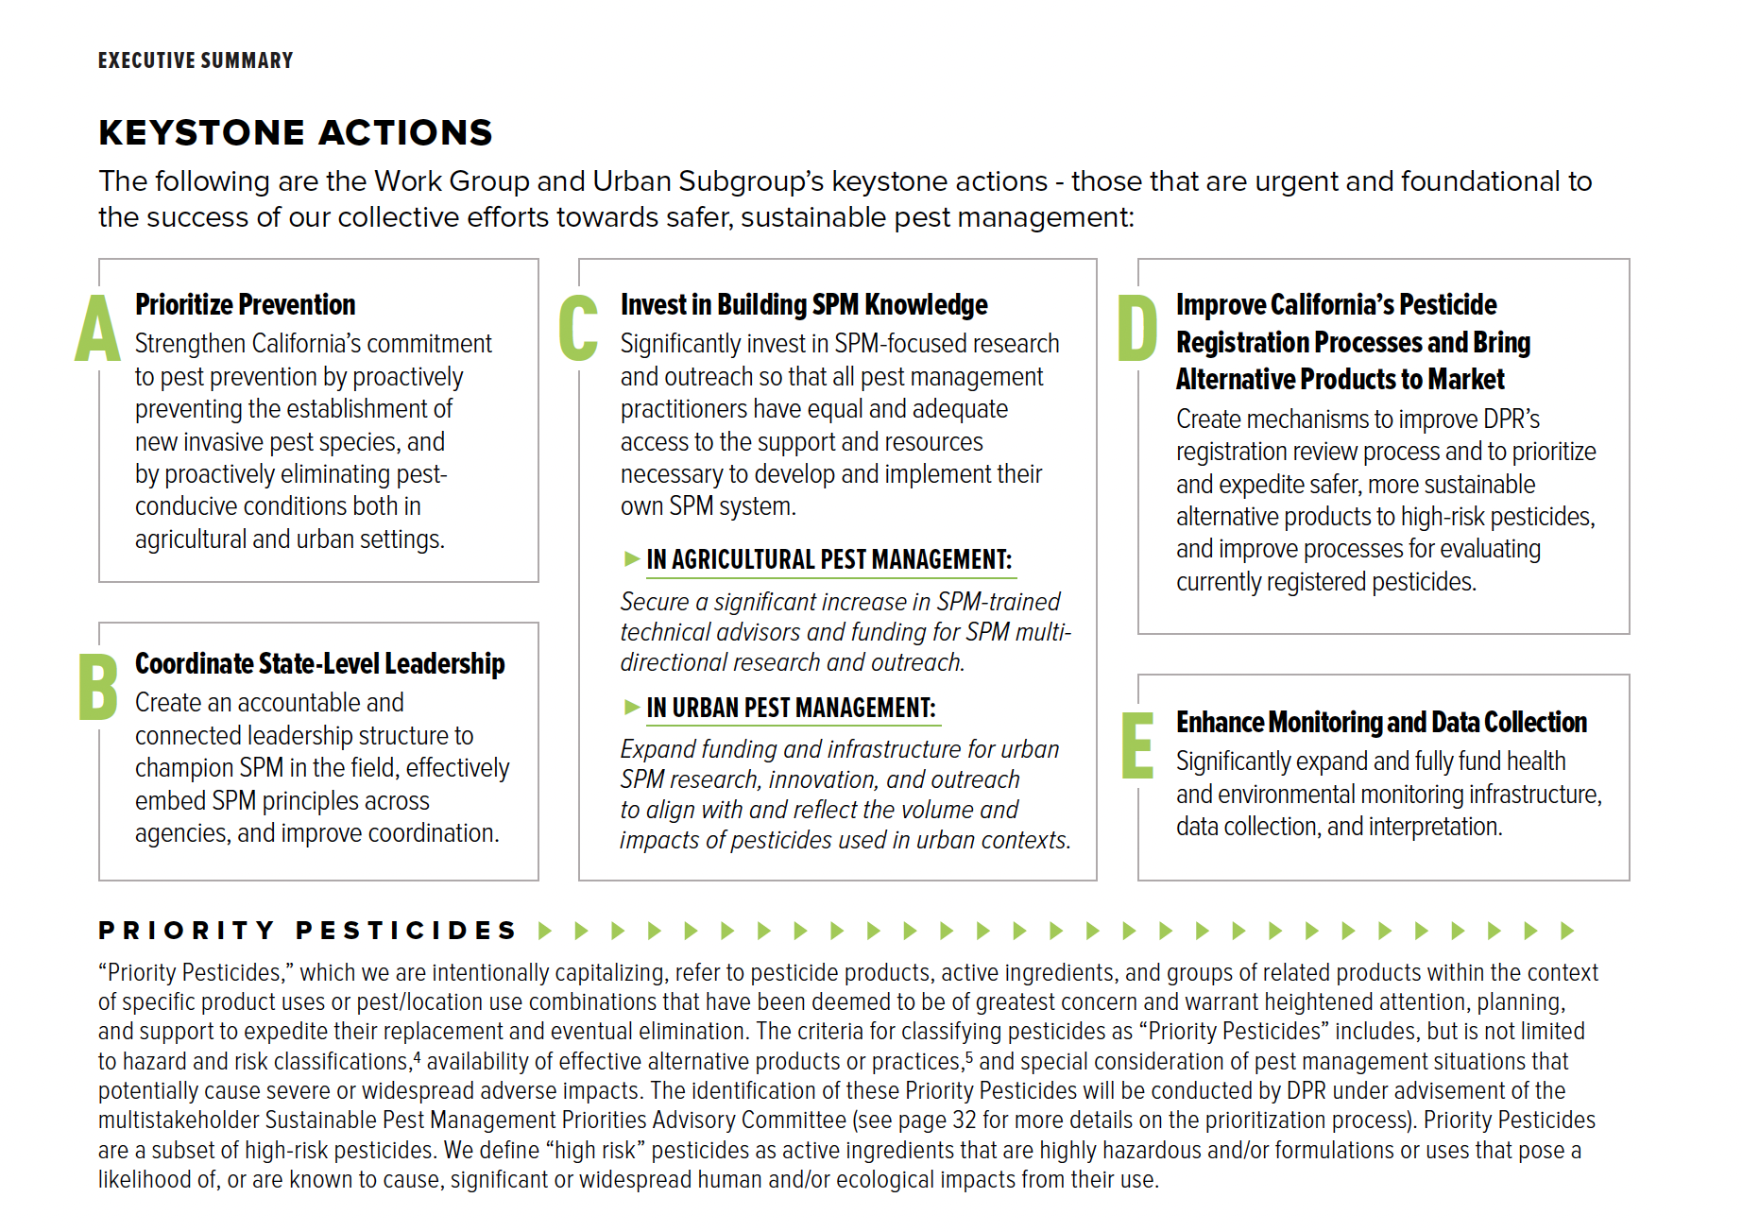

Slide 16
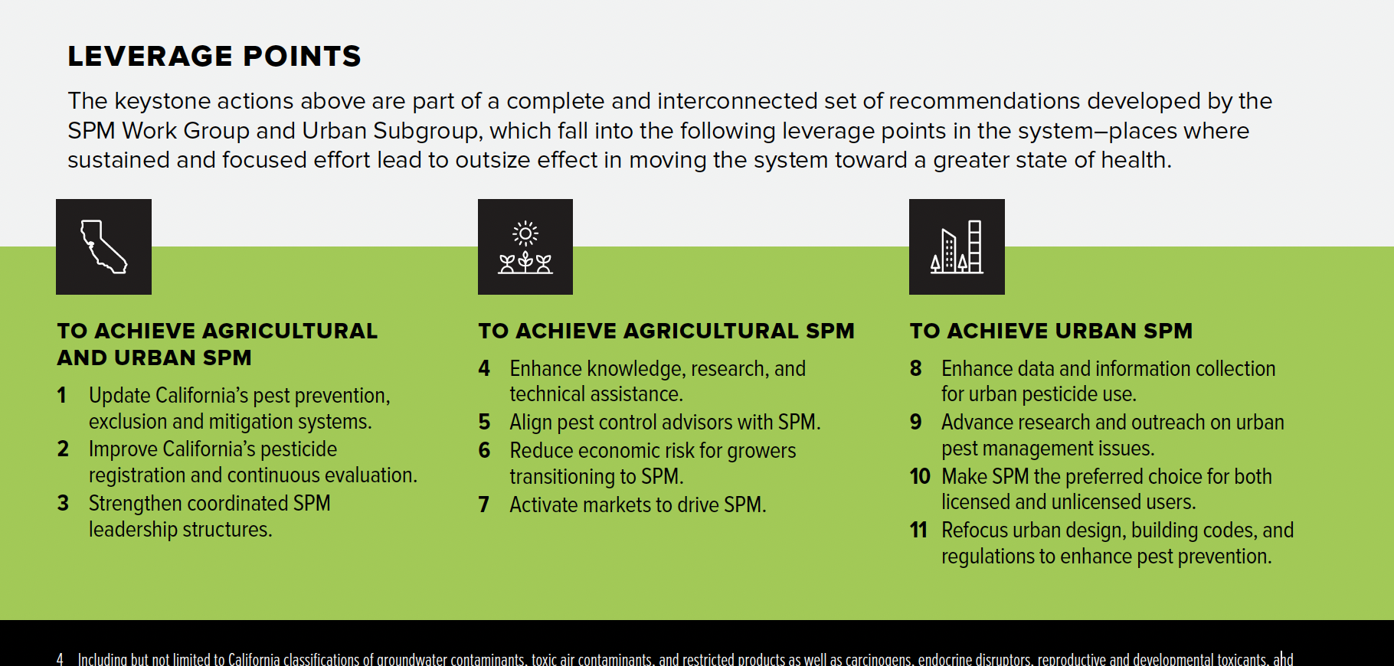
https://www.cdpr.ca.gov/docs/sustainable_pest_management_roadmap/

Slide 17
2050 Goals for California Pest Management
Eliminate the use of Priority Pesticides by transitioning to sustainable pest management practices
Adoption of sustainable pest management in California
Outcome: elimination of adverse human health and environmental impacts associated with pesticide use.
Notes:
The goals for pest management according to the roadmap, are to eliminate the use of Priority Pesticides, which are not yet decided upon by the Roadmap committees. Priority pesticides will be pesticides that are considered high-risk. “High risk” pesticides are active ingredients that are highly hazardous and/or formulations or uses that pose a likelihood of, or are known to cause, significant or widespread human and/or ecological impacts from their use.

Slide 18
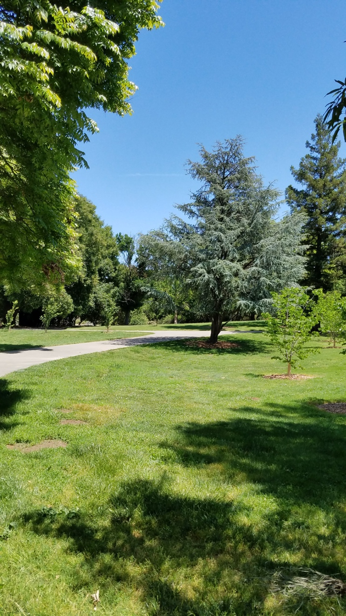
Sustainable Pest Management in Urban Areas
Examples of SPM methods
Classical biological control
Hand weeding
Monitoring
Mulch
Resistant rootstocks and/or varieties
Weed barriers
Weed flaming
“In short, it’s about keeping pests away from where you don’t want them, but doing so in a way that protects you, others, and the environment.”
Notes:
SPM methods look just like IPM methods, because they are! Just a different focus.

Slide 19
Provide long-term solutions
Manage potential problems before they get out of hand
Many nonchemical management options
Eliminate unnecessary pesticide use
Better for people and environment
Why choose IPM/SPM?
Notes:
Getting to the root cause of the problem and not just applying bandaid fixes
Focuses on pest prevention and monitoring so you can manage before things get out of hand and hard to control
IPM relies on numerous nonchemical management options that do not involve pesticides
All of this allows IPM to be a better option for people and environment – save you time and money too!

Slide 20
Why do we control pests in communities?
Pests can damage
People’s health
Asthma
Rat-borne diseases
Gardens and landscapes
Buildings
Improper use of pesticides can:
Harm people’s health
Harm pollinators and natural enemies
Waste money without controlling pests
Impact urban creeks and streams

Slide 21
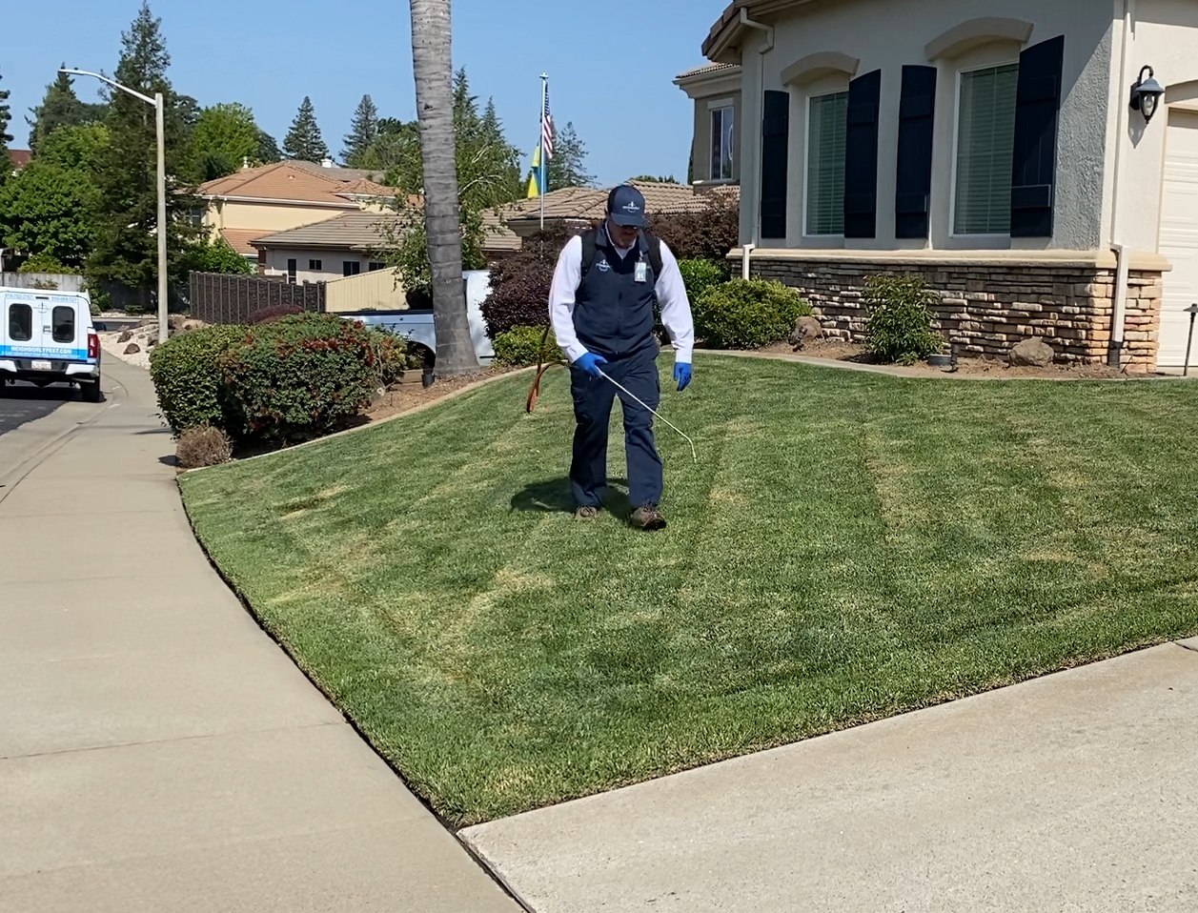
Urban Pesticide Use
35-55% of pesticide sales (pounds sold)
16-19% of reported pesticide use (pounds applied primarily by licensed applicators)
65-75% of reported pesticide-related illnesses

Slide 22

Today’s breakouts: the connection to IPM and SPM
Mosquitoes & public health pesticides
Is it safe?
Know your water
Human health & social equity
Environmental protection
Economic vitality

Slide 23
Why have a different term for SPM?
FROM IPM TO SPM
Integrated pest management (IPM) is an established approach to pest management decision-making, and is a widely applied concept The SPM Work Group concluded that a broadening of the IPM concept is needed in order to address the many environmental, economic, and equity challenges connected to pest management The term “sustainable pest management” is used in this document to represent this broader set of goals
SPM: AN OVERVIEW
Sustainable pest management (SPM) is a process of continual improvement that integrates an array of practices and products aimed at creating healthy, resilient ecosystems, farms, communities, cities, landscapes, homes, and gardens The priority outcomes for SPM are reducing human and environmental risks from pest management activities, while also providing effective pest management solutions
SPM involves stepping back and intentionally looking at the interconnectedness of pest pressures, ecosystem health, and human well-being SPM asks each of us to become an active participant and an informed steward in the effort to enhance a healthy, thriving California

Slide 24
Barriers to using IPM/SPM in urban communities
Lack of knowledge
Language barriers
Income
Physical ability
Lack of agency (tenant, not homeowner)
Poorly maintained buildings
Default conventional pest control (e.g., calendar sprays)
Stigma around pests like bed bugs
Notes:
Here are some things your clientele might be dealing with when trying to manage pests.
Income and physical ability influences pest management options/tools
- Education or language barriers can make it hard to understand IPM: making UC IPM materials accessible

Slide 25

A message from the Statewide MG Program

