Slide 1
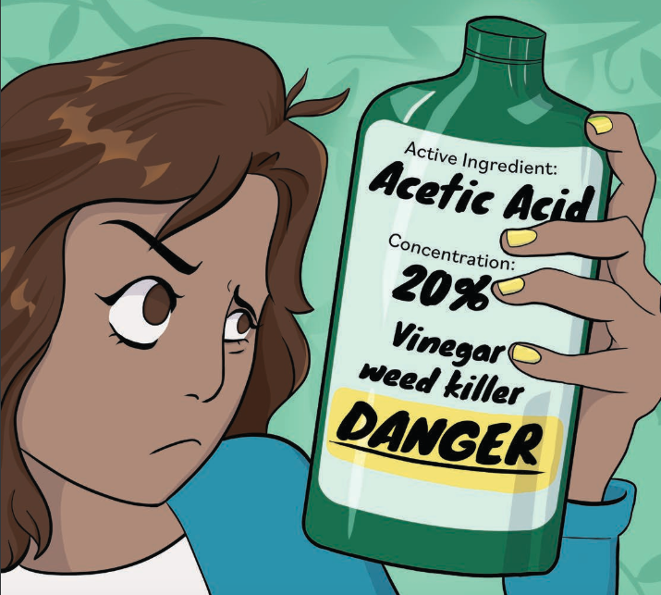
Is it Safe?!
[Your name, title]
[Date]
Photo credit: http://npic.orst.edu/
Notes:
Today’s talk is titled “Is it Safe” and in this presentation we will discuss how to choose, use, and apply pesticides with safety in mind.

Slide 2
Outline
What does safe mean?
Toxicity: acute and chronic
Choosing less toxic pesticides
Reducing exposure/risks
Notes:
Here is an outline of the concepts we will cover throughout this presentation.
We will start by defining the word safe and safety, then learn about toxicity, how to reduce risks associated with pesticides, and finally how to choose less toxic pesticides.

Slide 3
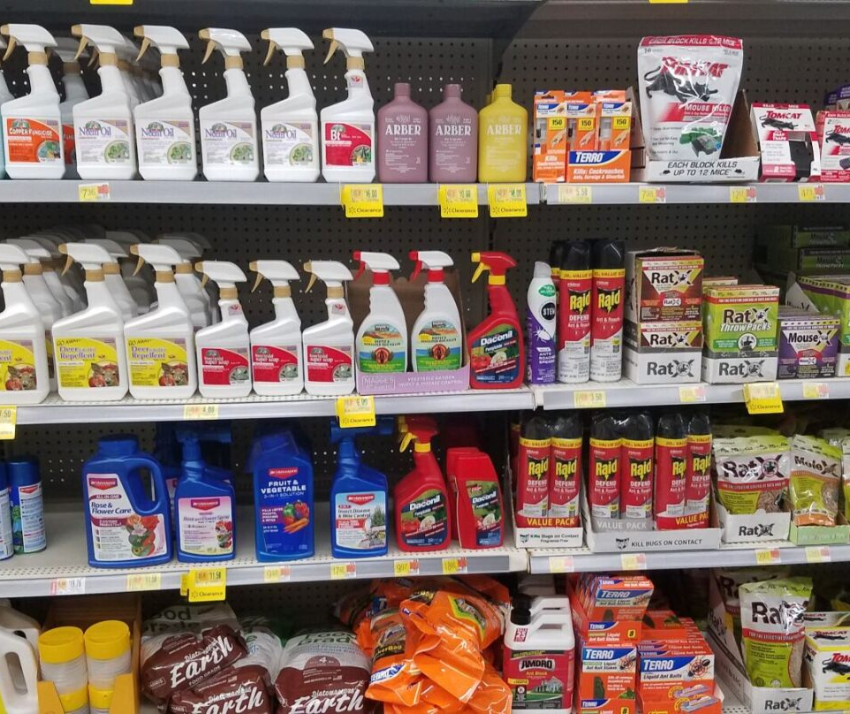
Why should YOU care about pesticides?
As a UC Master Gardener you get questions from the public about pesticides
The public has access to and readily uses pesticides
Pesticides can be a useful tool in IPM and managing pests
When not used properly they can cause harm to you, children, and the environment
Notes:
Before we get started, lets talk about why YOU should care about pesticides.
Sure, you may choose not to use pesticides but as a UC Master Gardener it is inevitable that you will be asked by the public/clientele about pesticides.
Another reason you should care about pesticides is they are widely available both in-store and online, and readily used by the general public to manage pests.
Pesticides can also be a useful tool for managing pests and are a component of Integrated Pest Management (IPM). In IPM we try to avoid using pesticides as the first option for controlling pests, but there are certain situations where they are valuable and more effective than other methods. This often applies to invasive weeds or pests that may harm structures (i.e.., termites) or people (i.e., bed bugs).
Overall, you (as a UC MG) should care about pesticides because it is important that you are able to educate the public on how to use pesticides in a way that causes the least risks to the environment and people.
In the case of pesticides, what you don’t know CAN hurt you.

Slide 4
What does safe mean?
Safe: protected from or not exposed to danger or risk; not likely to be harmed or lost; uninjured (Oxford dictionary)
  Are we ever 100% safe, 100% of the time?
  Is it safe to drive a car?
  Safe to who? Pets, bees, natural enemies?
    We’ll focus on human safety today
Notes:
The definition of the word safe is protected from or not exposed to danger or risk; not likely to be harmed or lost; uninjured.
Looking at this definition, are we ever 100% safe? No, we encounter risk/danger in our everyday lives.
Is it completely safe to drive a car? No, but we can make driving a car safer by wearing a seatbelt or having a car with airbags.
The same applies to pesticides, there are inherent risks associated with using them, but there are many things we can do to reduce those risks.
While it is important to consider safety to pets and pollinators, as well as people, this presentation will focus mostly on pesticide safety to humans.

Slide 5
Using the word “safe”
Using the term “safe” to describe pest control or pesticides can be challenging and problematic
Certain management methods may pose fewer risks or be less toxic, but often are not 100% safe
Safety depends on many, many factors
Notes:
Using the word “safe” to describe pest control or pesticides can be challenging and problematic.
Certain pest management methods may pose fewer risks or be less toxic than others, but as we’ve discussed, rarely is anything 100% safe or free or risks.
Safety depends on many, many factors
A pesticide label for an herbicide may say that the product is “pet safe”, but does that mean it is safe to apply the product to your lawn while your dog is walking around in it? Is it safe for your dog to lick the grass you just sprayed with the herbicide? No!

Slide 6

What does safe NOT mean?
Safe ≠ Natural
Safe ≠ Organic
Safe ≠ Homemade remedies
All chemicals pose the risk to be toxic or unsafe at some point, even those that are natural or organic
Notes:
Now that we know what safe DOES mean, what does it NOT mean?
Safe does not mean natural, it does not mean organic, and it does not mean homemade remedies using household ingredients.
ALL chemicals, even those that are natural or organic (i.e., neem oil), pose the risk of being unsafe or toxic at some point.
Who knows what O2 is? That’s right, it’s oxygen- the thing we need to breathe and survive!
Oxygen is a chemical compound. While essential for life, it can also be toxic.
Too much oxygen cause oxygen poisoning which results in chest pain, difficulty breathing and blurred vision. This can happen if you are receiving supplemental oxygen from an oxygen tank.

Slide 7
Assessing human risk
Risk is the probability of an undesirable response from exposure to a toxicant
Risk = toxicity x dose (exposure)
The risk of a pesticide depends on exposure (how much?) and toxicity (how poisonous?)
Even products that are low in toxicity can be risky if the exposure is high enough
  “The dose makes the poison”
Notes:
Risk is the probability of an undesirable response from exposure to a toxicant (i.e., a chemical, like a pesticide).
The standard risk equation is risk equals toxicity times dose or exposure.
The risk of a chemical like a pesticide depends on how much you were exposed to and how toxic or poisonous the chemical is to humans.
Keep in mind that even products that are low in toxicity can pose a risk and be dangerous if you are exposed to a high enough dose
This is where we get the phrase “the does makes the poison”.

Slide 8
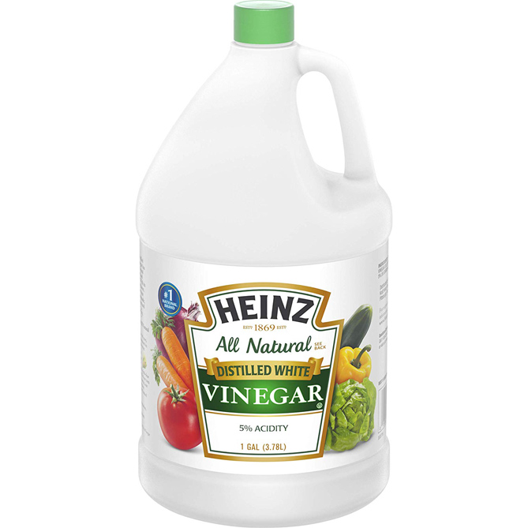
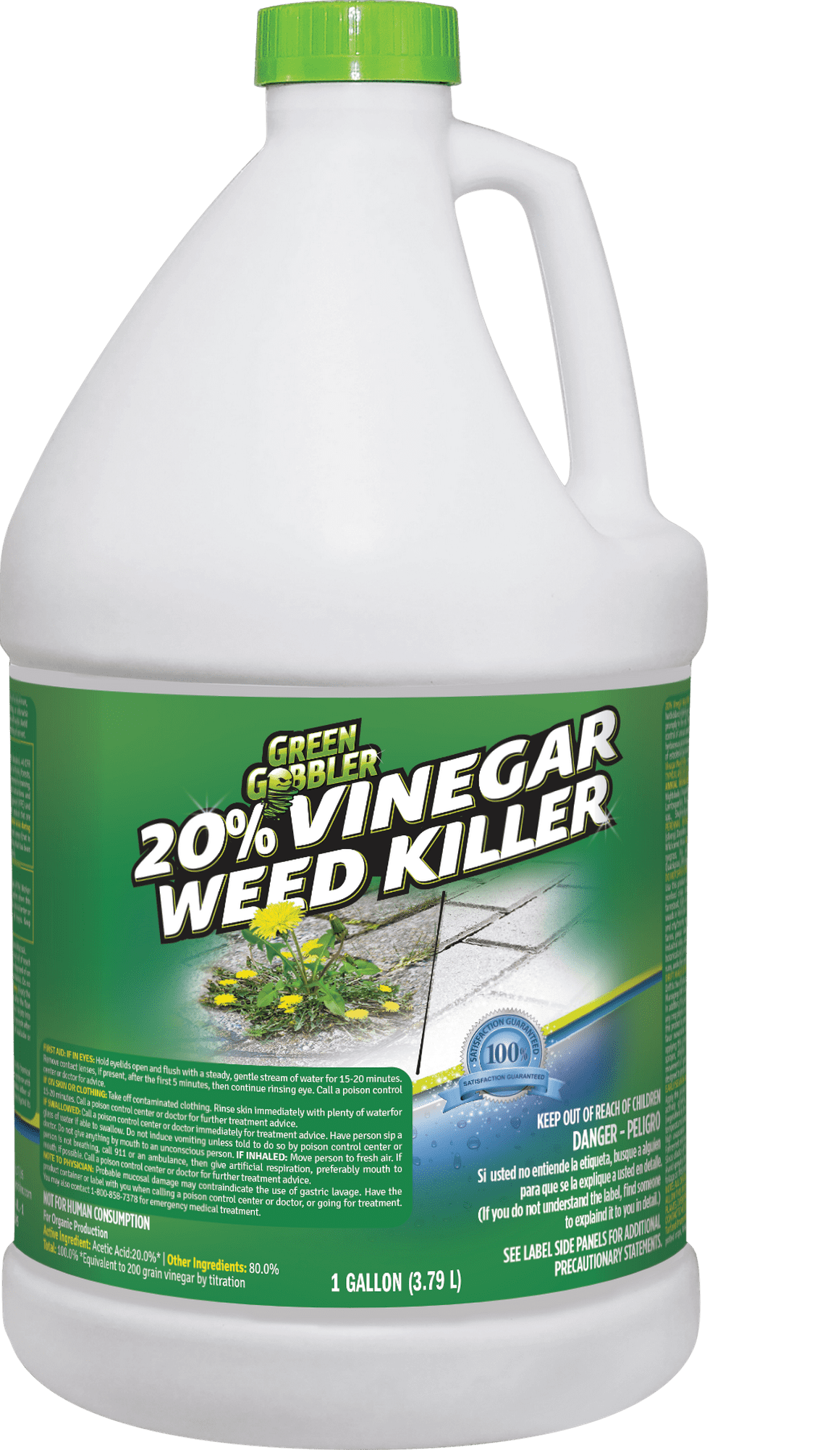
Pesticide Toxicity
Toxicity: ability of a chemical to injure a person, animal, plant, or other organism
All chemicals are toxic to some organisms to some degree
  Toxicity varies among organisms
  Pesticides are designed to be toxic to pests
Depends on the dose
  5% vs 20% acetic acid (vinegar)
Not a pesticide
Pesticide
This Photo by Unknown Author is licensed under CC BY-NC
Notes:
Toxicity is the ability of a chemical to injure a person, animal, plant, or other organism.
All chemicals are toxic to some organisms, to some degree. However, pesticides are specifically designed to be toxic to certain pests.
Toxicity may vary from organism to organism (i.e., a pesticide that is highly toxic to bees may not be toxic to fish).
As we mentioned on the last slide, the dose makes the poison and toxicity depends on dose.
Let’s use vinegar as an example of this. 5% acetic acid (vinegar) is often used for pickling or making salad dressings. It poses a low risk. 20% acetic acid is often used in herbicides (weed killers) and it poses a high risk. We can consume 5% acetic acid, but 20% acetic acid can cause permanent eye and skin damage.
As the dose (or concentration) increases, so does the risk!
”The dose makes the poison"

Slide 9
Acute toxicity
CAUTION | Slightly toxic if eaten, absorbed through the skin, inhaled, or causes slight eye or skin irritation
WARNING | Moderately toxic if eaten, absorbed through the skin, inhaled, or causes moderate eye or skin irritation
DANGER | Highly toxic and may be corrosive, causing irreversible eye or skin damage
DANGER-POISON | Highly toxic by any route of entry into the body
The ability of a chemical to cause harm/injury from a single exposure, usually in a short period of time
  Burning, itching, pain, coughing after pesticide exposure
Indicated by signal words (CAUTION, WARNING, DANGER) on the pesticide label
Based on LD-50 measurements of the active & inert ingredients
Notes:
Acute toxicity is the ability of a chemical to cause harm or injury, usually in a short period of time or from a single exposure incident.
Symptoms of acute toxicity generally include burning, itching, pain, or coughing after being exposed to the chemical.
The acute toxicity of a pesticide is indicated by signal words. These signal words are required by law to be on all pesticide product labels. They are often found on the front of the label near the bottom.
A CAUTION signal word means the chemicals in the pesticide are slightly toxic, where a DANGER signal word means the pesticide is highly toxic.
Signal words are based on LD-50 measurements of both and active and inert (other) ingredients. We will discuss LD-50 on the next slide.

Slide 10
LD-50
LD-50 is the lethal does of a toxicant to kill 50% of exposed individuals within a certain time
  Measured in mg/kg
Used to determine the acute toxicity of a chemical
  Signal words
High LD-50 values indicate low toxicity
  Lethal at high doses
Low LD-50 values indicate high toxicity
  Lethal at low doses
Notes:
LD-50 stands for the Lethal Dose of a toxicant (i.e., pesticide active ingredient) to kill 50% of exposed individuals within a certain period of time. It is recorded in milligrams of the chemical per kilogram of body weight (mg/kg).
These values are then used to determine the signal word for a pesticide to communicate the acute toxicity of the product.
The US EPA selects the appropriate signal word (i.e., CAUTION, WARNING, DANGER) after the pesticide manufacturer performs research studies to determine the LD-50 (on lab animals) for the toxicants.
The study that shows the highest toxicity is used to determine the signal word. For example, if a product demonstrated low toxicity when eaten, moderate toxicity when inhaled, and high toxicity when applied to skin, the EPA would assign the signal word DANGER, based on the most sensitive route of entry. In this example it was the skin.
And, as mentioned, the signal words are based on LD-50 measurements of ALL ingredients in a pesticide product. If a pesticide contains two active ingredients and one of them presents a low toxicity, but the other presents a high toxicity, the signal word assigned would be DANGER.
High LD-50 values indicate low toxicity, meaning you’d have to be exposed to a high dose for them to be lethal
Low LD-50 value indicate high toxicity, meaning they are lethal at low does.

Slide 11
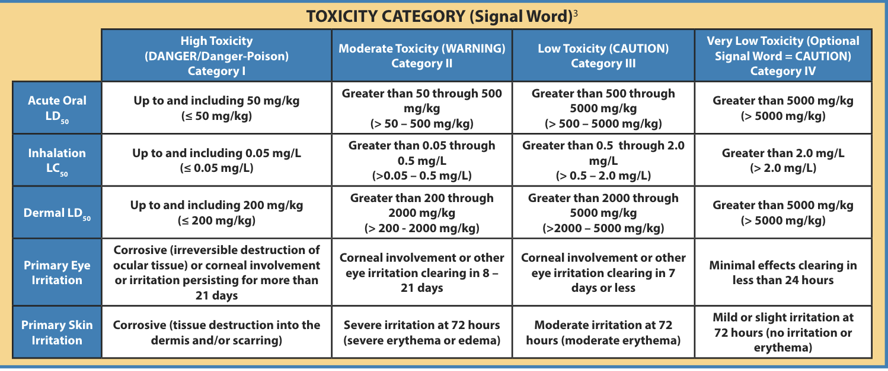
Notes:
These are the parameters EPA uses when determining signal words.
As you can see, each signal word has an associated range of LD-50 values.
Category 1-3 (DANGER, WARNING, CAUTION) are required to be on the pesticide label. Category 4, when the LD-50 values indicate very low toxicity, is optional for manufacturers to include a signal word on the label.

Slide 12
Comparing LD-50s
Acetic acid
Glyphosate
Oral LD50: 3310mg/kg
Dermal LD50: 1060mg/kg
Signal word: DANGER/POISION
Oral LD50: >5000 mg/kg
Dermal LD50: >5000 mg/kg
Signal word: CAUTION
Notes:
Let’s compare the LD-50 values for these two unknown active ingredients.
The active ingredient on the LEFT has an oral LD-50 value of 3,310 mg/kg and a dermal LD-50 of 1,060 mg/kg.
The active ingredient on the RIGHT has both an oral and dermal LD-50 value of greater than 5,000 mg/kg
Which active ingredient would you expect to have a signal word CAUTION? Left or right?
[CLICK to reveal the bullet with the signal words on the slide]
The active ingredient on the right has a signal word CAUTION, and the one on the right has a signal word DANGER/POISION.
You might be surprised to learn that the active ingredient on the left is acetic acid (vinegar) and the active ingredient on the right is glyphosate.
[CLICK to reveal active ingredient names on the slide]

Slide 13

“Keep out of reach of children”
Found on all pesticides, even if they are natural or organic
  Also cleaning chemicals and medications
Under age 18 cannot use
Children are often more sensitive to pesticides than adult
50% of the 2 million pesticide poisoning incidents each year involve children younger than six years old
This Photo by Unknown Author is licensed under CC BY-NC
Notes:
The ”Keep out of reach of children” statement is found on all pesticide product labels (even if they are organic or natural), as well as cleaning chemicals and medications.
It is usually found next to or near the Signal Words on a pesticide label.
This statement forbids children, which includes anyone under the age of 18, from using pesticides and encourages the user to keep the product in a safe place, where children cannot access it.
Children are much more sensitive to pesticides (and other chemicals) than adults because their bodies are still developing. A child’s liver and kidneys cannot remove toxins from the body as well as an adult's liver and kidneys can.
Keeping pesticides and other chemicals out of reach of children is an essential way to keep them safe and prevent accidental pesticide exposure.
However, it’s something many people overlook. Of the 2 million pesticide poisoning incidents reported to the EPA each year, half (50%) of them involve children younger than 6 years old.
Keep in mind that pesticides include antimicrobial products like toilet bowl cleaners, disinfecting sprays, and surface sanitizing wipes. People may overlook these products as pesticides and not be as careful with their storage.
* Note that a child who is one-fifth the weight of an adult would require only one-fifth the amount of pesticide to suffer the same toxic effects as the adult.

Slide 14

Chronic toxicity
Ability of a chemical to cause chronic damage or illness
  Repeated exposure over a long period of time, or result of high acute toxicity
  Birth defects, cancers, sterility, blood disorders, nerve damage, etc.
Notes:
Unlike acute (immediate) toxicity, chronic toxicity is the ability of a chemical to cause long term harm or injury.
It can be the result of repeated exposure over a long period of time, or the result of a high acute toxicity incident.
Long term toxicity can lead to the development of birth defects, cancers, sterility, blood disorders, nerve damage, and more.

Slide 15
Cancer risks
A carcinogen is something that scientist have shown causes cancer
  Known carcinogens include asbestos, arsenic, alcoholic beverages, cured meat, wood dust and UV rays, among others
Being exposed to a carcinogen increases your risk of cancer, but can depend on many things
  Amount of exposure (dose), severity of effects, genetics, etc.
Notes:
A carcinogen is something that scientist have shown causes cancer. Known carcinogens include asbestos, arsenic, alcoholic beverages, cured meat, wood dust and UV rays, among others.
Being exposed to a carcinogen increases your risk of cancer but that risk can depend on many things.
For example, how much of the chemical were you exposed to?; for how long?; how many other carcinogens were you exposed to?; are you genetically more susceptible to cancer than others?

Slide 16
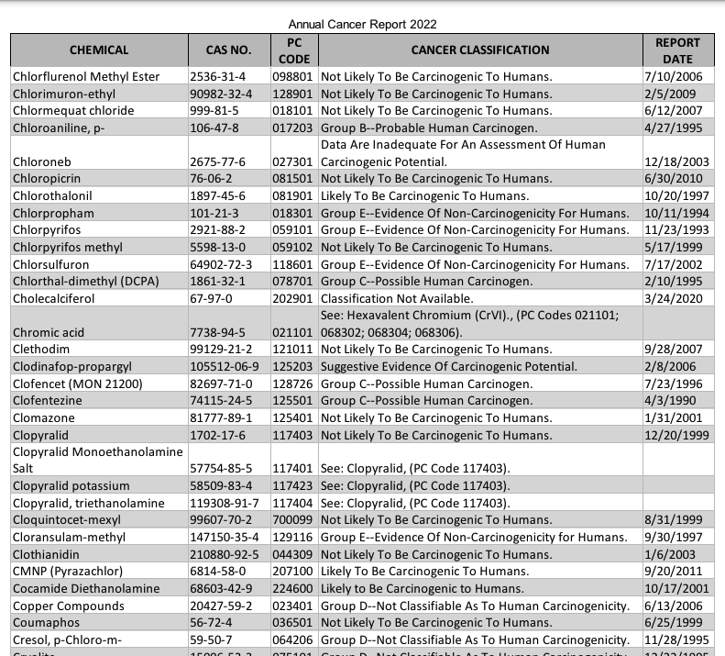
US EPA list
Annual cancer report of pesticides evaluated for carcinogenic potential
EPA reviews scientific studies and recommends a cancer classification
Notes:
To communicate the carcinogenic potential of a variety of pesticide active ingredients, the US EPA publishes an annual cancer report list
EPA performs an independent review of studies conducted in mice and rats to evaluate the carcinogenic potential of pesticides. The results of the independent review are peer-reviewed by the Cancer Assessment Review Committee. This committee then recommends a cancer classification.
A chemical may receive the following classifications:
Known human carcinogens: many studies show evidence that the chemical can cause cancer
Possible, probable, or reasonably anticipated to be human carcinogens: some evidence that the chemical can cause cancer, but not enough to be sure
Unknown or not classifiable: not enough information to say whether it can cause cancer
Not likely or non-carcinogenicity: not suspected to cause cancer

Slide 17
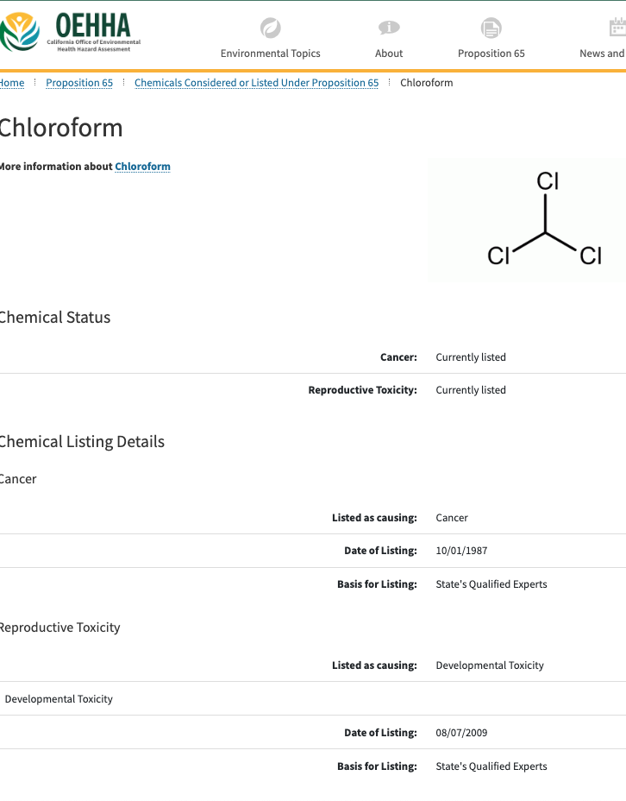
Prop 65 list
Requires California to publish a list of chemicals known to cause cancer, birth defects or other reproductive harm
  Updated yearly
  Includes over 900 chemicals
Includes naturally occurring and synthetic chemicals
  Additives or ingredients in pesticides, common household products, food, drugs, dyes, or solvents
Notes:
The Prop 65 list is another resources that provides carcinogen or chronic toxicity information for chemicals.
California is required to publish this list annually with chemicals known to cause cancer, birth defects, or other reproductive harms.
The list includes over 900 chemicals. While the EPA list only includes chemicals found in pesticides, the Prop 65 list includes pesticides, as well as additives or ingredients, common household products, foods, drugs, dyes, and solvents (even chemicals that are natural or organic!)

Slide 18
Reduce risks
Notes:
Now that we understand the risks associated with all chemicals, including pesticides and products that are natural or organic, let’s learn how we can reduce risks when using pesticides.

Slide 19
Routes of entry or exposure to chemicals
Notes:
We are exposed to many chemicals on a daily basis, either intentionally or not; in our environment, homes, workplaces
These are the 4 routes of entry for chemicals to enter the body
First is the skin via absorption, second is your mouth via ingestion, third is your lungs via inhalation (breathing) and fourth is your eyes.

Slide 20
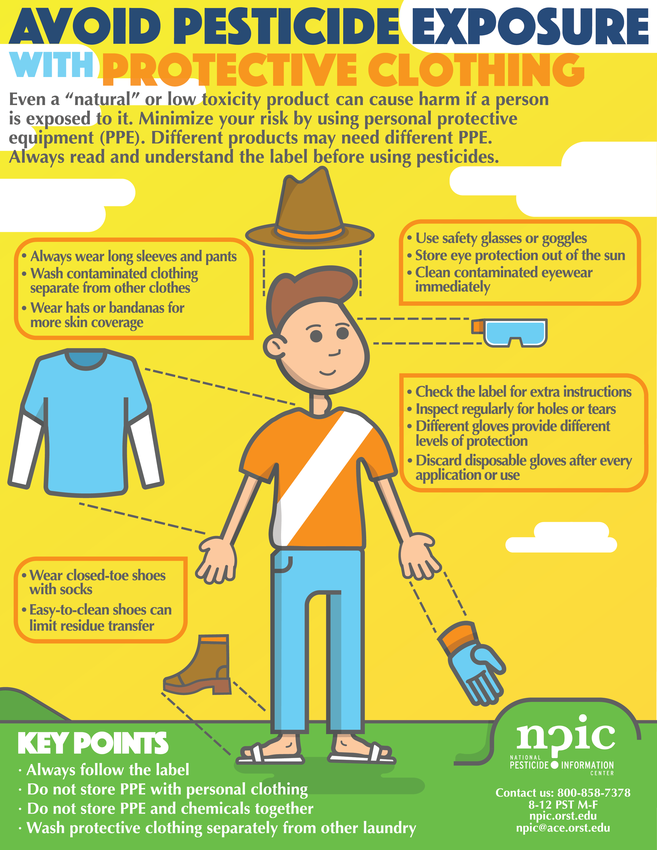
Minimize your exposure
Wear personal protective equipment (PPE)
  95% of all pesticide exposures come from dermal exposure, primarily to the hands and forearms
  Chemical-resistant gloves, long-sleeve shirts, long pants, eye protection, and closed toe shoes
Notes:
You can minimize your exposure to pesticides by protecting your routes of entry.
Wearing personal protective equipment (PPE) is a simple yet effective way to keep yourself safe.
Given that 95% of all pesticide exposure is on the skin, primarily the hands and forearms, just wearing chemical resistant gloves and a long sleeve shirt can do a lot to protect you!
At minimum, UC IPM recommends wearing chemical resistant gloves (nitrile), long sleeve shirts, long pants, eye protection, and closed toe shoes with socks.

Slide 21
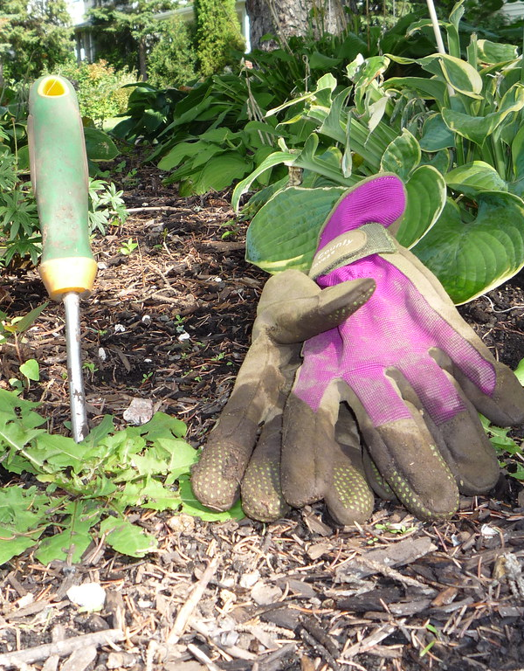
Minimize your risk & exposure
Avoid chemicals that are known or likely carcinogens
Manage pests using nonchemical methods when possible
  Biological
  Cultural
  Physical/mechanical
This Photo by Unknown Author is licensed under CC BY-SA-NC
Notes:
You can also minimize your exposure and reduce risks by avoiding chemicals that are known or likely carcinogens. Refer to the US EPA list or the Prop 65 list to choose pesticides that are not know to cause cancer.
Use IPM to manage pests without the use of chemicals. IPM offers a variety of nonchemical management options, including biological control (i.e., relying on natural enemies like lady bugs), cultural controls (i.e., improving the growing environment to favor plant success, such as proper irrigation or sunlight), and physical or mechanical controls (i.e., mowing weeds or hand removing insect pests).

Slide 22
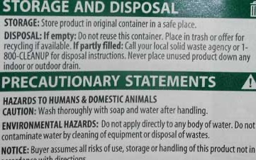

Store chemicals properly
Minimize risks to yourself, family, and environment
Follow label specific instructions
  Locked cabinet
  In original container with label
  Sealed or closed
Notes:
Lastly, you can minimize risks of accidental exposure by storing pesticide properly.
Pesticides should be stored in a locked cabinet or other secure location out of reach of children or pets.
Always keep pesticides in their original container with the product label. Do not store pesticides in plastic spray bottles or any other container, aside from it’s original packaging.
Always make sure the pesticide container is sealed or closed completely to avoid spilling it on yourself or the storage area.

Slide 23
Where to find toxicity information?
Notes:
Where can you find toxicity information for a pesticide?

Slide 24
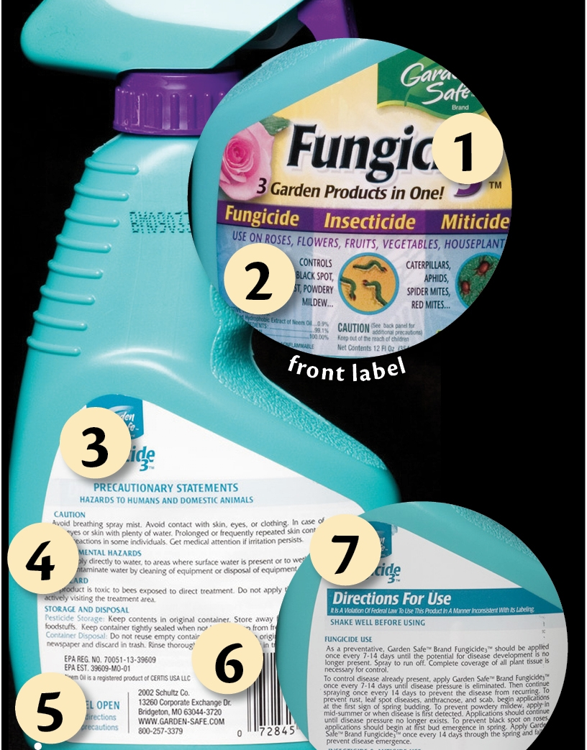
Pesticide product label
The label is the law!
Read, understand, and follow to protect yourself and the environment
Look for:
  Active ingredients
  Signal word
  Directions for use
  Precautionary statements
  Environmental hazards
Notes:
The product label is usually the first place you want to look to learn about the toxicity of the product and how you can apply it safely.
The pesticide label is the law, so you must read, understand, and follow it before using the pesticide. Doing so can help protect you, others around you, and the environment.
Safety or toxicity information can be found in the following sections on the pesticide label.

Slide 25
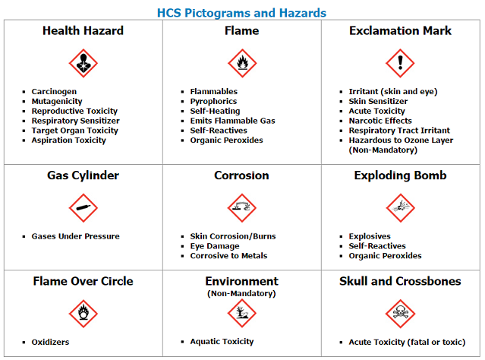
SDS
Safety data sheets (SDS) include information such as:
  Chemical properties
  Physical, health, and environmental health hazards
  Protective measures
  Safety precautions for handling, storing, and transporting the chemical
Notes:
An SDS is required to include specific information about a chemical product, as determined by OSHA.
The SDS is not intended for use by the general consumer but are still be useful in understanding the hazards a pesticide may pose
Employers are required to provide SDSs so employees have the information they need to know about the hazards of materials they handle on the job.
HCS: Hazard Communication Standards from OSHA

Slide 26
Choosing Less Toxic Pesticides
(No endorsements of named products are intended, nor is criticism implied of products not mentioned. Products shown are for demonstration purposes only.)
Notes:
Now, let’s discuss how you can choose less toxic, or safer, pesticides.
I want to mention that we will be showing example pesticide products in the following slides.
No endorsements of named products are intended, nor is criticism implied of products not mentioned. The products shown are for demonstration purposes only and are not meant as suggestions.

Slide 27
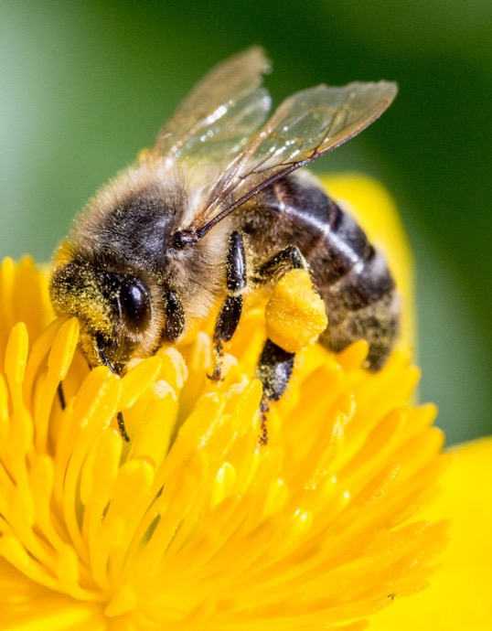
What are less toxic pesticides?
Products that pose fewer risks to humans and the environment
Preferred in IPM
Notes:
Less toxic pesticides are products that pose fewer risks to humans and the environment.
These products are often used and preferred when managing pests using IPM.
We refer to these products as less toxic instead of “safer” or “safe” because, like all chemicals, they can still cause harm in certain situations.

Slide 28
Choosing less toxic pesticides
Look for signal word CAUTION or none
What do the precautionary statements say?
  Toxic if inhaled; toxic if on skin?
What do the environmental hazards say?
  Toxic to bees; toxic to fish?
How long after applying can you harvest or consume the crop?
  Immediately, 24 hours, 3 days, 2 weeks?
Notes:
When we are trying to choose less toxic pesticides, we want to look on the product label for the following items:
The signal word. A less toxic pesticide would have the signal word CAUTION, or none at all (since it poses such a low toxicity) indicating low acute toxicity to people
Precautionary statements. This is where the manufacturer will includes information regarding the toxicity, irritation and sensitization hazards associated with the use of a pesticide, as well as treatment instructions and information to reduce exposure potential (i.e., PPE requirements). For example, does the label say the product is toxic if inhaled or on skin?
Environmental hazards. Tells you about potential adverse effects on wildlife and/or the environment, which might result from the use of the product. For example, is it toxic to bees or fish?
Directions for use. This section will tell you how long after application you can reenter the treated area or consume the crop you just treated. This is important to pay attention to as it varies from pesticide to pesticide and can also differ from crop to crop. For example, some pesticides you may be able to apply up to the day of harvest, while others you may have to wait 24 hours, 3 days, or 2 weeks!

Slide 29
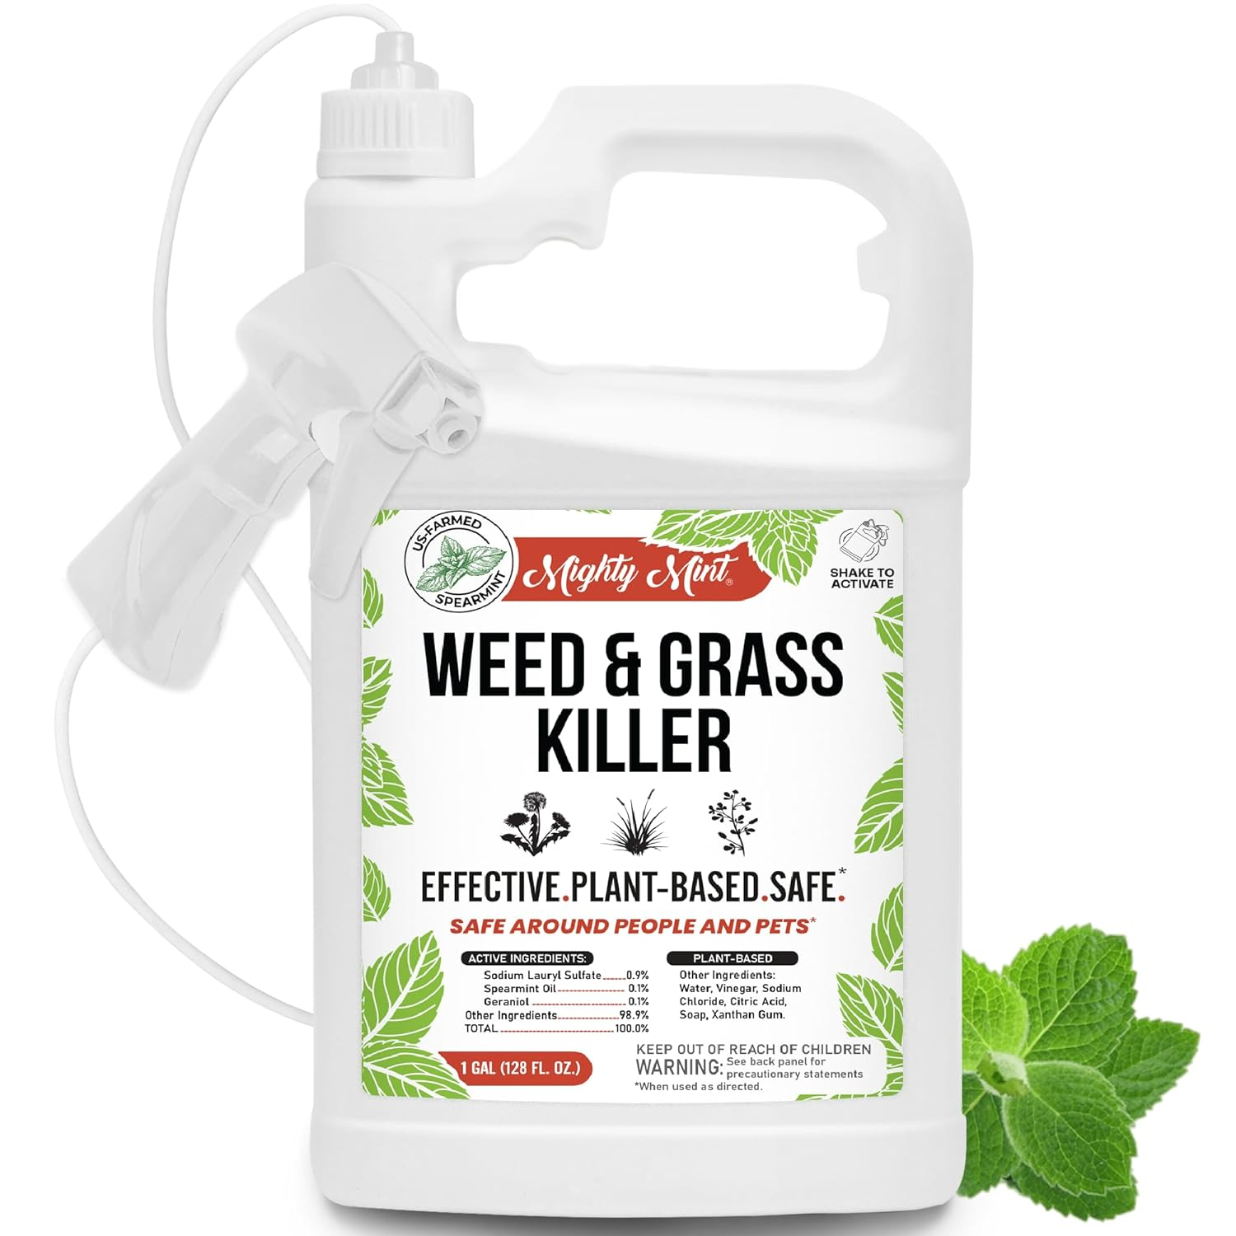


















How can you tell something is less toxic?
Don’t let buzzwords and marketing fool you!
  “Eco-friendly” “All natural” “Pet safe”
  Green product bottles or design
Notes:
When you are trying to determine if a product is less toxic, check for the items mentioned on the last slide.
Don’t judge a book by it’s cover! Read the label!
Don’t let good marketing and buzzwords like “eco-friendly”, “natural” or “pet safe” convince you something is safe.
For example, this product looks eco-friendly and safe, right? It says safe twice on the label! But what is the signal word? WARNING! So, it is moderately toxic to people!

Slide 30
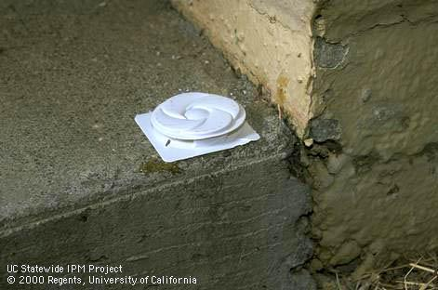
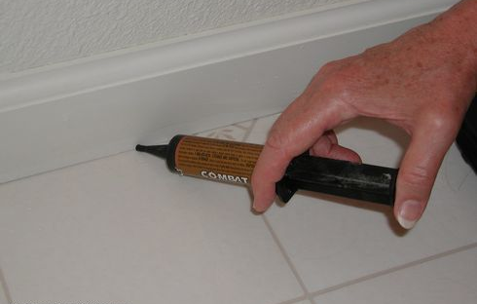
Pesticide formulation
Can reduce exposure and risks to people, nontarget organisms, and environment
Highly toxic active ingredients formulated in a bait station can be a less toxic pesticide
Notes:
Certain active ingredients can be made safer by packaging them in ways that reduces exposure or risks to people and the environment.
Bait stations contain the active ingredient in a tamperproof package that reduces risks to the environment (runoff, nontarget animals) and children or pets.
For example, the active ingredient fipronil is used to control ants but is highly toxic to aquatic organism. Spraying a pesticide containing fipronil around the perimeter of your house to control ants can result in the product running off into waterways when it rains, or sprinklers in your yard move it away from the application site. To reduce the risks associated with fipronil, we can use a bait station (as pictured at the top) where the product is contained and not at risk of running off into waterways where it will harm aquatic organisms.

Slide 31
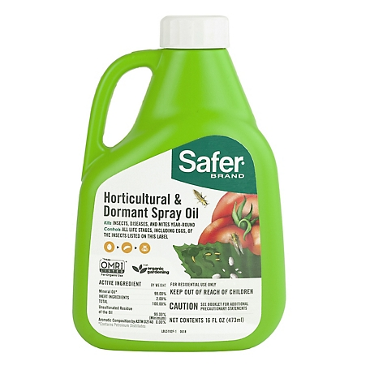
Less toxic pesticides
Soaps and oils
  Labeled for use as pesticides!
  Petroleum based oils or plant-based oils
Microbial products
  Bacillus thuringiensis var. kurstaki and aizawa– for caterpillars
  Bacillus thuringiensis var. israelensis – for mosquito, gnat, and fly larvae
  Spinosad – for caterpillars, thrips, leafrollers and leaf miners
Notes:
Some less toxic pesticides include soaps and oils; specifically, those that are labeled for use as pesticides, not homemade remedies using household oil or soap.
Pesticidal oils may be petroleum based like horticultural oils, or plant based like neem oil
Certain microbial pesticides can also be considered less toxic. These products are derived from microorganisms like bacteria, fungi, and viruses.
Bacillus thuringiensis (Bt) var. kurstaki and aizawa can be used for caterpillars while Bacillus thuringiensis var. israelensis is used for mosquitoes, gnat, and fly larvae
Bt products are also a good option because they are very selective, meaning they target a specific pest or group of pests. They won’t harm hundreds of other insects, just those few they are labeled for use on.
Spinosad can also be used for caterpillars, thrips, leafrollers, and leafminers. It is less selective than Bt.

Slide 32
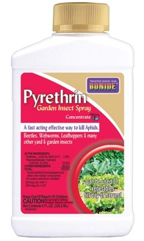
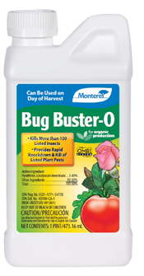
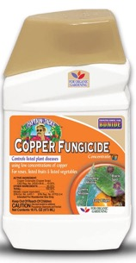
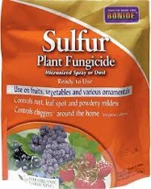
Other less toxic pesticides
Insecticides:
  Borate (Boric acid or borax)
  Pyrethrins – from chrysanthemum flowers
Fungicides:
  Copper formulations
  Sulfur
Notes:
Other less toxic pesticides you may choose to use include:
Borate, also know as boric acid or borax.
Pyrethrins which are derived from chrysanthemum flowers and break down quickly in the environment
Copper and sulfur formulations can also be as less toxic fungicides

Slide 33
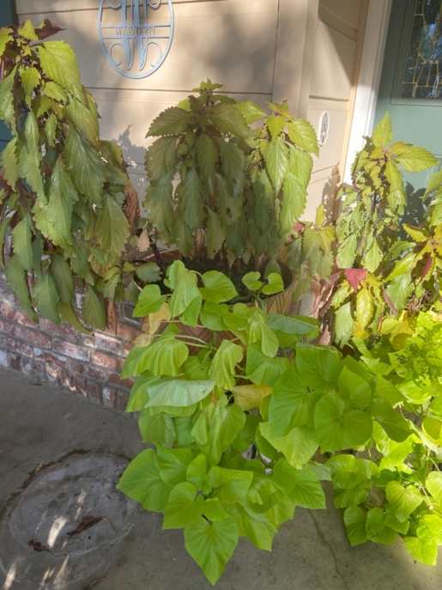
Homemade pesticides
Not tested for safety
No instructions for use
Can be harmful to people and plants
Notes:
Homemade pesticides cannot be considered less toxic or a safer alternative to traditional, store-bought pesticides.
They are not tested for human or environmental toxicity, they do not include detailed labels with precautions and instructions for use like conventional pesticides.
They can also unintentionally harm you or your plants.
Keep in mind, things like dish soap are specifically designed and tested for use in your kitchen, not the garden and contain many chemicals and additives that can be harmful to the soil and cause phytotoxicity to plants.

Slide 34

Take home message
“Safety” depends on toxicity and exposure
  Reducing your exposure reduces your risk
Treat all chemicals (even natural or organic) with caution
Be careful, but don’t freak out!
Notes:
Hopefully by now you see that safety depends on many factors, including the toxicity (how poisonous the product is) and exposure (or dose of the product).
All chemicals, even those that are organic or natural, or found in household products like soap, have the potential to be harmful to people and the environment.
You can reduce the risks chemicals including pesticides pose by following the product label, wearing proper PPE, and avoiding chemicals that are know to be toxic to people, water, pollinators, or natural enemies.

Slide 35
Disclaimers
No endorsements of named products are intended, nor is criticism implied of products not mentioned. Always read and carefully follow all precautions and safety instructions provided on the pesticide container label, as well as any other regulations regarding the use of pesticides. Not following label directions, even if they conflict with information provided herein, is a violation of state and federal law.
The views, thoughts, and opinions expressed are the speaker’s own and do not represent the views, thoughts, and opinions of the University of California. The material and information presented here is for general information purposes only. The "University of California" name and all forms and abbreviations are the property of its owner and its use does not imply endorsement of or opposition to any specific organization, product, or service.
It is the policy of the University of California (UC) and the UC Division of Agriculture & Natural Resources not to engage in discrimination against or harassment of any person in any of its programs or activities.
Inquiries regarding nondiscrimination policies may be directed to UC ANR, Affirmative Action Compliance & Title IX Officer, University of California, Agriculture and Natural Resources, 2801 Second Street, Davis, CA 95618, (530) 750-1343.

Slide 36
Resources
Notes:
Here are some resources you can go to to learn more about pesticides, their safety, and alternatives.

Slide 37
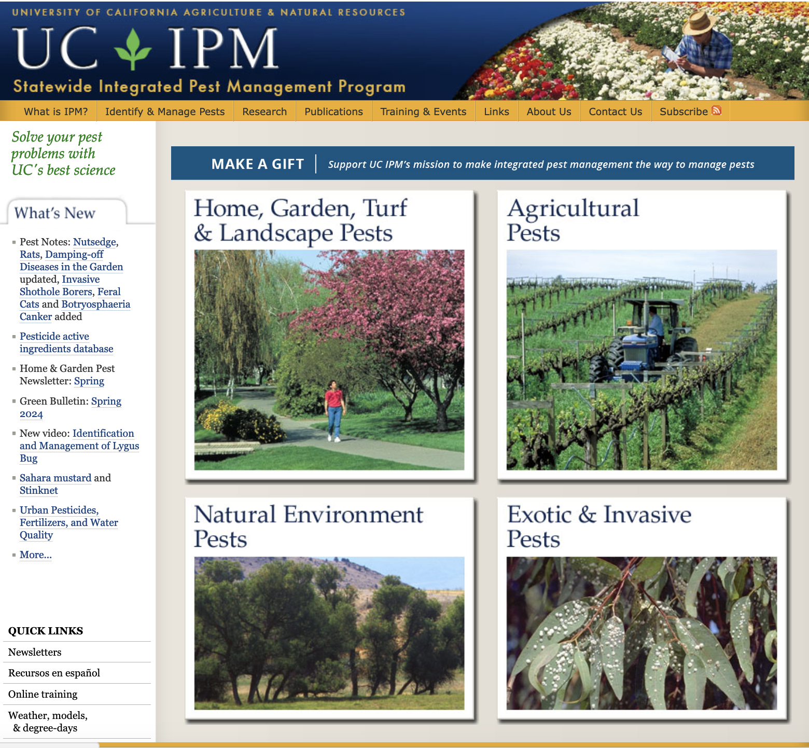
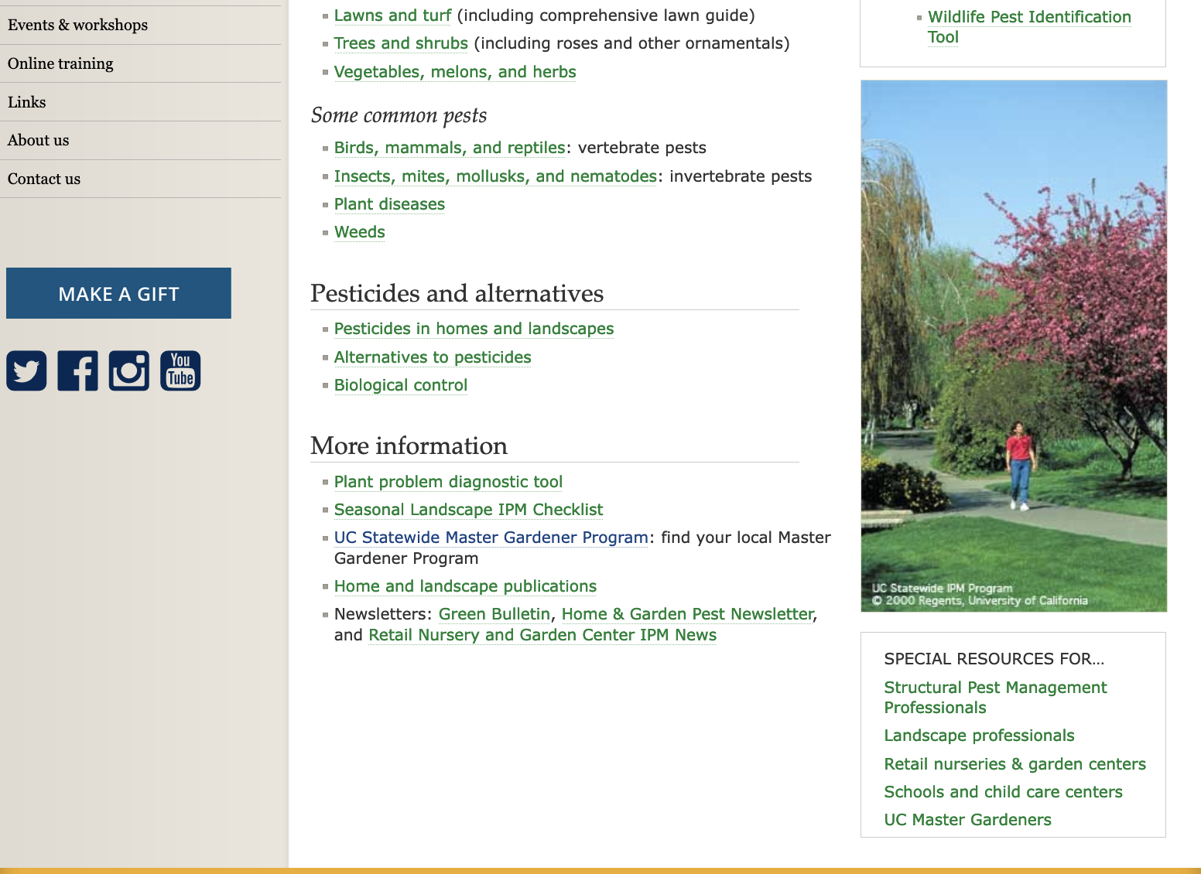
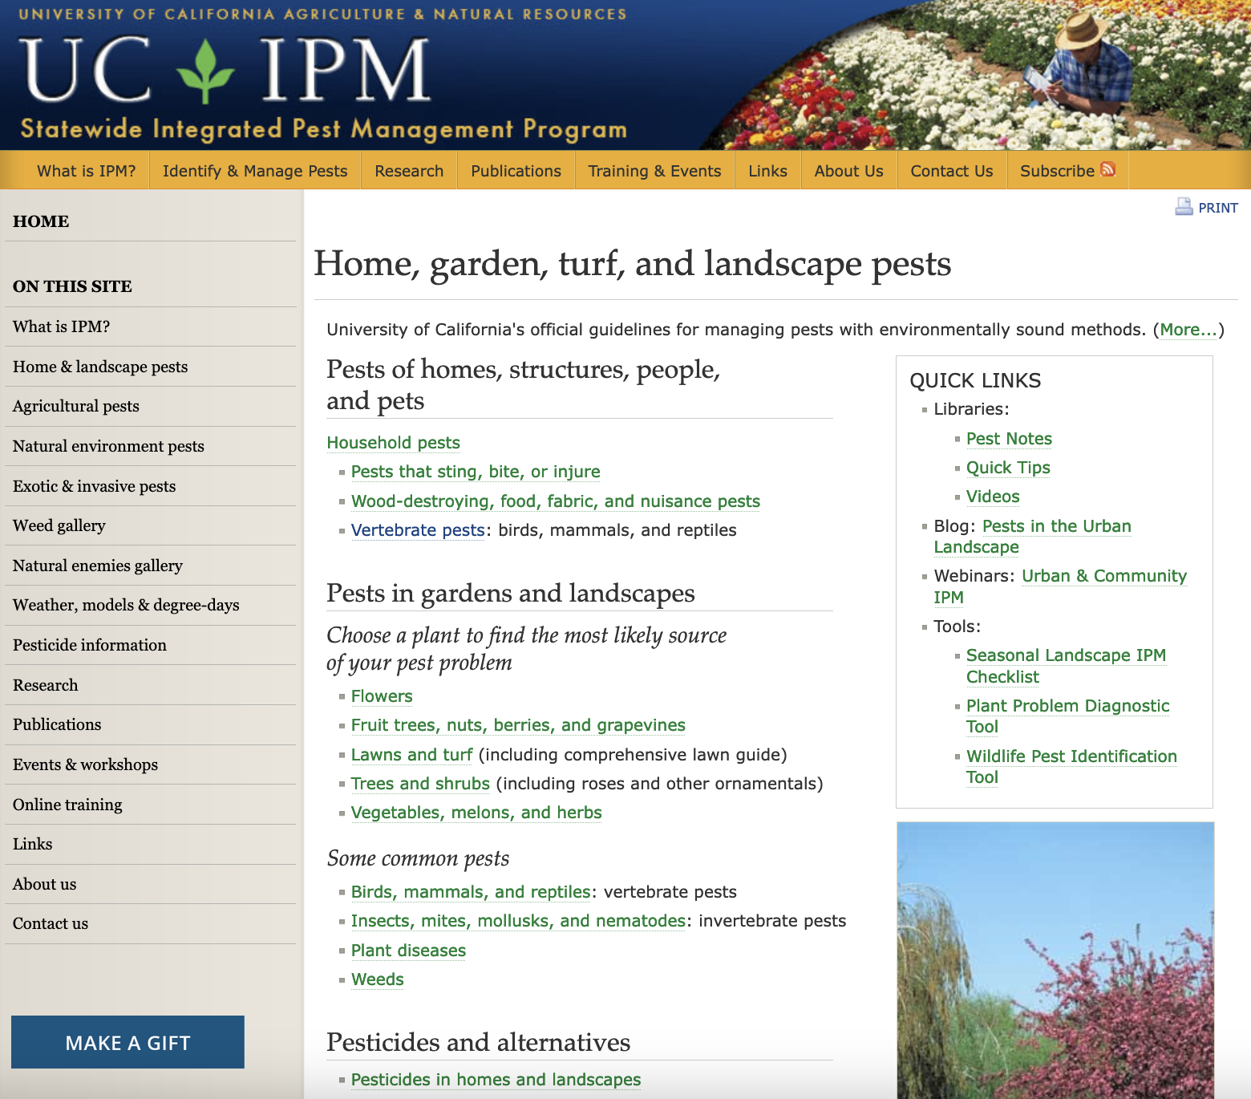
Notes:
To learn more about pesticide safety and alternatives to pesticides when managing pests, visit the UC IPM website at ipm.ucanr.edu
From the UC IPM home page, click on the top left square that says “Home, garden, turf, and landscape pests”
You will then get to them home and landscape main page where you can find numerous resources for managing pests in and around your home
If you scroll down on this webpage you will get to a section titled “Pesticides and alternatives” where you can learn about pesticides and pesticide safety, and also biological control (using natural enemies) and other nonchemical alternatives to manage pests

Slide 38
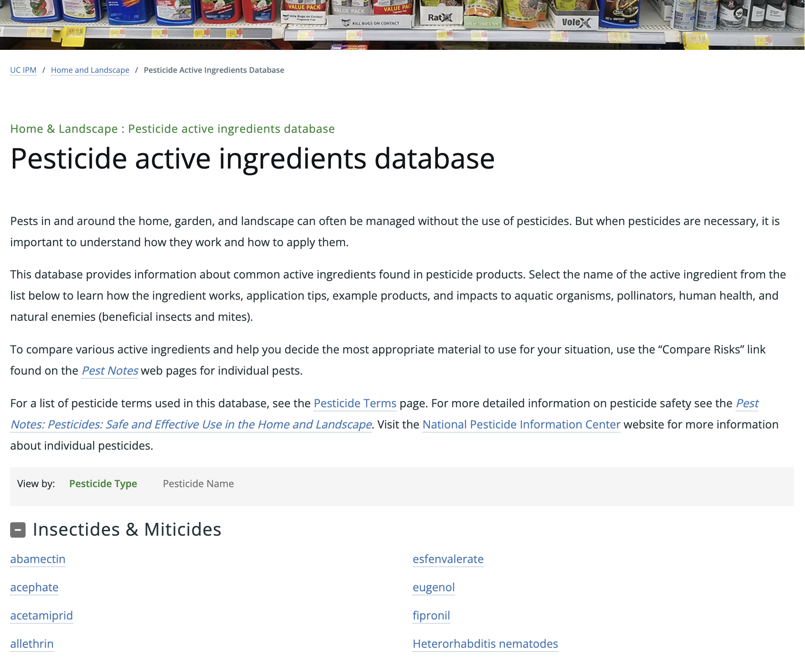
Pesticide Active Ingredient Database
Notes:
The UC IPM Active Ingredient Database is a great resource for learning more about common ingredients in pesticides

Slide 39
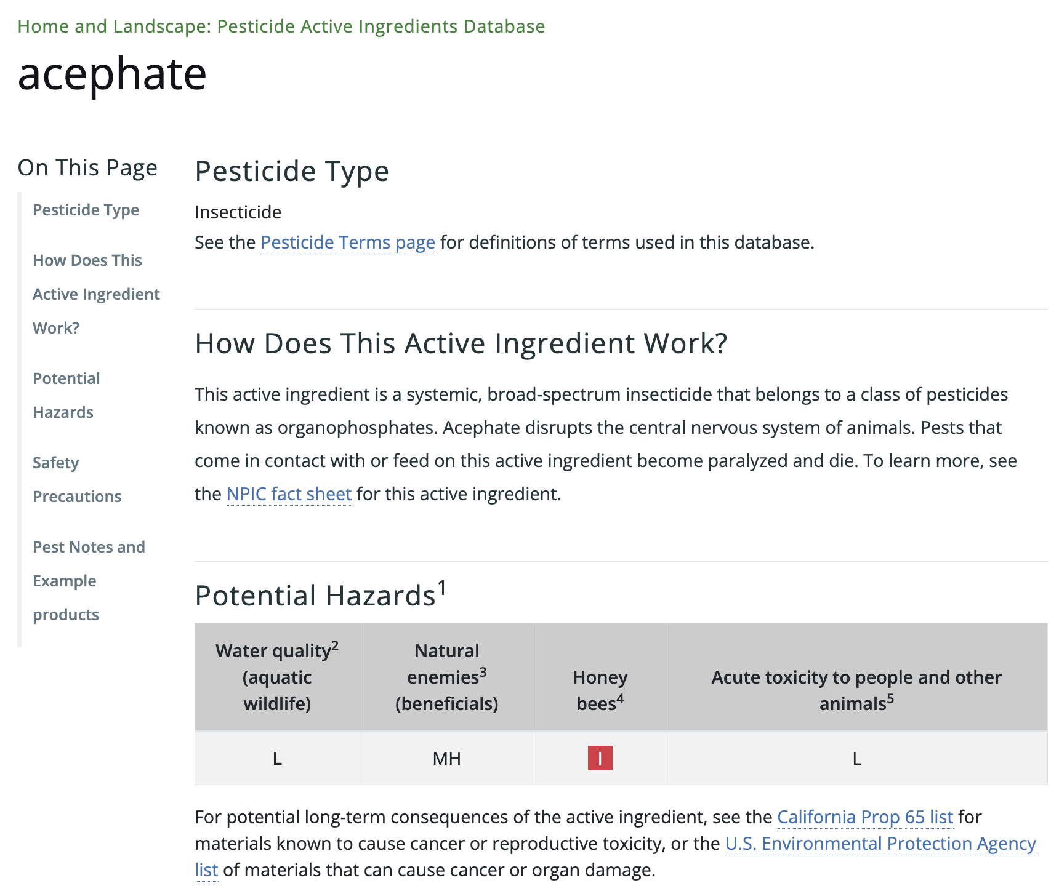
Pesticide Active Ingredient Database
  Details about the pesticide active ingredient
  Toxicity information for commonly available pesticide ingredients
Notes:
The UC IPM Active Ingredient Database provides information on how a pesticide active ingredient works and potentials hazards it poses to water quality, natural enemies, honey bees, and people and other mammals.

Slide 40
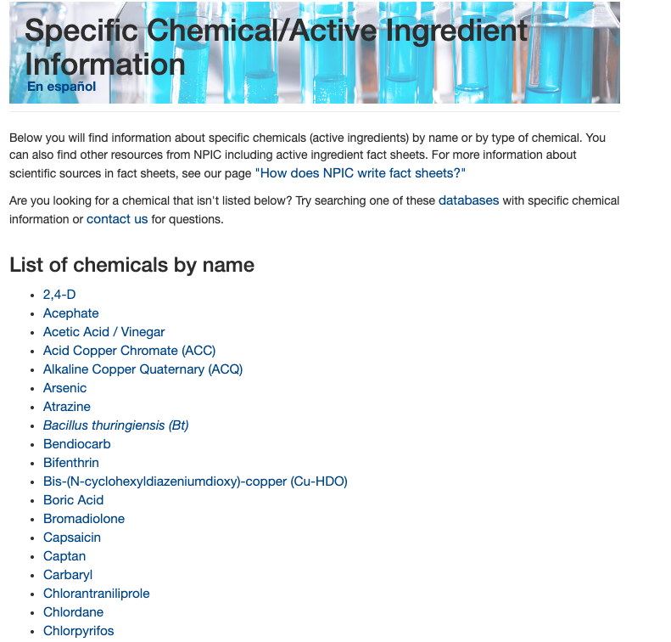
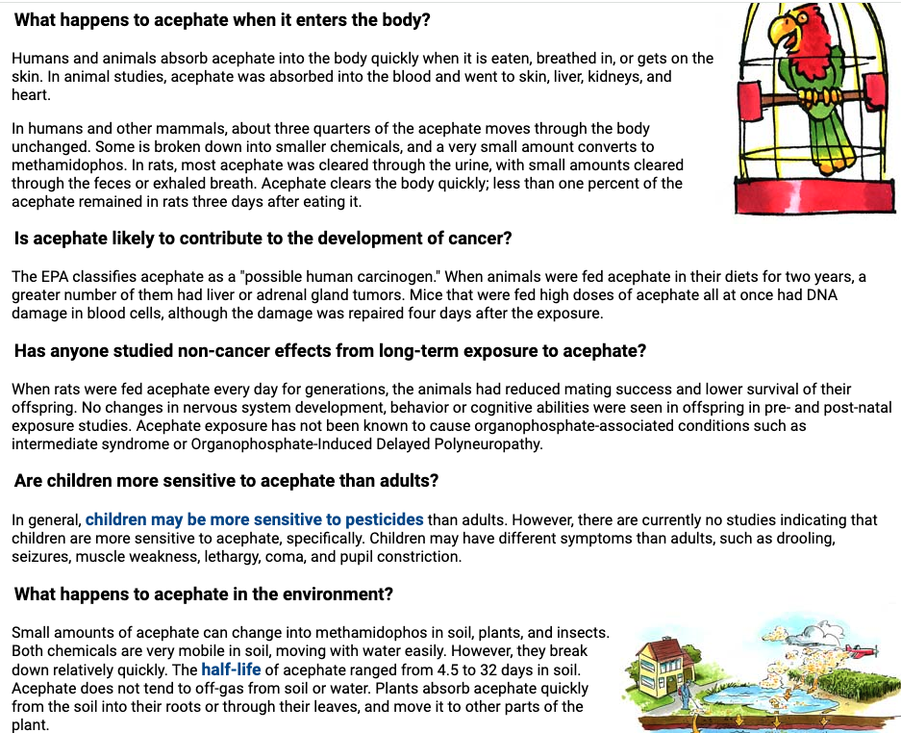
National Pesticide Information Center npic.orst.edu
  Free fact sheets with detailed information about many pesticide active ingredients
Notes:
You can also visit the National Pesticide Information Center’s website for more information about pesticides and how you can protect yourself, children, and the environment from them.
They offer detailed fact sheets about many pesticide active ingredients.

Slide 41
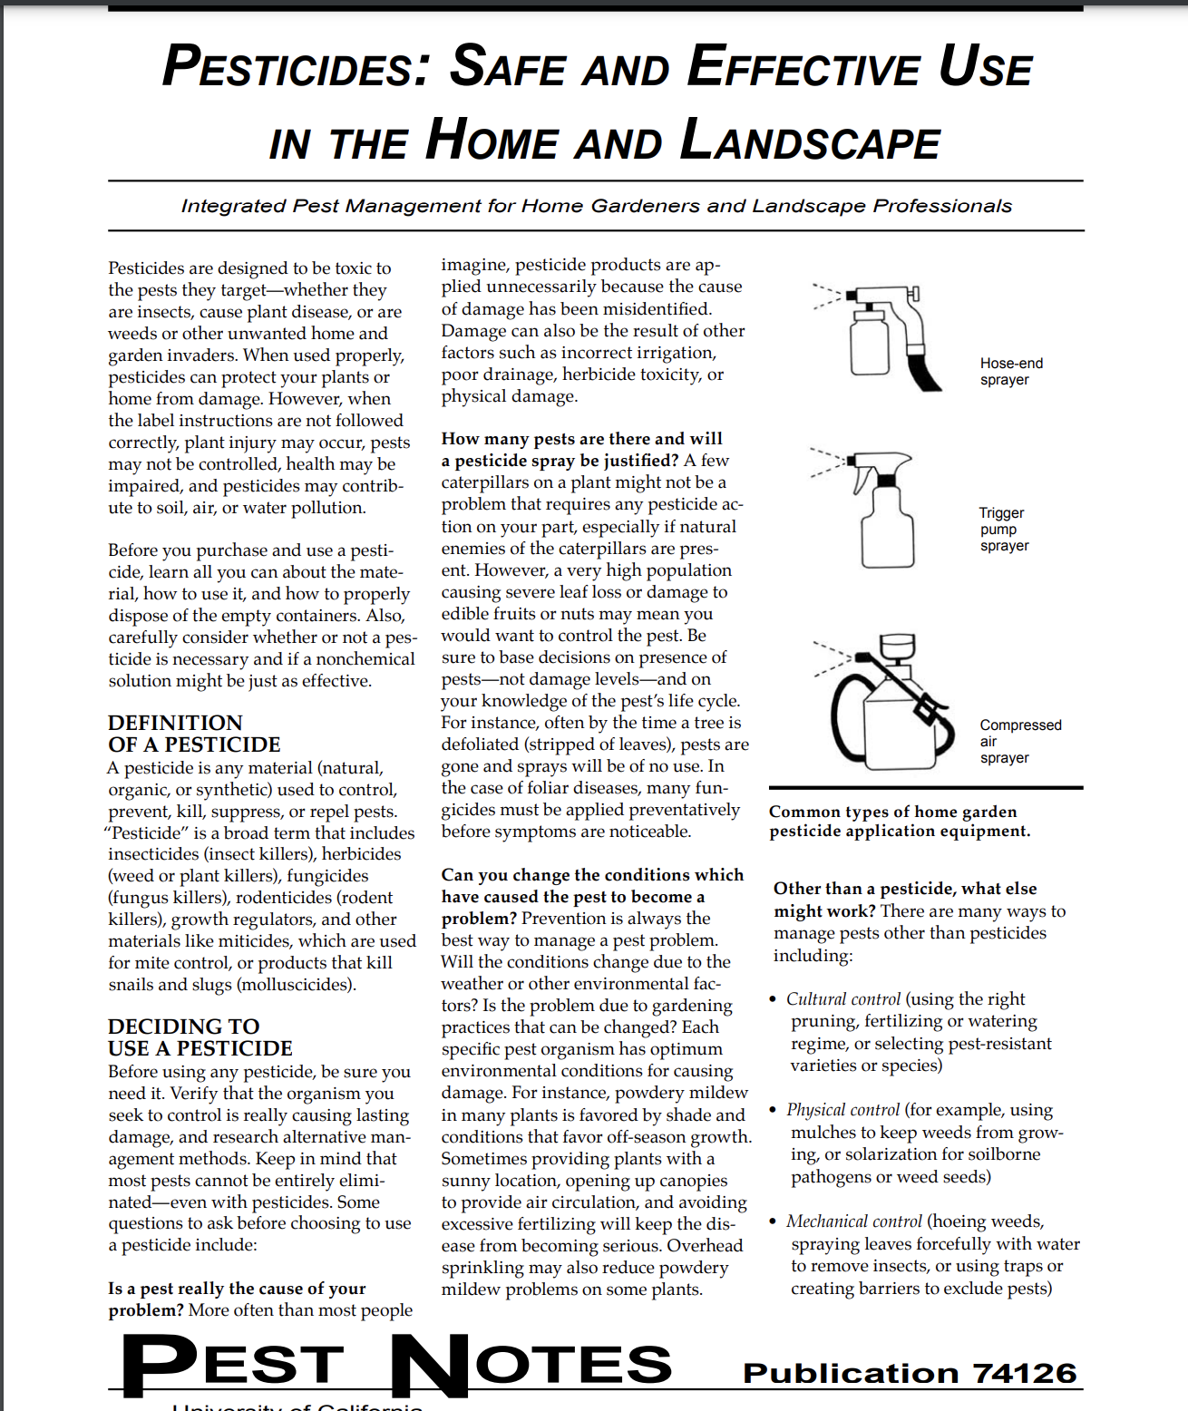
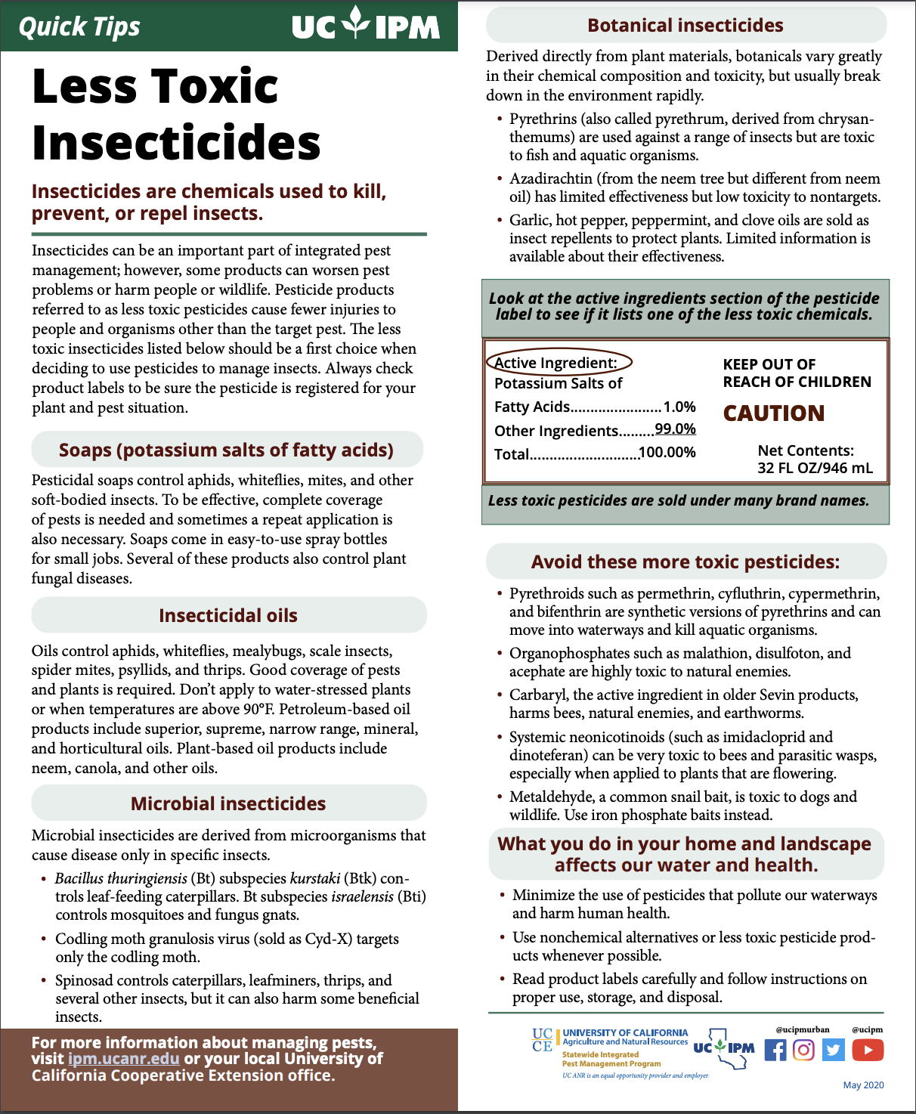
Pest Notes & Quick Tips
Notes:
UC IPM also offers Pest Notes factsheets on safe and effective use of pesticides and Quick Tips cards on less toxic pesticides.

Slide 42
Thank you!
[your contact information]
Notes:
Thank you for your attention! I can take any questions you may have.

