Slide 1
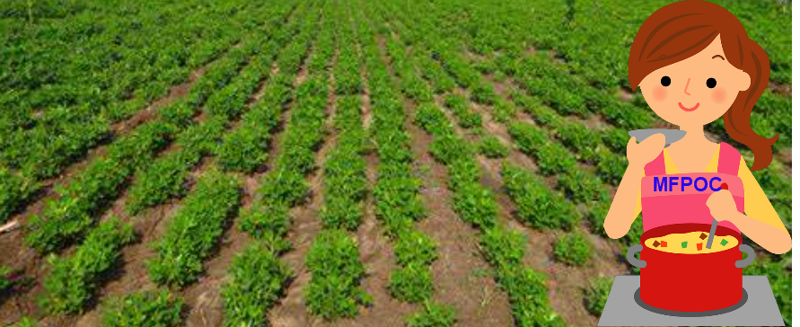
Orange County Great Park Farm + Food Lab Free Food Preservation Demonstration
The Master Food Preservers of Orange County Present:
Dehydration 101, Can I Dry That?
Orange County Great Park’s Food + Farm Lab
6990 Marine Way, Irvine, CA 92618
Saturday, December 7, 2024
10:00 AM - 11:00 AM
Come meet us in the garden at the Farm + Food Lab for a discussion of one of the easiest and versatile methods of preserving – Dehydration. Learn how to use kitchen items you already have and see what is available to up your drying game. Gain a few techniques to eliminate food waste and improve long term storage. Pick up tips on fruit, vegetable, and herb drying; plus, some surprising items you may not have considered. You will finally be able to answer the age-old question… Can I dry that?
Register at: Food + Farm Lab Event
It is the policy of the University of California (UC) and the UC Division of Agriculture & Natural Resources not to engage in discrimination against or harassment of any person in any of its programs or activities (Complete nondiscrimination policy statement can be found at http://ucanr.edu/sites/anrstaff/files/215244.pdf). Inquiries regarding ANR’s nondiscrimination policies may be directed to UCANR, Affirmative Action Compliance & Title IX Officer, University of California, Agriculture and Natural Resources, 2801 Second Street, Davis, CA 95618, (530) 750-1343.

