Slide 1
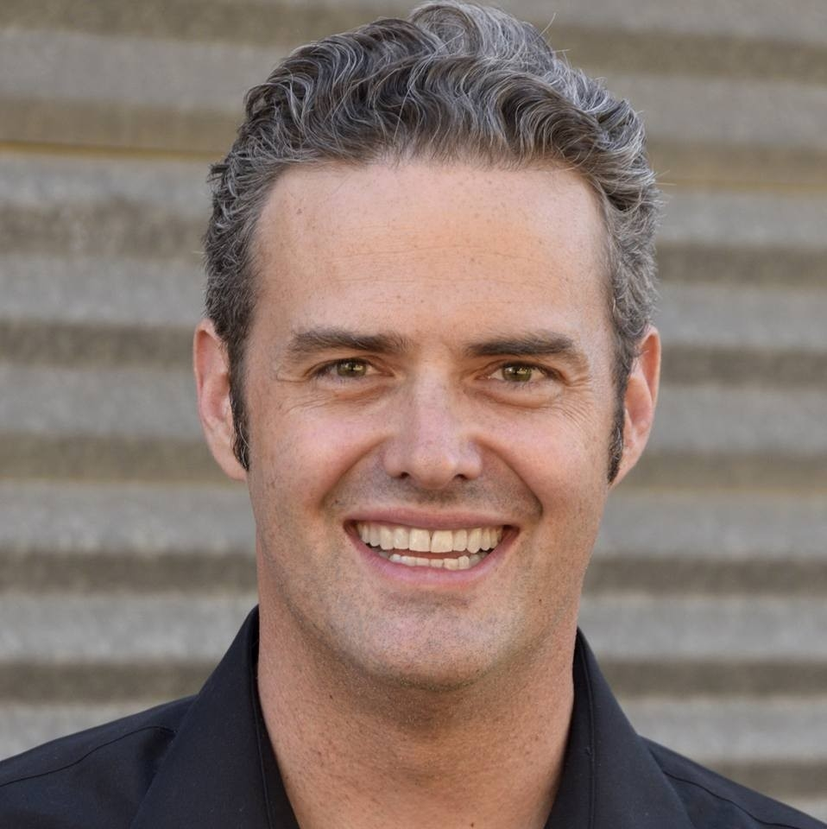
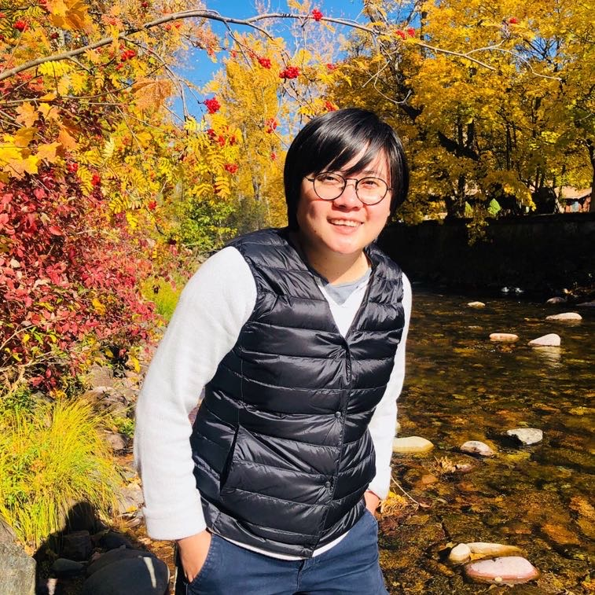
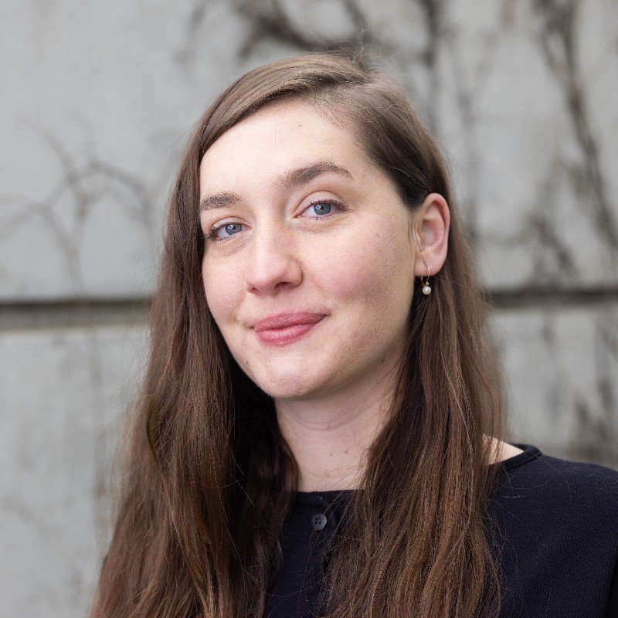
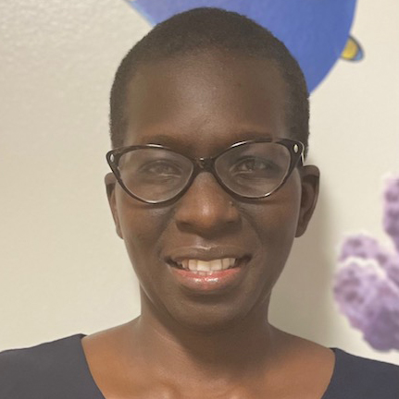
Recent Hires: Welcome to UC ANR
Norman Alberti UCCE SAN JOAQUIN COUNTY
Efrain Barrera UCCE FRESNO MADERA MCP
Shayna Blythe BUSINESS OPERATIONS CENTER
Sukhmony Amraj Kaur Brar UCCE FRESNO MADERA MCP
Julie Ann Brown UCCE MARIPOSA COUNTY
Kathleen Carter UCCE CENTRAL SIERRA NEVADA MCP
Cindy Xiaoning Chen UCCE CENTRAL SIERRA NEVADA MCP
Noah Alexander Cooke UCCE NEVADA_PLACER COUNTY
Cynthia A Crestmore BUSINESS OPERATIONS CENTER
Megan Cross NUTRITION,FAMILY&CONSUMER SCI
Stephen Dampier IT SERVICES
Alison Lee Deak UCCE MARIPOSA COUNTY
Jackson Manuel Dias UCCE FRESNO MADERA MCP
Jackson Manuel Dias UCCE FRESNO MADERA MCP
Regina Jasmine Dingler UCCE SONOMA COUNTY
Meaghan Donovan UCCE CAPITOL CORRIDOR MCP
Katherine Elise Fessler CALIFORNIA STATE 4-H OFFICE
Coral Franco UCCE FRESNO MADERA MCP
Brandon Frost UCCE SHASTA COUNTY
Marlen Gaspar UCCE RIVERSIDE COUNTY
Granville Goza UCCE SANTA CLARA COUNTY
Olivia Marie Quinlan Henry UCCE CAPITOL CORRIDOR MCP
Ashley Michelle Hooper UCCE LOS ANGELES COUNTY
Hanif Robert Houston UCCE ALAMEDA COUNTY
Ethan Ireland STRATEGIC COMMUNICATIONS
Sia'h Fanta Jimissa NUTRITION POLICY INSTITUTE
Amritpal Kaur UCCE KERN COUNTY
Tara Kelly UCCE SAN MATEO COUNTY
Citlali Lopez UCCE FRESNO MADERA MCP
Kathryn Elise Low UCCE NEVADA_PLACER COUNTY
Ethan Ireland
Cindy Chen
Olivia Henry
Jackie Atim

Slide 2
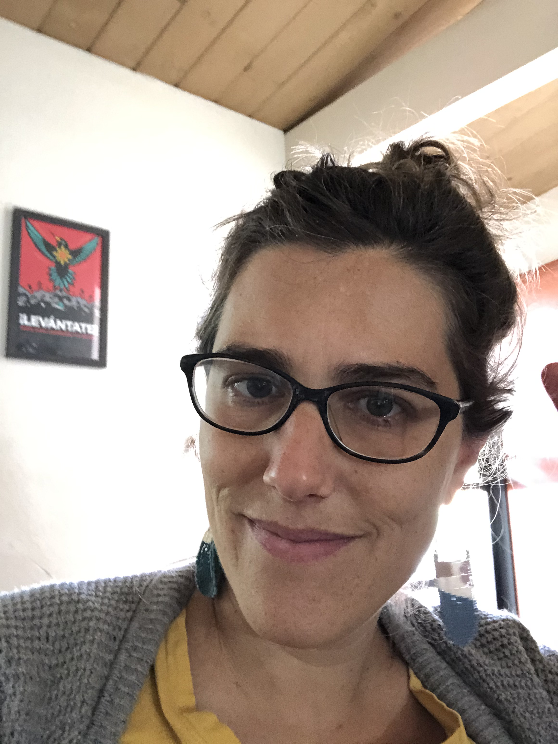
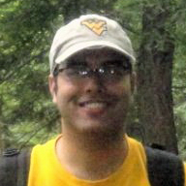
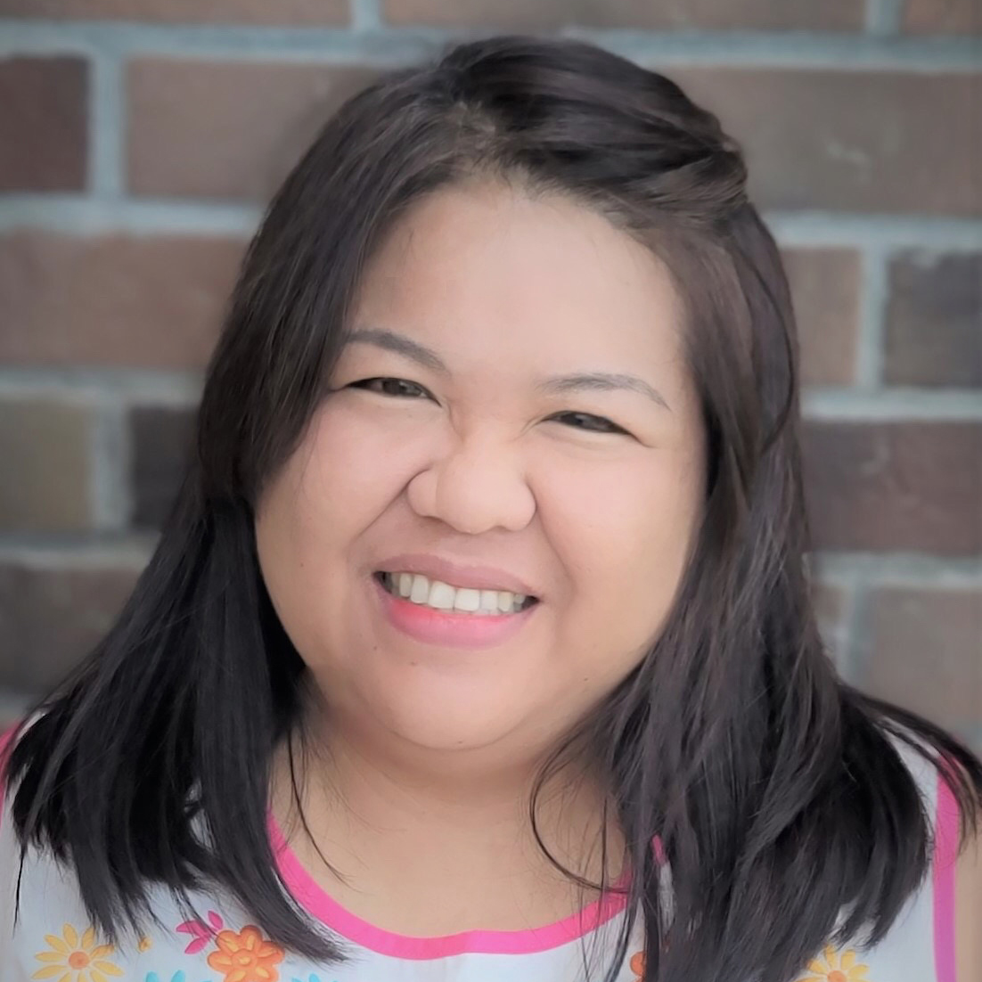
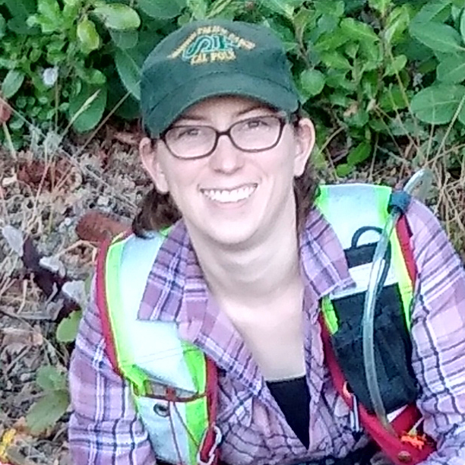
Recent Hires: Welcome to UC ANR
Lynnelle Madsen UCCE CENTRAL SIERRA NEVADA MCP
Michele Maia UCCE SAN MATEO COUNTY
Evelyn Mandujano UCCE CAPITOL CORRIDOR MCP
Robin Elizabeth Martin UCCE CENTRAL SIERRA NEVADA MCP
Maximus Mendez KEARNEY REC
Lizzeth Mendoza UCCE GLENN COUNTY
Ana Isabel Mora Camacho UCCE FRESNO MADERA MCP
Alfonso Mota UCCE CENTRAL SIERRA NEVADA MCP
Alyssabeth Navarro UCCE TULARE COUNTY
Sally E Neas UCCE SAN MATEO COUNTY
Tori Renae Norville UCCE SONOMA COUNTY
Daniel Obrist IMM OFFICE AVP
Jose Mauricio Paz Villegas UCCE FRESNO MADERA MCP
Cedric Renaudin NUTRITION,FAMILY&CONSUMER SCI
Cedric Tristan Renaudin NUTRITION,FAMILY&CONSUMER SCI
Todd Renstrom UCCE SAN DIEGO COUNTY
Ana Resendiz UCCE IMPERIAL COUNTY
Matthew Rene Rodriguez UCCE NEVADA_PLACER COUNTY
Braulio Rodriguez Villalobos UCCE FRESNO MADERA MCP
Julie Salomonson UCCE VENTURA COUNTY
Nichol Santisteven UCCE SANTA CLARA COUNTY
Arlene Wimer Silva UCCE IMPERIAL COUNTY
Yolanda Tabarez DESERT REC
Annalise M Traub UCCE CAPITOL CORRIDOR MCP
Daylin Wade UCCE CENTRAL SIERRA NEVADA MCP
Tyler Waltrip UCCE FRESNO MADERA MCP
Sierra Washington UCCE PLUMAS/SIERRA COUNTIES
Klacey Worthington UCCE GLEN COUNTY
Chun Fung Yu IT SERVICES
Sally Neas
Sudan Gyawaly
Irene Padasas
Tori Norville

