Slide 1
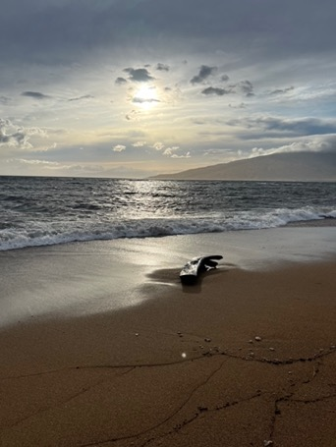
Town Hall
2-3 pm, Sept. 15, 2022
Chat warmup
Learning about each other
What was your favorite summer book or movie?
Agenda
Welcome
Leadership Update
Stories from the Field
Breakout session
Around UC ANR: Other updates
Close

Slide 2
Summary - this slide not shown
Welcome - Pam 2 minutes
Warm up question: What has been your favorite summer movie or book?
Leadership Update (10-15 minutes) (Glenda, Tu, Deanne) Transition
Story from the Field
Grafted watermelon - Zheng Wang 10-15 minutes
Personnel map demo by Han Pham (5 min)
Donor note (1 minute) (Pam c/- Scott Brayton)
Strategic focus (15 Minutes) Breakout session: What are you excited to work on this fall?
Other updates
L&D- Jodi (2 minutes)
Hispanic Heritage Month/Latinx & Friends Affinity Group - Ricardo (3 minutes)
ANR@Work survey – Tina Jordan (3 minutes)
New hire list (Pam 1 minute)
Close Glenda & Pam (1 minute)

Slide 3
Objectives: To inform and build unity
Why this meeting? It’s for all of us.
Comments…. Use “Chat”
“Panelists” or “Everyone”
Questions…. Use “Chat”
Recordings are posted after the meeting on the Town Hall page

Slide 4
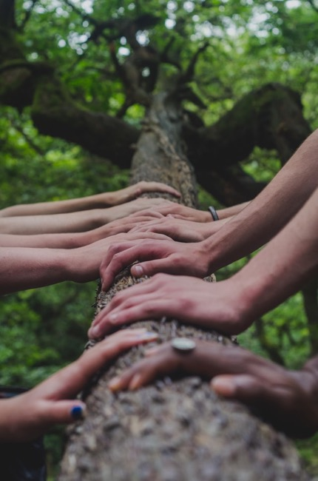
Our Principles of Community
Foster a sense of _________ and emotional safety
Photo by Mark Bell
Notes:
belonging

Slide 5
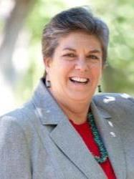
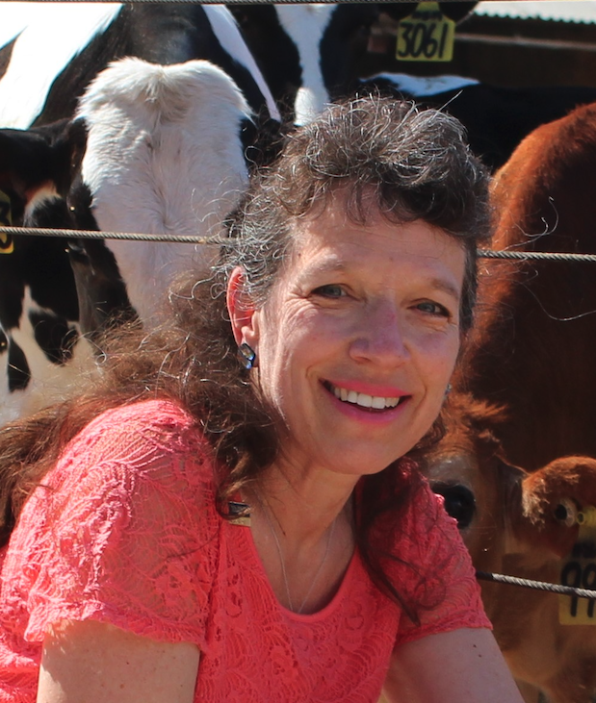
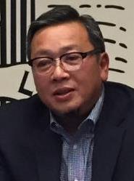
Leadership Update
Vision & News - (10-15 mins)
Notes:
Mark - we have 10-15 min

Slide 6
Leadership update
Glenda
$16 million for F3 Local Farm and Food Innovation
$185 million for UC climate initiatives
Tu
?

Slide 7
Stories from the field
Watermelon Grafting: The Art of Recombination Makes 1 + 1 > 2
UCANR Town Hall Meeting
Zheng Wang
Vegetable Crops and Irrigation Farm Advisor
September 15, 2022

Slide 8
In the next 10-12 mins: A Brief Story from the Field
Why watermelon grafting – Motivation
What did/are we do(ing) – Identify problems and REO
Current outcomes and impacts
Now and going forward……

Slide 9
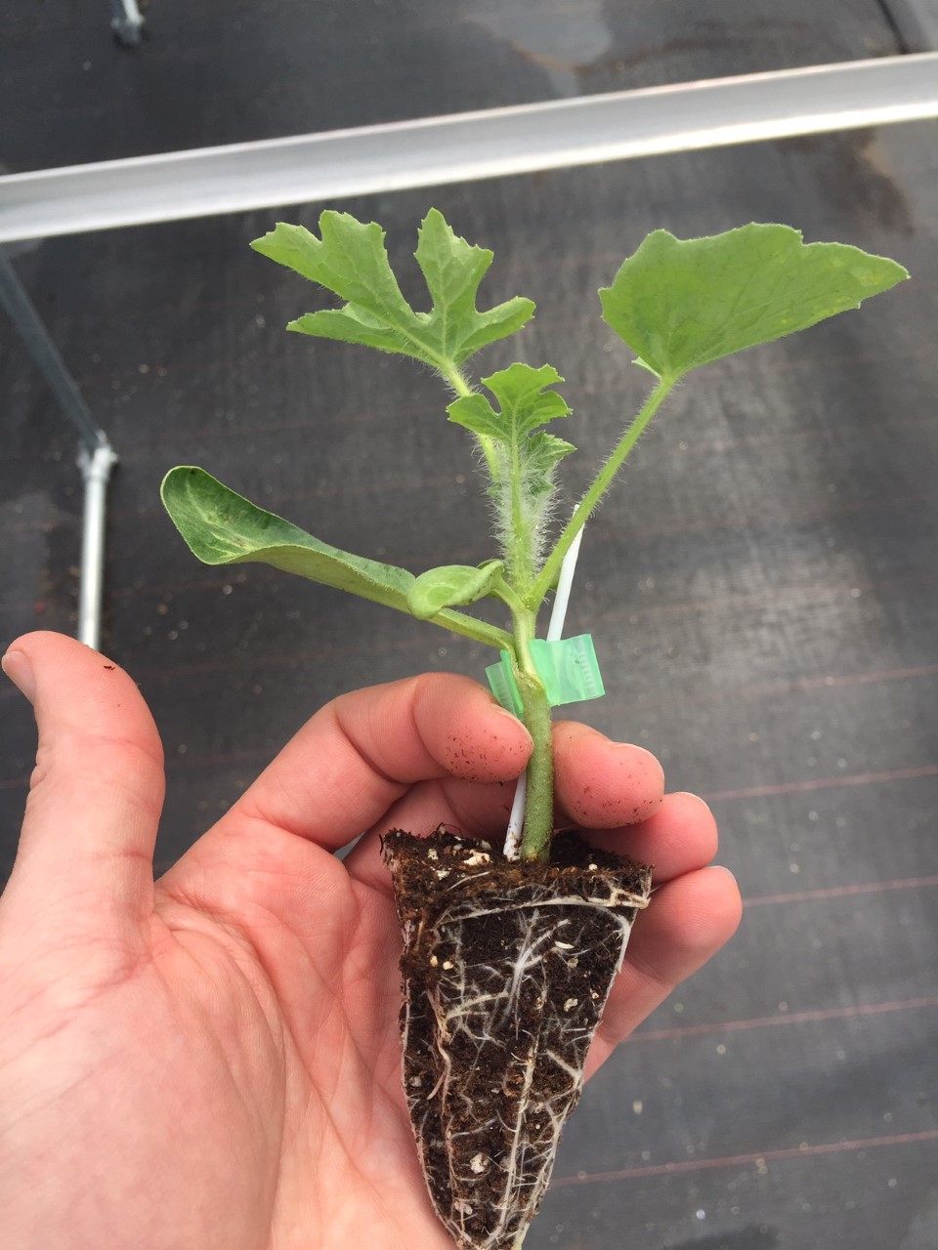
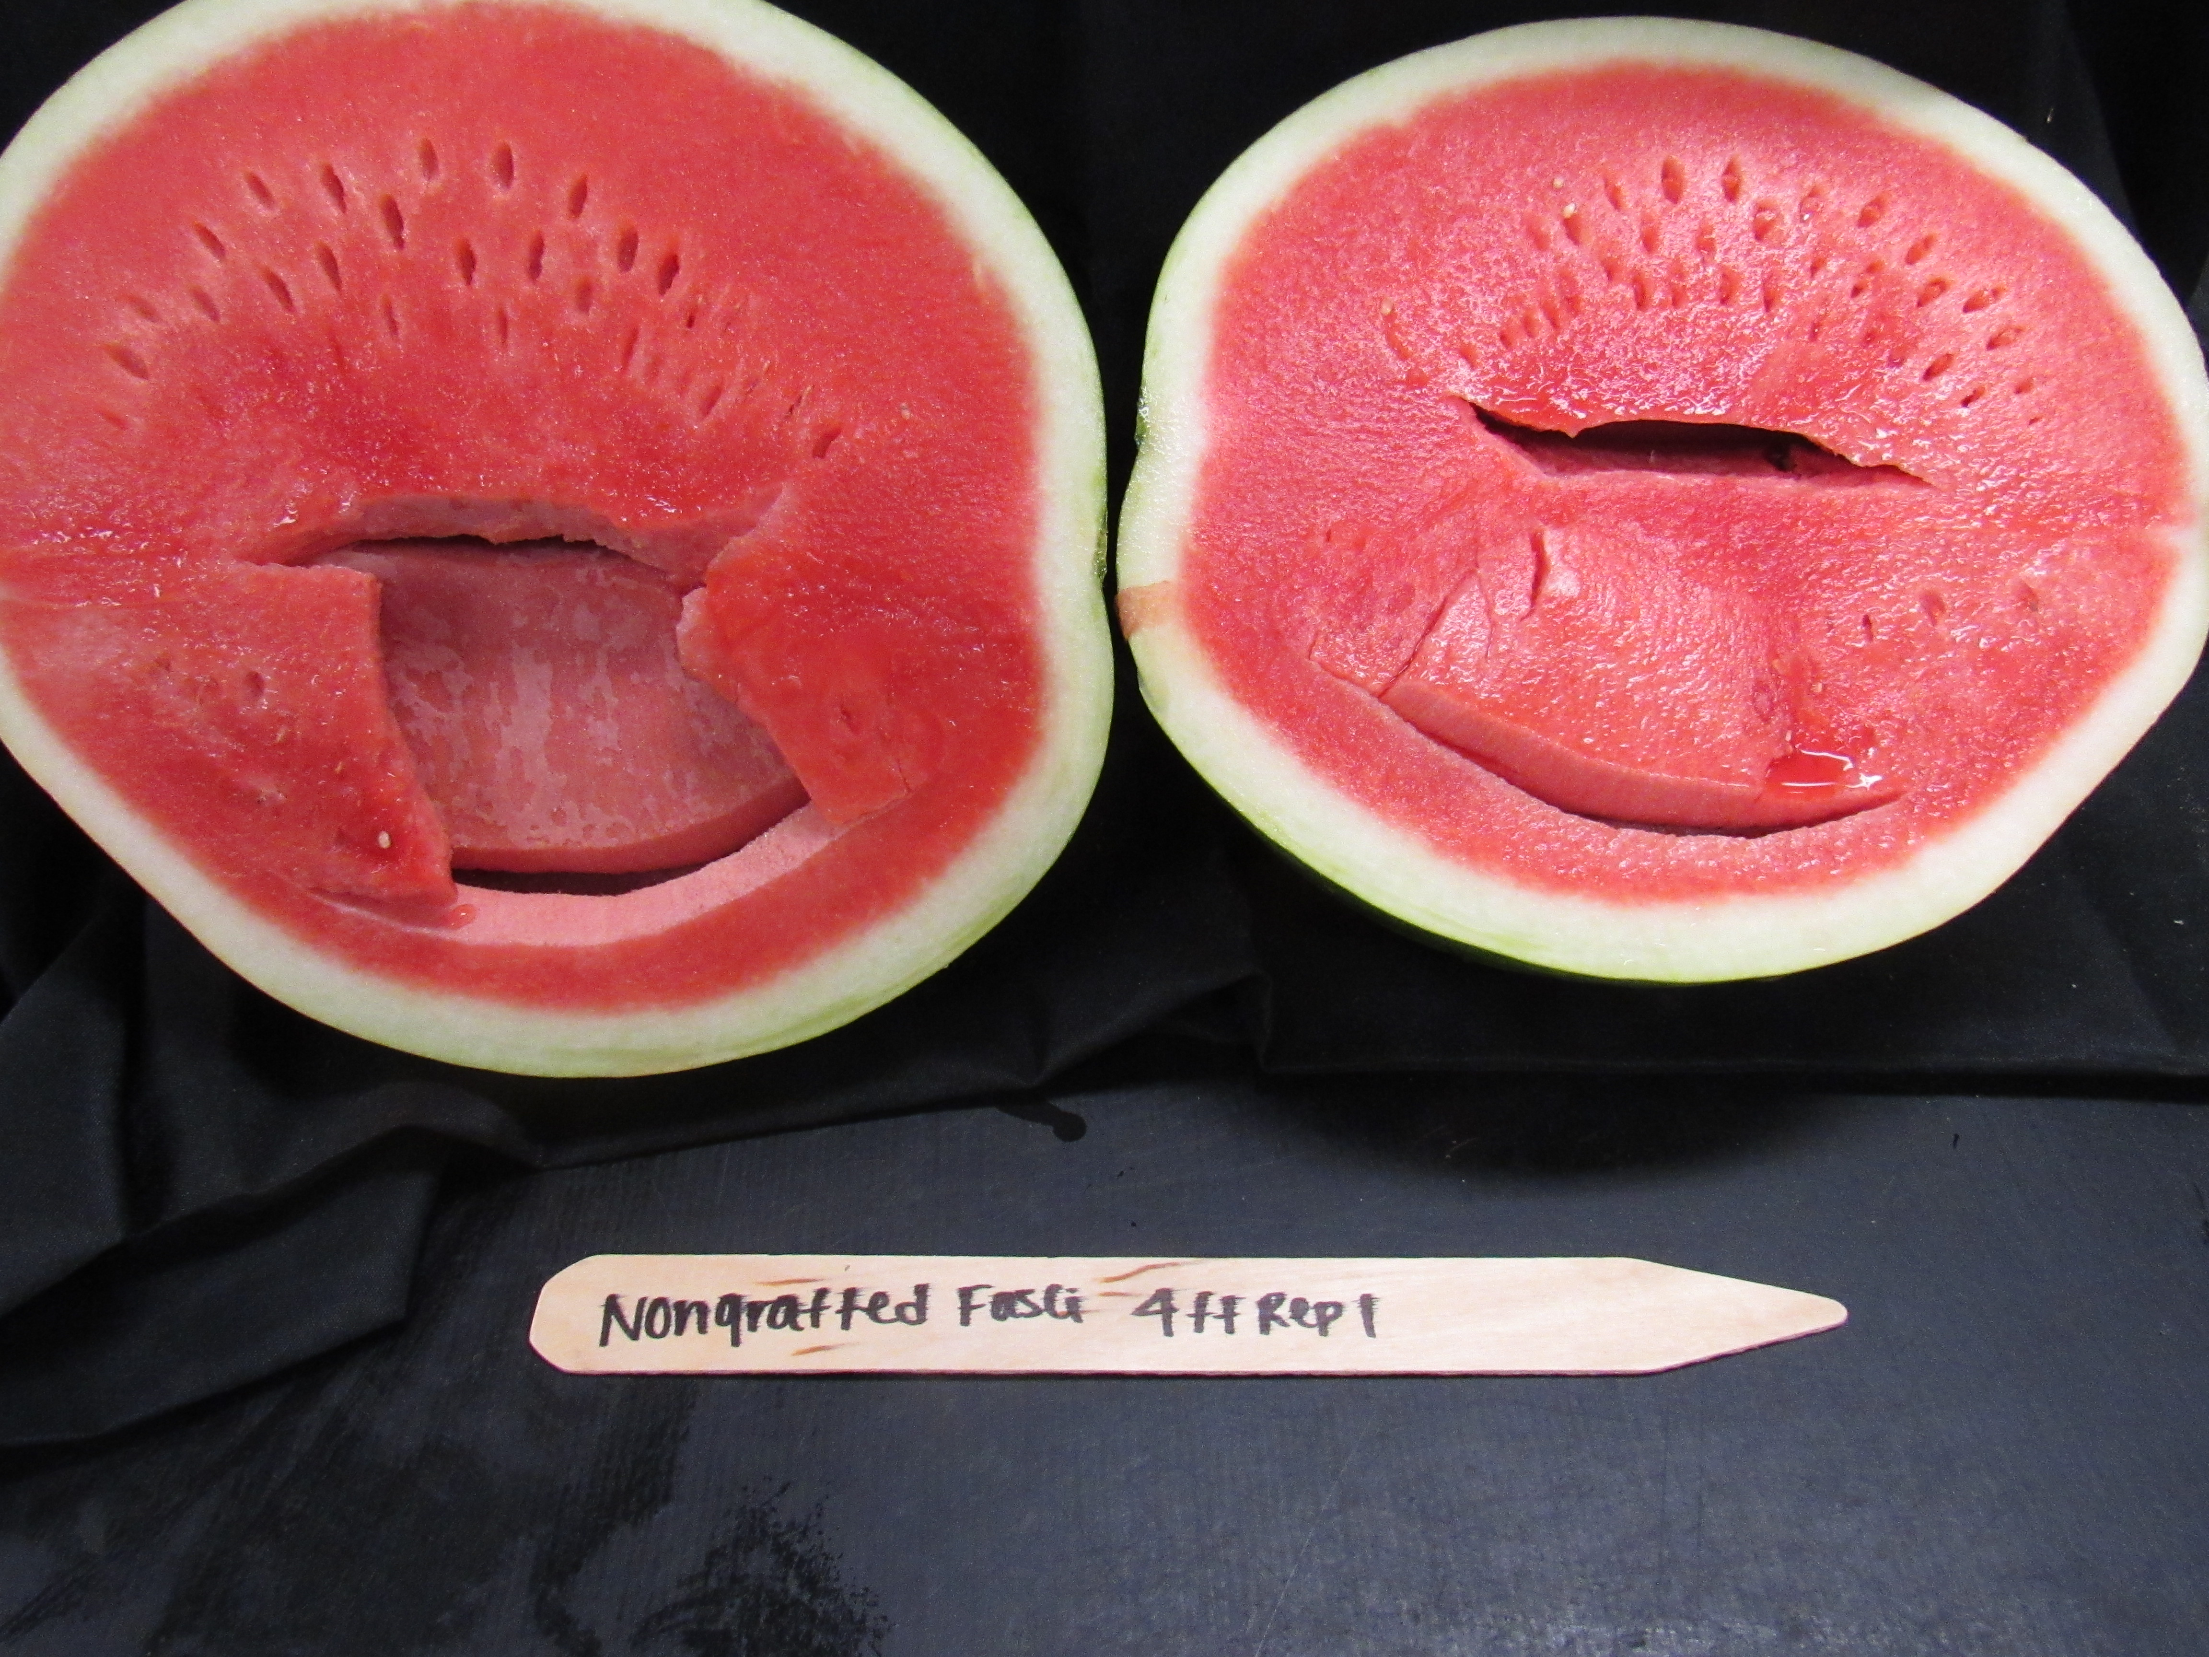
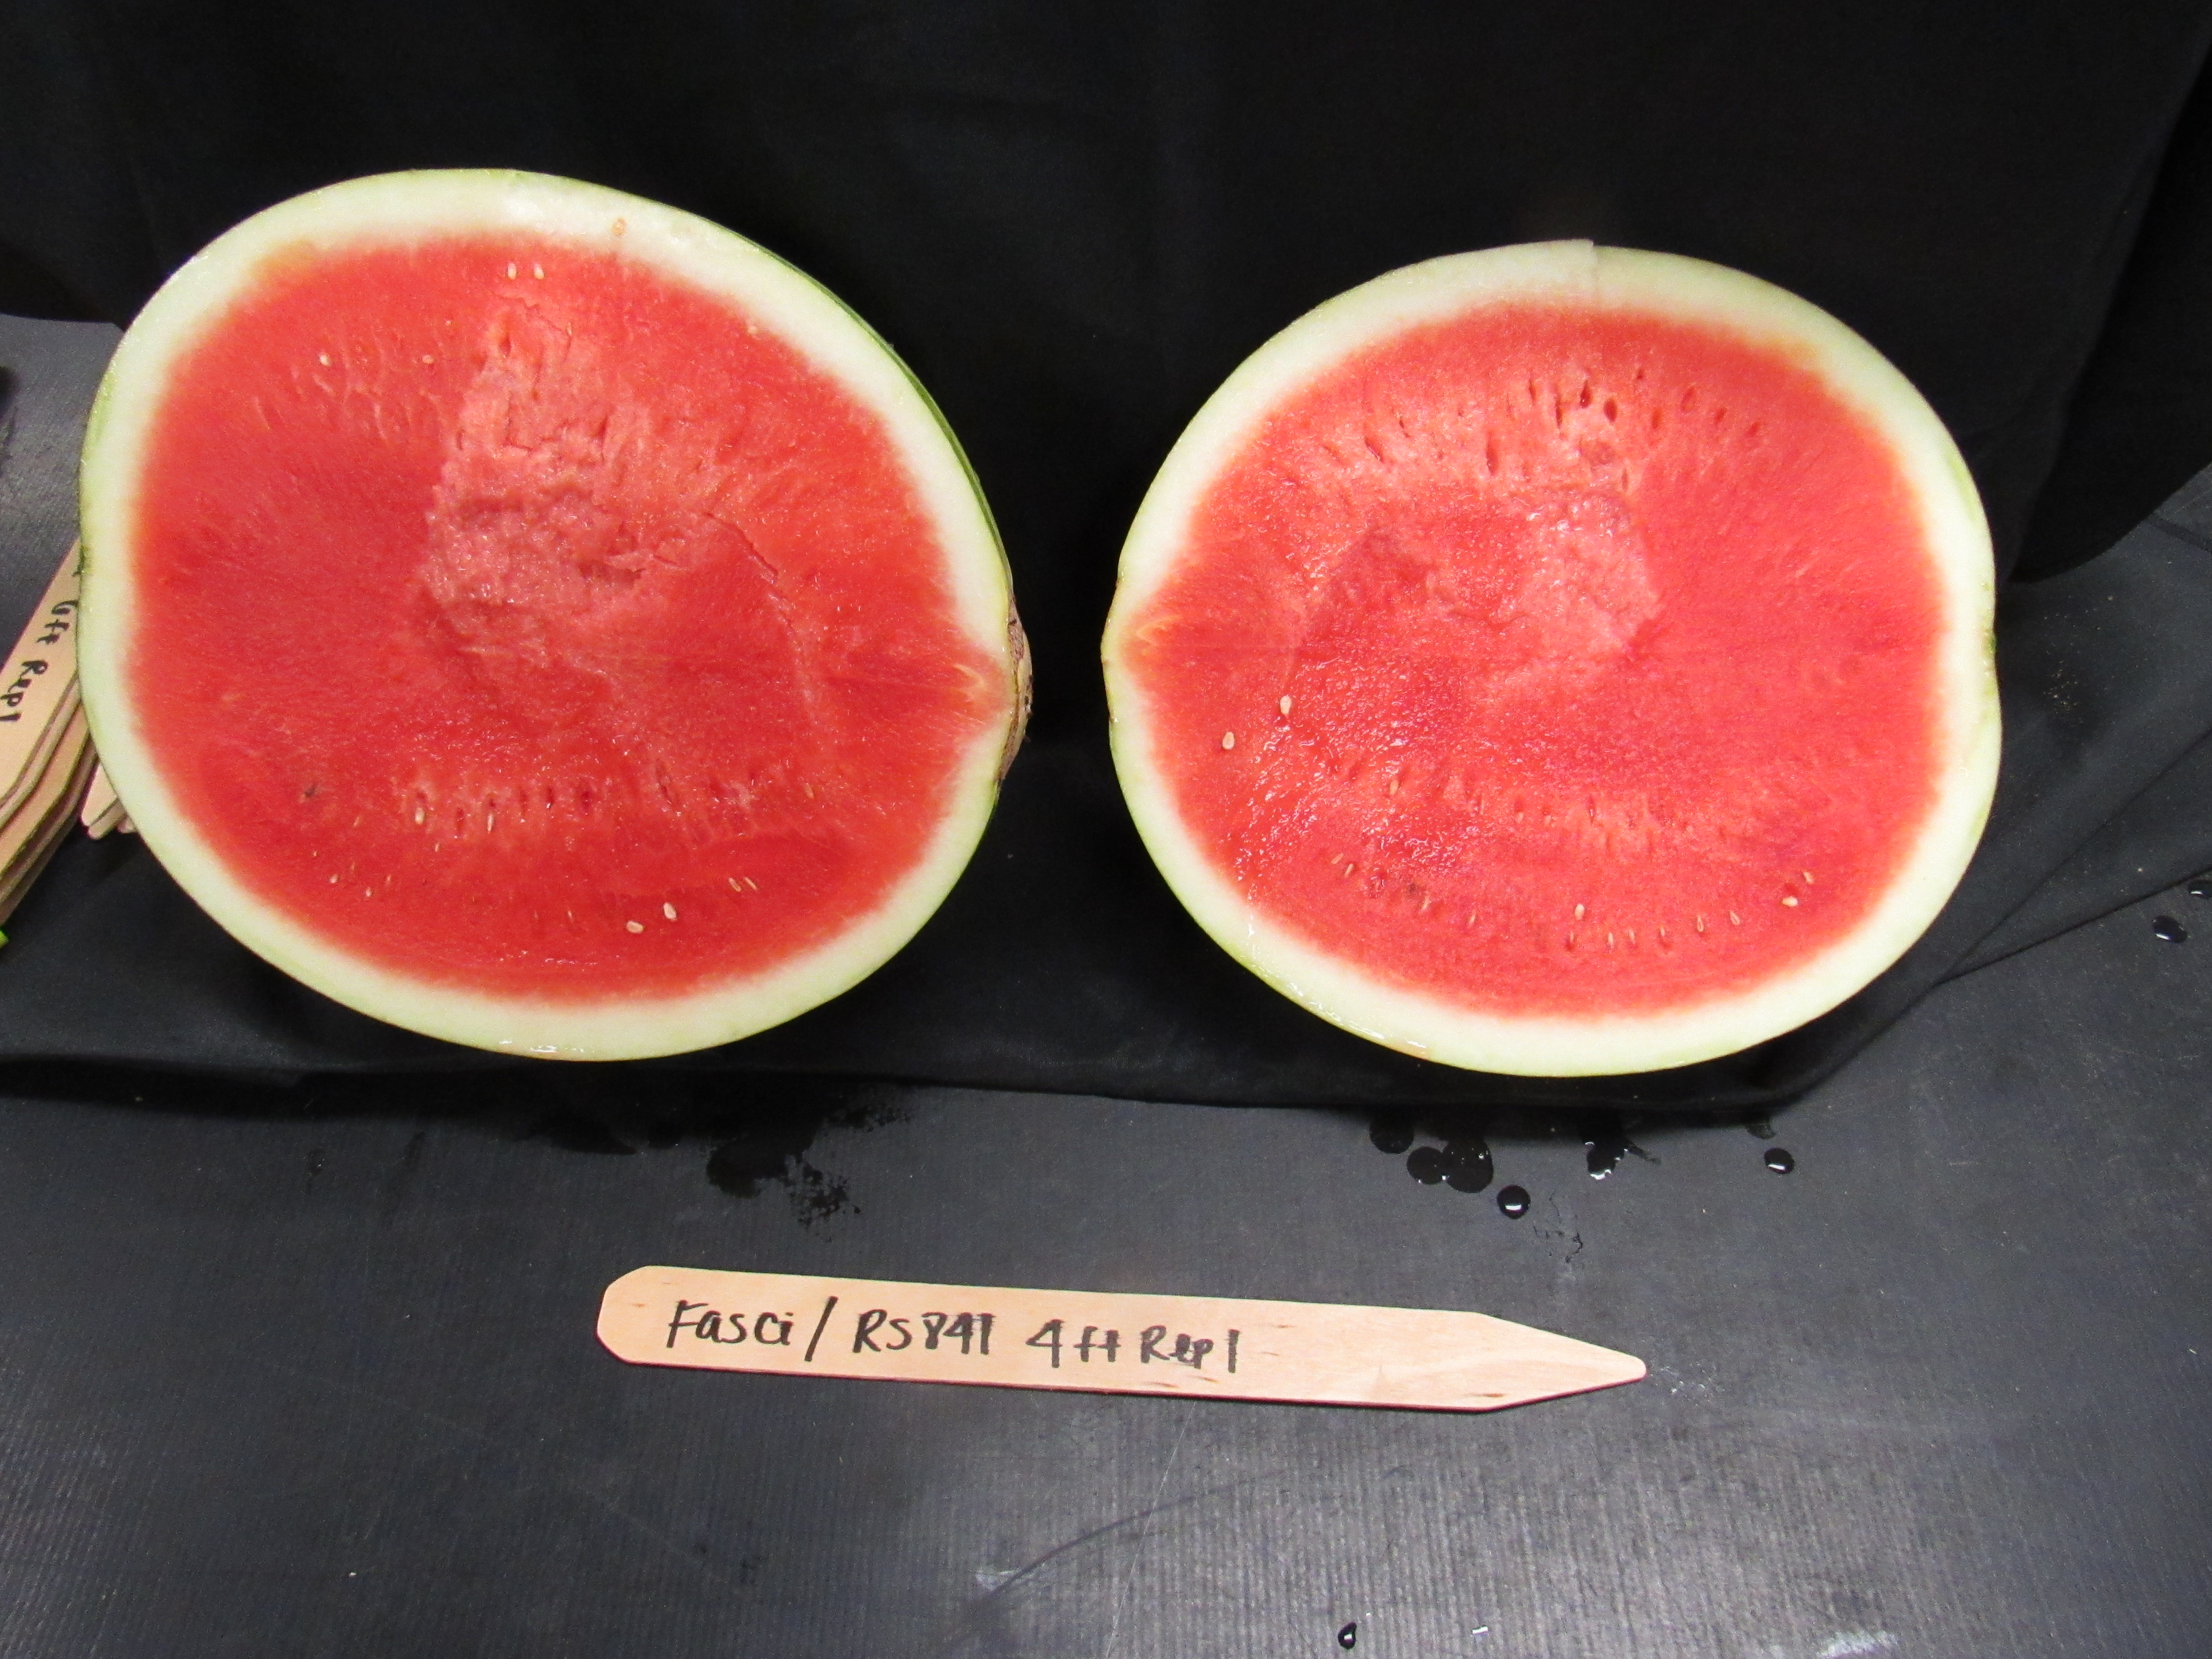
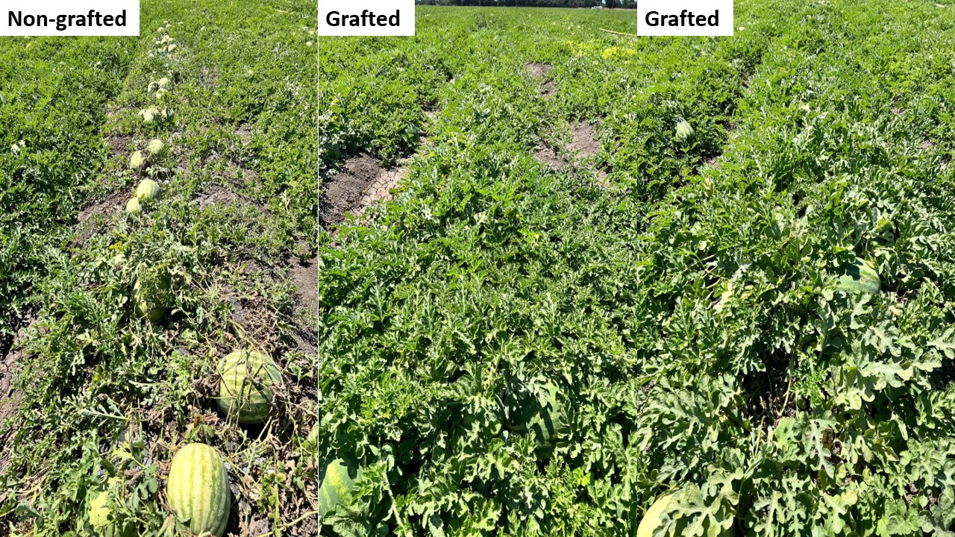
Organ transplantation - Creates a physical hybrid
Makes faster and more effective use of genetics in production - traits to farm
Scion
Productivity
Fruit quality
Plant health
Rootstock

Slide 10
Productivity
Fruit quality
Plant health
COST!!! Overrides other factors
COMPARE
Growers pay 2.5 to 4 times more for grafted transplants ($500 - $600 vs. $1,500 - $2,000 per acre).
Seeding both rootstock and scion, grafting, and healing
To compensate high costs for production, grafted plants must outyield, and the cost must drop.

Slide 11
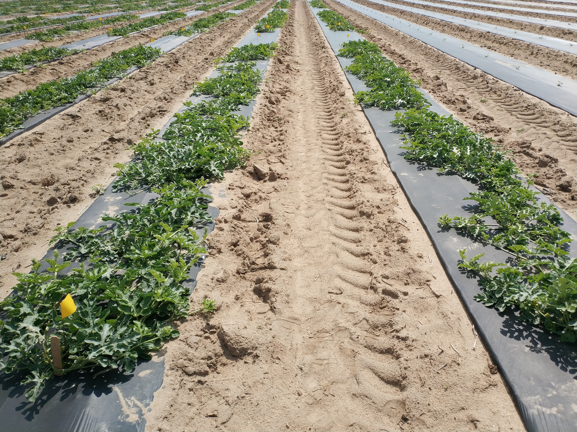
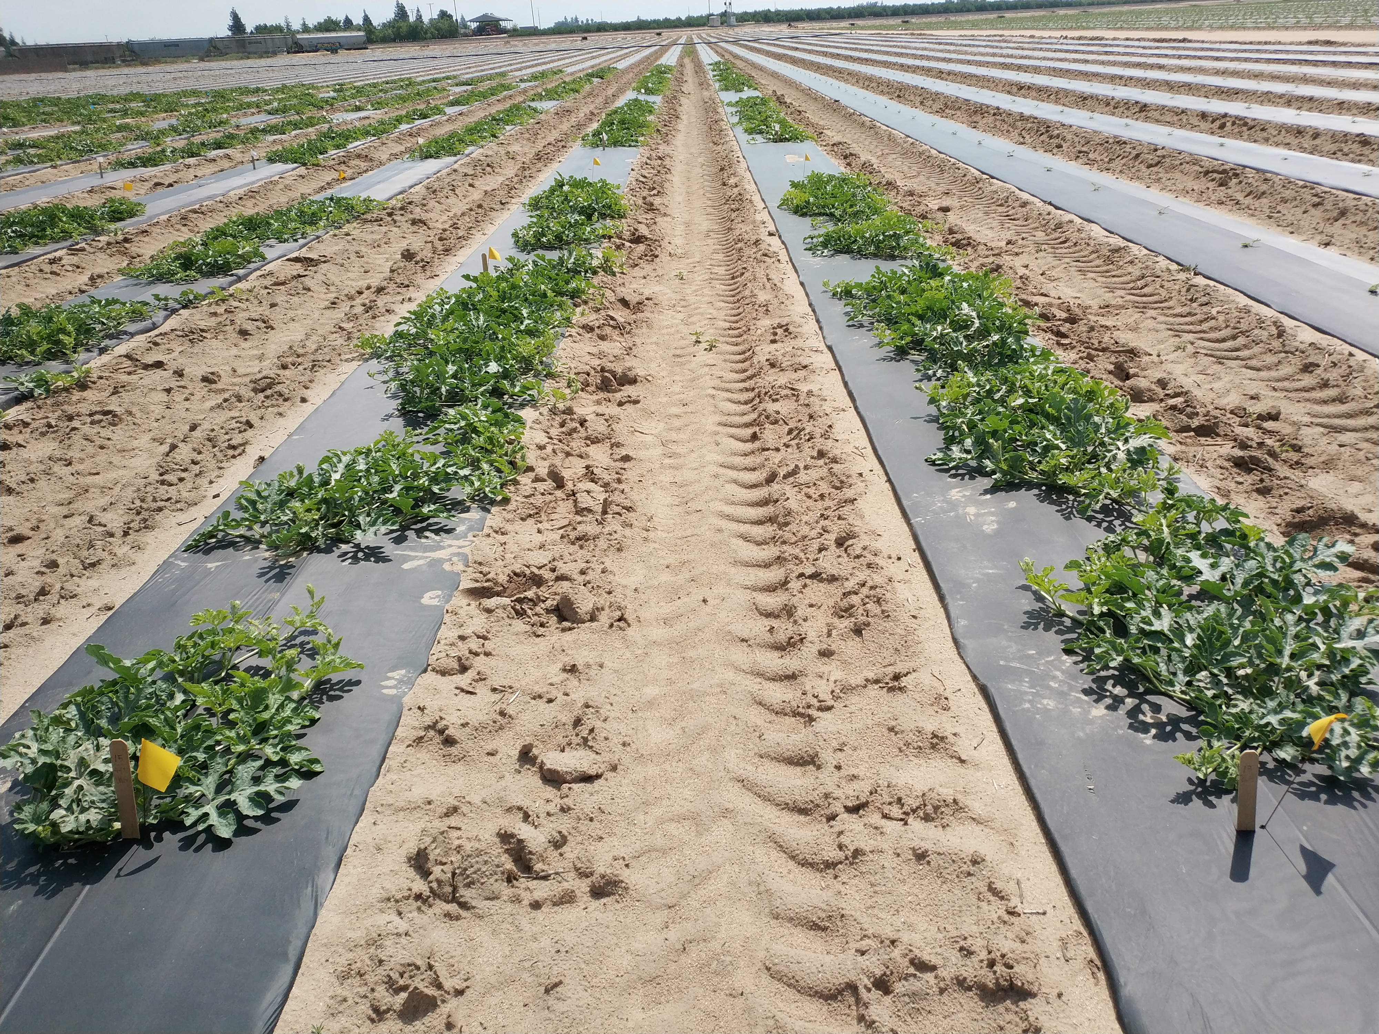
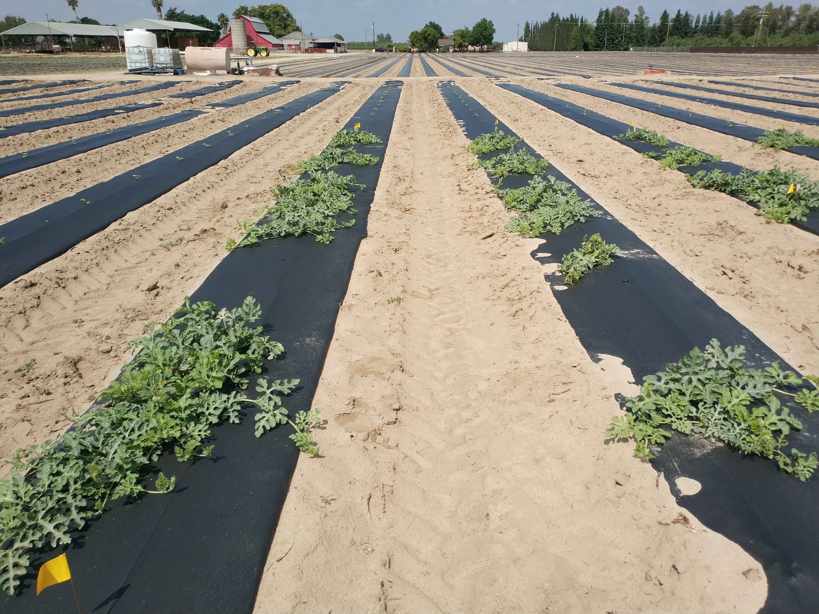
4-5 feet apart = 1,245 – 1,555 plants/acre (25-40% reduction)
6 feet apart = 1,050 plants/acre (50% reduction)
3 feet apart = 2,100 plants/acre
Yield
Quality
Cost
The in-row spacing of 4-5 feet balanced well among yield, marketability, taste, and cost (threshold of breakeven and more)
Adoption

Slide 12
Comparisons of production practices, costs, incomes, and net income gains between grafted and regular watermelons.
 | Non-grafted | Grafted
In-row spacing | 3 feet | 4 feet |  |  | 5 feet |  |  | 6 feet
Population per acre | 2,075 | 1,555 |  |  | 1,245 |  |  | 1,037
Seed cost (seedless plants) | $840 | $630 |  |  | $504 |  |  | $420
Seed cost (rootstock plants) | N/A | $210 |  |  | $168 |  |  | $140
Transplant production cost | $560 | $2,100 |  |  | $1,681 |  |  | $1,400
Total cost for seed and transplants | $1,400 | $2,940 |  |  | $2,353 |  |  | $1,960
Yield (tons/acre) | 50 | 55 (10% more) | 60 (20% more) | 65 (30% more) | 55 (10% more) | 60 (20% more) | 65 (30% more) | 55 (10% more) | 60 (20% more) | 65 (30% more)
Total income (assum. $360/ton) | $18,000 | $19,800 | $21,600 | $23,400 | $19,800 | $21,600 | $23,400 | $19,800 | $21,600 | $23,400
Net income increase | N/A | $260 | $2,060 | $3,860 | $847 | $2,647 | $4,447 | $1,240 | $3,040 | $4,840
Our observations from grower’s fields showed an average yield increase of 10-15%.

Slide 13
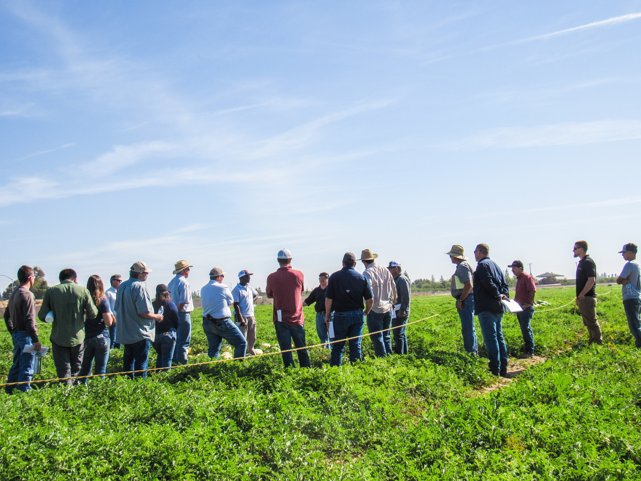
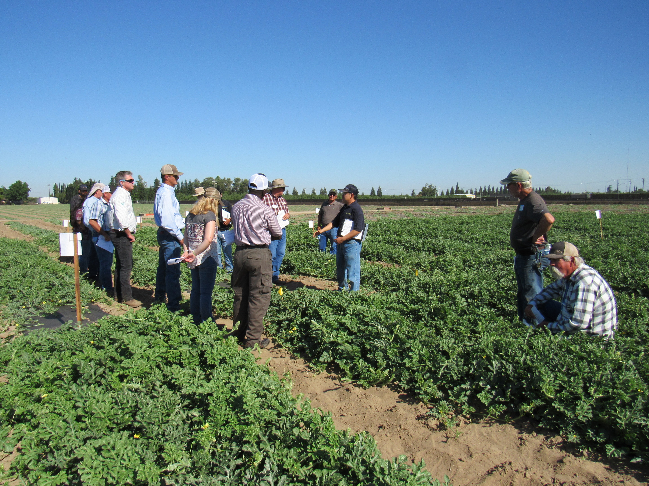
Extension and outreach deliverables: 5 Official Field Days (2019, 2021, and 2022), >15 in-person trial tours (more than 60 people), 10 rootstocks, 4 scions, 8 media interview/reports, >15 articles, plus many talks and grower meetings

Slide 14
Impacts from this project and beyond: multi-facet
Transplant production cost reduction: $1-1.25 per plant x (2,100 x 30%) = $630-787.5 per acre
Voice from growers and industry:
Dan Avila in Turlock (2021) – “I am having 300 acres of grafted watermelon this year compared
to 30 in 2018 and 2019”
Increase of planted acreage: <250 acres in 2018 to >1,500 acres in 2021.
David Jarrett in Manteca (2022) – “All of our full-size watermelons are grafted this year”.
Greenhouse nursery orders and income increased: less than 50,000 transplants in 2018 (cover less than 50 acres) to >450,000 plants (cover more than 400 acres) in 2022 from California and Texas
Ben Hinson at NC (2021) – “Indeed, trucks of grafted watermelon plants are being shipped to CA”.

Slide 15
Needs-driven rootstock evaluation and selection: soil type, planting time, disease pressure, and their interactions (select with confidence)
Validation of disease management for rootstocks and potential of replacing fumigation (environment and water)
Understanding irrigation and fertilization demands for grafted watermelons to REDUCE these inputs (CropManage, precise and tailored application)

Slide 16
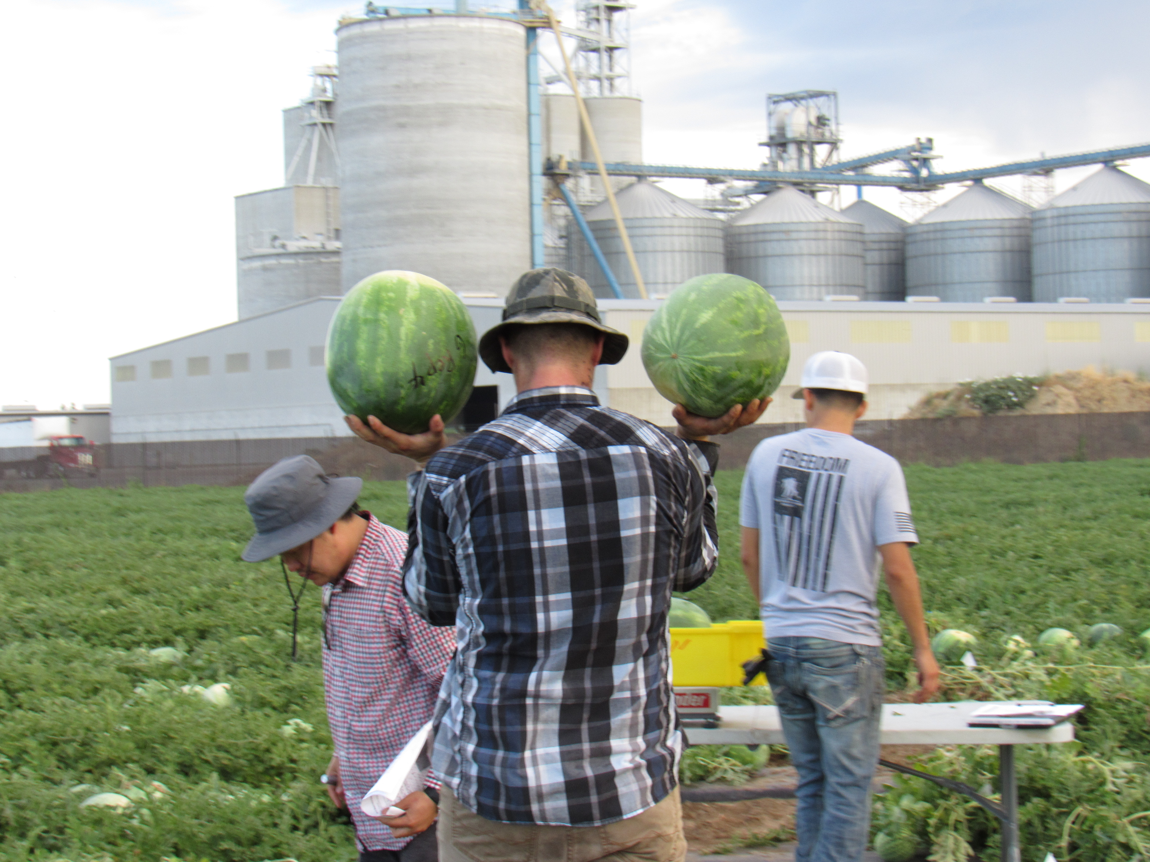
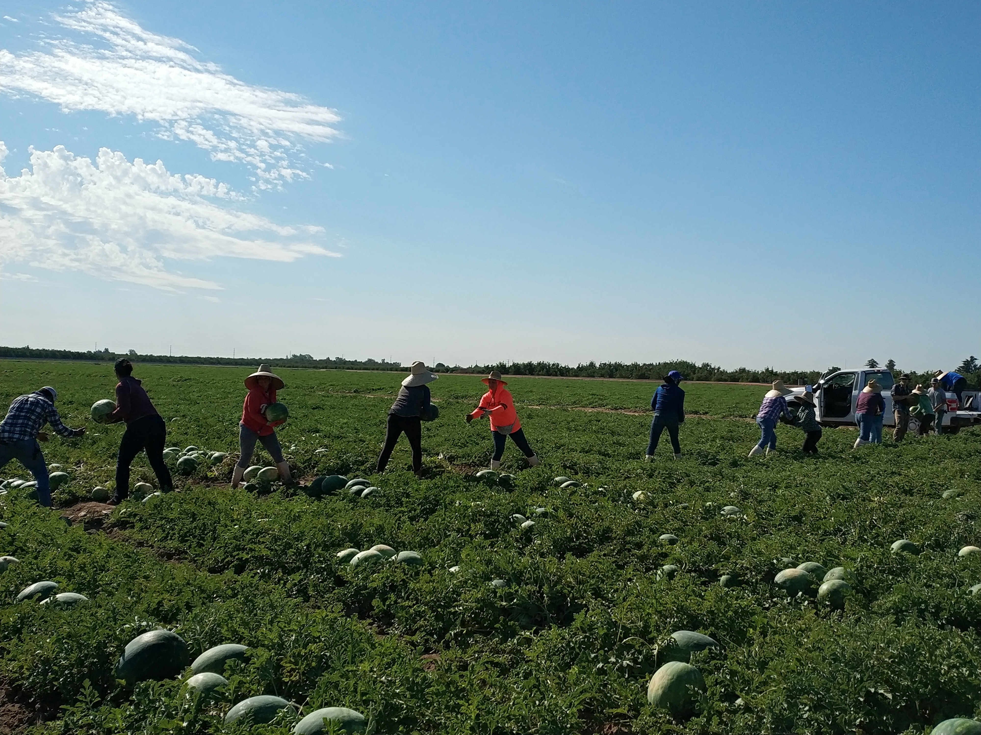
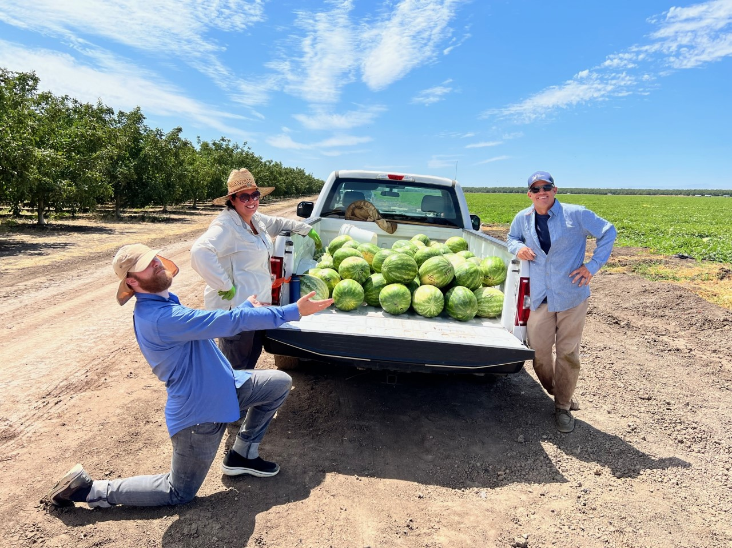
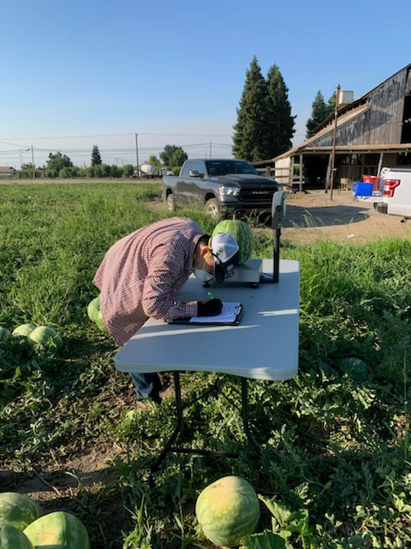
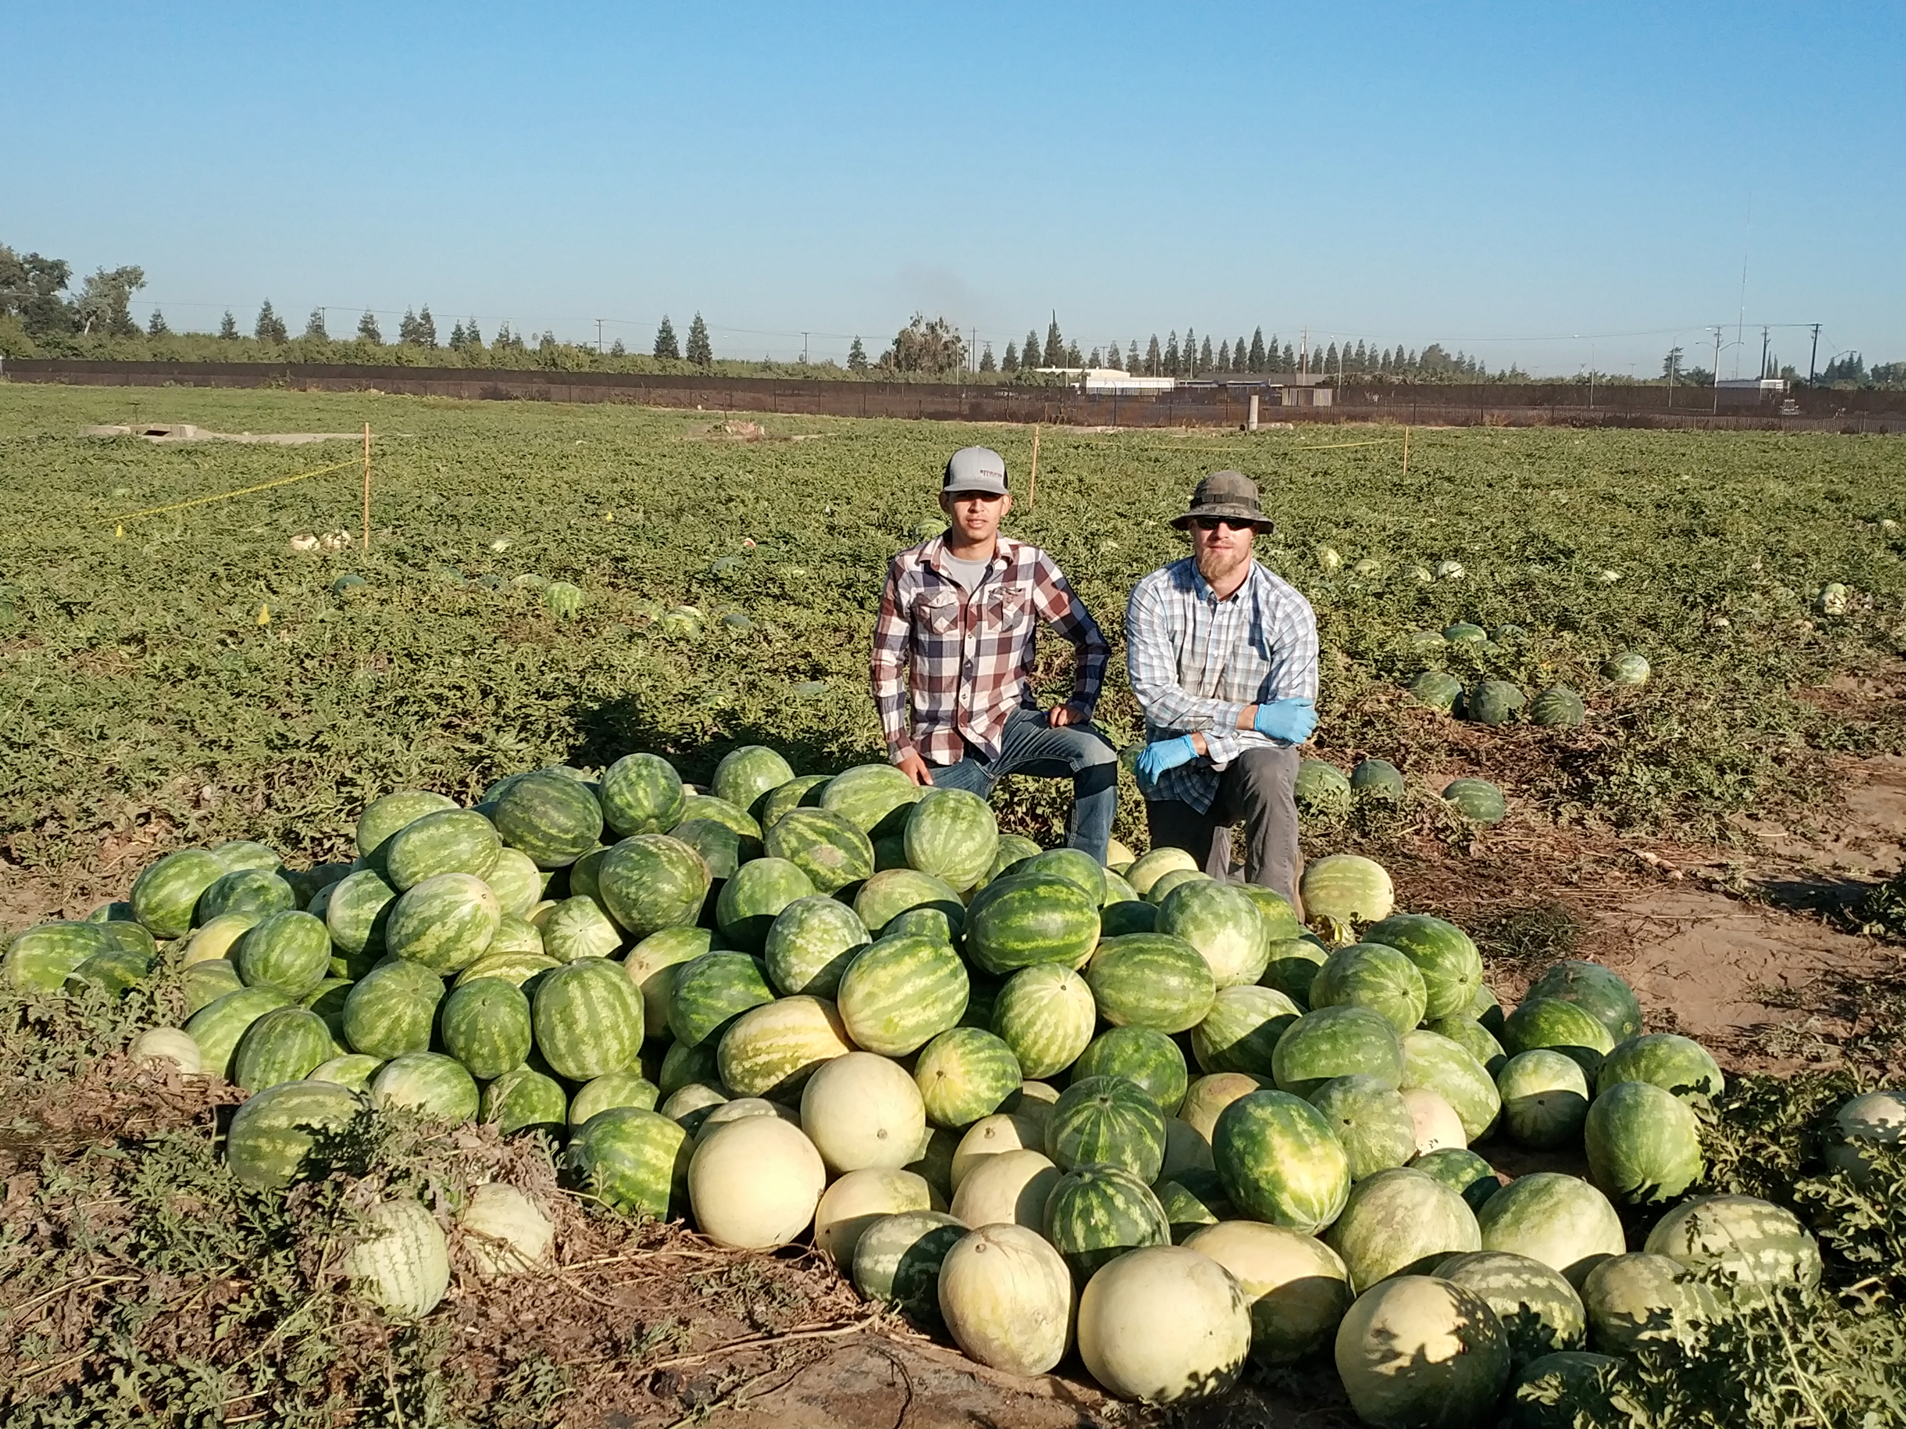
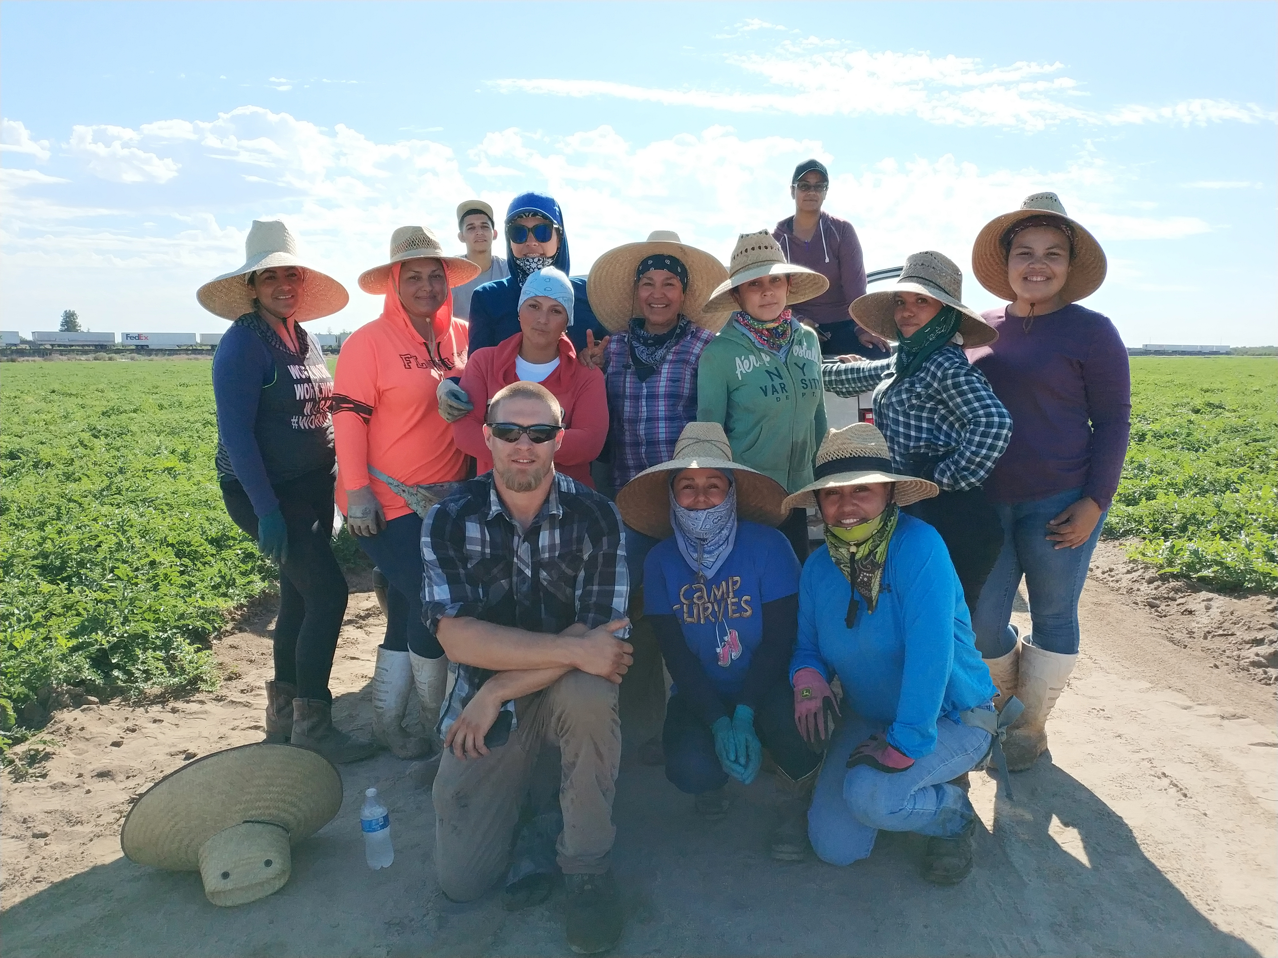
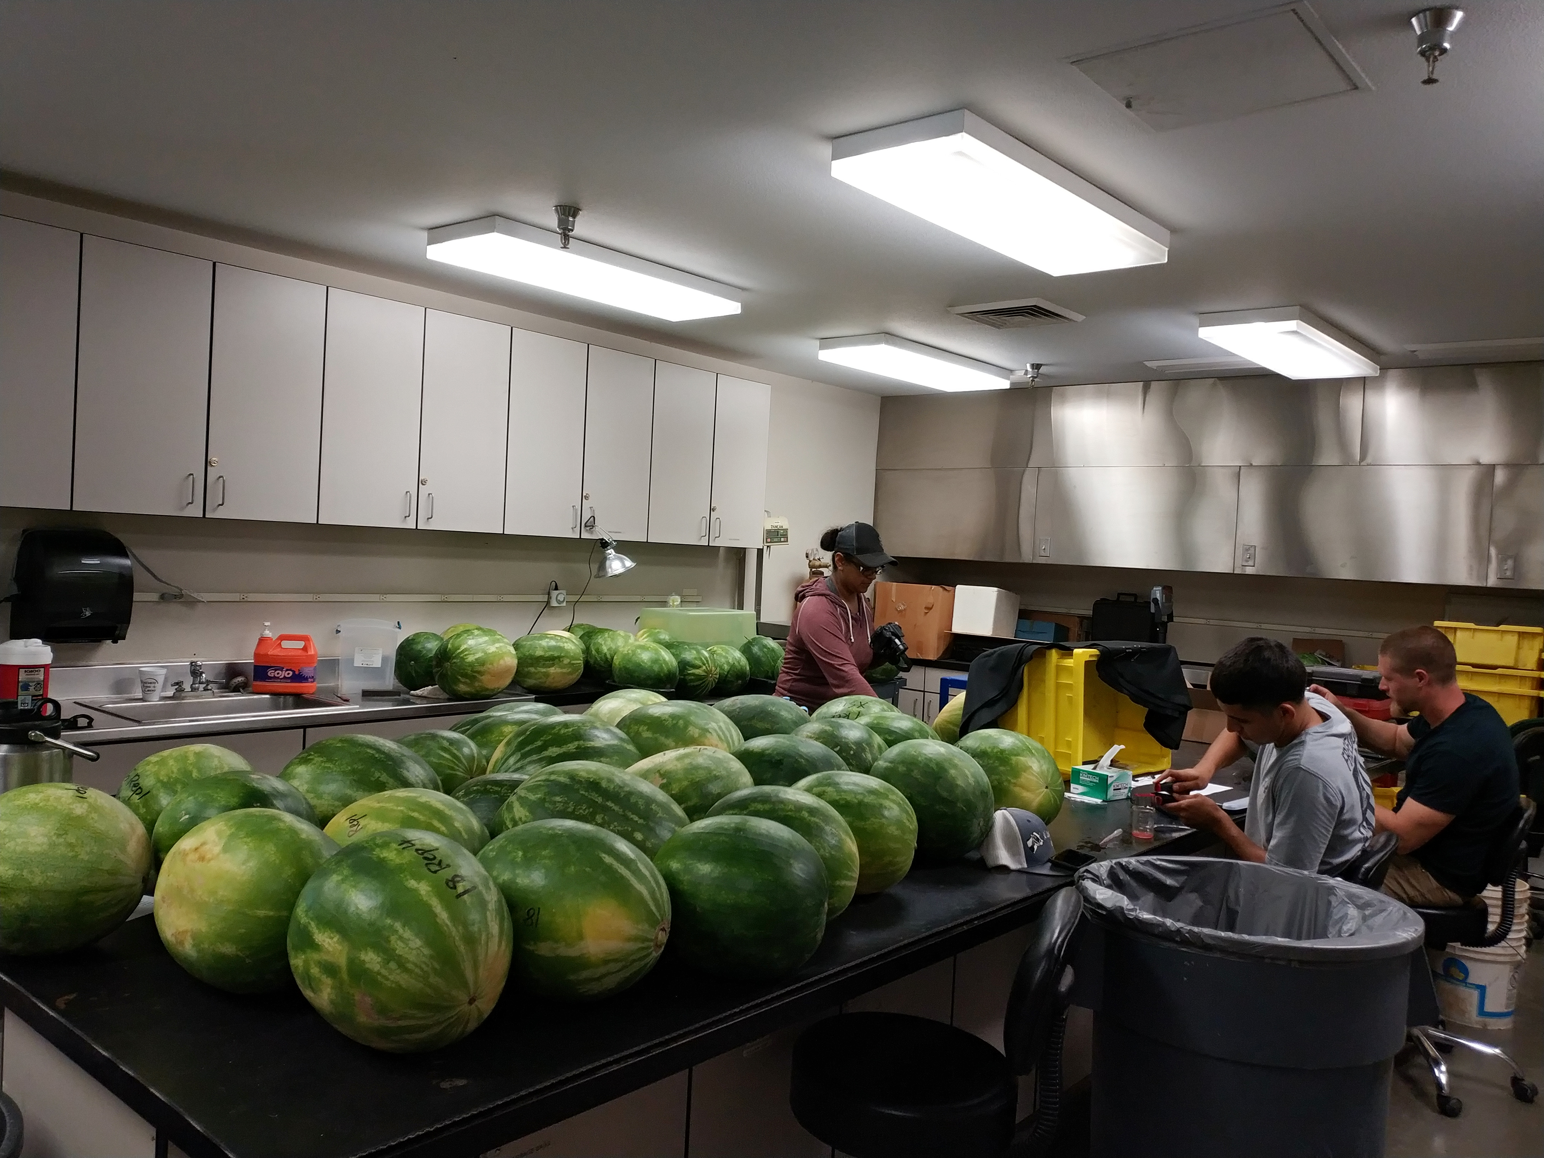
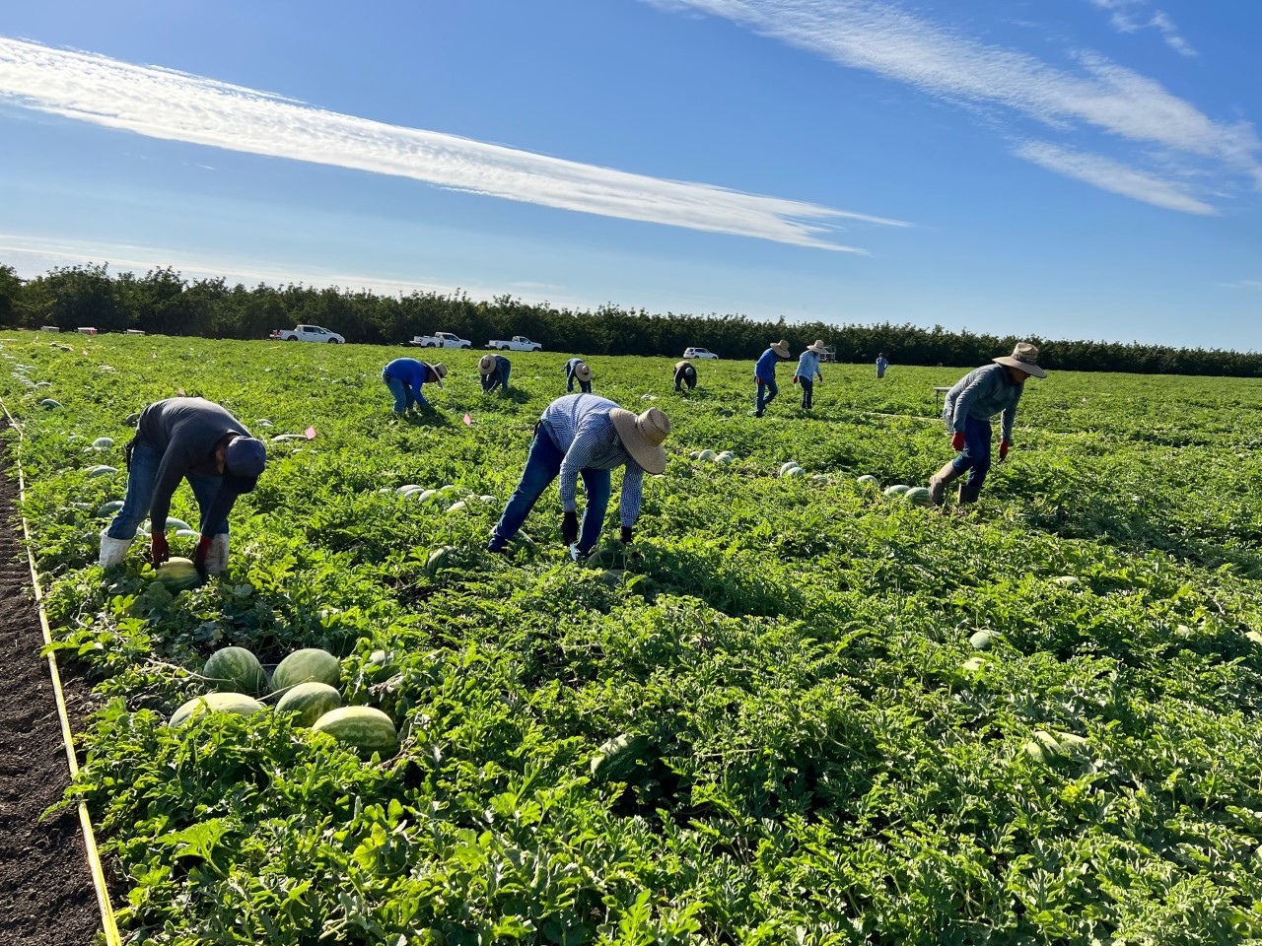
My Sweating, Pitching, and Back-aching TEAM

Slide 17
Thank you!

Slide 18
Strategic Element
Interactive personnel map

Slide 19
UC ANR Programmatic Footprint Maps
UC ANR Town Hall
September 15th, 2022

Slide 20
What are the Programmatic Footprint Maps?
Tasked by the leadership team, committee comprised of members from Informatics GIS, PPE, and RPM designed a mapping tool that displays UC ANR’s programmatic footprint across California
Internal and external stakeholders can use the mapping tool to locate CE Advisors, CE Specialists, other academics, and community educators and their respective program areas
Academic positions that are under recruitment are also shown in the programmatic maps
Leadership team and Internal Stakeholders will use the mapping tool to assist with the Cooperative Extension position call process
This tool is being officially released September 15th, 2022

Slide 21
How to find the tool
You can find the tool under ‘People’ on UC ANR’s website
Under the drop-down Menu, click on ‘Programmatic Footprint Maps’ link and you will be directed to the home page

Slide 22
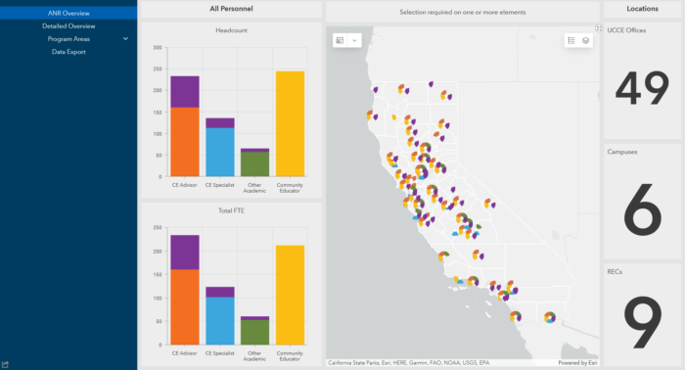
Demo

Slide 23
Getting Started using the Tool
We recommend reviewing the ‘Getting Started’ section of the website to familiarize yourself with a few basic features of the tool
Informatics and GIS Program (IGIS) will hold office hours to answer and questions on: Friday, September 16th and Friday, September 23rd from 2:00 to 2:30 PM. Office hour zoom link is https://ucanr.zoom.us/j/6968246840
To make changes to how you are displayed within the tool, please visit the ‘Help’ section for instructions
If you have any questions or comments, please leave them in the Programmatic Footprint Feedback/Question section, it can be found in the ‘Help’ section . A member from RPM, PPE or IGIS will respond to your inquiry.

Slide 24
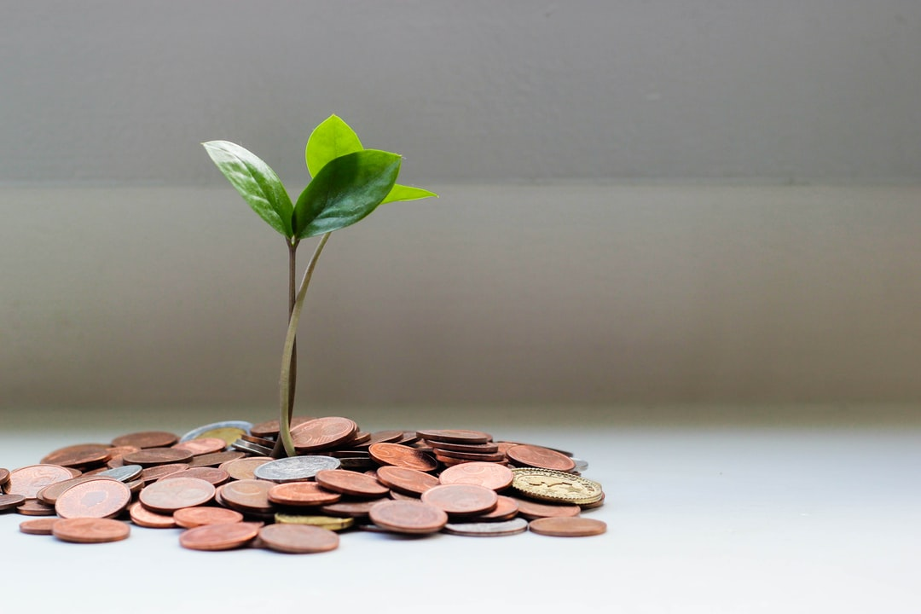
Donor Feedback
People care about what we do
“So very grateful for all your good work, teaching me and so many others how to grow and prepare delicious, healthy food!”
- Susan M., Santa Monica, CA

Slide 25
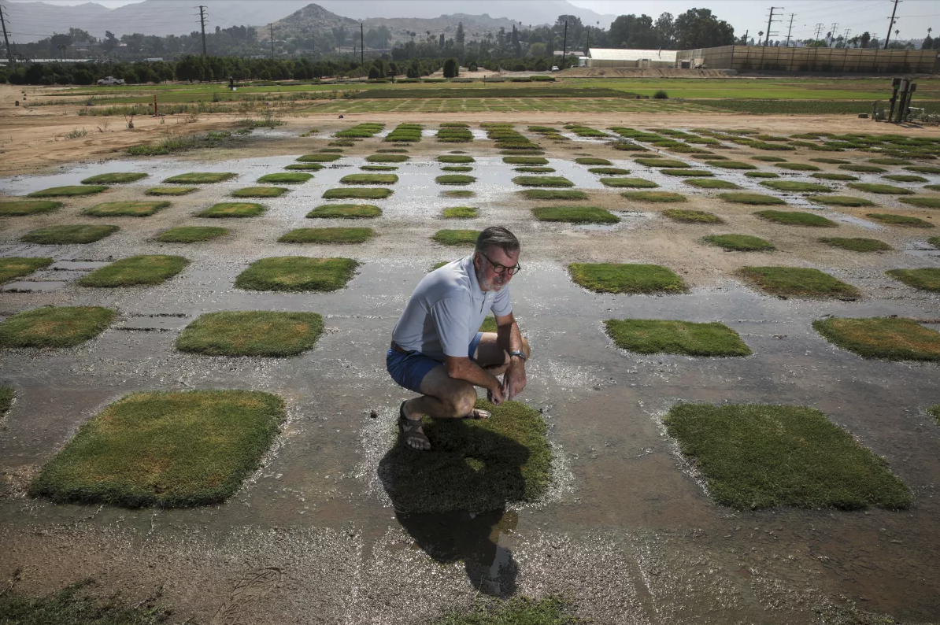
In the Media
Which UCCE specialist did the LA Times identify as “the state’s Mark Twain of turf. Our LeBron of lawns. The Ira Glass … of grass”?
Janet Hartin
Igor Lacan
Jim Baird
Photo by Irfan Khan, Los Angeles Times
Photo by Mark Bell

Slide 26
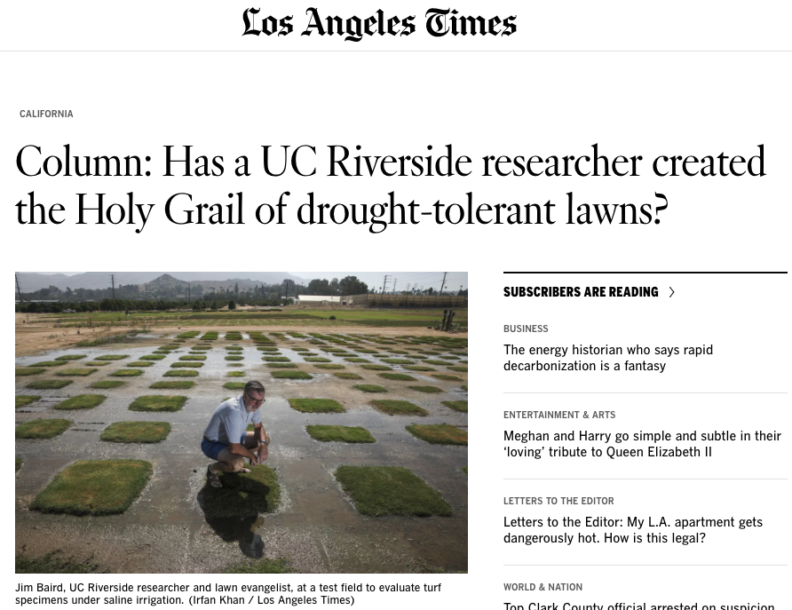
In the Media
Which UCCE specialist did the LA Times identify as “the state’s Mark Twain of turf. Our LeBron of lawns. The Ira Glass … of grass”?
Photo by Mark Bell

Slide 27
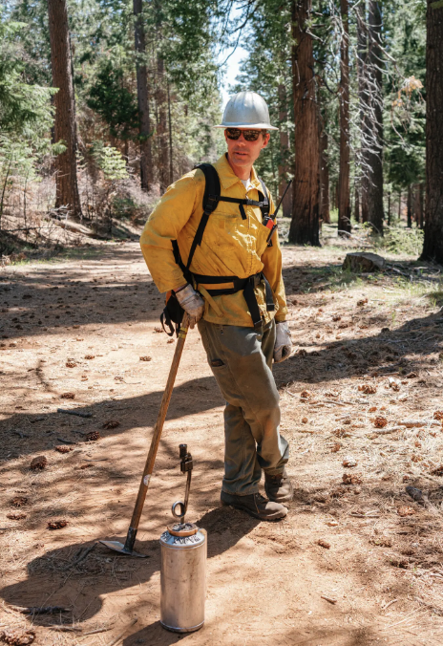
In the Media
Rob York was quoted in NY Times story featuring prescribed burn research at Blodgett Forest
Luis Espino and Aaron Smith were quoted in SF Chronicle story about drought reducing rice acreage
Lenya Quinn-Davidson was quoted in an LA Times story on prescribed fire
Multiple national outlets interviewed Kaan Kurtural and Anita Oberholster about heat & climate effects on wine grapes
Photo by Mark Bell

Slide 28
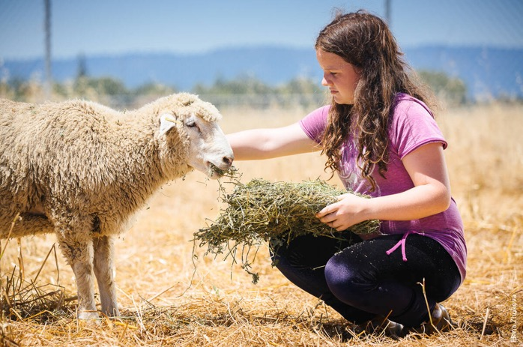
Making connections
15-minute breakout groups
Introduce yourself and your role
What are you excited to work on this fall?

Slide 29
Around UC ANR: Other updates
Jodi Azulai – Learning & Development
Ricardo Vela - Hispanic Heritage Month & Latinx & Friends Affinity Group
Tina Jordan - ANR@Work survey
@freegraphictoday from unsplsh.vom
Notes:
MARK - next a few updates….

Slide 30
Notes:
Add this to chat: Learning & Development landing page: https://ucanr.edu/sites/Professional_Development/

Slide 31
Foreign Engagement: Disclosures to ANR and Research Sponsors
Sept 28
9:30-10:30 AM
Mapping the impact of our work
October 20
Noon-12:30 PM
UC Davis Library Resources Workshop
Nov 3
3:00-4:00 PM

Slide 33
https://surveys.ucanr.edu/survey.cfm?surveynumber=38886

Slide 34
2022 ANR@Work Survey Update
ANR@Work Survey launched July 26, 2022 through August 26, 2022
We gave away forty ($75) gift cards and had a 55% participation rate
Next Steps:
- Survey results are expected in October 2022
- Survey reports will be issued to ANR Senior Leadership, Unit Directors, & Academic and Staff Assembly Councils
- Survey reports will be uploaded to the 2022 UC ANR@WORK SURVEY webpage

Slide 35
Your opinion matters!
The feedback obtained from the 2020 & 2021 ANR@WorkSureys helped to facilitate positive change and improvements in multiple key areas.
Our collective voice resulted in actions taking in the following categories.

Slide 36
Compensation
Instituted the 2022 Policy Covered Staff Market Adjustment Program
Reinstated 4th year of Cooperative Extension (CE) Advisor Compensation Plan in September 2021.
We have plans to contract with a firm to conduct a market analysis to assess CE Advisor salaries for future discussions.
Conversations with Leadership
We instituted conversations with Senior leadership
“Open conversation with leadership” session was just held September 9th
These quarterly sessions require RSVP to limit group to (20)
Look for these announcements via email
Academic Footprint & Administrative Support
We are currently undergoing a Hiring Blitz!
We approved 180 new positions in 2021, which included 90+ academic positions
(30) CE Advisor positions are filled and we are working through the rest
Daniel Obrist, the new Vice Provost for Academic Personnel started in August 2022
Workplace Environment:
We promote wellness and self-care through Townhall Meetings and newsletters
Ombuds services are now available for all employees
We continue to support Employee Resource Groups

Slide 37
Thank you to all that participated
Your input is the key
We shall keep the momentum going!

Slide 38
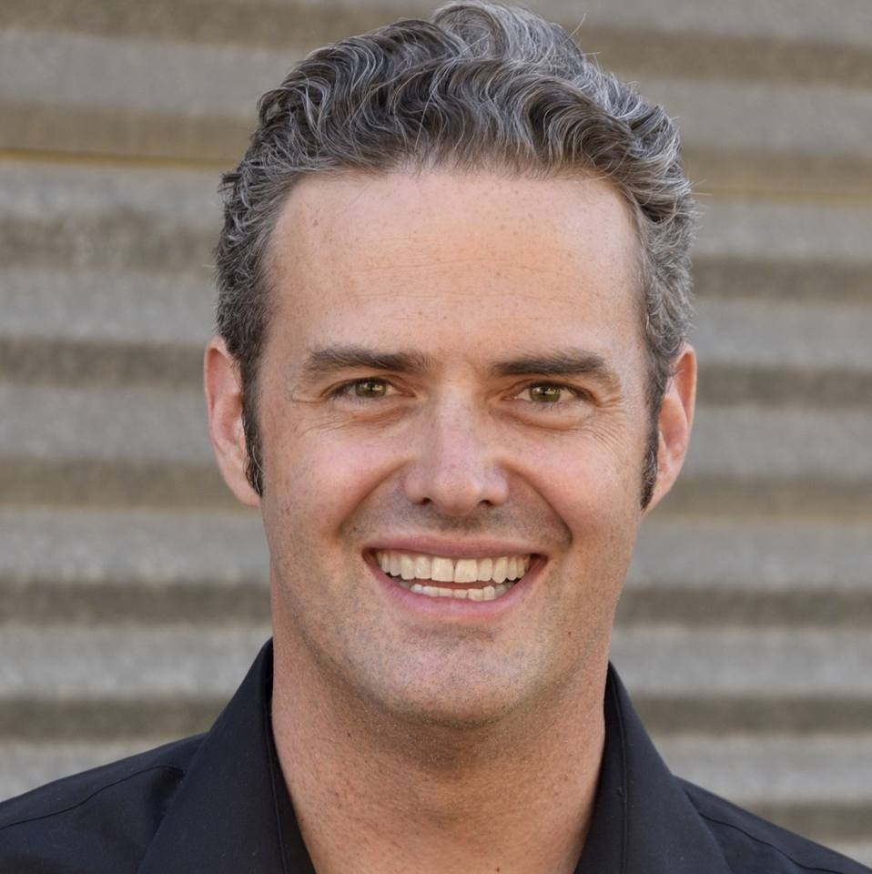
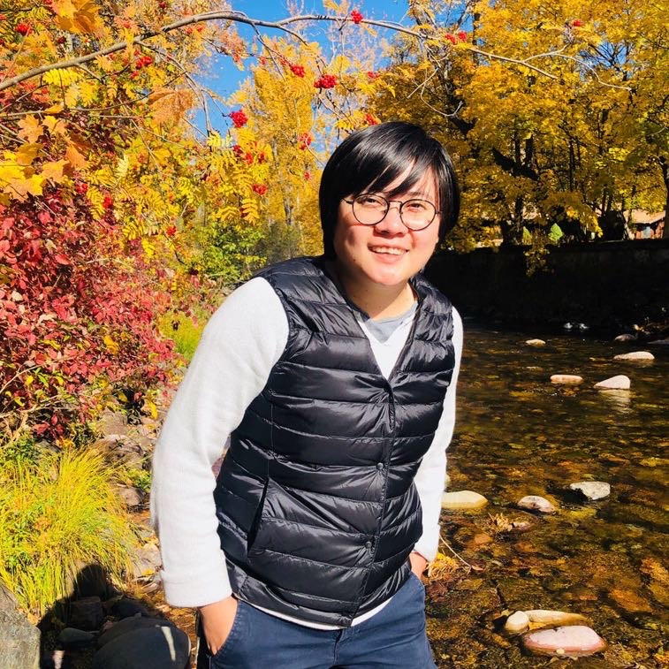
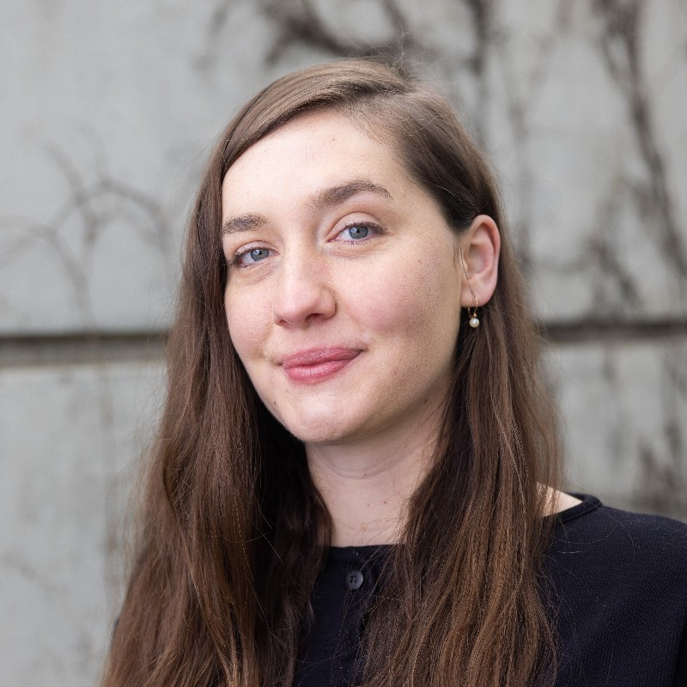
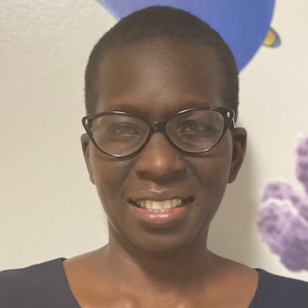
Recent Hires: Welcome to UC ANR
Norman Alberti UCCE SAN JOAQUIN COUNTY
Efrain Barrera UCCE FRESNO MADERA MCP
Shayna Blythe BUSINESS OPERATIONS CENTER
Sukhmony Amraj Kaur Brar UCCE FRESNO MADERA MCP
Julie Ann Brown UCCE MARIPOSA COUNTY
Kathleen Carter UCCE CENTRAL SIERRA NEVADA MCP
Cindy Xiaoning Chen UCCE CENTRAL SIERRA NEVADA MCP
Noah Alexander Cooke UCCE NEVADA_PLACER COUNTY
Cynthia A Crestmore BUSINESS OPERATIONS CENTER
Megan Cross NUTRITION,FAMILY&CONSUMER SCI
Stephen Dampier IT SERVICES
Alison Lee Deak UCCE MARIPOSA COUNTY
Jackson Manuel Dias UCCE FRESNO MADERA MCP
Jackson Manuel Dias UCCE FRESNO MADERA MCP
Regina Jasmine Dingler UCCE SONOMA COUNTY
Meaghan Donovan UCCE CAPITOL CORRIDOR MCP
Katherine Elise Fessler CALIFORNIA STATE 4-H OFFICE
Coral Franco UCCE FRESNO MADERA MCP
Brandon Frost UCCE SHASTA COUNTY
Marlen Gaspar UCCE RIVERSIDE COUNTY
Granville Goza UCCE SANTA CLARA COUNTY
Olivia Marie Quinlan Henry UCCE CAPITOL CORRIDOR MCP
Ashley Michelle Hooper UCCE LOS ANGELES COUNTY
Hanif Robert Houston UCCE ALAMEDA COUNTY
Ethan Ireland STRATEGIC COMMUNICATIONS
Sia'h Fanta Jimissa NUTRITION POLICY INSTITUTE
Amritpal Kaur UCCE KERN COUNTY
Tara Kelly UCCE SAN MATEO COUNTY
Citlali Lopez UCCE FRESNO MADERA MCP
Kathryn Elise Low UCCE NEVADA_PLACER COUNTY
Ethan Ireland
Cindy Chen
Olivia Henry
Jackie Atim

Slide 39
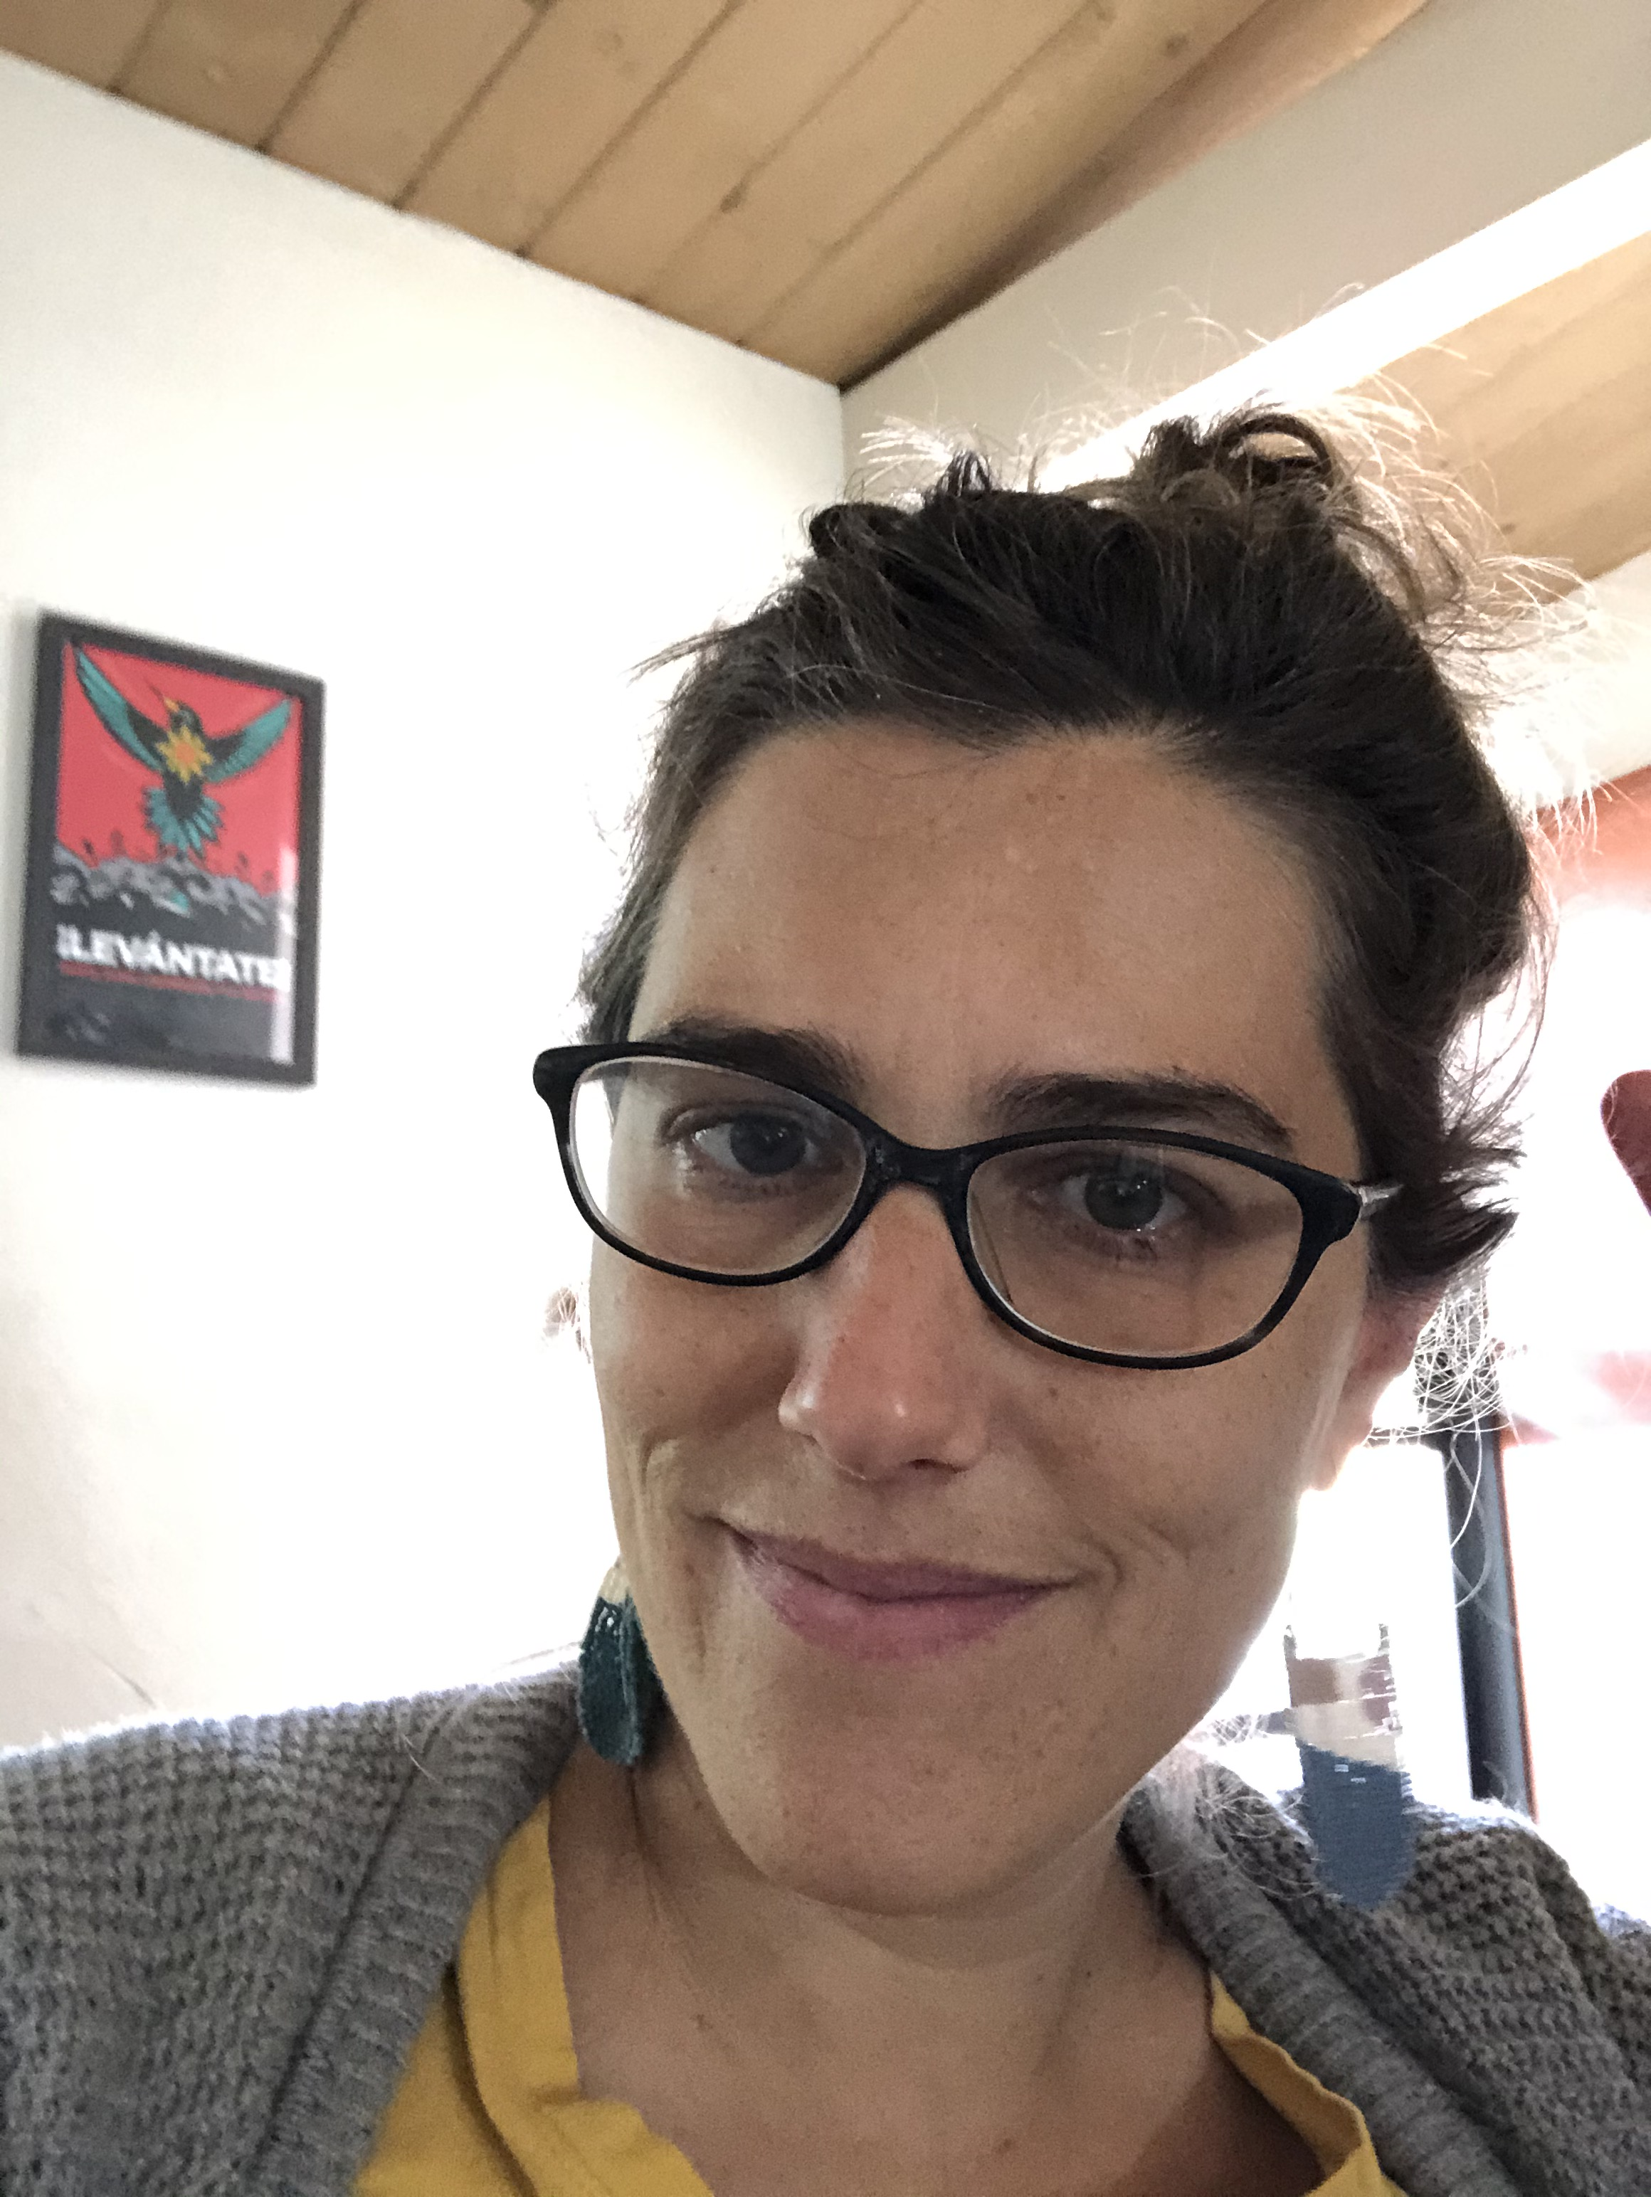
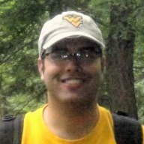
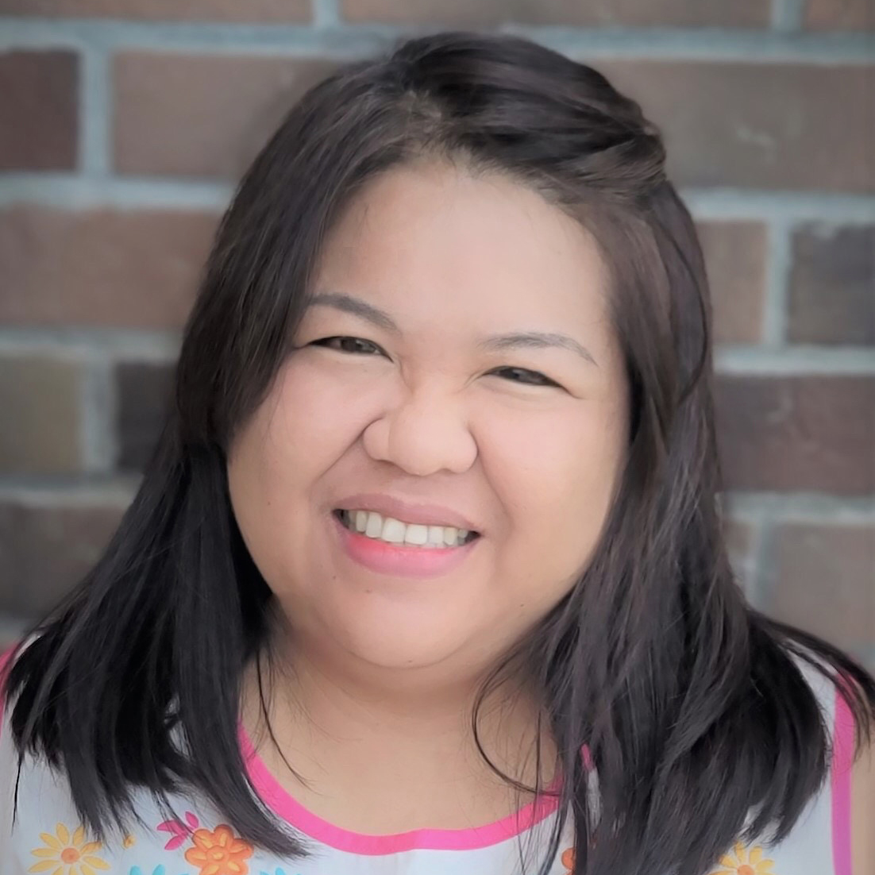
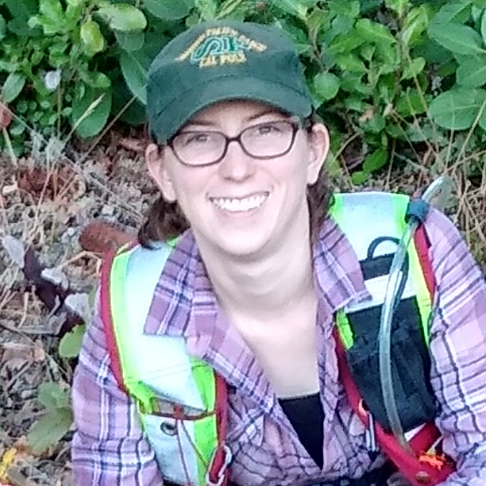
Recent Hires: Welcome to UC ANR
Lynnelle Madsen UCCE CENTRAL SIERRA NEVADA MCP
Michele Maia UCCE SAN MATEO COUNTY
Evelyn Mandujano UCCE CAPITOL CORRIDOR MCP
Robin Elizabeth Martin UCCE CENTRAL SIERRA NEVADA MCP
Maximus Mendez KEARNEY REC
Lizzeth Mendoza UCCE GLENN COUNTY
Ana Isabel Mora Camacho UCCE FRESNO MADERA MCP
Alfonso Mota UCCE CENTRAL SIERRA NEVADA MCP
Alyssabeth Navarro UCCE TULARE COUNTY
Sally E Neas UCCE SAN MATEO COUNTY
Tori Renae Norville UCCE SONOMA COUNTY
Daniel Obrist IMM OFFICE AVP
Jose Mauricio Paz Villegas UCCE FRESNO MADERA MCP
Cedric Renaudin NUTRITION,FAMILY&CONSUMER SCI
Cedric Tristan Renaudin NUTRITION,FAMILY&CONSUMER SCI
Todd Renstrom UCCE SAN DIEGO COUNTY
Ana Resendiz UCCE IMPERIAL COUNTY
Matthew Rene Rodriguez UCCE NEVADA_PLACER COUNTY
Braulio Rodriguez Villalobos UCCE FRESNO MADERA MCP
Julie Salomonson UCCE VENTURA COUNTY
Nichol Santisteven UCCE SANTA CLARA COUNTY
Arlene Wimer Silva UCCE IMPERIAL COUNTY
Yolanda Tabarez DESERT REC
Annalise M Traub UCCE CAPITOL CORRIDOR MCP
Daylin Wade UCCE CENTRAL SIERRA NEVADA MCP
Tyler Waltrip UCCE FRESNO MADERA MCP
Sierra Washington UCCE PLUMAS/SIERRA COUNTIES
Klacey Worthington UCCE GLEN COUNTY
Chun Fung Yu IT SERVICES
Sally Neas
Sudan Gyawaly
Irene Padasas
Tori Norville

Slide 40
Diversity, Equity & Inclusion Alliance
Image by Gerd Altmann from Pixabay
Notes:
https://ucanr.edu/sites/deialliance/DEI_Alliance_Home/

Slide 41
Closing
Stay safe & well
Thanks to our speakers and to you all.
Recordings of meetings posted at https://ucanr.edu/sites/anrstaff/All_Hands
Next Town Hall
October 20 @2 pm
Photo Mark Bell
Notes:
Remind that recording and Q&A will be posted
Next town hall date

Slide 42
Wellness break. Practicing what we preach.
David Ritz

Slide 43
Our Public Value Statements
Safeguarding abundant and healthy _____ for all Californians.
Photo by Mark Bell
Notes:
food

Slide 44
Strategic Element
2021 Annual Report

Slide 45
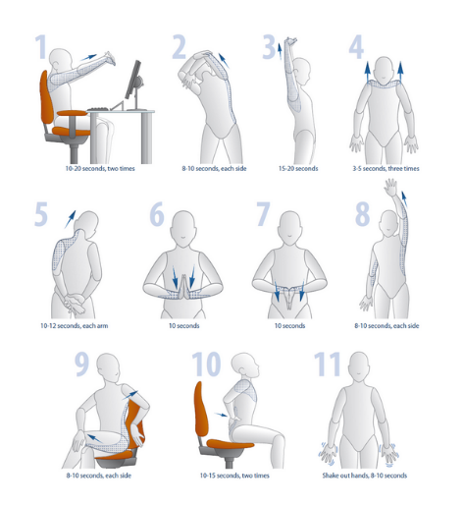
Remember to stretch
10, 2 and 4 stretches
https://safetyservices.ucdavis.edu/units/occupational-health/ergonomics/office-computer/stretches
Notes:
10, 2 and 4 stretches, https://safetyservices.ucdavis.edu/units/occupational-health/ergonomics/office-computer/stretches

