Slide 1
Some notes as you prepare
Spotlight series:
Sharing Stories of impact; Stories that others can understand and get excited about the work.
Identifying speakers:
SIs with their panels and relevant PTs can identify potential engaging speakers and topics relevant to the SI Focal Areas and/or Grand Challenges. They can also use Public Value language as appropriate.
Use the following as a possible template.
Plan for up to 15-20 minutes talking – with 10 minutes for questions and discussion.

Slide 2
The UC ANR “Spotlight” Webinar series
https://ucanr.edu/sites/StrategicInitiatives/
UC ANR: Our Public Value
The difference we make…
Economic prosperity
Qualified workforce
Abundant and healthy food
Protecting natural resources
Climate-resilient communities and ecosystems
Healthy people and communities
An inclusive and equitable society

Slide 3
Catchy title
Speaker
Highlighting Work across the UC ANR Strategic Initiatives
Date
Webinar target time – up to 15-20 minutes (Ted Talk length)
+ 10 minutes for questions

Slide 4
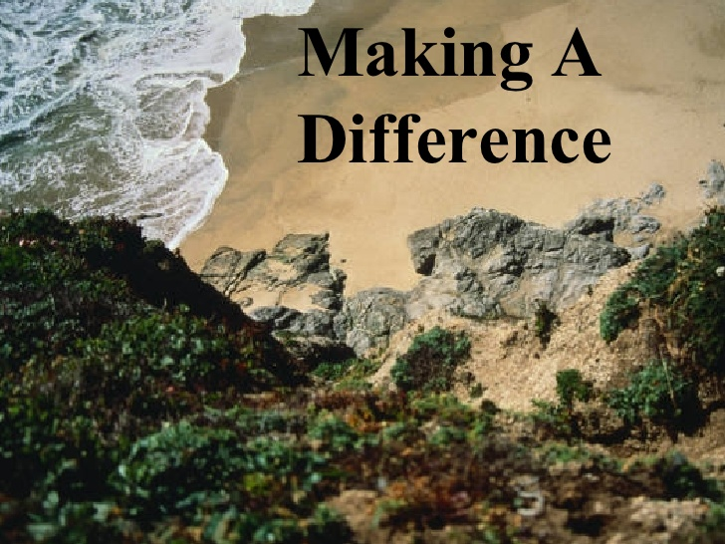
Goal of the “Spotlight” series
Provide an upbeat, interactive opportunity to see
how the work of UC ANR is making a difference:
breakthroughs, challenges and needs.

Slide 5
Structure (for reference)
Introduction – setting the scene
Did you know: 2-3 interesting points related to the problem addressed
What’s the problem of interest.
Why you should care: How the problem affects people everywhere (why it is relevant to a broad audience)
What we did
Brief summary of activities & major interesting findings
The impact – how it changed people’s lives
If you remember one thing, ….

Slide 6
Introduction – Setting the scene
Did you know
Highlight 2-3 interesting points related to the problem you will address
(picture title)

Slide 7
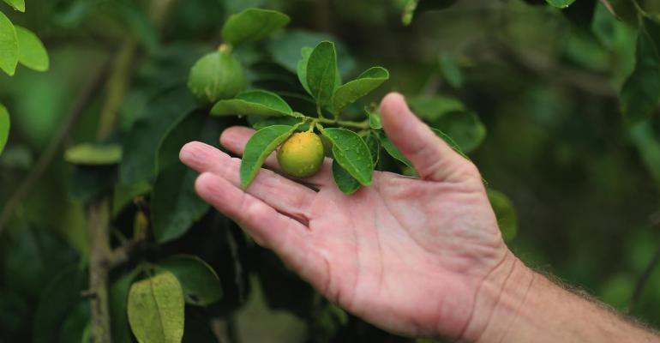
Introduction – Setting the scene
What’s the problem of interest?
Describe in simple terms
(picture title)

Slide 8
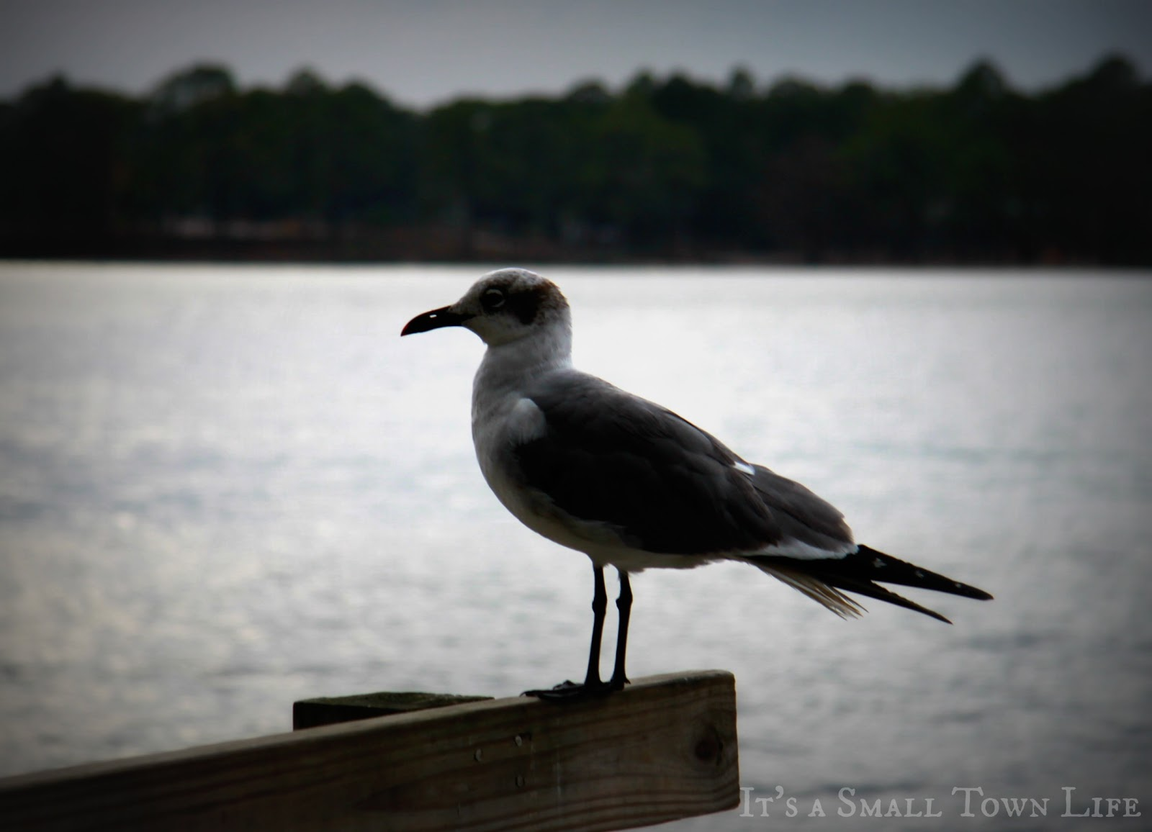
Introduction – Setting the scene
Why should they care?
Highlight how the problem affects people everywhere (why it is relevant to a brood audience)
Picture title

Slide 9
Can include a survey question
What question would you ask your audience?
For live feedback?

Slide 10
What we did
Brief summary of the activities (where, what)

Slide 11
What we found
Major interesting findings?
Picture title

Slide 12
The impact
Insert picture of how it changed people’s lives

Slide 13
Can include a survey question
What question would you ask your audience?
For live feedback?

Slide 14
If you remember one thing, remember this….
Stress one point as to how the work affects or relates to the everyday lives of the audiences.
or
What they should/could do to improve their lives

Slide 15
Want to learn more?
Visit here (include a url)

Slide 17
The UC ANR “Spotlight” Webinar series
https://ucanr.edu/sites/StrategicInitiatives/
UC ANR: Our Public Value
The difference we make…
Economic prosperity
Qualified workforce
Abundant and healthy food
Protecting natural resources
Climate-resilient communities and ecosystems
Healthy people and communities
An inclusive and equitable society

