Slide 1
Staff Assembly and Principles of Community
Karina Macias
Matt Baur

Slide 2
Looking backwards at the development of ANR Staff Assembly and the Principles of Community
2012
2015
2016
Work Environment
Assessment
6 workshops held in the spring
Teams formed to build the Assembly & develop the Principles of Community
Assembly built and Principles of Community document developed
Roll out in Town Hall meeting
Notes:
Survey helped to identify the characteristics of a welcoming and inclusive work environment. Translated the survey results into action (SA and the POC)

Slide 3
Principles of Community
The community includes employees, stakeholders, partners, volunteers, community groups and clientele
The community is founded on principles strengthened by shared goals, interests, and values
Community members have the right to work in an environment that promotes fairness, trust, respect, and physical and emotional safety and security
The principles must be sustained by an ongoing commitment of all community members to respect the shared goals, interests, and values
Notes:
Staff Assembly continues to promote the principles of Community, but we are all responsible for insuring that the principles are followed

Slide 4
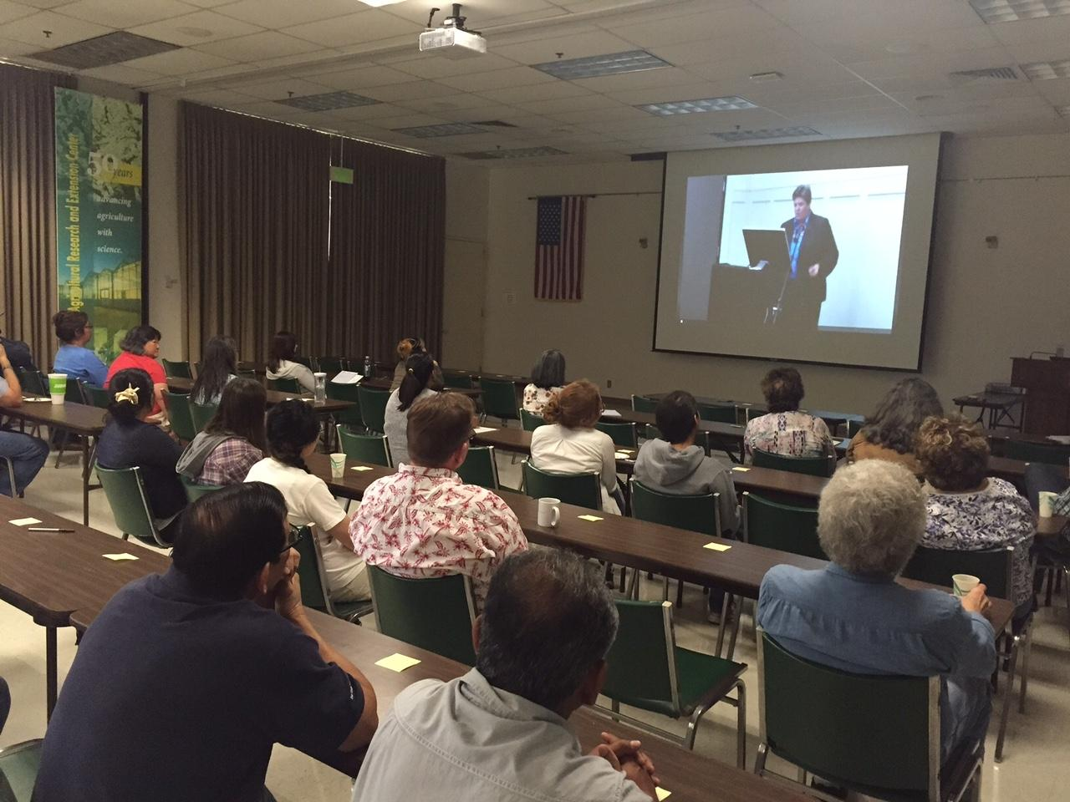
Vice President Glenda Humiston’s message from the 2016 Town Hall meeting
“I encourage staff to engage with the Staff Assembly as we work together to support healthy food systems, environments, people and communities in California”

Slide 5
Staff Assembly Vision
Staff Assembly works with ANR Leadership and other members of the ANR community to promote the interest and welfare of ALL staff employees
Find out more at staffassembly.ucanr.edu
Notes:
The assembly will be our voice, your voice to leadership on issues that you think are important, so get involved. All staff including county paid, part-time etc are members of the assembly. About 500 career staff, 250 limited term, 100 county paid.

Slide 6
Staff Assembly Mission
Reaching out to ALL ANR STAFF on issues of concern
Offering opinions and recommendations to leadership on policies, processes and programs
Fostering an understanding of ANR’s mission
Offering career training and professional development opportunities to ALL ANR STAFF
Notes:
Information moving vertically through the organization
Staff input on policies, processes and programs
Helping to make those connections within the ANR community
As we move to performance based evaluation, providing resources for staff to reach their career goals (things such as mentoring and leadership)

Slide 7
2016-17 Activities
Building a network of ‘Ambassadors’
Involvement in the Council of UC Staff Assemblies (CUCSA)
Staff survey (November 2016)
Career development was listed as a top priority identified by staff in the Staff Assembly survey

Slide 8
Staff Assembly Scholarship Program
Staff Assembly launched its 2016-17 scholarship program in February 2017
Three people applied and all three were awarded in 2017
This year a sub committee is developing the program for 2017-18

