Slide 1
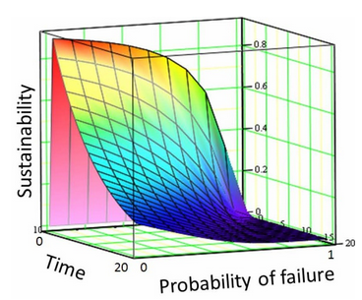
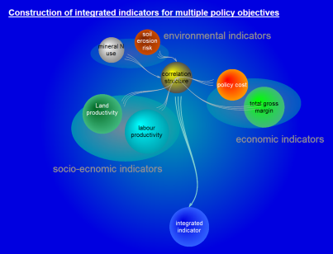
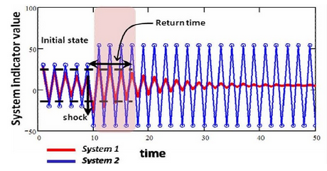
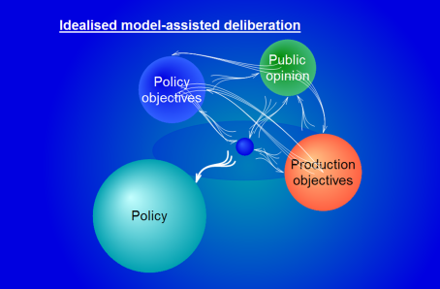
Sustainability:
Linking Theory to Practice
ANR Sustainable Food Systems Panel Webinar
May 31, 2013
Neil McRoberts
Assistant Professor of Plant Pathology

Slide 2
Scene-setting
Pick up on some themes raised by Tom Tomich in the first seminar in the series:
    http://lecture.ucanr.org/Mediasite/Play/1a20972eadba48cc95e01a7bd23b83571d
    Sustainability science
    Anticipating thresholds and challenges
    How to translate theoretical concepts into practical, local actions
    People
  Offer some observations on making interdisciplinary interaction work
  Give a few pointers to web resources on sustainability/resilience

Slide 3
Example Required Outputs from Scottish Sustainable Farming
Systems, science tendering document (2008)
Holistic, inter-disciplinary understanding of the interactions between social, economic, management and environmental drivers which impact upon farming systems (including climate change, protection of biodiversity and sustainability)
To develop acceptable ranges of key criteria for farm resilience and to test concepts of farm resilience under contrasting levels of farm management.
Optimised models of farm-scale management for landscape-scale environmental benefits.
An evidence base for advice to farmers on solutions that are good for the environment and good for business.

Slide 4
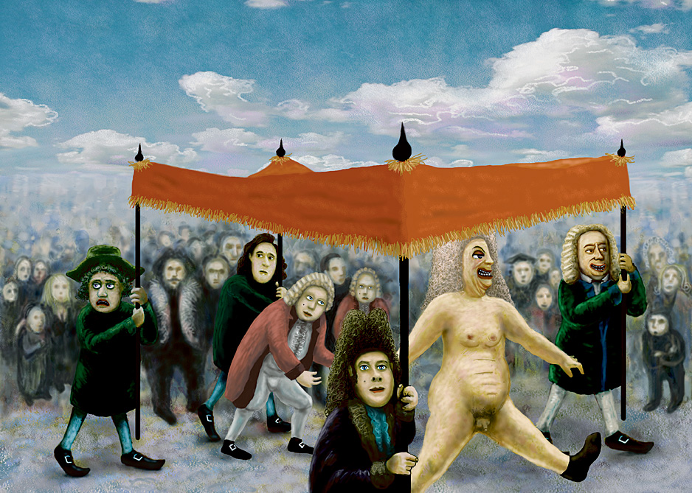
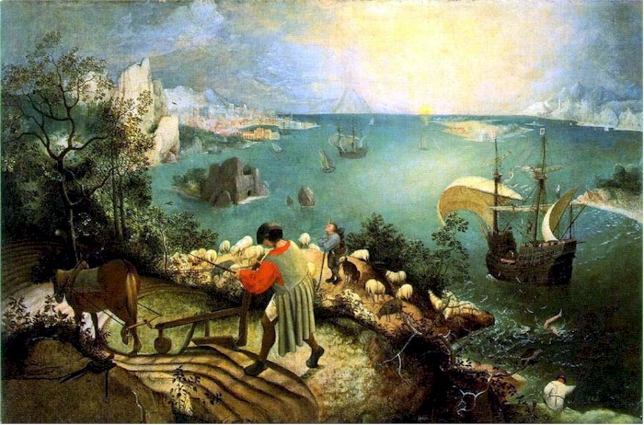
Why does so much of the policy discussion remind us of this cautionary tale?
Sustainability: is it all chatter?
Perhaps because
“…the ploughman may
Have heard the splash, the forsaken cry,
But for him it was not an important failure;”
W.H. Auden
© Thorarinn Leifsson
Pieter Breuegel, now attributed to unknown copyist, Musée des Beaux-Arts, Brussels
Notes:
Tom talked a lot about the core meaning of sustainability.

Slide 5
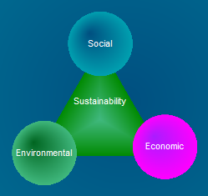
Simple concepts, difficult science
It is not easy to compare these domains directly

Slide 6
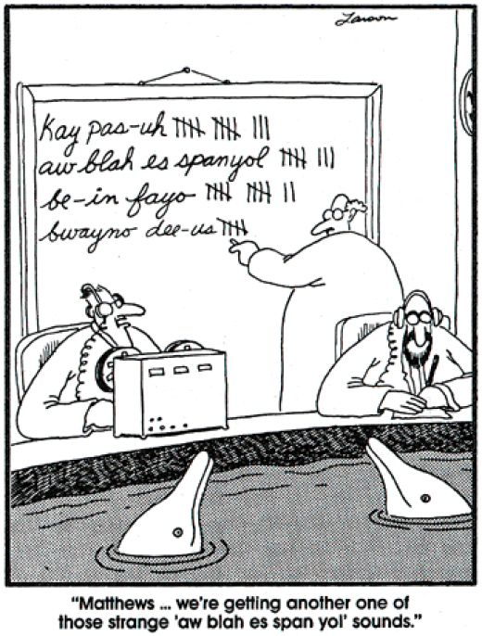
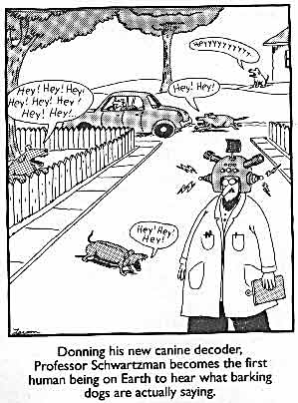

Scientists: sometimes we don’t help our rationale be understood
Policy
Science
Guard against the
“progressive policy wonk effect”
Niels Roling “the progressive farmer effect”
http://www.fao.org/docrep/008/y5983e/y5983e10.htm

Slide 7
First take-home
Give clear, technical definitions of important terms and stick to them to anchor the wider discussion in science
Particularly, Sustainability and Resilience

Slide 8
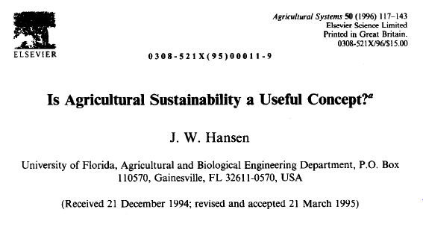
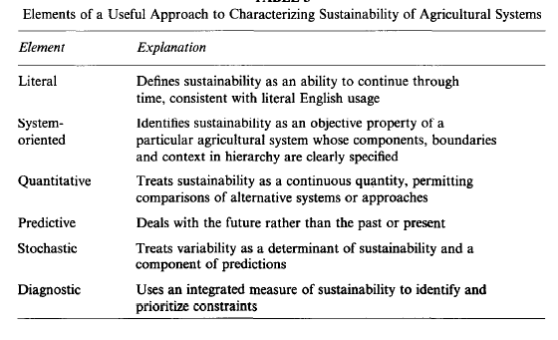
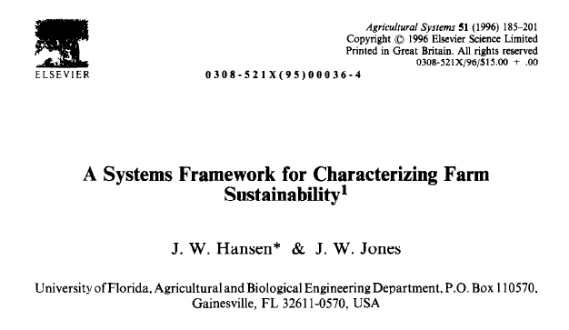

Retaining the core meaning of sustainability
Instantaneous probability of failure
Sustainability at time, T
Threshold for failure

Slide 9
Example Required Outputs from Scottish Sustainable Farming
Systems, science tendering document (2008)
Holistic, inter-disciplinary understanding of the interactions between social, economic, management and environmental drivers which impact upon farming systems (including climate change, protection of biodiversity and sustainability)
To develop acceptable ranges of key criteria for farm resilience and to test concepts of farm resilience under contrasting levels of farm management.
Optimised models of farm-scale management for landscape-scale environmental benefits.
An evidence base for advice to farmers on solutions that are good for the environment and good for business.

Slide 10
First take-home
Give clear, technical definitions of important terms and stick to them to anchor the wider discussion in science
Particularly, Sustainability and Resilience

Slide 11
Retaining the core meaning of sustainability
Instantaneous probability of failure
Sustainability at time, T
Threshold for failure

Slide 12
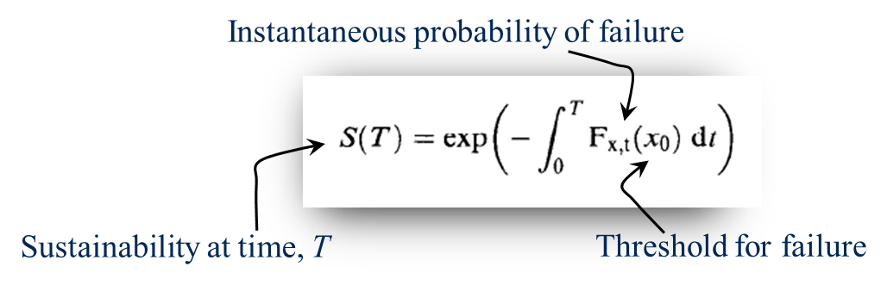
What does this suggest about the time-course for sustainability?
The simplest case:
If F_{x,t}(x₀) is a constant
Let p = p(t) = F_{x,t}(x₀)
Assume p(t) = p(t-1) ∀ t
If p is probability of failing, (1-p) is probability of not failing.
Probability of not failing for 2 consecutive periods is (1-p)×(1-p) = (1-p)²
Probability of not failing for t periods is (1-p)^{t}
S(T) = (1-p)^{t}
Notes:
In the version of the presentation which was used on 5/31/2013, there was a mistake in the slides which were used. This set of slides and notes should be seen as a replacement for the repeated pair of slides which appears as #10 and #11.
Let’s start with simplifying this concept a bit. First, note that we have two “working parts” in the model: a probability, F_{x,t}, that “failure” will occur in any given short time interval, and a threshold, x₀, which measures the value of an indicator of the state of the system against which we compare the current state to decide whether we’re still in business. Now, in reality the probability and the threshold are not really independent variables, but let’s proceed for now as if we can pull them apart and start by thinking about the probability of failure in each small time step.
Since we’re simplifying things we’ll change the notation so that we represent the probability by the letter p. This probability can change with time and there is now a priori reason to think that any particular type of change is more likely than any other. For the moment let’s take the simplest case in which, in fact, p is constant and does not change over time. In this case, as shown on the slide, we can rewrite the equation for sustainability as S(T) = (1-p)^{t}. Over the long term, with a constant probability of failure (or change of state) in each time step, sustainability takes the form of an exponential decay curve. This is depicted on the next slide.

Slide 13
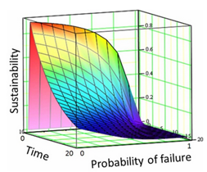
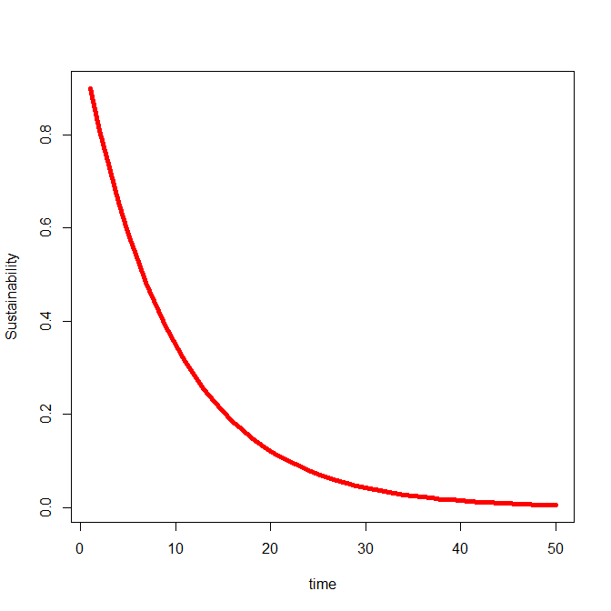
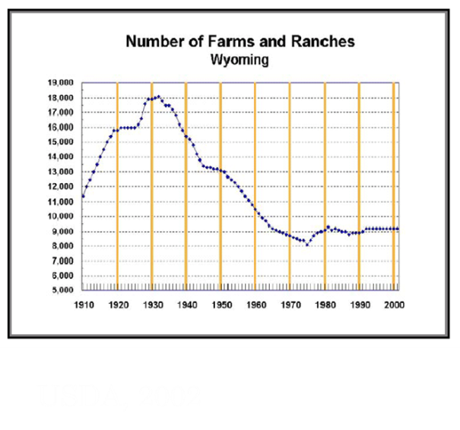
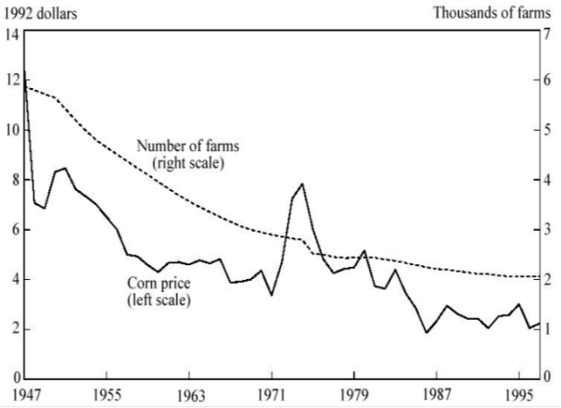
The simplest case, in pictures
Real-world examples
S(T) = (1-p)^{t}
p = 0.1
USDA, 2002
Drabenstott, M. 1999. Consolidation in U.S. Agriculture: The New Rural Landscape and Public Policy. First Quarter Economic Review
Federal Reserve Bank, Kansas City
Notes:
In the hypothetical example on the left of the slide, the instantaneous probability of failure is p = 0.1. The 3D surface in the top right-hand corner gives an idea of the sustainability curve changes as p changes from 0.1 to 0.9. A couple of real-world examples are illustrated. The upper middle graph shows the USDA NASS data (as of 2002) for the total number of farms and ranches in Wyoming from the period when official records started. The settling of the high plains in the early 20th century can be seen progressing until 1929 and the great crash and the process of de-settlement began.
A similar picture in the data from the 1990’s in Kansas is shown in the lower plot. The trend in declining farm numbers there may be weakly correlated with corn prices but it probably also reflects a large number of other factors driving structural change. Both of these data sets (and others like them) raise the interesting question of whether function of farming is declining along with the loss of farms or whether they reflect a process of consolidation, so that the land remains in production but the farm size distribution changes. This question is tied to the one the Sonja asked during the Q&A session about clearly defining what it is that one wishes to make sustainable. Is it farms we care about, or farming, or both?

Slide 14
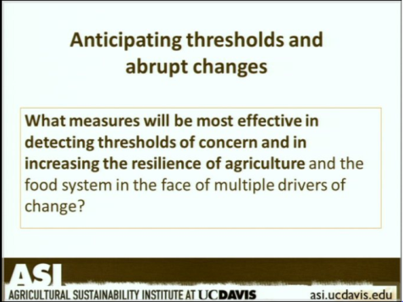
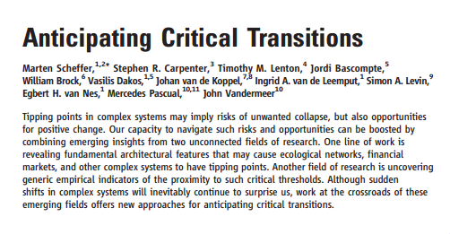
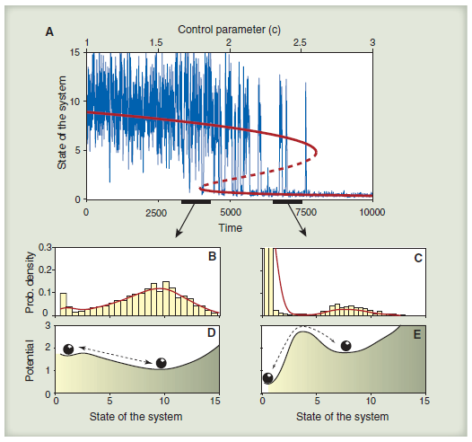
Anticipating thresholds
See slide #17 in Tom Tomich’s presentation
Science, May 2013
Notes:
Armed with the analytical tools for looking at sustainability and resilience we can start to think about some of the key questions that Tom raised in his seminar; none of these is more important than the question of being able to forecast when a system will change state – flip from a preferred state to a dis-preferred state for example. As Tom indicated we are only at the beginning of being able to do this well, but a recent review by Scheffer et al (2012) in Science lays out some of the analytical techniques that are now being used. Jordi Bascompte, one of the paper’s authors was a recent guest speaker in the UCD Major Issues in Biology Seminar series.
An important point to note about these kinds of analyses is that they rely on having enough data available to be able to estimate the underlying dynamics. For some global questions there are probably long term data to allow this type of analysis but for more local questions we may be struggling.

Slide 15

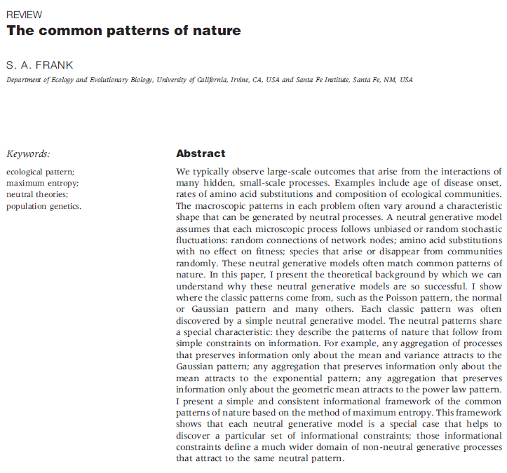
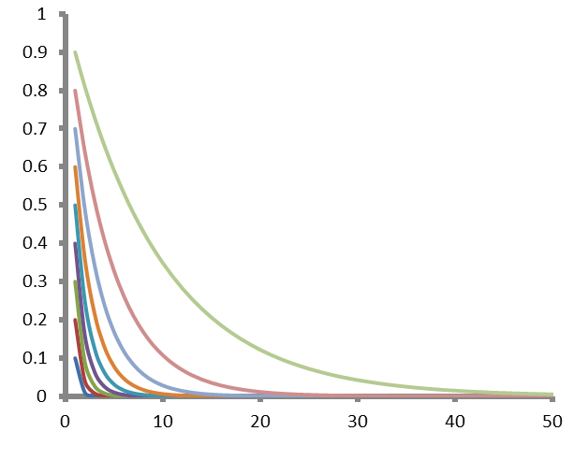


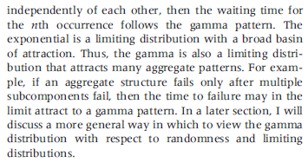
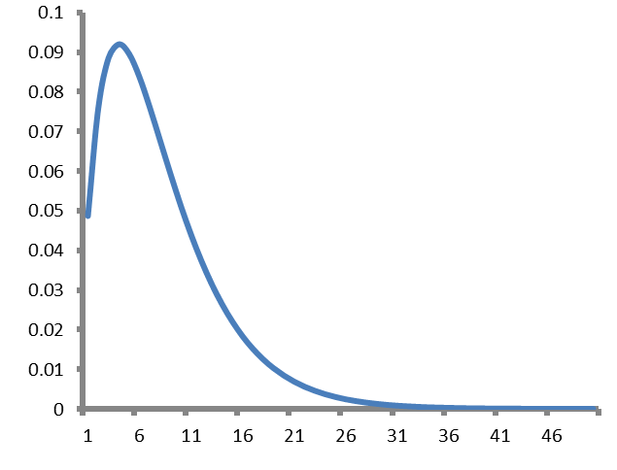
Sustainability is multidimensional: what should we expect to see?
S(T)
time
Probability density
time to failure
Notes:
It is also the case that while a lot of the theoretical work is developed with the idea of a single dimension for sustainability, we know that there are multiple dimensions and that “failure” might occur along any of them. There are at least the beginnings of analytical approaches for this kind of more complex problem too and the general form for the kind of results we expect is known in some specific cases. For example, suppose there are multiple dimensions along which sustainability might be declining. If these are all described by simple exponential decay curves with different probabilities for state change, the expected distribution of “time until failure” for a cohort of systems will follow a gamma distribution. These concepts are highlighted in the figures in the slide. Steven Frank, an evolutionary ecologist at UCI, has spent some time in the last few years thinking about how different underlying processes combines with the way we measure systems to generate data with different types of probability distribution. These are complex technical questions but might provide some basic pieces of methodology to allow us to look at systems in multiple dimensions.

Slide 16



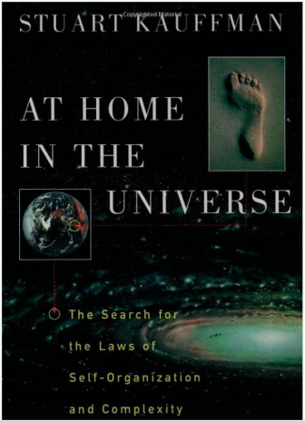
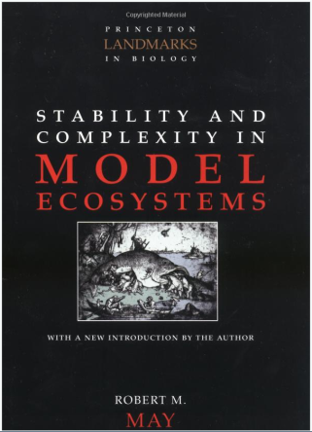


Two views of Resilience: “adaptionist” or “engineering”
Evolutionary, adaptive,
open hierarchical systems,
multiple stable states,
self-organizing
Equilibrium,
dynamics, stability
periodicity, regulation oscillations,
Notes:
One complication that people encounter in trying to learn about resilience is that there are multiple technical meanings in use. There are two major schools of thought, the adaptionist school and the system dynamics, or engineering school. The adaptionists, particularaly Holling, Gunderson, and followers have devoted a fair amount of time promoting their view of resilience and highlighting what they see as the shortcomings of the other view. I think both approaches have useful ideas to contribute.
On the slide I have identified a number of books that have been important in shaping my own view and providing some of the analytical tools that I use. One the left side the books are more in the adaptionist school, although I doubt that Kauffman associates himself with this lineage and my view of parts of his work as sitting within this philosophy is entirely my own “taxonomy”. The Panarchy book and the more recent one by Giampietro are not easy reads but they are full of lots of interesting concepts and useful insights.
On the other side, the ecological dynamics approach is a clearer lineage although I don’t suppose Pete Turchin sees his work as a descendent of Royama’s. May’s book on model ecosystem stability is a classic. Royama’s and Turchin’s books are heavy on statistics and mathematics, but contain many clear ideas on system dynamics from an ecological perspective that can be applied to other types of data.
All of these books on the behavior of systems over time can be traced in some way to a common ancestor in Arthur Koestler’s Ghost in the Machine which was first published in 1968 and did a great deal to establish the discipline of hierarchical systems analysis. Koestler’s book is actually about the origins of human nature but to get to the point of being able to talk about that difficult topic he first establishes the idea that hierarchies are important in dynamic processes in general and evolution in particular.

Slide 17
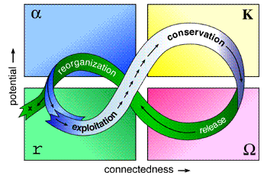
Resilience caricatures in pictures
Engineering viewpoint
emphasis on seriality?
Adaptionist viewpoint
emphasis on cyclicity?
Blight intensity index
year (t)
Are these views really different?
Notes:
We can caricature the difference between the engineering (dynamics) view and the adaptionist view of resilience in these two pictures. For the engineering approach the focus is on the properties of the time series of points for the system over time. For the adaptionist the focus is on the idea that systems cycle through an endless set of 4 eras in which there is accumulation of resources and increase in connectedness, followed by collapse and reorganization.
By straightening out the cyclic picture on the right and plotting it over time we can recover something like the picture on the left. Similarly by plotting this year’s value for the system against last year’s instead of plotting each of them in time, we can turn the picture on the left into something like the picture on the right, so the apparent difference between these two perspectives is over emphasized by the caricatures.

Slide 18
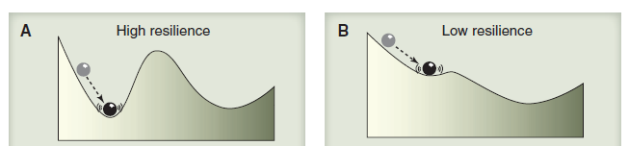
Both views of resilience depend on the “dynamical landscape” of the system
Indicator
variable value
From Scheffer
et al. 2012
System state or rate
HIGH RESILIENCE
Adaptionist: High capacity to absorb shock
Engineering: Short return time to initial state
LOW RESILIENCE
Adaptionist: Low capacity to absorb shock
Engineering: Long return time to initial state

Slide 19
Take home 2
Sustainability and resilience are properties of systems (physical, living, economic, social and hybrids of these)
Sustainability is the capacity for a system to persist over time and is best measured in relation to a stated time interval.
Resilience is a component of sustainability related to the dynamic stability of a system and can be measured in a number of different but connected ways some of which focus on temporal dynamics some of which focus on capacity to absorb perturbation

Slide 20
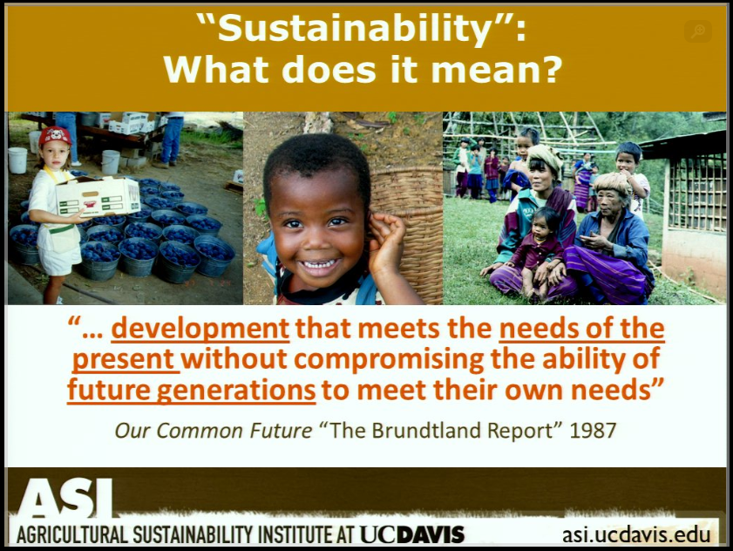
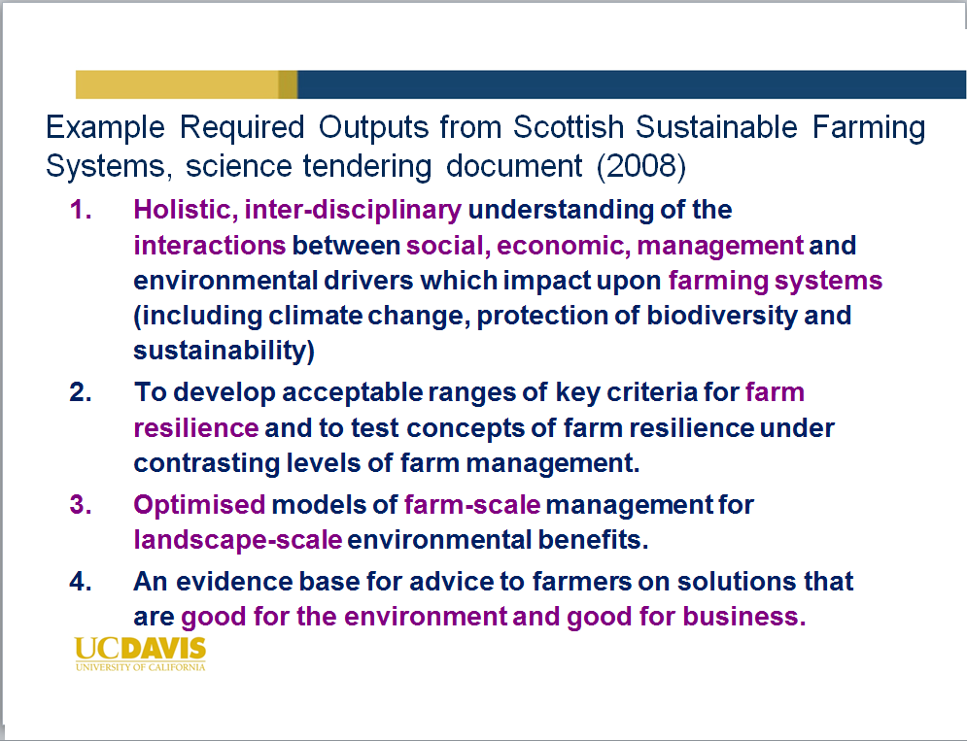
What can we do with our definitions to help make them operational?
Tom’s raised the issue of how to make broad,
aspirational definitions operational.
That was the issue here too
This step depends on having clear and formal
definitions for sustainability and resilience.

Slide 21

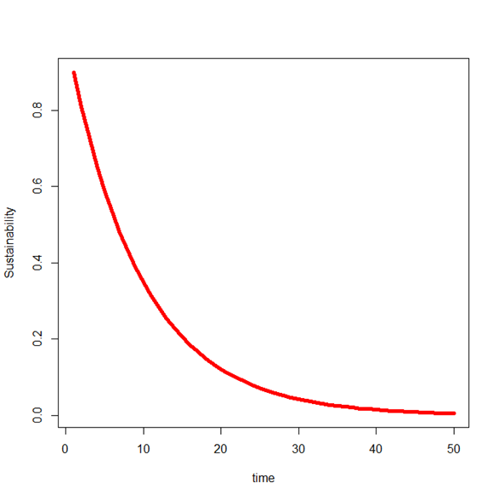
Getting operational: using our formal models as guides for action
The simplest case:
If F_{x,t}(x₀) is a constant
S(T) = (1-p)^{t}
Model suggest two access routes
for action:
Reduce probability of failure
Change/remove/buffer thresholds

Slide 22

How much difference can management make?
Time period for S(T)
Decrease instantaneous probability of failure by factor of 10
Individuals or
averages?
Cross-scale
perspectives
S(T) = 0.545
S(T) = 0.042

Slide 23
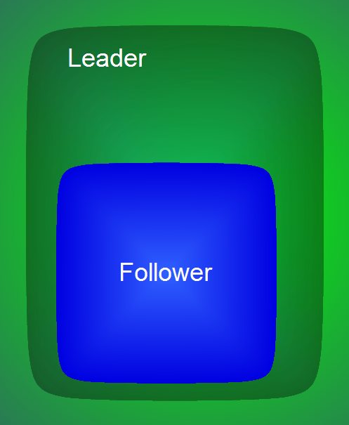
Levers and indicators
Sustainability management questions are often BLOPs:
Bi-level Optimisation Problems
Policy lever
Indicator

Slide 24

Within the follower level, we are dealing with individuals not aggregate (statistical) behavior
  N_{t} = B[N₀, (1-p)^{t}]
ANR

Slide 25

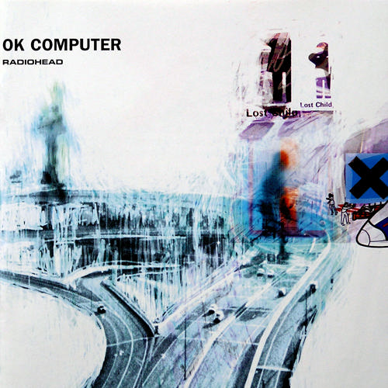

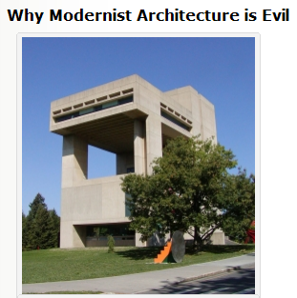







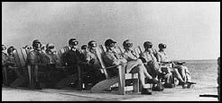
Modernity and the risk society
Current theoretical background developed by Anthony Giddens (LSE) and Ulrich Beck (Munich/LSE):
  Function of modernity: greatest risks now come from actions of society not the external world
Sociology-speak: Risk perception has both contextual and individualistic components, or;
Science-speak: Risk perception is a P×E interaction
An historical emphasis on farmer typologies (i.e. risk-behaviour phenotypes).
  Rodger’s work on diffusion of innovations
  David Pannell (WA) perspectives from Ag. Econ.
  Edinburgh farmer scales Ian Deary, Joyce Willock (+others)

Slide 26
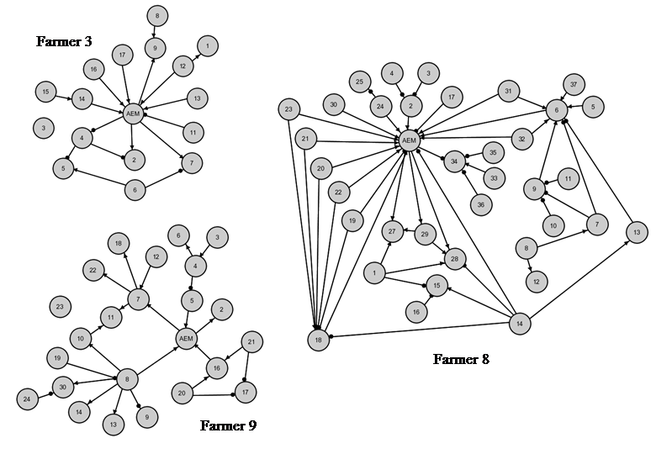
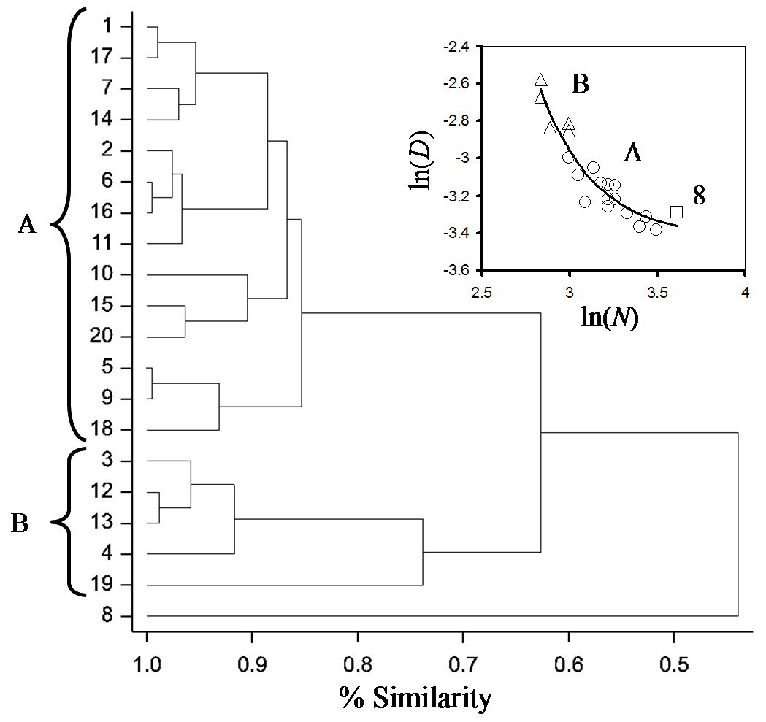
Followers are diverse
#8 sees connectedness but
has relatively low outdegree
score for AEM
Group B might be best
instigators of change

Slide 27
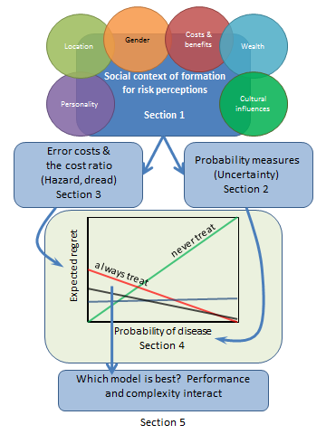
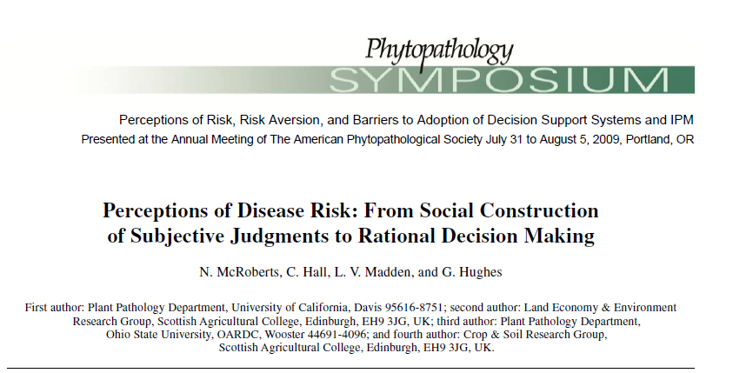

Slide 28
Linking individual decisions to policy outcomes
Cumulative value
Sustainability (mean survival time)
Cumulative value
Financial growth stabilises
as decision quality
increases
Decision false positive rate
Notes:
False decisions have costs. Crop protection example: As false decision rate goes down, unwarranted pesticide use declines, individual users save money and environmental protection increases. If business success depends on correct expenditure on pesticides, main graph shows results of simulation experiment (mean and standard error) showing probability of business survival (sustainability) against false positive error rate (over use of pesticides when not needed). Small graphs show the variation in 100 individual business behaviours in the model. In the small graphs the horizontal axis is time and the vertical scale is “wealth” and the thick black line is the sustainability threshold (if wealth drops below this the business fails). Note that improved decision making results in more wealth and more uniform trends among businesses

Slide 29
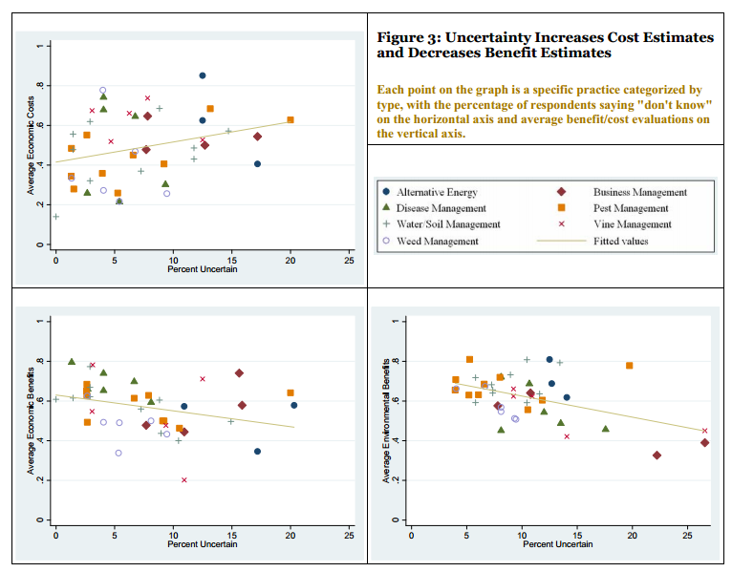
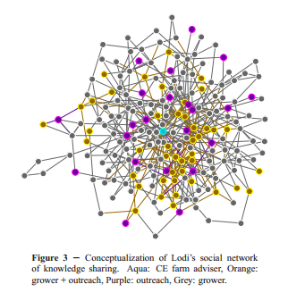
Social networks and (some aspects of) why they matter
From the Sustainable Viticulture project in the Center for Environmental Policy and Behavior, UCD. Matt Hoffman, Vicken Hillis, Mark Lubell.

Slide 30
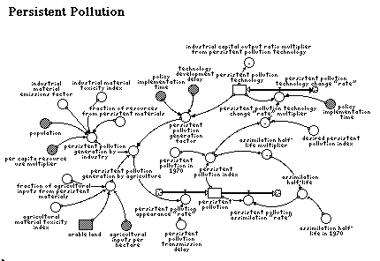

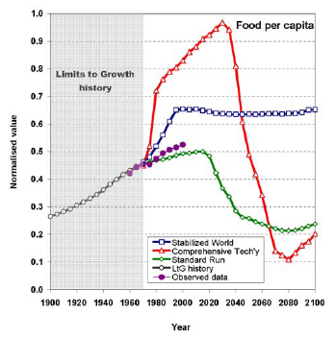
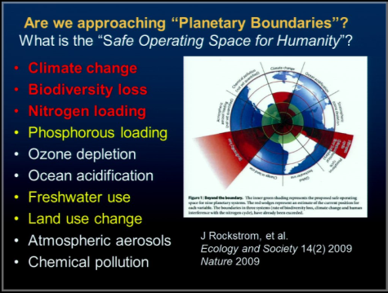
Cross-domain linkages are the most problematic pieces
World3 attracted a lot of adverse comment from fellow scientists
Some of the most telling criticisms of World3 concern linkages between different domains
In spite of the criticisms, World3 did a reasonable job of predicting some aspects of the earth system behaviour between 1980 and 2010
Tom’s slides 8-12

Slide 31

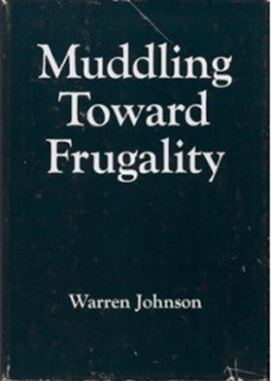
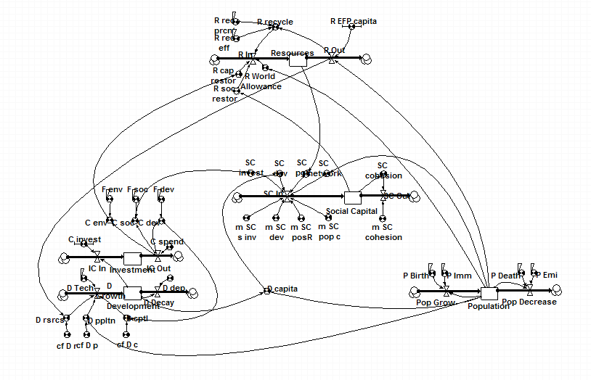
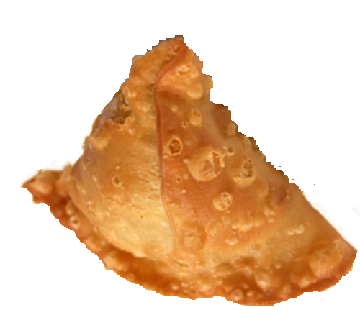

SiMoSu: Simple Model for Sustainability
Environment
Environmental
Resource use relative to
equitable, global C footprint
Novel function derived
from population size
& concept of social
scarcity
Social Capital
Economy
Economic
Social
Population

Slide 32
Voinov sustainability model
1
Population
3
Environmental.
degradation
4
Investment
capital
2
Development

Slide 33
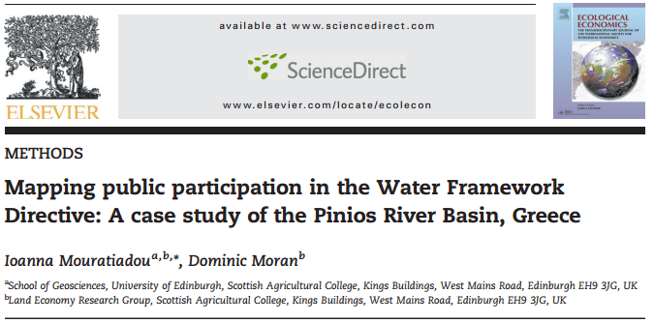
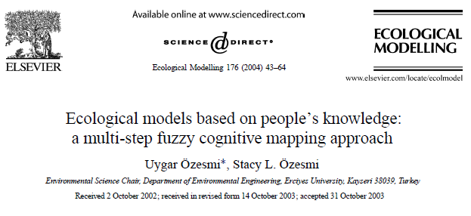
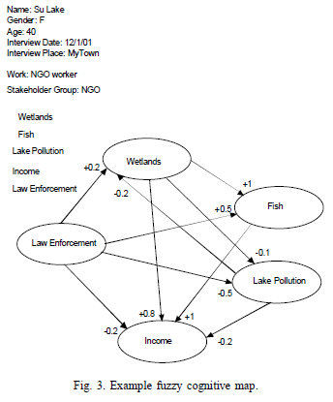

Participative modeling: bringing more people into the fold of science out of the wilderness of pseudo-science

Slide 34





Wider cultural effects and personal narratives are important if less easy to capture

Slide 35
Take-home 3
Be aware of the importance of hierarchies and their effects
Making sustainability or resilience operational means working with people, sometimes across scales
Can use formal methods to capture and use personal and collective knowledge/opinion

Slide 36


Resilience?

Slide 37
Essentials of stochastic series processes
N_{t} = f(N_{t-i}, Z_{t-j})
deterministic component
capturing self regulation
Stochastic component
capturing environmental
influence
Statistical property
Deterministic
Stochastic
Endogenous
f(N_{t-i})
Source of factor
Exogenous
g(t)
h(Z_{t})

Slide 38
Implications from time-series
“… I interpret the notion of (population) persistence…as a close resemblance of the behaviour of the population, until its accidental extinction, to the behaviour of a model process that conforms to the constraint on its second-order moment.” (Royama, 1996)
Fluctuations are, with high probability, finite in amplitude
There is no net long term change in system indicator
Trajectories are non-chaotic and converge on an attractor
(Turchin 2003)

Slide 39
Characterising resilience in dynamic systems
Chaotic, low AR
predictive
power
Chaotic, some AR
predictive
power
+
If system dynamics fall in this
region then the system is likely
to display resilience.
Note: if we are considering
a “bad” system property (e.g.
disease prevalence) this might
imply resistance rather than
resilience
(I)
(II)
LE
Tendency to chaotic divergence
Convergent,
low AR
predictive
power
Convergent,
some AR
predictive power
-
(III)
(IV)
-1
0
1
R²_{pred}
Predictability from historical trajectory

Slide 40



What do production systems deliver?
Soil properties fluctuating around stable equilibria, with dynamics dominated by environmental noise and first order lag dependence
LE
Soil OM%
Year
R²_{pred}

Slide 41
Reserves out of main cycles are important
n+1
n
£
n-1
e
n-1
Farm

Slide 42

Linking individual decisions to policy outcome
When there is no connection between policy formulation
and on-farm practice the two parts of the system have
separate dynamics
Example from arable weed management
BUT! If policy objectives are connected too much to farmer objectives, by over-monitoring of agri-environment measures, the policy cycle starts to be driven by short-term system dynamics

Slide 43
Take-home 4
Quantitative analysis of resilience requires long term data
Making theories operational requires working with people (c.f. sustainability)
Hierarchies and cross-scale effects are important

Slide 44

Design principles for sustainability science
I.O.U.O.R.M.I.
Identify Object(s) to be sustained
Use Occam’s Razor and
Methodological Individualism
Be clear about what is at risk
Keep it as simple as possible
Beware of over doing reductionism

Slide 45
How should we organize ourselves to deliver sustainability science?
Work from stable, scientific core definitions of key concepts
Reaffirmation/rejuvenation/redefinition of the Land Grant mission
  2D Interdisciplinarity
Institutional support/recognition for “connectors”
Promote hybrid disciplines and non-standard views of scientific methodology
KT interactions
Academic interactions

Slide 46
Some useful web resources
The Resilience Alliance:
  www.resalliance.org
Dashboard of Sustainability
  http://www.iisd.org/cgsdi/dashboard.asp
World Bank global atlas of statistics
  http://www.app.collinsindicate.com/worldbankatlas-global/en-us
Statistical Visualization tools (and other fun things)
  http://www.gapminder.org/
FAO statistics
  http://www.fao.org/corp/statistics/en/

Slide 47
Sustainability:
Linking Theory to Practice
Questions?
May 31, 2013
Neil McRoberts
Assistant Professor of Plant Pathology

