Slide 1
READ ME --1
All images in this deck are copyright UC Regents.
You can change the text on any of the slides in this deck. The headers, branding footer, and photos are one image on most of these slides.
This is so the header will display in the Chronos font and/or so the copyrighted image is protected.

Slide 2
READ ME --2
If you want to change the image – you can duplicate and use any of these Read Me slides.
If you like, can change the theme of this slide to one of the themes with an ANR sub brand. We’re using the basic ANR slide for simplicity.

Slide 3
READ ME --3
Delete slides not relevant to your audience.
This mini-deck is designed to work with We Are UC ANR when shown to internal audiences.
For large images, charts, or graphs – use a blank slide for best viewing

Slide 4
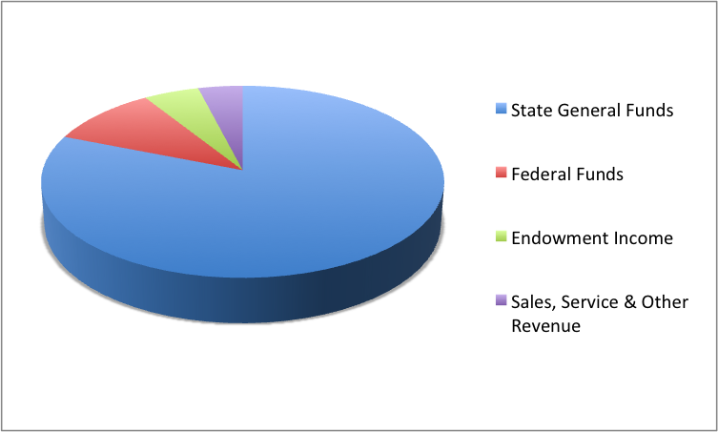
Funding Sources
Notes:
Exact funding levels vary, but ANR receives the bulk of its funding from California state general funds. Federal “Formula” funds and AFRI grant funds supply the next largest slice. Endowment income and sales and other revenue sources are the smallest sources of revenue. County and other local funding provides an important, but smaller part of funding for UCCE. In [your county here] local funding is $XX.

Slide 5
Money In:
Contracts and Grants
http://ucanr.edu/contracts grants
Development Services
http://ucanr.edu/Development_services/

Slide 6
Money Out:
Business Operations Center Davis
Serves Statewide Programs, REC’s, and Davis-based support units
http://ucanr.edu/boc davis
Business Operations Center Kearney
Serves Cooperative Extension statewide
http://ucanr.edu/boc kearney

Slide 7
PI Hub
http://ucanr.edu/sites/pitraining/

Slide 8
GETTING THINGS DONE
Program Planning and Evaluation
http://ucanr.edu/program plan and eval

Slide 9
Spreading the Word
ANR Communication Services and Information Technology
http://anrcs.ucanr.edu/
ANR Portal – access to all things ANR
https://ucanr.edu/portal
ANR Brand Toolkit
http://ucanr.org/sites/Toolkit/

Slide 10
Management and Oversight:
Budget Office
http://ucanr.edu/budget
Controller and Business Services
Administrative Policies and Business Contracts
Oakland Computer Services
Environmental Health & Safety
Financial Services
Risk Services
http://ucanr.edu/controller

Slide 11
HR & Personnel:
Academic Personnel
http://ucanr.edu/academic personnel
Staff Personnel
http://ucanr.edu/staff personnel
Affirmative Actionhttp://ucanr.edu/affirmative action

