Slide 1
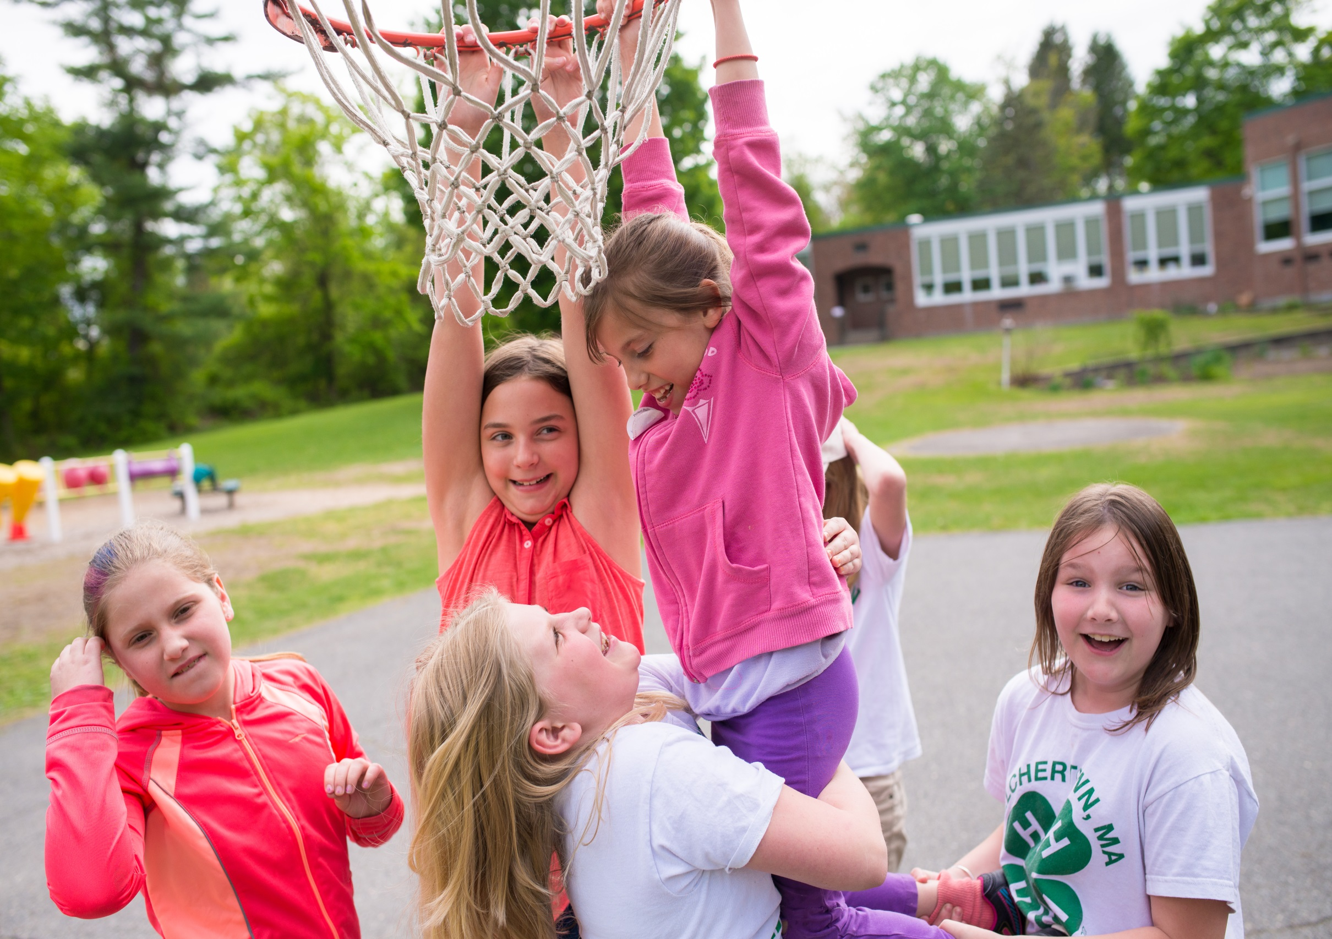

Slide 2
“It’s not hard once you get started and the more you involve the kids and their families the easier it is to keep it going. So come join us and earn your pin!”

Slide 3
“I enjoyed seeing our youth club officers work together to help create an environment where good health is encouraged and supported. It was really fun.”

Slide 4
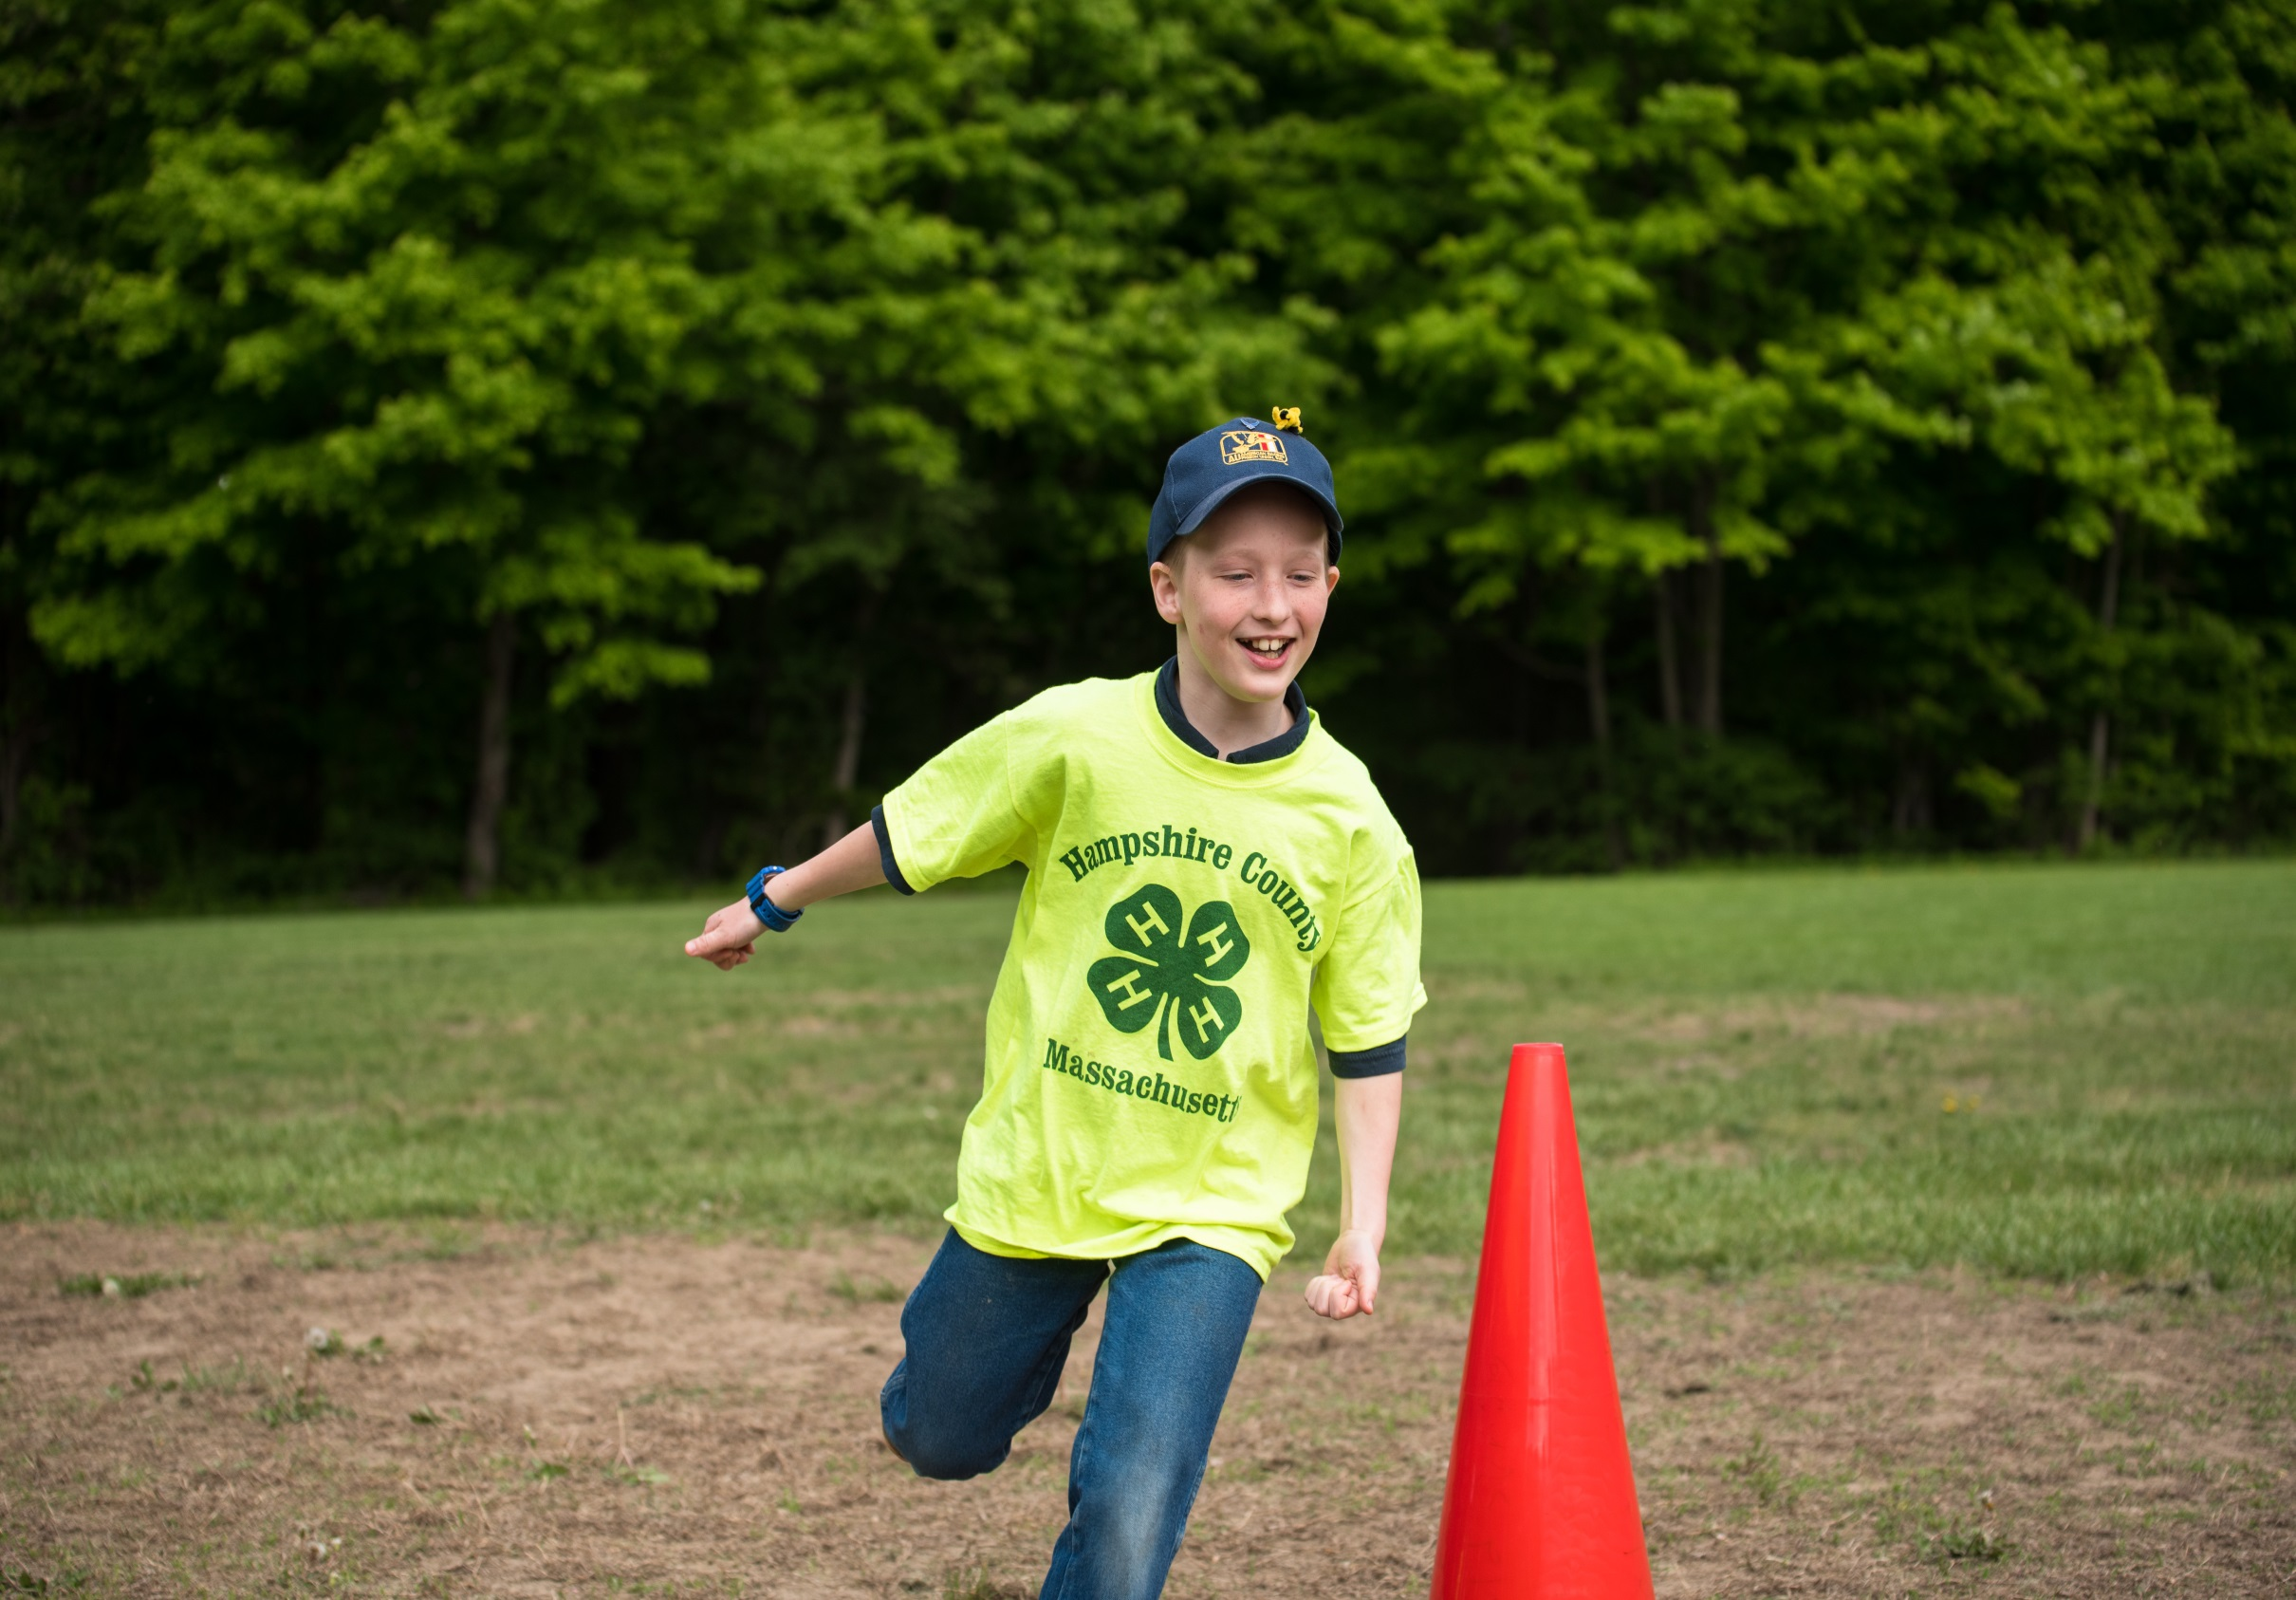

Slide 5
“You will be surprised by how willing the kids are to participate. They encourage each other. We are going to keep the healthy meeting practices as a part of our regular monthly meetings.”

Slide 7
“Parents have commented that they are seeing changes in food choices at home and their kids are also being more active.”

Slide 9
“When asking for a snack from the families they are making a better choice. What was once cookies and cupcakes are now bananas and apples.”

Slide 11
“Parents are supporting water, and now virtually all outside sugar sweetened beverages disappeared from club meetings.”

Slide 12
“Go for it! Lead by example. Youth are more likely to try new things once you have modeled it for them.”

Slide 14
“We focus on agriculture a lot in our group, and that ties in well with healthy living. Even field trips to local farms were good exercise, digging carrots and walking the greenhouses.”

Slide 16
“I’ve noticed changes - the kids have more focus and less hyperactivity with crashes and brain fog during events.”

Slide 18
“We’ve made this a permanent change and they like being a part of it. The kids are interested in competing in dog agility so having a healthy dog and body to run will make it easier for them to achieve success.”

Slide 19
“I would say to other leaders that this is a great opportunity to encourage healthy habits by starting with 4-H. It was easy to do.”

Slide 21
“It is said that after doing something consistently a few times it can become a habit. I would encourage all leaders to take this challenge with their clubs to teach the members strong healthy habits.”

Slide 22
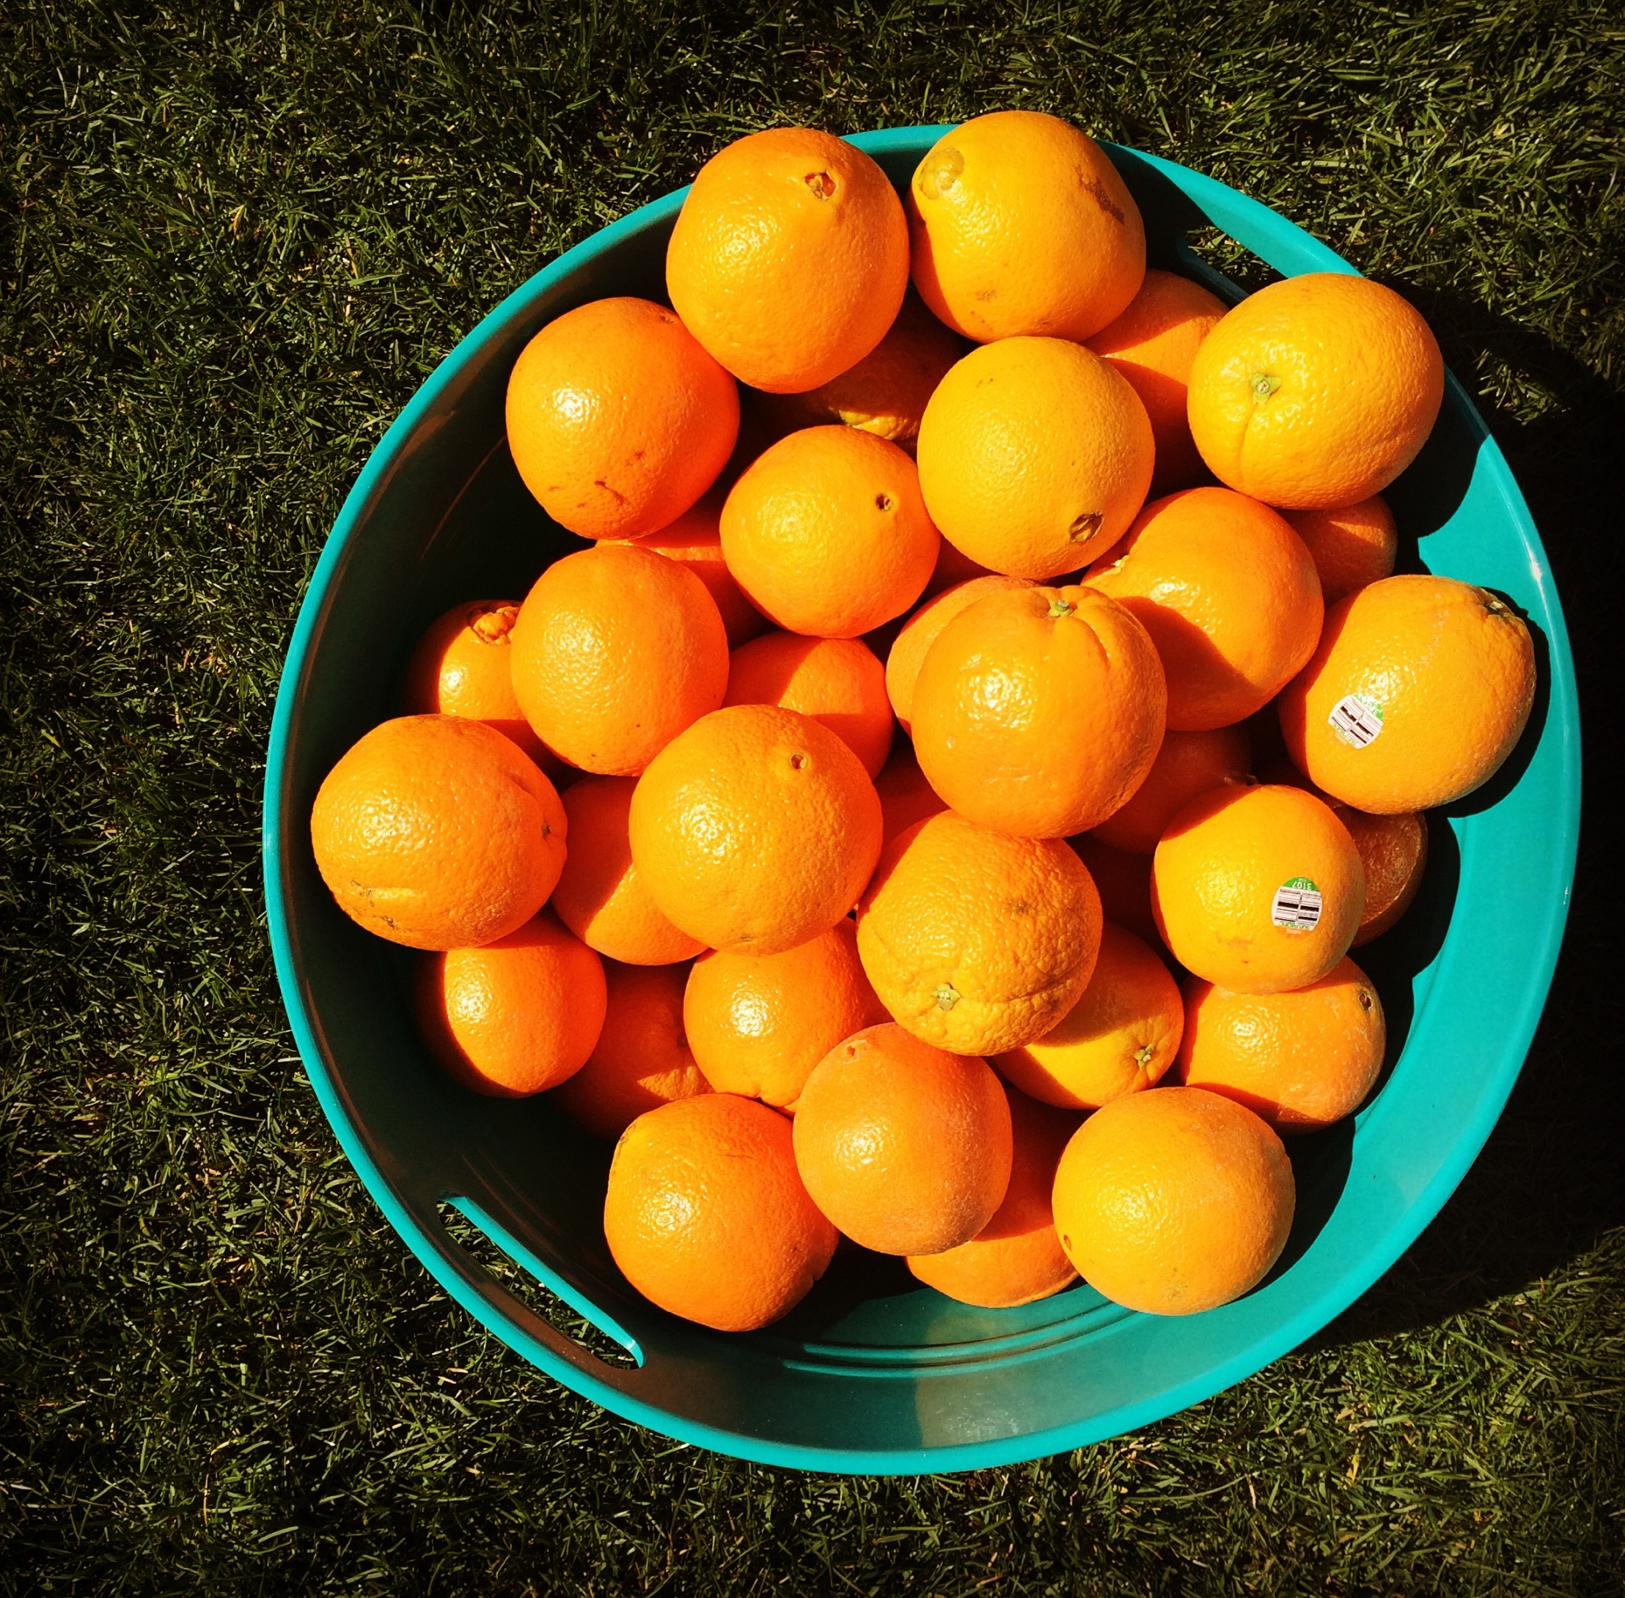

Slide 23
“I’ve noticed the 4-H members being more conscious of health and food choices. They’re more willing to try healthier snack options as well as incorporate more physical activity during monthly meetings.”

Slide 25
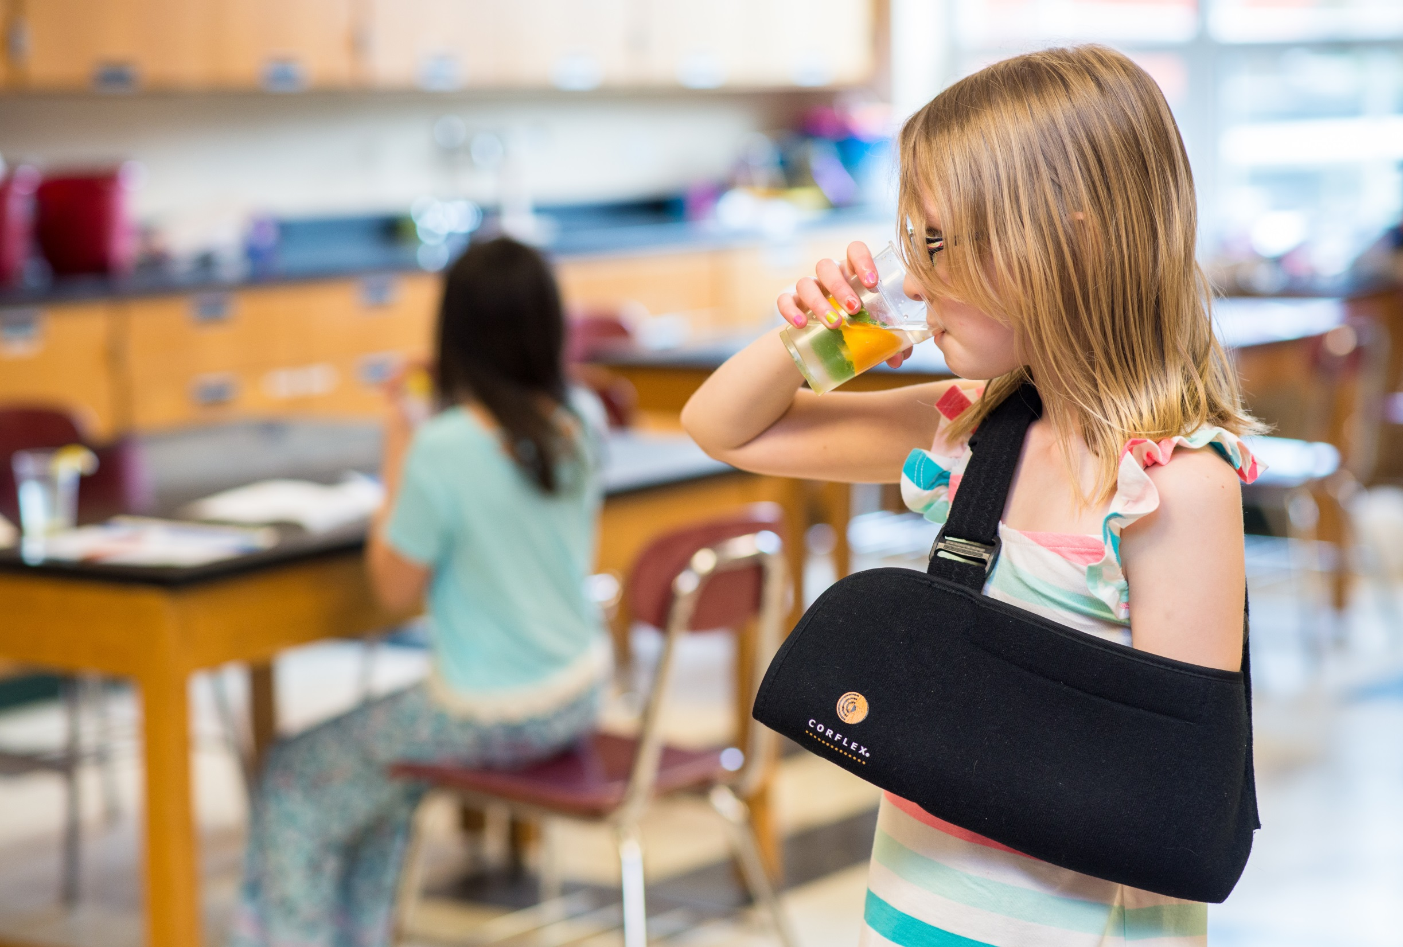

Slide 26
“I worked the challenge into our science activities. For instance, when learning about the five senses we had a fruit and vegetable taste test.”

Slide 27
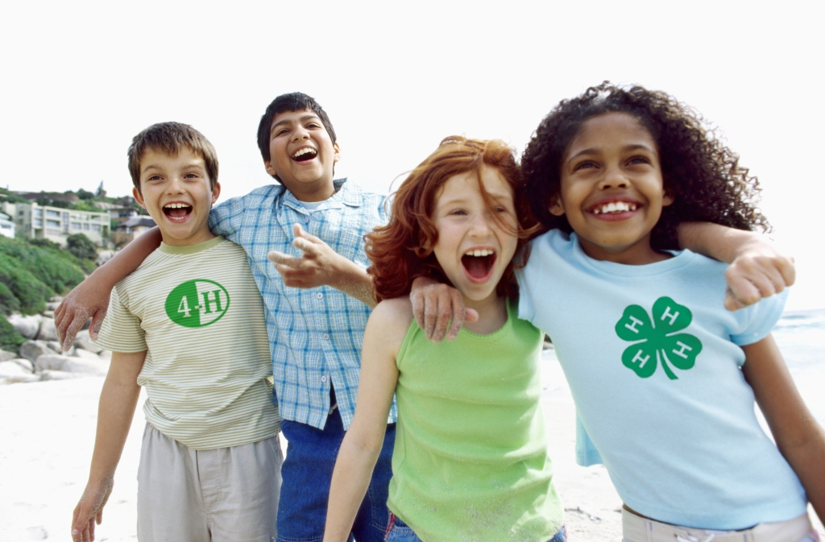

Slide 28
“Club members enjoyed the healthy snacking, and moving around working off some energy. We will continue to add healthy activities and get the members involved in the planning.”

Slide 30
“Club members have accepted water, healthy fruits and vegetables, and exercise as a standard part of our club meeting.”

Slide 32
“The 4th H for Health Challenge is easy and fun, and kids are proud that they completed it. Leaders are proud too.”

