Slide 1
2014 Call for CE Positions
Reviewer Orientation
Bill Frost
Katherine Webb-Martinez
May 20, 2014

Slide 2
Agenda
Overview of Process
Reviewer Roles & Responsibilities
Instructions & Criteria
URS Demo
Reminder:
Mute phone until you want to speak. Press *6 to mute and *7 to unmute.
Silence cell phones.
Do not put call on “hold” (problem with music).

Slide 3
Notes:
Now in the review phase -- phase 2 of the position process
Note: the public comment period remains open until July 21st during part of the review phase so stakeholders have more time to comment on proposals.

Slide 4
Program Area/Unit Reviews
Timeframe: 3 months – May 20th through August 18th
Who serves as reviewers?
Program Teams
County and MCP Directors
Deans Offices
Final pool of proposed advisor & specialist positions --http://ucanr.edu/sites/anrstaff/Divisionwide_Planning/2014_Call_for_Positions/

Slide 5
Program Teams
Review all position proposals (specialist and advisor) relevant to program area
Program Teams identify which positions are pertinent to review
Program Team Leaders submit reviews in URS

Slide 6
County and MCP Directors
Review advisor position proposals within your surrounding geographic area, based on programmatic relevance
Work in review teams -- one person submits review and identifies review collaborators
Suggested geographic-based groupings are provided for guidance
Notes:
Map next slide

Slide 7
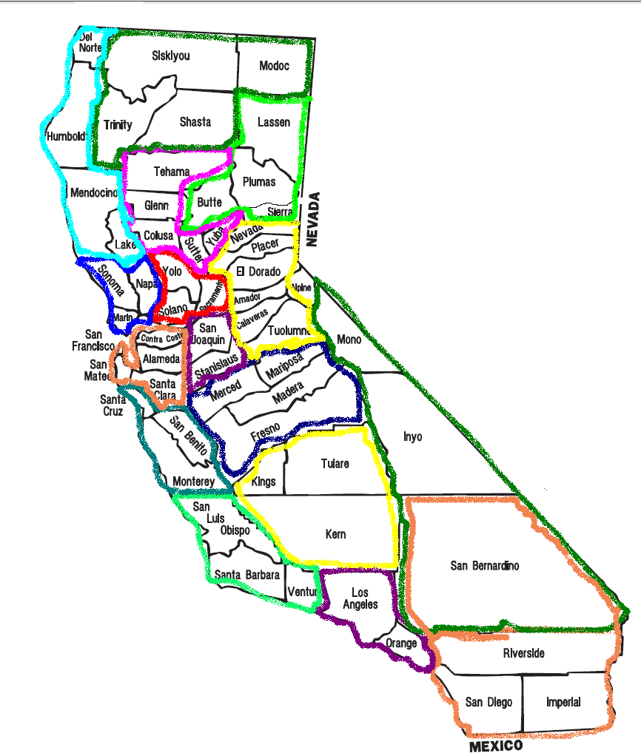
CD/MCP Geographic Grouping Guidance
Notes:
The geographic grouping depends on the programmatic scope of the position
For example, San Bernardino -- the CD may work with Inyo-Mono for a nutrition focused position OR with Riverside for a subtropical horticulture position
The main point is to focus your review on advisor position proposals within your surrounding geographic area

Slide 8
Deans Offices
Review all specialist position proposals for your college/school
Executive Associate Deans submit reviews
Notes:
Executive Associate Deans set-up their own review and prioritization process within the colleges/school

Slide 9
2014 Review Instructions
Within respective pool of position proposals:
Rate by grouping into categories
high priority, medium priority, & “this can wait”
no specific number must be grouped into each category
Among high priority positions rank the top positions -- up to 5
Provide comments to explain rationale for rating, and ranking as appropriate
Notes:
This ranking is new this call -- before it was tell us your top 3-5 now we want them prioritized

Slide 10
Criteria
Develops ANR’s capability to address critical issues
Demonstrates input from stakeholders
Strengthens the ANR network
Likelihood of making a significant impact
Has support necessary to be successful
Consistent with Strategic Vision 2025
Full description posted http://ucanr.edu/sites/anrstaff/files/177874.pdf
Notes:
Develops ANR’s capability to address critical needs.
Resources should be committed to positions that address critical existing and emerging issues, local and/or statewide, in order for ANR to contribute to the economic, environmental and social health of the state.
Position proposals should clearly explain how the position will address stakeholders’ needs-based priorities.
Demonstrates input from stakeholders.
Resources should be committed to positions developed through a broad, participatory process.
Position proposals should include input from internal and external stakeholders.
Strengthens the ANR network.
Resources should be allocated to positions that contribute to an integrated research and outreach approach to addressing programmatic issues.
Position proposals should explain how the position would significantly augment the capacity of the existing network of AES scientists, non-AES scientists, UCCE Specialists, and/or UCCE Advisors. For recent CE position hires and current recruitments, refer to the list posted on the 2014 Call for Positions webpage http://ucanr.edu/2014callforpositions.
Likelihood of making a significant impact.
Resources should be invested in positions where Division research and outreach efforts can be realistically expected to make a difference to the public served given the Division’s mission and unique capabilities. Focus should be on where ANR has a competitive advantage relative to other agencies and organizations in contributing to meaningful economic, environmental or social impacts.
Position proposals should articulate specific, intended outcomes for the identified key clientele groups, as well as the potential, broader public value impact.
Has support necessary to be successful.
Resources should be invested in positions that are feasibly designed.
Position proposals should describe sufficient infrastructure support, including county/campus support, to enable success. They can include the possibilities for future resource leverage and partnerships.
Consistent with Strategic Vision 2025.
Resources should be committed to positions in keeping with Strategic Vision 2025, which identifies multiple opportunities for integrated, strategic initiatives that address the overlapping challenges facing California. The major challenges to be addressed and ANR’s capacity to address these trends and issues were identified by the Strategic Planning Steering Committee and Program Council, with considerable internal and external input. Refer to http://ucanr.edu/strategicvision2025.
Position proposals should be relevant to the ANR Strategic Vision 2025.

Slide 11
Additional Comments on Related Positions
You may also recommend sets of related positions to be considered during Program Council’s review process
programmatic, geographic and/or cluster hires
Please send to Katherine Webb-Martinez katherine.webb-martinez@ucop.edu

Slide 12
2014 CE Call for Positions
Contact Katherine Webb-Martinez
(510) 987-0029
katherine.webb-martinez@ucop.edu

