Slide 1

Town Hall
Note: Please use…
Chat for sharing: “panelist” or “panelist and everyone”
2. Q&A for questions
Agenda 1:30-2:30
  Start at 1.30 pm!
  Vision & News – Leadership (10 min)
  ANR@Work Survey (25 min)
  Methodology and Overall Results – John Fox
    DEI Analysis – Katherine Soule, Rebecca Ozeran, Charles Go
  Q&A (10 min) - John Fox moderator
  Close
“UC ANR – Making a positive difference in the lives of All Californians”
August 20, 2020
(Central share screen)

Slide 2
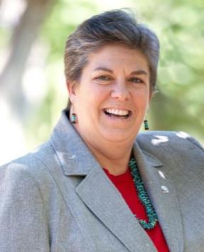
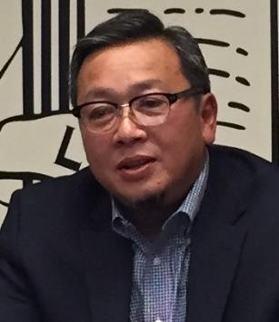
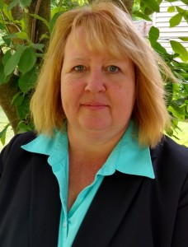
Vision & News
Updates from Leadership

Slide 3

Leadership Updates
        Statewide wildfire emergency
        Thanks for everyone’s participation in the Strategic Plan input sessions (Final session, Tuesday, 8/25, on Virtual Reach)
        We expect to announce budget decisions in early September, although final State and Federal budget numbers may not be available even at that time
        A group is exploring virtual tours of ANR’s programs/RECs to showcase our work to President Drake and others (Regents, elected officials, prospective partners, etc)
        Many of the academic searches that were released in December 2019 are winding down. We are excited that these new colleagues will join us between August and January
        Glenda first 1:1 meeting with UC President Drake coming up

Slide 4
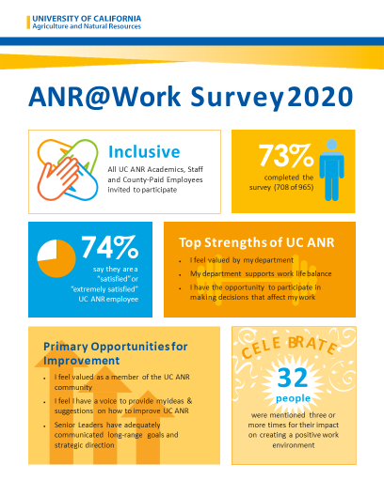
2020 ANR@Work Survey
Overview of methodology and overall results

Slide 5


Download 2020 ANR@Work Survey Results
Survey results and UCSD Tritonlytics video available at
https://ucanr.edu/sites/anrstaff/Diversity/ANR@Work_Survey_741/
Angela Song, PhD
Sr Director, Organizational Assessments and Strategy, UC San Diego

Slide 6
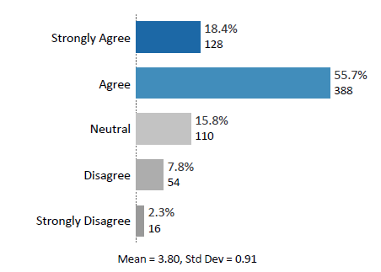
ANR@Work Survey Overview
Survey Period: March 17 – April 3, 2020
965 academics, staff, and county-paid employees invited; 708 responded
73% response rate
74% say they are “satisfied” or “extremely satisfied”
Overall I am a satisfied UC ANR employee
Setting the Baseline - 2020 is inaugural ANR@Work survey. Commitment to repeat the survey annually for at least five years.

Slide 7
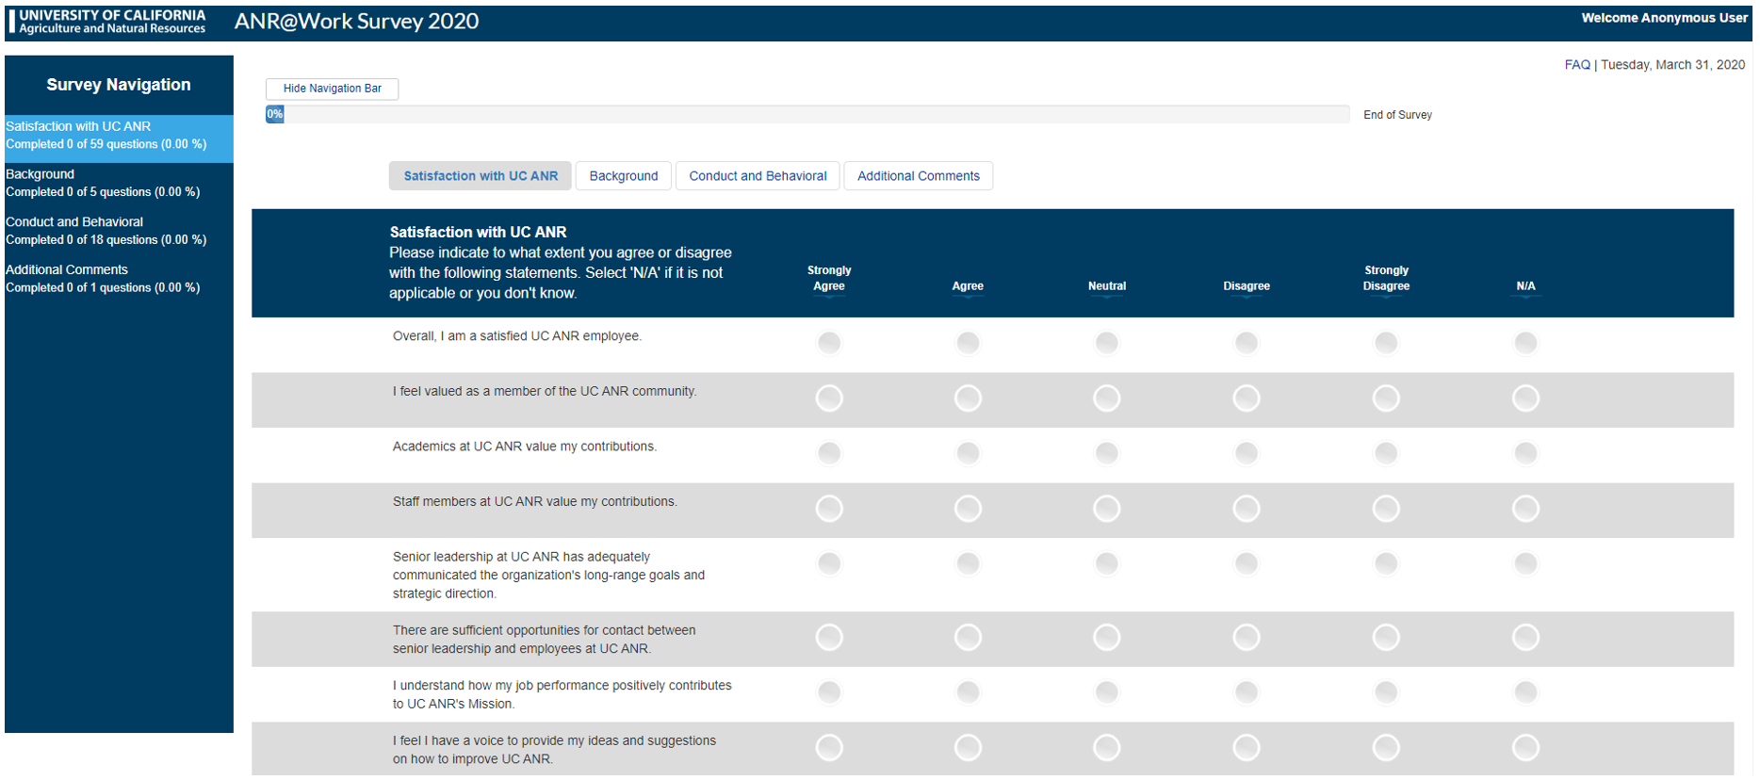
University overall
Supervisor effectiveness
Department effectiveness
Employee success
Diversity and climate
Civility
Ostracism
Gender
Race/Ethnicity
Years of service
Race/Ethnicity
Gender identity
Sexual orientation
Veteran status
Physical and mental disability
Open-ended comments
Recognize a colleague

Slide 8
ANR@Work Survey – Dimension Mean Scores

Slide 9
What is the “Employee Net Promoter Score?” (eNPS)
Overall, I am a satisfied UC ANR employee.
I would recommend UC ANR to a colleague or friend.
eNPS

Slide 10
A profile of UC ANR’s promoters/detractors and engaged/disengaged workforce
42 Disengaged Detractors
(low satisfaction/not likely to recommend)
Implications:
Turnover, low productivity, absenteeism, low satisfaction
439 Engaged Promoters
(high satisfaction/likely to recommend)
Implications:
Innovation, high productivity, work satisfaction, sense of pride in work, commitment
What this means:

Slide 11
Influential Strengths & Primary Opportunities

Slide 12
Influential Strengths & Primary Opportunities
Influential Strengths
  I Feel Valued By My Department
  All People Are Welcomed
  My Department Supports Work Life Balance
  My Department Practices Principles of Community
  I Have the Opportunity to Participate In Making Decisions That Affect My Work
Primary Opportunities
  I Feel Valued as a Member of the UC ANR Community
  I Feel I Have a Voice to Provide My Ideas and Suggestions on How to Improve UC ANR
  Senior Leaders Have Adequately Communicated Long-range Goals and Strategic Direction
  There are Sufficient Opportunities for Contact with Sr. Leadership
  I am Satisfied with my Opportunities for Career Advancement

Slide 13
What is UC ANR doing with the survey results?
Unit level summary reports shared with Directors to facilitate small group discussions
  Differences between local results and overall UC ANR results?
  How can we use the survey to improve our local work environment?
Increased connection between leadership and ANR community through Town Halls and other all-hands Zoom sessions
  Pandemic has created new opportunities
Expanded consultation on ANR Strategic Plan refresh
Analysis of survey results by employee demographic categories

Slide 14
DEI Analysis of ANR@Work Survey Results
Presented by Katherine Soule, Charles Go, & Rebecca Ozeran
with contributions from Kit Alviz
August 20, 2020

Slide 15
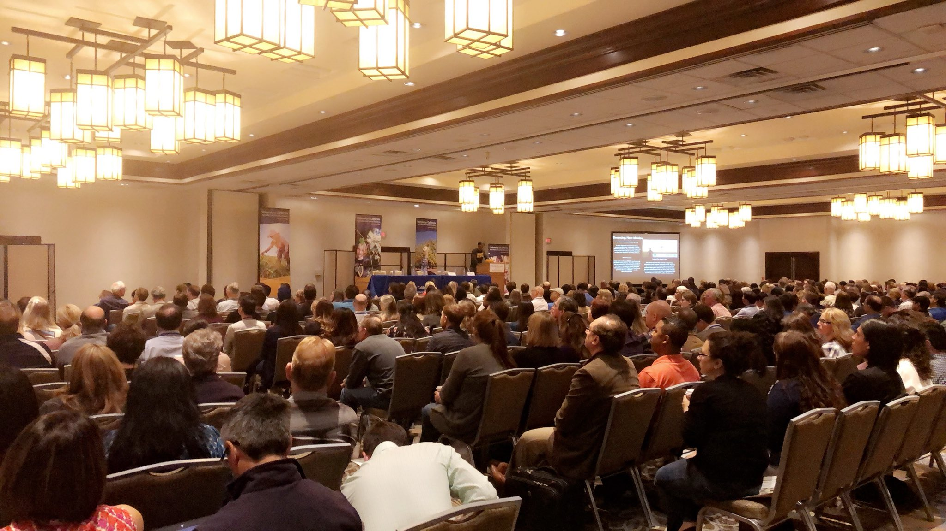
Background
Efforts build on feedback from prior "campus" climate survey to analyze results by demographics
  Campus Climate Study 2012
Evaluation team includes members of the DEI Alliance Evaluation Subcommittee, Staff Assembly, and Academic Assembly Council
UC ANR Conference in Ontario Photo: @RosYeQueEn

Slide 16

Purpose
Research Purpose: Investigate whether work satisfaction and experiences at ANR vary by employee demographic categories (i.e., race/ethnicity, age, years of service, job title, sexual orientation, gender, (dis)ability).
UC Davis IRB Determination: Research not HSR
Anticipated Use: Inform recommendations to UC ANR leadership to improve work environments, inform DEI strategic planning and objectives, and support similar efforts at other academic institutions.

Slide 17

Methods
UCSD Tritonlytics Team conducted survey and standard analyses
Analyses conducted at the Division level to ensure anonymity and have appropriate sample sizes.
  Quantitative – compared demographic group means (from ANOVA) for significant differences
    Men, Women, Decline to state
    White, POC (combined responses), and Prefer Not to State/No Response
    Heterosexual, ALGB+ (combined responses), and Prefer Not to State/No Response
  Qualitative – In-Progress.

Slide 18
Methods
Measures
57 satisfaction questions
17 work environment (Conduct and Behavioral) questions
Demographic questions (i.e., years of service, military status, gender identity, ethnicity/race, and sexual orientation)
UCSD categorized scores + corresponding colors. Example:
We will use the following:
  ☹ Low 😐 Marginal ☺ Good ‼ Excellent
Notes:
You’ll notice that the survey asked about a few other demographic categories that we aren’t discussing today – we are focusing on gender, ethnicity/race, and sexual orientation for now.
Darkest red is most concerning/highest priority category; darkest blue is least concerning/lowest priority (keep doing what we’re doing) category.

Slide 19
Results
73% Response Rate - 965 Invited, 708 Responded
* “Dominant” does not always mean “majority”. In this case it refers to employees who identify as male, white, and/or heterosexual.
Demographic category | Dominant group* | Marginalized group(s) | Other groups
Gender | Men (27%) | Women (61%) | Decline to state (13%)
Ethnicity/race | White (55%) | People of color (28%) | Decline to state (17%)
Sexual orientation | Heterosexual (69%) | ALGB+ (8%) | Decline to state (23%)
Notes:
Note that in this slide, the dominant group is a column. In later slides, the dominant group will be the second row in each satisfaction topic, for comparison purposes.
I will spend a little extra time clarifying “dominant group” for the purposes of this presentation- note that they are characteristics that dominate current social norms.

Slide 20
Preliminary Results – Work Satisfaction
☹ Low
😐 Marginal
☺ Good
‼ Excellent
Contact between leadership and employees
😐 Women 😐 POC 😐 ALGB+ ☹ Decline to State
😐 Men 😐 White 😐 Heterosexual
Feeling like a valued member of UC ANR
☺ Women ☺ POC ☺ ALGB+ ☹ Decline to State
☺ Men ☺ White ☺ Heterosexual
Senior leadership communication of goals
☺ Women ☺ POC ☺ ALGB+ ☹ Decline to State
😐 Men 😐 White 😐 Heterosexual
Notes:
You may recognize these statements as some of the Primary Opportunities that John mentioned in his portion of the presentation. What we explored was, how does it vary by demographic? Some groups were much more satisfied (blue responses) than others (pink and red responses).
*DTS on sexual orientation had Marginal satisfaction with communication and feeling valued, but the other DTS groups reported Poor satisfaction on both of those themes.

Slide 21
Preliminary Results – Work Satisfaction
☹ Low
😐 Marginal
☺ Good
‼ Excellent
Total compensation
☹ Women ☹ POC 😐 ALGB+ ☹ Decline to State
😐 Men 😐 White ☺ Heterosexual
Opportunities for career advancement
😐 Women 😐 POC 😐 ALGB+ ☹ Decline to State
☺ Men 😐 White ☺ Heterosexual
Having a voice on campus
😐 Women 😐 POC 😐 ALGB+ ☹ Decline to State
😐 Men 😐 White ☺ Heterosexual
Notes:
These also connect back to the primary opportunities, except compensation which UCSD tells us is always a relatively low score.
Compensation: only heterosexual employees reported “good”, everyone else marginal to low, and this was particularly low satisfaction - somewhere to focus efforts.
Career advancement: men and hetero employees good, everyone else marginal to low, again a place to focus efforts.
On campus = within the division: only heterosexual scored “good”

Slide 22
Preliminary Results – Work Environment
Women, POC, ALGB+ and those who declined to state experience marginalizing behaviors at work more often than employees from dominant groups.
Marginalizing behaviors included when someone:
  Paid little attention to your statement / showed little interest in your opinion
  Kept you out-of-the-loop on information that is important
  Interrupted or spoke over you
  Was condescending to you
  Excluded you
Notes:
Note that these could be negative interactions with colleagues, supervisors, employees, volunteers, or clientele.
Marisa suggested a little extra time for audience to absorb this and the following 2 slides.

Slide 23
Preliminary Results – Work environment
☹ Low
😐 Marginal
☺ Good
‼ Excellent
“How often have you experienced when someone..."
  Paid little attention to your statement or showed little interest in your opinion
  ☺ Women 😐 POC 😐 ALGB+ ☹ Decline to State
  ☺ Men ☺ White ☺ Heterosexual
  Kept you out of the loop on information that is important
  ☺ Women ☺ POC ☺ ALGB+ ☹ Decline to State
  ‼ Men ☺ White ☺ Heterosexual
  Interrupted or spoke over you
  ☺ Women ☺ POC 😐 ALGB+ 😐 Decline to State
  ☺ Men ☺ White ☺ Heterosexual
Notes:
Dark red means experiencing these negative interactions a lot- high priority to address- and dark blue is not experiencing them very much. Although almost no one had “excellent” reports, POC and ALGB+ and DTS populations are clearly experiencing these negative interactions the most.
Overall, we need to make sure that at a local and divisionwide scale, our colleagues and employees are being respected, included, and heard.

Slide 24
Preliminary Results – Conduct and Behavior
☹ Low
😐 Marginal
☺ Good
‼ Excellent
"How often have you experienced when..."
  At UC ANR, you feel the need to minimize various characteristics of your culture (e.g., language, dress) to fit in.
  ‼ Women ‼ POC ‼ ALGB+ ‼ Decline to State
  ‼ Men ‼ White ‼ Heterosexual
  Someone treated you differently because of your race/ethnicity
  ‼ Women ‼ POC ‼ ALGB+ ‼ Decline to State
  ‼ Men ‼ White ‼ Heterosexual
  Someone treated you differently because of your gender
  ‼ Women ‼ POC ‼ ALGB+ ‼ Decline to State
  ‼ Men ‼ White ‼ Heterosexual
Notes:
Although all scored in the Excellent range, there are differences between marginalized groups and dominant groups in the overall frequency of these experiences – room for improvement.

Slide 25

Preliminary Results – Decline to State
Decline to State - When comparing ANR vs UCSD, found similar percentages.
Employees who “Declined to state” their sexual orientation reported significantly lower satisfaction than heterosexual employees on 24 of 57 questions.
While most research does not evaluate responses from populations that “Decline to state”, we are including their responses while keeping anonymous.
Notes:
Note, we seem to be the only UC campus concerned about this and looking into further analyses.

Slide 26
More on Declining to State
  In rural and in more conservative counties, many residents oppose government intrusion and surveillance. This opposition may present a cultural barrier to data collection in general, and to demographic data collection in particular. (Mapping the Road to Equity, 2018)
  LGBTQ+ individuals are less likely to self-report their authentic gender identities and/or sexual orientations. Nearly half (46%) of LGBTQ+ Americans are closeted at work (HRC, 2018).
  Anecdotally, some respondents did not want to be identified – no specific reason given. Perhaps a sense of not trusting anonymity.

Slide 27
Next Steps
Analyze qualitative results
Compare responses to ANR population demographics
  Were responses representative of ANR?
Compare (where possible) to Staff Engagement Survey
  Work with Staff Assembly
Notes:
Note that what we share with leadership will be much more detailed than what we summarize in this presentation.
Also will be connecting our findings to existing literature, for all of these next steps.

Slide 28
Get Involved
Would you like to join this effort?
DEI Eval Committee contact:
Kit Alviz, kit.alviz@ucop.edu
Have questions?
Katherine Soule, kesoule@ucanr.edu

Slide 29

Discussion/comments
Time for a few questions.
Please use Q&A for questions
Chat for sharing

Slide 30

Wrap –up
(Central share screen)
Stay safe & well
Next Town Hall
September 17, 2020

