Slide 1
Extending research-based information through the news media
June 2, 2017 Master Food Preserver Program Conference Davis
Pam Kan-Rice
Assistant Director of News and Information Outreach

Slide 2
Today’s agenda
Different types of news media
How to prepare for an interview
What to do during the interview

Slide 3
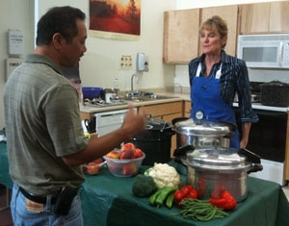
The medium is the message
Television – visual, engaging, very brief
Radio – sound, create visuals with words, brief
Newspaper – more detailed, in-depth
Internet/blogs/social media

Slide 4
When a reporter calls
Ask
When is the deadline?
What is the story about?
Who else will be interviewed?
What will be asked?
Live or taped interview?

Slide 5
Interview: What works? What doesn’t?
Doing a demo during an interview
http://www.kcra.com/article/kcra-kitchen-mandarin-smoothies-d761vfeu/8301558

Slide 6
Preparing for the interview
Write down 3 key messages
Make the messages memorable
How does this affect your audience?
Why should they care? – head, health or wallet?
Use “real life” anecdotes or examples
Develop analogies or word pictures
“If you dry fruit too long, it’ll become hard, like chewing on a piece of wood.”

Slide 7
“Flag” important points
It’s important to remember…
The main thing is…
What people may not know is…
"The problem with not following a USDA-approved recipe is someone could get sick

Slide 8
Turn key messages into soundbites
Distill key points into 3 concise, complete sentences
Memorize these sentences
Practice saying them aloud
Work the sentences into the interview verbatim
“To prevent foodborne illness, make sure you pressure can vegetables.”

Slide 9
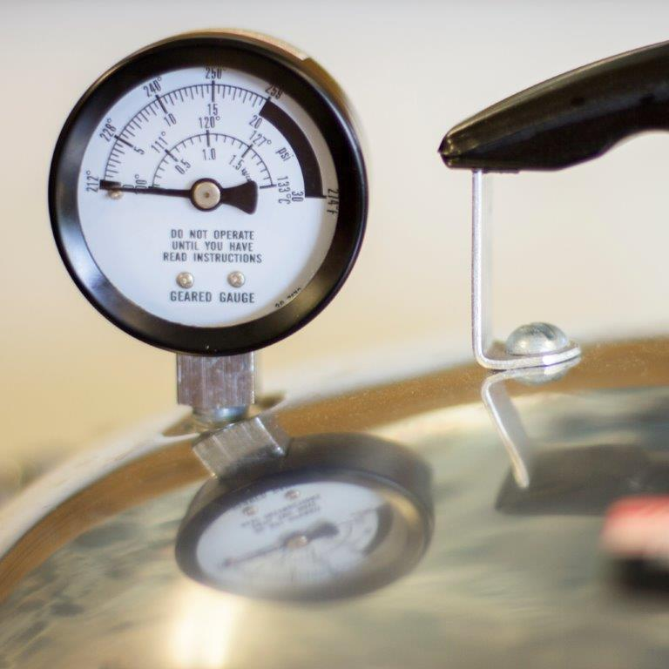
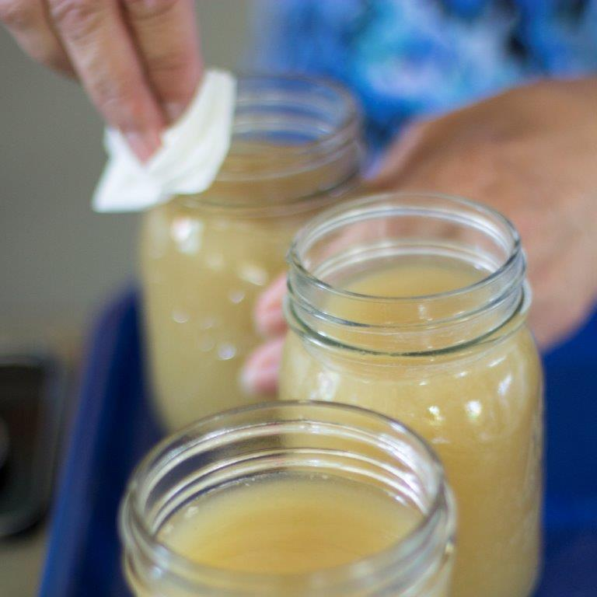
Prepare visuals
Set up demonstrations
Prepare samples
Offer simple, clear graphics and photos

Slide 10
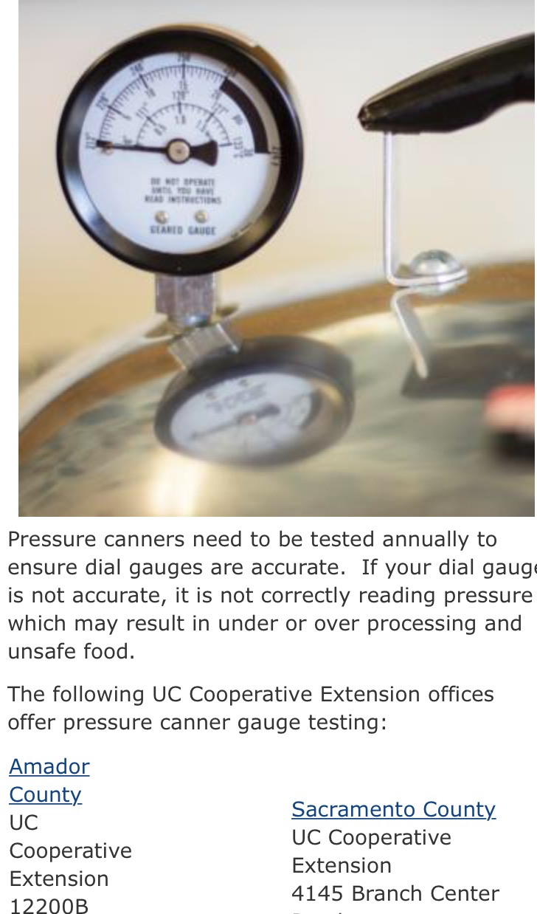
Prepare/collect background material
Fact sheets
Recipes
Articles on the subject
Website address http://mfp.ucanr.edu
Your business card

Slide 11
What to wear
UC Cooperative Extension or Master Food Preserver logo
Apparel appropriate for scene
Solid colors for TV
Simple jewelry and accessories

Slide 12
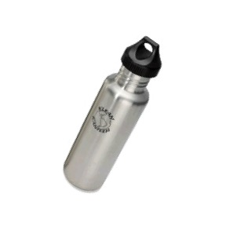
What to bring to an interview
Information to leave with the reporter
Bottle of water
Business card

Slide 13
Keep in mind
Everything is “on-the-record”
Appearance is as important as what you say
Time is limited. Get your message out early
State that you are with UC Master Food Preserver Program (credibility)

Slide 14
Let’s practice
Who are you?
What’s your message?
How can I get more information?

Slide 15
During the interview
If you need a question clarified, ask
If you misspeak, start over Say something like, “What I mean is…” or “In other words…”
Give examples to illustrate a point
Use simple language (avoid acronyms– MFP, UCCE, USDA, etc.)

Slide 16
During the interview
Stick to the facts you know, stay on message
Say something other than “no comment”
Tell your story with positive words
State a fact rather than repeat misinformation

Slide 17
During the interview
Be specific
Use complete sentences
Restate your message so it’s clear what is important

Slide 18
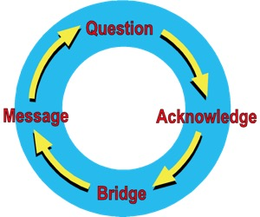
During the interview
Anticipate tough questions; rehearse answers
Make your points early and often
Plan to bridge back to key points

Slide 19
“Bridge” to your message
Answer briefly, then transition to your point: “Yes, and years of research show . . .” “True, however . . .” “That’s a misconception, what really happens is. . .”

Slide 20
The end of the interview
Invite the reporter to call back for more information or to clarify points.
Let him or her know: - When you will be available - Your cell phone number
Hand the reporter your business card

Slide 21
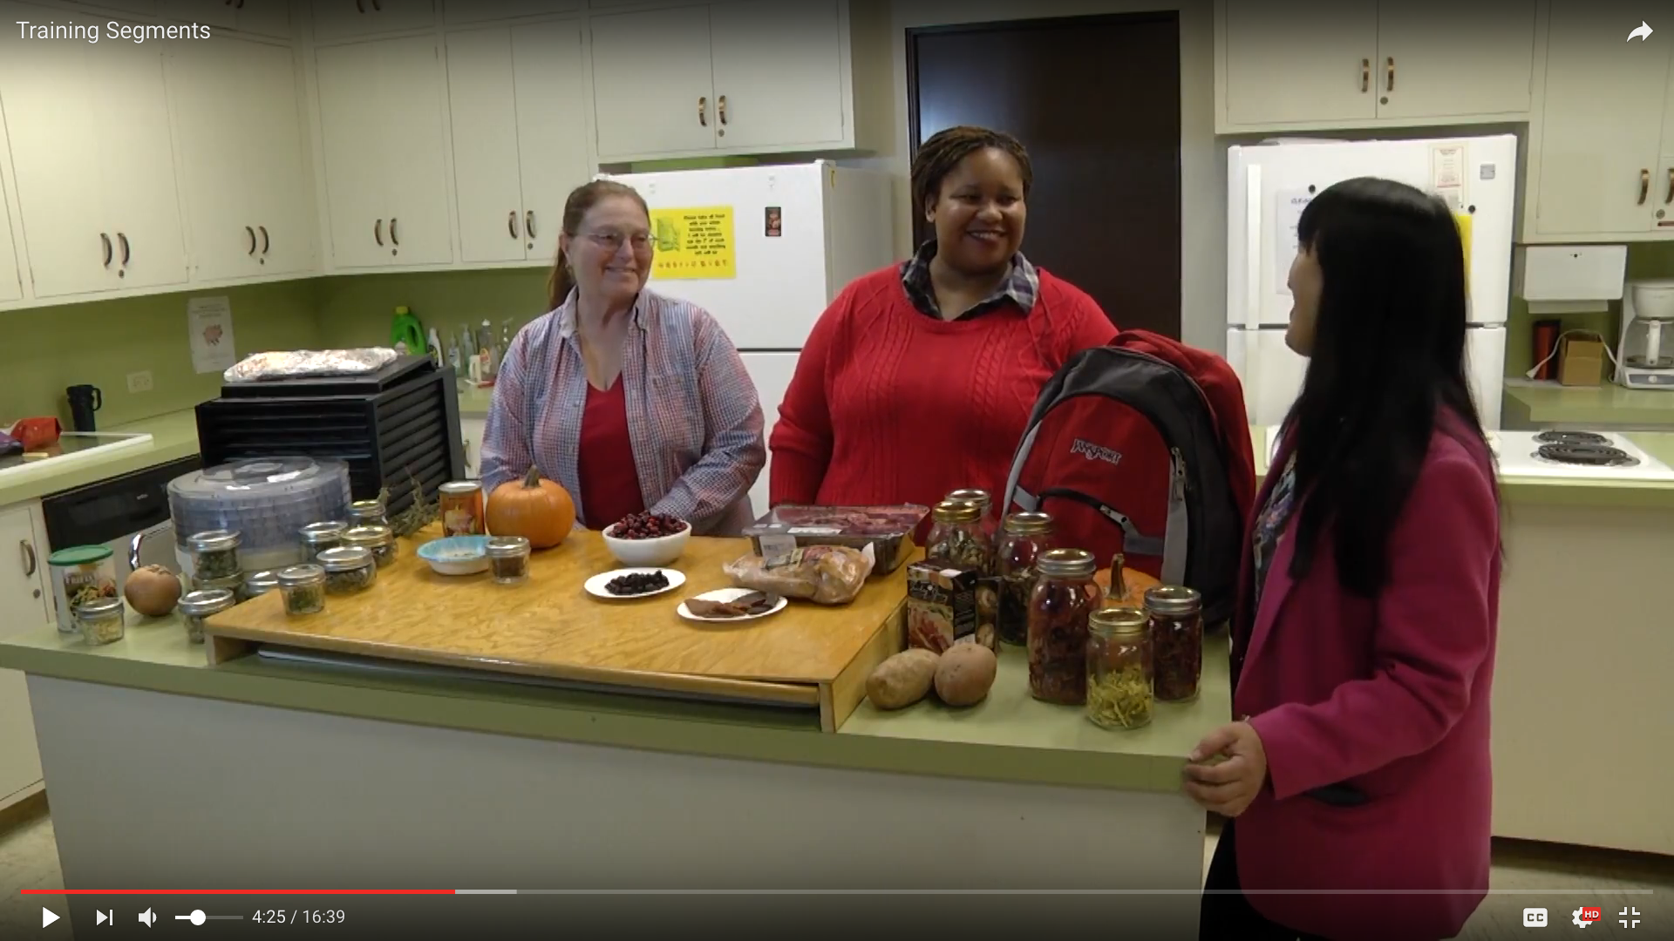
Capitol Corridor MFP Dress Rehearsal

Slide 22
Good Day Sacramento Live Shot
https://www.youtube.com/watch?v=adCyLbz0HQA

Slide 23
Establish yourself as a source
Knowledgeable
Credible
Approachable

Slide 24
#WeAreUCANR
http://ucanr.edu/WeareUCANR
From more bountiful berries to safer food to cleaner water, #UCANR turns science into solutions. #WeAreUCANR http://bit.ly/WeAreUCANR
Follow us on Twitter: @ucanr

Slide 25
Thank you!

