Slide 1
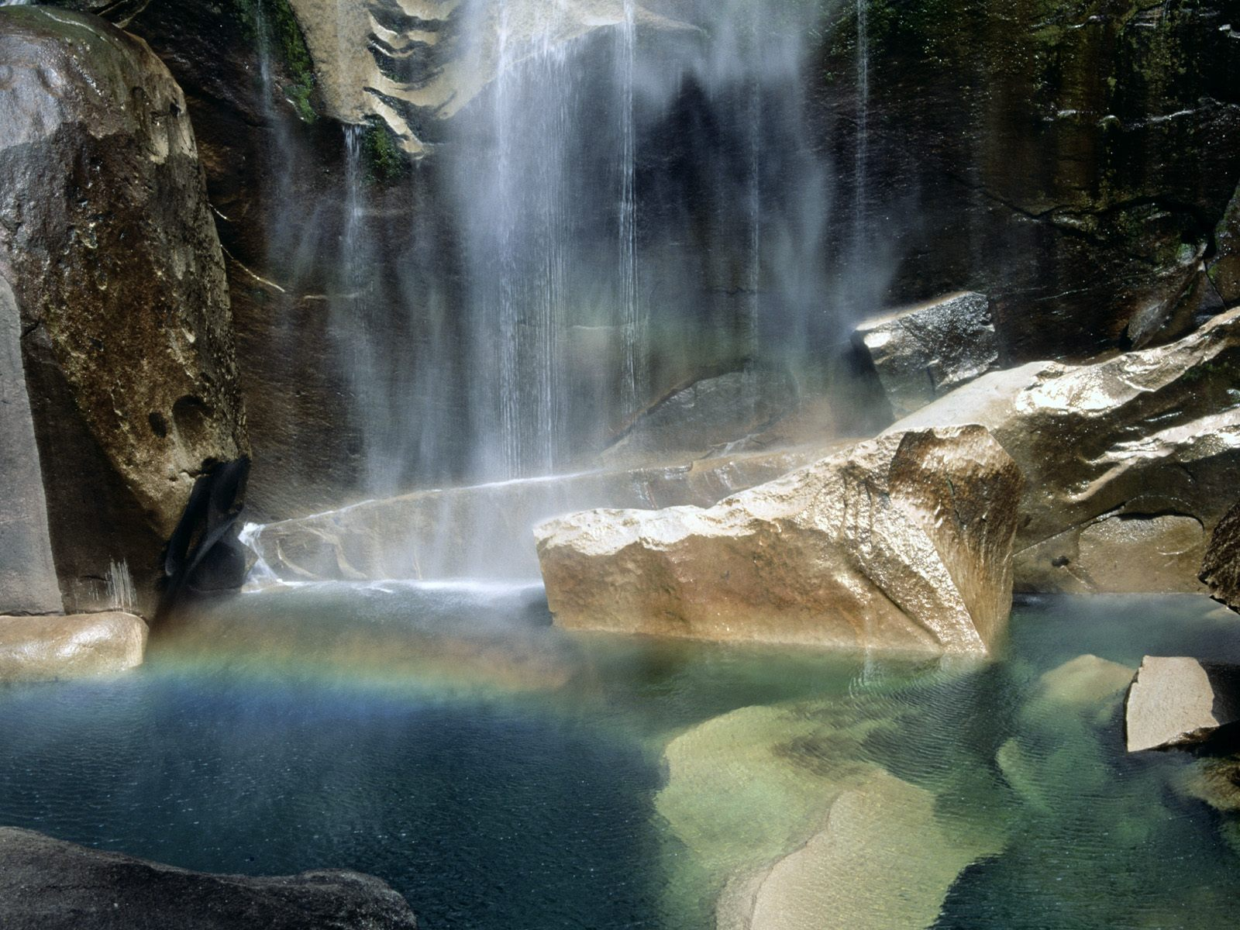

Chapter 3
Water and hydrology
The Water Molecule
The Water Cycle
Stream Processes
The Path of a River
River Derivatives
California's Lakes
Aquatic Ecosystem Management
Challenges for the Future

Slide 2
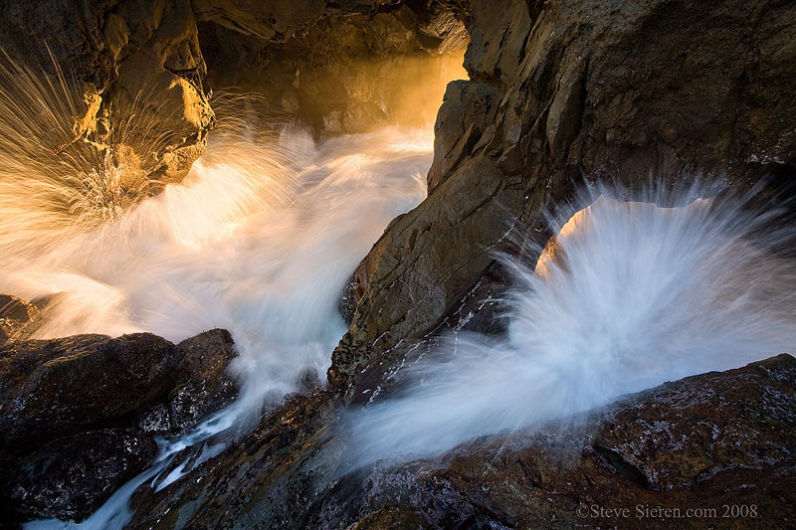
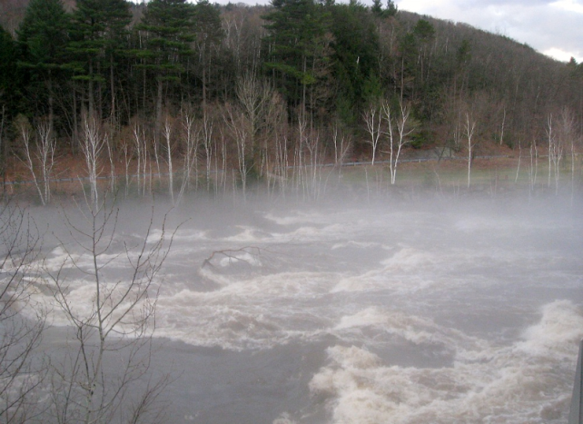
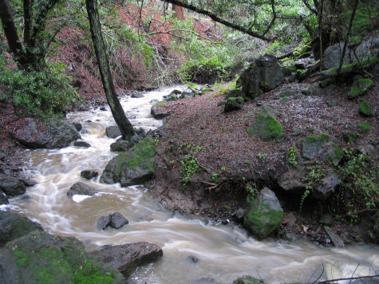
Water and hydrology
driven by gravity
falls from sky as precipitation
flows from high to low elevation
shapes and alters the landscape
spills over banks
moves sand, pebbles, rocks, boulders, trees
periodically floods houses built too close to the river
factors determining influence of water on landscape
water volume
shape of the channel through which it flows

Slide 3
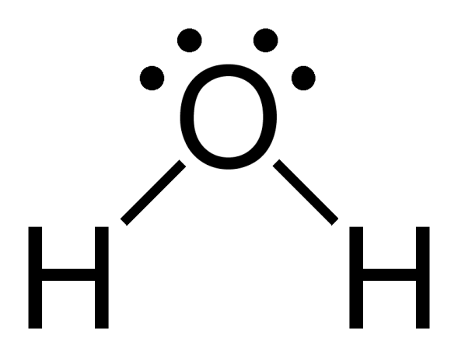
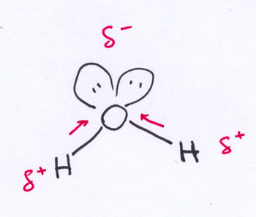
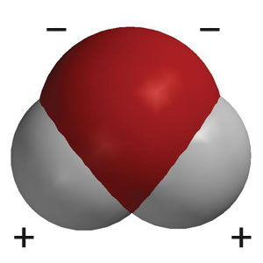
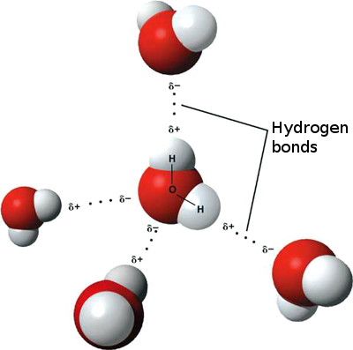
The Water Molecule
basics
molecular weight: 18 grams/mole
boiling point: 100 °C
freezing point: 0 °C
density: 1.000 g/mL
water is polar
electric dipole caused by oxygen's higher electronegativity
reason why oil and water don’t mix
hydrogen bonding
the electrical attraction between a partially + charged H atom of one polar molecule to a partially - charged oxygen atom on a second polar molecule
dynamic, constantly breaking and reforming
Notes:
http://www.saulsteinbergfoundation.org/gallery/gallery_girlbath.jpg

Slide 4
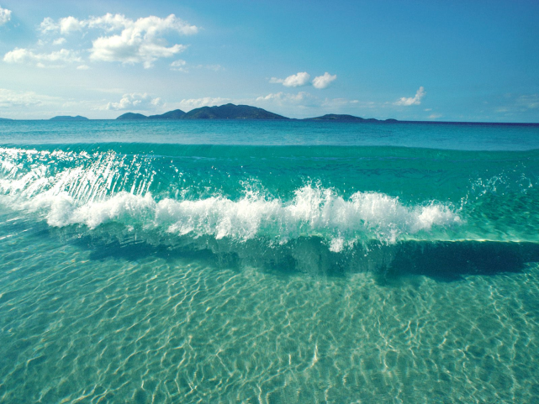
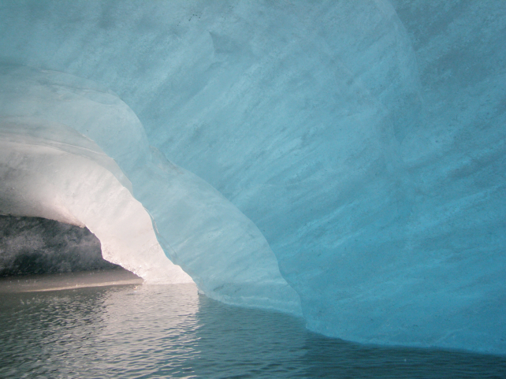
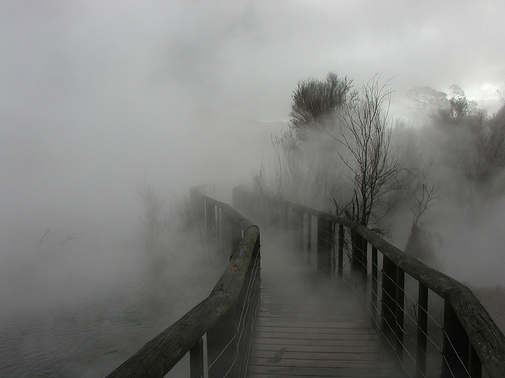
hydrogen bonding gives water its unique properties
liquid phase (water)
more dense than solid phase
hydrogen bonds form and break apart quickly and locally
solid phase (ice)
less dense than liquid phase
crystalline structure
hydrogen bonds cannot break and reform as readily because the water molecules are moving too slowly
gaseous phase (water vapor)
Notes:
http://www.saulsteinbergfoundation.org/gallery/gallery_girlbath.jpg

Slide 5

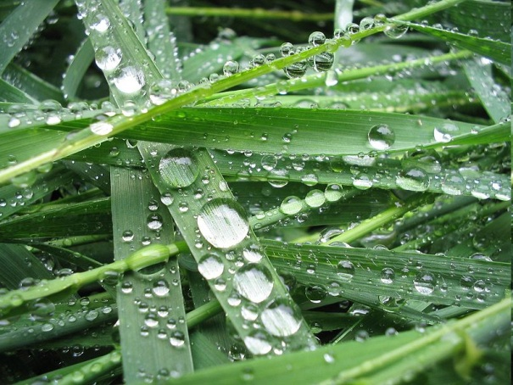
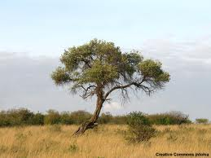
cohesion
the attraction of like molecules to like molecules
surface tension of water
quasi-crystalline structure in liquid water makes it difficult to break or stretch
adhesion
attraction of unlike molecules
adhesion keeps these water droplets in place
transpiration
evaporating water from leaf pores pulls up water from the roots
cohesion between water molecules
adhesion along internal plant vessel wall
Notes:
http://www.saulsteinbergfoundation.org/gallery/gallery_girlbath.jpg

Slide 6
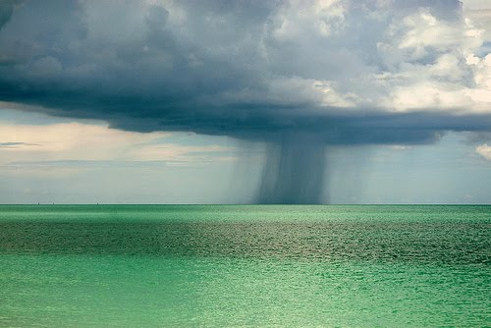
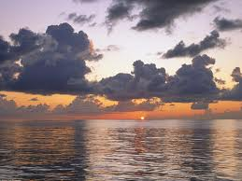
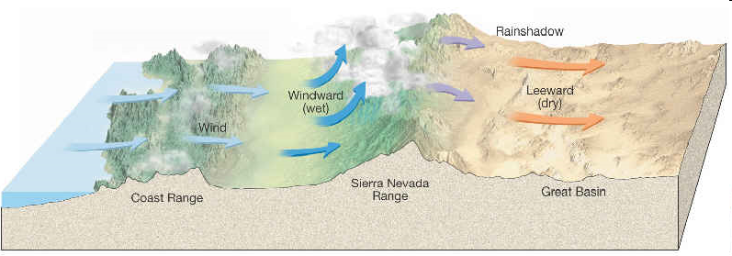
The Water Cycle
wind and solar radiation over an incredibly large surface area results in the evaporation of ocean water
cloud formation
winds begin blowing these clouds across the continent
Notes:
http://www.saulsteinbergfoundation.org/gallery/gallery_girlbath.jpg

Slide 7
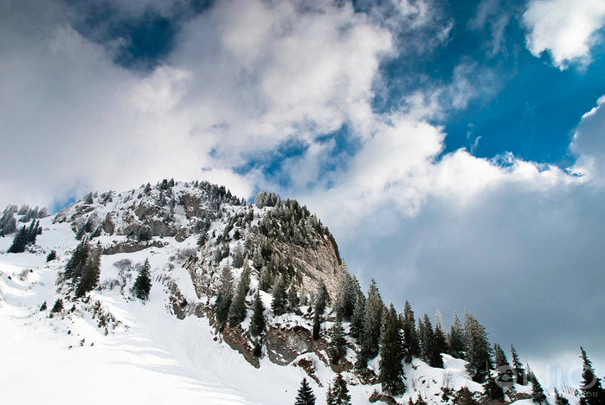
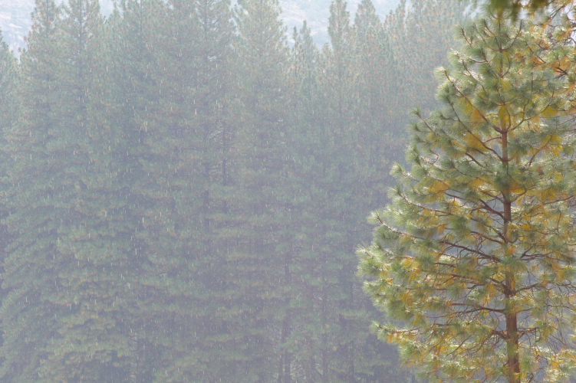
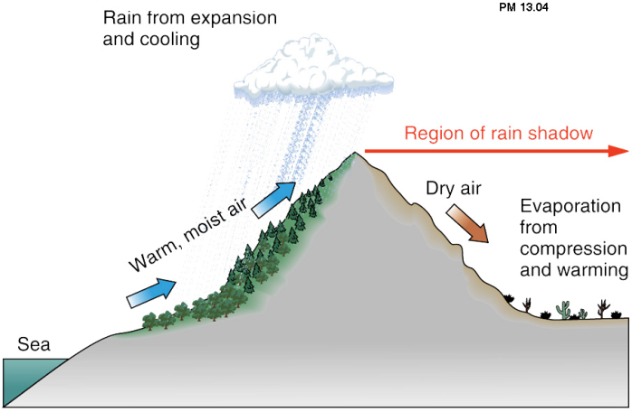
orographic effect
clouds cool as they rise up mountain
eventually results in release of precipitation (rain, snow)
precipitation trends
increases along coast
increases northwards
increases with increasing mountain elevation
rain shadow
areas on leeward side experience less rainfall due to drier clouds
Notes:
http://www.saulsteinbergfoundation.org/gallery/gallery_girlbath.jpg

Slide 8
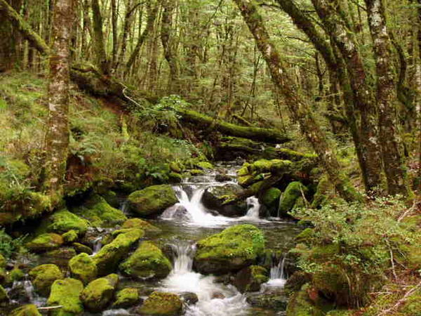
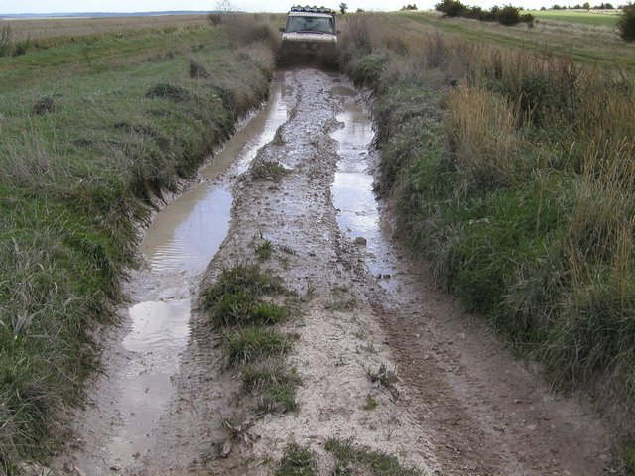
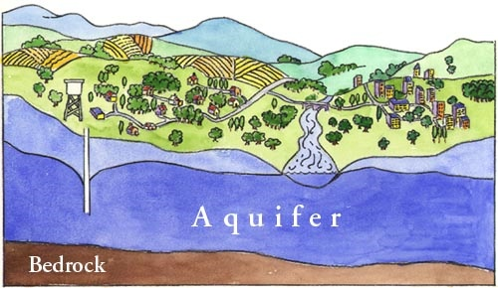
destinations for precipitation
60% ends up in streams
usually flows back to the ocean
soil
causes stream levels to rise
ground-water holding areas
variable permeability, but overall less permeable than soil
often becomes saturated and no longer able to absorb
ex. bedrock

Slide 9
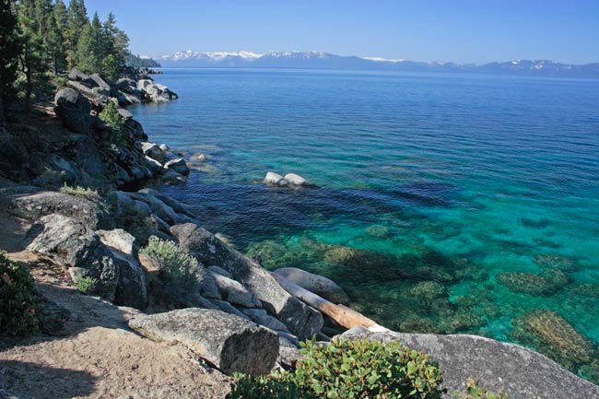
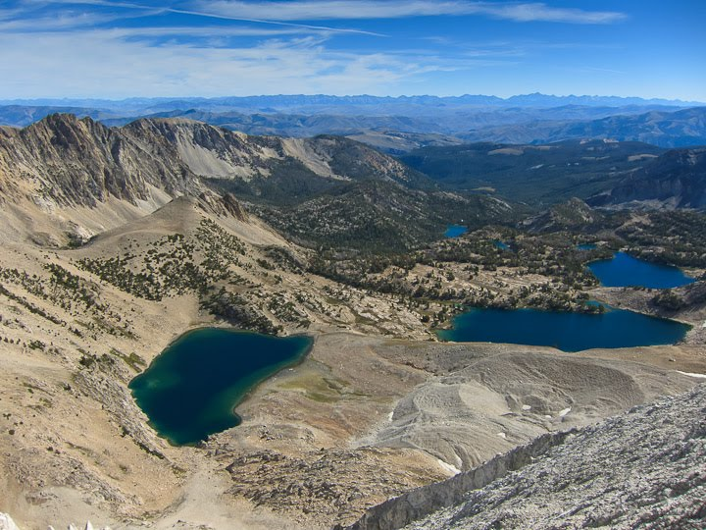
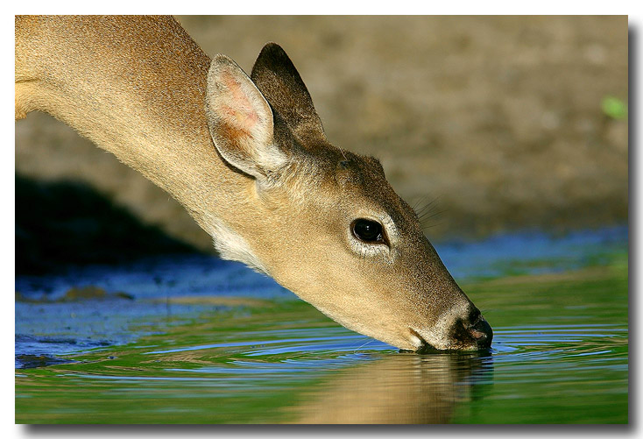
Lake Tahoe
Large lakes
CA topography and geology is not conducive to formation of large lakes, but we still have a few
small lakes nestled in glacier carved depressions up in the mountains
absorbed by plants
ingested by animals
evaporated

Slide 10
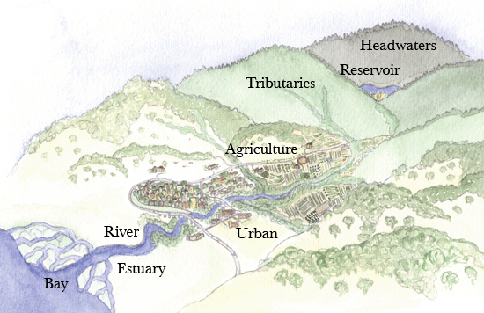
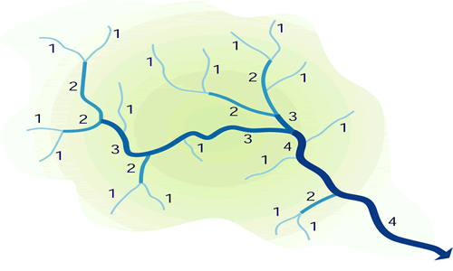
Stream Processes
stream classification by watershed type
watershed is portion of land for which all rainfall drains through a common stream point
provides water and anything else that can be transported downstream by water
stream classification by stream order
number streams beginning with small headwater streams
two streams of equal order combine to form a stream of the next highest order
ex. two first order streams combine to form second order stream

Slide 11
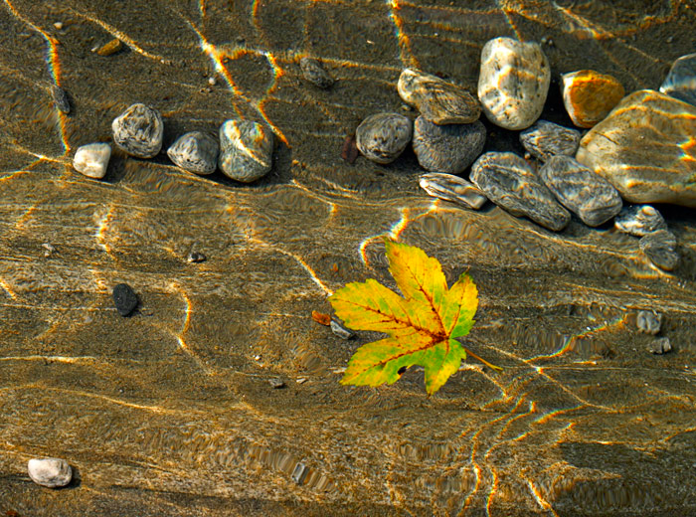
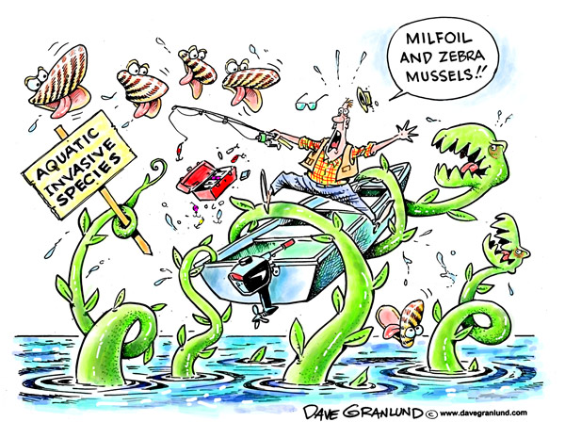
bio inputs from nearby terrestrial ecosystems
food and nutrients from immediate riparian zone
leaf litter
trees and branches, large woody debris provides source of nutrients and shapes stream channel
transport of aquatic invasive species
disrupts agriculture, shipping, water delivery, recreational and commercial fishing
undermines levees, docks and environmental restoration activities
impedes navigation and enjoyment of the state's waterways
damages native habitats and the species that depend on them

Slide 12
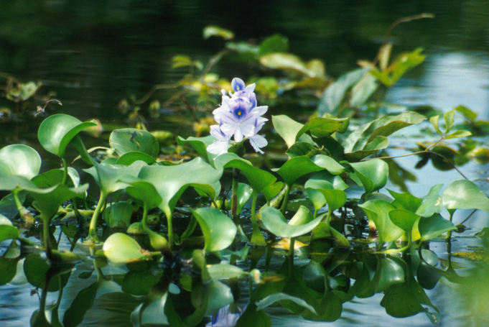
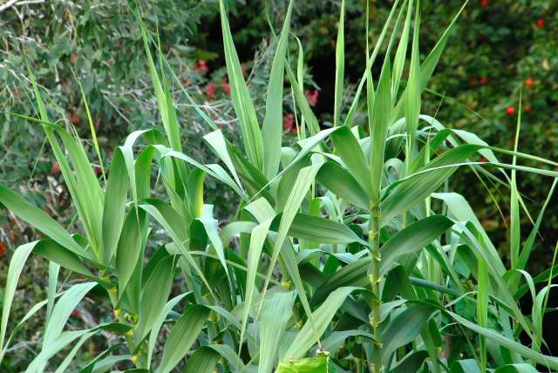
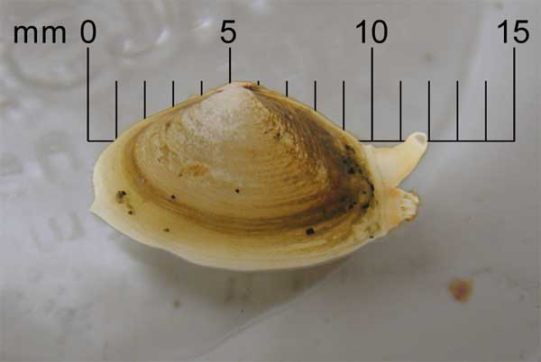
ex. water hyacinth
introduced as ornamental plant for water gardens
in hot weather, can double the area it covers in ten days
blankets over 4,000 acres of Sacramento-San Joaquin Delta in summer
arundo
originally planted for erosion control
displaces native vegetation
increases flooding
increases siltation (deposition of silt in waterways)
degrades wildlife habitat
Asian overbite clam
hermaphroditic, reproduces rapidly
outcompetes native clams
clogs power plants
can lead to declines in fish and shrimp populations

Slide 13
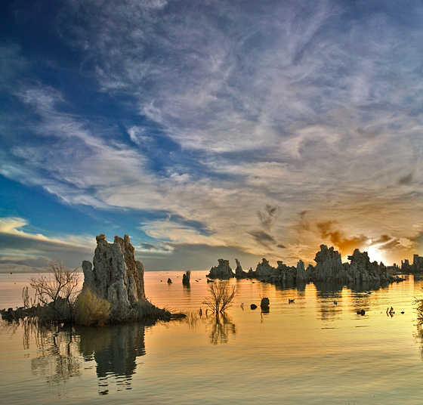
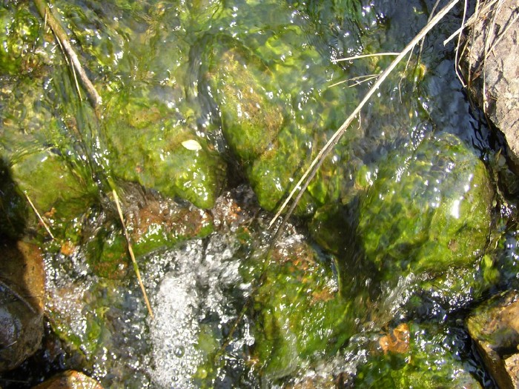
chemical inputs
transportation of ionic compounds
dissolves ionic compounds on rock surfaces and carries them downstream from higher headwaters to lower reaches
supplies the salt that makes desert lakes salty
transportation of autochthonous nutrients
nutrients weathered from bedrock
Phosphorous
Nitrogen
Carbon
these nutrients promote algal and biofilm (periphyton) growth along the stream bed
foundation for many aquatic food webs

Slide 14
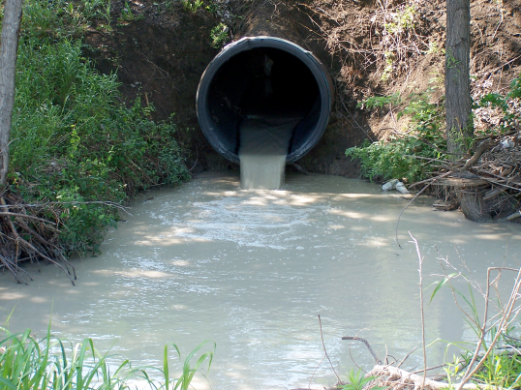
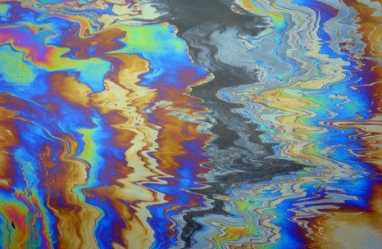
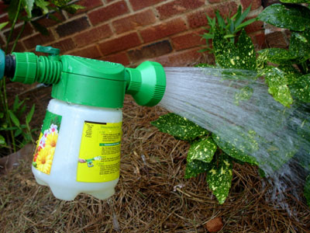
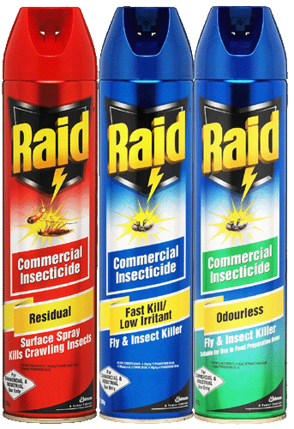
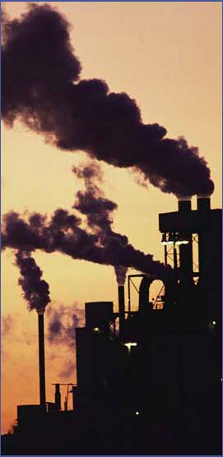
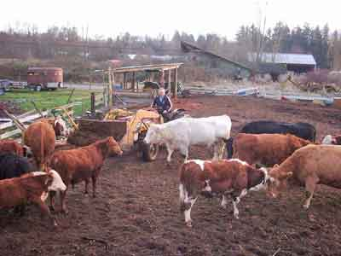
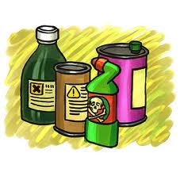
transportation of pollutants
point source
non-point source
derives from many scattered point sources
rainfall or snowmelt picks up and sweeps pollutants into lakes, rivers, coastal waters, wetlands, underground sources of drinking water

Slide 15
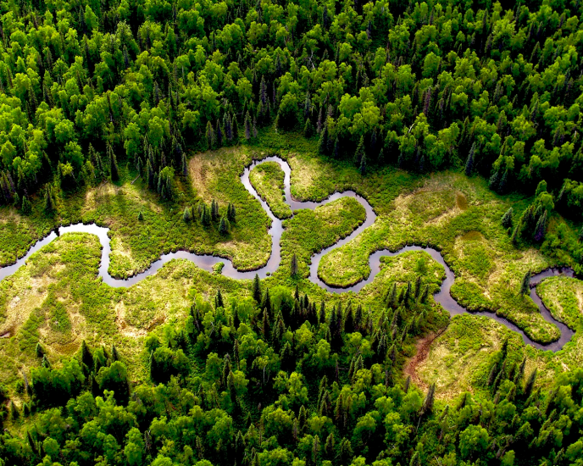
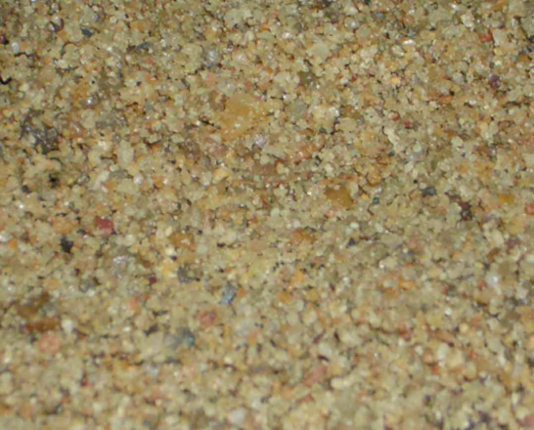
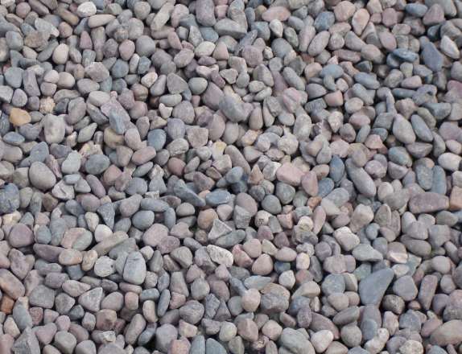

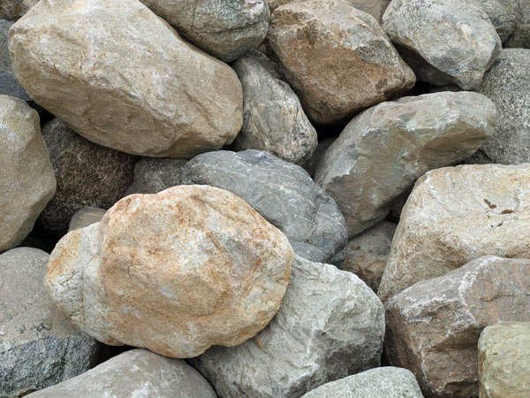
physical inputs
dictate shape of stream channel
provide substrate and suspensions to the stream
fine sediment
coarse cobble
fine gravel
sand
coarse boulders that roll along channel bed during very high-flow conditions

Slide 16
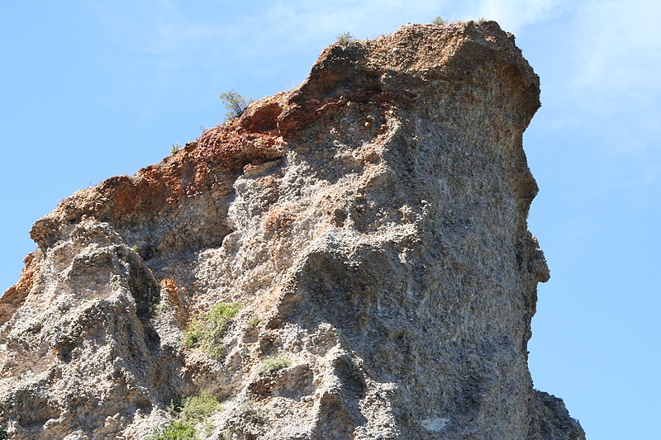
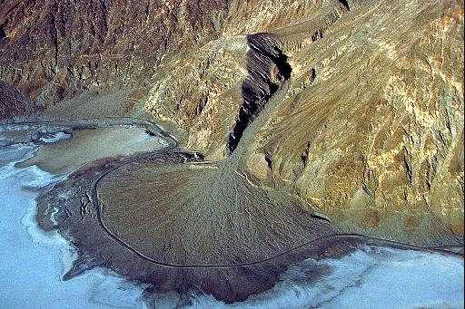
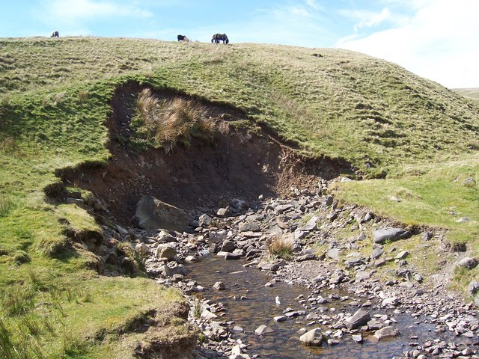
alluvium is sediment that moves due to the force of water in the stream
hillslope failures often coincide with alluvial forces
high-flow events eroding stream channels may undermine and destabilize hillslopes
hillslopes become much heavier when saturated with water and lose their stability
colluvium is material that can collect at the foot of a slope as a results of gravity
problems arise when land use activities lead to higher rates of erosion, which produce more sediment than can possibly be moved downstream by alluvial processes

Slide 17
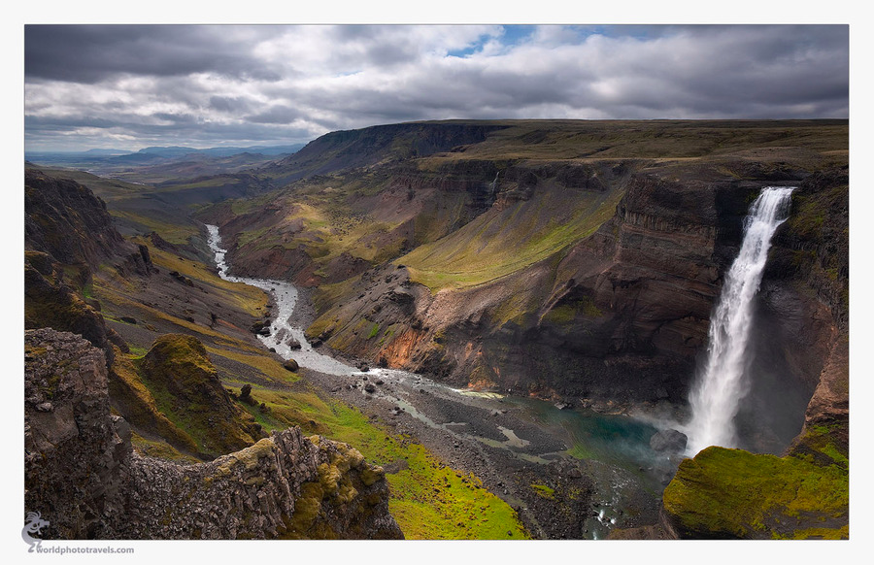
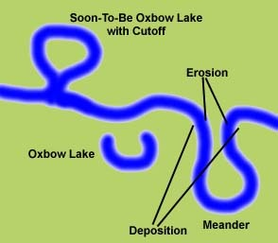

The Path of a River
most rivers around the globe have headwaters in mountains and downstream portions in valleys
begin as first-order stream in mountain and then branch out to higher stream orders
drainage network occurs in its upper headwaters
oxbow lakes

Slide 18


floodplains
caused by inundation of river during and after flood season
vegetation within a river’s floodplain is adapted to the frequency of inundation it may experience
water spilling over onto the floodplains moves much slower than that occurring in the river channel
silt material in water has opportunity to settle on the floodplain
silt contains an abundance of nutrients that supports aquatic plants and animals

Slide 19


estuary
transition zone where river meets ocean
intermediate salinity
varies depending on season and tide
supports both marine and freshwater organisms, as well as specialists adapted to intermediate salinity
nutrient inputs and constant mixing by tides make estuaries among the most biologically productive zones of the ocean

Slide 20






salt marsh
vernal pools
swamps
riparian area
wetlands
bogs
baylands

Slide 21



values and functions of wetlands
home to 50% of federally listed threatened or endangered species
waterfowl habitat
fish habitat
flood control
absorbs and filters pollutants
recharges ground water
recreation
historically viewed as dumping grounds or pest-ridden bogs to be drained, filled and developed
97% of the San Francisco Bay-Delta Estuary has been lost

Slide 22



Rivers Today
levee
prevents water from spilling out of the channel
disrupts natural processes of flooding & sediment/nutrient deposition onto the floodplain
threatens survival of organisms dependent on periodic inundation
dam
permanent, reliable, and protective against flooding
changes type and size of sediment accumulating in river
changes the species composition of the stream ecosystem
small reservoirs
located on small streams
lack capacity to release water until they are filled
a single reservoir usually does not pose adverse effects downstream
Notes:
http://www.jonco48.com/blog/NO_20levee.jpg

Slide 23



conflicting water needs
ex. San Joaquin River
at 300 miles, San Joaquin River is the second longest river in California
ordinarily has ample seasonal flows and abundant salmon runs
in 1949, Friant Dam built in 1949 on San Joaquin River
resulted in near annihilation of salmon runs
should we increase flows from Friant Dam to the river to help restore the ecosystem?
pro: this will restore the salmon population
con: less water available for human consumption
how will changes in the snowmelt regime due to global warming effect our decision?
Notes:
http://fresnobeehive.com/photos/assets_c/2010/01/SAN%20JOAQUIN%20RIVER%20SCENIC%20blog-thumb-600x400-29968.jpg
http://www.treehugger.com/Bristol-Bay-Sockeye-Salmon.jpg

Slide 24

California’s Lakes
Lake Tahoe
located in the Sierra Nevada
famed for its blueness, clarity, beautiful surroundings
trends since 1959
lost 1/3 of its transparency
algal growth has increased 5% per year
loss of native fish and increase in exotic fishes that can tolerate warmer, more polluted waters
air pollution
nitrogen pollution
warming of lake

Slide 25

Mono Lake
early 20th century, Los Angeles bought up vast tracts of land in Owens Valley and Mono Basin
starting in 1941, as many as 90,000 acre feet of water diverted each year from Mono Basin for Los Angeles
high quality, inexpensive water
level of Mono Lake dropped from an elevation of 6,417 ft to 6,372 ft
in 1976, a massive grassroots effort to “Save Mono Lake”
restored to an elevation of 6,392 feet (an elevation last occurring in 1964)

Slide 26

Clear Lake
oldest natural lake in North America
largest freshwater lake entirely within the state borders of CA

Slide 27



Aquatic Ecosystem Management
reconciling water needs of a growing human population with those of aquatic ecosystems
climate change further complicates this problem
changes the timing and amount of water available
increasing temperatures→ increased demand for water
CA water law
appropriative water rights: prioritization according to seniority
riparian rights: water users divert as needed, in proportion to what is available during times of shortage
these rights are particularly important in areas not served by irrigation districts, being the only legal means for obtaining water security

Slide 28



changes over the years in criteria for the granting of water rights have been based on:
the recognition of ecological water use as “beneficial use,” a legal term designating the right to use of property that is not strictly yours
federal laws that protect endangered species
state agencies are currently working to finalize guidelines for operating water rights to protect coho salmon and steelhead trout in coastal watersheds
California Supreme Court ruling in the 1980s that resulted in the legal recognition of public trust resources
foundation for restoring water to Mono Lake

Slide 29

Water Quality
identification and mitigation of physical & chemical inputs to water bodies that may harm the use of that water either by humans or aquatic organisms ( Total Maximum Daily Load Analysis or TMDL)
mandated for polluted water bodies under the federal Clean Water Act, US EPA

Slide 30



many streams along Northern CA coast are impaired by fine sediment
streams in agricultural and urban areas are often impaired by excessively high nutrient, heavy metal levels, or trash
one solution at a local scale is to restore riparian zone as a means for ameliorating many of the sediment and nutrient loading problems caused by the watershed
plants in riparian zone can take up excessive nutrients, as well as slow the rate of non-point sediment penetrating into the stream

Slide 31


Challenges for the Future
as our population grows, our need for water will increase
CA’s population today is close to 38 million
by 2050, it will be 50 million
if agricultural use is to remain constant in 2030, an additional 5.9-7.4 million acre-feet of water supply will be required
global warming
warmer temperatures will increase fraction of precipitation occurring as rainfall
less snowmelt in summer→ less water in the reservoir during the growing season

Slide 32



possible solutions
new dams
reducing water use
increasing efficiency
peripheral canal
ships water around the Delta from Sacramento River to reach southern part of CA
this may have added benefit of restoring proper flow conditions in the Delta
one thing we can be sure of: water will remain at the center of economic and policy discussions far into the future.

