Slide 1
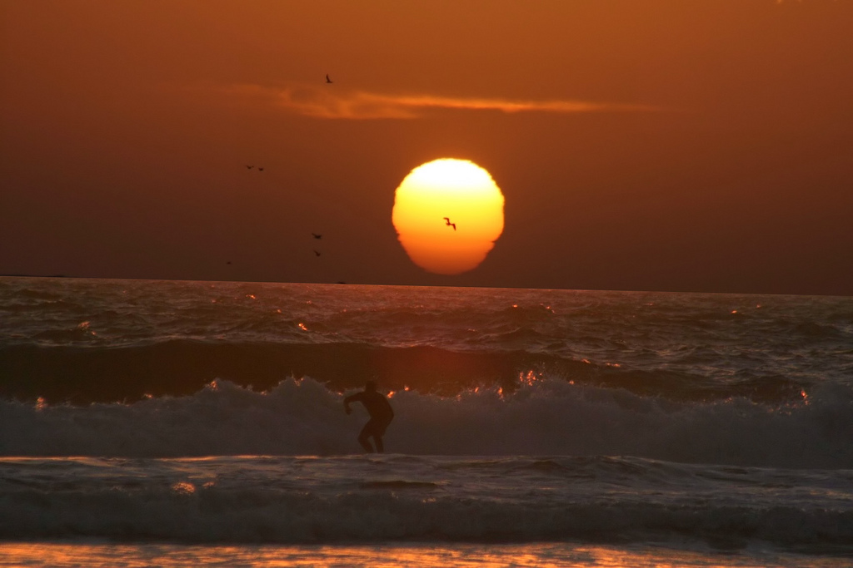

Chapter 8
Introduction to Energy: Sources and Kinds
Energy within the Earth
Energy from the Sun
The energetic basis of life
Energy use by people: renewable energy and non-renewable energy
Agricultural land issues
Global Environmental Challenges
Climate change
Ozone depletion
Dead zones, fertilizers and manure management
Population
Solid waste
Air quality

Slide 2
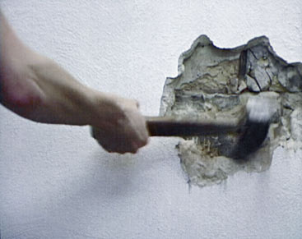
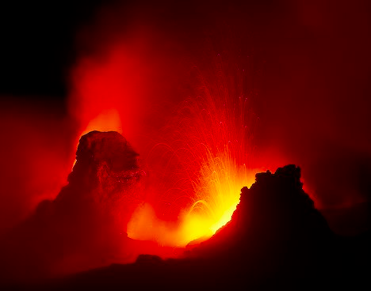

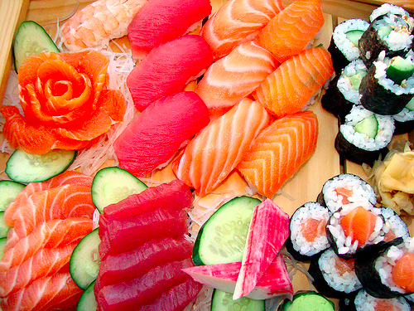
Introduction to Energy: Sources and Kinds
Energy exists in a variety of forms
mechanical
thermal
electrical
chemical
Energy can be converted from one form to the other

Slide 3


Potential and Kinetic Energy
Ex. Dropping a ball from shoulder height
at shoulder height, the ball is full of potential energy
when you drop it, the potential energy gets converted to kinetic energy
the ball’s speed increases as its potential energy is completely transformed to kinetic energy
once the ball hits the floor, some of its kinetic energy is converted to electromagnetic energy
sound
light
heat
most of its kinetic energy is transformed to elastic potential energy
used to power the rise of the ball back to your hand
it will never return to its original height however

Slide 4

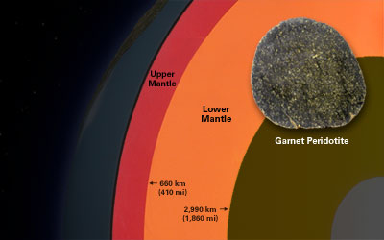
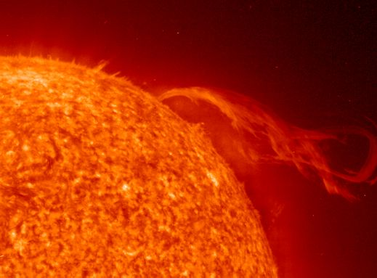
Sources of Energy
energy from within the Earth
primordial heat
earth was formed 4.6 billion years ago by bits of rock and dust coalescing
each bit of rock contained certain amount of energy
as rocks coalesced, some of the energy was trapped
this energy melted superior layers of rock to form mantle
energy from the sun
giant ball of gasses undergoing continuous fusion reactions
releases electromagnetic energy
captured by photosynthetic organisms on Earth

Slide 5
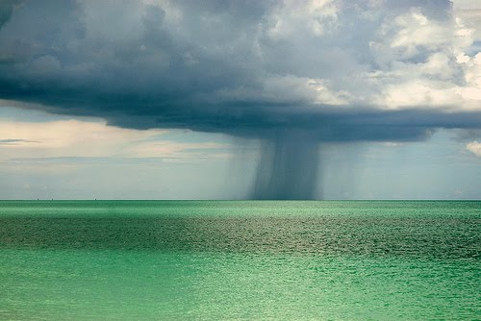

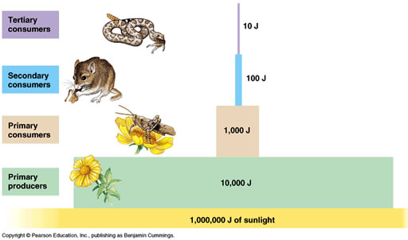
The Energetic Basis of Life
Sun’s energy is used mainly in two ways
changing water from solid to liquid form to gas form
drives climate
transformation into energy of chemical bonds in green plants
provides food for all other life forms
energy transformations in biological systems are inefficient
only 10% of energy passes up the next level of the food chain
its most energetically efficient when people eat grains, vegetables and fruits

Slide 6
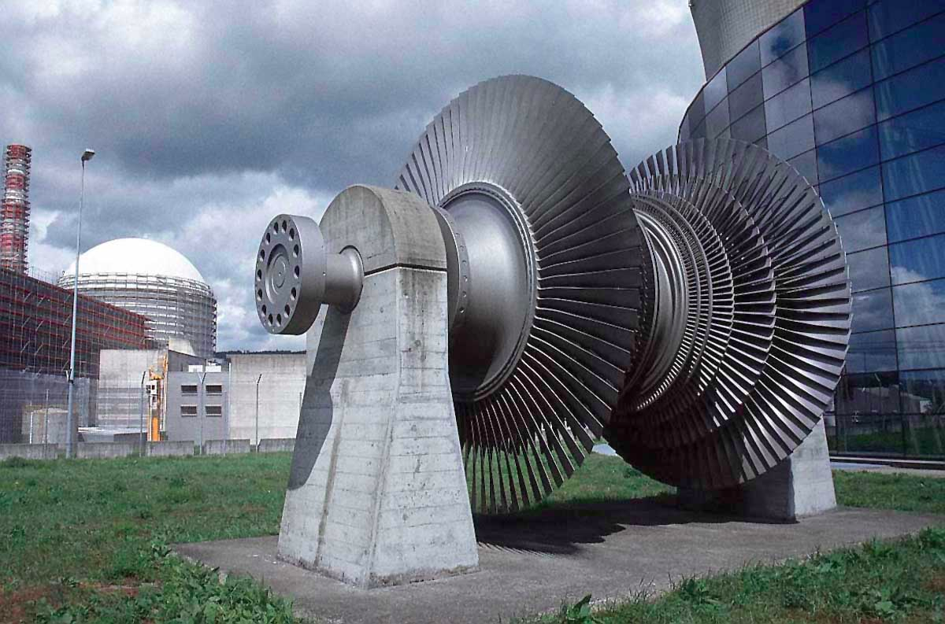
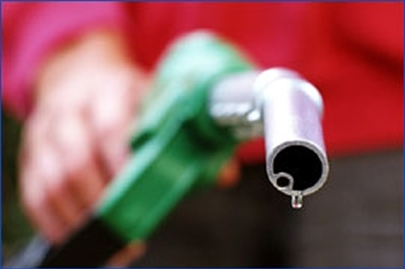
Energy use by people
Two most common types of energy usage
electricity: the flow of electrons
often generated using a turbine
gasoline
burned and converted to mechanical energy

Slide 7
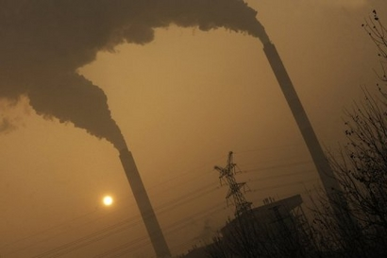
90% of energy that people use is generated from burning fossil fuels
fossils fuels: carbon rich compounds formed by ancient plants
inexpensive to obtain, cheap to transport or store
technology to transform fossil fuels to useable energy is simple, well developed and safe
NOT RENEWABLE
petroleum and natural gas will be depleted within 100 years
coal will be depleted in 400 years
undesirable byproducts
CO2 production

Slide 8
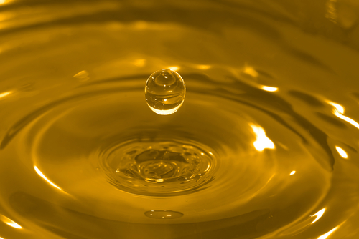
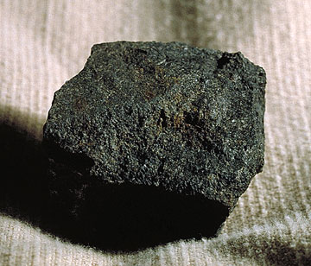
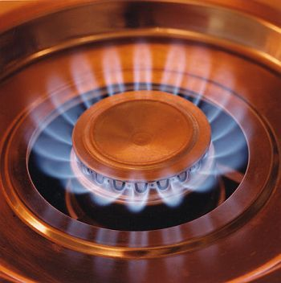
Three forms of fossil fuels
oil
procured by drilling and pumping
used to make gasoline, diesel fuel, and plastic
coal
extracted from Earth using digging, mining techniques and heavy machinery
dirty energy source
CA imports electricity from coal- powered power plants in Utah and Wyoming
outsourcing our air pollution?
natural gas
cleanest of the three
used to power CA power plants (CA has no coal fired power plants)
40% of our electricity
inefficient usage of natural resource
more efficient to directly use it to heat homes

Slide 9
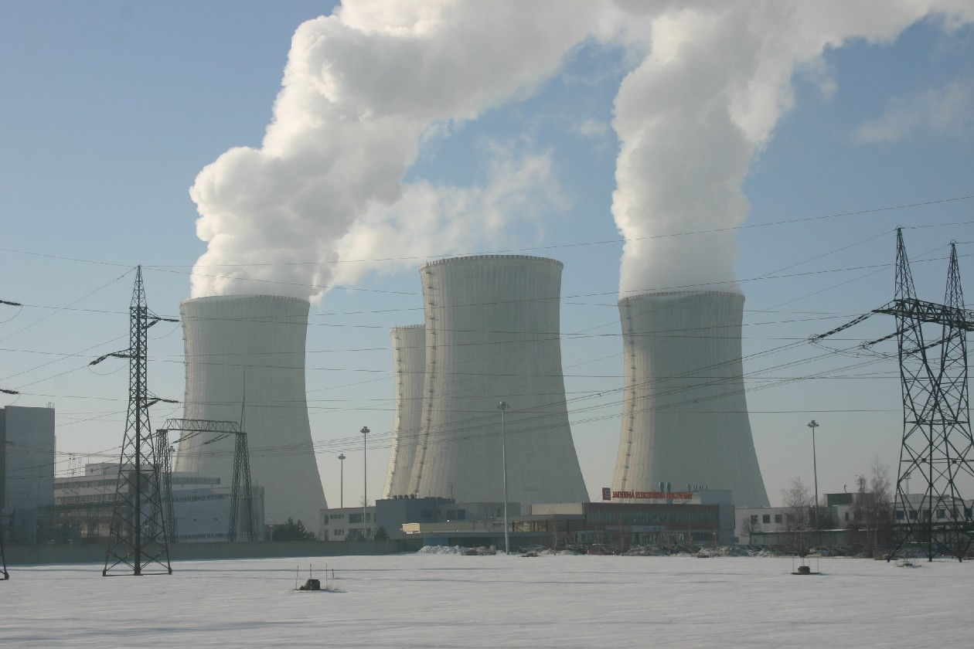
Another form of non-renewable energy is nuclear power
can last for another 100-200 years
clean
highly expensive
first generation funded by federal subsidies
withdrawal of subsidies makes power companies face the full cost= less economically attractive
highly dangerous
produces long-lived radioactive waste
feasible to store it underground, but in who’s neighborhood?

Slide 10
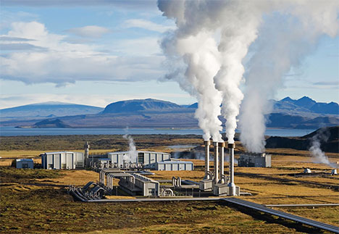
Geothermal energy straddles border between renewable and non-renewable energy
virtually inexhaustible
portion accessible from surface area often distant from major metropolitan areas
technology used to transform the geothermal heat to electricity can sometimes behave like non-renewable energy
potential locations often located in our most pristine park lands

Slide 11
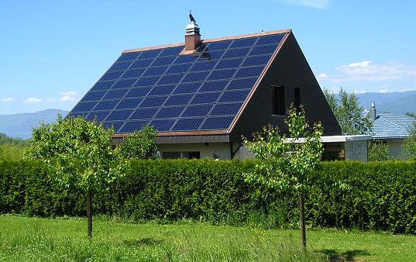
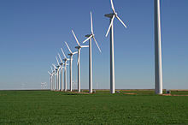
Clean, renewable energy
solar
huge potential for small scale and industrial production
currently expensive compared to fossil fuels, although that is in part due to oil subsidies
cost structure for solar power will change as technology improves and growing demands facilities mass production
b. wind power
captures wind energy via large arrays of windmills
captured energy used to drive a turbine
main limitation is the lack of many places that have sufficient windy conditions
wind farms run into local opposition
aesthetic objections
opposition from bird lovers who fear for safety of birds

Slide 12
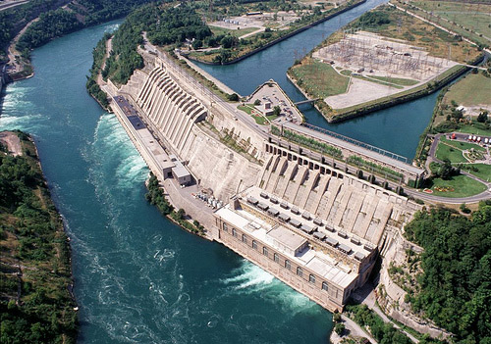
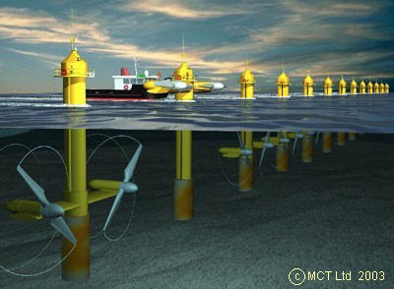
hydroelectric energy
captures mechanical energy of falling water via dams and turbines
dark side is that it requires damming rivers, which can dramatically alter river ecology
caused the Pacific salmon crisis
ocean wave/tidal wave power
wave power is captured by buoys anchored to the sea floor
tidal power is captured in estuaries
uses dams that allow the tide to raise the water level, then run the outflow through turbines to generate electricity

Slide 13
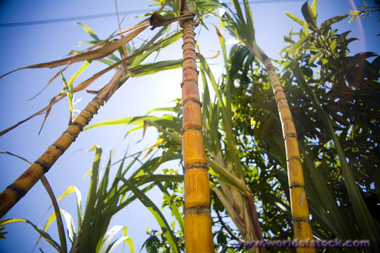
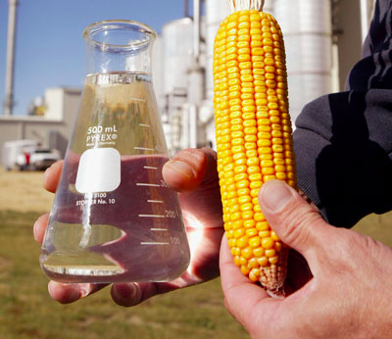
biofuels for powering vehicles
ethanol and alcohol are energy rich fuels
produced from various plant products
technology is still being perfected
most cars in Brazil run on 85/15 blend of alcohol to gasoline
What plants will be the sources?
sugar cane is the easiest to use technically
requires prime agricultural land to grow which could have been used to grow food
input energy to make grow sugar cane < output energy
corn on the other hand represents a net overall loss of usable energy
it is only subsidies to corn agriculture which make corn biofuel more salient in the public mind

Slide 14
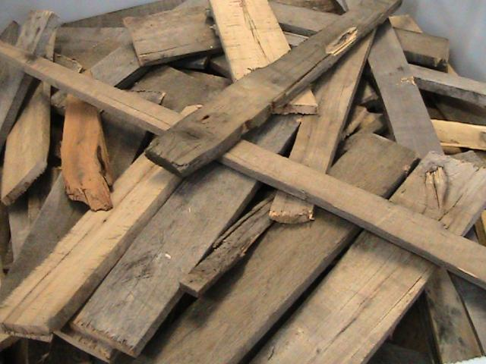


Cellulose biofuels
advantageous because we don’t need to eat cellulose
waste products could then supply our energy needs
wood waste
paper pulp
technically difficult
All various forms of energy have advantages and disadvantages
Evaluating these trade-offs is a complex, often technical problem
How will we balance competing needs and desires for energy prosperity, safety, and environmental health?
Can nuclear power provide a safe option?
Would you raise fewer objections if there was a severe energy shortage?
Is increased energy generation essential for continued economic growth?

Slide 15
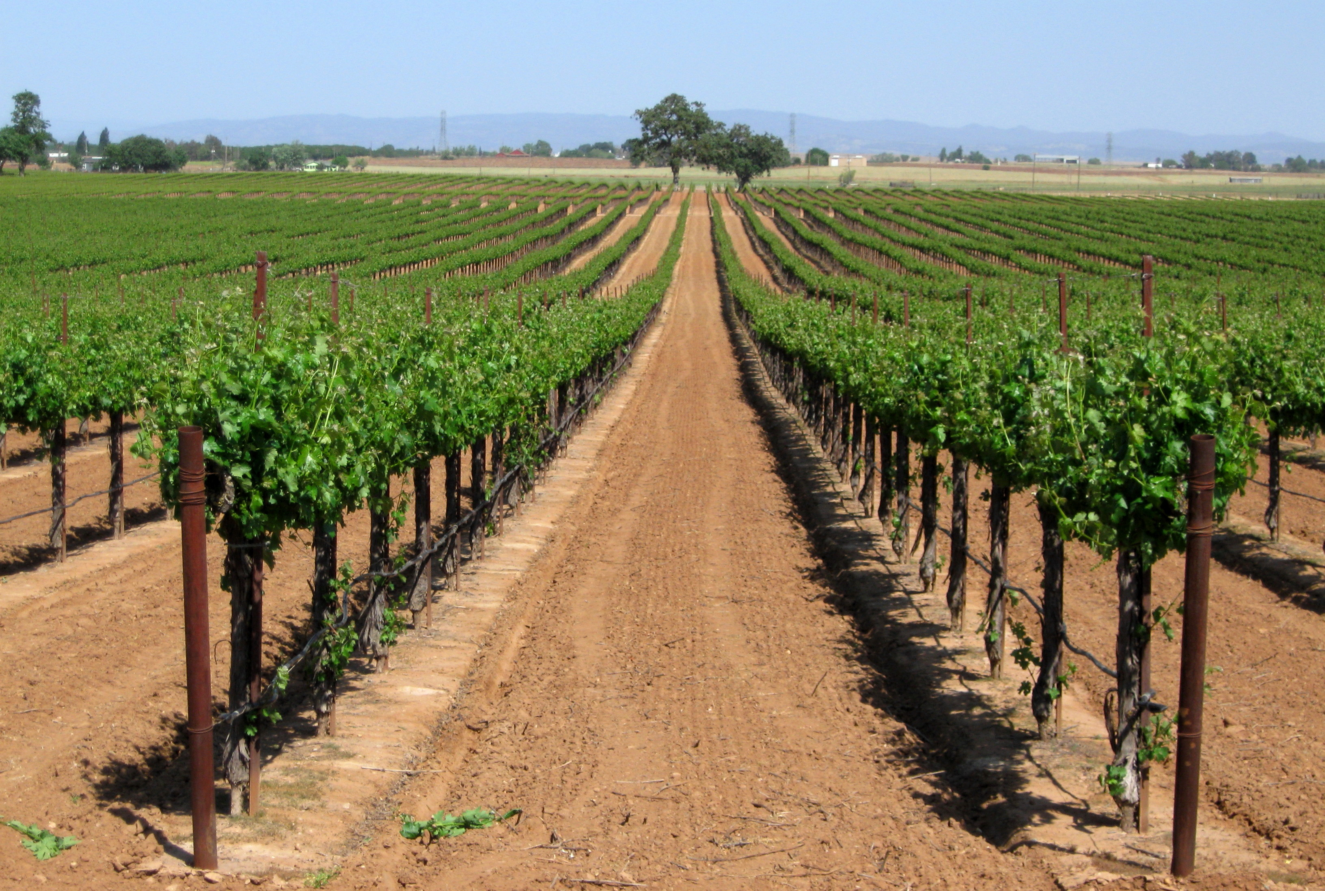
Agricultural land issues
“California is home to the most productive agricultural counties in the nation.”
US Department of Agriculture, 2008
our farms produce nearly half of the vegetables, fruits and nuts grown in the nation
almonds, artichokes, olives, walnuts, and figs are commercially produced only in California
CA is the nation’s largest dairy producer
of the state’s 100 million acres, 25.4 million acres are dedicated to agriculture
CA farms are on average smaller than the national average (312 acres vs 418 acres nationwide)
we are doing more with less

Slide 16
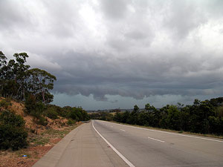
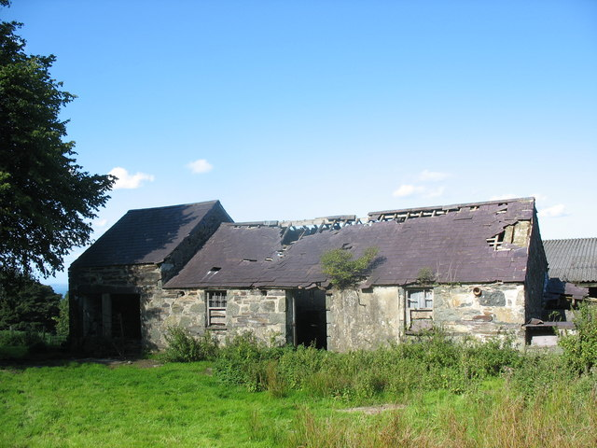
Land conversion
the development and conversion of farmland to urban use
driven by rising population and higher land prices, which place pressure on farmland
throughout the Central Valley, about 30,000 acres converted annually from farmland to urban use
increased willingness to sell off family farms
children want to pursue other careers
farming is less profitable
c. significant losses in prime farmland from 1982 to 2007, but has since stabilized
planners advocating for higher density residential areas
agricultural conservation easements
novel financing arrangements to help farmers keep their land

Slide 17
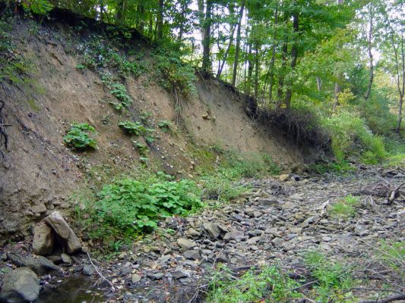
Water Use
agriculture uses between 50-90% of the state’s fresh water
most of the farm and ranch land is located in the drier southern half of the state.
a high percentage of water used in these southern farms is conveyed via aqueducts and dams from the north
supported by federal government and water subsidies that benefit large industrial growers
ecological concerns
coastal summer agricultural water need are met by tapping riparian and groundwater resources
this has effect of decreasing stream flow during dry season
contamination of ground and surface water by surface runoff of fertilizer and pesticides

Slide 18
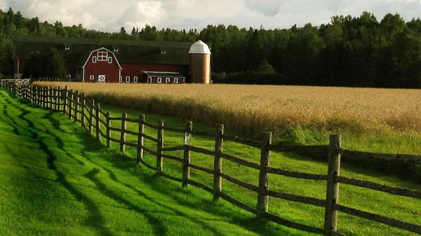
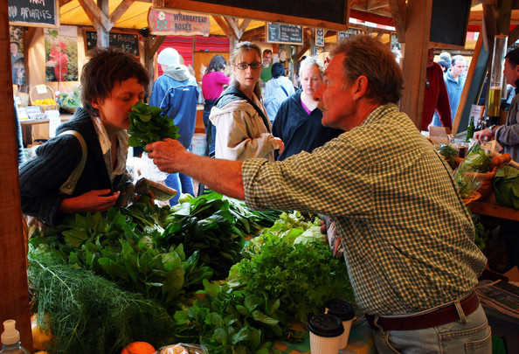
Sustainable agriculture
agricultural lands can provide other things beyond ample food supply and substantial revenue
maintenance of open space
refuge for wildlife
possibility of locally based food systems
b. most if not all farmers and ranchers see themselves as guardians of the land
rather than focusing on only buying organic, an insistence on buying local food may go further in reducing our carbon footprint

Slide 19
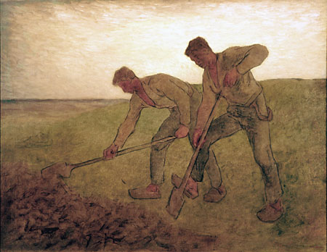

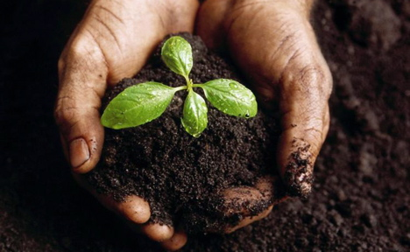
c. has roots in traditional agriculture
integrates three main goals
environmental health
economic profitability
social/economic equity
uses a variety of approaches
selection of species and varieties well suited to the site
diversification of crops (including livestock)
management of the soil to protect and enhance its quality
efficient and humane use of animals
consideration of farmers’ goals and lifestyle choices

Slide 20
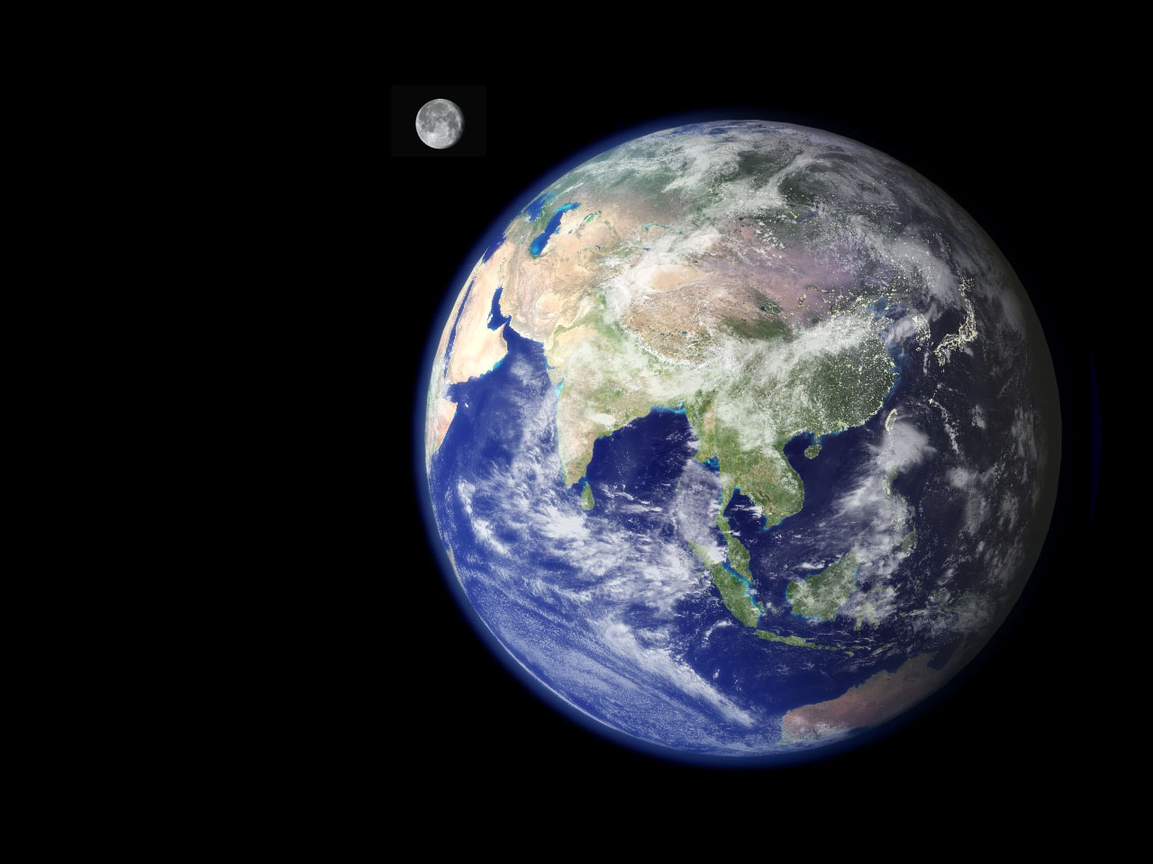
Global Environmental Challenges
“The first day or so, we all pointed to our countries. The third of fourth day, we were pointing to our continents. By the fifth day, we were aware of only one Earth.”
The Discovery 5 Space Mission

Slide 21
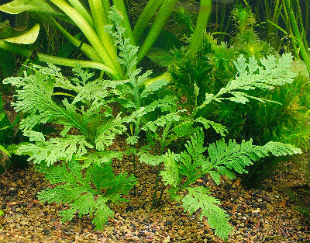
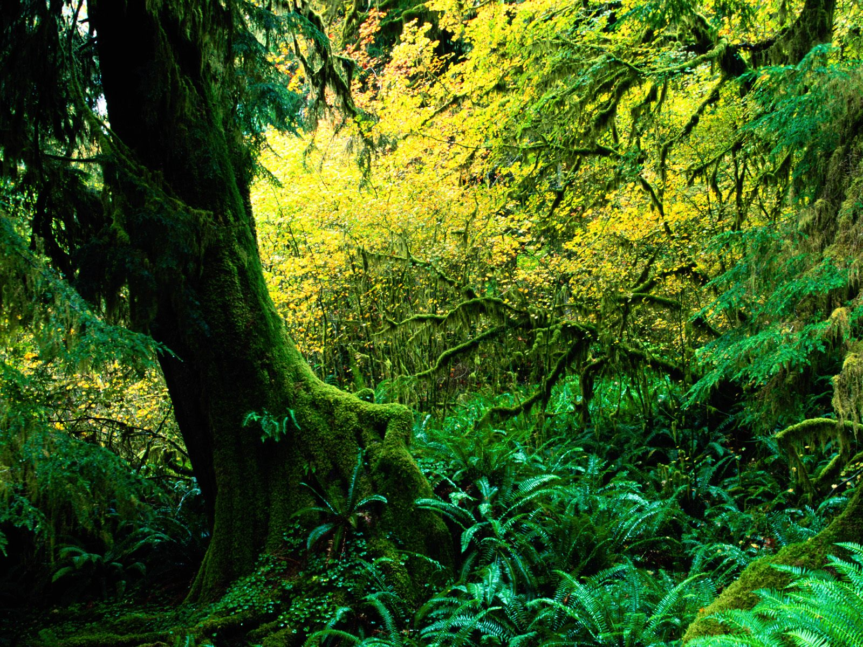
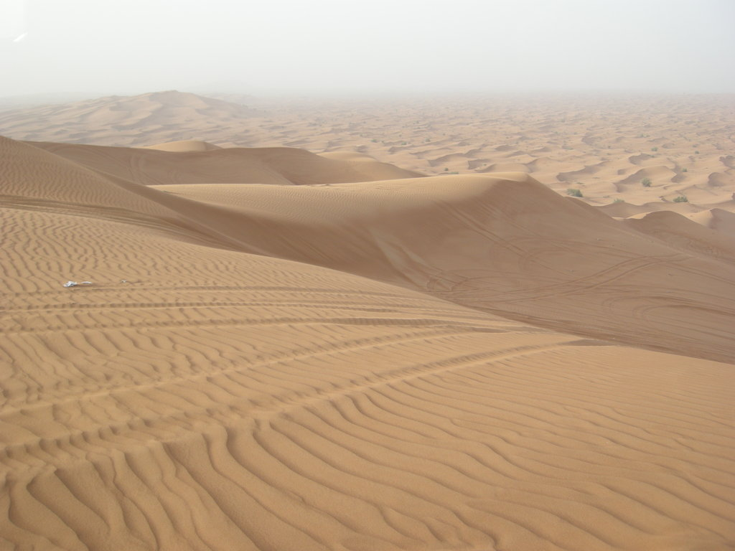
Global warming
atmospheric and climate change can be natural phenomena
the ancient atmosphere before the advent of green plants contained very little oxygen
the rise of plants eventually raised the concentration of atmospheric oxygen to 20%
annihilated many species, but opened the door for the existence of other species
cold glacial cycles alternating with warm interglacial
North American has at times hosted tropical forests, been buried under sheets of ice miles thick, or has been a dry and virtually lifeless desert

Slide 22
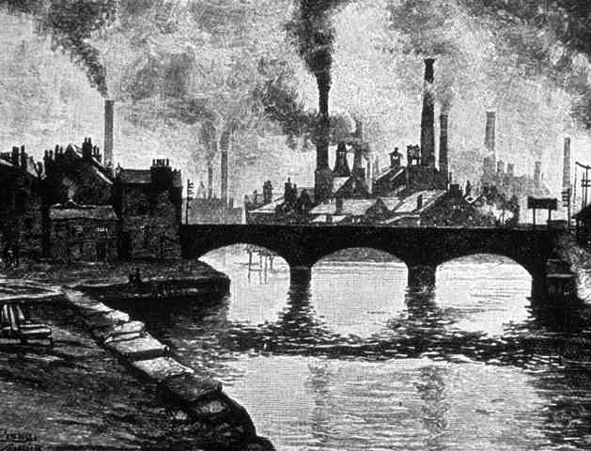
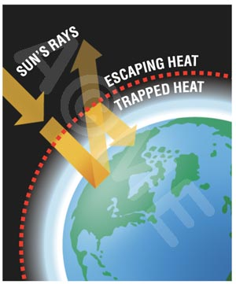
the most pressing global environmental problem of our time is human induced climate change
atmospheric chemical change took off with the start of the Industrial Revolution
greenhouse effect
heat-trapping blanket of greenhouse gases- primarily carbon dioxide, methane, and nitrous oxide- in the atmosphere
reflects heat that would otherwise escape out into space back towards the earth

Slide 23
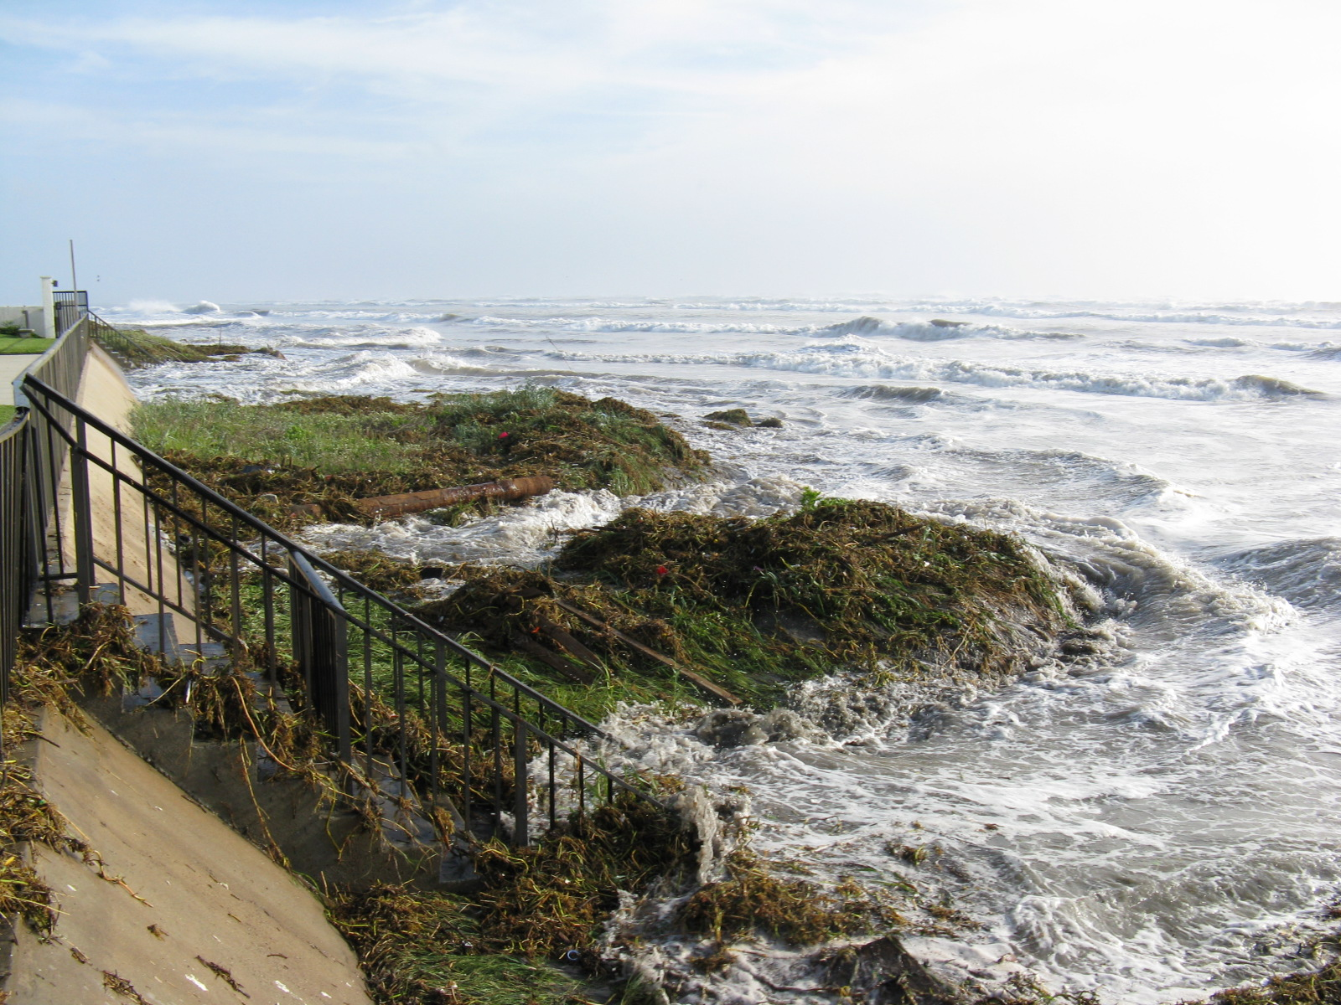
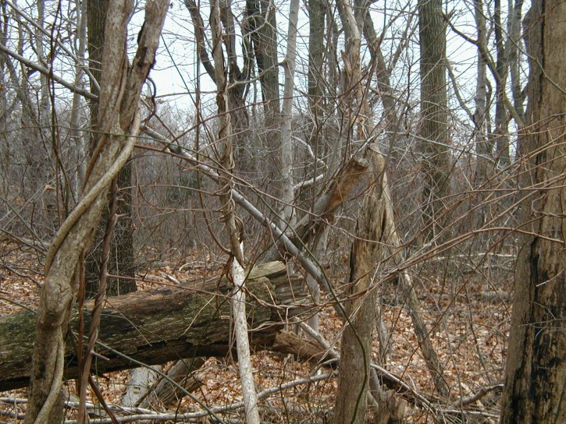
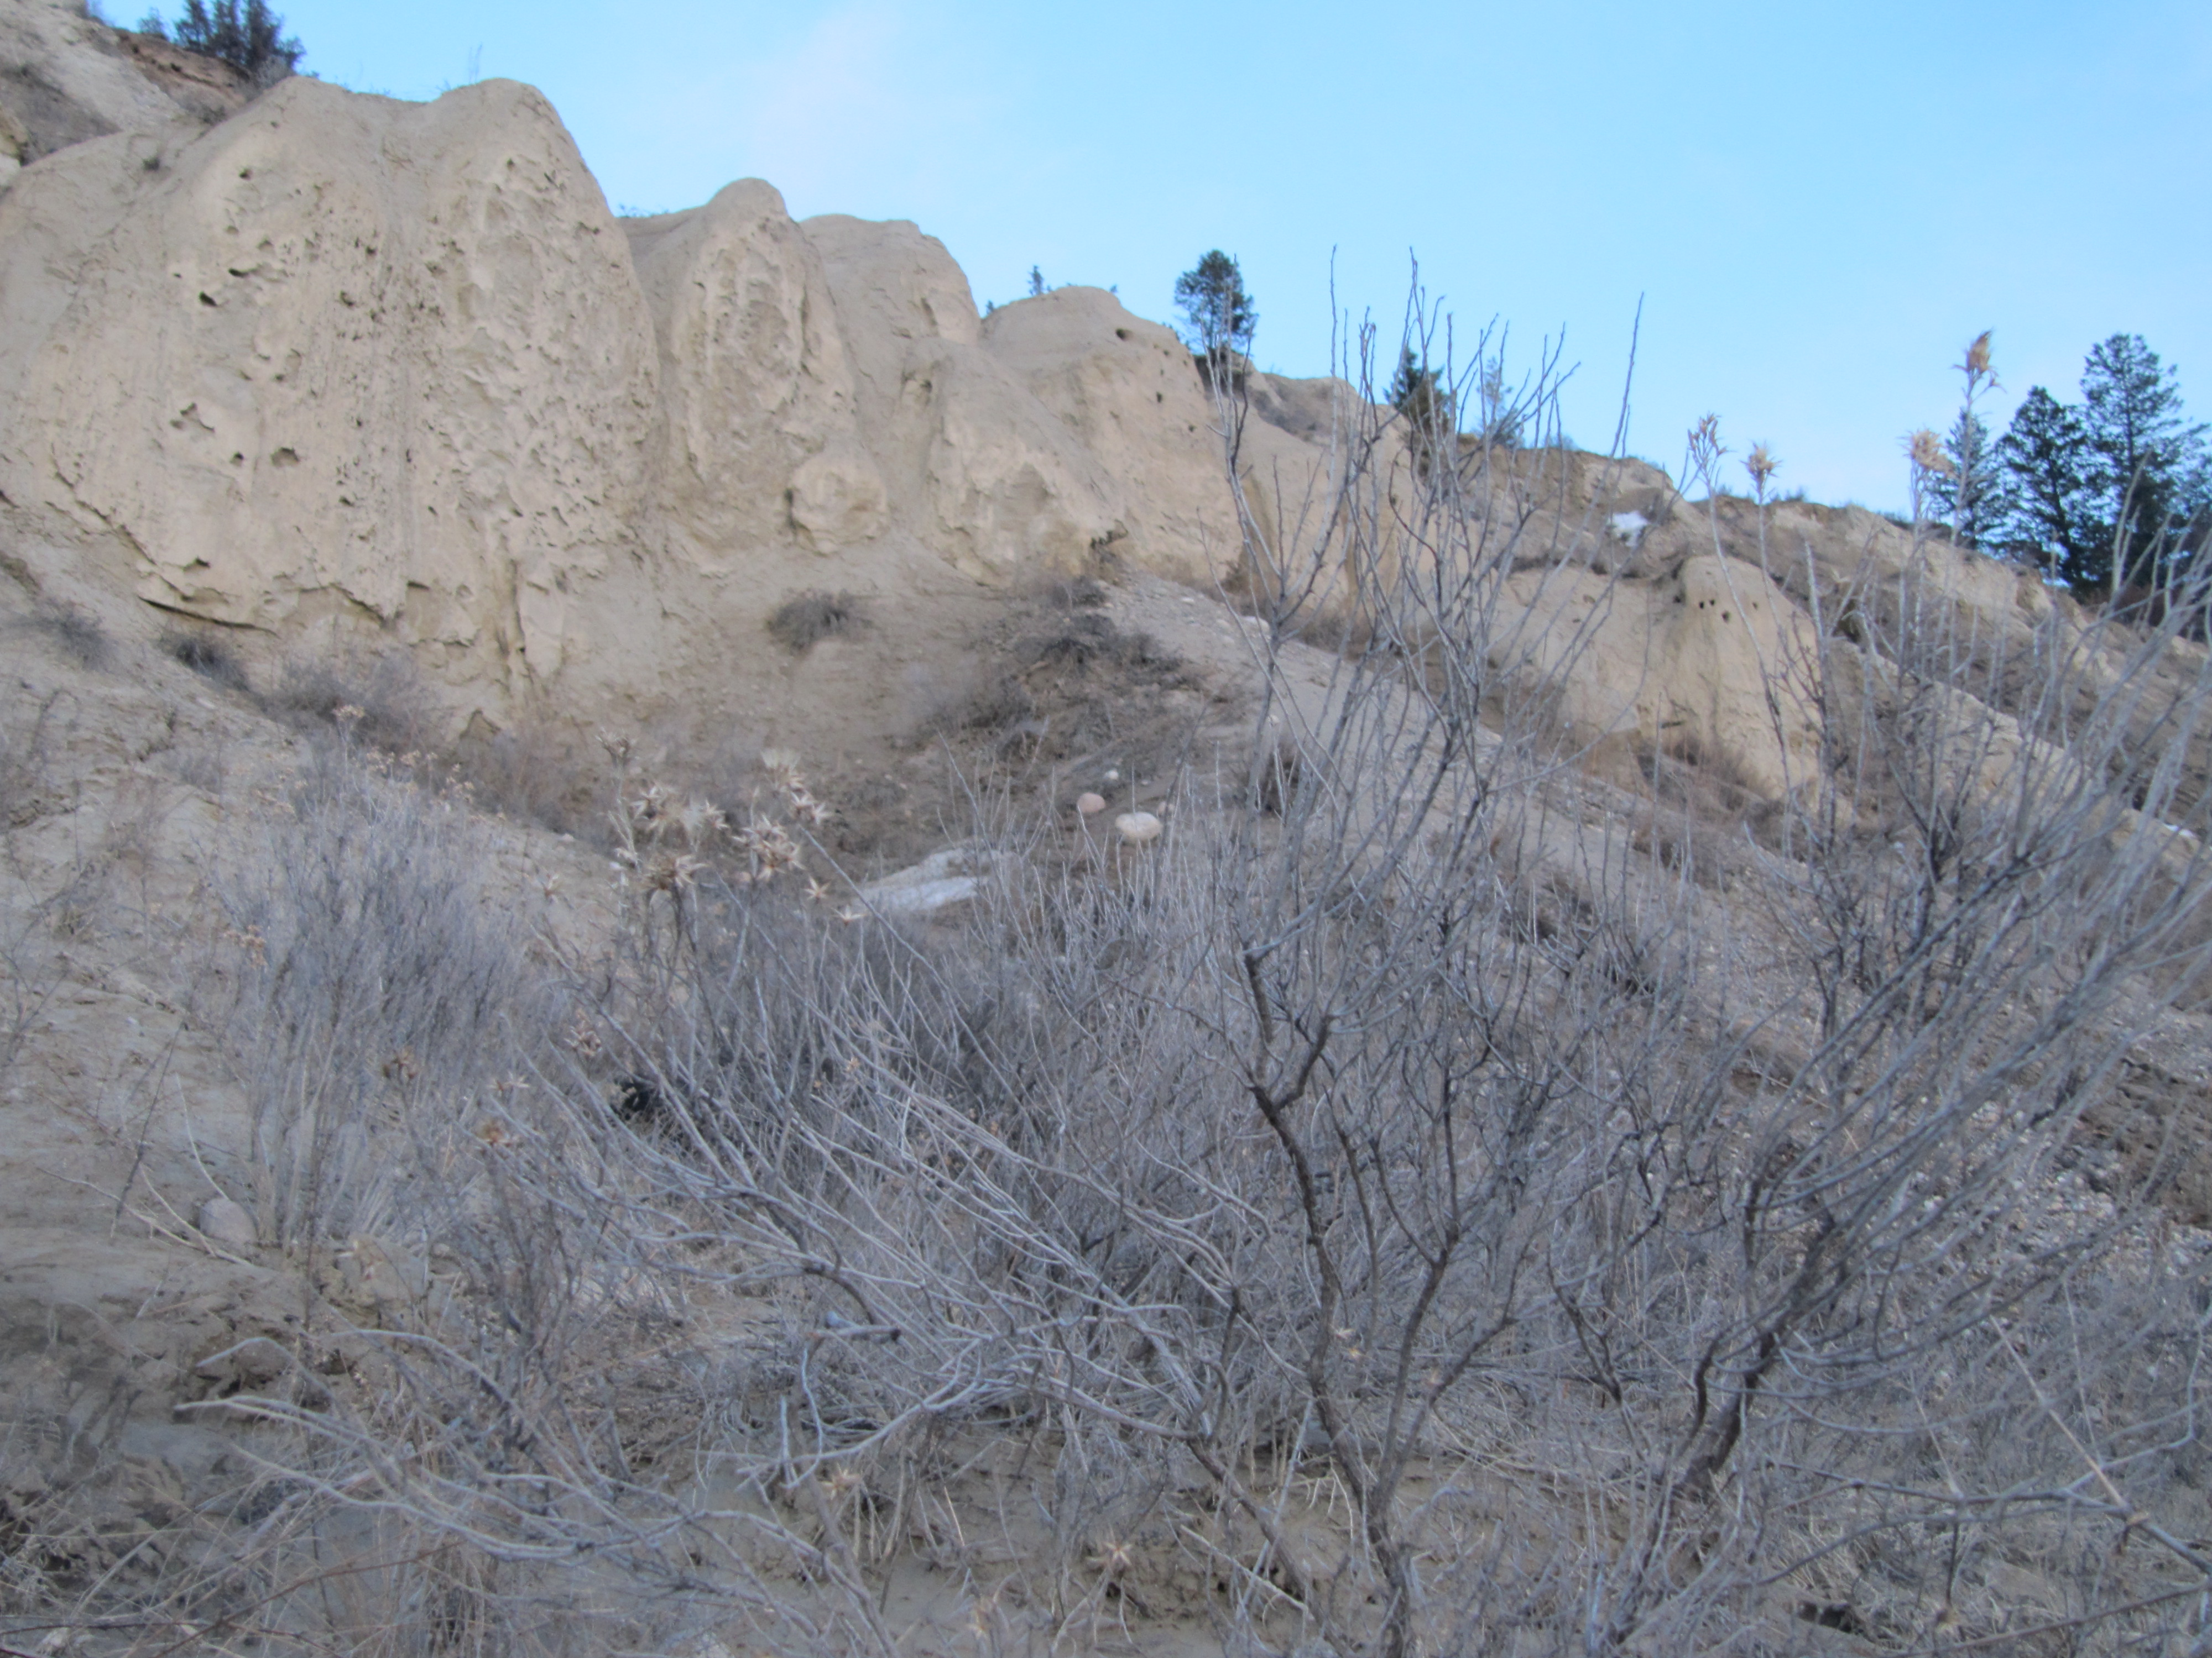
Global Warming’s projected impacts in CA
sea level rise, coastal flooding and coastal erosion
rising sea levels erode the coastline and cause greater storm surges
saltwater intrusion into the delta will threaten wildlife and drinking water for 20 million CA
warmer and more acidic ocean water will alter marine ecosystems and fog patterns
b. higher risk of fires
makes forests and brush drier

Slide 24
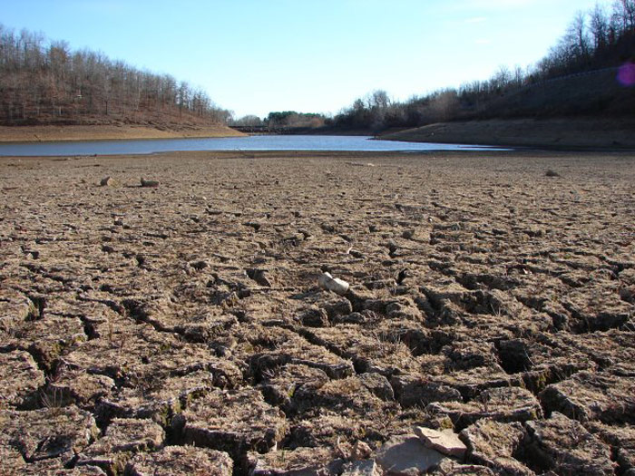
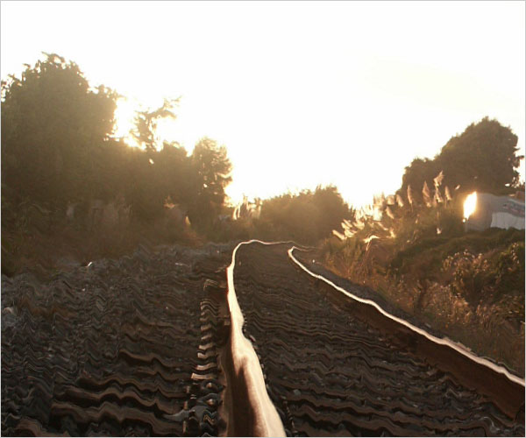
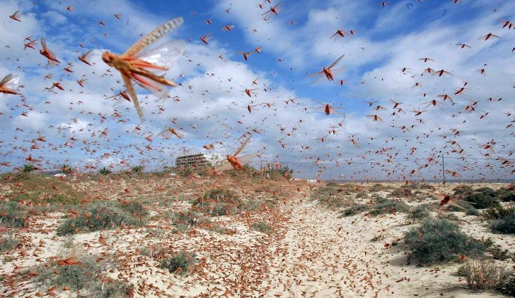
c. damage to agriculture
reduced precipitation
caused by northward shift of winter storms
leads to more severe summer drought
rising temperature
0.5-1 degrees increase by 2025
w/ more acute rises during summer
increase in heat wave days
decreased summer soil moisture
increased risk of pest infestations
@the watchers

Slide 25
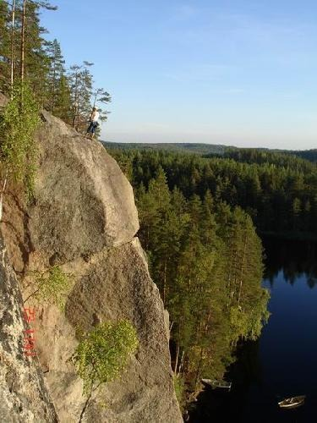
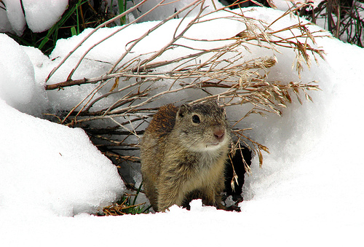
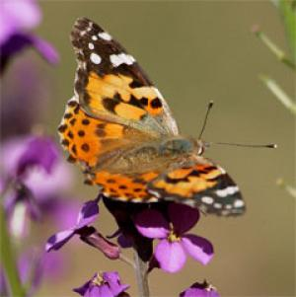
habitat modification, destruction, loss of ecosystems
impairs ecosystem ability to provide clean water supplies, wildlife, fish & timber
ex. the lower edge of the forests in the Sierra Nevada have been retreating upslope over the past 60 years
@lionwheeler
small mammals in Yosemite found at higher elevations now
@jeremy yoder
butterflies in Central Valley arriving earlier in the spring over the past four decades
@Debbie Aldridge

Slide 26
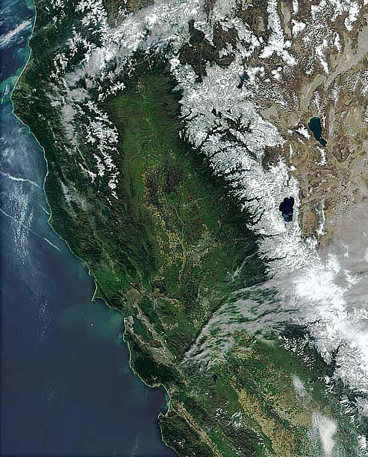
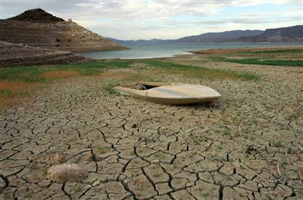
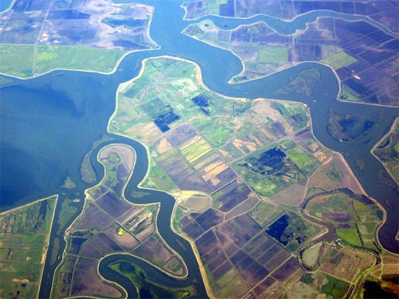
reduction in CA water supply
the Sierra snowpack provides 65 percent of CA’s water supply
projection of 25% loss of snow packs by 2050
longer and more severe droughts
general drying of the southwest US region
the probability of Lake Mead going dry by 2025 is 50%
@rivers edge
rising sea levels threaten Sacramento-San Joaquin Delta
source of water for 20 million CA residents
source of water for millions of acres of prime farmland

Slide 27
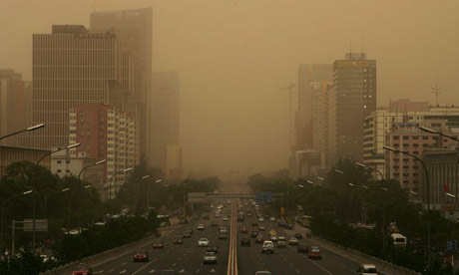
Dodging the climate change bullet
China and India (with about half of the world’s population) currently emit less greenhouse gas per person than the US or Western Europe
But they are on a trajectory to overtake us
This would be a recipe for a climatic disaster

Slide 28



China
consumes more coal than the US, EU and Japan combined
every two weeks another coal-fired power plant opens up in China large enough to serve all the households in San Diego
@greenbeat
clearly we need to cooperate with rapidly developing countries and help them develop cleaner energy solutions
increased emissions from developing countries are not a foregone conclusion
combination of new technologies, regulations, changes in consumption/behavior will be essential
@thegrowspot.com

Slide 29




@lisa henderling
@andrea gracia
Reducing our carbon footprint can be fun
walking and riding bikes
going to farmer’s markets
planting a trees
sharing with neighbors
@tree plant raleigh

Slide 30






Here are a few places to start (with annual carbon savings in pounds)
replace a regular light bulb with compact fluorescent light bulb: 150 lbs
drive less: 1 lb of C02 for every mile you don’t drive
check your tires: keeping your tires inflate properly improves gas mileage by more than 3%
recycle at least half of your household waste: 2,400 lb
use less hot water: it takes a lot of energy to heat water. Use less by installing low flow showerhead (350 lbs) and washing your clothes in cold or warm water (500 lbs saved per year).

Slide 31



avoid products with lots of packaging: reduces your garbage and saves 2,000 lbs of C02 yearly
plant a tree: a single tree will absorb one ton of carbon dioxide over its lifetime
turn off electronic devices when not in use: 1,000 lbs of C02 per year

Slide 32






Additional suggestions
teleconference, vacation locally, plan trips to reduce plane travel
eat food grown locally: much of the food sold in supermarkets has been driven and flown thousands of miles
@planet matters
advocate for renewable energy: electricity generation produces 40 percent of carbon emissions for the US
@citation technologies inc
support projects that restore and protect the ocean, forests, and wildlands

Slide 33



Ozone (O₃ )depletion
Ozone
ozone exists in small quantities in the stratosphere
protects us from ultraviolet radiation
Chlorofluorocarbons (CFC’s)
1920s, created by Thomas Midgley who was trying to create a substitute for dangerous gasses used in refrigerants
quickly adopted across all walks of industry
We now know that CFC’s are dangerous
destroy ozone layer
broken down by light to form chlorine and bromine atoms
chlorine and bromine react with ozone to destroy it
10,000 times more potent as greenhouse gasses than carbon dioxide
@buzzle.com

Slide 34

Since 1990, CFC production and use have been banned worldwide
world’s first global political response to an environmental threat

Slide 35



Dead Zones, Fertilizers, Manure Management
dead zones are low-oxygen areas in the world’s oceans and lakes
caused by eutrophication
today 146 dead zones have been identified
some are small, but the largest one covers 70,000 square km
ex. Mississippi river collects agricultural runoff from Midwest, the breadbasket of the world
high concentration of fertilizer combined with animal waste make the runoff extremely high in nitrogen and phosphorus
dead zones can be recovered
Black Sea dead zone was once the world’s largest dead zone
disappeared following collapse of the Soviet Union and its subsidies of fertilizer use

Slide 36


Manure Management
manure effects on ecology
nutrient poisoning of rivers
composting it creates methane, a greenhouse gas
25X more potent than carbon dioxide
Air quality
smog
in western states, mostly composed of ozone
formed from nitrogen oxides (NOx) and volatile organic compounds (VOC)
worst on warm, stagnant days
@caremen vidal

Slide 37



transported between continents
rural areas in NorCA receive smog from ozone plumes moving across the ocean from Asia
@union of concerned scientists
effects
difficulty breathing
worsening of asthma
reduces lung volume over long periods of time
reduces photosynthesis, growth, and root development in plants
marked by bronze speckling on the upper leaf surface
@g.krishnaswamy
@university of missouri

Slide 38


particulate matter
consist of many chemical constituents/fine particles from diverse sources
wood burning
diesel engine emissions
road and agricultural dust
coal fired power plants
Air pollution, China
@nasa
effects
premature death in old or unhealthy populations
generally not damaging to vegetation unless containing high levels of nitrogen
cement dust, which is alkaline and corrosive and particles mixed with heavy metals are hazard for grazing animals and consumers of milk and meat

Slide 39


sulfur dioxide (SO₂)
derived from burning coal
effects
asthma attacks
acid rain
particularly acute effects in Sierra Nevada, where pH buffering is weak
visibility degradation
@phil noble
carbon monoxide
byproduct of incomplete combustion
automobile engines
campfires
other sorts of biomass burning
accumulates in valleys with little air movement, in caves, enclosed tents or automobiles
effects
not harmful to plants
headache, chest pain, even rapid death in humans

Slide 40



carbon dioxide (CO₂)
primarily from vehicle exhaust
effects
warmer temperatures
exacerbates ozone air pollution
increases risk of wildfire, extension of fire season
further increases particulate matter and ozone concentrations in downwind communities
@webmd

Slide 41

Solid Waste
In nature, there is no such thing as waste
a tree dies and decomposes
becomes food for fungi
home for insects and birds
later becomes a seed log for new trees

Slide 42


Humans on the other hand treat materials as if they can “go away”
average CA generates 42 lbs of trash weekly
every item we buy has “embodied energy”
embodied energy is the energy that was used to get the product from its source to you
manufacturing
packaging
advertising
shipping from manufacturing center to commercial store
transportation from store to home
collection for recycling and landfilling
when we fail to use something to its fullest potential, we:
waste materials comprising the product
waste resources that had gone into creating the product

Slide 43



Disposal
“trash day”
sorting and parsing of recyclable items at transfer station from waste stream
remaining waste trucked to landfill
gigantic hole lined with clay or plastic
space is becoming more scarce
decades to thousands of years to decompose
nearly half of US landfills have been closed due to groundwater contamination
covered with soil to shield from rain, wind, sun, air
as materials degrade, emit methane which is 25X more potent greenhouse gas than CO₂
food waste and organics are biggest generators of methane
amplifies importance of composting food and organics

Slide 44



Its difficult to build new landfills due to “not in my backyard” mentality
trucking of garbage far away at great expense.
San Francisco hauls all its trash over 50 miles to Livermore, CA
Los Angeles is considering long rail hauling of their garbage for disposal in Mojave Desert
CA’s efforts
improved waste reduction and recycling rates due to new laws
we still throw away a third of our bottles/cans and recycling <50% of our paper
Recycling achieves huge savings in energy
ex. recycling aluminum can save 95 % of energy required to make same amount of aluminum from its virgin source

Slide 45


How does your household stack up?
write down everything you think you would find in your weekly garbage
assign predicted percentages to each type of trash
now go through garbage before trash day and sort it out
use gloves and maybe goggles
@green building services
ask yourself questions
How much of this could have been recycled?
How much composted?
Why did I buy this product in the first place?
Did I use it fully?
Could I have bought something similar that could have been reused, recycled, or composted?
@green building services

Slide 46


Masses of garbage, mostly plastic, swirl around the world’s oceans
largest one is the Great Pacific Garbage Patch
twice as large as the state of Texas
heavier than all the plankton living in the northern Pacific Ocean
extends up to 10 feet below surface
sea life mistake plastic as food
80% of the patch comes from land sources
packaging and plastic bags left on beaches, littering creeks, blown from highways to storm drains
is it time to ban plastic bags?

Slide 47


These four Rs help us see products as part of the natural material cycle
Reduce
Reuse
Recycle
Rot (compost)
Oakland and San Francisco have set the example by setting the exciting and ambitious goal of generating zero waste by 2020
Manufacturers in the solid waste solution
often have greatest ability to reduce environmental impacts of their products
process of rethinking their products, their relationships with the supply chain and the ultimate consumer is good for business
increases productivity
cuts costs
fosters product and market innovation
provides customers with more value at less environmental impact
@bizneos

Slide 48

Tips to reduce your trash footprint
buy less
buy products with little or no packaging
try items that can be reused
cloth bags for shopping
cloth napkins for meals
dish towels for the kitchen
buy gently used toys, clothes and furniture at garage sales, but NOT old electronics (which can be hazardous)
choose lasting, durable items
buy/build compost bin
recycling at your home
no transportation costs
useful for your garden

Slide 49


Population
All of the previously mentioned problems are outgrowths of the size of the human population
grew slowly for most of the 4.5 million years we have existed, hovering a around 5 million people
invention of agriculture about 11,000 years ago led to the first spike
following 9,000 years saw human population expand to 300 million
By 1650, 130 million
By 1800, 1 billion
By 1930, 2 billion
By 1960, 3 billion
By 1974, 4 billion
By 1987, 5 billion
By 1999, 6 billion
though the world population growth rate has fallen from its peak at 2 %/yr to 1.3%/yr, it is expected to increase substantially during the 21st century
UN projections suggest that world population will stabilize at just above10 million by 2200

Slide 50



CA population
by 2008: 38,246,598
most dense around coastal counties
by 2025, expected to be 46,720,307
driven by births and immigrations
17% increase in coastal counties
45% increase in inland counties
a tenacious situation considering that inland temperatures are projected to rise dramatically!
age distribution
in 2008, 14% of population is age 60 or older
by 2030, this proportion will increase to 24%

Slide 51

Conclusion
We live on one planet, with nowhere else to go
We are rapidly reaching the limits of human population and resource use that the planet can support
We are creating global environmental dangers unprecedented in human history
We have unprecedented technological tools to overcome these problems that no previous generation has possessed

Slide 52

The next hundred years will be interesting indeed……

