Slide 1

Pruning Fruit Trees for
Napa Home Gardeners
Presented by UC Master Gardeners of Napa County
January 2016

Slide 2

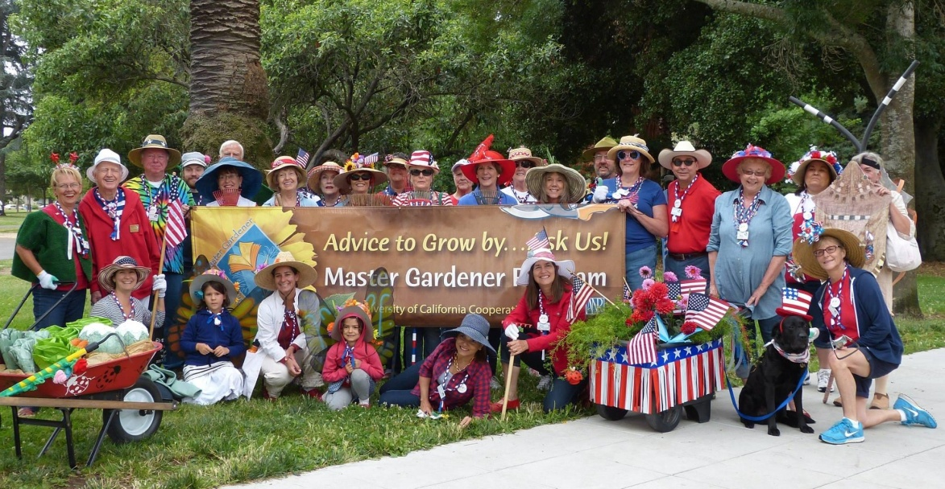
Who Are Napa Master Gardeners?
We are trained volunteers providing practical, research based horticultural information to Napa County residents
Notes:
The Master Gardener program is designed to provide scientifically based gardening information to home gardeners.
We are all volunteers, and are part of the University of California Cooperative Extension system. See our logo!
We receive 80 hours of initial training to become certified. We take continuing education classes each year to remain certified.
And we train new Master Gardeners! Just ask us after the program how and when to apply!

Slide 3
What Do We Do?
Public Workshops All Year (check website)
Help Desks: UCCE Office, Mobile & Farmers Markets
Website
Weekly Newspaper Column
Demonstration Garden at Connolly Ranch
Notes:
And we have several services we want to make sure you know about!
First, workshops—you already know that, because you are here!
We have a Help Desk (bricks and mortar), and here (Hold up business card) is the information for that. And we have Mobile Help Desks at various nurseries in the area in the spring, and we are generally a presence at all the valley Farmers Markets. Have any of you seen us around?
Our website is just packed with help! Google Napa County Master Gardeners. One of our team today will give you a brief tour of our website towards the end of the program today.
We are also linked to the Agriculture and Natural Resources library at UC Davis.
We have a weekly column in the Napa newspaper—have you seen it? You can find an archive of our newspaper articles on our website.
We have a comprehensive demonstration garden in Napa at Connolly Ranch, at Browns Valley and Thompson roads. Have any of you been there? Please check our open garden schedule on our website and come have a look!
We have our Monthly Garden Guide specific to Napa County and have just completed an update to our book about Trees in Napa.
We want you to take advantage of all this information!
But wait, there’s more!
We train future Master Gardeners! Check our website to sign up to be notified when we begin recruiting for the 2017 class next summer! Our 2016 class just started on January 5.

Slide 4
And more . . .
Monthly Gardening Tips
“Trees in Napa” Updated Book
Tomato Sale: April
Bi-Annual Garden Tour: Next: 2017
Train New Master Gardeners

Slide 5
Four Questions
What is pruning?
Why are trees pruned?
When is the right time to prune?
How to do it right?
Notes:
We are going to answer four questions today—What, Why, When, and How.
We will answer those questions. The How will be longer than the others, because there are some basic principles to understand, such as tree anatomy, some general pruning vocabulary, the types of pruning cuts plusIwe have a pruning tools outline to show you.
Almost everything we will talk about today came from this book The Home Orchard, published by UC. While we are not allowed to sell you one today, you can order one. Just ask one of us how later on.
Anyone have some thoughts on WHAT pruning is? (Wait for replies. Maybe write them down.)

Slide 6
What Is Pruning?
Trimming and cutting twigs and branches
Removes dead and living parts
Then what happens?
Notes:
Here’s what pruning is.
Pruning is cutting twigs and branches—they can be dead or living parts of the tree.
And what I want to be sure you know is that when part of a tree is cut, something else grows because of it. Something else grows because the tree was cut.
Our job is to understand what and how to cut in order to get the growth we want.

Slide 7
Why Do We Prune?
(Re)establish a sound structure
Tree health (air circulation, balance)
Optimize fruit production (light, fruitwood/fruit load)
Control tree height/bring down tall trees
Revitalize tree
Notes:
Fruit trees are pruned so the tree will be as healthy and productive as possible.
The goal is good fruit production and a happy tree.
And a happy gardener.
Pruning helps the tree maximize its potential.
Controlling growing and development also addresses the shape of the plant
C-a-n increase fruit production quantity (and thinning of immature fruit can increase individual fruit size)
By being familiar with the tree, by being out there touching it, you can catch potential problems earlier
Being outside and working in the garden feels good, like winter may be ready to turn into spring
Can also tie tape on branch/es to remind you to give them another look in summer or next pruning season

Slide 8

When is the right time to prune?

Slide 9
When to Prune
It’s never too late! Trees and shrubs can be pruned any time of year.
Trees respond differently to pruning depending on the time of year.
Dormant pruning manages fruit and tree structure and promotes growth.
Summer pruning manages tree size.

Slide 10
Helpful Vocabulary to Do It Right
Tree anatomy
Pruning vocabulary
Pruning tools
Notes:
We have talked about WHAT pruning is,
And WHY we do it—mostly for the good of the tree,
And WHEN the right time to do it is—
So now it’s HOW to do it right.
This is the big question, and the one with the longest answer.
First, some basics:
Terminology: Tree Anatomy, Pruning Terms
Let’s all understand the right words for a tree’s anatomy,
some common terms used for pruning,
have a quick look at some of the usual suspects when it comes to pruning tools,
and finally look at the main types of pruning cuts,

Slide 11
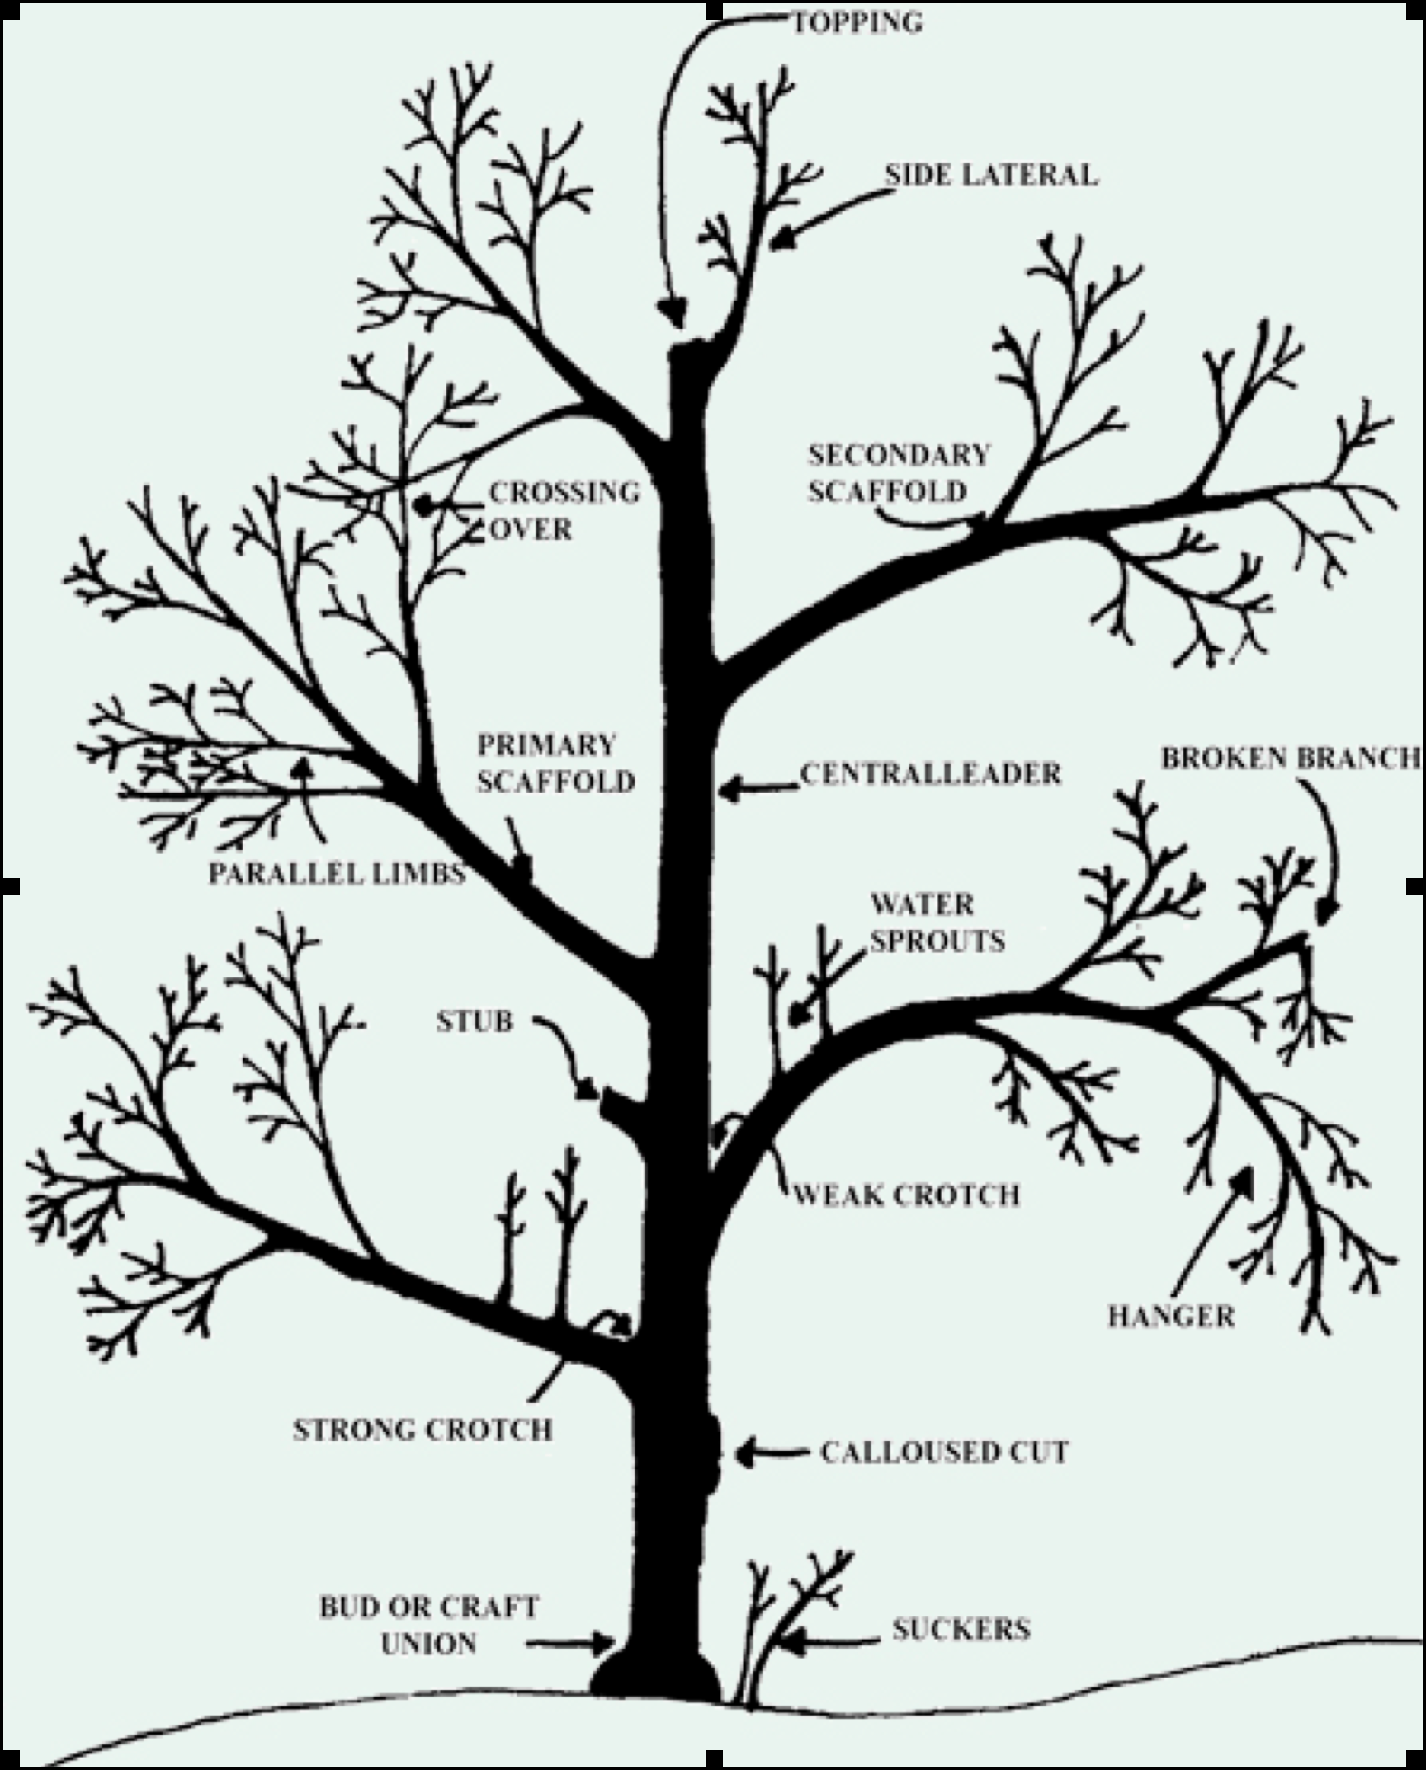
Tree Anatomy
Notes:
You each have a copy of this slide so you can see the parts I’m talking about better.

Slide 12
Tree Anatomy Terms
  Trunk
  Canopy
  Collar
  Scaffold branches
  Lateral
  Shoot
  Leader/Central Leader
  Node/Internode
  Fruitwood
  Spur
  Graft Union
  Watersprout
  Sucker
Notes:
Trunk. The main structural and strongest part of the tree.
Canopy. Refers to the leafy crown that surrounds the woody parts of the tree.
Collar. One of the most important parts of the tree, especially with the larger limbs. Look carefully at the point where one of the main, or scaffold, branches attaches to the trunk. There is a build-up of special bark material in that area. Not only does that part of the tree hold that limb especially tightly, it also has special healing hormones that are activated when the limb is cut. That’s one of the REACTIONS that occurs when you make a cut.
Scaffold branches are the main branches on the tree, attached to the trunk. They provide a lot of structure for the tree. Many trees has a primary scaffold area, and a secondary one. The angle of attachment to the trunk is important—too narrow or vertical an attachment is a potential weak point in the tree. What we WANT is a somewhat more horizontal angle of 45 to 60 degrees.
Lateral branches grow from scaffold branches.
Shoots are the current year’s growth, sometimes one year-old growth.
The leader/central leader part of the tree is the part going right up the middle. For some kinds of fruit, a central leader is ideal. Susanne will talk more about this.
Nodes are the little bumps on the laterals or shoots. Some nodes develop leaves, some develop fruit spurs, some develop blossoms. The space between the nodes is called the Internode. If you look at some of the branches on your table, you can see the internodes. In true dwarf varieties, the internodes are tiny! And on watersprouts (we’ll get to them in just a minute), the internodes may be very far apart.
Fruitwood is the part of the tree that will grow . . .Fruit! This can be a spur, or first or second year growth. Different trees have different kinds of fruitwood. It’s another bit of tree anatomy to know—for example, apples grow on spurs and can begin bearing fruit the first year a spur develops, and that spur can continue to produce for 8 to 10 years. Pomegranate, on the other had, bears on short new shoots, and not ever again on that same shoot. Peach and nectarine bear fruit on lateral long branches for 1 to 2 years. The Home Orchard, both online and in paper, has all of this information.
Spur. This is a short branch that is specialized for flower and fruit production.
Scion. Two definitions. One is the aboveground portion of a tree, and the other is a branch, shoot, or bud removed from one plant and grafted onto another.
Rootstock. The lower portion of most fruit and nut trees, onto which the desired fruiting scion is grafted. Rootstocks are developed to manage the mature size of the tree, or to tolerate certain soil conditions, or for disease resistance, or for drought or frost tolerance. They give trees a certain vigor.
The fruit tree itself reflects the characteristics of its rootstock and its scion in growth habit and in the fruit.
Graft union is where the rootstock and the scion come together. It should always be above the grade of the soil, as the graft union is an area vulnerable to disease and mechanical injury.
Watersprouts are vigorous upright growths generally right out of the most lateral branches. They have a lot of leaves so they can provide good shade if needed. You have to decide whether or not to remove all of the watersprout or just part of it.
Suckers are vigorous upright growths right out of the rootstock. 99% of the time, they should be removed—below the soil grade.

Slide 13
A Brief Word on Tree Biology
Buds at end of branches (apical buds) sprout most easily
The tallest branch tends to grow the most
Flatter branches put more energy into fruit production
All branches need light to survive
Trees can sunburn
Notes:
Discuss these aspects of tree biology.
Find a way to mention anything else you feel are really important aspects of tree growth!
The next section addresses Pruning Vocabulary--______________ will lead this next part.

Slide 14
Pruning Vocabulary
  Dormant pruning
  Summer pruning
  Heading cut
  Thinning cut
  Topping
  Open center
  Leader/Central Leader
Notes:
Let’s define some pruning terms.
Dormant Pruning – pruning that takes place when the tree is not actively growing. The tree has lost all of its leaves.
Summer Pruning – Pruning to slow down overly vigorous trees, trees that are too large or to remove damaged or diseased branches.
Heading Cut - removes part of the shoot. Usually done with hand-held pruners, heading stimulates the buds just below the cut, encouraging dense growth.
Thinning Cut - eliminates the entire shoot. Use hand-held pruners, loppers, or a pruning saw to make thinning cuts, depending on the thickness of the member being cut. Thinning reduces the bulk of a plant with minimal regrowth: each cut removes an entire stem or branch, either back to its point of origin on the main stem or to the point where it joins another branch. Because you remove a number of lateral buds along with the stem or branch, you're less likely to wind up with clusters of unwanted shoots than you are when you make heading cuts.
(A common mistake of inexperienced gardeners is to make a heading cut when what's needed is a thinning cut.)
Topping - Reducing the height of a tree by heading large branches (generally considered poor practice); also, removing upright shoots to maintain a tree at its desired height. Compare with heading cut.
Open Center - A method of training trees in which scaffold branches are trained upward and outward from the trunk and the center is kept free of vigorous upright shoots.
Leader - A dominant upright branch. The central leader is the trunk that extends from the root to the top of a tree.
Central Leader - The main trunk of the tree; a method of training trees that consists of a single dominant trunk and tiers of lateral branches.

Slide 15
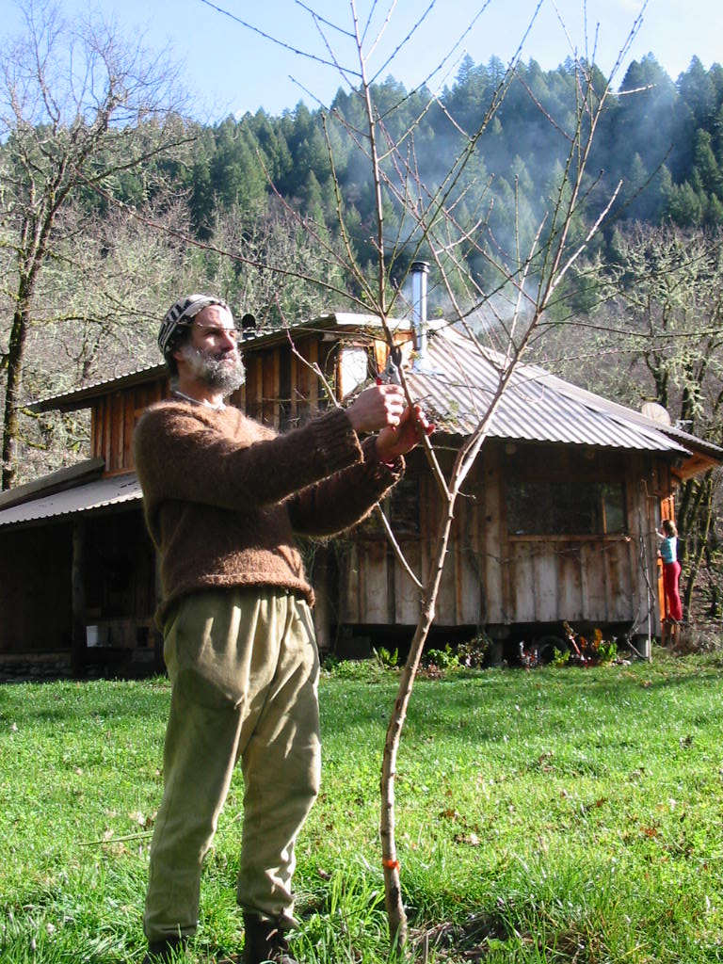
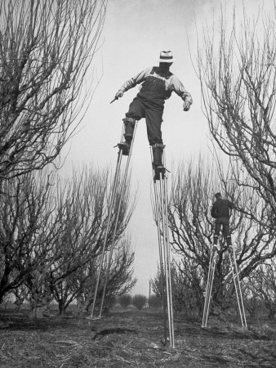
Dormant Pruning
  Pruning that takes place when the tree is not actively growing. The tree has lost all of its leaves.

Slide 16
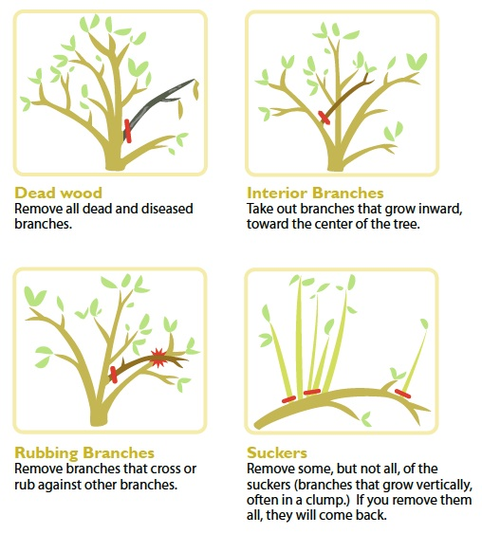
Summer Pruning
Pruning to slow down overly vigorous trees, trees that are too large, or to remove damaged or diseased branches.

Slide 17
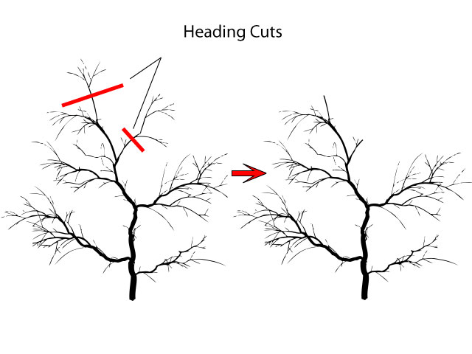
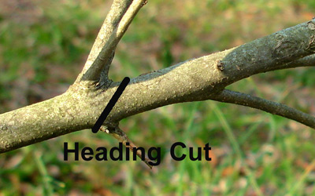
Heading Cut
Removes part of the shoot. Usually done with hand-held pruners. Heading stimulates the buds just below the cut, encouraging dense growth.
Notes:
It encourages dense growth because the nodes below the cut will take all the energy that would have gone into the part that was removed, particularly the two closest nodes.

Slide 18
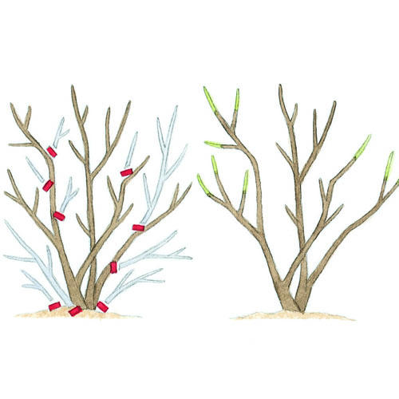
Thinning Cut
Eliminates the entire shoot.
Reduces the bulk of a plant with minimal regrowth
Notes:
Eliminates the entire shoot.
Use hand-held pruners, loppers, or a pruning saw to make thinning cuts, depending on the thickness of the member being cut.
Thinning reduces the bulk of a plant with minimal regrowth: each cut removes an entire stem or branch, either back to its point of origin on the main stem or to the point where it joins another branch.
Because you remove a number of lateral buds along with the stem or branch, you're less likely to wind up with clusters of unwanted shoots than you are when you make heading cuts.
(A common mistake of inexperienced gardeners is to make a heading cut when what's needed is a thinning cut.)

Slide 19
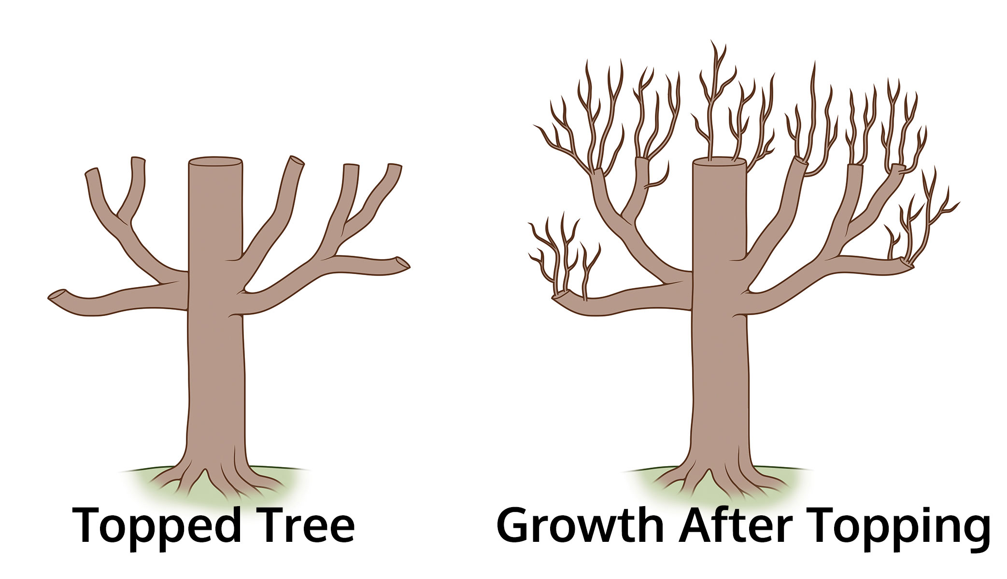
Topping
Reducing the height of a tree by heading large branches; also, removing upright shoots to maintain a tree at its desired height.

Slide 20
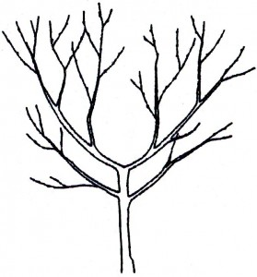
Open Center
A method of training trees in which scaffold branches are trained upward and outward from the trunk and the center is kept free of vigorous upright shoots.

Slide 21
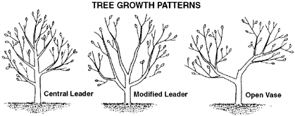
Leader / Central Leader
A dominant upright branch. The central leader is the trunk that extends from the root to the top of a tree.

Slide 22
Selecting the
Right Pruning
Tools

Slide 23
Pruning Tools
Tool types
  Hand pruners
  Loppers
  Pruning saw, Pole saw
Tool maintenance
Safety
Notes:
(Have topics appear on command, not all at once)
Hand pruners:
Hand-held to prune small branches, 5/8 inch diameter, look for bypass pruners for a good clean cut. Use or routine garden cutting.
Some have: coated blades to reduce sap build-up, rotating lower handle, left-handed, large and small handed.
Loppers:
Pruners with long handles, cut larger branches, to about 1.5 inches diameter, regular and heavy-duty.
Can operate just like hand-held pruners or have a gear mechanism, use on bigger branches or when leverage is needed
Pruning saw:
Blade designed specifically for tree limbs, designed to not gum up, cuts on the draw not the push, straight or curved blade a matter of choice.
Blade length varies, use for the 3-cut method.
Tool care:
EVERY time: Blades: clean, sharpen, lubricate.
Handles, sand & oil
Extras:
Bucket, sharpening file, lubricating oil, disinfectant, gloves, waste bag, cell phone, sun protection, orchard ladder, REALLY long handled-saw

Slide 24
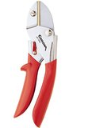
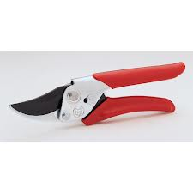
Hand Pruners
Bypass Pruners
(Best!)
Anvil Pruners

Slide 25
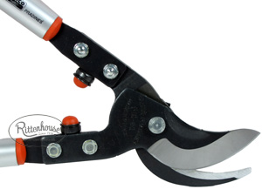
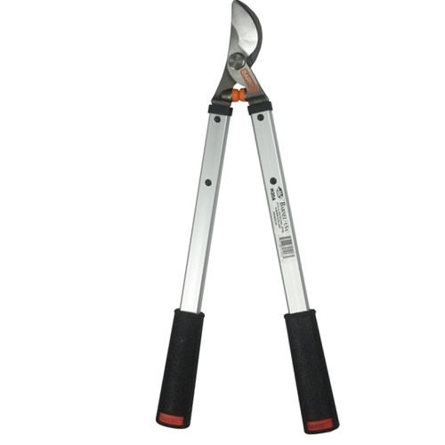
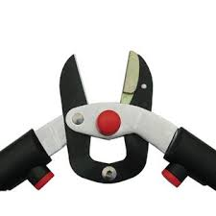
Loppers
Bypass
(best)
Anvil
Notes:
First, look at the lopper label to make sure it will cut the branch size you’ll be pruning today as well as in the future.
Many lopper features to be aware of are the same as those for hand pruners. The blade types are the same and bypass is preferred over anvil. Over the long run you’ll be better off with high quality hardened or carbon steel blades, choosing a lopper that’s the correct size and weight for you physically, and is easy to disassemble for routine maintenance. There are also ergonomically designed loppers to better fit your hands.
Some lopper designs include a gear-like feature that increases cutting power, essentially multiplying your effort. Look for loppers with handles in varying lengths, including ones that telescope to extend your reach. Many loppers have a rubber or plastic bumper or shock absorber just below the cutting blades to prevent the handles from crashing together as each cut is completed. These bumpers add to the cost but increase efficiency making it money well spent. Another feature to consider is telescoping handles which will allow you to reach further with your loppers.

Slide 26
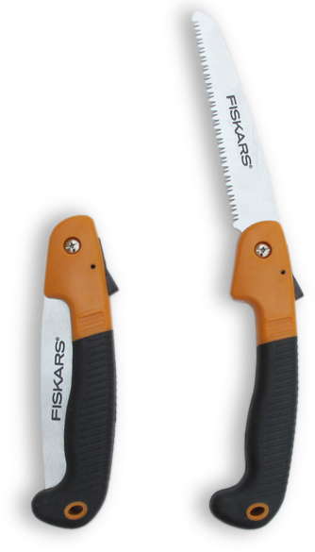
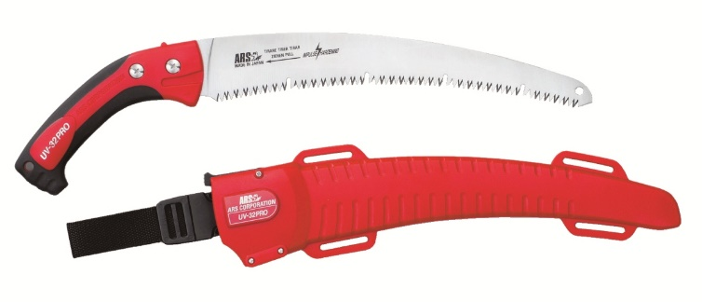
Pruning Saws
Folding
(smaller branches)
Fixed
(larger branches)
Notes:
Available as folding saws (smaller branches) or fixed blade saws (larger branches). Most pruning saws are designed to cut branches with a diameter of 2” to 3”, although with more effort you can use them to cut slightly larger branches. The reason for buying a special garden pruning saw is that they are designed with sticky, gummy plants in mind which means they won’t get stuck or bind when cutting.
A tempered steel blade is a non-negotiable requirement for pruning saws. Tri-edged blades ('pull-saws') are replacing traditional lance-toothed saws for garden use. Tri-edge saws have three bevels on each tooth giving the saw a faster, smoother action. The design of the tri-edge also means that the teeth are self-cleaning. Curved pruning saws require less effort than straight-edged saws because the teeth penetrate the wood more easily.
The connection between the blade and the handle must be solid. A wooden handle will absorb more of the cutting vibrations than a plastic handle.

Slide 27
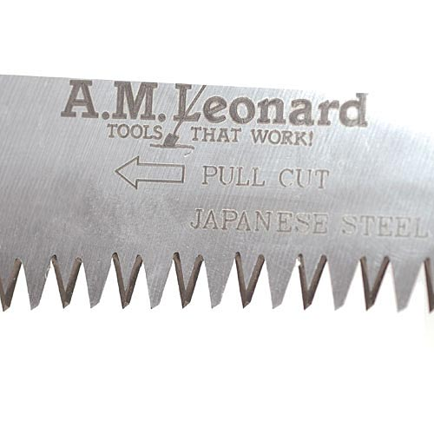
Tri-Edged Saw Blades
3 bevels on each tooth teeth are self-cleaning

Slide 28
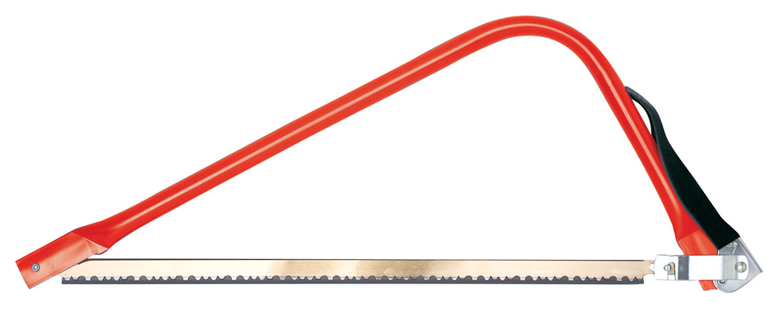
Bow Saw
for the really big branches
Notes:
Bow saws come in a variety of sizes and can cut branches up to about a foot in thickness. For home use a 21” or 24”bow saw should be able to do the job. The teeth are big and splay out wide. They clear plenty of wood as they cut so the blade will never stick. A sharp bow saw and a strong arm will cut up medium-sized, branches quicker than many power saws.

Slide 29
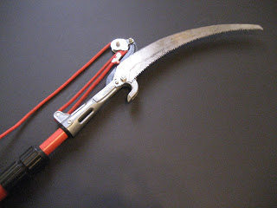
Pole Pruner
for those high up, hard to reach branches
Notes:
Allows you to cut branches that are beyond your reach. Most of these saws cut limbs up to 2” or 3” in diameter. For the cleanest, healthiest cuts, choose a bypass-style pruner.
For versatility in tackling larger branches, purchase a pole pruner that includes interchangeable cutting tools for the pruning head: a bypass pruner and a pruning saw.
These saws can do the tough jobs that are hard to reach but they are difficult and time consuming to use. Balancing the pole, getting to the correct limb, staying out of the way of falling branches, and the reaction of your shoulders to using this tool are some of the downsides to using pole and rope saws.

Slide 30
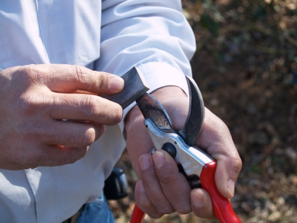
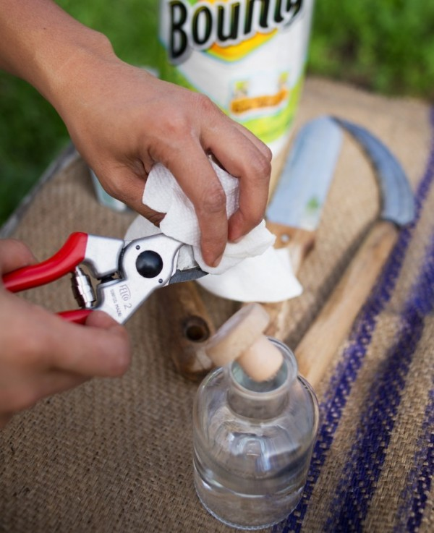
Tool Maintenance
Sharp tools produce the best cuts
Sanitize tools between cuts

Slide 31
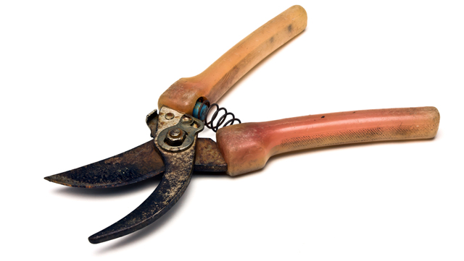
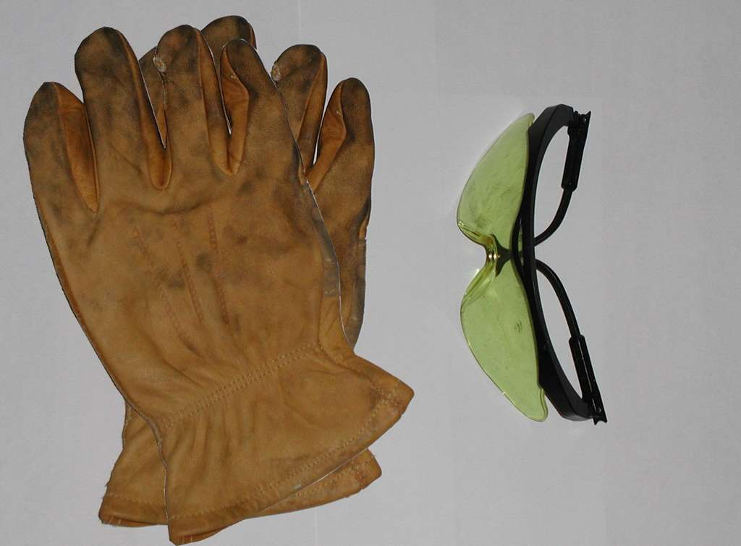
Safety
Inspect your pruning tools before using
Safety glasses and gloves are a must

Slide 32
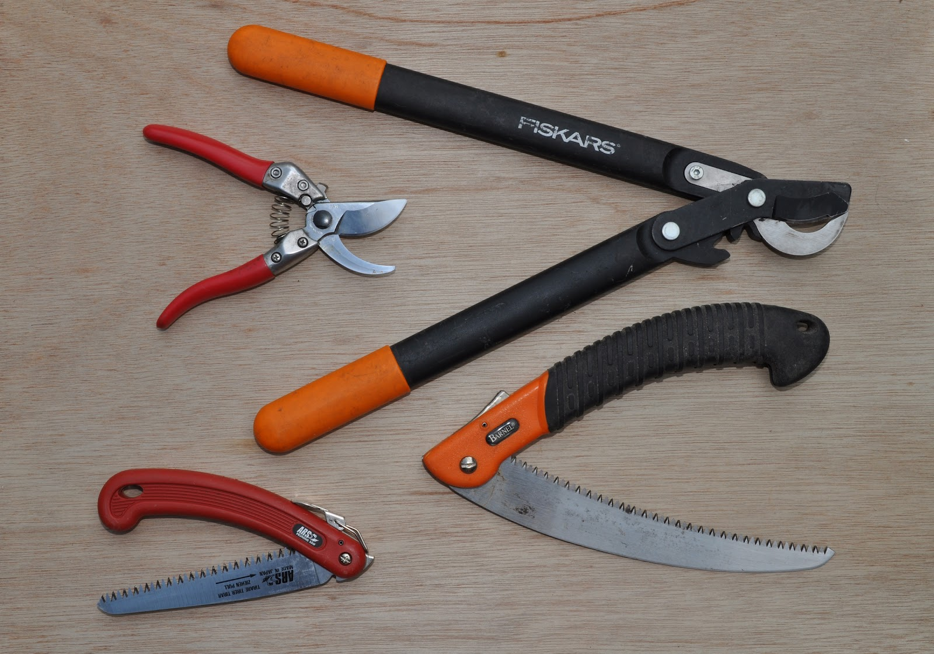
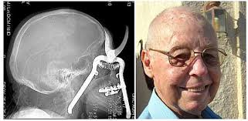
Safety
Choose the right tool
Handle tools properly

Slide 33
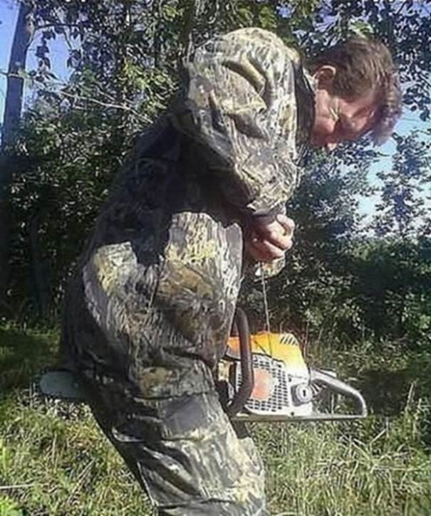
Chain Saw
for those branches you’re willing to risk most anything to remove

Slide 34
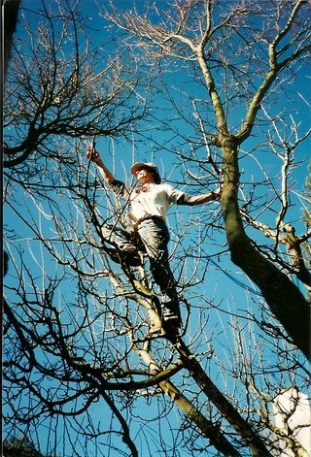
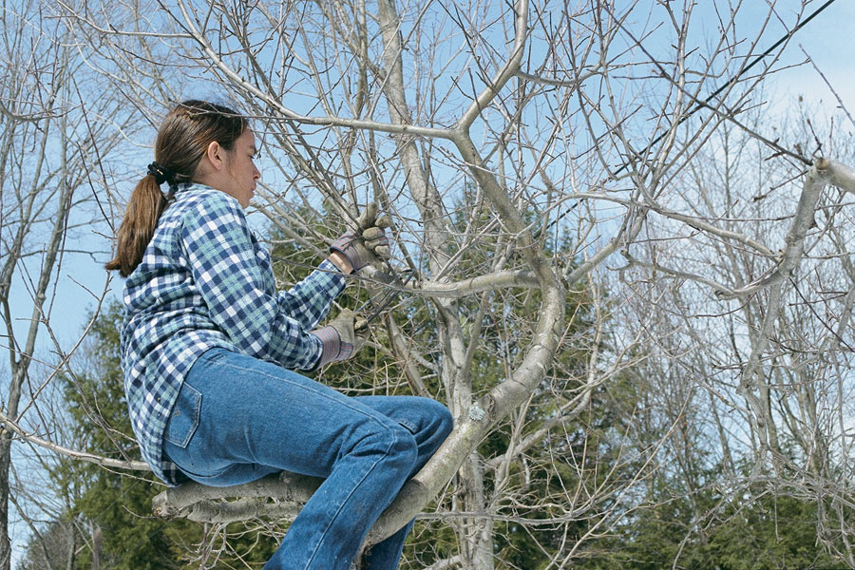
How Not to Prune

Slide 35
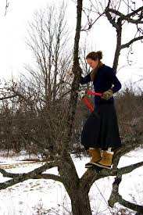
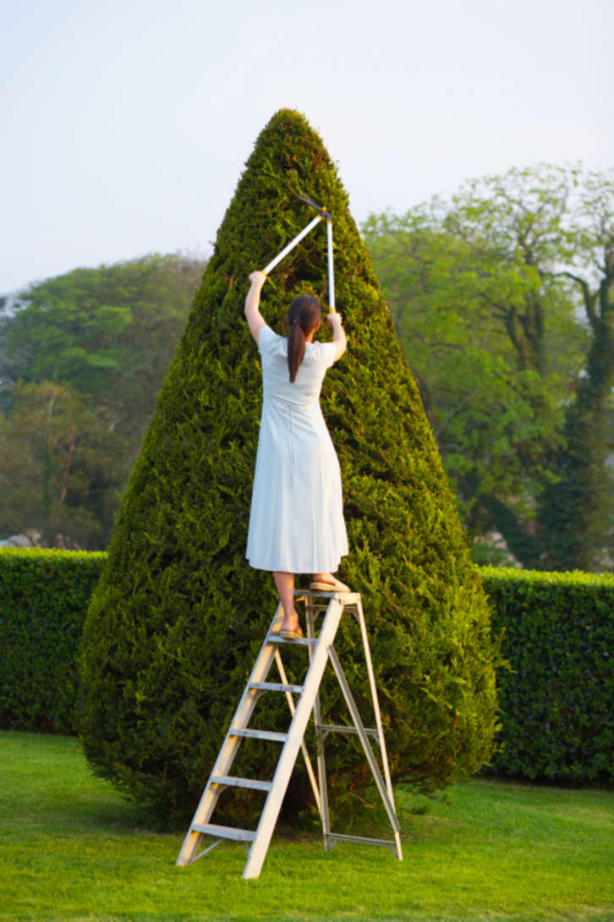
How Not to Prune

Slide 36
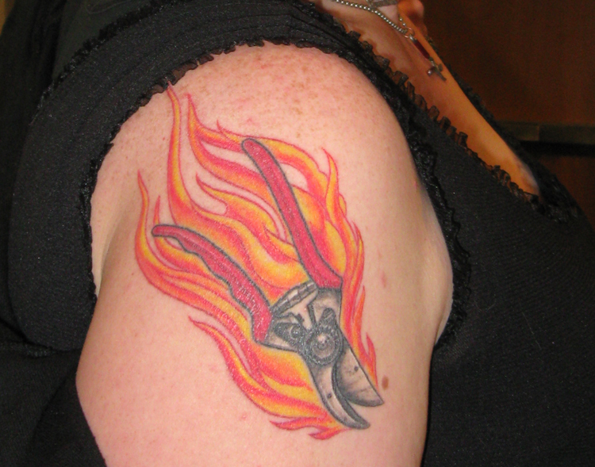
Pruning Tattoo
For those folks that are really serious about pruning
Notes:
Smile!
Now we’ll get back to Helpful How-Tos, guidelines to assist your pruning planning. _______________

Slide 37
Pruning Time!
Allow plenty of time
Assemble all tools
Step back and look from all sides
Develop a plan of “attack”
Mark what & where you want to prune
Notes:
Time to prune!
Allow time, assemble tools even if you don’t think you’ll need them all, step back and assess frequently
Keep these goals in mind:

Slide 38
Pruning Goals
For established/mature trees---
  Remove broken, dead, or diseased wood
  Remove crossing, crowded, and weak branches
  Help sunlight reach lower fruiting wood
Notes:
(Speak to these goals, adding your own observations and information that you have researched.)
There are many talking points thanks to UC ANR—our handbook, the website, the Home Orchard, and so forth.

Slide 39
Pruning Goals
  For established/mature trees---
  Help sunlight reach lower fruiting wood
  Control/reduce tree size
  Remove unproductive fruiting wood and stimulate growth of new fruiting wood
  (Re)establish sound structure
Notes:
Be sure to read about these goals in the research available through UC ANR.

Slide 40
Pruning Goals
For young trees, including bare root:
  Set the height of the first branches
  Produce a strong framework to support future crop
  Production of fruit (after the first year or two)
Notes:
UC ANR pdfs, other MG groups, our handbook, and the Backyard Orchard book have much more detail about these points.
To transition to the next slide, you could say something like
I’ll leave you with the concept of the magic of sunlight.

Slide 41

Magic!
Notes:
CLICK the remote a couple of times to start the animation!
I’ll leave you with the concept of the magic of sunlight---
Sunlight on lateral branches promotes fruit
Sunlight on leaves provides food for the tree—remembering always that some shade IS needed.
The next section addresses fundamental pruning concepts.

Slide 42
Fundamental Pruning Concepts
Cutting creates reactions.
  Where will the energy for new growth go?
  Think several growing seasons ahead
  Reaction decreases each time

Slide 43
Fundamental Pruning Concepts
Pruning is a step-by step process occurring over time
  How does the tree want to grow? Go with it or control?

Slide 44
Three Basic Cuts
Heading Cut: cuts twig & little branches
Thinning Cut: cuts back to a branch or
  trunk
3-Cut method: cuts really big branches
Notes:
The HEADING CUT :Cuts the end of a stem off. Trick is to make that cut at about the right place. We’ll show you on the branches we have here, and again out at the fruit tree field trip. In some cases, the lateral bud has already grown a leaf, and you make the cut right above the leaf. Usually done with hand-held pruners, heading stimulates the buds just below the cut, encouraging dense growth. On fruit trees, you try to locate the previous year growth, and cut back half of it (or more for stone fruit) and you cut back to a bud.
The THINNING CUT: Thinning cuts remove an entire stem or branch, either back to its point of origin on the main stem or to the point where it joins another branch. Because you remove a number of lateral buds along with the stem or branch, you're less likely to wind up with clusters of unwanted shoots than you are when you make heading cuts. (A common mistake of inexperienced gardeners is to make a heading cut when what's needed is a thinning cut.) Use hand-held pruners, loppers, or a pruning saw to make thinning cuts, depending on the thickness of the member being cut.
The THREE CUT method is done with a limb saw, and we’ll show you pictures of how to do it.
Here are some illustrations, and we’ll also show you on the branches here.

Slide 45
Heading Cut
Removal of part of branch or shoot
Used to promote branch development, esp. on young trees
Stimulates growth from buds just below cut
Can result in reduced sunlight penetration
Heading => Hedge

Slide 46
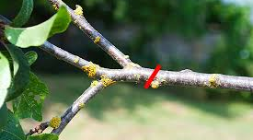
Heading Cut
Notes:
Remember, a heading cut removes cuts some of the branch at some point between last year’s growth and the end of the branch/twig

Slide 47
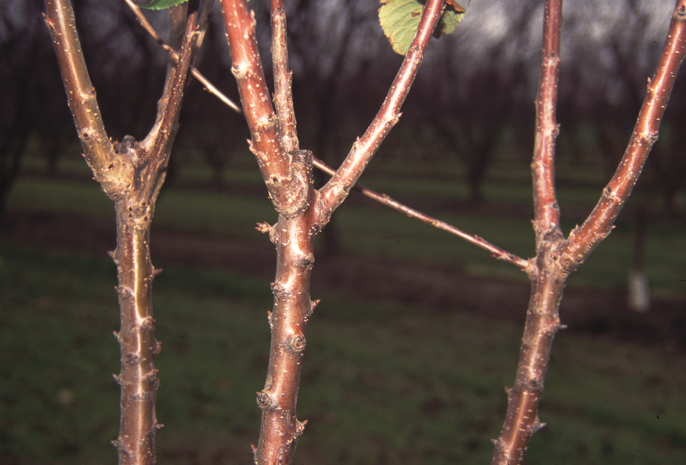
Previous year’s heading cuts

Slide 48
Thinning Cut
Removal of entire branch or shoot
Used to prevent crowding and improve sunlight penetration
Defines main (scaffold) branches
Notes:
Thinning is the removal of the entire branch or limb at its base. Thinning cuts are employed to remove an entire limb or branch where crowding occurs.

Slide 49
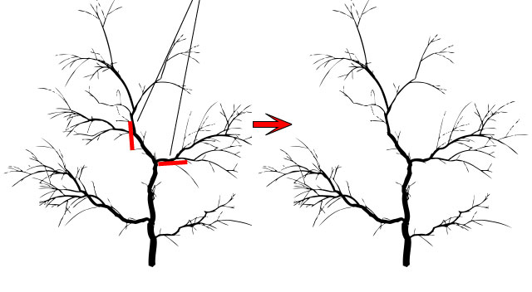
Thinning Cut

Slide 50
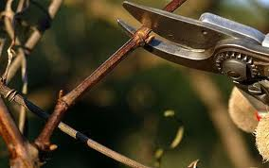
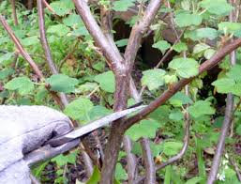
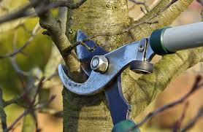
Thinning or Heading?
Notes:
Let’s look at these together and see if we can agree on which cuts are which.

Slide 51
Thinning Cut for Big Branches
Called a 3-cut, or jump cut
Remember the tree anatomy, especially the branch collar
Notes:
Here is how to remove a large branch from a fruit tree—maybe it’s dead or dying, maybe it’s rubbing on a branch you want to favor or nuture, maybe you want to reshape the tree somewhat.
Keep the branch collar in mind when making this cut.

Slide 52
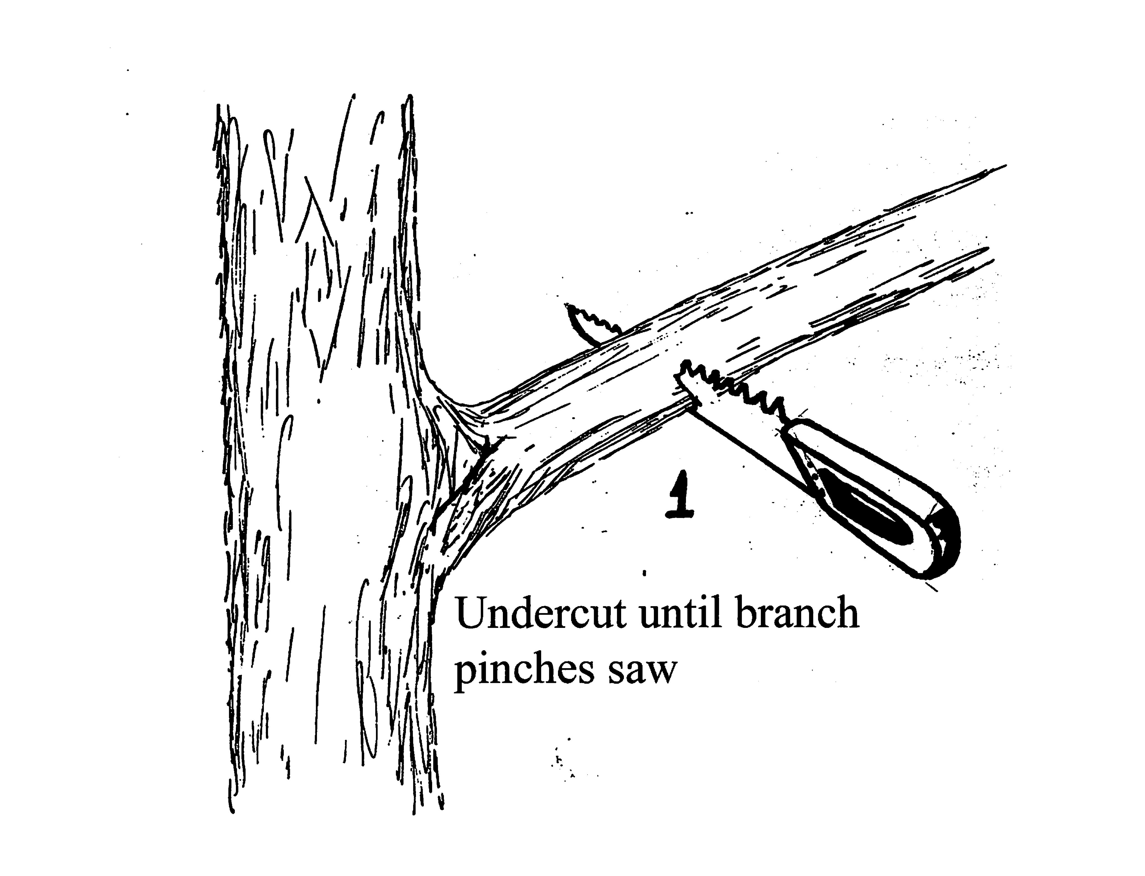
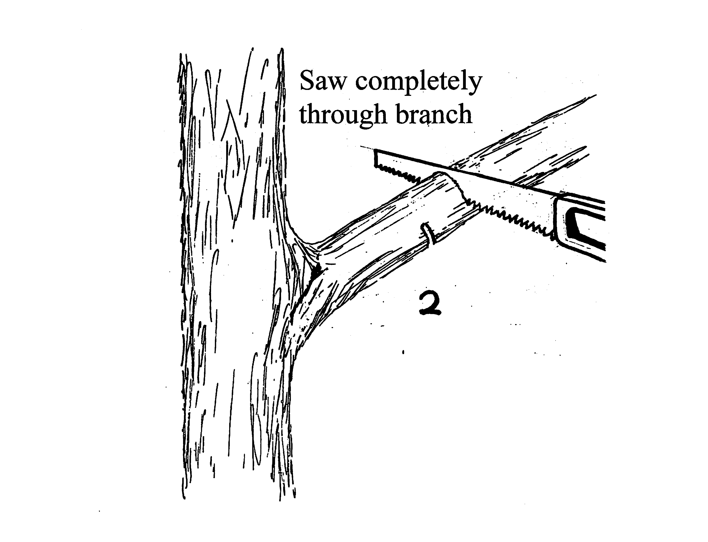
Cuts 1 and 2

Slide 53
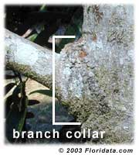
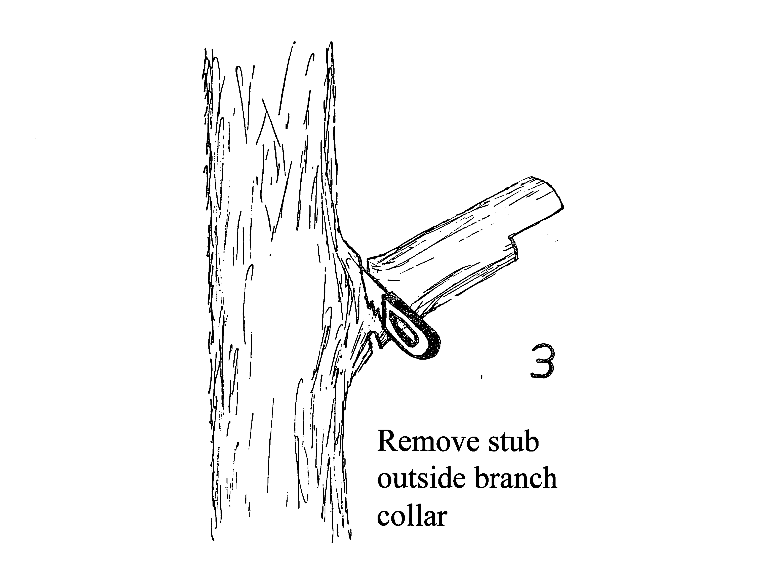
Cut 3
Steps
Steps
Notes:
Remember, the branch collar has the part of the tree with hormones that heal the wound. Cut just outside the branch collar.

Slide 54
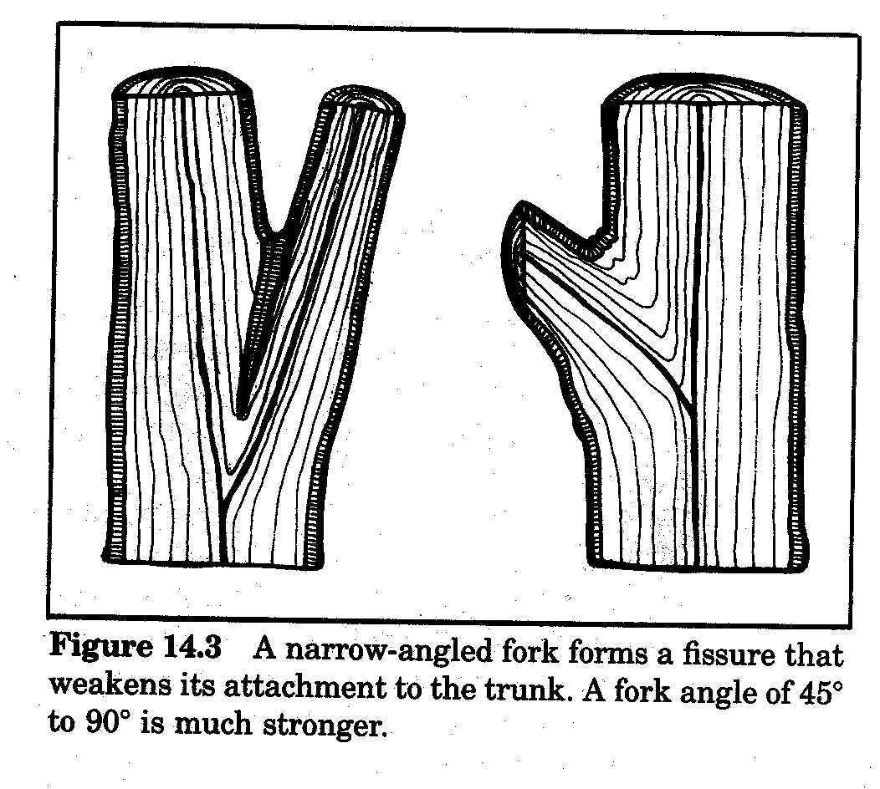
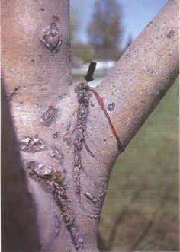
Narrow vs. Wide Branch Angles
Notes:
More considerations when deciding whether or not to remove branches.
Narrow versus Wide branch angles. Wide angles are stronger than narrow ones. Narrow ones are likely to build up this weaker bark growth, and trap leaves and water which can weaken the angle and lead to the tree splitting.

Slide 55
Drastic cut =
Drastic result
Notes:
The drawing on the left shows some very drastic pruning.
The picture on the right shows what happens when that kind of pruning is done on all the main branches. I don’t think it’s very attractive, or very tree-like.

Slide 56
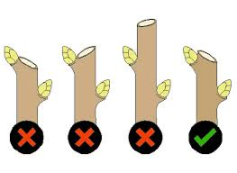
Proper Cut Angles and Locations
Notes:
Let’s have a look at the right places to make those heading cuts.

Slide 57
Re-leadering
Why do this? (shape, disease, size)
Best done in winter. Be careful not to open tree to sunburn.
Look at the whole tree. How low can it go?
Use thinning cut/s to choose new leader/s.
Head back other branches to choose new leader.
Notes:
Here are some other considerations to keep in mind when approaching your fruit trees. Remember, you don’t have to remember all this! It’s all available in the references and resources we’ve given you. You’ll find them all on our website, too. Just look on the main page ------- (explain)
Why would you want to re-leader a tree?
Several reasons:
Sometimes the gardener decides the central leader is too dominant or shades the tree too much (Remember that sunlight on the leaves of the branches is what makes the tree’s food for next year)
And sometimes the central leader becomes diseased or damaged.
Occasionally, the growth pattern can be unattractive or unbalanced, and the gardener decides to re-leader the tree.
And it’s time to rearrange the central part of the tree
The central leader is headed back thoughtfully, taking into account where the energy will go when that part is cut, and the wider angled better positioned laterals are retained as scaffold limbs and the others are removed. However, no leader is allowed to become dominant as the main leader. From four to as many as eight scaffold limbs may be present with this system. And they represent the re-leadering of the tree.
Let’s review.

Slide 58
Let’s Review—Dormant Pruning
When is it done?
When there are no leaves, and before bud break.
What does it do?
Invigorates the tree, manages fruit production and tree structure.
Notes:
Dormant pruning:
No leaves
Before bud-break
Invigorates tree
Structural and tree health focus
Basic fruit load management

Slide 59
Let’s Review—Summer Pruning
When is it done?
Summer is May to mid-June, first round.
What does it do?
Controls tree size, increase sunlight and productivity of lower fruiting branches.
Is it done more than once?
Can be done up to 3 times for esp vigorous trees like stone fruits, even into September.
Keep in mind the potential for sunburn!
Notes:
Controls tree size! Think about it—summer pruning removes leaves, and when leaves are removed, there is less food for the tree.
Secondary fruit load management
“Summer” = May to mid-June for first round
May need to summer prune up to 3 times
For very vigorous trees, can prune into September
Purpose: To control tree size, increase sunlight and productivity of lower fruiting wood
Reduces tree vigor
Remove unwanted vigorous, upright shoots 1-3 times during season
Potential for sunburn

Slide 60
Special Considerations
Citrus
Overgrown trees
Tall trees
Other fruit besides pomes and stones
Fruit tree shapes
Notes:
Citrus has its own special needs. Pruning is NOT done in the winter because citrus doesn’t become dormant. And if it freezes, the damage should not be cut out until new growth appears in late April or May.
Overgrown trees have their own special pruning methods, too. Homeowners can find detailed information on this through our website, and resource list.
UC recommends that fruit trees be kept at height levels the homeowner can comfortably prune, pick, and care for trees without a ladder! Help in controlling height, or bringing a tall tree down over time is available from UC. And ask yourself if the tree is worth keeping.
The Backyard Orchard book has information on every kind of fruit you ever thought of growing and eating—apricots, cherries, persimmons, kiwi, fig, pomegranate, all kinds of nuts. Pruning principles vary from fruit to fruit. Be sure to check for the fruit trees YOU have.
You may hear terms like open center or vase-shaped, central leader, or modified central leader, fruit hedges, and espalier. Generally the pomes can be trained to central leader, modified central leader, open center, espalier or fruit hedge. The stone fruits grow best as open centers, or fruit hedge/bush.
Finally, we’ll get to giving some practical guidelines for getting started!

Slide 61
How to Get Started
Don’t be afraid!
Take your time.
The tree WANTS TO GROW!
Follow a plan and steps.
Notes:
Take your time.
You can’t kill the tree unless you cut it off at the graft union! Your pruning may give the tree a peculiar shape, but you can visit the pruning process again in the summer and do a little adjusting!
Follow a plan—we’ll tell you those steps coming up next.

Slide 62
Basic Steps 1, 2, 3, 4
Have a plan. Mark where and what to prune.
Remove dead or dying branches.
Remove broken or diseased branches.
Remove watersprouts and suckers.

Slide 63
5, 6, 7
Remove crossing and unwanted branches.
Look for narrow/weak branch angles.
Open up and shape the tree.
Make thinning cuts first, then heading
cuts.
7. Head back to an outside bud.

Slide 64
Remember . . .
Trees needs lots of leaves to generate new growth and fruit
Stop frequently and LOOK!

Slide 65
And a few “Rules”
Work from large to small (can be scary!)
When heading back, consider where the bud faces
When thinning, cut just outside the branch collar
Never leave a stub
DO NOT paint or seal the pruning cut, no matter what size (Tree will heal itself!)
Notes:
Forgot these few Rules!

Slide 66
Review: Four Questions
What is pruning?
Why are trees pruned?
When is the right time to prune?
How to do it right?
Notes:
Do you think we got these questions answered?
What questions can we answer for you now?

Slide 67


Slide 68
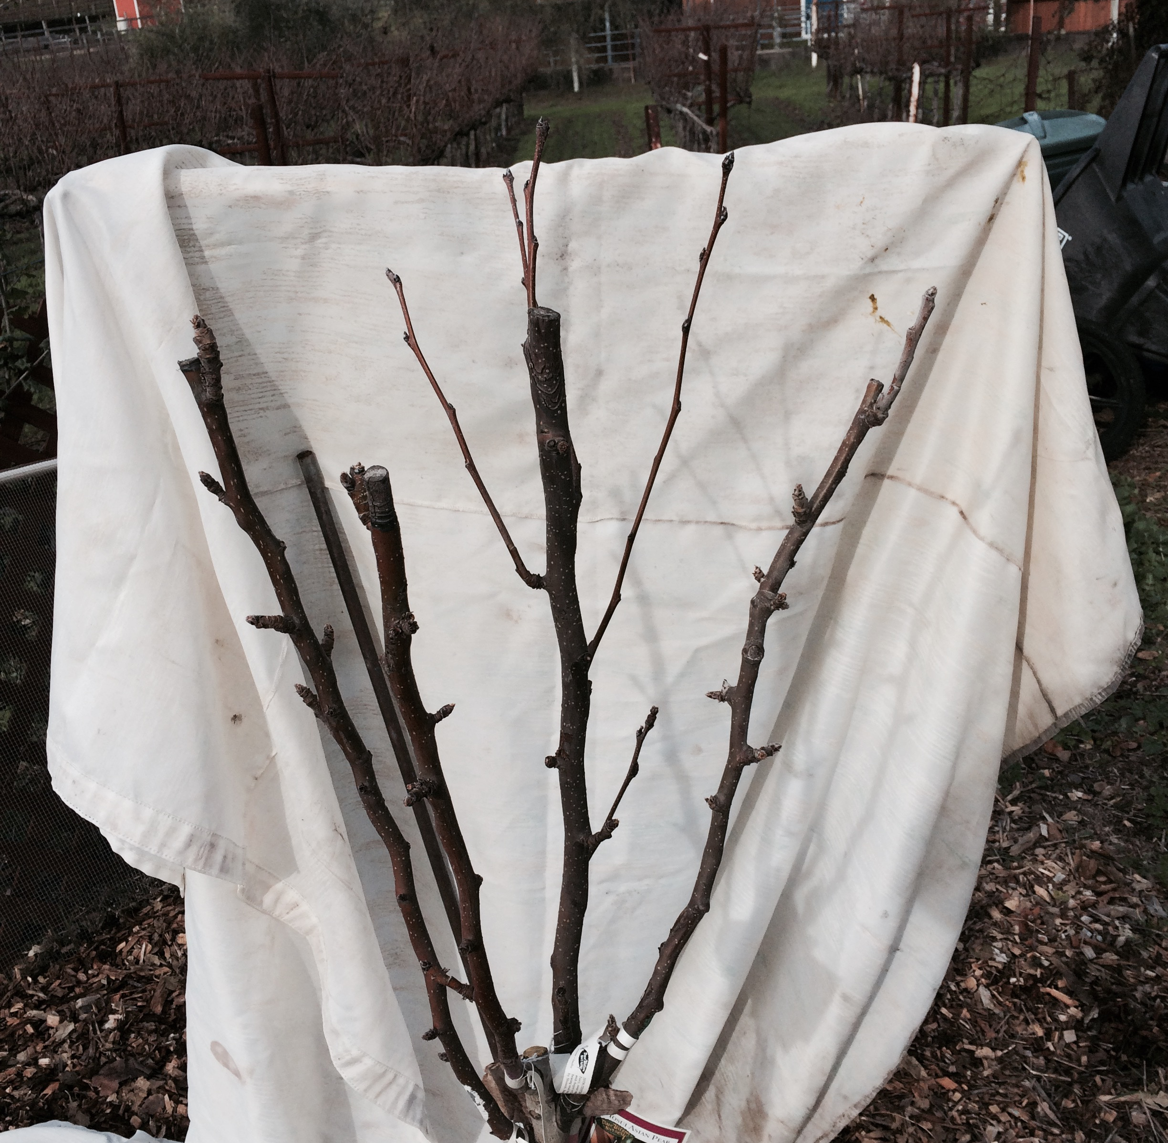
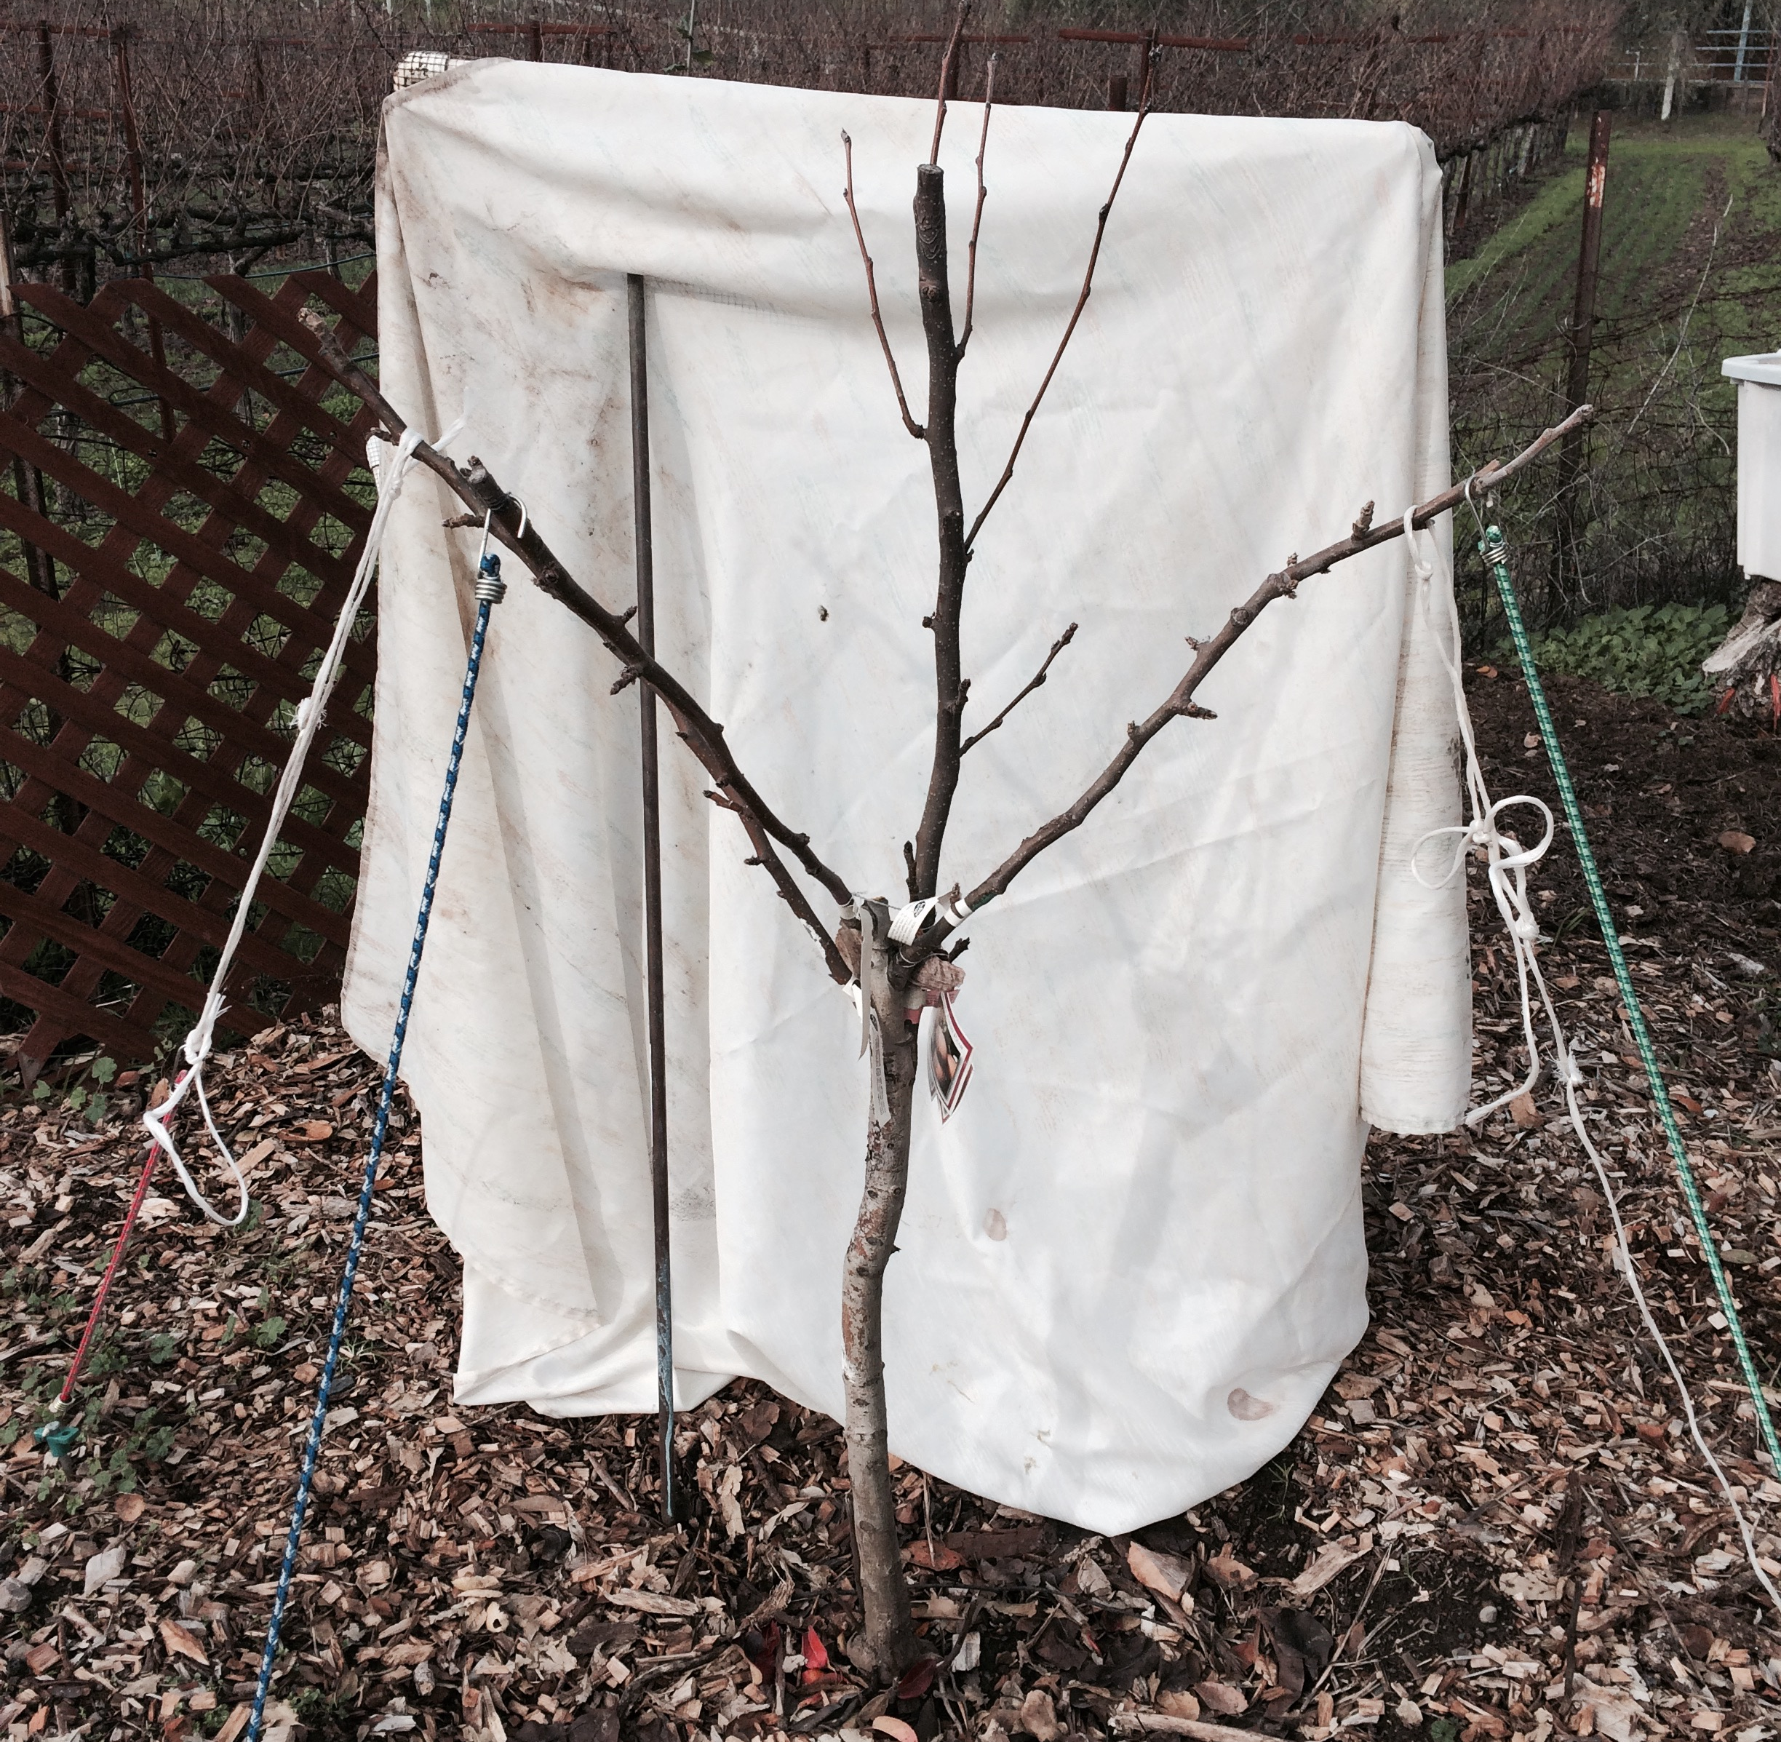
Staking
Before
After

Slide 69
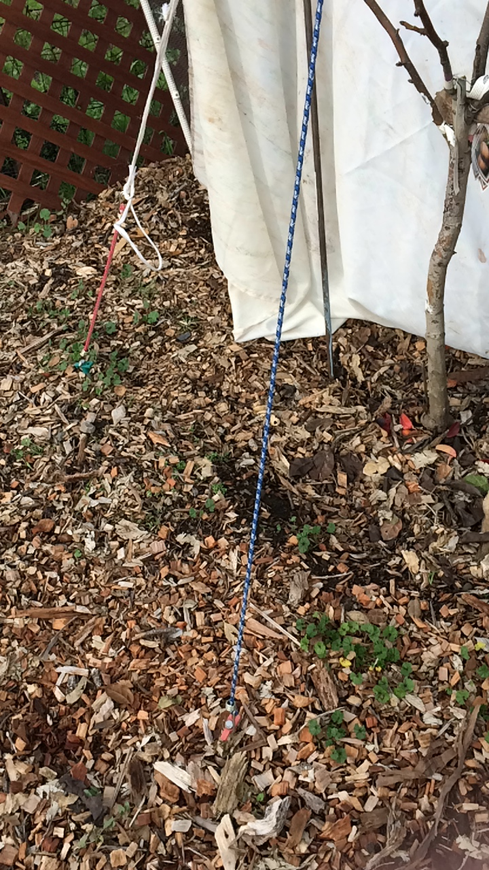
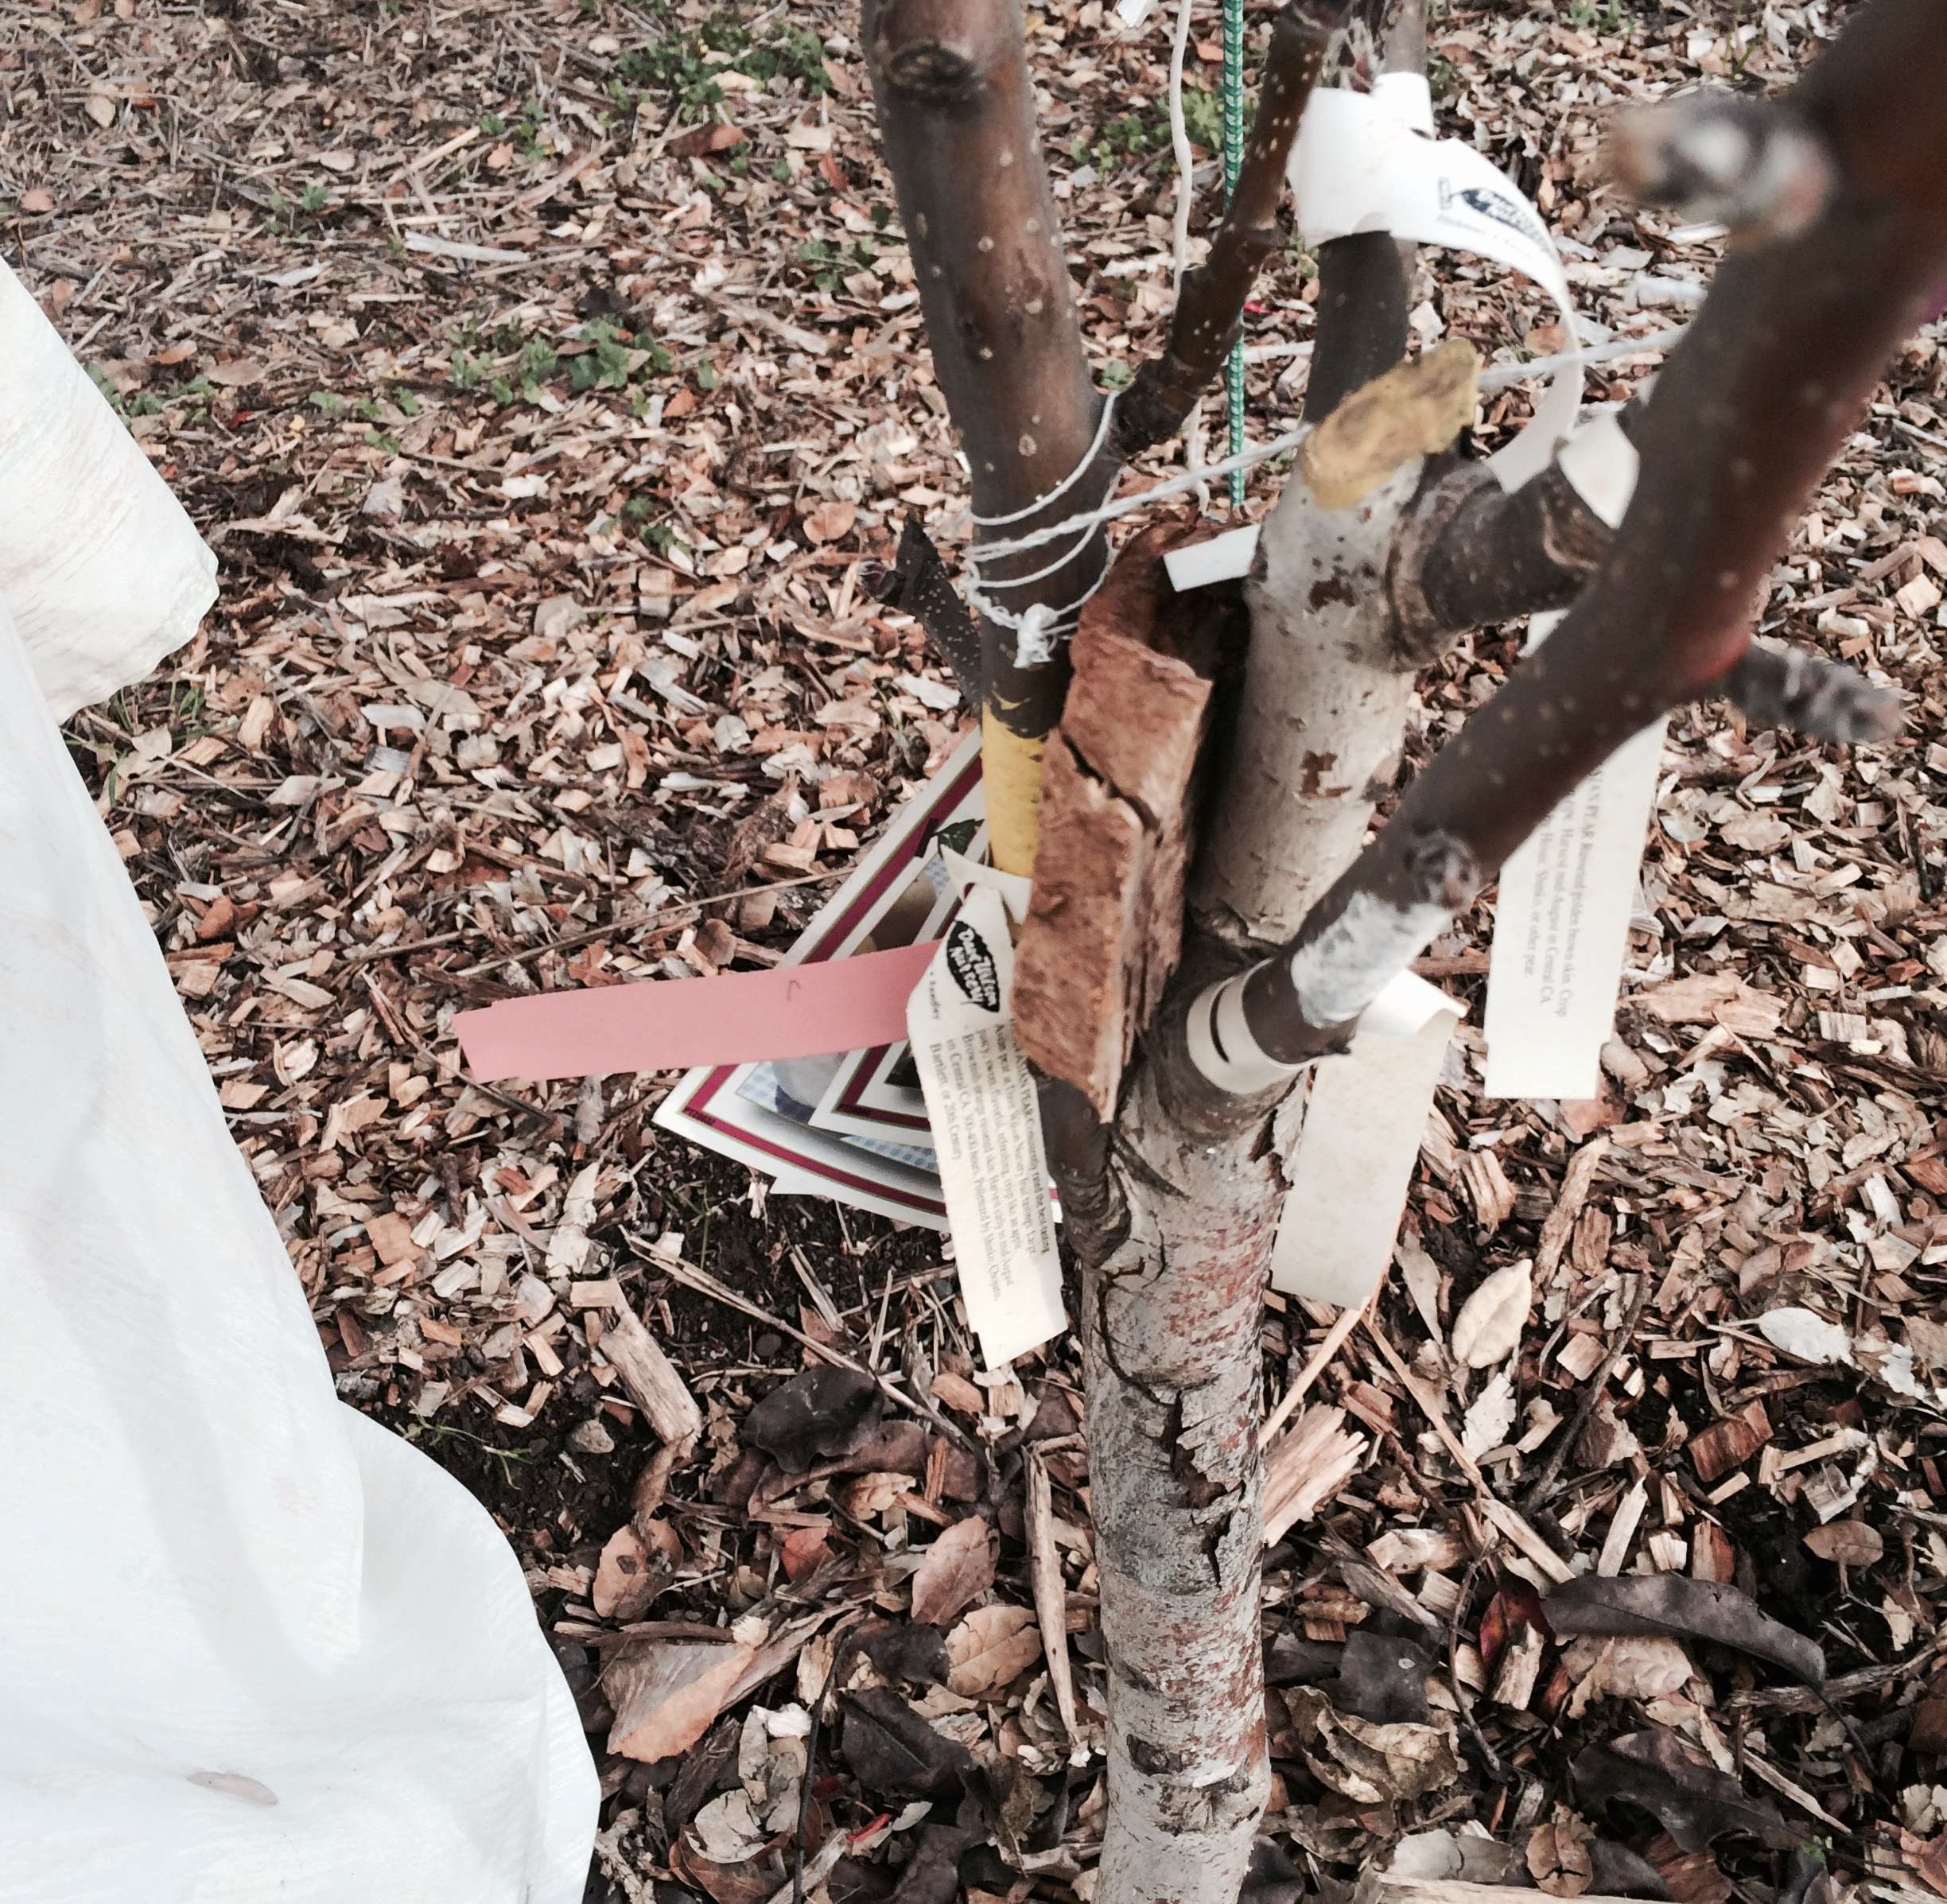
Creating that Horizontal Branch
Bungie
Wedge

Slide 70
Before we leave today . . .
http://ucanr.edu/sites/ucmgnapa/
Let’s have a look at what UCCE has to offer!
Notes:
Before we leave today, ______________ is going to give us a short demo of using our website. We can’t tell you everything UC has to offer about fruit trees—that would take a whole semester!

Slide 71

How To Reach Us
Internet Search: “Napa Master Gardeners”
Select Garden Questions
Notes:
Has Help Desk hours, phone number, email and form to submit problem description

Slide 72


Slide 73
YOUR Questions
THANK YOU from UC Master Gardeners of Napa County.
And . . . .
We have a field trip for a pruning demo
Notes:
There are many references on one of the handouts we gave you. And you can place an order for The Home Orchard at the UC ANR website, or here on the order forms we have today.
Please remember to complete the evaluation form and leave it at the back table.
Thank you for coming today, and remember---we have a field trip at Silverado Middle School. Cindy, would you explain how to get there?
12.30 sharp, everyone, rain or shine.

Slide 74
Thank You
(Please tell a friend!)
Presented by UC Master Gardeners of Napa County
January 2016

