Slide 1
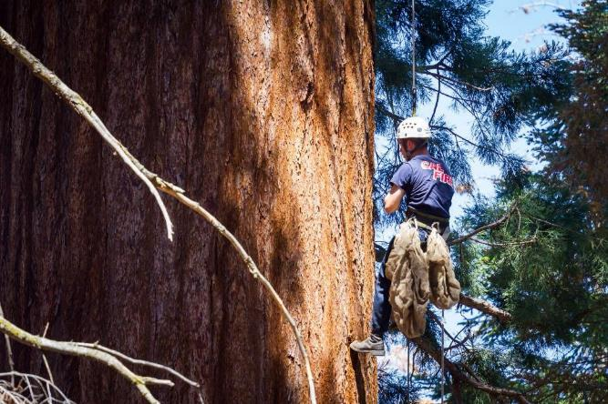
Selection of Nursery stock
Dorus Van Goidsenhoven
CAL FIRE
L.A. Moran Reforestation Center

Slide 2
State Seed Bank Program Objectives
PRC directs the Dept. to provide an adequate, reliable & continuous supply of site adapted seed of the widest possible diversity & highest quality
for purposes of reforestation after fire & other disasters, gene conservation, and to mitigate the effects of climate change
Provide seed processing, testing & storage services for CAL FIRE, agencies and the private sector
Provide technical assistance to landowners & resource professionals on a wide range of reforestation and cone & seed matters
Notes:
This is a truly daunting task! There are literally hundreds of species, seed zone, and elevation combinations and the supply needed is, on average, a 10 years supply of each.. Over 40,000#’s of seed!
continuous operation since 1927
The nursery operations closed in 2003
Currently we still function as the Cone & Seed Processing facility & State Seed Bank

Slide 3
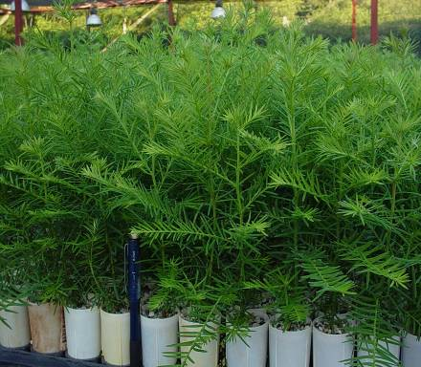
Seed quality is the goal
Vigorous site adapted seedlings come from good quality local seed
Seed quality affects every phase of the reforestation effort :
Planning – collections – processing – yield – growing – planting
High quality seeds produce more vigorous seedlings!

Slide 4
Cone Crop Periodicity
Periodicity is the number of years between collectable crops of a particular species
Depending on species, there can be 3-7
or even 10 or more years between acceptable crops
The goal is to collect the maximum amount of high quality seed in the good years and store for the years in-between

Slide 5
Genetic Considerations
Importance of seed source
Correct identification of seed source is crucial for survival & growth rate of seedlings
Why? – Local trees are best adapted to the local environment
Mismatching elevation or geographic origin w/planting site may cause:
Stunted growth, Poor form, Low drought resistance, High susceptibility to insects & disease, Frost damage from premature bursting
How? – 2 components of seed source
Seed Zone
Elevation

Slide 6
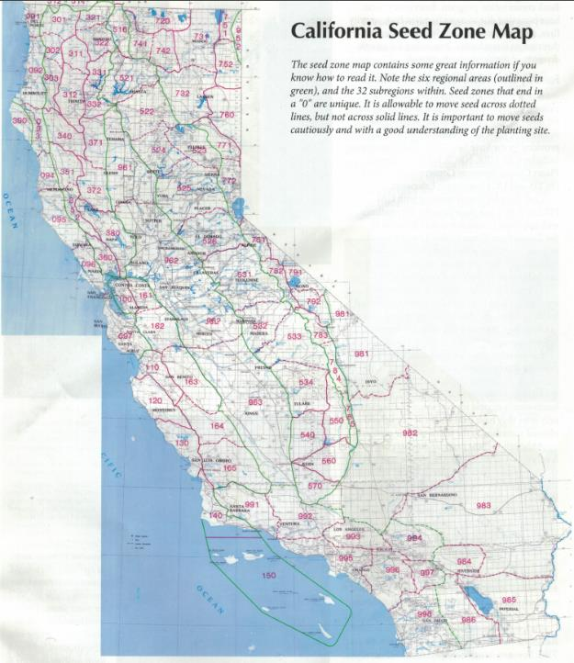
Six Major Regions based on physical features and climate:
090 – N coast redwood 500 – W slope Cascades/Sierra
100 – Central coast 700 – E slope Cascades/Sierra
300 – N coast interior 900 – Catchall (950,960,980,990)
Each seed lot must be separated by zone and 500-foot elevation band!
How far can a seed source be moved?
Broadly adapted versus narrow
DF, LP are specialists – occupy a narrow niche
IC, WWP are generalists – they have more adaptive traits so can be moved farther
Center versus edge
Material from center of range - more diversity
Crops at edge of range - less frequency; less diversity

Slide 7
Genetic Considerations
Broad genetic base
Within a stand, it is highly likely that many individuals are related. Best approaches to avoid inbreeding & decreased vigor of progeny are:
Collect from widely spaced trees in a stand
200-300 feet apart
Collect from a number of different trees within a stand and an equal amount from each
Collect from a number of different stands within an elevation band
Notes:
A stand is considered different if separated by at least 200 yds. from an adjacent collection area.
With seed from many stands – more likely to have some individuals well adapted to any local variations like site, aspect, disease resistance

Slide 8
Good Collection Candidates
Characteristics of individual tree
Dominant or co-dominant – wind firm
Fast growth rate
High vigor - full, compact crown
Free from disease & insects
Straight stem
Small branch size
Branch angle horizontal or slightly upward
Free of obvious defects

Slide 9
Finding the cones
Surveys Conduct cone crop survey(s) on a stand basis within each designated seed zone & across elevation bands within a seed zone using CAL FIRE cone crop survey form(s)
Cone Sampling Upon results of surveys, contractors are needed to collect cone samples for assessment and/or transport them to LAMRC for assessment
Certification Oversee cone collection work and certify the collection according to CAL FIRE protocols

Slide 10
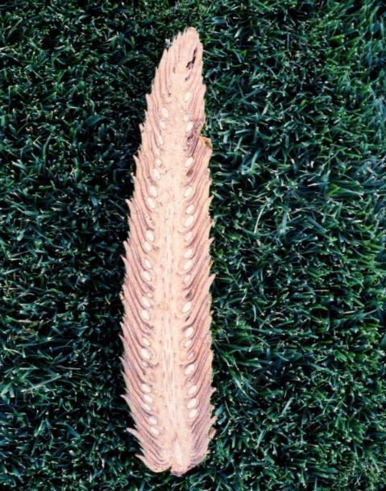
Seed Cutting Test
Observe cone exterior for color & condition
Note scale flexing and damage or signs of insect activity
Cut cone in half lengthwise
Count the filled seed per ½ face*
Note any insect activity in axis or among seed and scales
Break cone apart to release seed
Note seed wing color & condition
Does it fall freely or need to pry out
Should feel like parchment paper, not moist
Note seed coat color & condition
Approaching a golden to medium brown color

Slide 11
Cone Handling & Processing
List important points from each lesson.
Provide resources for more information on subject.
List resources on this slide.
Provide handouts with additional resource material.

Slide 16
Notes:
Preliminary x-ray PP

Slide 18
Notes:
Final X-ray PP

Slide 19
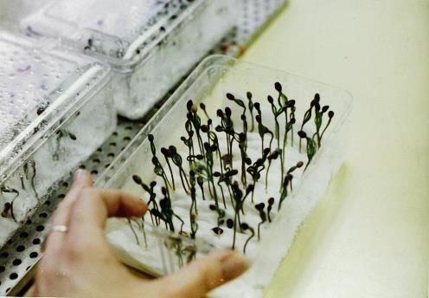
Seed Evaluation
The elements of seed quality measured are:
moisture content
purity percent
clean seed per Lb
Percent filled (x-ray)
Germination percent or viability
Procedures for uniform testing of various types of seeds are described in Rules for Testing Seeds (AOSA, 1984 and ISTA, 1996). Standardized germ tests are designed to give maximum values with minimum variation, allowing the results to be repeated.
They are conducted :
- Upon completion of processing/upgrade
- Every 5 years thereafter

Slide 21
Seed Availability for Tuolumne County – SZ 531
Species | Zone Elevation | Approx. # seedlings
Ponderosa pine | 531.20-40 | 4,862,244
Ponderosa pine | 531.40-60 | 6,562,212
Douglas-fir | 531.20-40 | 1,740,042
Douglas-fir | 531.40-60 | 646,461
Sugar pine | 531.20-40 | 68,400
Sugar pine | 531.40-60 | 183,312
White fir | 531.40-60 | 578,891
Notes:
Approx. # of seedlings we could grow from the available stock in the State Seed Bank
At higher elevations we also have RF

Slide 22
CFIP Speculative sowing order
Species | Seed Zone | Elev (low av) | Stock | Quantity
Ponderosa Pine | 525 | 2,500 | 1Styro 6 | 6,000.0
Ponderosa Pine | 526 | 2,000 | 1Styro 6 | 10,000.0
Ponderosa Pine | 531 | 2,000 | 1Styro 6 | 18,000.0
Ponderosa Pine | 532 | 3,000 | 1Styro 6 | 18,000.0
Giant Sequoia | 534 | 6,500 | 1Styro 6 | 3,000.0
Sugar Pine | 525 | 2,500 | 1Styro 6 | 1,500.0
Sugar Pine | 526 | 3,000 | 1Styro 6 | 3,500.0
Sugar Pine | 531 | 4,000 | 1Styro 6 | 9,000.0
Sugar Pine | 533 | 5,500 | 1Styro 6 | 9,000.0
Sugar Pine | 534 | 5,500 | 1Styro 6 | 1,500.0
Sugar Pine USFS | 533 | 4,000-4,500 | 1Styro 6 | 2,000.0
Notes:
Highlighted in yellow = number of seedlings for Tuolumne County which will be available for sale next planting season

Slide 23
How can you order seeds from LAMRC?
Directly from LAMRC:
Identify species, SZ (T-R-S, aspect), elevation, quantities
Choose/contract private nursery to grow the seedlings
Orders for most nurseries must be placed by early November
From the El Dorado County Resource Conservation District:
Seedlings grown at the US Forest Service Placerville Nursery
http://www.eldoradorcd.org/nodes/info/reforestation.htm

Slide 24
As a private landowner you can help the seed bank!
Keep an eye on your conifer trees
If it looks like an exceptional year for cones let us know!
If you have a sizeable property and are willing to allow collections, we would appreciate it
CAL FIRE reimburses landowners for the privilege of collecting cones from their properties through a rebate arrangement (10% of the yield) of clean upgraded seed
CALL LAMRC at 530-753-2441 or email: dorus.vangoidsenhoven@fire.ca.gov

Slide 25
References
Anatomy & Morphology of Conifer Tree Seed, David Kolotelo, 1997
Native Seed Collection, Processing, and Storage for Revegetation Projects in the Western United States, Lippitt, et al., Restoration Ecology Vol. 2 No. 2, pp. 120-131, June 1994
Reproduction of Conifers, EIS, et al., Canadian Forestry Service, Victoria, BC. March 1981
Rules for Testing Seeds, Association of Official Seed Analysts, Larsen, et al., 1984
Tree Seed Technology Training Course, Bonner, et al., General Technical Report, SO-106, Sept. 1994
Woody Plant Seed Manual, available online@ http://www.nsl.fs.fed.us/nsl_wpsm.html
CA Tree Seed Zone Map available online@ http://frap.fire.ca.gov/data/frapgisdata-sw-seed_zones_download
T. Griffis – retired CAL FIRE Forester

Slide 26
Thank You!
dorus.vangoidsenhoven@fire.ca.gov
California Dept. of Forestry & Fire Protection
L.A. Moran Reforestation Center
5800 Chiles Road
Davis, CA 95618
530-753-2441

