Slide 1

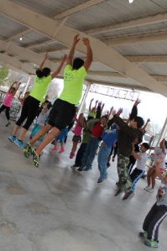
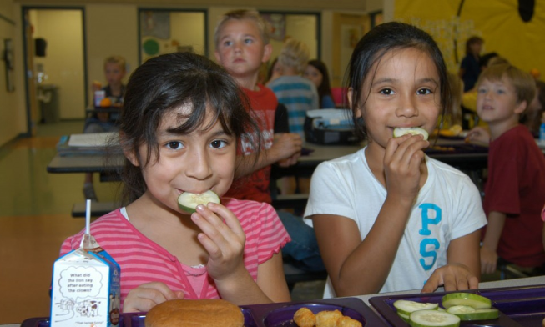
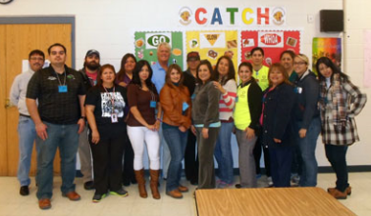
Notes:
Procedure:
1) Welcome training participants and introduce yourself and the co-Trainers.
2) Introduce the training and begin the CCT Intro PowerPoint presentation.
Script: Hello! My name is Austin Cantrell, and I am from the University of California Cooperative Extension’s UC CalFresh Nutrition Education Program. I am the Physical Activity Coordinator. (Introduce other staff). Thank you all for being here today. I am here to train you on how to effectively use the CATCH afterschool box. CATCH is about bringing individuals together to work towards creating a healthy school environment for kids and helping kids enjoy physical activity. The primary reason we are all here is for the health and well being of kids. And, we believe that the CATCH Program can help you guide children in the process of being healthy for a lifetime.
1

Slide 2
Objectives for Today
To provide you with the knowledge and skills to meet the goals and objectives of the program.
To have fun learning how to use the CATCH PE
resource and even more fun implementing the program at your school.
Notes:
State the CATCH Objectives for the day.

Slide 3

UC CalFresh Mission
Collaborate and leverage UCCE resources to positively impact the nutrition, physical activity and food buying behaviors of CalFresh eligible families in Fresno and Madera Counties through education and applied research.

Slide 4


Fresno/Madera MCP
© University of California 2015

Slide 5




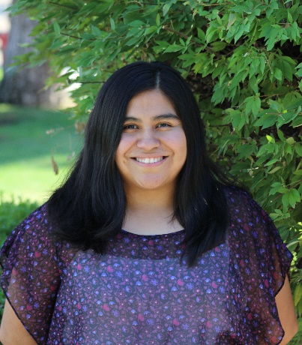

Madera Team
Karina Macias
Program Manager
Kristi Schultz-Sharp
Program Supervisor
Austin Cantrell
Physical Activity Program Coordinator
Angelica Perez
Youth Program Coordinator
Elizabeth Lopez
Adult Program Coordinator
Ruth Salazar
Program Educator

Slide 6
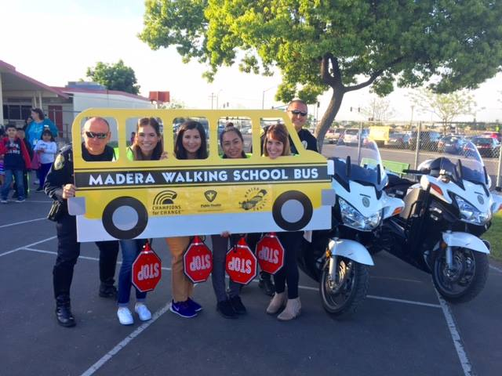
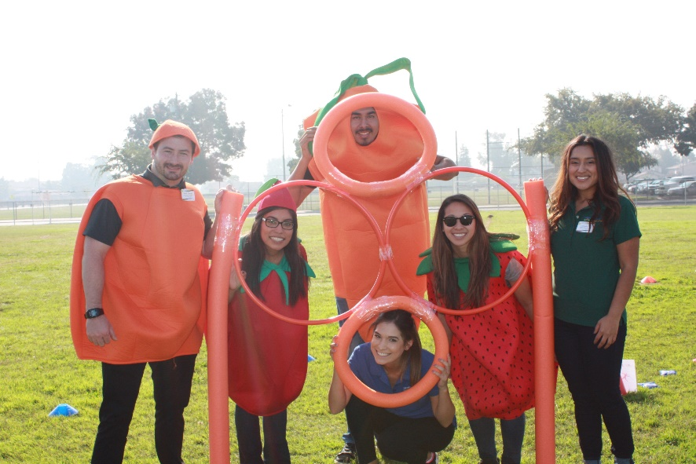
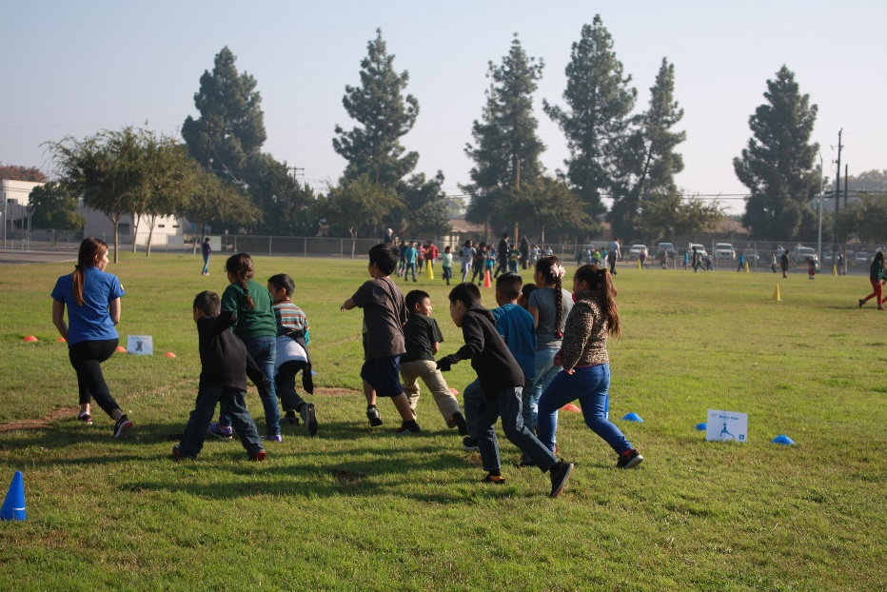
Partners in Madera
MUSD Schools
CAPMC Head Starts
Senior Centers
Housing Authority
Madera Dept. Social Services
Madera Public Health
Community Health Fairs
Farmers Market
Dairy Council
Other Community Agencies

Slide 7
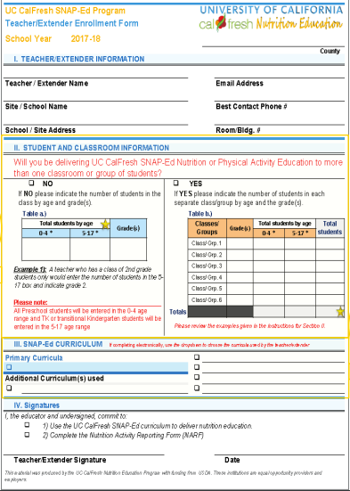
Teacher Enrollment Form
Collected yearly
  at the beginning of the year
Captures information
  Teacher/extender
  Student and classroom
  Curricula used

Slide 8
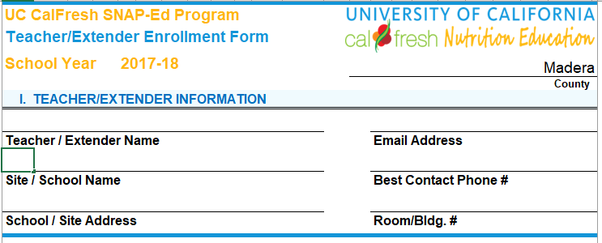
Section I

Slide 9
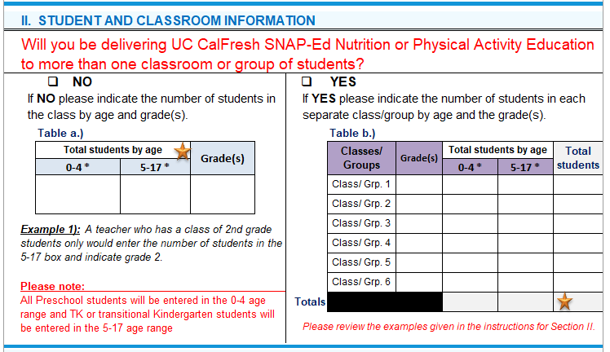
Section II
If the teacher will be delivering UC CalFresh SNAP-Ed Nutrition or Physical Activity Education to only one classroom or group of students the teacher/extender will complete Table a.) by indicating the total number of students by the appropriate age range and entering in the grade(s) taught.
If the teacher will be delivering UC CalFresh SNAP-Ed Nutrition or Physical Activity Education to multiple, separate classrooms or groups of students, please have them complete Table b.)

Slide 10
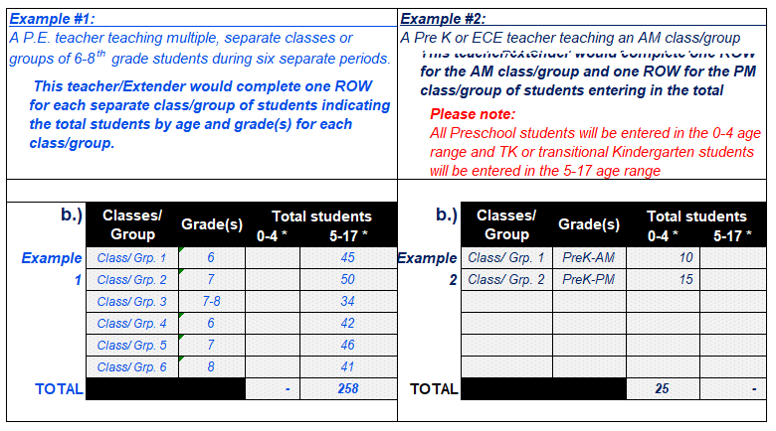
Section II cont.

Slide 11
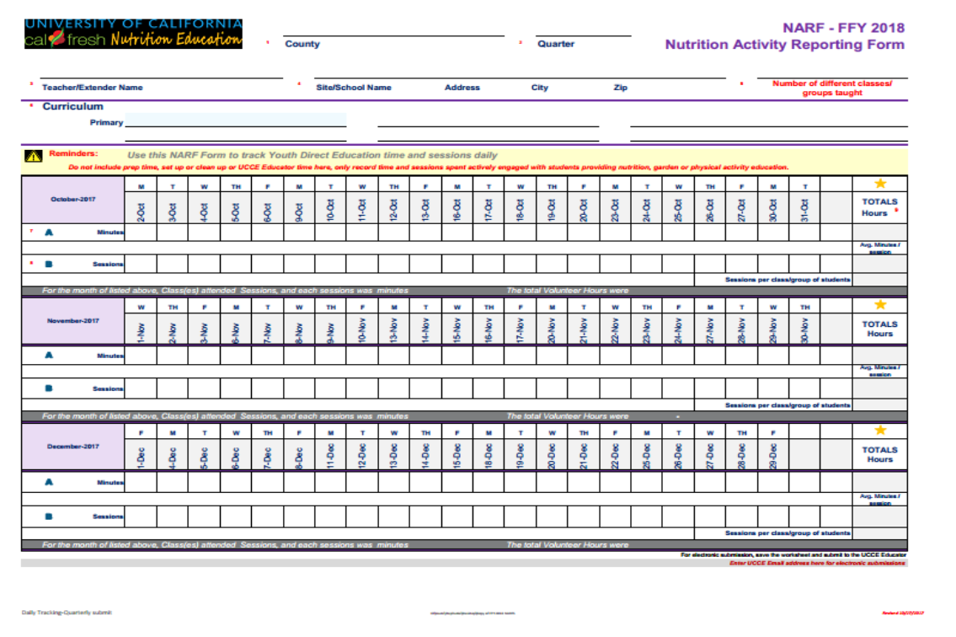

NARFS
Captures the time and materials teachers invest in teaching nutrition education.
This information is used to evaluate program impacts and communicate local support for the program to funders
Collected every quarter
  Q1: Oct., Nov., Dec hours
  Q2: Jan, Feb, Mar hours
  Q3: Apr, May, Jun hours
  Q4: Jul, Aug, Sep hours
Collection days TBD

Slide 12
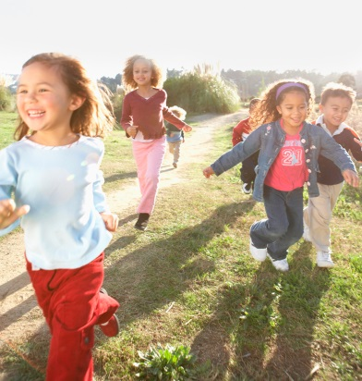
Physical Inactivity
According to NHANES 2003-04 data, about 25% of kids 6-15 yrs old were at least moderately active for 60 mins a day on at least 5 days a week. The 2014 United States Report Card on Physical Activity for Children & Youth.
  6-11 yr olds = 42%
  12-15 yr olds = 8%
Since 1969, the proportion of elementary and middle school students walking or biking to school fell from 47.7% to 12.7%. The 2014 United States Report Card on Physical Activity for Children & Youth.
Only 6 states require PE K-12.
NASPE/AHA. 2012 Shape of the Nation Report: Status of PE in the USA.
Notes:
Elem & MS Slide – data specific to older kids.
Paraphrase the bullets on the slide.
Another alarming fact is that as children get older, their physical activity slowly declines. We all know how hard it is in today’s society to make time for exercise, so if elementary aged children already do not have daily physical activity, and do not think it is fun…than the chances that they make time to do it as adults is low. Many people also will tell you that they do not feel their neighborhoods are safe enough for children to go outside and play, or that now many children return to an empty home after school and are not allowed to go out and play.

Slide 13
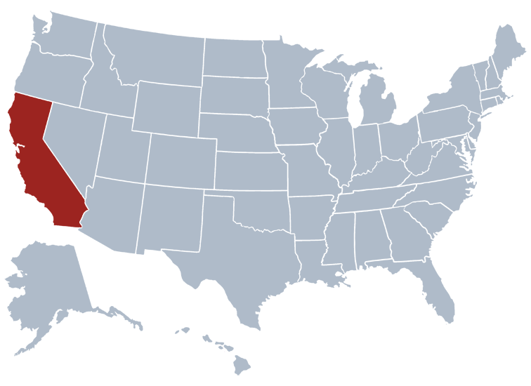
PE in California
California mandates at least 200 minutes of physical education every 10 school days in grades 1-6, and also requires daily recess.
State has developed its own standards for physical education, although school districts are not required to comply.
The state does not require the use of specific curricula for elementary, middle school/junior high and high school physical education.
  No guidance or standards.
Notes:
How active are kids supposed to be every day?
Answer: at least 1 hour every day.

Slide 14
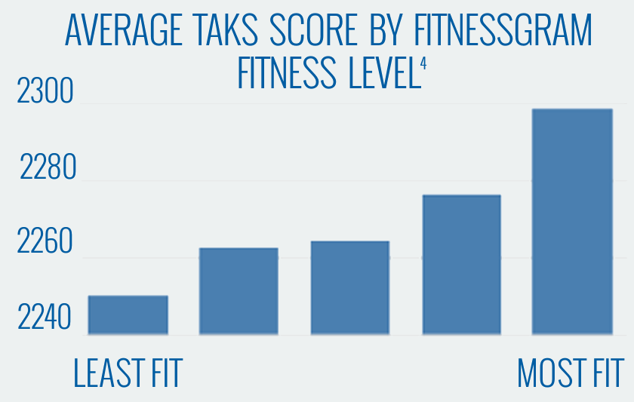
Better Physical Fitness = Better Test Scores
Source: Van Dusen et al, Associations of physical fitness and academic performance among schoolchildren. Journal School Health. (2011)
Notes:
Script: This graph shows that students that are classified as the most fit scored higher on the TAKS test (Texas’ state test at the time) than students who were less fit. The difference actually comes out to around 10%. Kids that are more physically fit scored 10% better than less fit kids. Think about it, it you went to your principal and said, “Hey, I’ve got something that can increase our scores 10%.” do you think he/she would be interested? Yeah, they would!

Slide 15
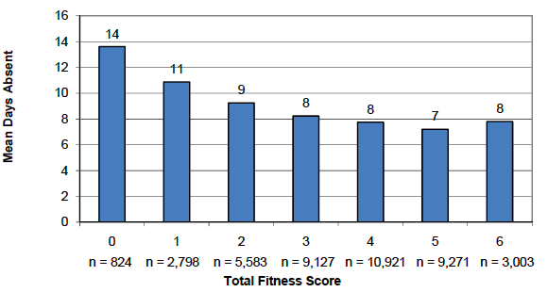
Better Physical Fitness = Better Attendance
Total Fitness and Absences, Grades 3-12
Source: Austin Independent School District. E-Team Report: DPE Publication Number 07.93. May 2009
Notes:
Source: Austin Independent School District. E-Team Report: DPE Publication Number 07.93. May 2009
Script: Across grades 3-12, a significant linear relationship was found between students’ total fitness scores and attendance. Students who had higher total fitness scores were absent fewer days than students who had lower fitness scores. This significant association persisted across school level – at all grade levels, as fitness levels increased, absences decreased. Why are absences important to a principal or administrator? (Money!) Again, if you could potentially reduce absences by almost 10% don’t you think folks would be interested in that?
Fitnessgram comprises 6 separate indicators of student fitness: (a) BMI, (b) aerobic/cardiovascular capacity, (c) abdominal strength, (d) upper body strength, (e) endurance, and (f) flexibility. The total fitness score is the number of indicators on which students scored in the healthy zone.

Slide 16
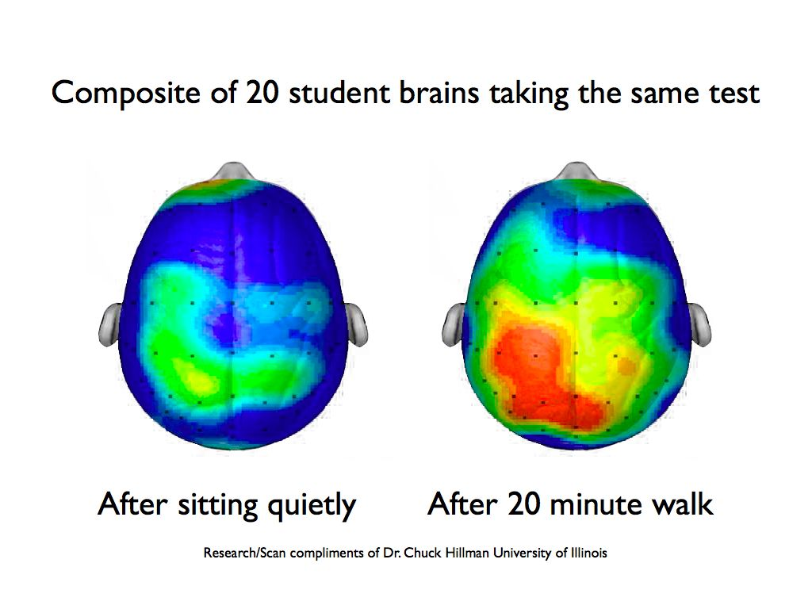
Exercise and Brain Activity
Regular exercise helps to improve memory and thinking skills both directly and indirectly (Godman, 2016).
Godman, H. (2016, November 29). Regular exercise changes the brain to improve memory, thinking skills. Retrieved November 07, 2017, from https://www.health.harvard.edu/blog/regular-exercise-changes-brain-improve-memory-thinking-skills-201404097110

Slide 17
Goal of CATCH PE
CATCH PE is designed to promote children’s enjoyment and participation of MVPA (moderate to vigorous physical activity) during PE classes, recess, and extracurricular activities, and recreation time with family and friends.
Notes:
Review overall goal of CATCH PE.
17

Slide 18

Key Objectives of CATCH PE
Students enjoy physical activity
Students are involved in MVPA for 50% of class time
All students are provided with many opportunities to participate and practice skills
Students are encouraged to participate in physical activity outside of PE class
Notes:
These are the objectives of CATCH PE.
First and foremost, we want children to enjoy being active. If kids enjoy being active, they’re more likely to be active as they get older and throughout their lives.
Also, during PE class we want to keep kids moving in moderate to vigorous physical activity (MVPA) – that’s basically a brisk walk and above – for at least 50% of class time. Now, you’re not necessarily going to be able to attain that every class on every single day, but it’s the goal.
While we’re keeping kids moving during class, we also want to provide students with lots of opportunities to practice and participate. Hopefully, gone are the days of students sitting in long relay lines or waiting for other teams to play. You can remember this one with: practice, practice, practice.
Finally, we want the students to take the message home and encourage kids to be active outside of PE class time. Whether it is at recess time, not just standing around talking to their friends, or if they go home and simply ride their bike instead of watching TV.
Stop - Explain that they are about to “go to PE”. Once they are done with the sample lesson, come back to this slide to review the objectives one more time.
18

Slide 19
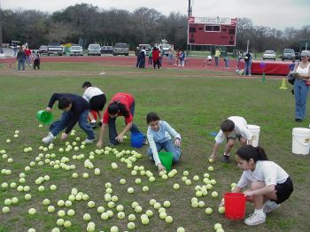
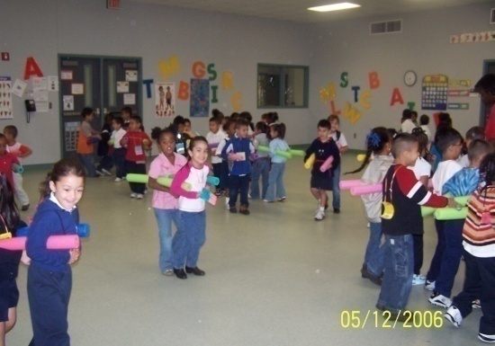
“The Language of CATCH”
“Hitting the Track”/ “Mingle-Mingle”
Lost & Found
Eliminate elimination games
Re-Entry Tasks/Re-Entry Zone
Challenge by Choice
The “When” before the “What”
Nutrition language integration
“CATCHify” old favorites
“CATCH” them making healthy choices!
Notes:
Discuss the “Language of CATCH” that was demonstrated in the sample lesson
Hitting the Track – children walking the boundaries.
Mingle, Mingle – a great game for kids to learn their personal space and get quickly into groups.
Lost & Found – this term is used to refer to the teacher when kids are getting into groups. If they don’t find a group, they can go to “lost & found” and get placed quickly into a group.
Eliminate elimination games – CATCH games are designed to have all children involved.
Re-Entry Tasks/Re-Entry Zone – a child can go to a designated re-entry zone to perform a task and re-enter the game.
Challenge by Choice – the focus is taken off of “winning and losing” and placed more on improving yourself.
The “When” before the “What” - For example: “ When I say GO, you will hit the track”.
Nutrition Language Integration- Integration of the GO, SLOW, and WHOA food categories is encouraged (e.g., Perform 5 jumping jacks and call out 5 GO Foods).
Go Activities – Activities that are designed to get your heart rate up and increase moderate-to-vigorous physical activity.
CATCHify old favorites – how can you make low movement games, like kickball, more in line with the CATCH objetives
“CATCH” them making healthy choices – constantly try to give positive recognition to kids when they make healthy choices.
19

Slide 20
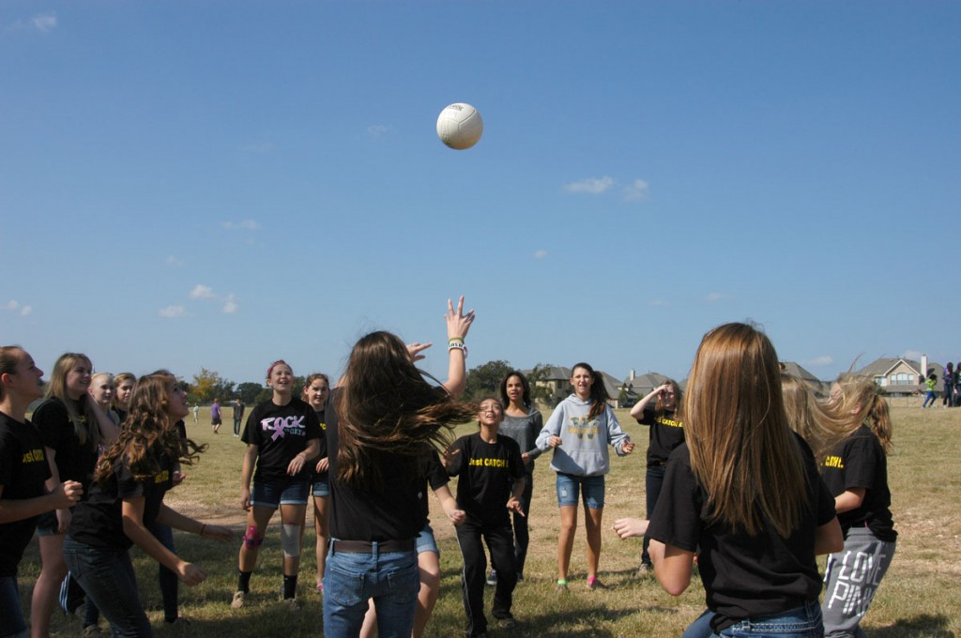
Hit the Track- Let’s try some games!
Hit the Track (establishes boundaries)
Mingle Mingle-Toe to Toe
Frogs on the Lily Pad (127-128)
Dragon’s Tail

Slide 21
“The Language of CATCH”
“Hitting the Track”/ “Mingle-Mingle”
Lost & Found
Eliminate elimination games
Re-Entry Tasks/Re-Entry Zone
Challenge by Choice
The “When” before the “What”
Nutrition language integration
Go Activities - MVPA
“CATCHify” old favorites
“CATCH” them making healthy choices!
Notes:
Discuss the “Language of CATCH” that was demonstrated in the sample lesson
Hitting the Track – children walking the boundaries.
Mingle, Mingle – a great game for kids to learn their personal space and get quickly into groups.
Lost & Found – this term is used to refer to the teacher when kids are getting into groups. If they don’t find a group, they can go to “lost & found” and get placed quickly into a group.
Eliminate elimination games – CATCH games are designed to have all children involved.
Re-Entry Tasks/Re-Entry Zone – a child can go to a designated re-entry zone to perform a task and re-enter the game.
Challenge by Choice – the focus is taken off of “winning and losing” and placed more on improving yourself.
The “When” before the “What” - For example: “ When I say GO, you will hit the track”.
Nutrition Language Integration- Integration of the GO, SLOW, and WHOA food categories is encouraged (e.g., Perform 5 jumping jacks and call out 5 GO Foods).
Go Activities – Activities that are designed to get your heart rate up and increase moderate-to-vigorous physical activity.
CATCHify old favorites – how can you make low movement games, like kickball, more in line with the CATCH objectives
“CATCH” them making healthy choices – constantly try to give positive recognition to kids when they make healthy choices.
21

Slide 22
CATCH PE BASICS
B Boundaries and Routines
A Activity from the Get-go
S Stop and Start Signals
I Involvement by All
C Concise Instructional Cues
S Supervision
Notes:
Discuss each letter of the BASICS – one of the CATCH behavioral management strategies. Most PE teachers will be able to speak to what each letter means to them, and how the BASICS helps reach the CATCH PE objectives and overcome barriers.
22

Slide 23
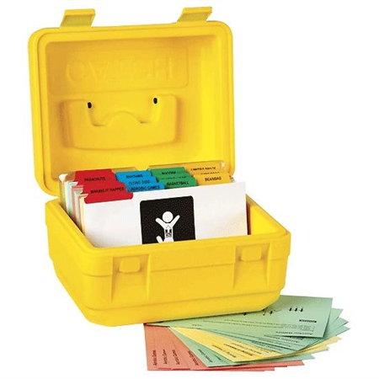
CATCH PE Materials
The CATCH Kids Club (CKC) Activity Box for Grades K-5:
Over 400 games and activities.
Fully organized tabbed sections include activities for Aerobic Games; Limited Space; Parachutes; Rhythms; Hoops; and more.
Also included is a specially written group of cards with teaching techniques and ideas for adapting the activities for those with special needs.
Notes:
The CATCH PE materials include the Activity Boxes which contain hundreds of games and activities that are enjoyable and developmentally appropriate for each grade level.
23

Slide 24
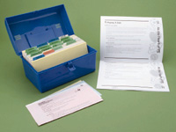
CATCH PE Activity Box
WARM-UP/COOL-DOWN ACTIVITIES
GO FITNESS
    CARDIOVASCULAR EFFICIENCY
Quick Cardio Games Bench Aerobics
Aerobic Games Jump Rope
Aerobic Rhythms
    MUSCULAR STRENGTH & ENDURANCE
    FLEXIBILITY
    GO, SLOW, WHOA EAT SMART GAMES
    FITNESS CHALLENGES
GO ACTIVITIES
    BASKETBALL FOOTBALL SOCCER
    FLOOR HOCKEY HULA HOOP SOFTBALL
    FLYING DISC PARACHUTE TENNIS
    VOLLEYBALL
ALSO: LIMITED SPACE & FORMATIONS SECTIONS
Notes:
The activity box is broken down into the four components of the CATCH PE lesson format, as well. In the front are the Warm-Up and Cool-Down cards. Next are the Go Fitness cards which include activities for cardiovascular efficiency, flexibility, and muscular strength. Then, there are the Go Activity cards. This is an example of the 3-5 box, and you can see the variety of sections that include different sports to parachute and hula hoop. They are all color coded, and there are even blank cards to add in your own games.
24

Slide 25
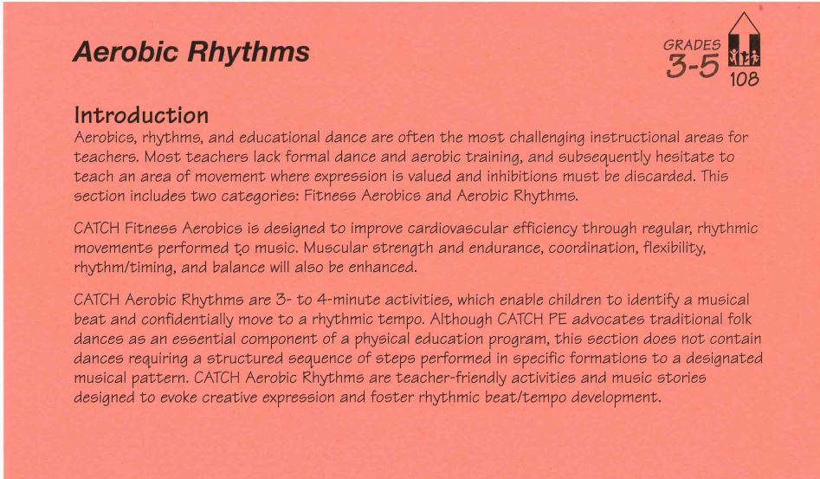
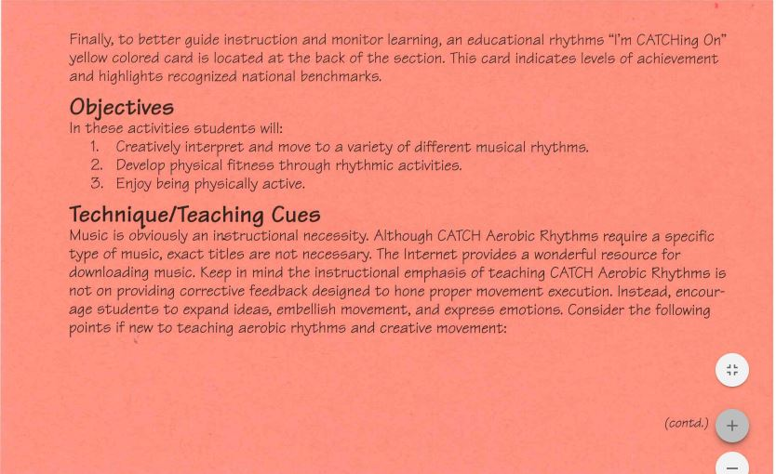
Activity Box Cards
INTRODUCTION CARDS
1. Introduction & Objectives
2. Technique/Teacher Cues
3. How to Use this Section & Safety Hints
4. Glossary of Terms
Notes:
Each section is then broken down. (Take out the jump rope section and hold it up) Each section is divided up by tabbed cards which provide a list of activities in each section. A neat thing on the back of the tabbed cards is (flip the card around) other activities that are not included in this section, but that could be applied to add more variation.
-This is the introduction card which give the objectives of the section along with definitions, safety hints, and other general information.
25

Slide 26
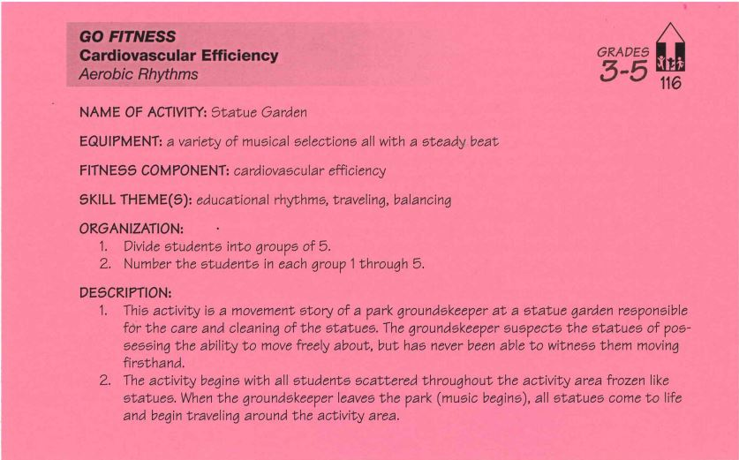
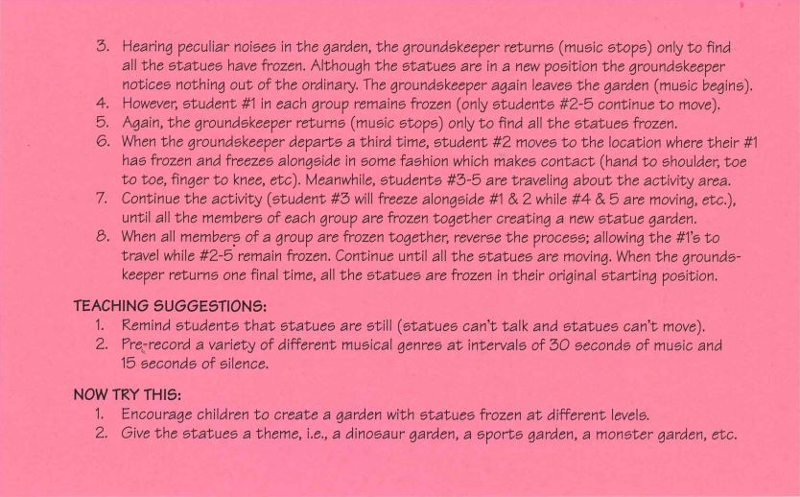
Activity Box Cards
ACTIVITY CARDS
1. Name of Activity
2. Grade Level & Equipment
3. Skills Emphasized
4. Organization & Description
5. Teaching Suggestions & Variations
Notes:
These are the activity cards. These cards provide the equipment you will need, how to organize the students, and even other variations for the activity.
26

Slide 27
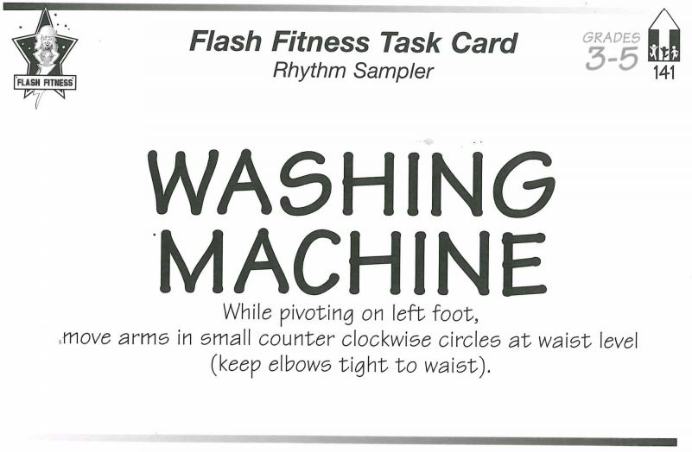
Activity Box Cards
TASK CARDS
1. Description & Picture
Notes:
The task cards (move the green cards to the back) are pictures and written descriptions of the task to be performed. The are easy to understand and are great for stations.
27

Slide 28
Activity Box Cards
INTRODUCTION CARDS
1. Introduction & Objectives
2. Technique/Teacher Cues
3. How to Use this Section & Safety Hints
4. Glossary of Terms
ACTIVITY CARDS
1. Name of Activity
2. Grade Level & Equipment
3. Skills Emphasized
4. Organization & Description
5. Teaching Suggestions & Variations
TASK CARDS
1. Description & Picture
Notes:
Each section is then broken down. (Take out the jump rope section and hold it up) Each section is divided up by tabbed cards which provide a list of activities in each section. A neat thing on the back of the tabbed cards is (flip the card around) other activities that are not included in this section, but that could be applied to add more variation.
28

Slide 29
Explore your CATCH box
Look through the box and find an activity you would like to try out today!

Slide 30
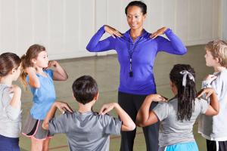
Physical Activity Demo 2
Aerobic Rhythms
Teacher taught games

Slide 31

Questions

