Slide 1
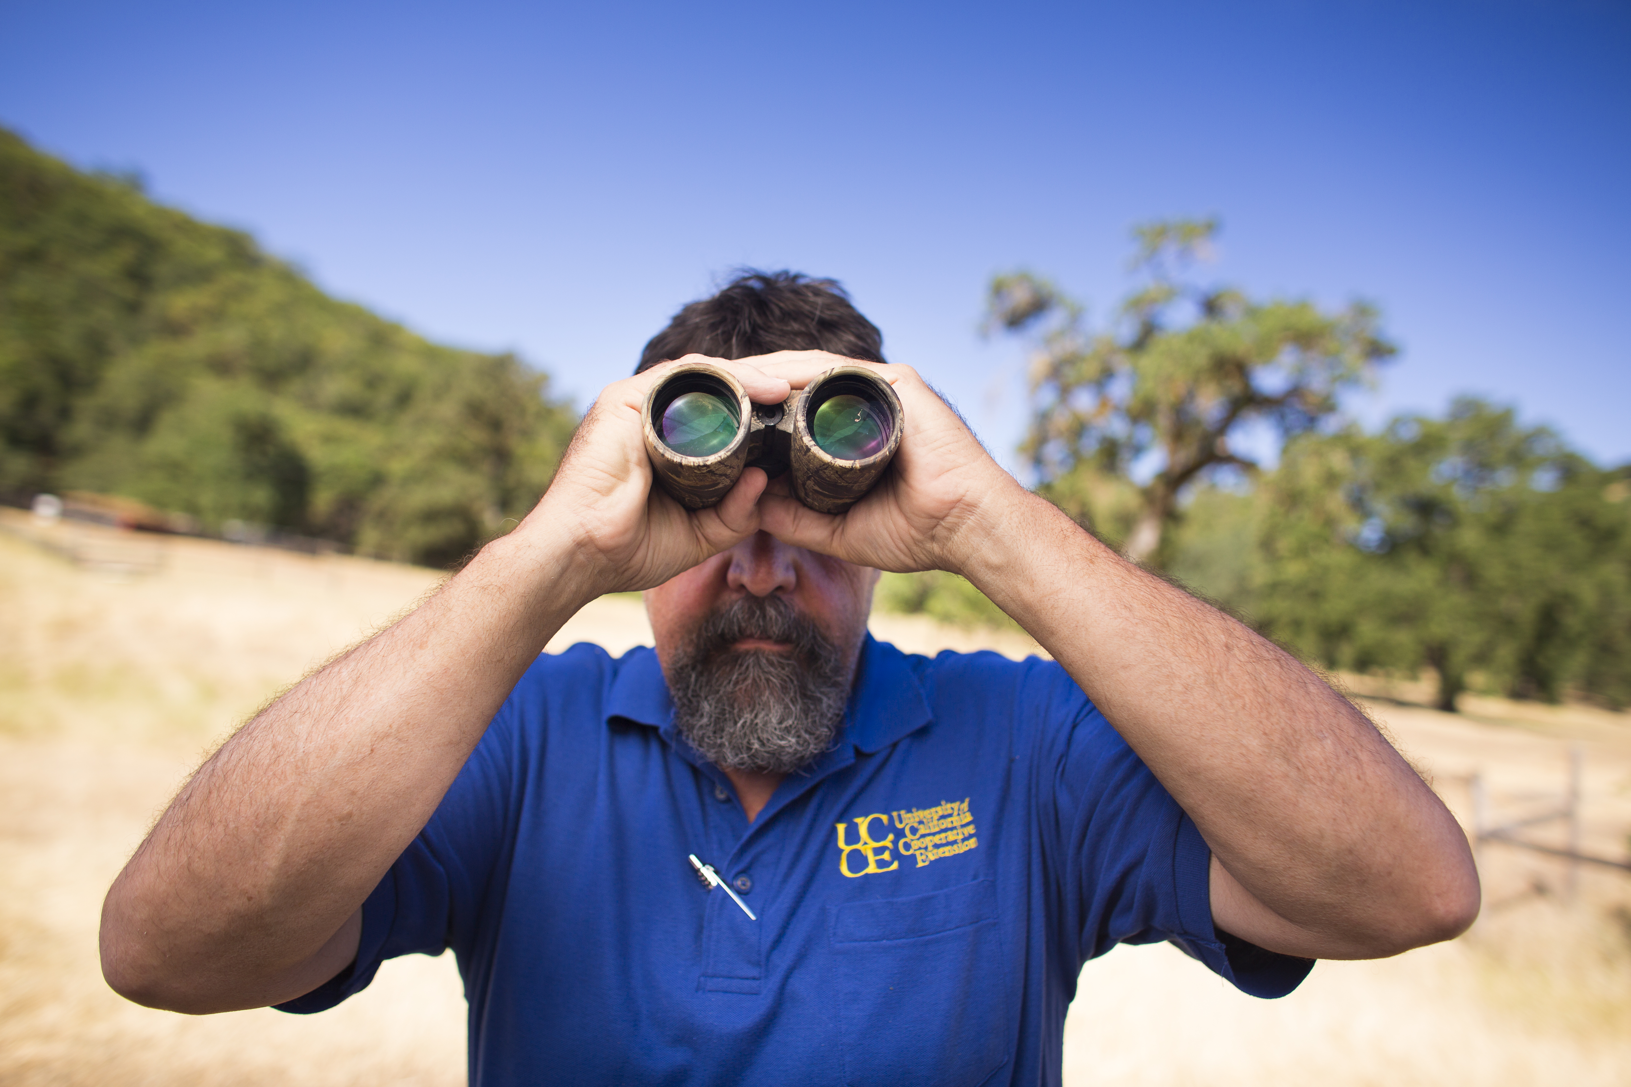
Here’s your title slide
Add a sub-title if you need one
Location information about where you’re presenting
Presenter 1 Your title
Presenter 2 Manager, Web Development and Applications Programming
Date of your presentation

Slide 2
The UC ANR Brand Promise
Be a leader to bring science-based solutions;
Provide trustworthy and unbiased information;
Provide research results that are practical to use;
Address the local concerns of communities;
Invite all concerned stakeholders including industry to participate; and
Serve where need arises

