Slide 1

Title Slide
Use this version if you want a sub-brand
UC ANR Statewide Conference
Your name
Your title
April 2018

Slide 2

Headline
Headline 2
Use this slide if you have a lot of copy or a large image, chart or graph. Do not mix the old brand elements with the new; don’t add a sub-brand to the new logo-type.
Ut vel esse imperdiet definitiones. Sed et fugit suscipit. In laudem disputando nam. Quodsi inermis concludaturque ut mea, illum viris et pri. Duo et atomorum hendrerit, nusquam oporteat urbanitas cum an, et erant moderatius est. In illud incorrupte eam.
Duo ea diam impedit oporteat, graeci nostrum mea ea. Inermis nusquam sed te, eum unum vero ceteros te, duo ei elit mollis. Per ne magna offendit elaboraret, pri modus detracto consequat ad. Est at mucius sapientem complectitur. Et ius suas reformidans,

Slide 3


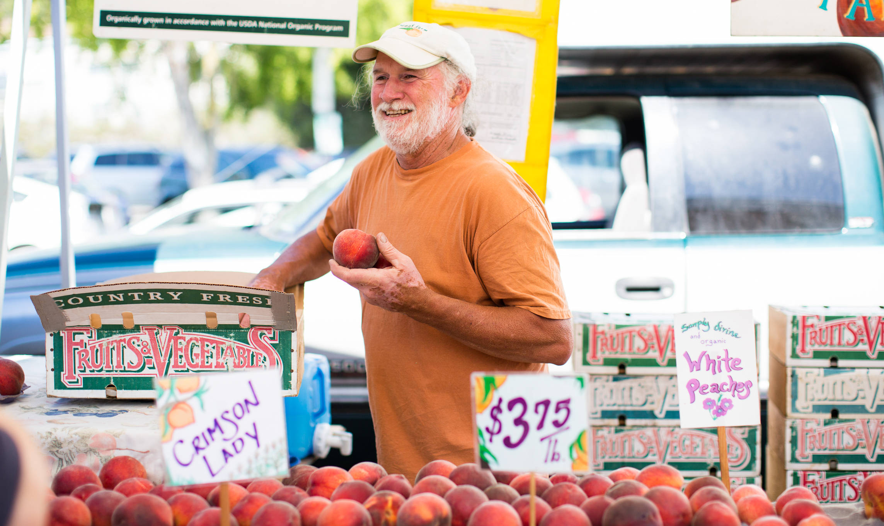
Slide Title
Add you own photos here. Don’t delete the yellow bar in the upper right corner, the bar provides the branding on this slide and visually grounds the other images.
Duo et atomorum hendrerit, nusquam oporteat urbanitas cum an, et erant moderatius est. In illud incorrupte eam.

Slide 4
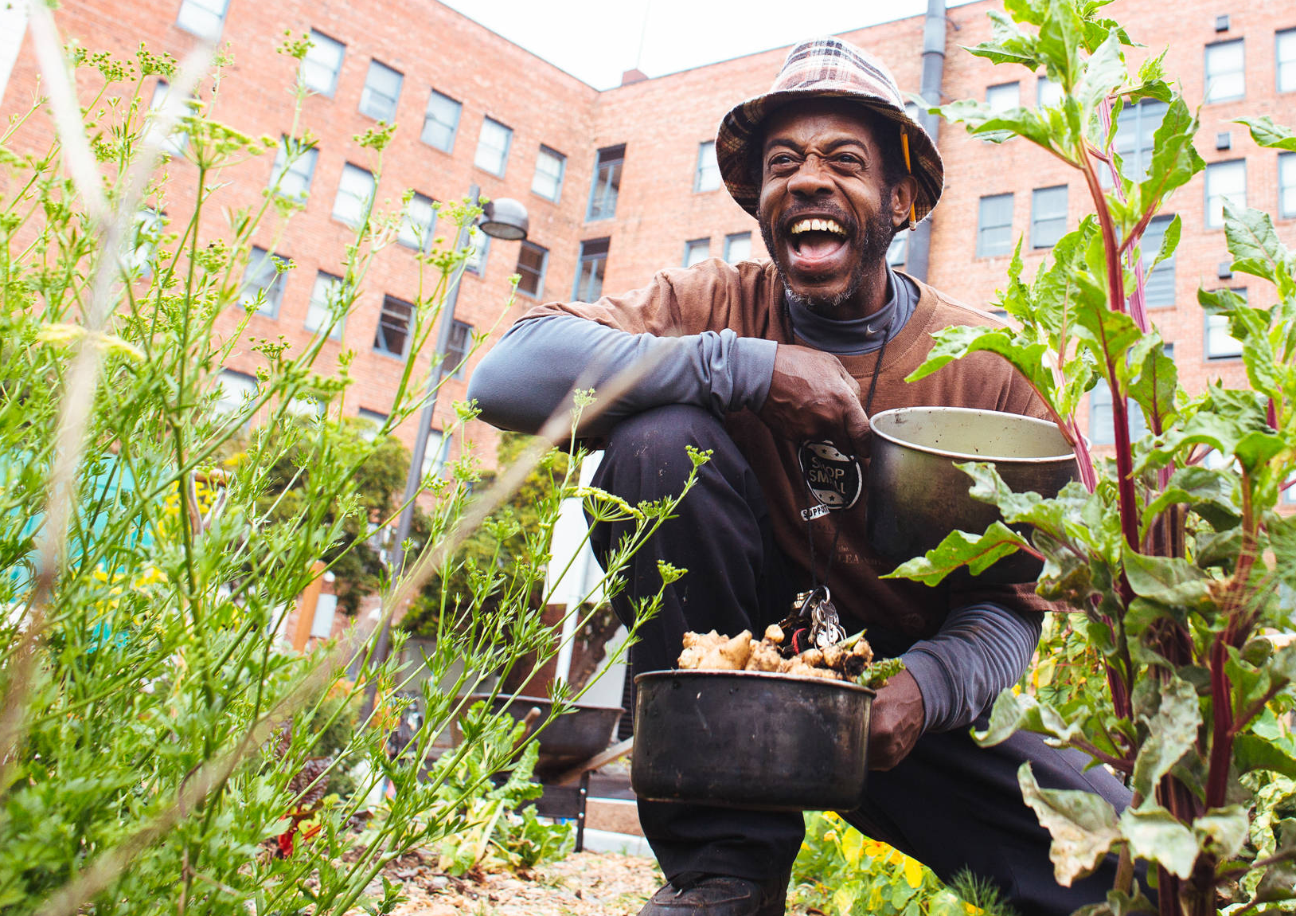
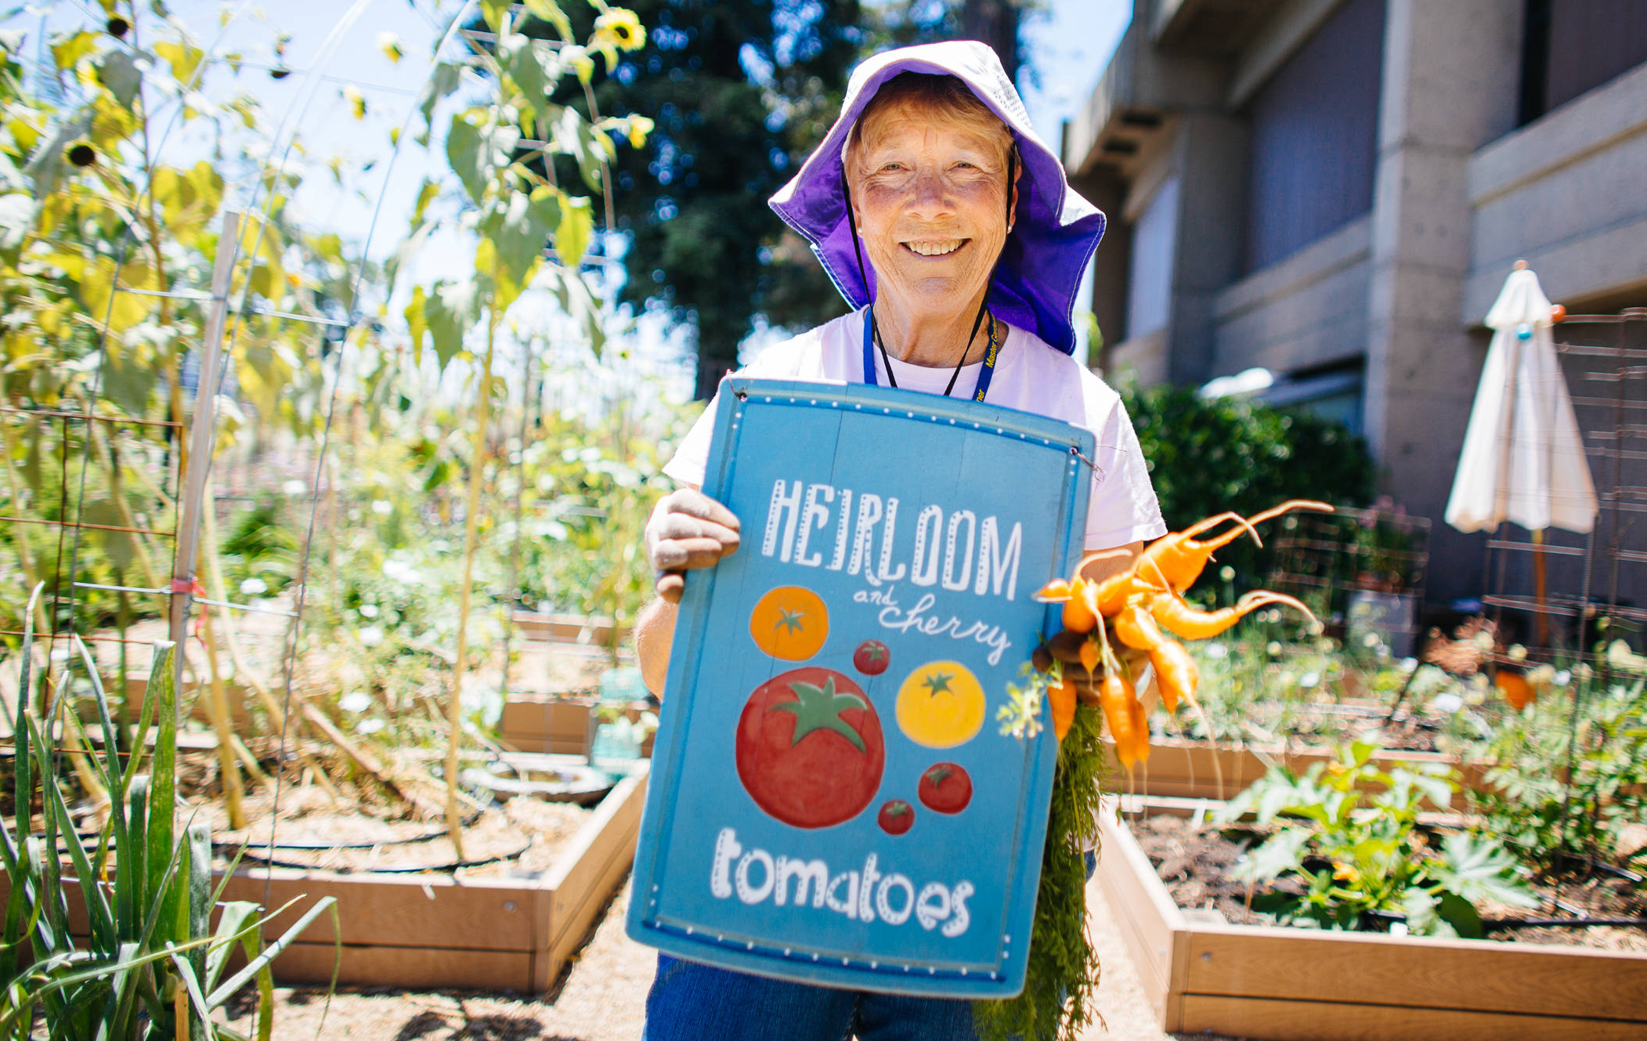
Slide Title
Add you own photos here. Don’t delete the yellow bar in the lower right corner, it provides the branding on this slide and visually grounds the other images.
Duo et atomorum hendrerit, nusquam oporteat urbanitas cum an, et erant moderatius est. In illud incorrupte eam.

