Slide 1
Shooting and editing video on your iPhone

Slide 2
Before shooting:
Space
Block Notifications
Set Phone Orientation

Slide 3
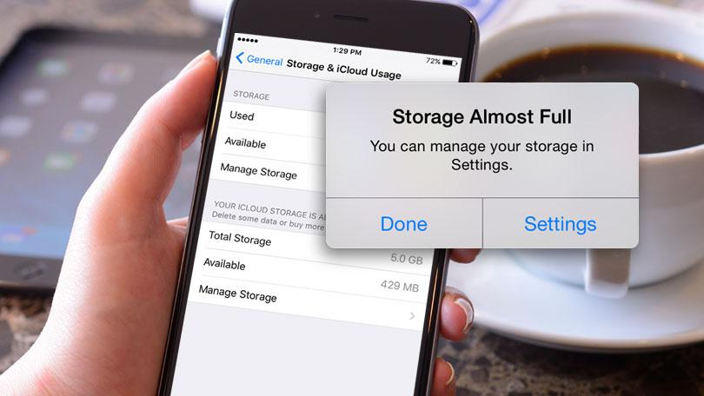
Before shooting:
Space
Notes:
Space: Before you shoot, make sure you have space on your phone for those new video masterpieces. On an iPhone go into Settings - General - Storage & iCloud Usage. From here you can view how much storage your phone has and what using it.

Slide 4
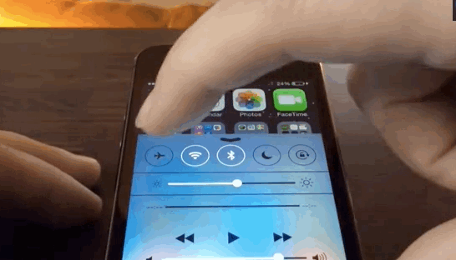
Before shooting:
Block notifications
Notes:
Block: putting your phone into Airplane mode. This will prevent texts, phone calls and other notifications from distracting you while you shoot. If you don't have it on, notifications can pop up on your screen, making it harder to see what you're recording. If you receive a phone call, video recording will automatically stop which can also be annoying.

Slide 5
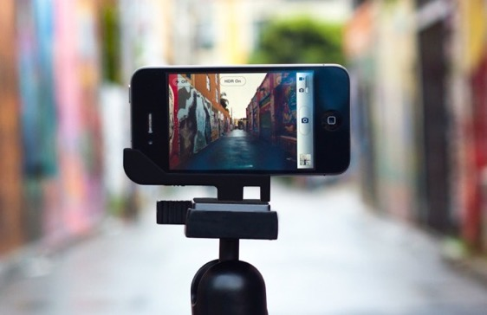
Before shooting:
iPhone
orientation
Notes:
Orientation: As a rule of thumb you should always shoot in landscape orientation to avoid seeing black bars on your screen during playback. On the other hand, some social media apps work better with video shot in portrait. Ultimately, it's all about where the video will end up. If you are going to watch your video on a TV or computer screen (uploading it to YouTube or Vimeo), horizontal is the best way to go. Snapchat is a great example of when shooting "vertical" video is actually better.

Slide 6
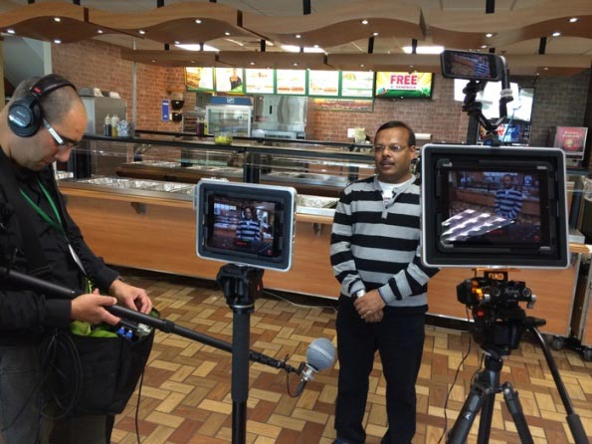
Stop the shaking:
Tripod
Hand Held Stabilizer
Notes:
But even with the iPhone's built-in magic, you should keep your phone as still as possible when shooting. This can be especially handy for when you film someone talking directly to the camera, close-ups, time lapses or slow-motion shots.

Slide 7
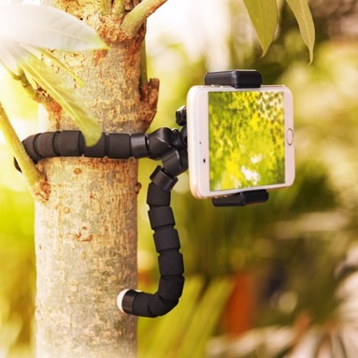
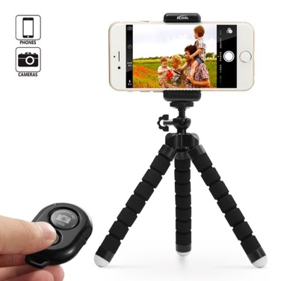
A. Tripod
Notes:
One of the tools to help us to have a steady video is the tripod, and if it can be versatile, even better

Slide 8
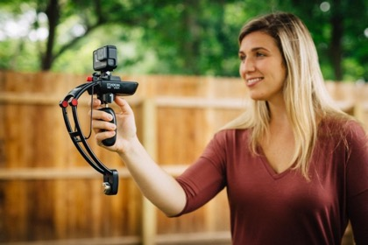
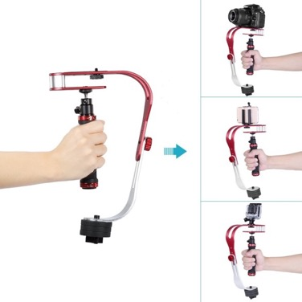
B. Stabilizer
Notes:
Stabilization: Inside those smartphones there's a whole lot of technology. One of the latest trends is optical image stabilization (OIS) in the camera which helps reduce motion and shaking. The iPhone 7 Plus is considered to have one of the best cameras because of its OIS technology. The iPhone has dual OIS including both wide angle and telephoto modes.

Slide 9
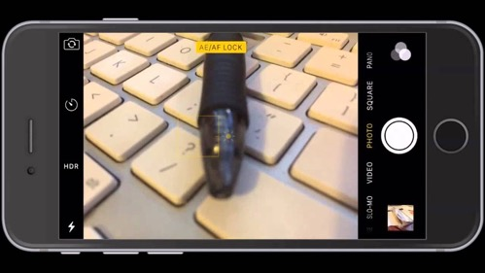
Let there be light:
ae/af lock
Led Light
Natural Light
Notes:
Auto exposure / auto – focus lock

Slide 10
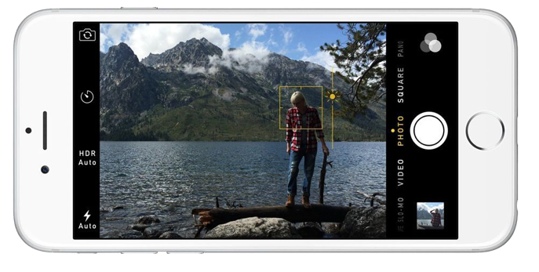
ae/af lock auto exposure /autofocus lock
Notes:
AUTO EXPOSURE / AUTO FOCUS: If you want to lock your exposure, tap and hold where you want to focus until the yellow focus/exposure square pulsates and "AE/AF LOCK" appears on your screen. From there you can adjust the exposure and the iPhone will hold these settings until you touch the screen again

Slide 11
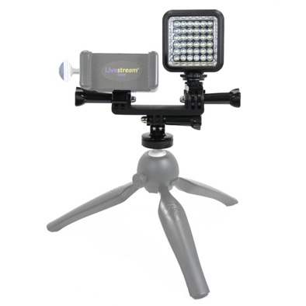
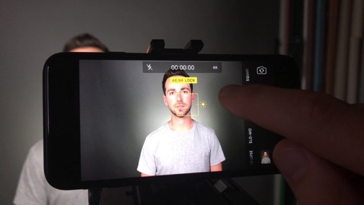
Led Light
Notes:
Led light: Make sure that if you’re shooting an interview, you let the natural light from the window fill in the scene for you.
Avoid backlit scenes, it means shooting your subject against a bright window behind them. If you do, you’ll end up with the familiar silhouette you may have seen in videos of witnesses who don’t want their identity revealed. So avoid that, unless you’re actually filming an anonymous source.

Slide 12
Natural Light
Notes:
Make sure that if you’re shooting an interview, you let the natural light from the window fill in the scene for you.
Avoid backlit scenes, it means shooting your subject against a bright window behind them. If you do, you’ll end up with the familiar silhouette you may have seen in videos of witnesses who don’t want their identity revealed. So avoid that, unless you’re actually filming an anonymous source.

Slide 13
Ideal Light

Slide 14
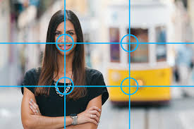
Composition:
Rule of thirds
Notes:
lining up important parts of your subject on thirds can make your compositions more interesting. This is called the rule of thirds. Imagine drawing a tic-tac-toe grid on your phone screen and aligning your image on the intersection of those lines.

Slide 15
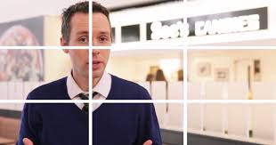
Rule of Thirds:
Notes:
Notice how the primary subject in the image is positioned where two of the four points (which are known as the “anchor points”) intersect? This technique is used to draw the eye toward the main points of interest in the shot. The viewer’s eye will naturally gravitate towards the top-left anchor point, and many people will spend longer dwelling on this area than other parts of the shot, making it a logical point at which to position the main area of interest in your shot – in this example, the face of the subject. This is a pretty standard composition using the Rule of Thirds, and although it might not seem that remarkable, composing your shot in this way makes it easier for the eye to “read” and results in a much more aesthetically pleasing shot overall. Your audience probably won’t even notice the composition of the shot, because it just “works.”

Slide 16
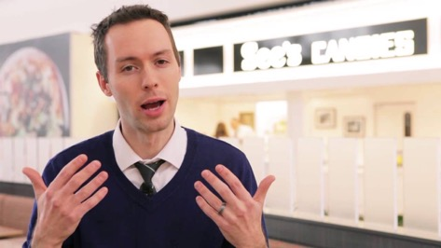
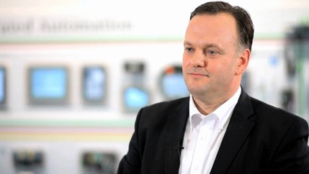
Balance:
Notes:
Wherever you’re shooting, ensure that your primary light source is even and consistent. If you shoot indoors, avoid rooms with windows. If this isn’t possible, position your subject sufficiently far from the windows to avoid the daylight interfering with your shot

Slide 17
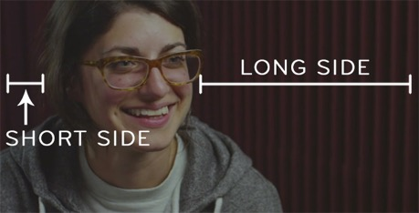
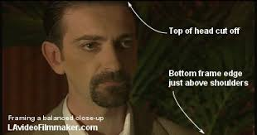
Balance:
Notes:
Wherever you’re shooting, ensure that your primary light source is even and consistent. If you shoot indoors, avoid rooms with windows. If this isn’t possible, position your subject sufficiently far from the windows to avoid the daylight interfering with your shot

Slide 18
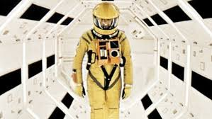
Symmetry & Balance:
Notes:
Balancing the left and right sides normally gives off a feeling of harmony, and an unbalanced frame one of tension. While going counter to the rule of thirds, sometimes completely symmetrical framing with the object of interest in the exact center can be used extremely effectively.

Slide 19
Other Points:
Prep your interview subjects
Know what extra video you need ( b-roll)

Slide 20
Prep your interviewees:
What to expect
Avoid Memorizing
Notes:
Make sure all your presenters or subjects know what’s expected of them beforehand to minimize mistakes or wasted time on the day of the shoot to avoid anxiety try to avoid having your presenters memorize pages upon pages of script

Slide 21
Extra Video (B-roll):
Wide Shot
Medium Shot
Close Up
Extreme Close Up / cutaways
Notes:
B-roll is essentially any footage that isn’t of your primary subject. Whatever footage you need, figure it out during the pre-production phase to avoid situations in which you need footage you don’t have. Remember – there’s no such thing as too much B-roll.

Slide 22
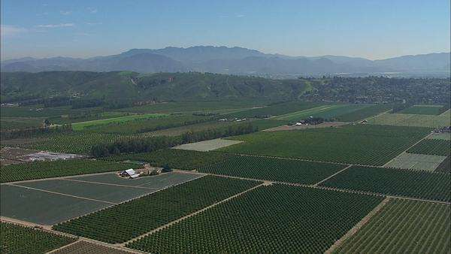
Wide Shot:
Often referred to as “establishing shot” because it establishes where the scene takes place
Notes:
Wide shot , typically shows the entire object or human figure and is usually intended to place it in some relation to its surroundings.

Slide 23
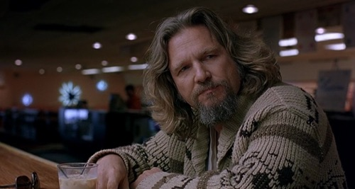
Medium Shot:
A general, all-purpose shot
Notes:
Medium shots are also used when the subject in the shot is delivering information, such as news presenters. It is also used in interviews. It is the most common shot in movies, and it usually follows the first establishing shots of a new scene or location.

Slide 24
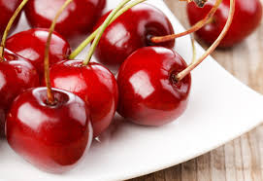
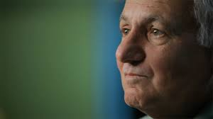
Close Up:
Useful for showing detail and can also be used as a cut-in
Notes:
A close-up or closeup in filmmaking, television production, still photography and the comic strip medium is a type of shot, which tightly frames a person or an object. Close-ups are one of the standard shots used regularly with medium shots and longshots (cinematic techniques).

Slide 25
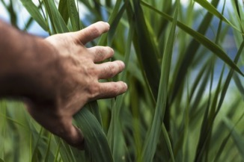
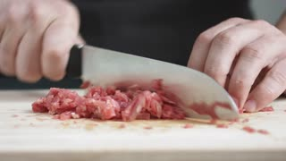
Cutaways:
Close up details of the main action
People’s faces
Their hands
Shots from the point of view of the main subject of the sequence
Notes:
Extreme Close Up ("ECU" or "XCU"): The shot is so tight that only a detail of the subject, such as someone's eyes, can be seen. Lean-In: when the juxtaposition of shots in a sequence, usually in a scene of dialogue, starts with medium or long shots, for example, and ends with close-ups.

Slide 26
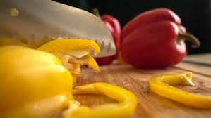
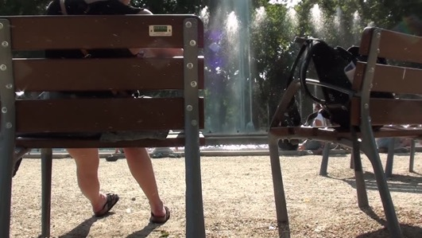
Cutaways:
Notes:
In film and video, a cutaway shot is the interruption of a continuously filmed action by inserting a view of something else. It is usually, although not always, followed by a cut back to the first shot, when the cutaway avoids a jump cut.

Slide 27
Extra Video (B-roll):
2 shot
Panning
Point of view
Notes:
B-roll is essentially any footage that isn’t of your primary subject. Whatever footage you need, figure it out during the pre-production phase to avoid situations in which you need footage you don’t have. Remember – there’s no such thing as too much B-roll.

Slide 28
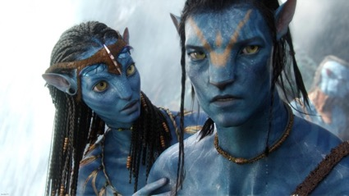
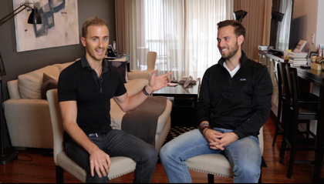
2 Shot:
Notes:
A two shot is a type of shot in which the frame encompasses a view of two people (the subjects). ... The shots are also used to show the emotional reactions between the subjects. For instance, in the movie Stand By Me, this shot is used multiple times to show these emotions.

Slide 29
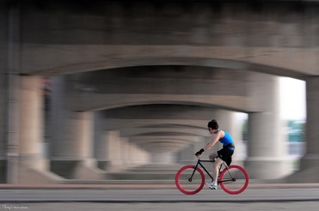
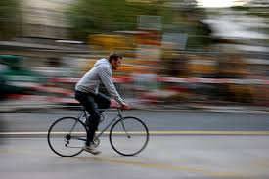
Panning:
Notes:
Panning is the horizontal movement of a camera as it scans a moving subject.
And since someone out there who’s mind is permanently blocked to technical jargon, as mine is, there was bound to be a “huh?” or two. So let me break it down a bit.
When you pan you’re moving your camera in synchronicity with your subject as it moves parallel to you. Still a little wordy huh? It’s not as complicated as it sounds. Shake your head “no.” Go on and do it. Now cut that in half and pretend like you’re moving you head along with a cheetah as is it flies by and you’ve got the idea. In order to pan successfully your camera has got to follow the subject’s movement and match it’s speed and direction as perfectly as possible.
.

Slide 30
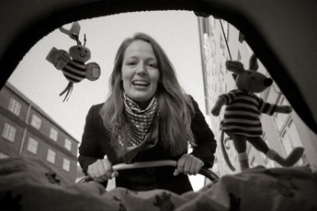
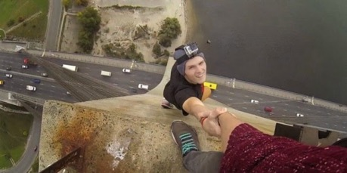
Point of View:
Notes:
A point of view shot (also known as POV shot, First-person shot or a subjective camera) is a short film scene that shows what a character (the subject) is looking at (represented through the camera). ... The technique of POV is one of the foundations of film editing.

Slide 31
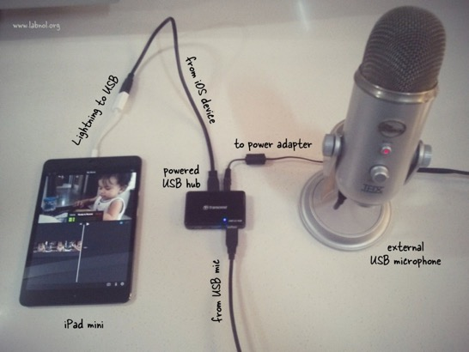
Audio:
Notes:
When it comes to choosing an external microphone for your iOS device, you have options.

Slide 32
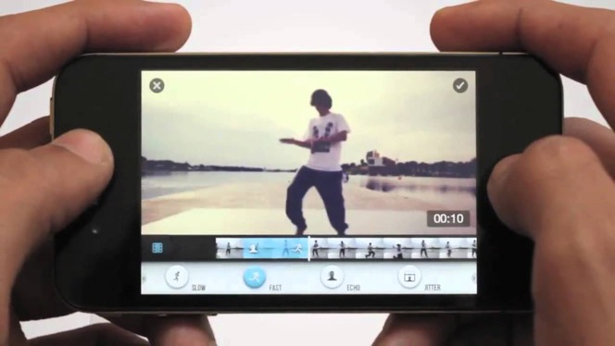
Editing:
Notes:
There are some pretty cool editing apps available for the iPhone, but they still don't beat editing on your computer. When you finish shooting, plug your phone in, offload your footage, and import your videos into your editor of choice. If you've never edited a video before, there's never been a better time to start. The iPhone's camera combined with some minor editing can unlock some serious potential. Plus, free tools like iMovie have made editing easier for everyone.

Slide 33
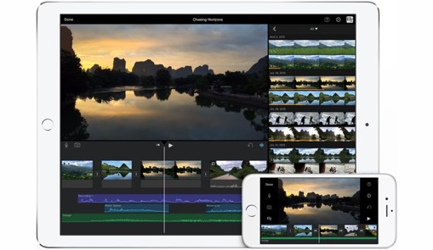
Editing in iMovie:
Create a new event
Upload all your clips
Tutorial on YouTube
https://youtu.be/B_5oZ0vI968
Notes:
There are some pretty cool editing apps available for the iPhone, but they still don't beat editing on your computer. When you finish shooting, plug your phone in, offload your footage, and import your videos into your editor of choice. If you've never edited a video before, there's never been a better time to start. The iPhone's camera combined with some minor editing can unlock some serious potential. Plus, free tools like iMovie have made editing easier for everyone.

Slide 34
#NOSotrosUC
UC ANR News, Information & Outreach in Spanish
Ricardo Vela
Program Manager
4501 Glenwood Dr.
Riverside, CA 92501
(951) 781-2151
(951) 660-9887
ricardo.vela@ucr.edu

