Slide 1
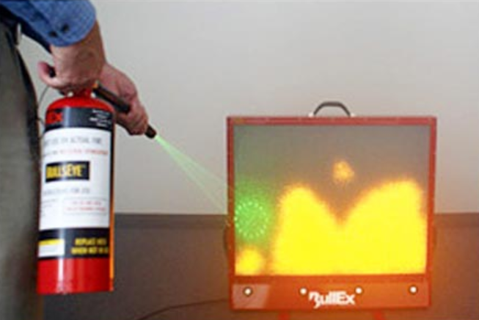
Fire Extinguisher Training
By UC ANR EH&S

Slide 2
Today, we will discuss
  what to do if there is a fire
  different types of fire
  types of extinguishers
  when to use a fire extinguisher
  Also, we will
    practice use of an extinguisher

Slide 3

What should I do if there is a fire?
  Some things you need to think about –
    Are you in impending danger?
    Do you have a safe way to exit the area?
    How big is the fire?
    What type of fire is it?
Remember – Using a fire extinguisher by ANR employees is completely voluntary
Run
Fight
Hide

Slide 4

If you:
  are in danger – Evacuate to a safe area
  DO NOT have a safe way to exit – Find a way to exit the area or make an exit and evacuate to a safe area
  Remember: No Fire is worth risking your life.

Slide 5
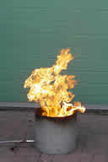
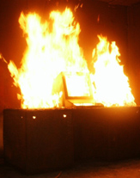
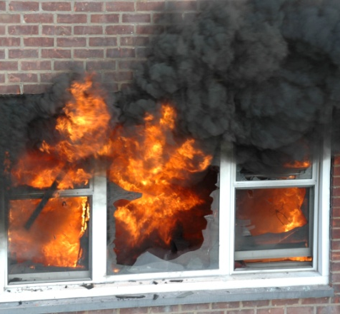
How big is the Fire?
Small Trash or early developing Fire
Desk or Room Fire
Building Fire

Slide 6
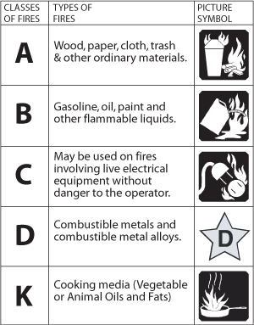



What type of Fire is it?
ABC type fires are the most typical of an office setting

Slide 7

Elements of a Fire
  Fuel – can be from vapor, liquid, or a solid source
  Oxygen – in the air around the fire
  Heat – as small as a spark, or a large heat source
  Need all three to have a fire, remove one and the fire will die
OXYGEN
HEAT
FUEL

Slide 8
Types of Extinguishers
Fire Extinguisher Chart
Extinguisher | Type of Fire
Type |  |  |  |  |  |  | Special Notes
Water |  |  |  |  |  |  | Dangerous if used on ‘liquid fires’ or live electricity
Foam |  |  |  |  |  |  | Not practical for home use
Dry Powder |  |  |  |  |  |  | Safe use up to 1000V
Carbon Dioxide (CO2) |  |  |  |  |  |  | Safe on high and low voltages
 |  |  | Yes |  |  | No
A
B
C
K

Slide 9
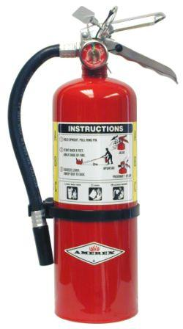
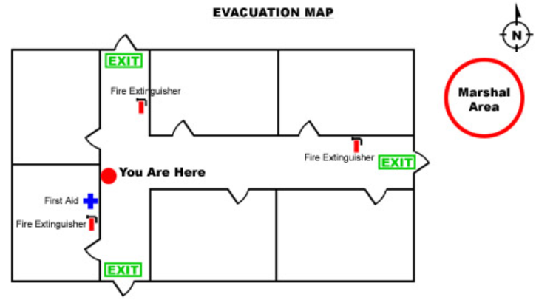
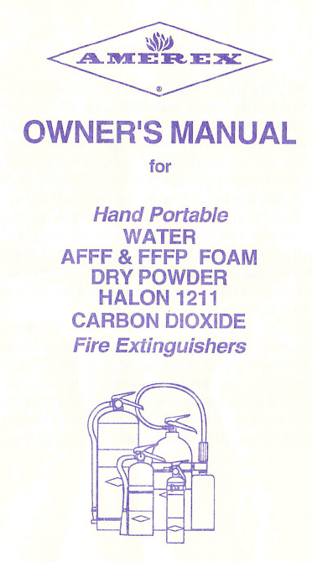
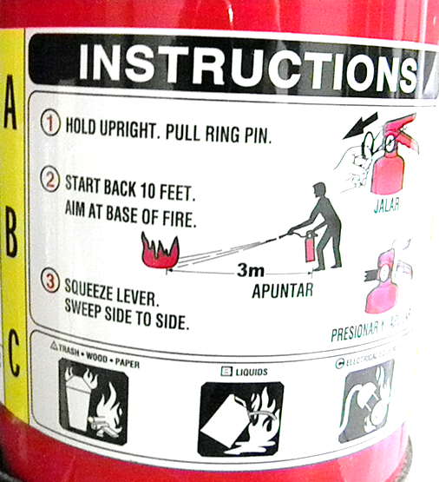
What Type do We Have?
In most office settings the extinguisher is a
Dry Chemical rated for A, B, & C fires
Location designated with a sign
and on your emergency route map
Instructions are found on the extinguisher
and sometime on a separate pamphlet

Slide 10
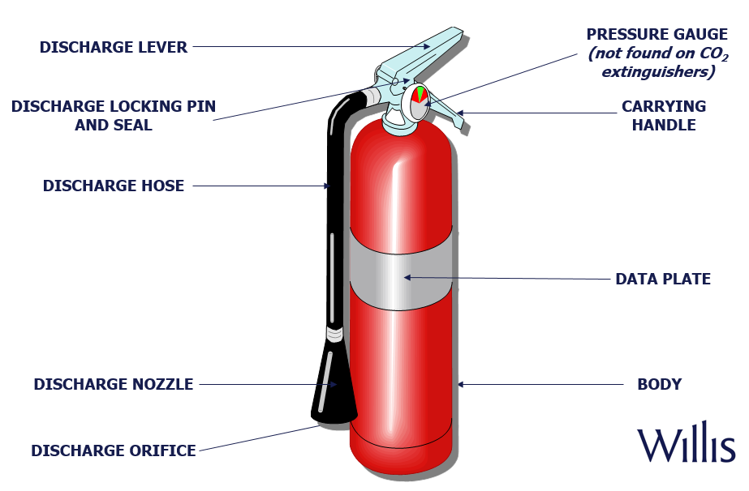

Fire Extinguisher Anatomy

Slide 11
Is there a danger in using a Fire Extinguisher?
  In most cases fire extinguishers do not pose a direct hazard to the operator when use appropriately
  Dry Chemical – have a non-toxic powder that may be like a nuisance dust if inhaled
  Carbon Dioxide - the CO2 will be cold coming out and will displace the oxygen in the room. If problems occur, remove yourself and others from the area
  Consult your SDS for specific health and protective measures for your extinguisher
      SDS – Safety Data Sheet

Slide 12
What are the limits of a Fire Extinguisher?
  Have an Effective range of 6 to 10 feet
  Have a duration of 10 to 20 seconds dependent on size
  Only work on small, semi-contained fires
  Only work if you know where they are and how to use them
  Home use extinguishers (non-rechargeable) have a shelf life of 8-10 years, see manufacture guidelines
  Note: Never throw a fire extinguisher at a fire!!!

Slide 13
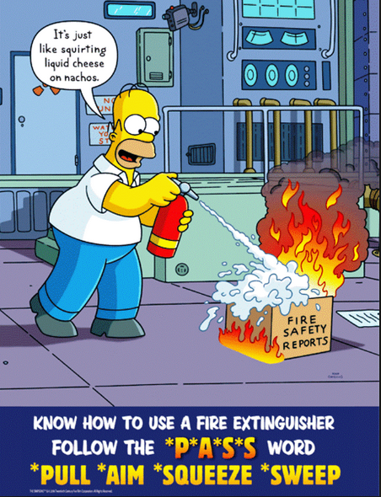
Remember the Password

Slide 14
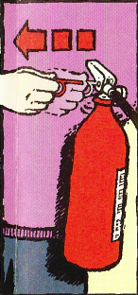
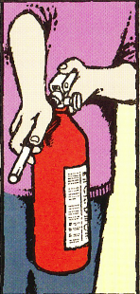
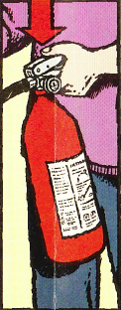
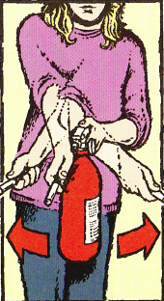
How to use a Extinguisher
P - Pull
A - Aim
S – Squeeze
S - Sweep

Slide 15
Before you attempt to extinguish a fire:
  Make sure everyone has left, or is leaving, the building
  Make sure the fire department has been called/alarm sounded
  Make sure the fire is confined to a small area and is not spreading
  Be sure you have an unobstructed escape route to which the fire will not spread
  Be sure you know what’s likely burning and your extinguisher is right for the fire
It is reckless to fight a fire in any other circumstances. Instead, leave immediately and close off the area.

Slide 16
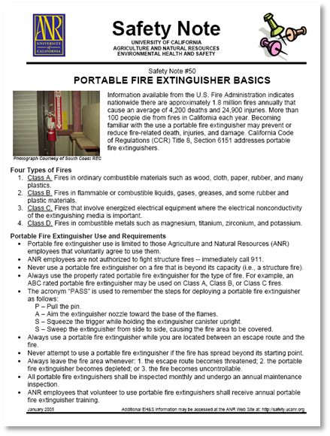
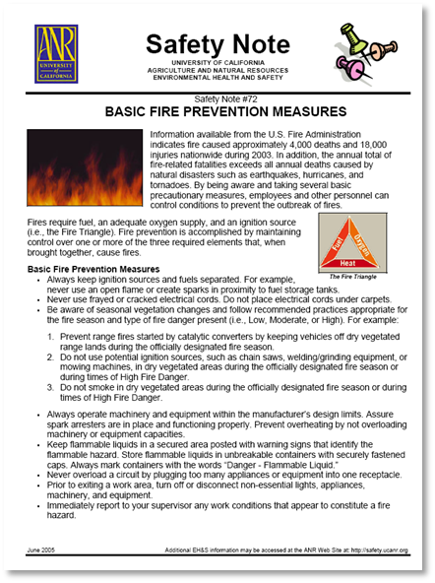
Fire Extinguisher Training Materials
Safety Note #50 (Portable Fire Extinguisher Basics)
http://safety.ucanr.edu/files/1444.pdf
Safety Note #72 (Basic Fire Prevention Measures)
http://safety.ucanr.edu/files/1468.pdf
Fire Extinguisher Monthly Inspection Form
http://safety.ucanr.edu/files/3064.pdf
Emergency Action & Fire Prevention Plan
http://safety.ucanr.edu/Plans,_Forms_and_Templates/
EH&S Web Training Video
http://safety.ucanr.edu/Safety_Training_Resources/Fire_Extinguisher_Video/
Fire Extinguisher Presentations
http://safety.ucanr.edu/Safety_Training_Resources/Power_Points/
Notes:
Options For training:
Use Safety Notes
Video
download a powerpoint slide show

Slide 17
Fire Extinguisher Training
If you need more information please visit
http://safety.ucanr.edu

Slide 18
Fire Extinguisher Video
(available on the ANR EH&S website) http://safety.ucanr.edu/Training/Fire_Extinguisher_Video

