Slide 1
Invasive Species: Identification, Status, and Action
MacKenzie Patton
Invasive Species Community Educator
UC Statewide Integrated Pest Management Program

Slide 2
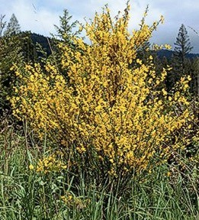
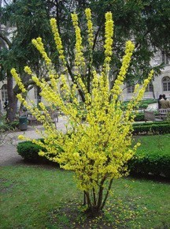
What is an Invasive Species?
Exotic Species: Non-native species to a local ecosystem
Invasive Species: An exotic species that has spread within the ecosystem and may cause environmental or economic harm
Scotch broom – exotic and invasive
A POTENTIAL PEST
Forsythia – exotic but not invasive
NOT A PEST

Slide 3
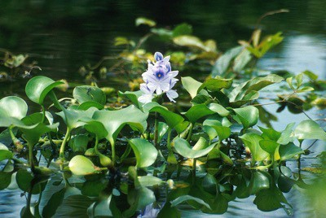
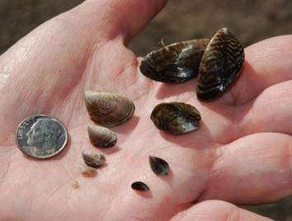
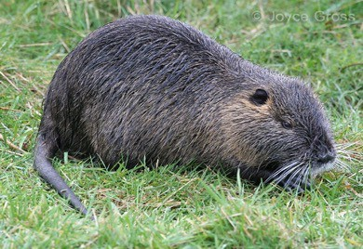
What are the types of Invasive Species?
Types:
Aquatic & Terrestrial Plants -
Water hyacinth
Invertebrates such mollusks & annelids: Quagga
mussels clog pipes & drains
Vertebrates: nutria, wild pigs, carp, others

Slide 4
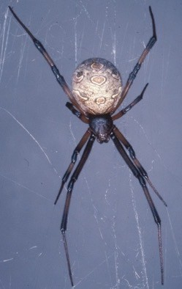
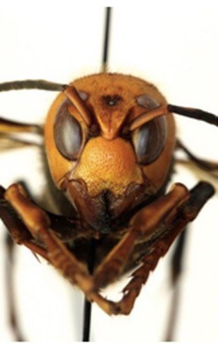
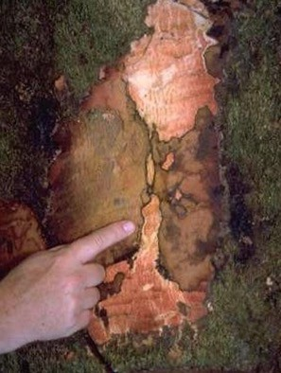
What are the types of Invasive Species?
Types:
Arthropods: Brown Widow Spider, Northern Giant Hornet ('Murder Hornet')
Plant & Animal pathogens: Sudden Oak Death (SOD), Phytophthora ramorum,

Slide 5
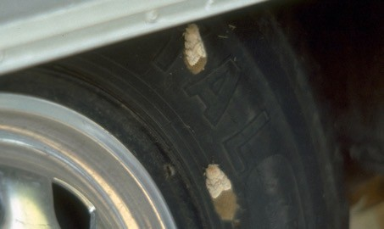
How do Invasive Pests Spread?
Interstate and international commerce
With luggage, cars, movement of household items
Nursery stock
Firewood
Boats and ships
Produce
Construction materials
Rusty Haskell, University of Florida, Bugwood.org
Spongy moth egg masses on wheel

Slide 6
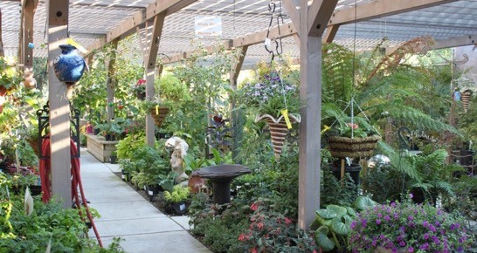
Why do Invasives Matter?
(*Zenni, R.D. et al. 2021).
Threat to:
Economic consequences*
Agricultural crops
Horticultural landscapes and Gardens
Environment
Native ecosystems
More pesticides may be required
Human and animal health (some)

Slide 7
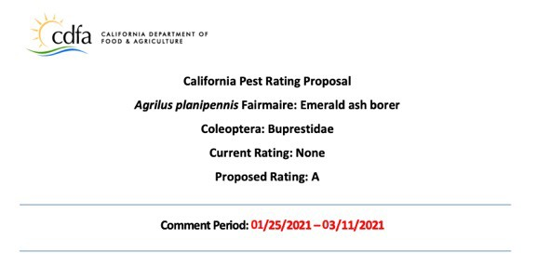
What may happen when a new invasive arrives?
CDFA Evaluation
Grad A - D
Based on
Biology of Organism
Environmental impact
Economic impact
Horticultural impact

Slide 8
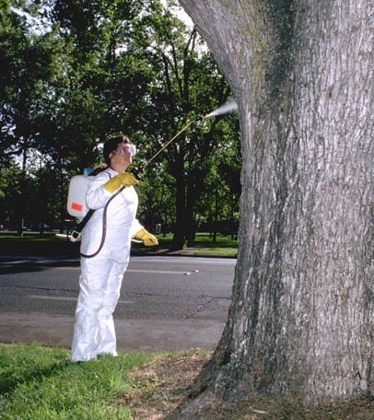
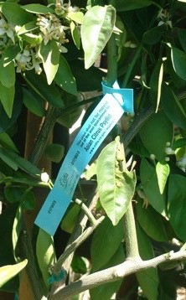
What may happen when a new invasive arrives?
Invaded areas quarantined
Eradication efforts
Infested plants and nearby areas may be removed or treated
Special shipping permits or restrictions
Tagging inspected plants

Slide 9
Examples of Invasives of Concern in CA
FOR FOOD CROPS
Asian citrus psyllid and HLB disease
Bagrada bug
Brown marmorated stink bug
European grapevine moth
Glassy winged sharpshooter
FOR LANDSCAPES AND WOODED AREAS
Giant whitefly
Goldspotted oak borer
Ligurian leafhopper (rosemary & sage)
Polyphagous shothole borer
Sudden oak death
Thousand cankers disease (walnuts)
AQUATIC SPECIES
Quagga/zebra mussels
Killer algae
New Zealand mud snail
Water garden plants
Spotted wing drosophila
INVASIVE ORNAMENTAL SPECIES
Vine mealybug
Various exotic fruit flies
Brooms
Mexican feathergrass
Pampas grass
Big periwinkle
Water garden plants
Many others
HEALTH CONCERNS*
Africanized bee
Brown widow spider
Red imported fire ant
*so far all in S. CA only
This is only a partial list—there are many others already here or threatening to invade.

Slide 10
So many invasives and so little time!
Today talk about…
Asian Citrus Psyllid
Bagrada Bug
Brown Marmorated Stink Bug
Glassy-winged Sharpshooter
Mediterranean Oak Borer
Jumping Worm
Sudden Oak Death
Emerald Ash Borer
Spotted Lanternfly
And FINALLY Invasive Plants

Slide 11
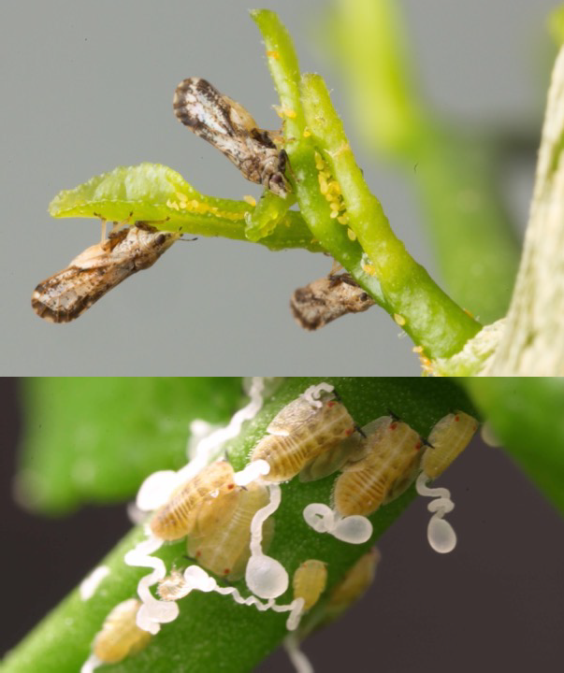
Asian Citrus Psyllid
Small jumping insect ~1/8”
Detected in CA in 2008
Adults feed at 45° angle.
Eggs and nymphs are yellow and tucked into new growth
Nymphs secrete waxy tubules
Feeds on all citrus

Slide 12
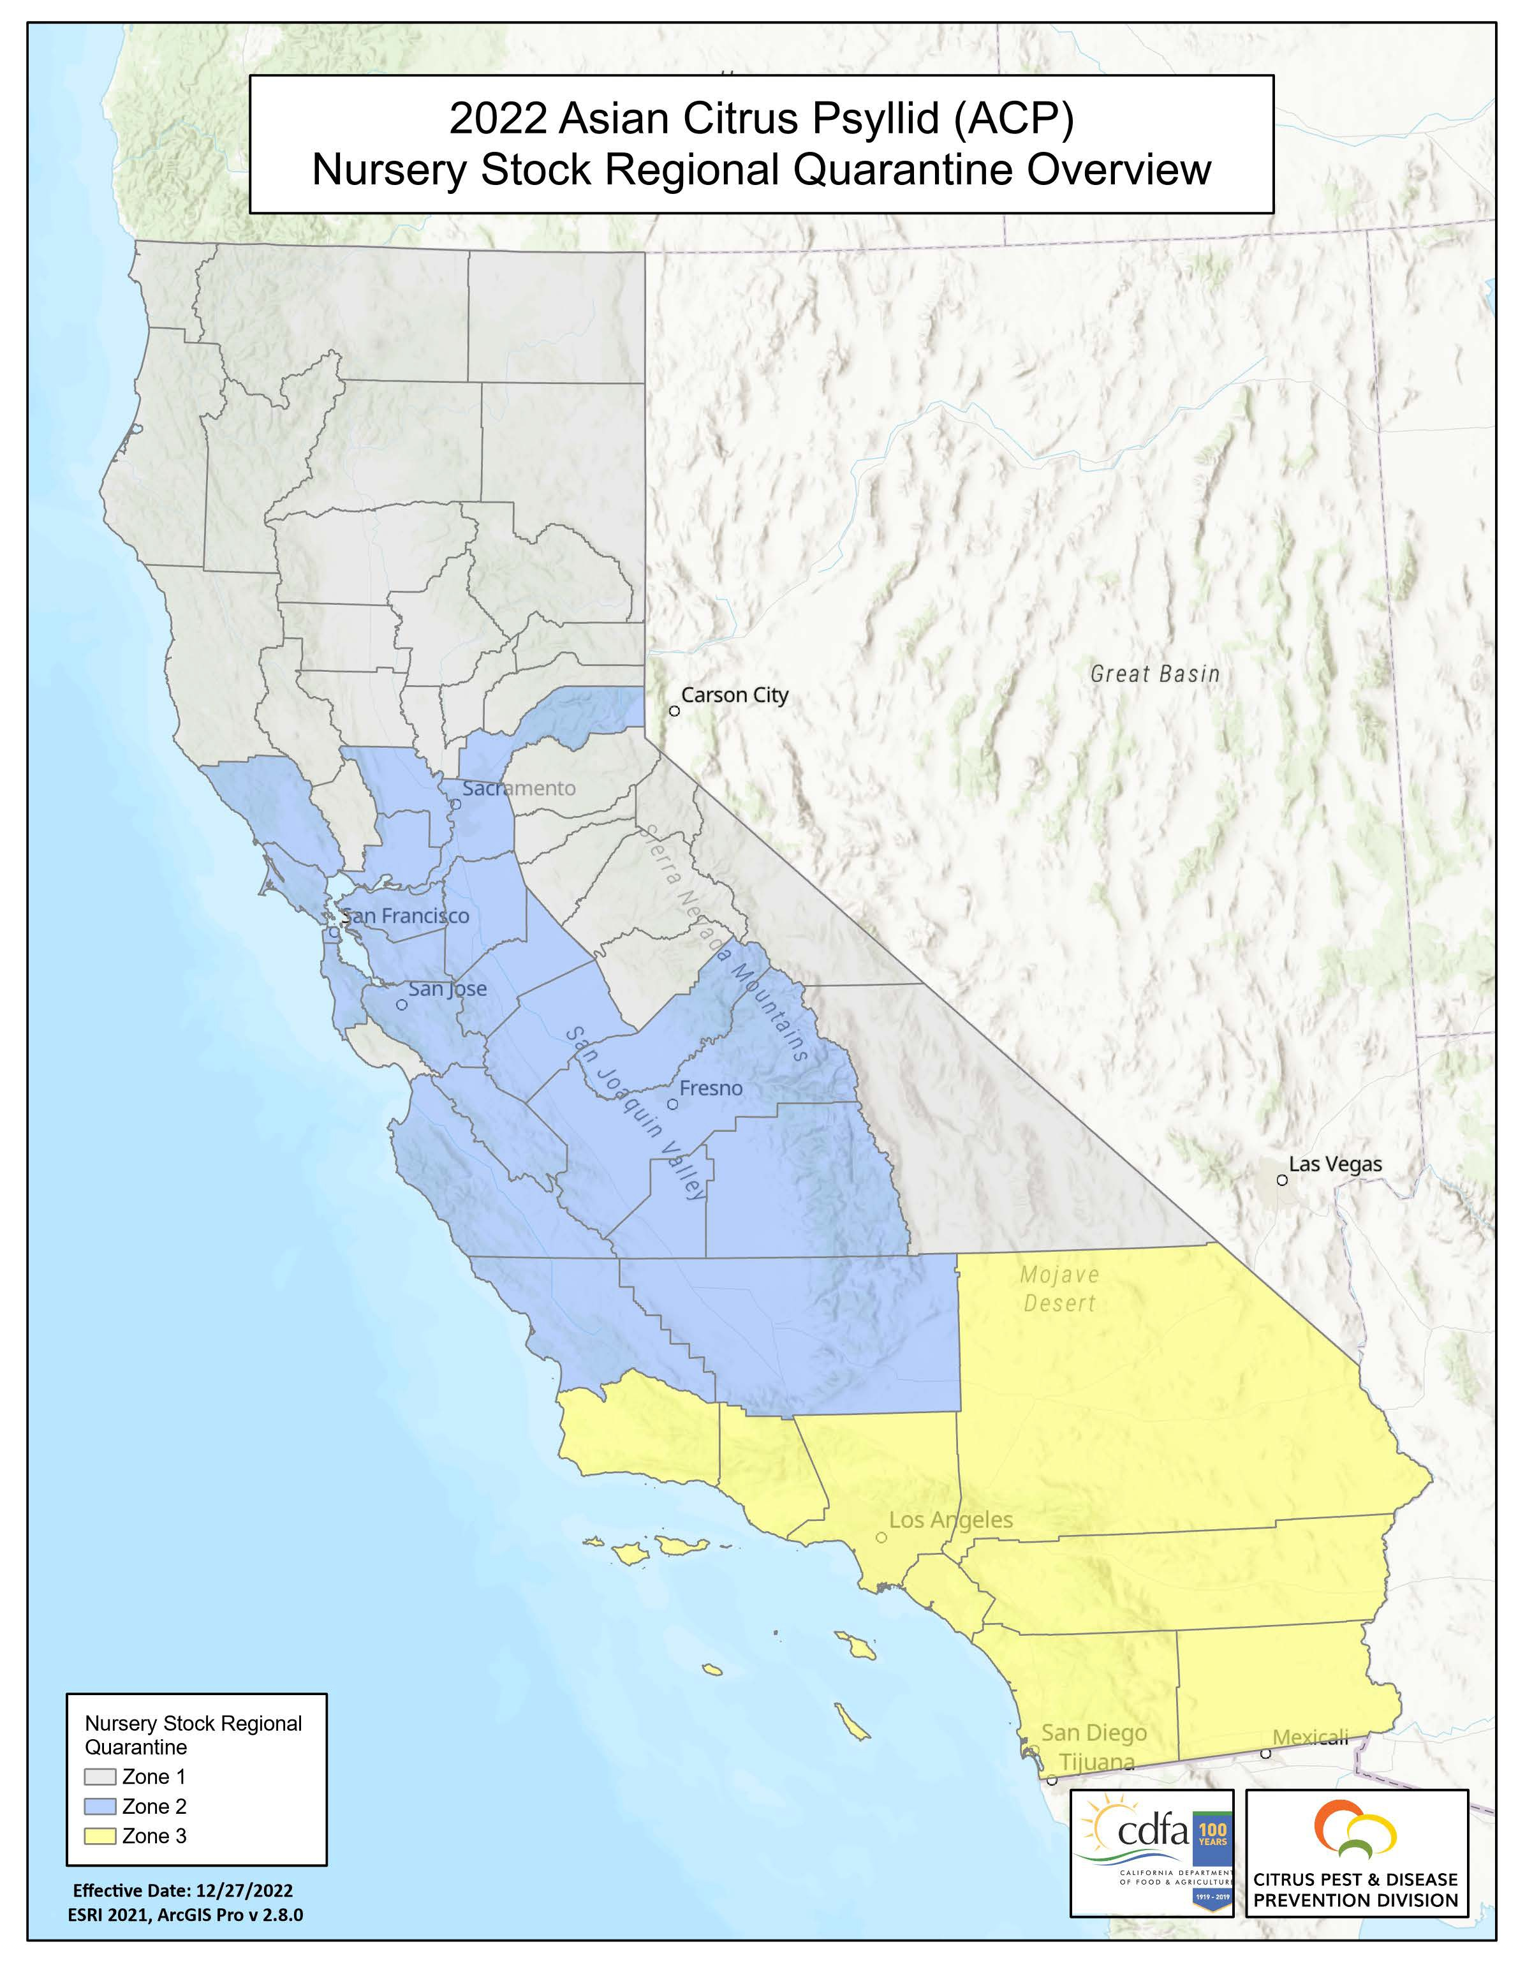
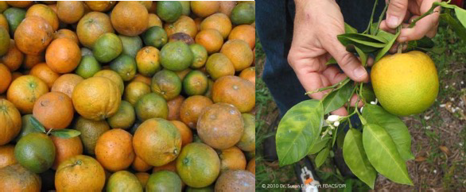
Asian Citrus Psyllid
Transmit Huanglongbing (HLB)
Early HLB symptoms blotchy yellow mottle of leaves
Disease can kill a healthy tree in as little as 5 years
Detected in CA in 2012 (Residential)

Slide 13
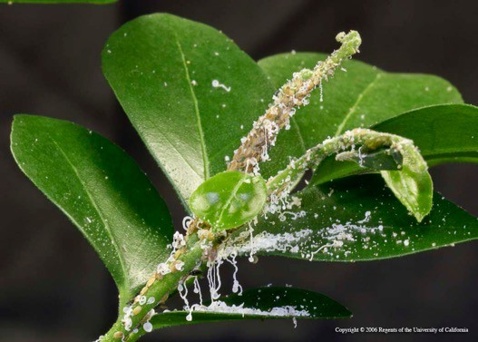
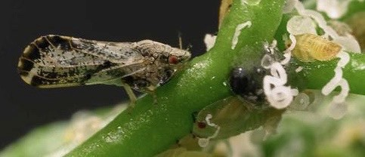
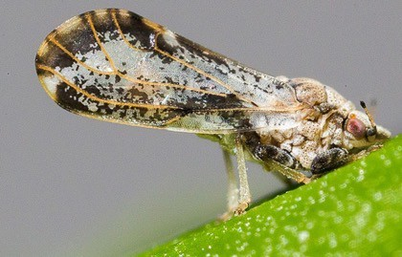
Asian Citrus Psyllid
How can you help?
Look at young tissue for nymphs
Keep citrus plants local
Adult, nypmhs, and waxy tubules
Adult feeding at angle

Slide 14
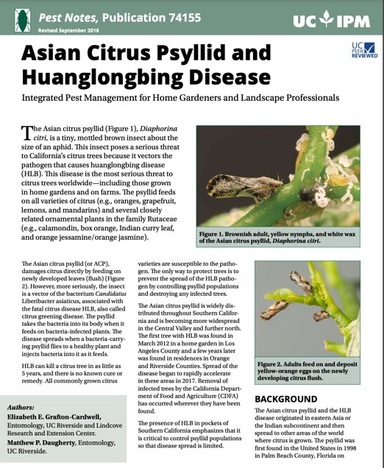
Asian Citrus Psyllid
More information!
ACP Distribution and Management
UC IPM Pest Notes
https://ipm.ucanr.edu/PMG/ PESTNOTES/pn74155.html
https://ucanr.edu/sites/ACP

Slide 15
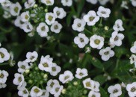
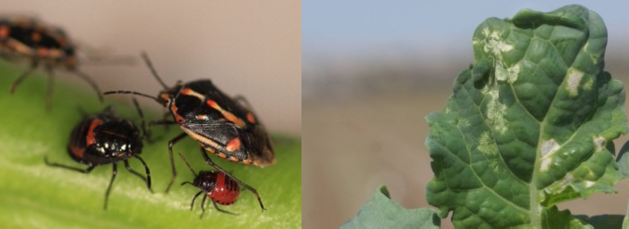
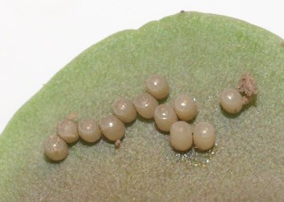
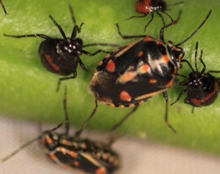
Bagrada Bug
Small Shield bug (~1/4”)
Feeds on all crucifers
Females are larger than males
Nymphs black and red
Eggs on underside of leaves
Favorite ornamentals: sweet alyssum, stock, candy tuft
Sweet Alyssum
Candytuft
Stock

Slide 16
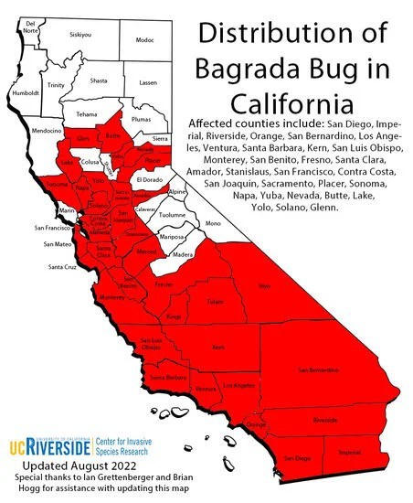
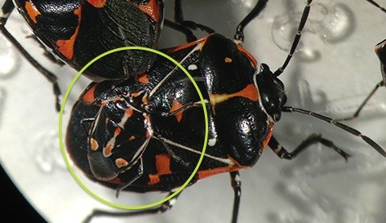
Bagrada Bug
Often confused for Harlequin bug, but is much smaller
Control is difficult due to wide host range + fast reproduction
Bagrada bug (circled) on top of a Harlequin bug.

Slide 17
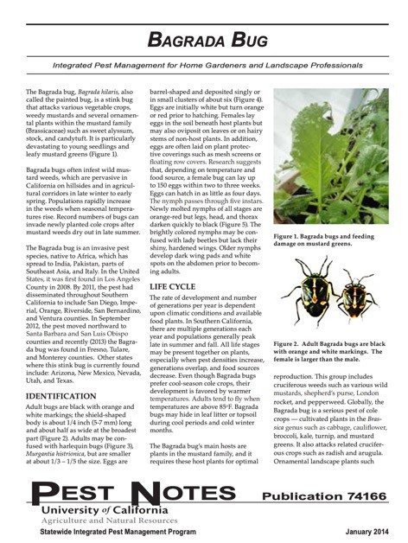
Bagrada Bug
More Information
UC IPM Pest Notes
UCR CISR
https://ipm.ucanr.edu/PMG
/PESTNOTES/pn74166.html
https://cisr.ucr.edu/invasive- species/bagrada-bug

Slide 18
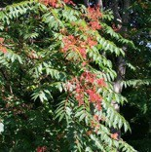
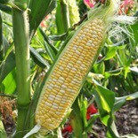
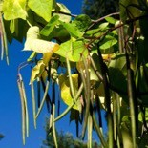
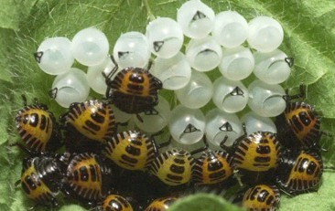
Brown Marmorated Stink Bug
Adult is typically 5/8”
Distinct bands on abdominal and antennae
Eggs are small white cylinders on leaf bottoms
Damages fruits, vegetables, trees and ornamentals.
overwinter in large groups in buildings.
Feeds on over 100 species

Slide 19
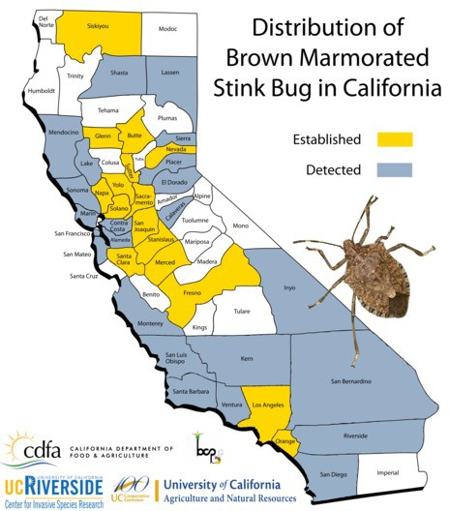
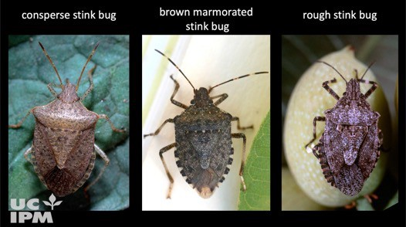
Brown Marmorated Stink Bug
Arrived 2006 in CA, 2013 in Sacramento
May be confused with other stink bugs
Exclude from buildings
Pheromone traps often used for crops

Slide 20
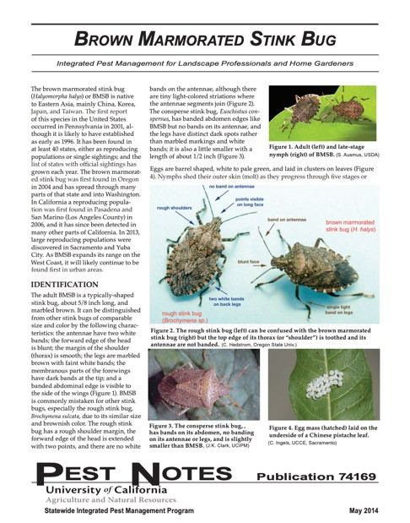
Brown Marmorated Stink Bug
More information
UC IPM Pest Notes
National Stop BSMB
https://ipm.ucanr.edu/PMG/ PESTNOTES/pn74169.html
https://www.stopbmsb.org/

Slide 21
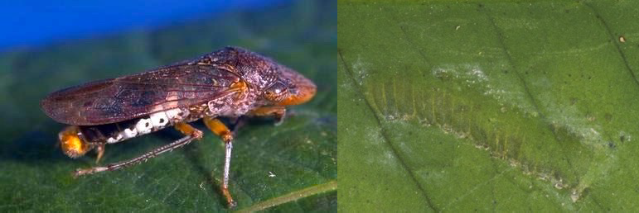
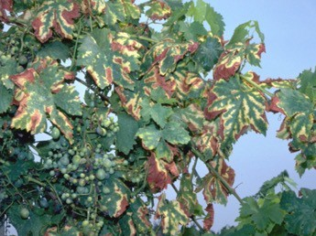
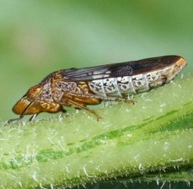
Glassy-winged Sharpshooter
Large leafhopper (1/2”)
Feeds on many plant species
Dark brownish with speckled yellowish head
Eggs appear as green blisters beneath leaves
Transmits Pierce’s disease, a grapevine disease caused by Xylella fastidiosa
May kill vine via clogging of xylem

Slide 22
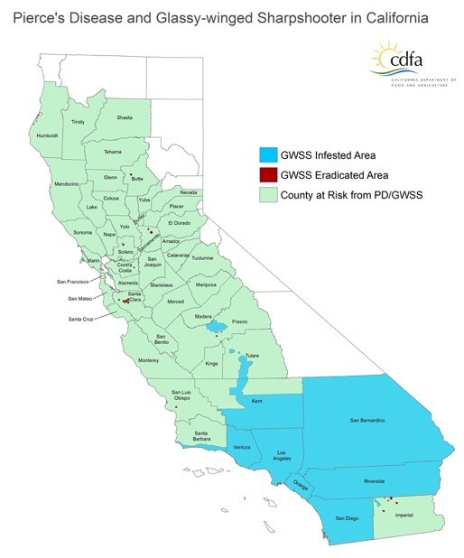
Glassy-winged Sharpshooter
Pierce’s disease Control Program
Certifications/Inspections
Grapevine, citrus
Trappings across state
Active biocontrol programs
Parasitic wasps
Solano County 2021
Found on Crape Myrtles

Slide 23
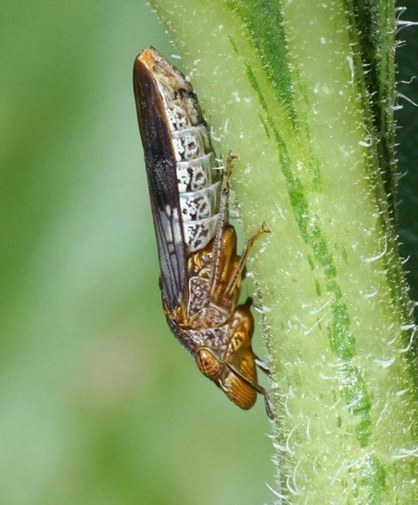
Glassy-winged Sharpshooter
How can you help?
Educate your community
If suspected, report if you live in county that is not infested
Inspect plants when purchasing
Be involved with PDCP outreach

Slide 24
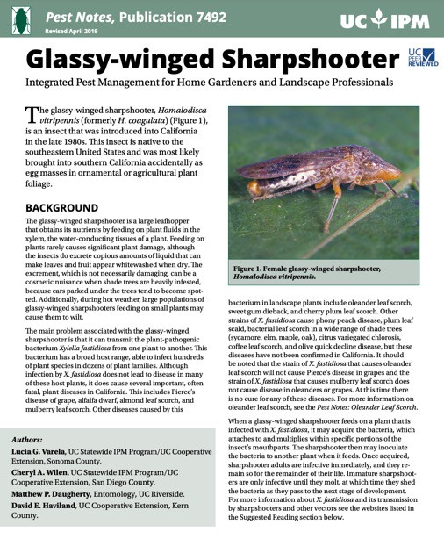
Glassy-winged Sharpshooter
More information
UC IPM Pest Notes
CDFA Pierce’s disease
www.ipm.ucanr.edu/PMG/ PESTNOTES/pn7492.html
https://www.cdfa.ca.gov/pdcp/

Slide 25
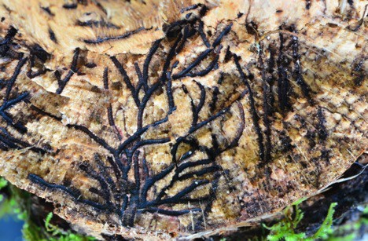
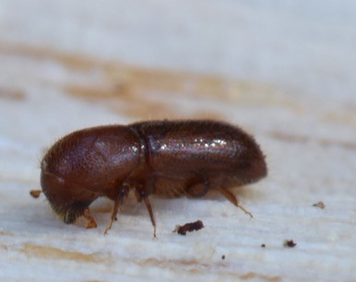
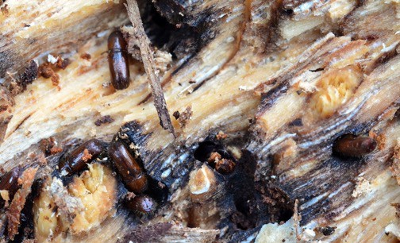
Mediterranean Oak Borer
Very small ambrosia beetle (~1/8”)
Native to Europe
Tunnel into host trees: Chestnut, Beech, and Oak species
“Gardens” a fungus it eats which may infect trees
Cork and Valley Oak very susceptible

Slide 26
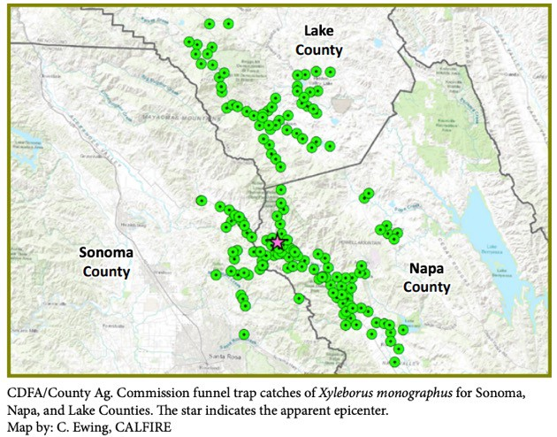
Mediterranean Oak Borer
Only establish in CA in USA
Found in 2019 in Napa
As of 2023 Lake, Napa, Sacramento, Sonoma, Contra Costa.
Sacramento is believed to be from movement of infested material
No quarantine
Report Report if found

Slide 27
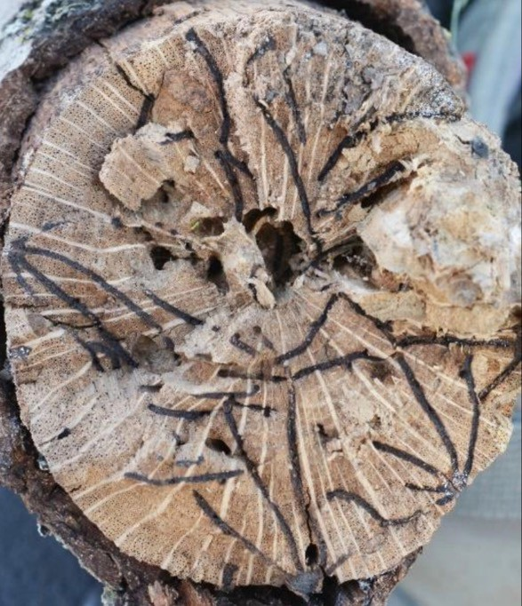
Mediterranean Oak Borer
How can you help?
Don’t move firewood!
Educate!
Monitor oak species
Valley and cork
Report it!

Slide 28
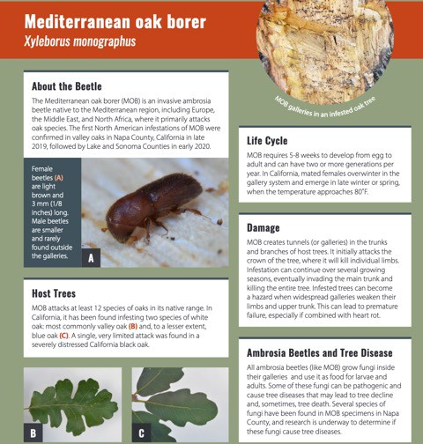
Mediterranean Oak Borer
More information!
MOB Website
Pest Alert
https://ucanr.edu/sites/mobpc/
https://ucanr.edu/sites/mobpc/files
/330538.pdf

Slide 29
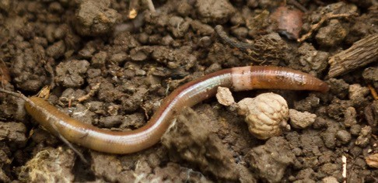
Jumping Worm
Very limited detections in CA (Napa)
Voracious feeders with large mouths
Outcompete the native soil organisms
Negatively impact soil structure and strip nutrients
More active in late summer to early fall

Slide 30
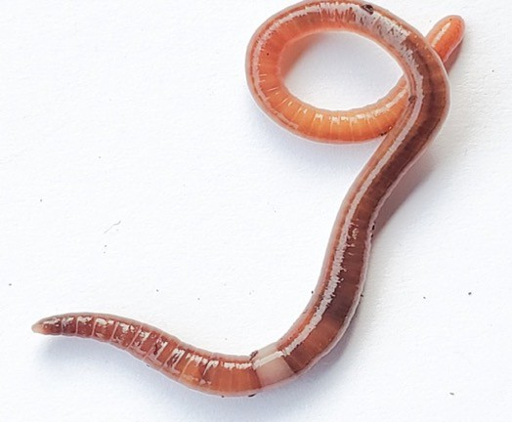
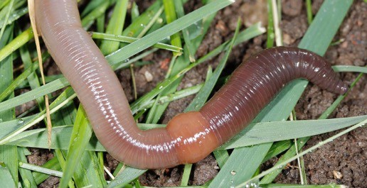
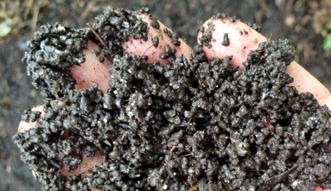
Jumping Worm
Jumping Worm
Resembles common earthworms but wiggles wildly and “jumps.”
Major difference is the color of the collar-like ring which is white and smooth instead of raised and pinkish
Earthworm
Coarse castings from Jumping worm

Slide 31
Jumping Worm

Slide 32
Jumping Worm
More Information
USDA National Invasive Species Information Center
https://www.invasivespeciesinfo.gov/terrestrial/ invertebrates/asian-jumping-worm

Slide 33
Sudden Oak Death (SOD)
Fungal-like organism
Phytophthora ramorum
Trunk pathogen on many species
Oaks are sensitive
Oozing, bleeding, discoloration
As foliar pathogen
Camellia, Rhododendron
Lesions on leaves and may have stem cankers.

Slide 34
Sudden Oak Death (SOD)
Sudden Oak Death Infestation Map
0 50 100km
Limited to Coastal areas – possible due to moisture
Still, many areas not infected are at risk!
Main source of spread by movement of infected material.
windy rains, high moistures, splashes, etc.
Quarantine Pest:
Report if found in new areas. Infected trees cannot be cured.
Confirmed isolation of Phytophthora ramorum
Community submitted incidents of Phytophthora ramorum
Data sources:
- Confirmed isolations of Phytophthora ramorum provided by UC Davis, UC Berkeley, and CDFA. Nursery confirmations are not depicted.
Produced on 02/10/13 by UCB GIF http://www.suddenoakdeath.org/ http://www.oakmapper.org/

Slide 35
Sudden Oak Death (SOD)
More information
UC IPM Pest Notes
SOD Website
https://ipm.ucanr.edu/PMG/PESTNOTES/ pn74151.html
https://www.suddenoakdeath.org/

Slide 36
Emerald Ash Borer
A green jewel beetle (3/8 – 1/2")
Upper abdomen is red
Larva have flattened bell- shaped segment
Infests on all ash species
Adults feed, but most of the damage is from larvae
Creates shallow extensive galleries
David Cappaert, Bugwood.org

Slide 37
Emerald Ash Borer
Arrived in US in 2002
Detected in Oregon in 2022
May be confused with many with many other green beetles

Slide 38
Emerald Ash Borer
What can you do?
Keep an eye out and report
Peak activity is May- July
D-shaped exit holes
Be familiar with host and insect
Don’t move firewood!
Steven Katovich, Bugwood.org

Slide 39
Emerald Ash Borer
More Information
Emerald Ash Borer Network
http://www.emeraldashborer.info/

Slide 40
Spotted Lanternfly
Large plant hopper (1”)
Eggs look like dried mud, young nymphs are black and white (1/8”)
Older nymphs are red black and white (1/2”)
Feed on many plants but favorites include: Tree-of-heaven, Grapes, Walnuts, Maples
Generally considered plant stressor

Slide 41
Spotted Lanternfly
Dickinson
Delta
Mackinac
Menominee
Charlevoix
Emmet
Cheboygan
VT
Orleans
Charlevoix
Antrim
Otsego
Presque Isle
Montmorency
Alpena
Spotted Lanternﬂy
Reported Distribution
Updated May 15, 2023
NY
Leelanau
^{Grand} Franklin
Benzie
Grand Traverse
Kalkaska
Crawford
^{Oscoda} Alcona
Saint Lawrence
Franklin
Clinton
Isle
Lamoille
Essex
Coos
Manistee
Wexford
Missaukee
Roscommon
Ogemaw
Iosco
Chittenden
Washington
Caledonia
Arrived in PA 2014, now in 14 states
Not established west of IN
Regulatory Incidents in CA
Most recent 2022 intercept of eggs in Truckee
Must be on look-out!
Mason
Lake
Osceola ^{Clare}
^{Gladwin} Arenac
Huron
Jefferson
Essex
Addison
Orange
Grafton
Carroll NH
Oceana
Newaygo
Mecosta
Isabella
Midland ^{Bay}
Tuscola
Sanilac
Lewis
Herkimer Hamilton
Warren
Rutland
Windsor
Sullivan
Belknap
Muskegon
Montcalm
Gratiot
Saginaw
Genesee _{Lapeer}
Niagara
Orleans Monroe
Wayne
Oswego
Oneida
Washington
Bennington
Merrimack
Strafford
Ottawa
Kent
Ionia
^{Clinton} Shiawassee
Saint Clair
Genesee
Cayuga
Onondaga
Madison
Fulton
Saratoga
Windham
Cheshire
Hillsborough
Rockingham
Livingston
Oakland
Macomb
Erie
Wyoming Livingston
Ontario
Seneca
Montgomery
Schenectady
Rensselaer
Essex
MI
Allegan
Barry
Eaton
Ingham
Yates
Tompkins
Cortland Chenango
Otsego
Schoharie
Albany
Franklin
Worcester
Middlesex
MA
Washtenaw
Wayne
Chautauqua
Cattaraugus
Allegany
Steuben
Schuyler
Greene
Columbia
Berkshire
Hampshire
Suffolk
Van Buren Calhoun
Kalamazoo
Jackson
Lenawee
Monroe
Erie
Chemung
Tioga
Broome
Delaware
Hampden
Norfolk
Plymouth
Berrien
Cass
Saint
Joseph Branch
Hillsdale
OH
Lorain
Lake
Ashtabula
Crawford
Warren
Mc Kean
Potter
Tioga
Bradford
Susquehanna
Sullivan
Ulster
Dutchess
Litchﬁeld
Hartford
Tolland
^{Windham Providence} Bristol
La Porte
St Joseph
Elkhart
La Grange Steuben
Fulton ^{Lucas}
Ottawa
Wayne
Kent Bristol
Barnstable
Porter
Williams
Wood
Cuyahoga
Geauga
Venango
Forest
Elk
Cameron
Lycoming
Sullivan
Wyoming
Lackawanna
Putnam
_{New Haven Middlesex} New London Washington
Newport
Lake
Starke
Marshall
Kosciusko
Noble De Kalb
Deﬁance
Henry
Sandusky
Erie
Trumbull
Mercer
Clarion
Clinton
Luzerne
Pike
Sussex
Orange
Westchester
Fairﬁeld
Dukes
Nanvtucket
Whitley
Paulding
Seneca
Huron
_{Medina} Summit Portage
Clearﬁeld
Rockland
CT RI
Newton
Jasper
Pulaski Fulton
Allen
Putnam
Hancock
^{Mahoning} Lawrence
Butler
Jefferson
PA
Centre
Union ^{Montour}
Columbia
Carbon
Monroe
Warren
Passaic
Bergen
Bronx
White
Cass ^{Miami}
Wabash Huntington
^{Wells} Adams
Van Wert
Allen
Wyandot Crawford
Richland
Ashland
Wayne
Stark
Columbiana
Armstrong
Snyder ^{Northumberland}
Northampton
^{Morris} New
Essex ^{York}
Suffolk
Hardin
Beaver
Indiana
Mifflin
Schuylkill
^{Hudson} Queens ^{Nassau}
Benton
Carroll
Grant
Mercer Auglaize
Marion
Morrow
Holmes
Tuscarawas
Carroll
Hancock
Huntingdon
Juniata
Lehigh
Hunterdon
Somerset
Union Kings
Warren ^{Tippecanoe}
Howard
^{Blackford} Jay
Shelby
Logan
Union
Delaware
Knox
Coshocton
Harrison ^{Jefferson}
Allegheny
Cambria
Blair
Perry
Dauphin
Lebanon
Berks
Bucks
Middlesex
Richmond (Staten Island)
Clinton Tipton
Madison
Delaware
Randolph ^{Darke}
Champaign
Licking
Brooke
Washington
Westmoreland
Cumberland
Lancaster
Montgomery
Mercer
Monmouth
Fountain
Montgomery Boone ^{Hamilton}
Henry
Miami
Clark
Franklin
Muskingum
Guernsey
Belmont
Ohio
Fayette
Somerset
Bedford
Adams
Chester
Delaware
Philadelphia
Ocean
NJ
Washington _{MD}
Vermillion
Parke
Putnam
^{Hendricks} Marion
Hancock
Wayne
^{Preble} Montgomery _{Greene}
Madison
Pickaway
Fairﬁeld
Perry
Morgan
Noble
Monroe
Greene
Marshall
Monongalia
Allegany
^{Fulton} Franklin
York
Cecil
Gloucester
Camden
Burlington
Vigo _{Clay}
Morgan Johnson
Shelby
Rush Fayette Union
Butler
Warren
Clinton
Fayette
Hocking
Washington
Tyler
Wetzel
Marion
Preston
Garrett
Morgan
Berkeley
Frederick ^{Carroll}
Baltimore ^{Harford}
New ^{Salem} Castle
Atlantic
Owen
_{Monroe} Brown Bartholomew
Decatur
Franklin
Hamilton
Highland
Ross
Vinton
Athens
Wood
Pleasants
Doddridge ^{Harrison}
Taylor
Mineral
Hampshire
Frederick ^{Jefferson}
^{Winchester} Clarke
Howard
Baltimore City
Kent
Cumberland
Cape May
Ripley
Dearborn
Clermont
Pike
Meigs
Ritchie
Barbour
Tucker
Grant
Montgomery
Anne Arundel
^{Queen} Kent
Sullivan
Greene
Jennings
Ohio
Jackson
Wirt Lewis
Gilmer
Calhoun
Upshur
Hardy
Warren
Loudoun
Anne’s
Knox ^{Davies Martin}
Lawrence
Jackson
Scott
Jefferson
Switzerland
^{Brown} Adams
Scioto
Gallia
Mason
Jackson
Roane
Braxton
Randolph
Pendleton
Shenandoah
Rappahannock
Fauquier
Fairfax
DC
Prince George’s
Calvert
Talbot
Caroline
Sussex
DE
Washington
Orange
Clark
IN
Lawrence
Cabell
Putnam
Clay
Webster
Rockingham
Page
Culpeper
Prince William
Charles
Dorchester
Gibson
Pike
Dubois
Crawford
Harrison
Floyd
Kanawha
Nicholas
Pocahontas
Highland
VA
Augusta
Greene
Madison
Stafford
King George
Saint Mary’s
Wicomico
^{Posey} Vanderburgh
Warrick Perry
Spencer
Wayne
Lincoln
Boone
Fayette
Bath
Albemarle
^{Orange} Spotsylvania
Caroline
Westmoreland
Somerset ^{Worcester}
WV
Mingo
Logan
Raleigh
Greenbrier
Alleghany
Rockbridge
Nelson
Fluvanna
Louisa
^{Hanover} King
Essex
^{Richmond} Northumberland
Lancaster
Wyoming
Monroe
Summers
Botetourt
Amherst
Buckingham
Goochland
William King and Queen
Middlesex
Accomack
McDowell
Mercer
Craig
Cumberland
Powhatan
Chesterﬁeld
Henrico ^{New Kent} Gloucester
Charles James
City City
York
Prince
George _{Surry}
Mathews
Individual ﬁnds of Spotted Lanternﬂy. No infestation present.
Buchanan
Giles
Roanoke
^{Bedford} Lynchburg ^{Appomattox}
Prince Edward
Amelia
Northampton
Wise
Dickenson Tazewell
Bland
Pulaski
Montgomery
Franklin
Campbell
Charlotte
Lunenburg
Nottoway
Dinwiddie
Newport News Hampton
Russell
Smyth
Wythe
Carroll
Floyd
Pittsylvania
Halifax
Brunswick
Sussex
Isle of Wight
Virginia Beach
Lee
Scott
Washington
Grayson
Patrick
Henry
Mecklenburg
Greensville
Southampton
Suffolk Chesapeake
Spotted Lanternﬂy infestation present.
NC
Ashe
Alleghany
Surry
Stokes Rockingham
Caswell Person Granville Vance Warren Halifax
Northampton
Camden
Gates Currituck
Watauga
Wilkes
Yadkin
Forsyth
Hertford
Pasquotank
Perquimans Chowan
Yancey
Madison
Mitchell ^{Avery}
Caldwell
Alexander Davie
Iredell
Davidson
Guilford ^{Alamance} Orange
Durham
Wake
Franklin
Nash
Edgecombe
Martin
Bertie
^{Washington Tyrrell} Dare
Internal state quarantine areas.
Swain
Haywood
Buncombe
McDowell
Burke
Catawba
Rowan
Randolph
Chatham
Johnston
Wilson
Pitt
Beaufort
Hyde
Graham
Jackson
Henderson
Rutherford
Lincoln
Cabarrus
Lee
Harnett
Wayne
Greene
Beaufort
Cherokee
Clay
Macon
Transylvania
Polk
Cleveland Gaston
Mecklenburg
^{Stanly} Montgomery ^{Moore}
Hoke
Sampson
Lenoir
Jones
Craven
Pamlico
Union
Anson
Richmond
Scotland
Cumberland
Bladen
Duplin
Onslow
Craven Carteret
Robeson
Pender
Columbus
Brunswick
New Hanover
State quarantine, Report Report if found

Slide 42
Spotted Lanternfly
More Information
USDA National Invasive Species Information Center
CDFA Spotted Lanternfly
https://www.invasivespeciesinfo.gov/ terrestrial/invertebrates/spotted- lanternfly
https://www.cdfa.ca.gov/pdcp/board
/spottedlanternfly.html

Slide 43
Invasive Plants
There are hundreds of invasive plant species, both aquatic and terrestrial
Many invasive plants are introduced by humans and escape landscapes into natural habitats.
CA spends an estimated $82 million per year on invasive weeds

Slide 44
Tree-of-Heaven
Introduced into landscape as ornamental
Is a preferred host for BMSB and SLF.
Allelopathic
Blooms in May/June
Reproduces with samaras or clonally
Rotten peanut butter smell when crushed

Slide 45
Tree-of-heaven

Slide 46
Tree-of-heaven
More Information
USDA Forest Service Field Guide
www.fs.usda.gov/Internet/FSE_DOCUMENTS
/stelprdb5410131.pdf

Slide 47
Japanese Dodder
Parasitic annual plant
Infest >150 species
(crops, ornamentals, woody, herbaceous)
Slender spaghetti stems
Pale green to gold
limited photosynthesis
Grows faster than native dodder

Slide 48
Japanese Dodder
Repeatedly introduced and eradication
Established population in Sacramento
Lemon Hill 2017
Clarksburg 2011

Slide 49
Japanese Dodder
More Information
Weed Research and Information Center
UC IPM Pest Notes
https://ipm.ucanr.edu/PMG/ PESTNOTES/pn7496.html
wric.ucdavis.edu/information/crop
/natural%20areas/wr_C/Cuscuta.pdf

Slide 50
Plant Right
Project within the ‘Plant California Alliance’ (2005)
Works with nurseries and retail stores to minimize sales of invasives and promote native plantings
Helps evaluate “invasiveness”
Begin surveys in 2009
15 ‘retired’ invasives

Slide 51
Plant Right Nursery Survey

Slide 52
Plant Right Nursery Survey
5/12 species sold in more than 1% of retailers
Still decrease compared to previous years

Slide 53
Invasive Plants
More information
UC IPM Pest Notes
CA Invasive Plant Council
Plant Right
https://ipm.ucanr.edu/PMG/PEST NOTES/pn74139.html
https://www.cal-ipc.org/
https://plantright.org/

Slide 54
How can Garden Centers and Retail Nurseries help?
Become familiar with the potential invasives in your area!
Encourage customers not to plant invasive ornamental species.
Inspect newly arriving plants.
Educate your community
Work with PlantRight

Slide 55
How can Garden Centers and Retail Nurseries help?
When you or your customers find pests that might be invasive—consult the county Agricultural commissioner.
Don’t bring uncertified plants or fresh produce, into CA or from quarantine areas.
Buy firewood where you burn it!
Take our online trainings!

Slide 56
Thank you! Questions?
MacKenzie Patton
University of California Statewide Integrated Pest Management Program
mfpatton@ucanr.edu

